Slide 1
Who Has Time for Biological Collections Data Quality Feedback? Maybe a Community Can Help
Teresa J. Mayfield-Meyer
Collections Assistant, Museum of Southwestern Biology
Treasurer, Arctos Consortium
SPNHC/TDWG 2018
Website: http://arctosdb.org
Search: http://arctos.database.museum
Notes:
Thank you to Deb Paul for asking me to participate in this symposium. I am somewhat of an outsider in this group, but I hope that my experiences will help provide some understanding of what collection managers face when dealing with data. This presentation did not turn out to be anything like I thought it would when I signed up, but I guess that’s the way most of life goes..[CLICK]

Slide 2
Website
Catalog
Purchase
What do biodiversity collection managers do all day?
Tag
Mentor
Exhibit
Apply for grants
Loan
NAGOYA
OSHA
Research
Prepare and Preserve
Volunteer Manage-ment
HAZMAT
Train
Tour
Darwin Core
Budget
IATA
Social Media
Teach
Present
Publish
Notes:
So – What does a collection manager do all day?
[CLICK]
Most people think of this, and once upon a time, this made up a lot of their job. But over time, duties and job requirements have been added….
[CLICK]
Honestly, no single person can have all of the expertise required to manage a biological collection that ranges across the variety of life. My experience and what I see of others’ is that we are overwhelmed, understaffed, and required to have expert knowledge of biology, taxonomy, collections care, people and facilities management, accounting, shipping rules, workplace safety, current educational practices, marketing, fundraising, and I’m sure there are things I have failed to mention.
But something else has encroached on the time and talents of those who curate or manage biological collections, especially those who have lovely handwriting and beautifully organized card catalogs or bound catalog books. Technology made it to collections and now it seems that people who once only had to deal with these duties are now required to….
[CLICK]

Slide 3
What do biodiversity collection managers do all day?
DIGITIZE AND MANAGE DATA
Apply for grants
Loan
NAGOYA
Budget
Research
Prepare
Volunteer Manage-ment
HAZMAT
IATA
Tour
Darwin Core
OSHA
Train
Social Media
Teach
Present
Publish
Notes:
Yes, this is sometimes how it feels.
[CLICK]

Slide 4
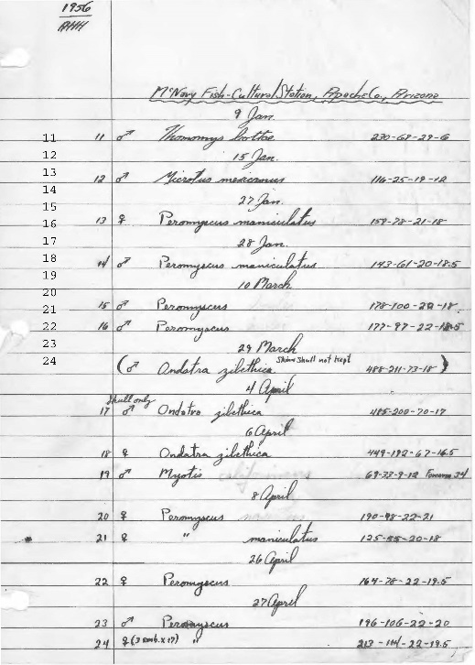
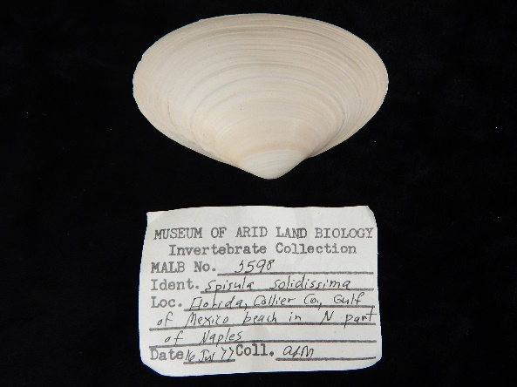
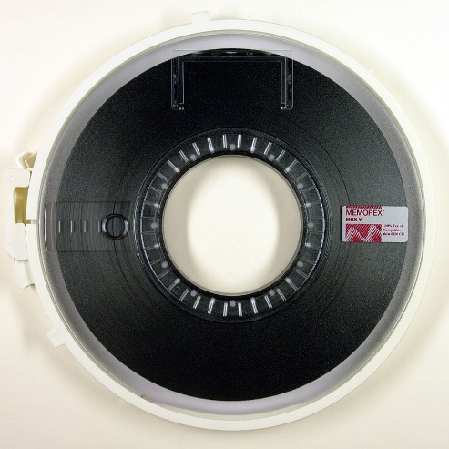
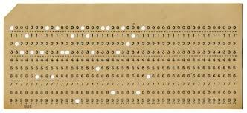
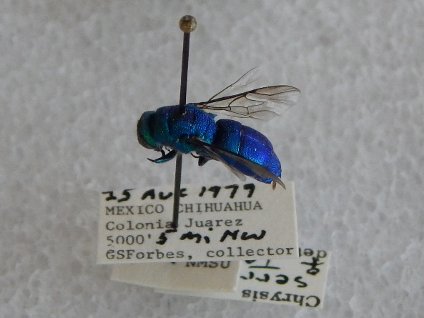
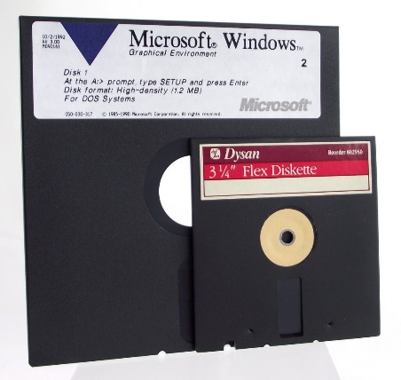
Stuff happens when you digitize…
COBOL
dBASE
LOTUS123
Arctos
EMu
Specify
Symbiota
FileMaker
ACCESS
Cloud Computing
Notes:
Just a quick reminder: stuff happens when you digitize…
[CLICK]
Many collections are documented on paper, sometimes in legible handwriting. The paper maybe all in one place, or attached to the specimens. The data might even be typed! (but in an awfully small font…)
[CLICK]
From there, a transition has probably been made and the information has been saved to some electronic format, which may or may not still be readable. Done properly, this information would have been transferred to new formats as they became available (mostly wishful thinking). Instead, the information has probably been upgraded to new formats only when it was no longer possible to support the old. This might even mean that someone used a printed copy of the information from an old format and re-entered it into a new one.
[CLICK]
In addition to storage formats, transfer of information might also be required when migrating to new software. This may or may not happen along with a storage format migration.
And every time the information is transferred there are transcription errors and loss or insertion of data.
Let’s not forget that some of the information is still here.
[CLICK]

Slide 5
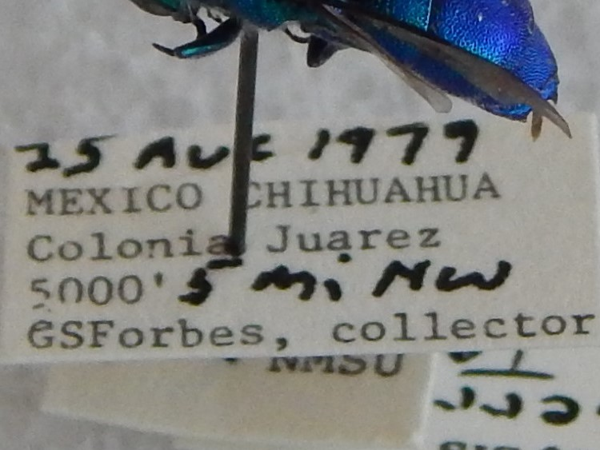
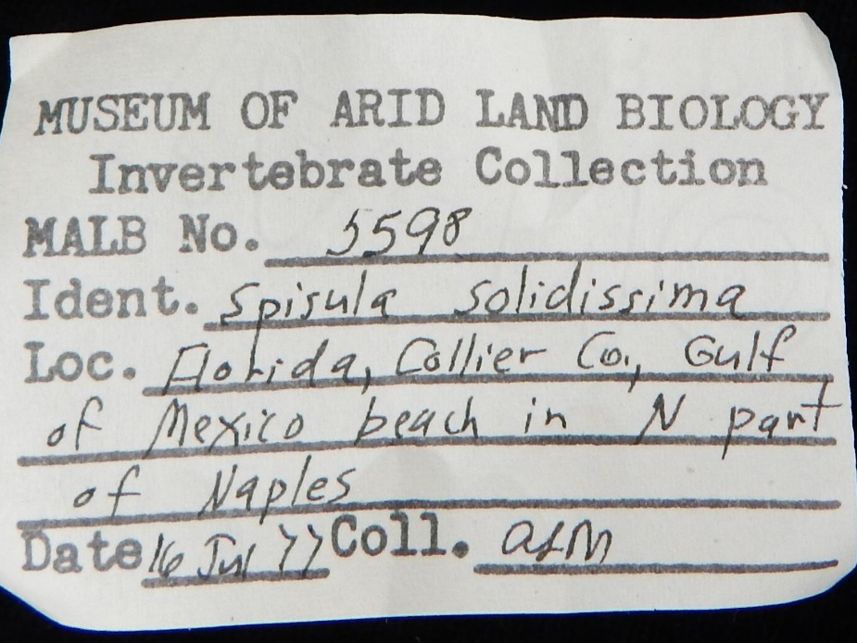
No Excuses (Not)
Notes:
So I’m not making excuses (but I’m making excuses) for everything that follows.
The entire premise of my talk was to demonstrate how a community could respond to data quality flags and improve data overall. I tried to get my Arctos collaborators to answer some very basic questions about the iDigBio data flags and their usefulness. Before I discuss the questions and responses, can we focus on the number of participants?
[CLICK]

Slide 6
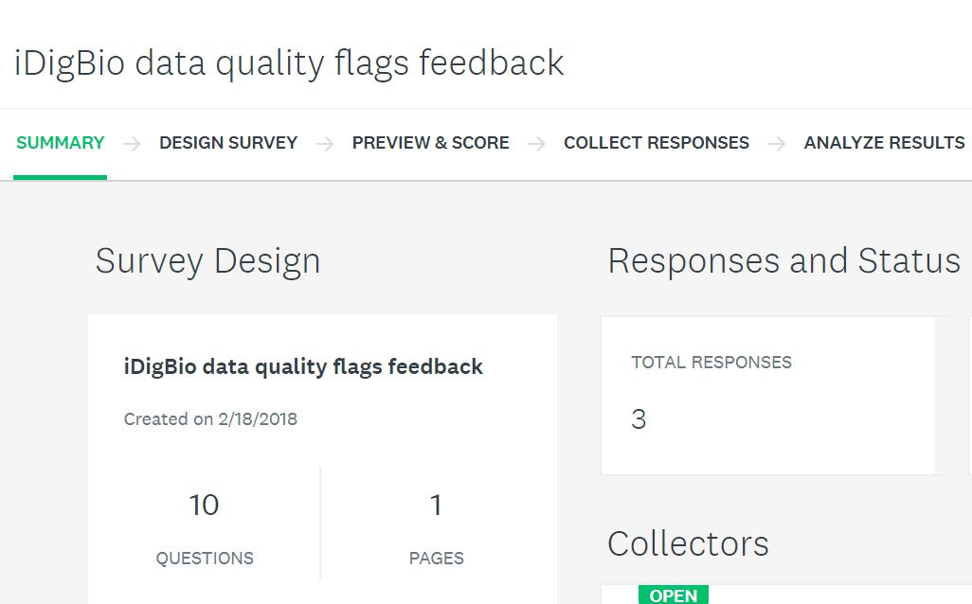
Who has time for surveys?
Notes:
With 26 participating institutions holding about 130 collections, this response rate is abysmal.
[CLICK]
And it was not for lack of asking. Several months of announcing the survey at our monthly working group meeting, posting it to our Google Group, posting an issue on our collaborative management site, and asking people directly, still only left three responses. One of which is mine.
[CLICK]
I thought that my cohorts in Arctos, who I meet with monthly and interact with even more often on our issues management site, could help me understand why there are so many flags on our data. But people DO NOT HAVE TIME OR RESOURCES to go looking for problems, or answer questions about where to look and why. They are busy with the problems at hand on a daily basis. So let’s look at some responses, as statistically invalid as they may be.

Slide 7
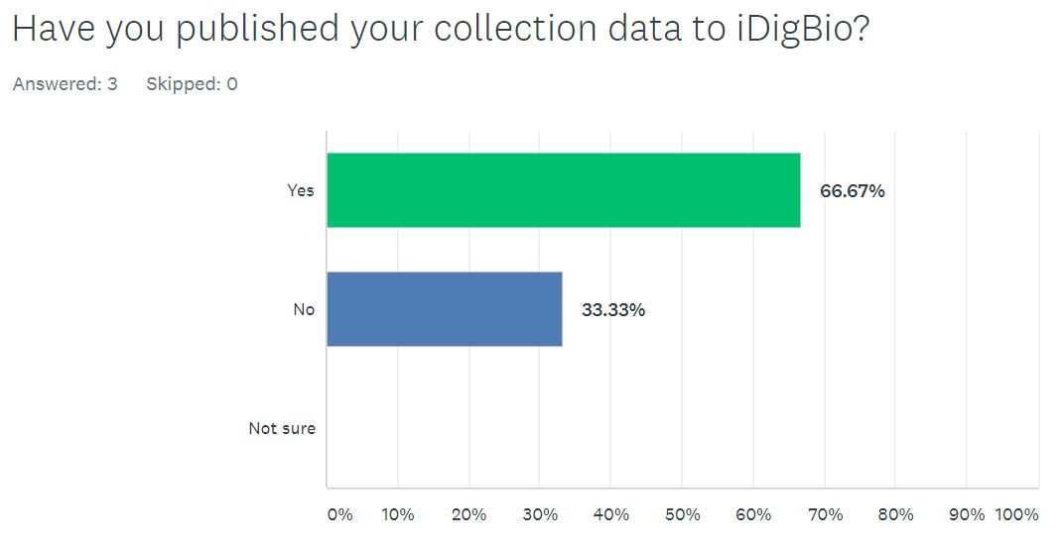
Data Publishing
I'm not even sure what this is referencing:
data in Arctos or data that is being migrated into Arctos! I have never heard this terminology until now.
Notes:
First up, Have you published your data to iDigBio?
Of the three responses, one collection isn’t published to iDigBio. The respondent commented later in an open-ended question….
[CLICK]
“I'm not even sure what this is referencing: data in Arctos or data that is being migrated into Arctos! I have never heard this terminology until now.”
This isn’t some 500 specimen collection in a basement, this is a large state-run university. The message still isn’t out…
At any rate, that leaves responses from me and one other collection.
[CLICK]

Slide 8
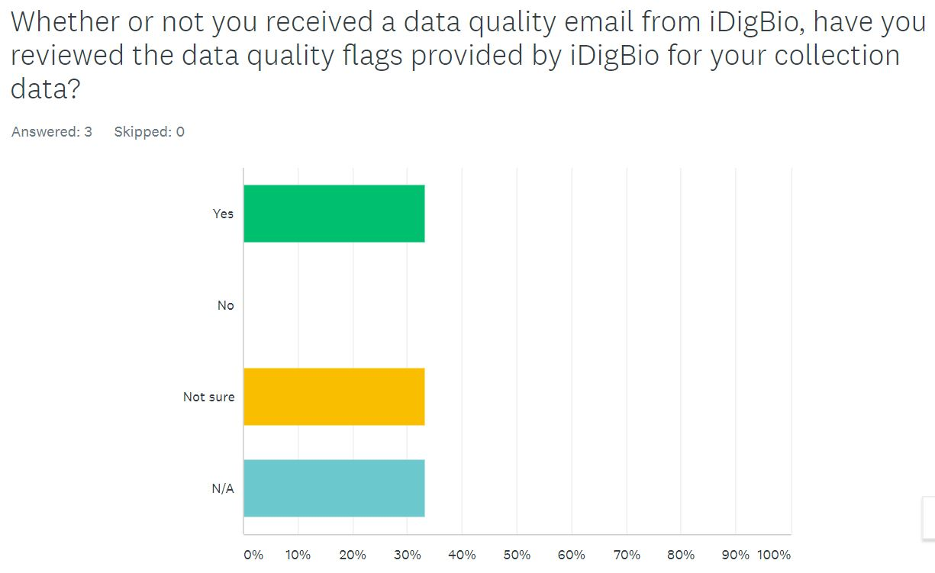
Wait, there are data flags?
Notes:
So you know iDigBio exists and you have published data there, Have you reviewed data quality flags provided by iDigBio for your collection?
Two of us have published data to iDigBio and only one of us has made an effort to review iDigBio data flags. Which leaves me and my experience plus some remarks from older discussions within the Arctos community. So much for community assistance – but here goes.
[CLICK]

Slide 9
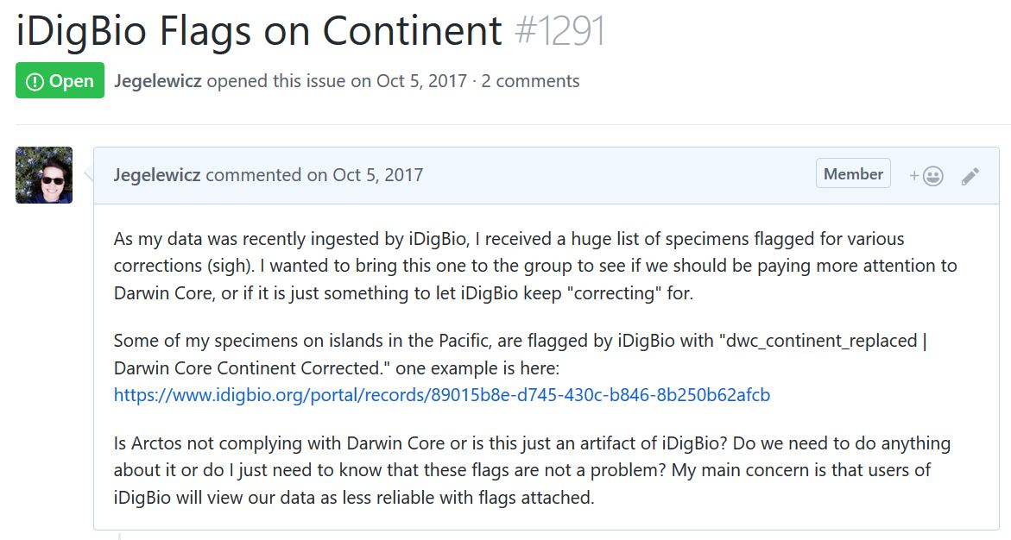
My initial experience
huge list of specimens flagged for various corrections (sigh)
dwc_continent_replaced
users of iDigBio will view our data as less reliable
Notes:
A long time ago, in a galaxy far, far, away…OK it was last year in El Paso…I finally managed, after about a year of work, to get data ingested by iDigBio. YES! Then came the email – you have some data flags.
After a review of said flags and a slight panic attack,
[CLICK]
I submitted a question to my Arctos cohorts. I limited myself to a single flag type that seemed like it would be pertinent to ALL Arctos collections in the hope that I could remove some of these red marks on my data’s name in one fell swoop. As all Arctos collections share higher geography, “dwc_continent_replaced” for me would be the same for any other Arctos collection using the higher geography that prompted the flag.
[CLICK]
My main concern at the time
[CLICK]
was that users of iDigBio data would view Arctos as an unreliable data source.
[CLICK]

Slide 10
My initial experience
noticed something similar in GBIF regarding dates
Darwin Core is an exchange standard; Arctos isn't "complying" with any data standards because none exist
I agree with your assessment: User's initial reaction to the flag will be "Arctos is broken," which is absolutely not the case.
Notes:
The responses were surprising.
[CLICK]
“noticed something similar in GBIF regarding dates”
OK, that at least means it isn’t just us or iDigBio experiencing issues…
[CLICK]
“Darwin Core is an exchange standard; Arctos isn't "complying" with any data standards because none exist”
We can argue about that one all day….
[CLICK]
“I agree with your assessment: User's initial reaction to the flag will be "Arctos is broken," which is absolutely not the case.”
At least I’m not the only one worried about appearances….
But one response was comprehensive and insightful.
[CLICK]

Slide 11
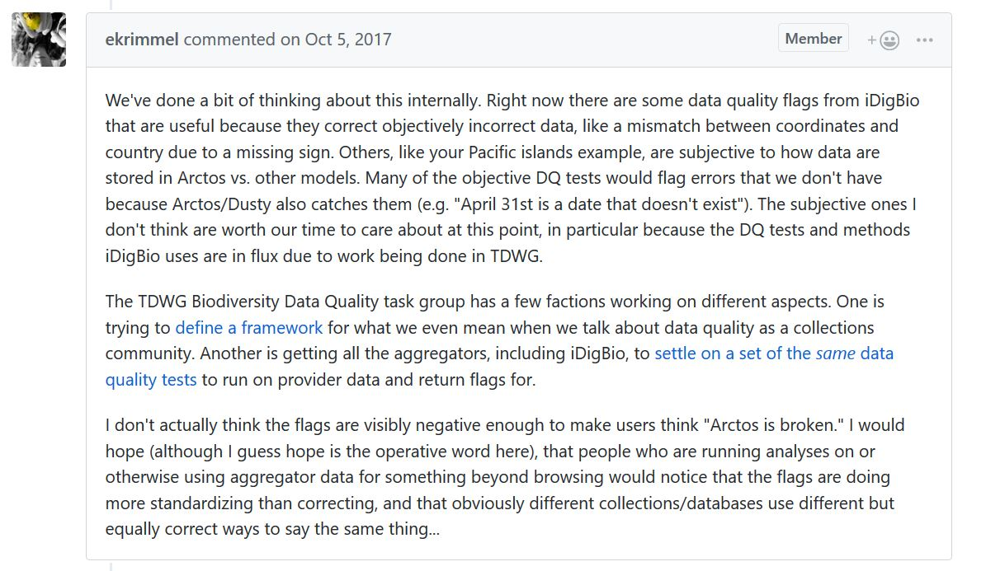
My initial experience
“..subjective to how data are stored in Arctos vs. other models. The subjective ones I don't think are worth our time to care about at this point”
“..some data quality flags from iDigBio that are useful because they correct objectively incorrect data”
the DQ tests and methods iDigBio uses are in flux due to work being done in TDWG. ….
Notes:
The person who wrote this response has since left the Arctos collective due to a family move and we miss her insights. She first notes that
[CLICK]
“some data quality flags from iDigBio are useful because they correct objectively incorrect data”
Missing minus signs on western and southern hemisphere coordinates; misspelled countries, states, counties, and other geography; misspelled taxa, etc. These flags create better data for everyone, but they often require some research effort on the part of an experienced collection staff member to sort out.
[CLICK]
Her second observation, “others…are subjective to how data are stored in Arctos vs. other models [and] aren’t worth our time to care about at this point” carries some truth but also is problematic.
Do we care if our data doesn’t play well with others? I submit that we should, but I also submit that it is hard to play well with others when you don’t know the rules of the game, or worse yet,
[CLICK]
there are no agreed-upon rules. [PAUSE]
[CLICK]

Slide 12
My initial experience
I would hope (although I guess hope is the operative word here), that people who are running analyses on or otherwise using aggregator data for something beyond browsing would notice that the flags are doing more standardizing than correcting, and that obviously different collections/databases use different but equally correct ways to say the same thing...
Notes:
Her response goes on to express something I think we all hope.
[CLICK]
“that people who are running analyses on or otherwise using aggregator data for something beyond browsing would notice that the flags are doing more standardizing than correcting, and that obviously different collections/databases use different but equally correct ways to say the same thing...
Well, the first problem may be that they DON’T notice the flags at all, and the second is that if they do notice the flags, they automatically assume they signal poor quality data. How do we know what they think of the flags? We don’t even look at them…
[CLICK]

Slide 13
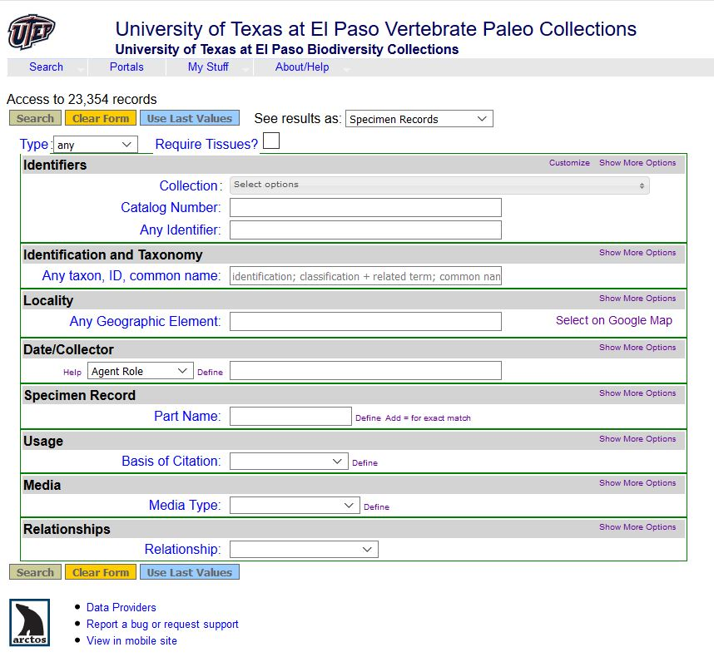
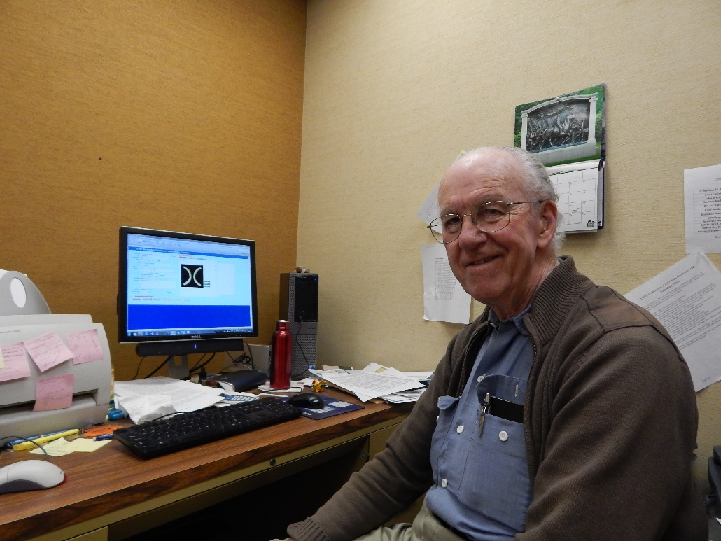
One Collection’s Data Flags
Notes:
As I began to despair about my survey results and think about my previous experience attempting to discuss the iDigBio data flags with colleagues, I decided to take some initiative and explore some of the data flags in a collection over which I had some control. I chose UTEP Earth Sciences
[CLICK]
because I have at least one reliable partner in crime
[CLICK](Dr. Art Harris) for this collection,. Art has been a pioneer in collections data management. All those storage devices at the beginning of my presentation? He’s used them all (yes, punch cards…). He has also used most of the database management software options and created his own data management systems in them. He is not afraid of technology or digital data and he has lovely handwriting to boot.
Art not only managed the UTEP Earth Sciences data through the decades, but also collected most of the specimens. He has first-hand knowledge of the collection that always comes in handy. At just over 23,000 cataloged fossil specimens, the collection isn’t huge, and because it is mostly from New Mexico, geographic flags should be minimal. So, let’s see what we found…

Slide 14
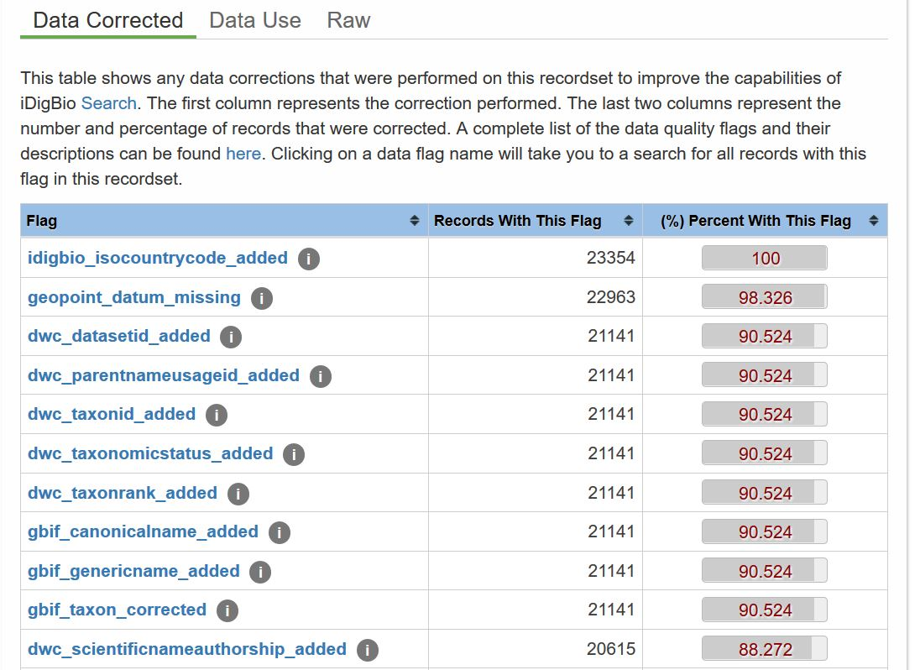
23,354
Notes:
Show of hands
How many of you have seen this for your collection?
How many of you have done anything about it?
[CLICK]
There are only 23,354 public records in this particular collection. Which as you can see,
[CLICK]
has not been georeferenced (because who has time for that?). Even worse….
[CLICK]
Look at all these problems with taxa!
This isn’t everything, the list goes on…
[CLICK]

Slide 15
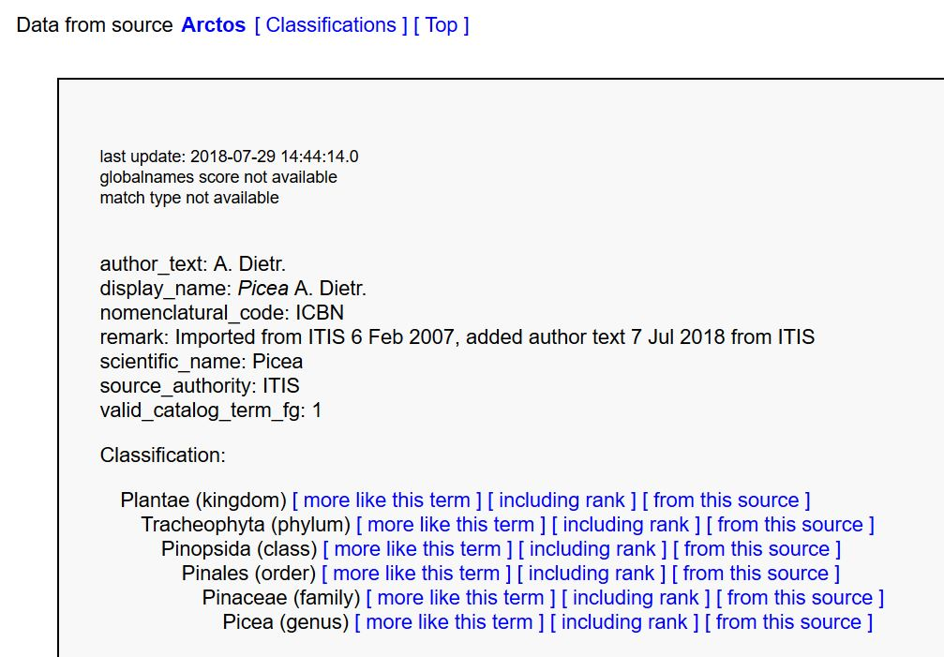
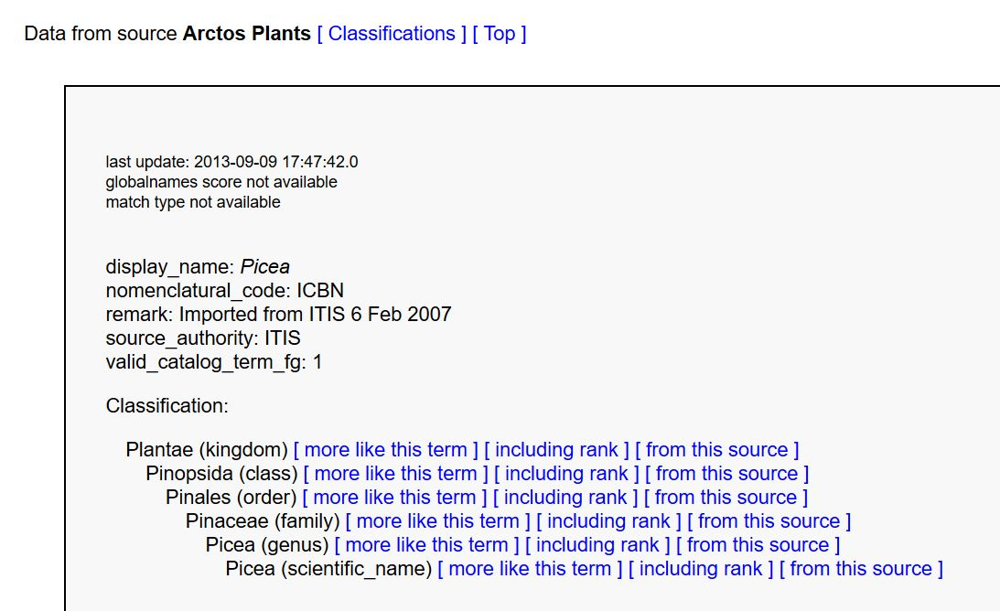
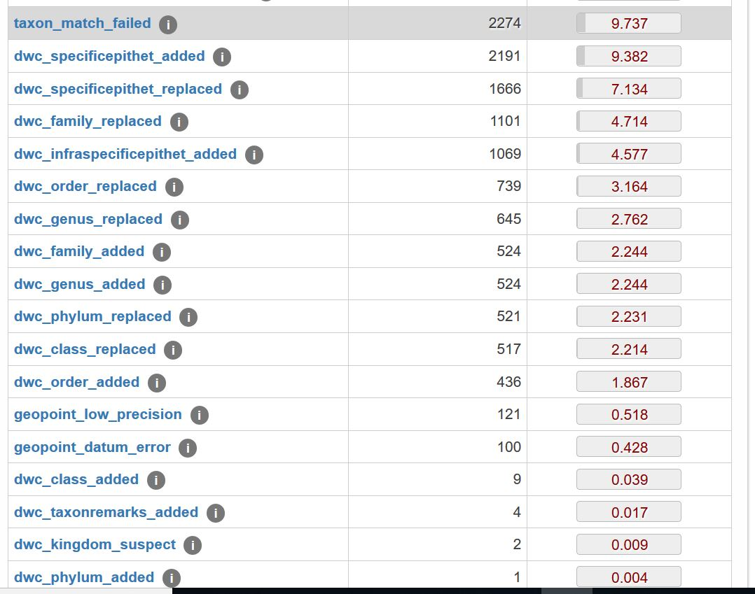
Notes:
AHHHHHHH!!!! My first response was to run away and never look back. But I took a deep breath and picked one flag to explore.
[CLICK]
I decided to start small and discovered one of the objective problems listed in my Arctos colleagues’ thoughtful response.
[CLICK]
The classification in Arctos for the genus Picea, was missing the rank of Phylum.
[CLICK]
This has been added
[CLICK]
and now all Arctos Picea with this flag should be corrected. Neato! Not only did I make this data set better, but I managed to remove flags from others as well. I felt like Super Collection Manager!
That was easy! Emboldened by my success, I moved on to something a lot more challenging…..
[CLICK]

Slide 16
Notes:
“Darwin core class replaced”
Why would part of a classification be replaced? A click on the flag and I was rewarded with a list of all 514 specimens bearing it.
[CLICK]

Slide 17
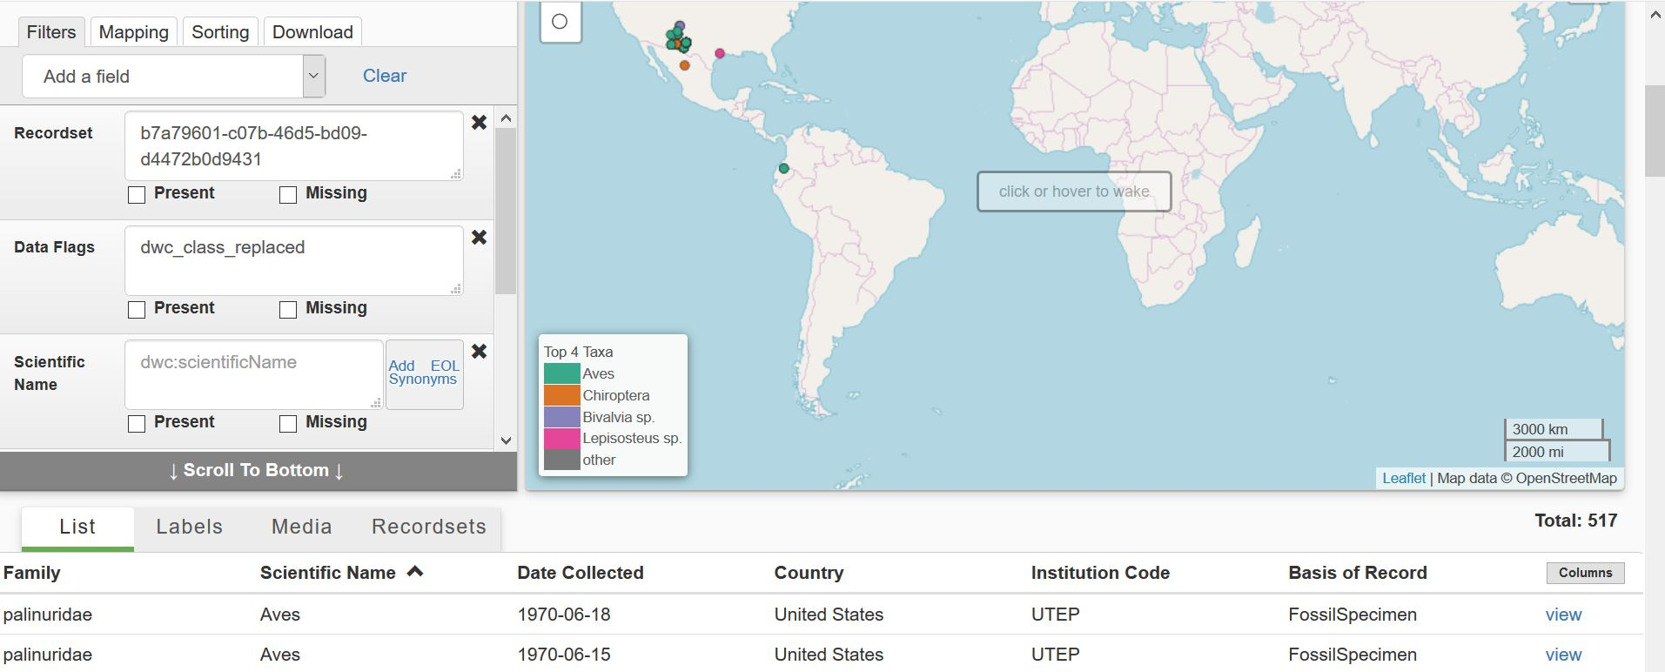
Is Aves not a class?
Family=palinuridae
Notes:
What do I see? A long list of Aves, among other stuff.
And why would something identified only to class include a family designation?
[CLICK]
AND that family looks suspiciously un-bird-like….
Maybe checking a single specimen will help.
[CLICK]

Slide 18
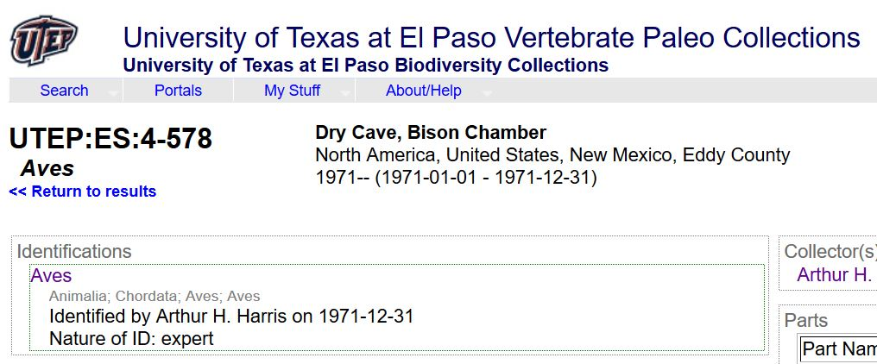
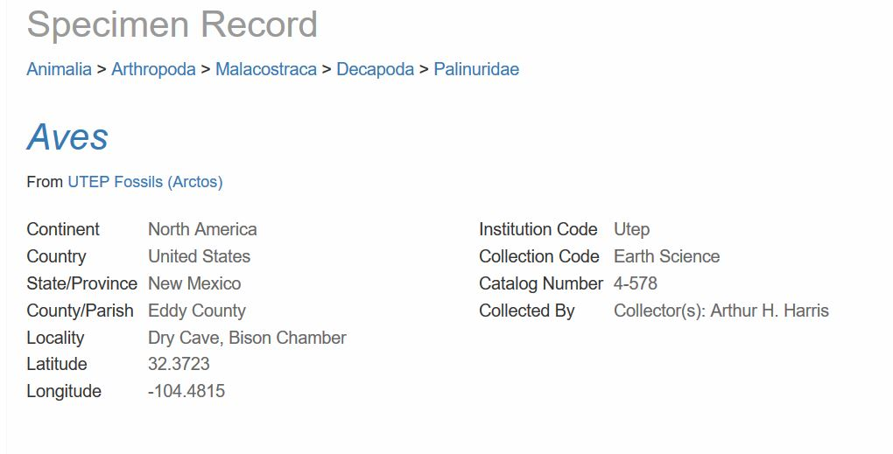
What the what?
Animalia > Chordata > Aves > Aves
Animalia > Arthropoda > Malacostraca > Decapoda > Palinuridae
Notes:
I selected a record from the list and what the what?
[CLICK]
Compare this to what you see for the same specimen in Arctos…
[CLICK]
Why did iDigBio decide that this UTEP bird is some sort of mollusk? Why is Aves listed twice on the Arctos classification? Are these things part of the same problem or completely unrelated? Who would have the answers?
[CLICK]

Slide 19
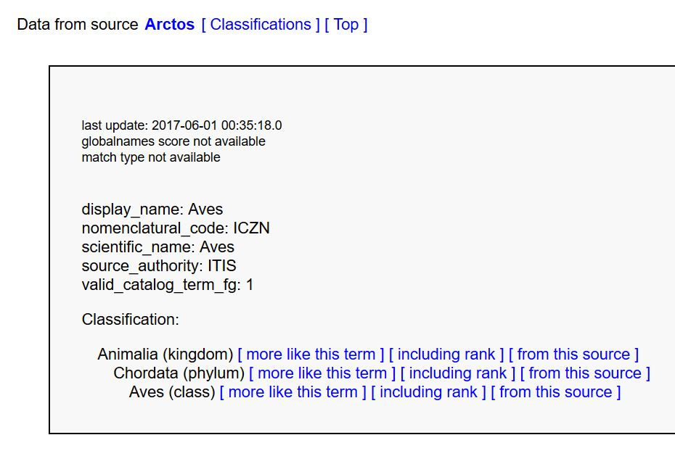
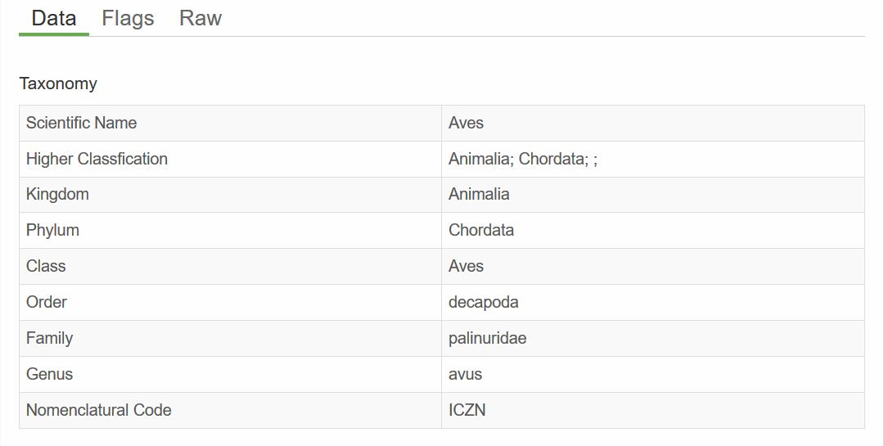
The mystery deepens…
Animalia > Chordata > Aves > Aves
Genus = Avus
Notes:
In Arctos,
[CLICK]
the last name listed in the classification under an identification is the “scientific name”
the name assigned in the identification and the tie between the specimen identification and the taxonomic classification.
[CLICK]
It shouldn’t affect the classification – or so I’m told…
So what else could it be?
[CLICK]
Scrolling down the iDigBio record, I found this unusual item….
[CLICK]
Where did that come from? Apparently, iDigBio has decided that “Aves” is a misspelling of the genus “Avus” and changed not only the classification, but the identification of this specimen, (along with hundreds of other bird records originating in Arctos and even some coming from elsewhere).
Questions to the Arctos programmer and VertNet ipt about this laid all the blame on iDigBio (imagine that). So I went to the source – Deb Paul.
[CLICK]

Slide 20
An answer, I think
Animalia > Chordata > Aves
Aves
Identification=scientific name=dwc:scientificName “Aves”
Taxon rank=dwc:taxonrank “class”
Notes:
It appears that what we are sending via the VertNet ipt to iDigBio is this classification,
[CLICK]
which seems pretty ordinary, along with this identification (aka scientific name),
[CLICK]
which also seems pretty ordinary.
What I didn’t know, and I feel that a lot of others don’t know, is that iDigBio wants THIS identification:
[CLICK]
It’s the addition of taxon rank that tells iDigBio we really mean Aves the class and that we just didn’t forget to put in the part of the classification between class and genus.
Am I the only person in the room who didn’t know this juicy little detail? I may be the only person in this room, but I know I’m not the only one in the world, because a bunch of other collections are passing data to iDigBio and it is being changed in just the way these aves records were. Aves isn’t the only example – all of the UTEP Earth Science order chiroptera (bats) appear as stick insects to anyone viewing them in iDigBio.
Can Arctos pass along a taxon rank? Probably.
As part of my research into this issue, I found an old issue in the Arctos GitHub where this was briefly discussed and then dropped as not a priority. At the time that issue was raised, I was fairly new to this process and I was working about 5 full time jobs at UTEP, only one of which was managing the UTEP Biodiversity Collections’ data. This was not on my list of high priorities either.
The issue remains open for Arctos and will probably work its way up the priority list after this talk and as more paleo collections come on board as it is more of a problem for specimens with identifications that don’t reach the species level. We will have to work out a way to collect this information that makes sense and it is going to be part of a larger discussion about handling homonyms and hemihomonyms.
In the mean time, I suggest that hardworking, problem-solving, collection managers be given the small courtesy of leaving our data in the format we sent it. It is hard enough to keep it correct on our own platforms, why make even more work for us as we chase down changes we didn’t ask for?
And just to remind you, the people who generate this data and who you are asking to review these flags are doing this too:
[CLICK]

Slide 21
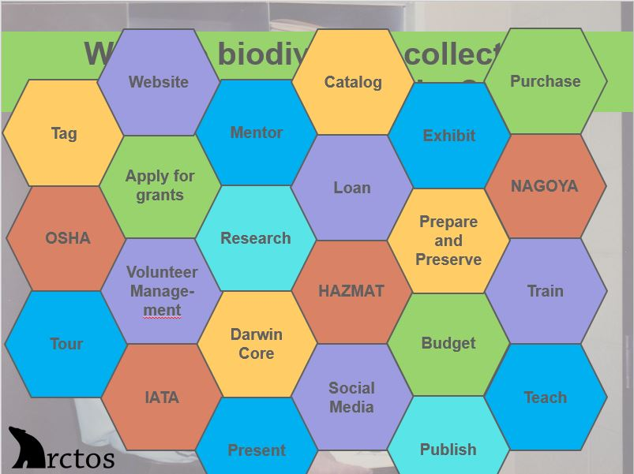
Notes:
Trust me, we all want our data to be perfect, but we need resources to make that happen and we don’t need imperfections added in for us. We can handle that part on our own, thank you very much!
[CLICK]

Slide 22
In My Backyard
We need more help at home!
under-staffed and under-funded
lack of experience/knowledge on the tech end
assistance expressing the importance of the endeavor to administrators
sustainability
Notes:
What’s my message? I had hoped that my little community of Arctos collaborators would provide us with help bringing research-grade, integrated digital biodiversity data to the world through clean-up of data quality flags. I think we can, but not in the way we are being asked. I’m sure that everyone here has dealt with GIGO (garbage in, garbage out). I will not dispute that a lot of the digital biodiversity data going in to projects like iDigBio and GBIF include various quantities of smelly stuff, but I don’t believe it can be sanitized by the guesses of someone (or some script) without access to original source information.
The best way to aggregate awesome data is to start with awesome data.
[CLICK]
Given that, I think we need more help at home.
[CLICK]
It has been my experience that biological collections in general are undervalued, understaffed, and under-funded. If every collection had one trained staff person that would be a start, but it isn’t enough. I hope that I have made my point that collections’ staff are stretched too thin and required to be experts in too much. If we really want excellent data, we need excellent data management staff. Staff members who are dedicated to data entry, maintenance, publication, and enrichment. These staff members should understand the technology they are working with, contribute to data management rules for the community, and seek ways to improve the data for which they are responsible without the burden of preparing specimens, filling loan requests, managing the HVAC in the collection space, and so on. This goes right along with under-funded, as the reason that most collections don’t have a data manager is that “there aren’t funds available”. Rather than holding workshops to stuff ever more information into a few collection manager’s brains, I think it would be preferable to fund positions such as this if we want excellent data.
[CLICK]
Most collection managers are not IT specialists. Many are biologists, some came to biological collection management through other routes, but my guess is that the percentage of collection managers with an information technology background is pretty low. Tech moves fast and it is not easy to keep up. I don’t see much support from administration either in museums or universities for technology to maintain collection data. In most collections this has been accomplished by some committed curator or collection manager who learned some system (FileMaker, Access) and entered information themselves or wrote a grant to “digitize”. That approach has become insufficient in today’s world of aggregators. Maybe it is time to bring institutional IT into the collections, but we don’t want to be overrun by administration policy. We need help with this. We need to be able to make use of our institution’s IT experience without fear of a hostile takeover. Presentations reaching high-level positions in institutions holding biological collection data might help garner support. Or how about community support? Access to a SQL programmer, someone to perform data or system interface audits, a specialist in creating eml files, or assistance getting data to an ipt. Providing these services free or at a very low cost would relieve collection managers of the burden of learning a skill they will only use once or have to re-learn two years from now when they need to perform a task again.
[CLICK]
Ever get the feeling no one knows you exist? I’ve had this feeling in several biological collections now. So many times, these collections are part of some much-larger institution and they operate under the radar, some purposefully so. This is not good for data. We need help inside our institutions. We need administrators to understand the importance of biological data and that just because it is in a database, it isn’t “done”. We need attribution when our data is used in research, we need defined measurements of success, and we need more sustainable funding. And please, let us not forget that the most important source material related to this data is the specimen itself, which also requires care and maintenance.
[CLICK]
On that note…Digitization is not taking photographs of specimens and putting them on the web. In fact, photographs aren’t even required. The information in field notes, catalogs, specimen labels, research papers – is what make a specimen interesting and important. Text is not sexy, but it is how we really communicate. Language changes over time, as does information about a specimen. We need people to maintain that information over long periods of time. Grants to “digitize” are nice, but then what? That static information will soon become stale or fail to meet aggregator standards. Your aves will become avus and your specimens will become irrelevant. We have to be thinking about LONG TERM SUSTAINABILITY. One-off, grant funded projects are not the answer, this is a never-ending project that will require constant monitoring, technological upgrades, and staff training AT THE INSTITUTION LEVEL.
[CLICK]

Slide 23
Thank You!
Photos courtesy of:
Arctos
Arthur H. Harris
Museum of Obsolete Media
Wikimedia Commons
All opinions expressed are my own. I would like to thank
Everyone in the Arctos Working Group for putting up with my multiple requests and issues on the Arctos GitHub. You all make my life so much richer!
Dr. Art Harris for being my iDigBio data quality flag guinea pig and partner in biological data crime.
Deb Paul for taking my questions seriously and making an honest attempt to answer them even while traveling.
Notes:
I hope that my experience will help in small way. Thank you for listening to my story.

