Slide 1





The GB3D Fossil Types Online project (www.3d-fossils.ac.uk) – the inside story
Mike Howe, British Geological Survey, Keyworth, Nottingham, UK
Notes:
14-30 – 14-50
The British Geological Survey (BGS) manages the national borehole archive, with corestores at Keyworth, Nottingham, holding samples and cuttings from over 15,000 onshore boreholes, including 250 km of core. The marine corestore at Loanhead, Edinburgh, held 12,000 metres of core and 15,000 seabed samples, and the UK Continental Shelf corestore at Gilmerton, Edinburgh, contained DECC’s UK seaward hydrocarbon well cores and samples from over 8,000 wells, with 300 km of core and 4.5 million samples of cuttings.
In 2009, the decision was taken to consolidate the core holdings into a single “state of the art” facility at Keyworth. Because of the importance of the Gilmerton material to Britain’s energy security, the BGS worked closely with a group of advisors to develop and monitor a safe transfer methodology. The move required 125,000 boxes of core and 47,000 boxes of cuttings to be packed into caged pallets and transferred to Keyworth within 18 months. Every box of core (often containing three internal boxes) was opened, the contents photographed (7216x5412 pixels) and additional conservation grade packaging added to protect the material during transit. Adoption of a production line technique, coupled with the extensive use of barcodes and database systems, is enabling the transfer to proceed on target. It has also provided a unique opportunity to audit 100% of the core, adding metadata or conservation issues to the database. QC inspection of the core on arrival at Keyworth has failed to detect any transfer damage.

Slide 2
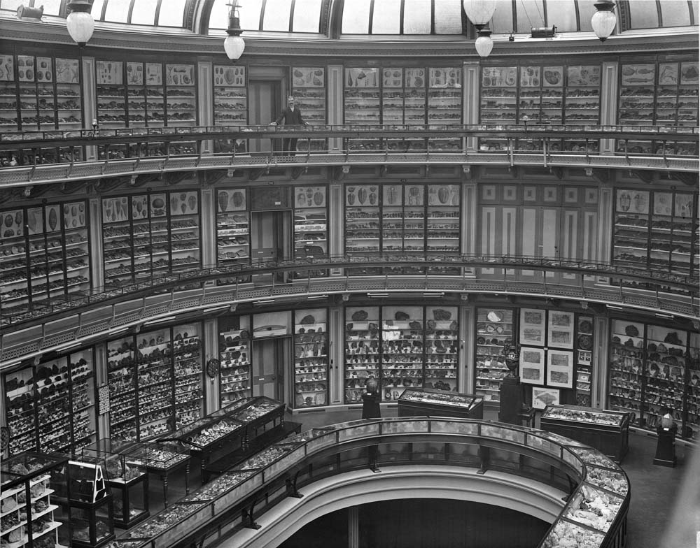
The story begins in …..
Museum of Practical Geology (1851 – 1935)

Slide 3
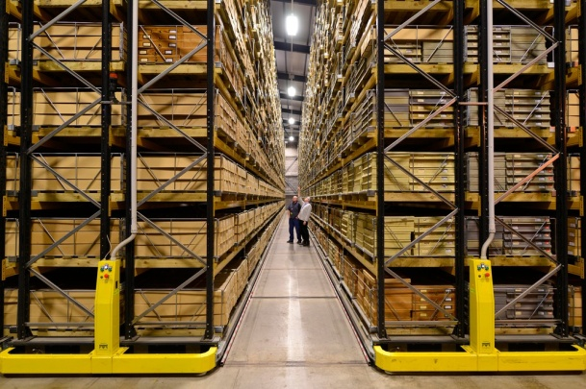
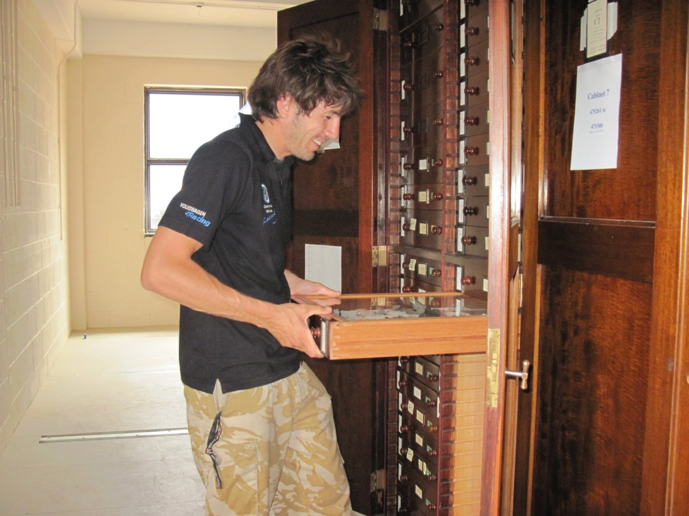
and continues at…….
BGS Keyworth, 1985 -

Slide 4
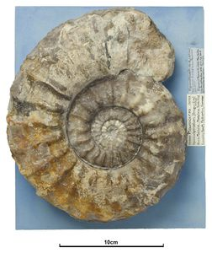
Plan
Brief history of collections digitisation at British Geological Survey
The Jisc GB/3D fossil types online project
The future – but funding?
Lessons learnt

Slide 5
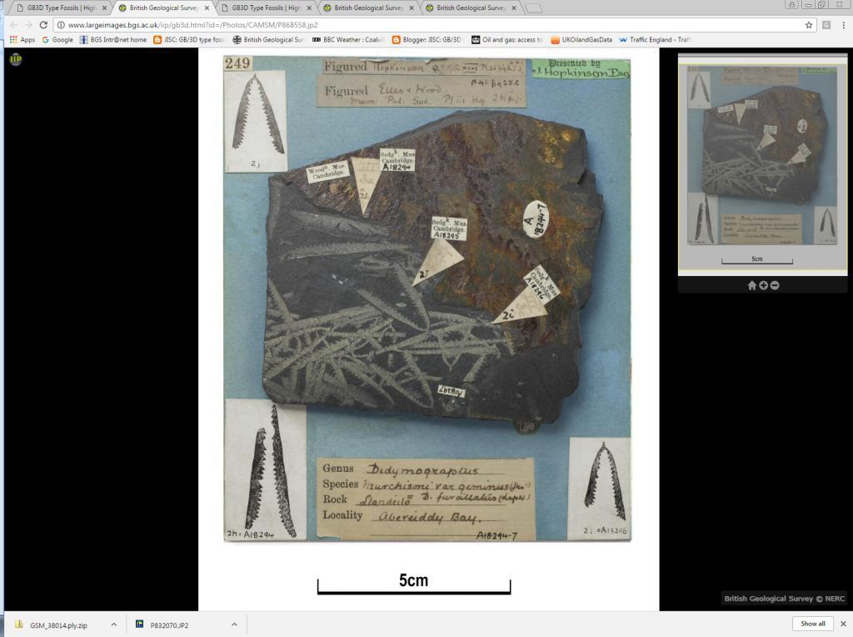
Brief history of Collections digitisation at BGS

Slide 6
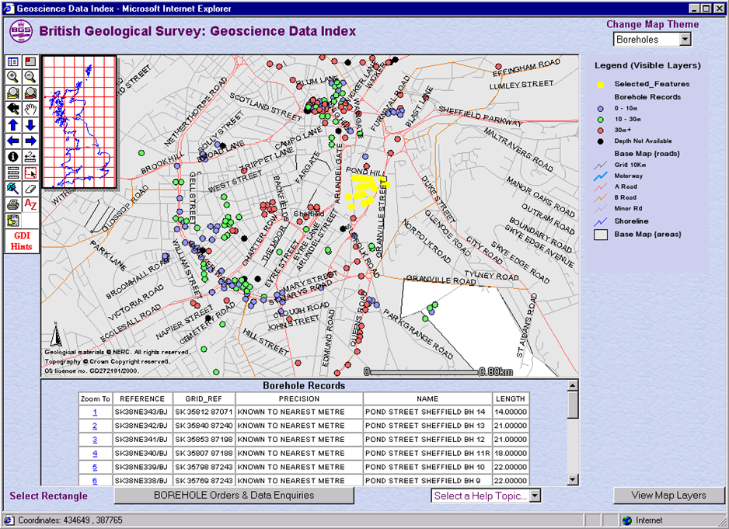
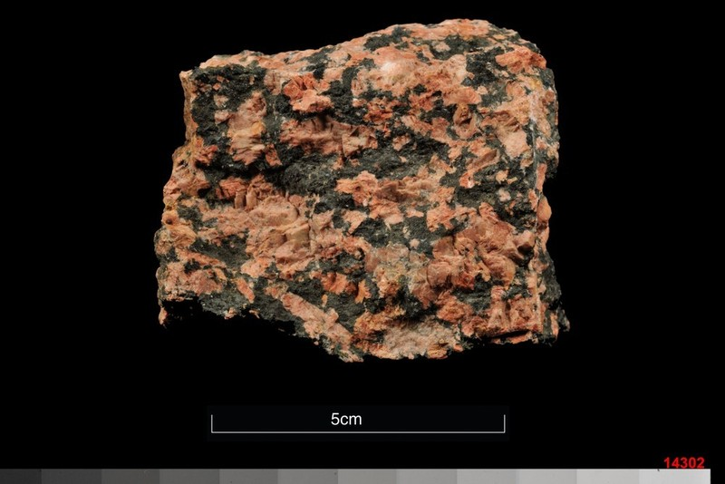
British Geological Survey: Digitisation Timeline
2000
2002
2004
2006
2008
2010
2012
2014
2000 – Online images and GIS (with collections data)

Slide 7
British Geological Survey: Digitisation Timeline
2000
2002
2004
2006
2008
2010
2012
2014
2001 – “Virtual Museum” bid to New Opportunities Fund failed

Slide 8
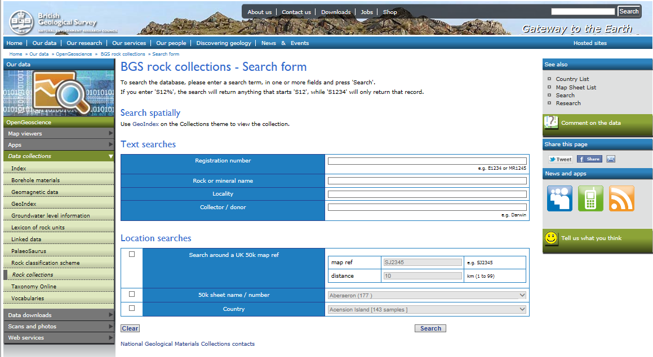
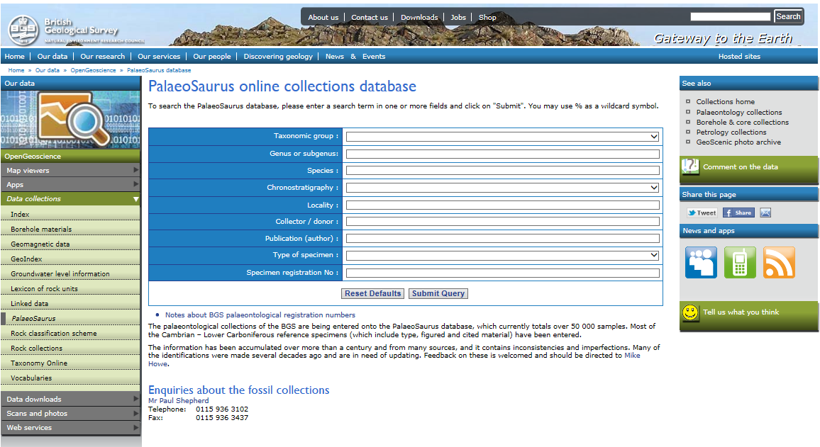
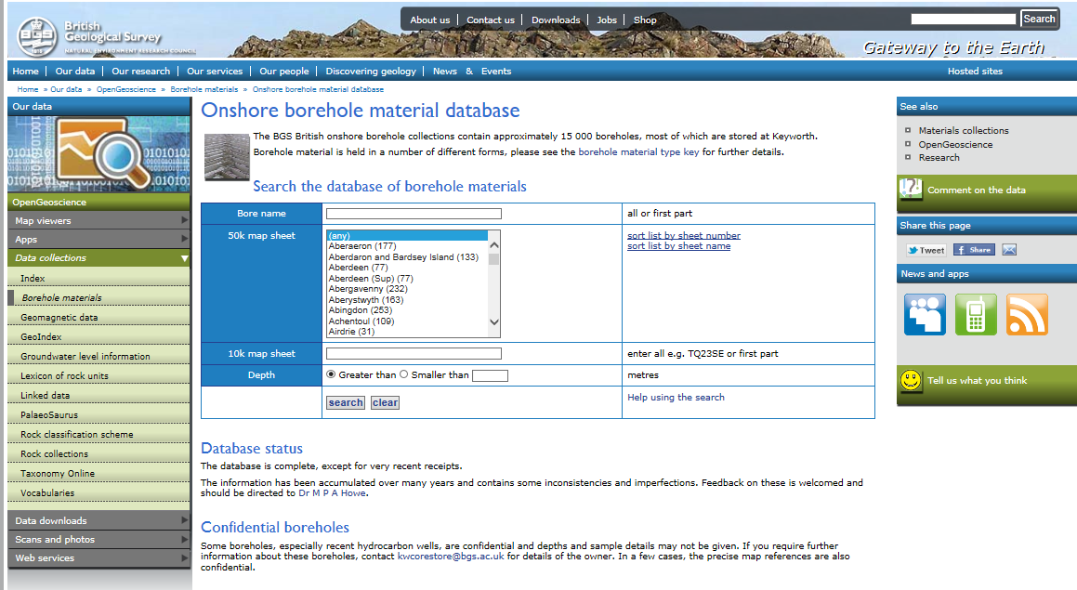
British Geological Survey: Digitisation Timeline
2000
2002
2004
2006
2008
2010
2012
2014
2006 – All the main collections databases online (rocks/minerals – fossils – boreholes

Slide 9
British Geological Survey: Digitisation Timeline
2000
2002
2004
2006
2008
2010
2012
2014
2009 – “3D Access to Collections” bid to Arts & Humanities Research Council failed

Slide 10
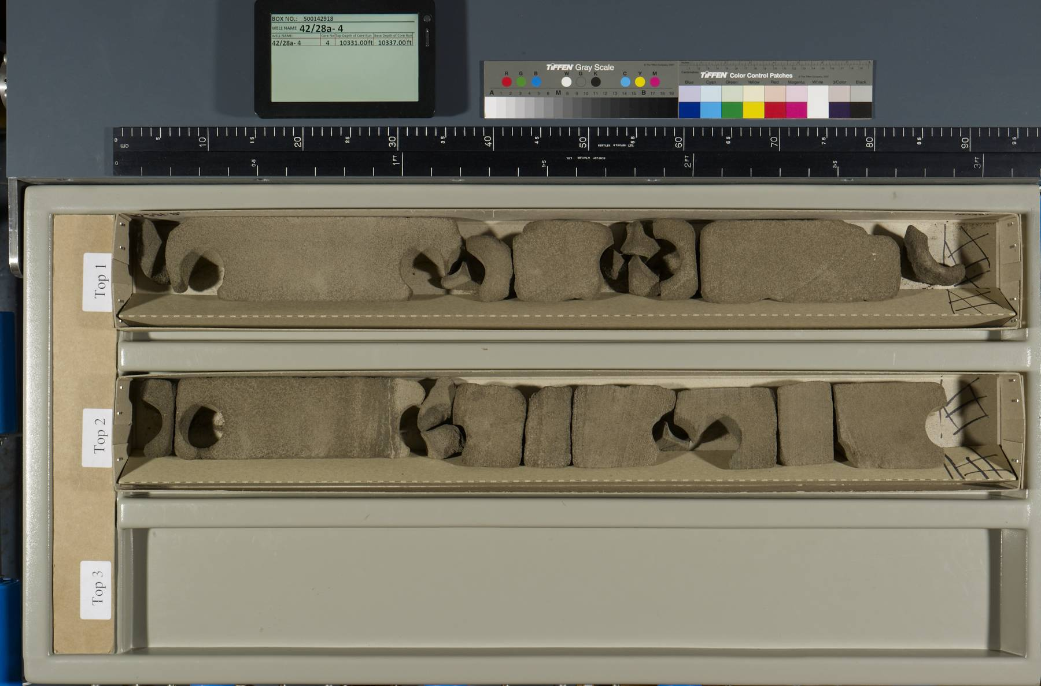
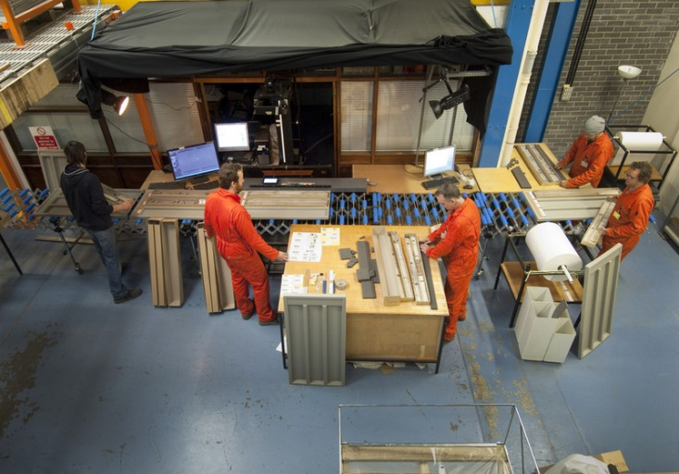
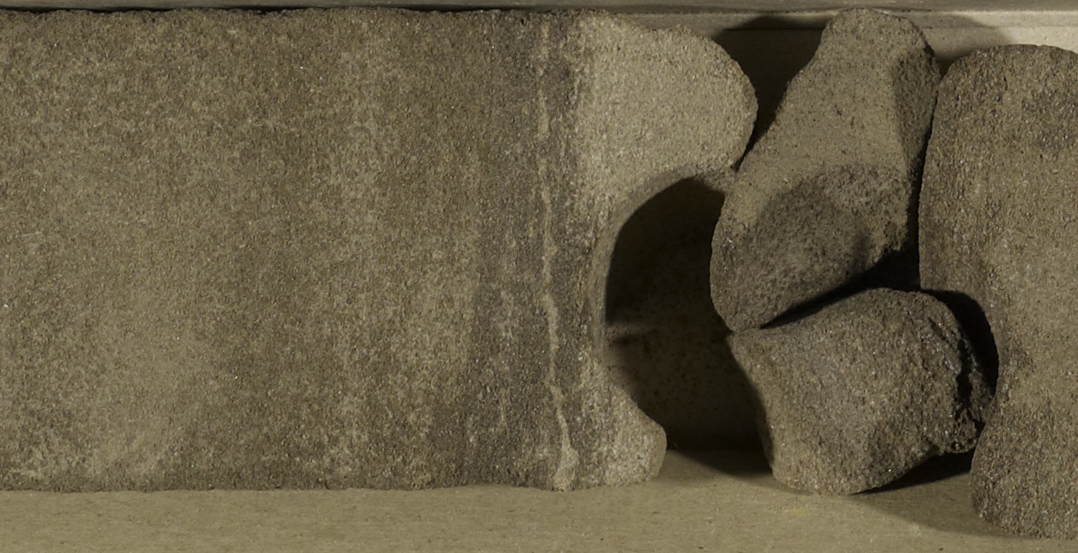
British Geological Survey: Digitisation Timeline
2000
2002
2004
2006
2008
2010
2012
2014
2010 – 2012 – HR photography of 125,000 UKCS hydrocarbon cores

Slide 11
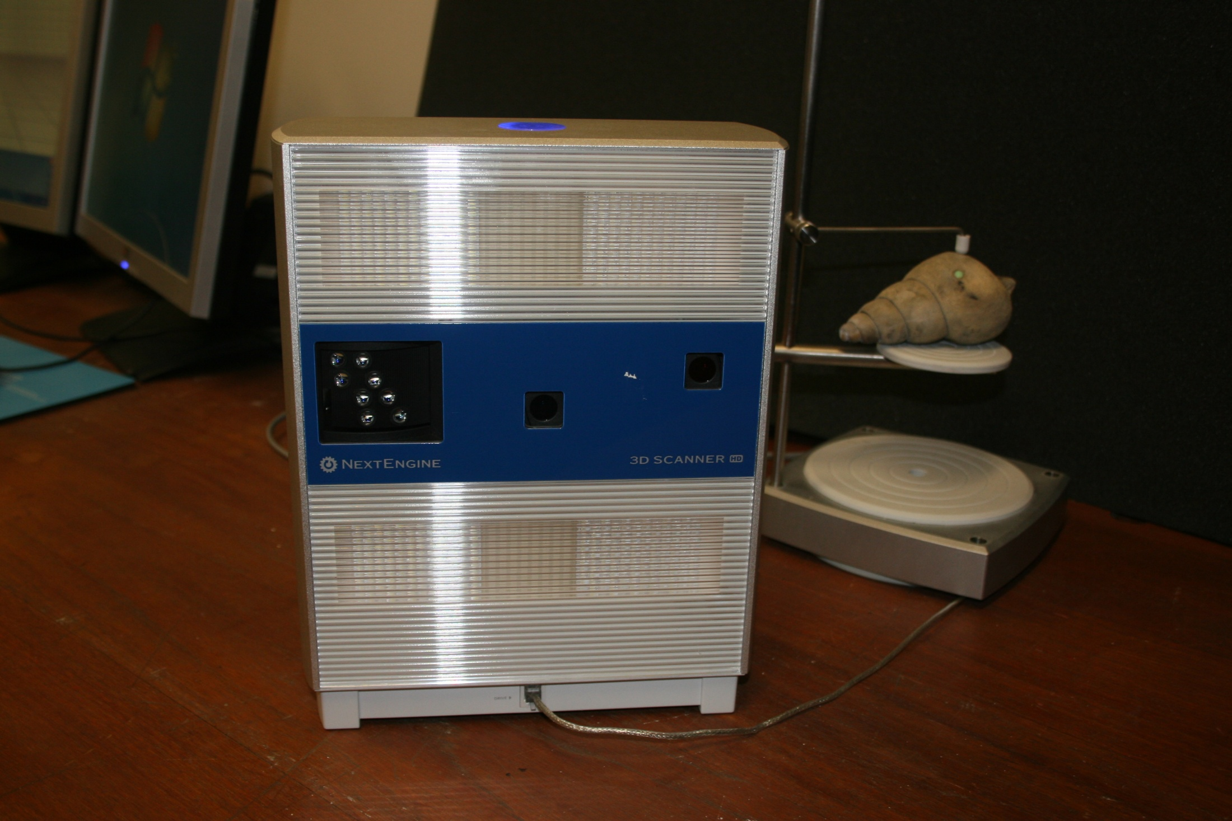
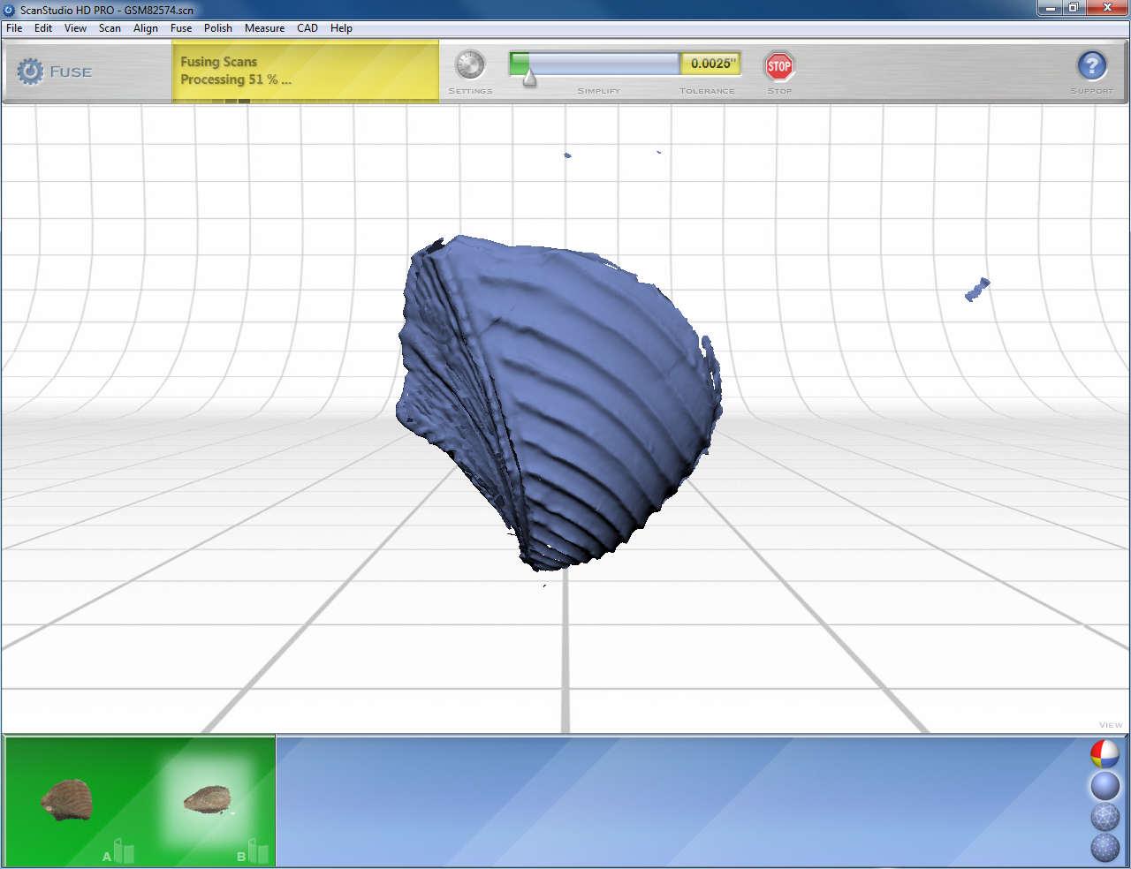
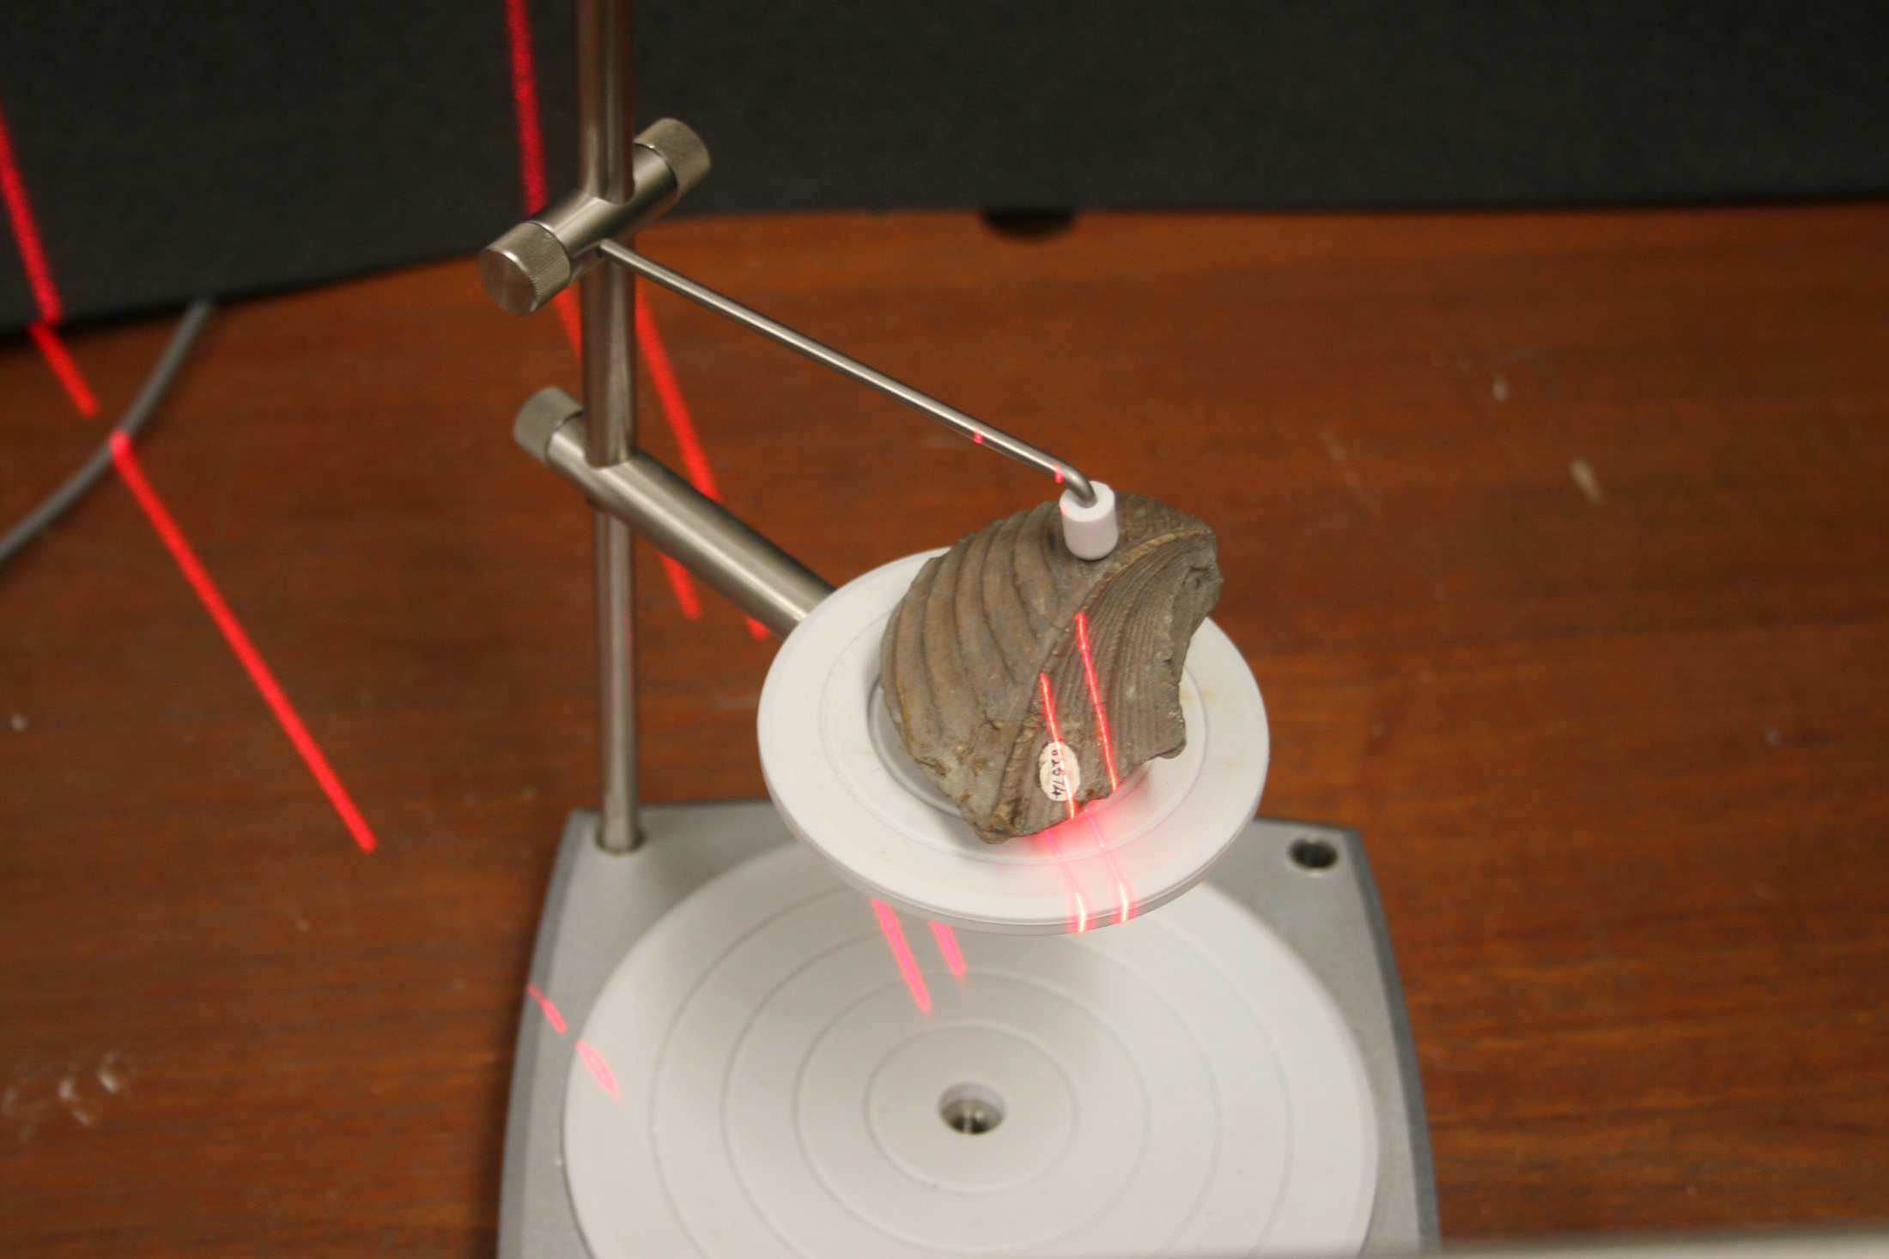
British Geological Survey: Digitisation Timeline
2000
2002
2004
2006
2008
2010
2012
2014
January 2011– Purchased NextEngine HR Laser Scanner

Slide 12
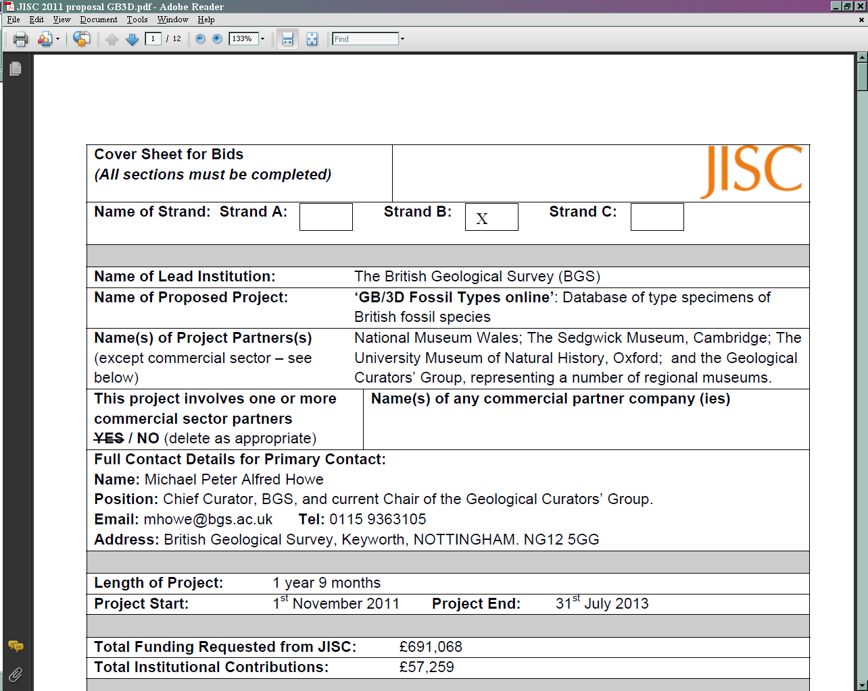
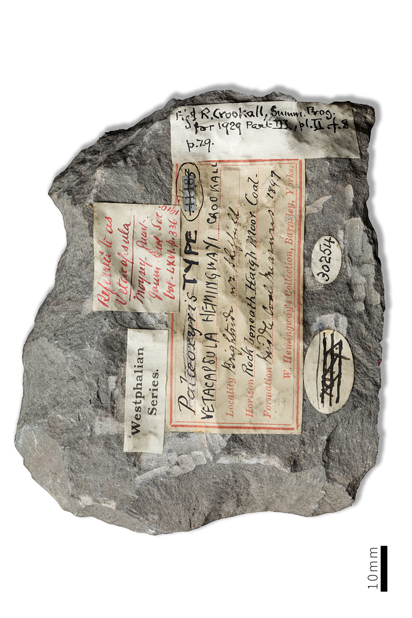
British Geological Survey: Digitisation Timeline
2000
2002
2004
2006
2008
2010
2012
2014
August 2011 – Submitted JISC grant application

Slide 13
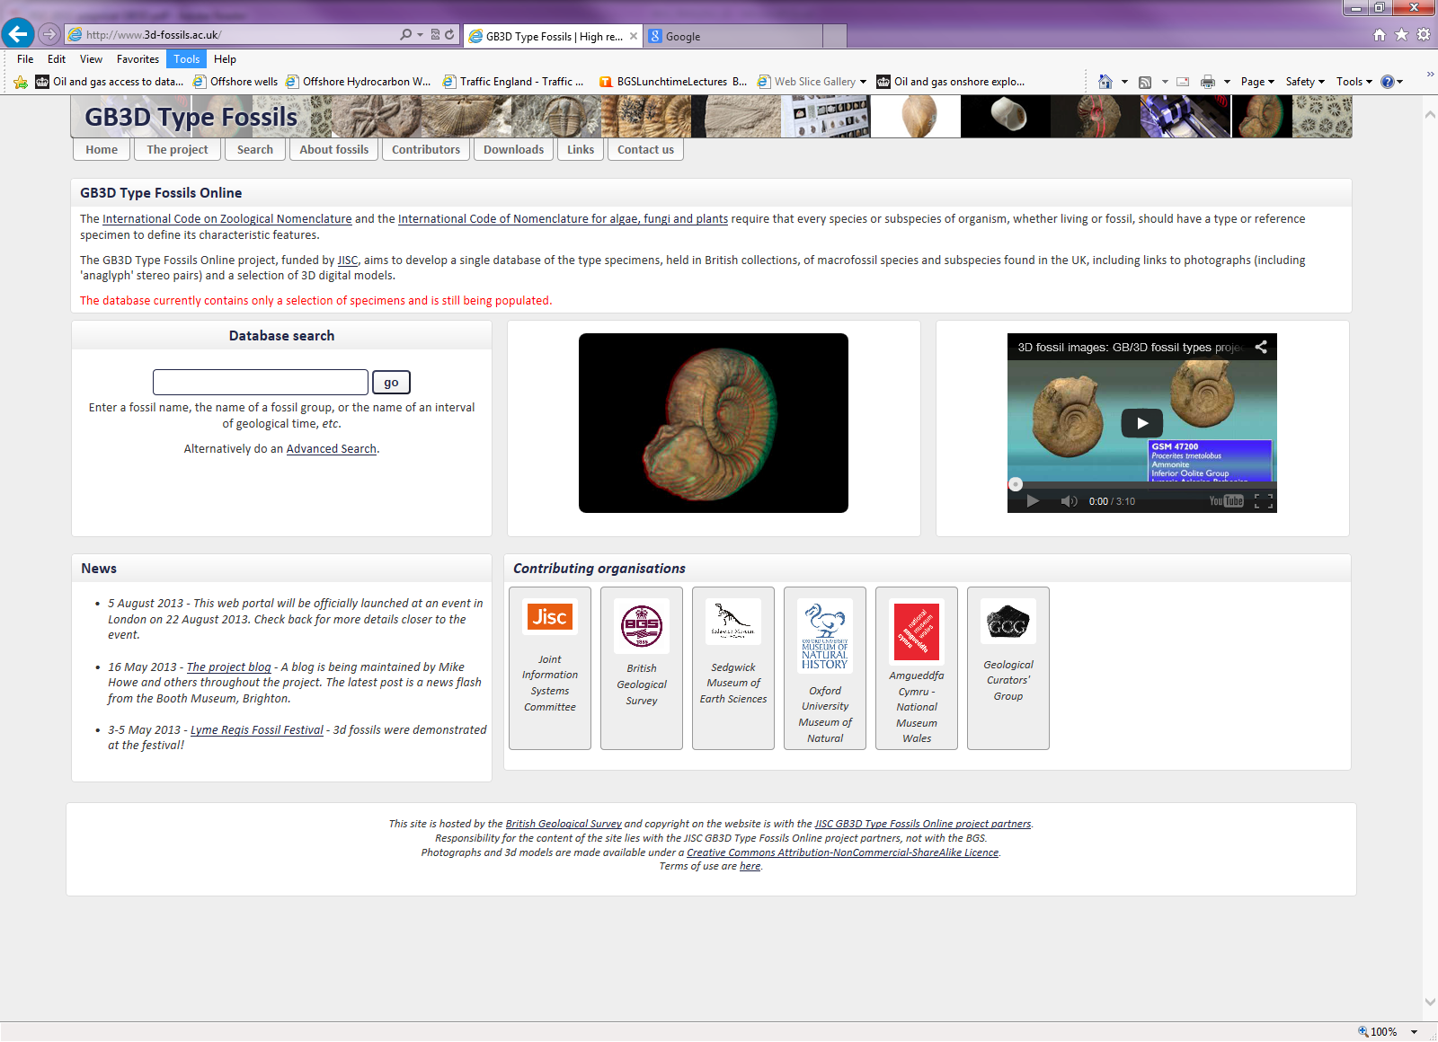
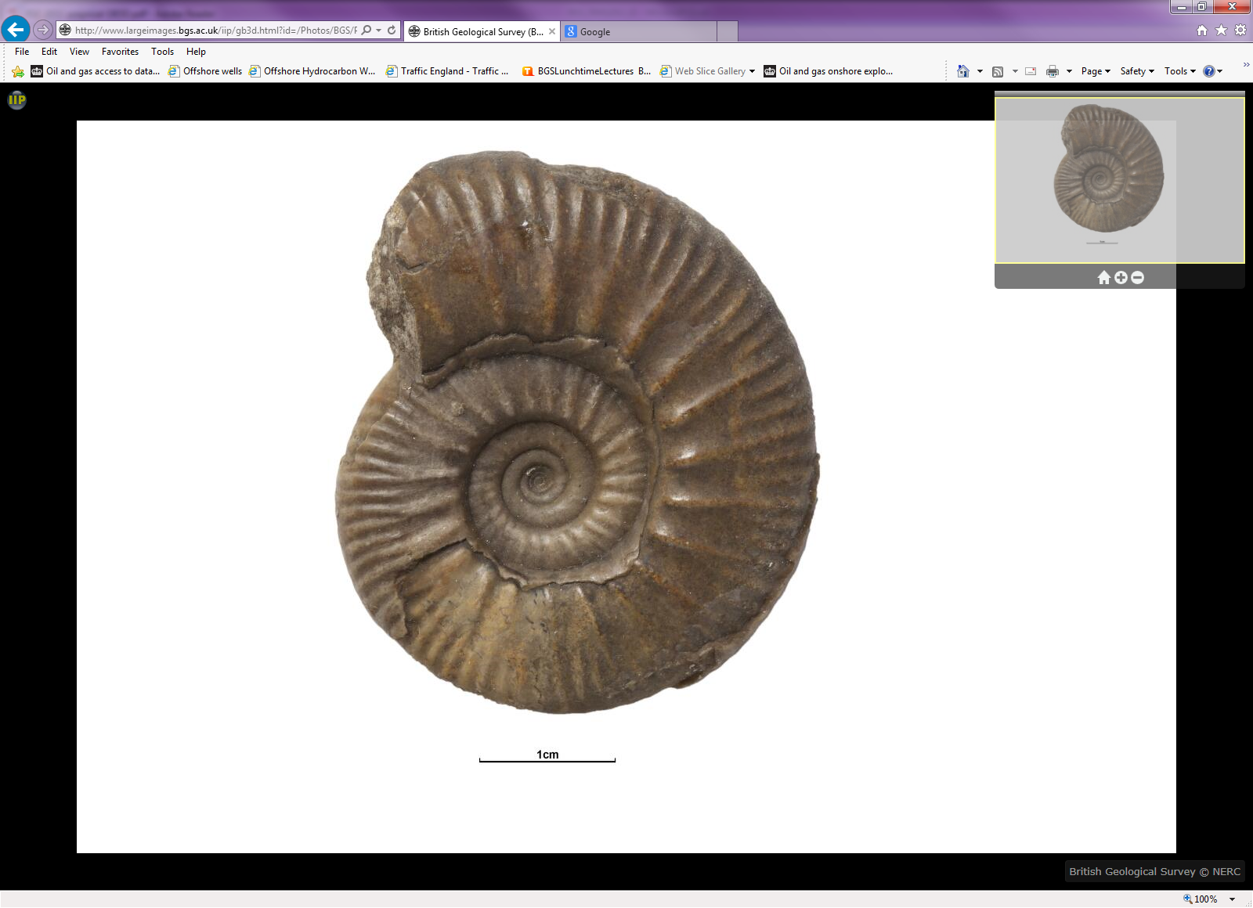
British Geological Survey: Digitisation Timeline
2000
2002
2004
2006
2008
2010
2012
2014
Website
www.3d-fossils.ac.uk
2011 – 2013 – Jisc GB/3D fossil types online project

Slide 14
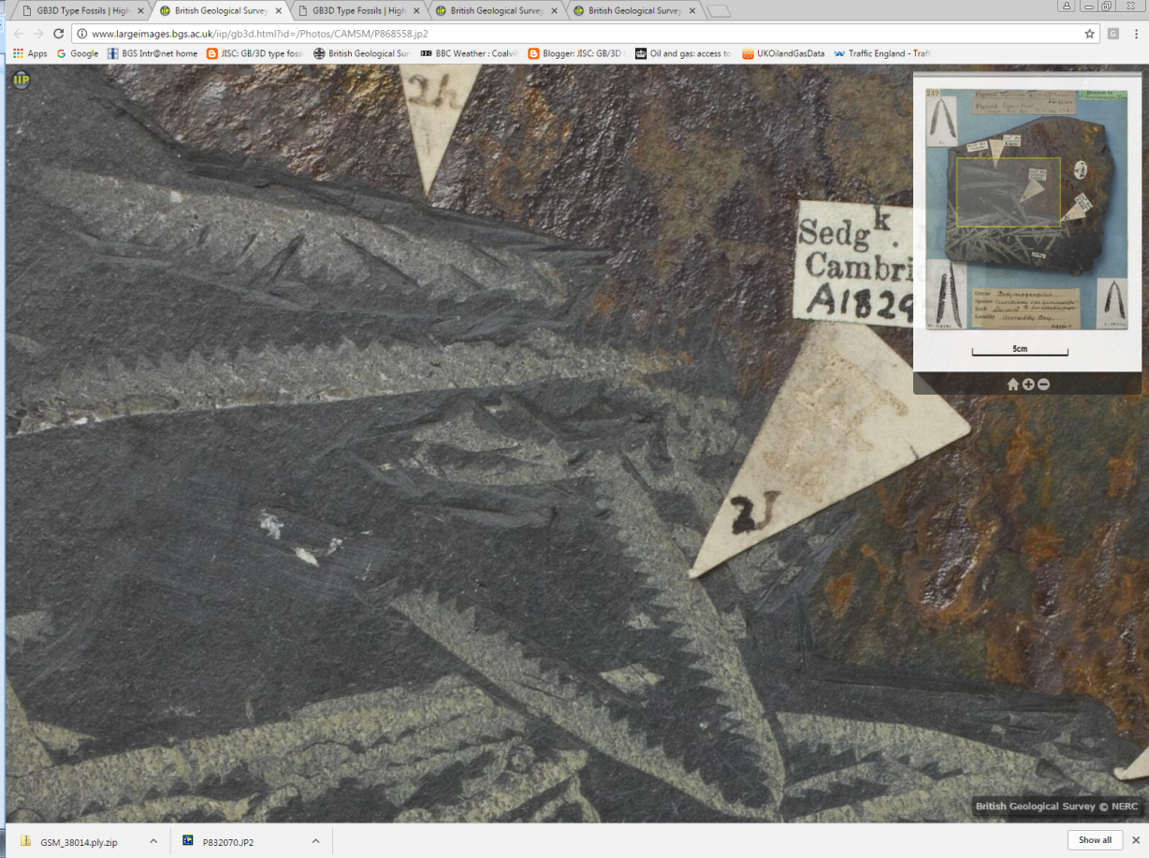
The Jisc funded GB3D fossil types online project

Slide 15
Jisc funded GB3D Fossil Types Online
17,500 types, each with HR images, anaglyphs & labels + 2000 3d digital models
Cameras: Canon EOS5D (22.3Mp). Images served as JPEG2000. Models available as Zipped .PLY and .OBJ
Partners: British Geological Survey; National Museum Wales; The Sedgwick Museum, Cambridge; The University Museum of Natural History, Oxford; and the Geological Curators’ Group, representing a number of national, regional and university museums - (most of major British type repositories, except London Natural History Museum).
Web-based uploading and API undergoing beta testing

Slide 16
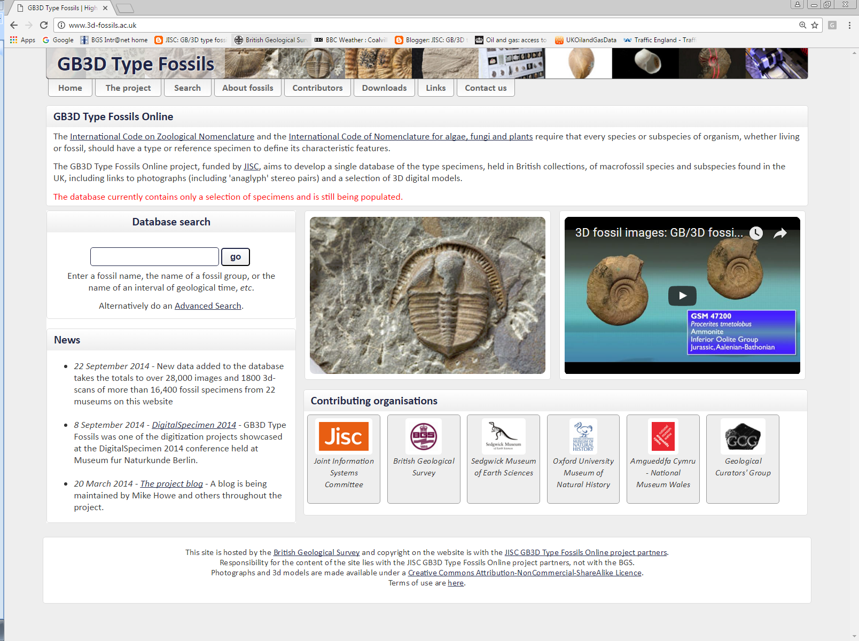

Slide 17
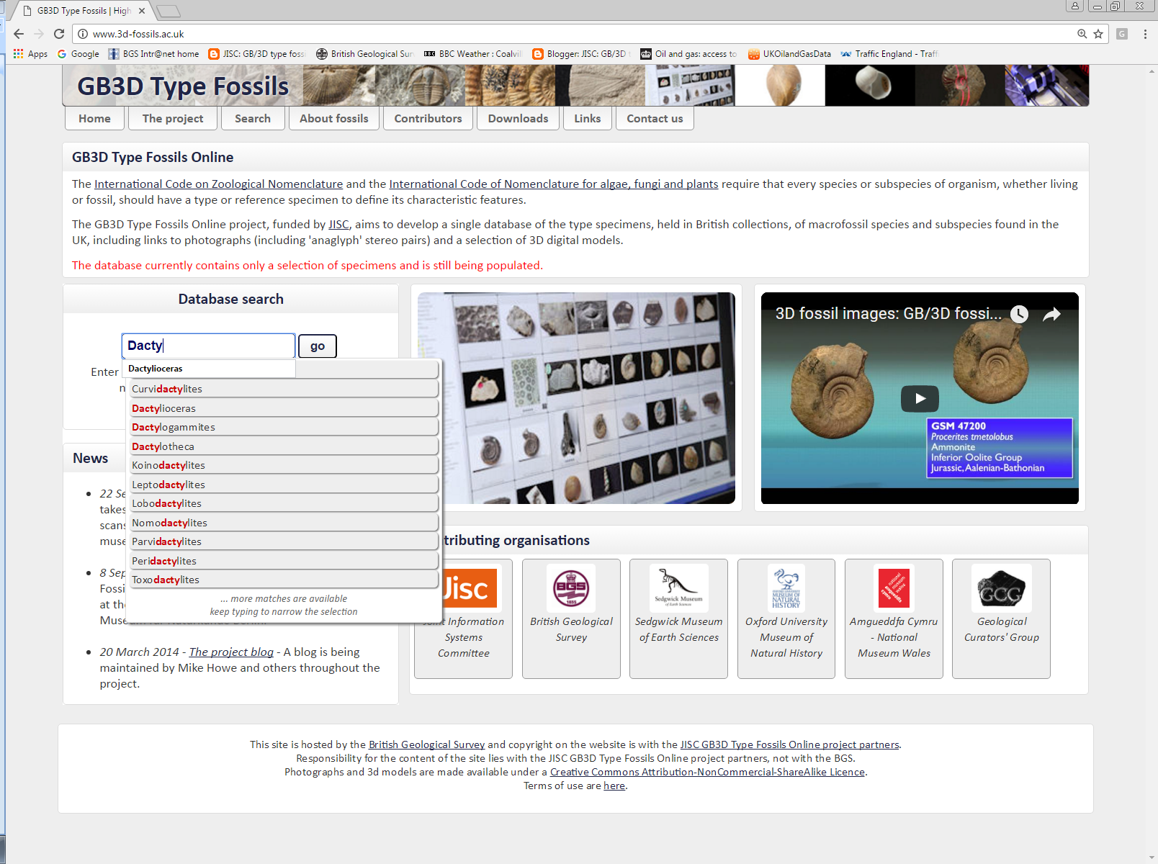

Slide 18
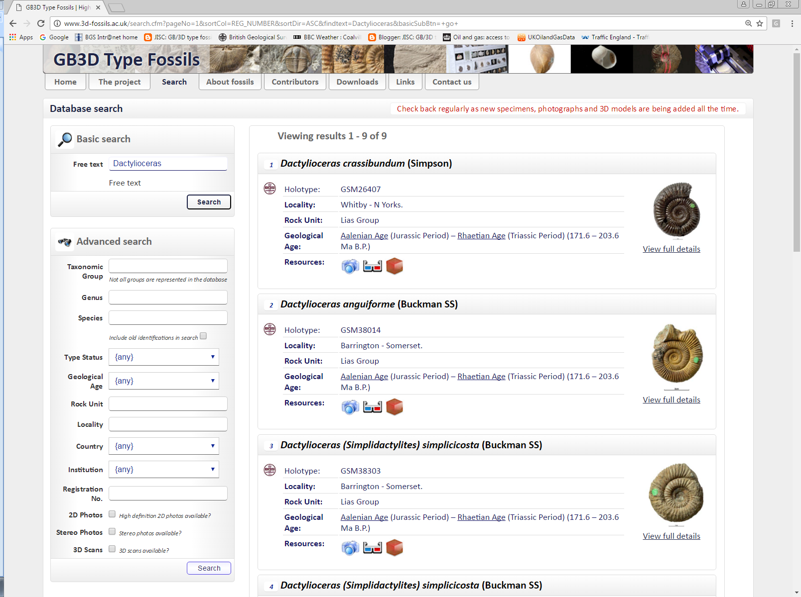

Slide 19
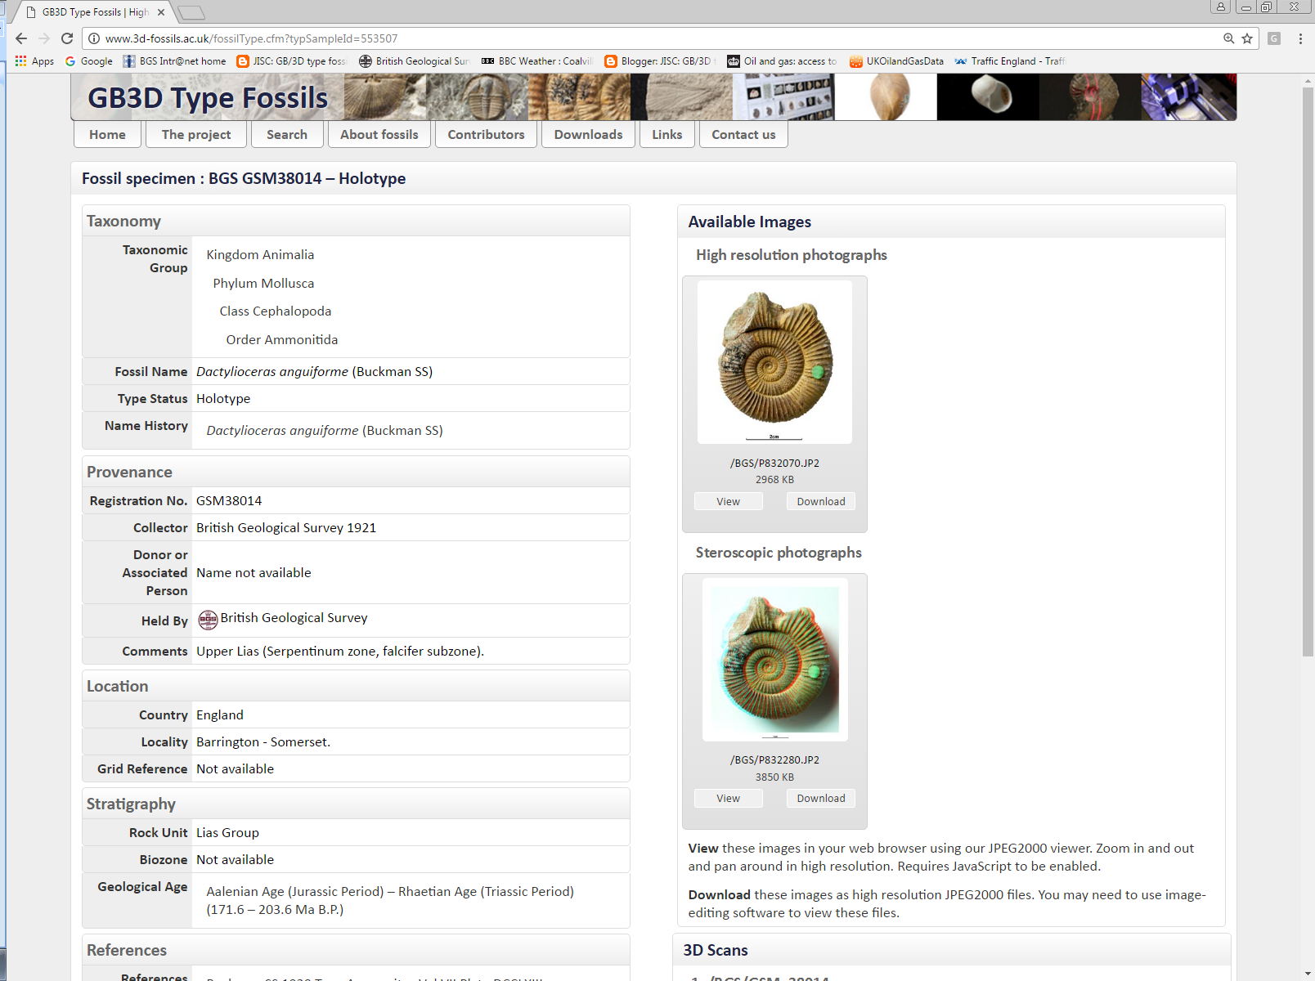

Slide 20
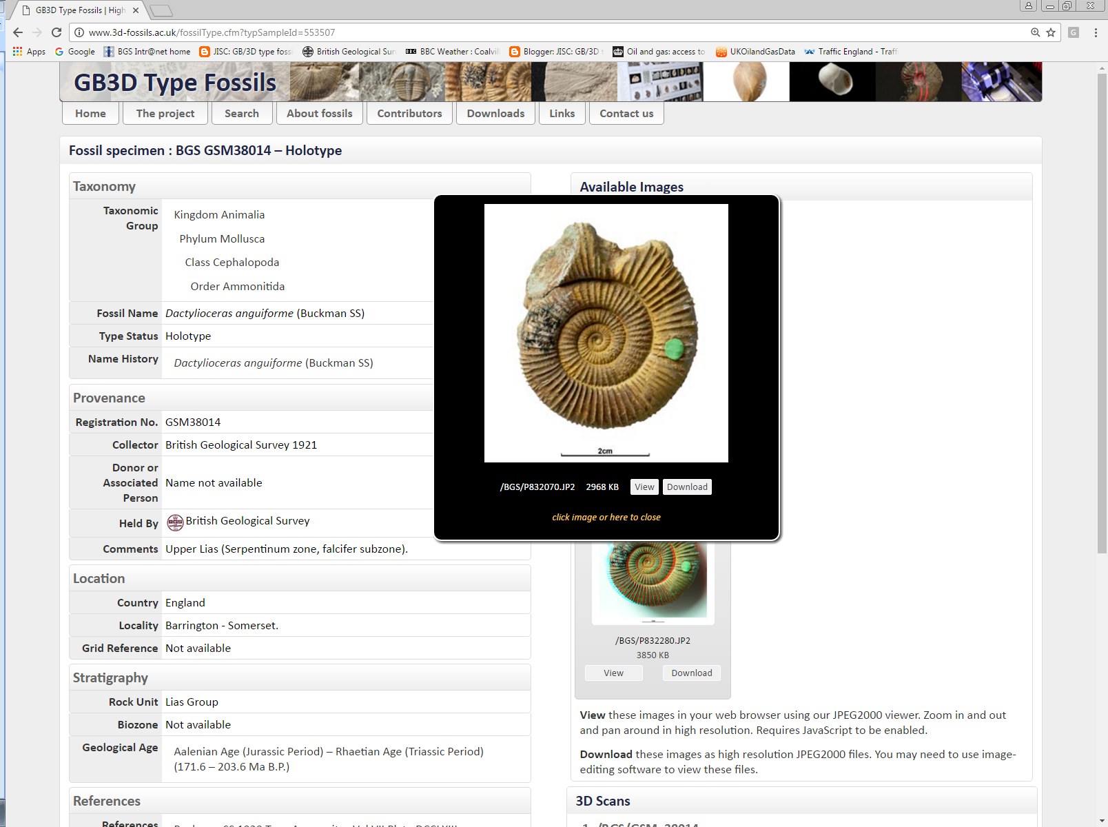

Slide 21


Slide 22
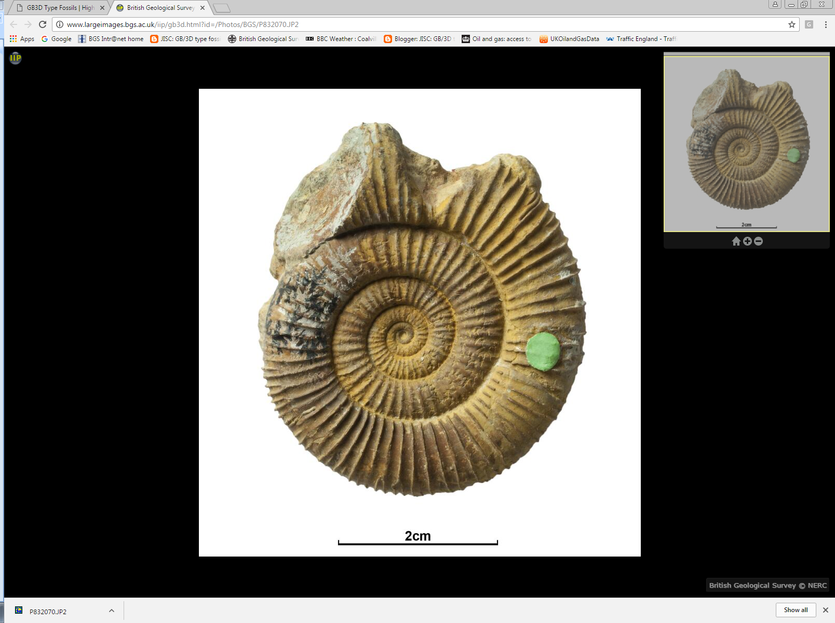

Slide 23
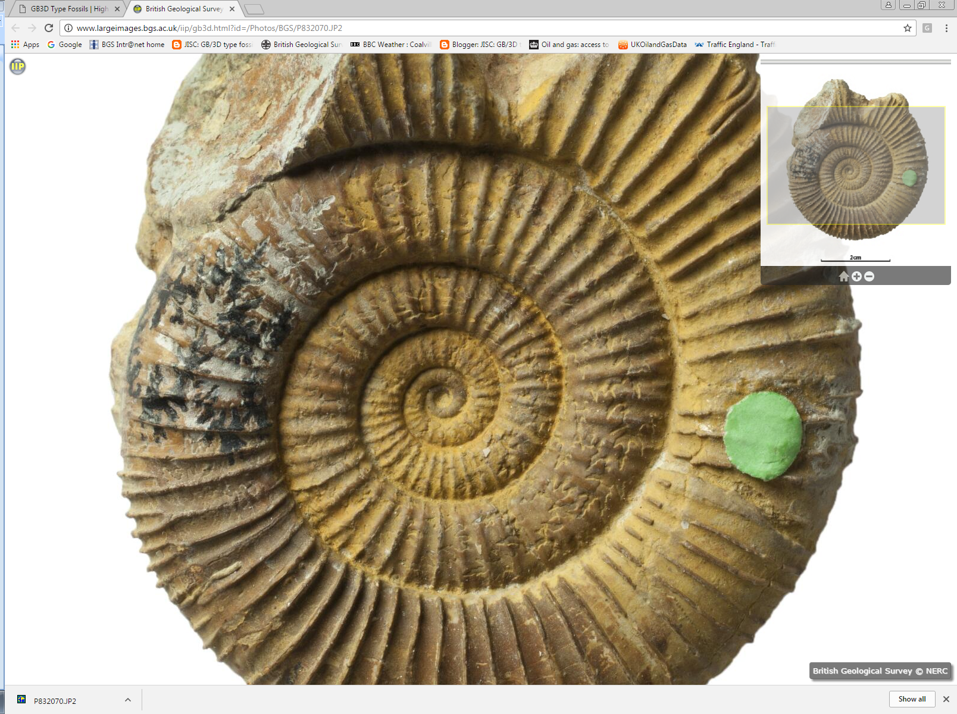

Slide 24
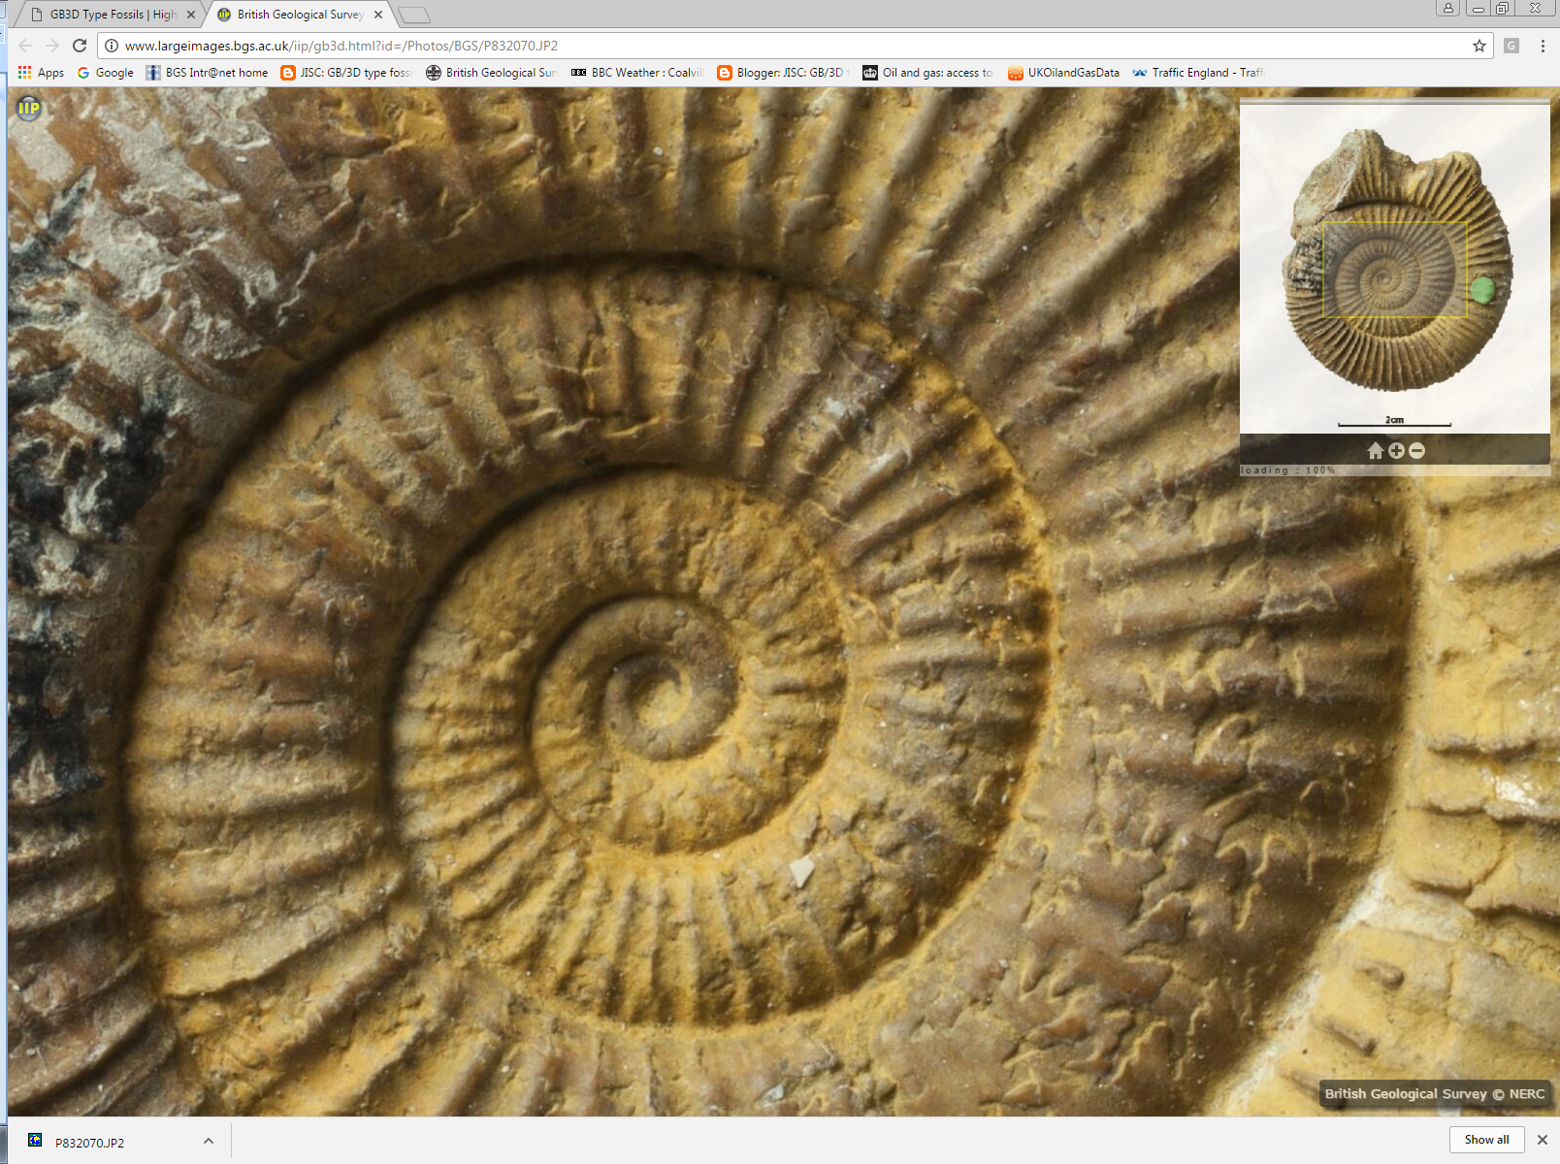

Slide 25
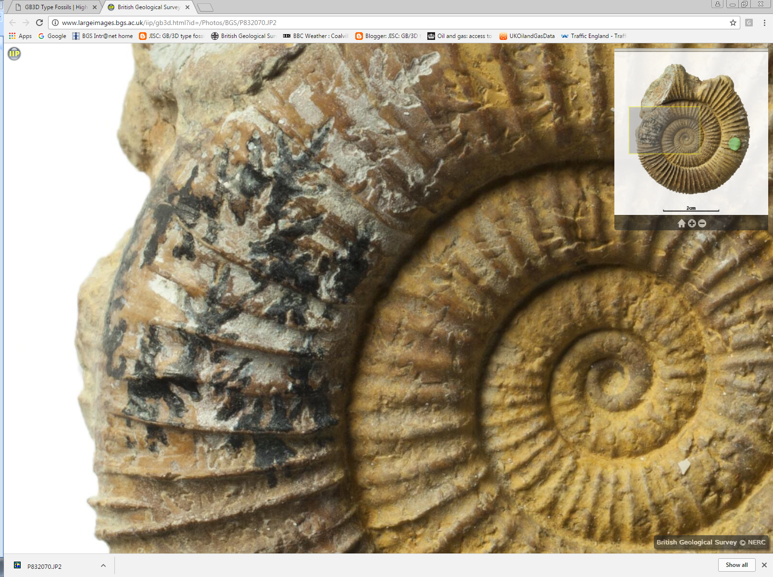

Slide 26
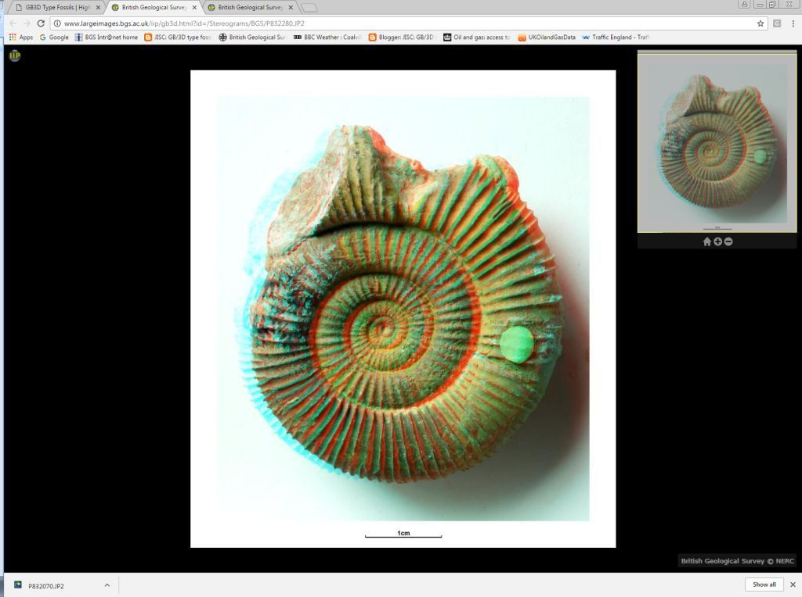

Slide 27
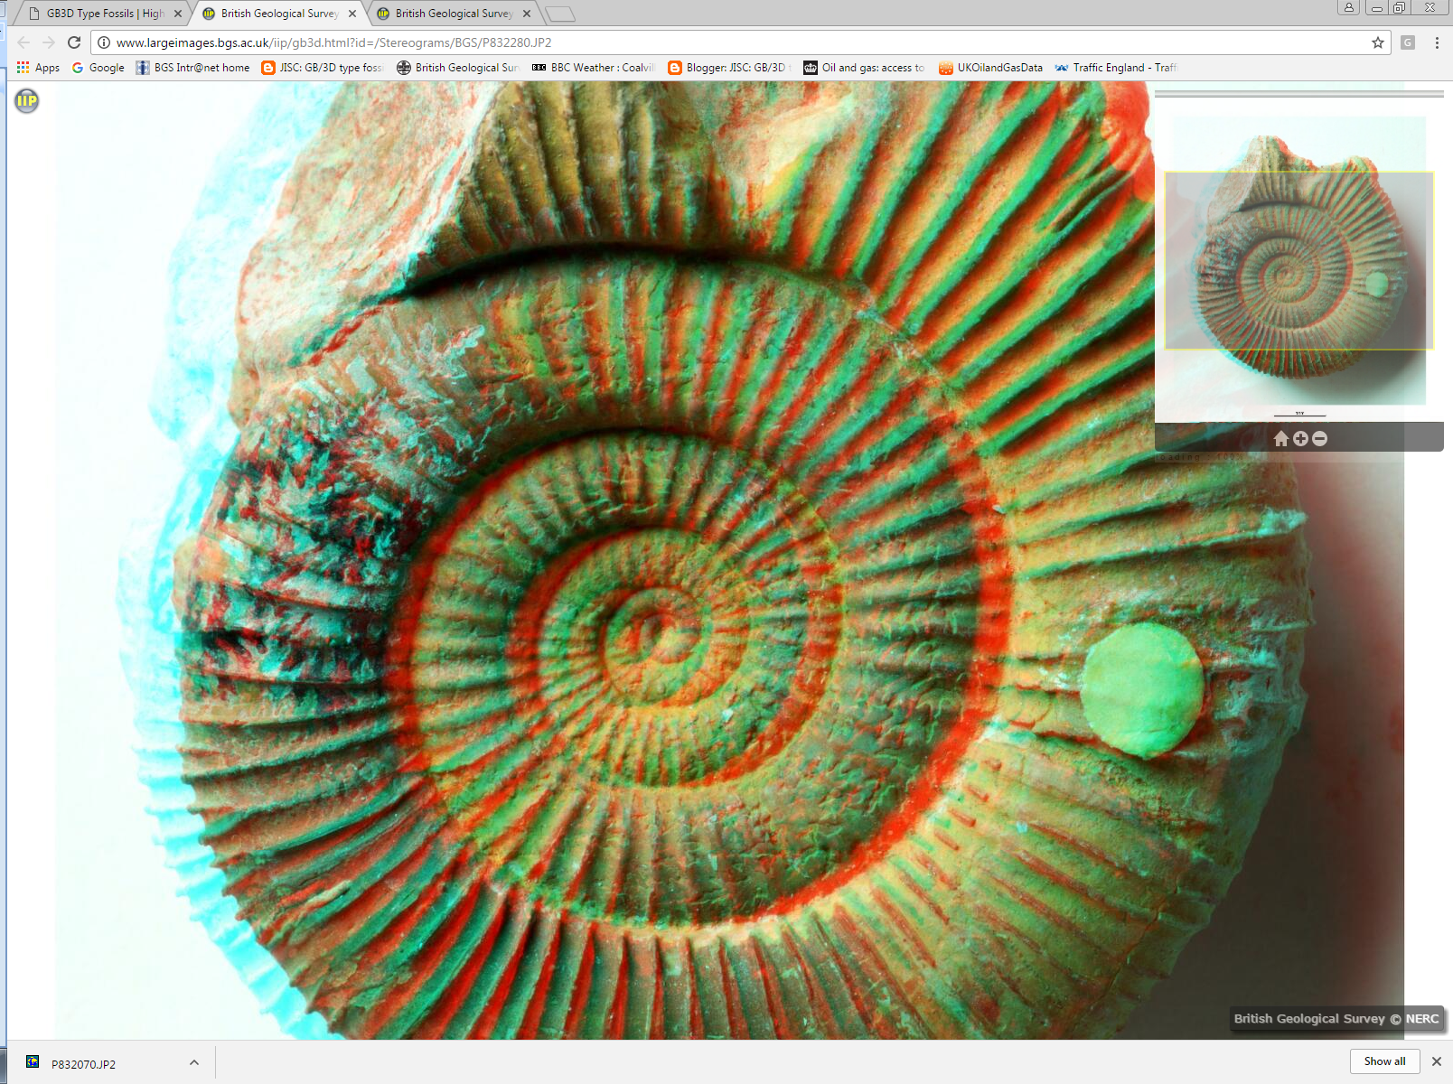

Slide 28
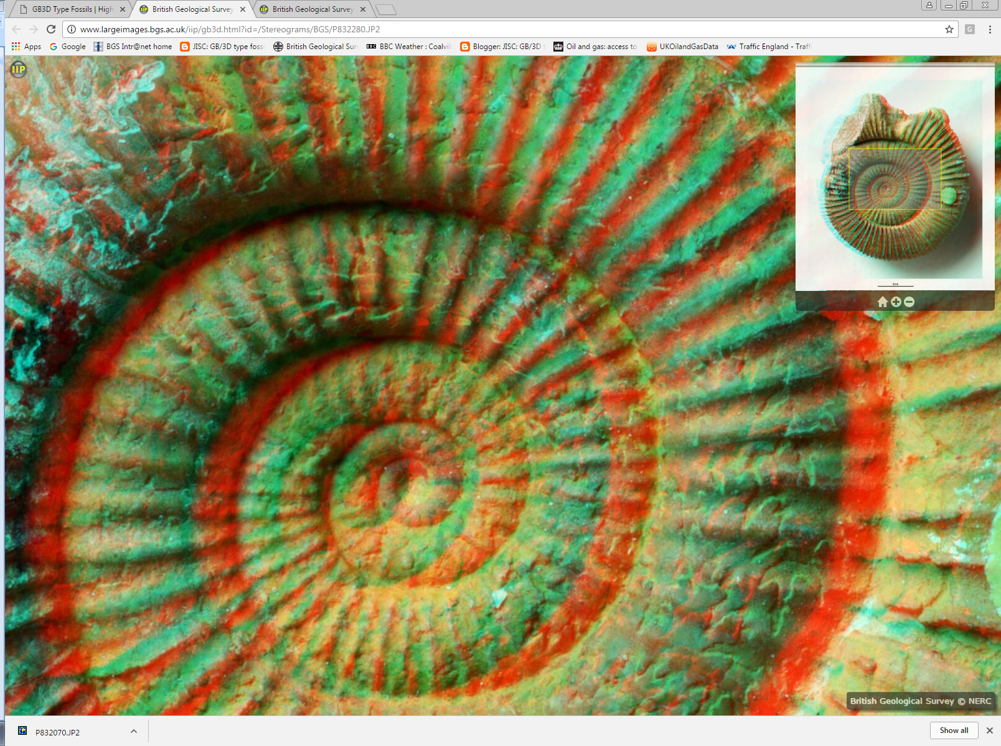

Slide 29
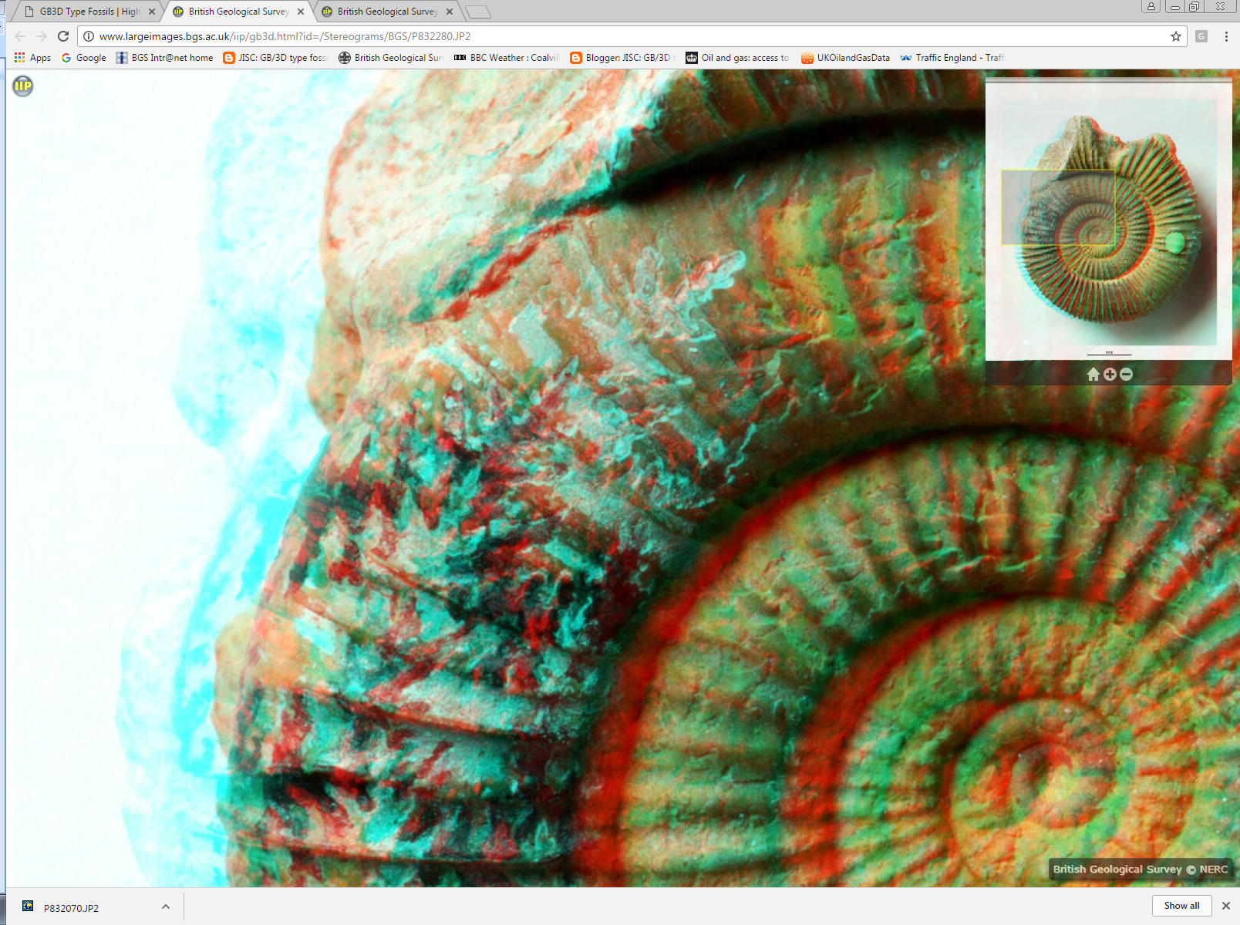

Slide 30
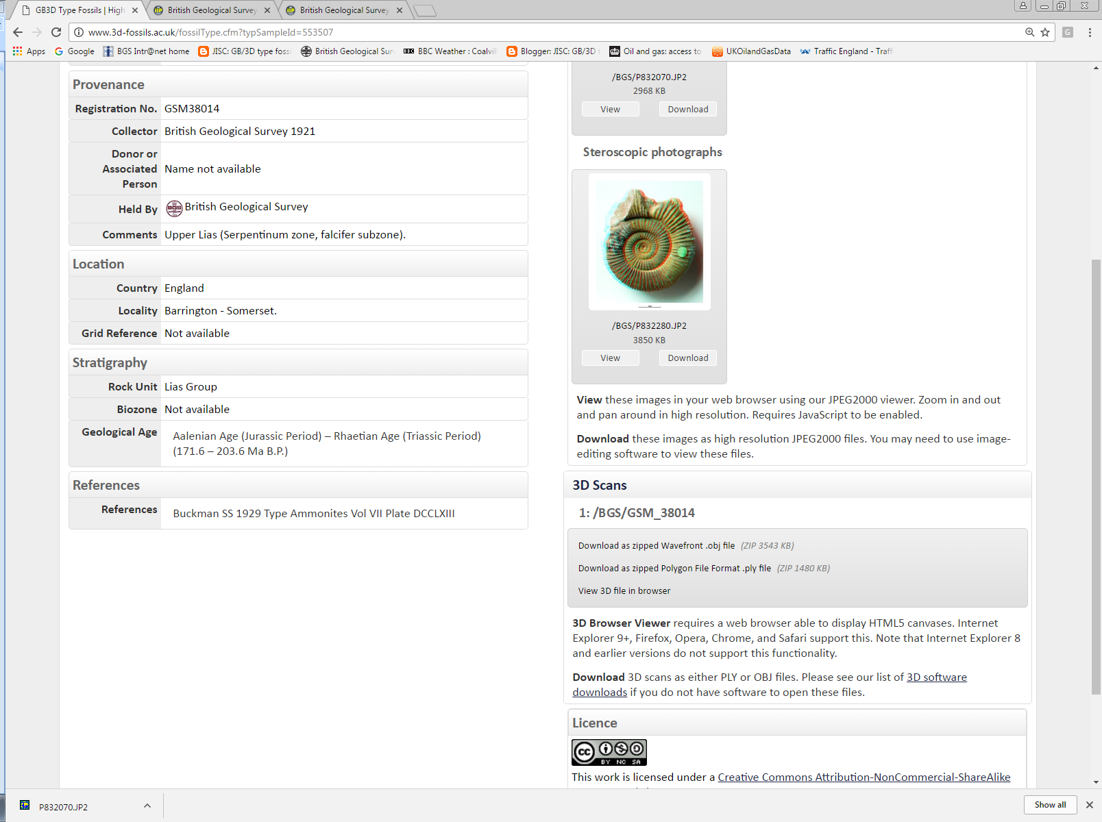

Slide 31
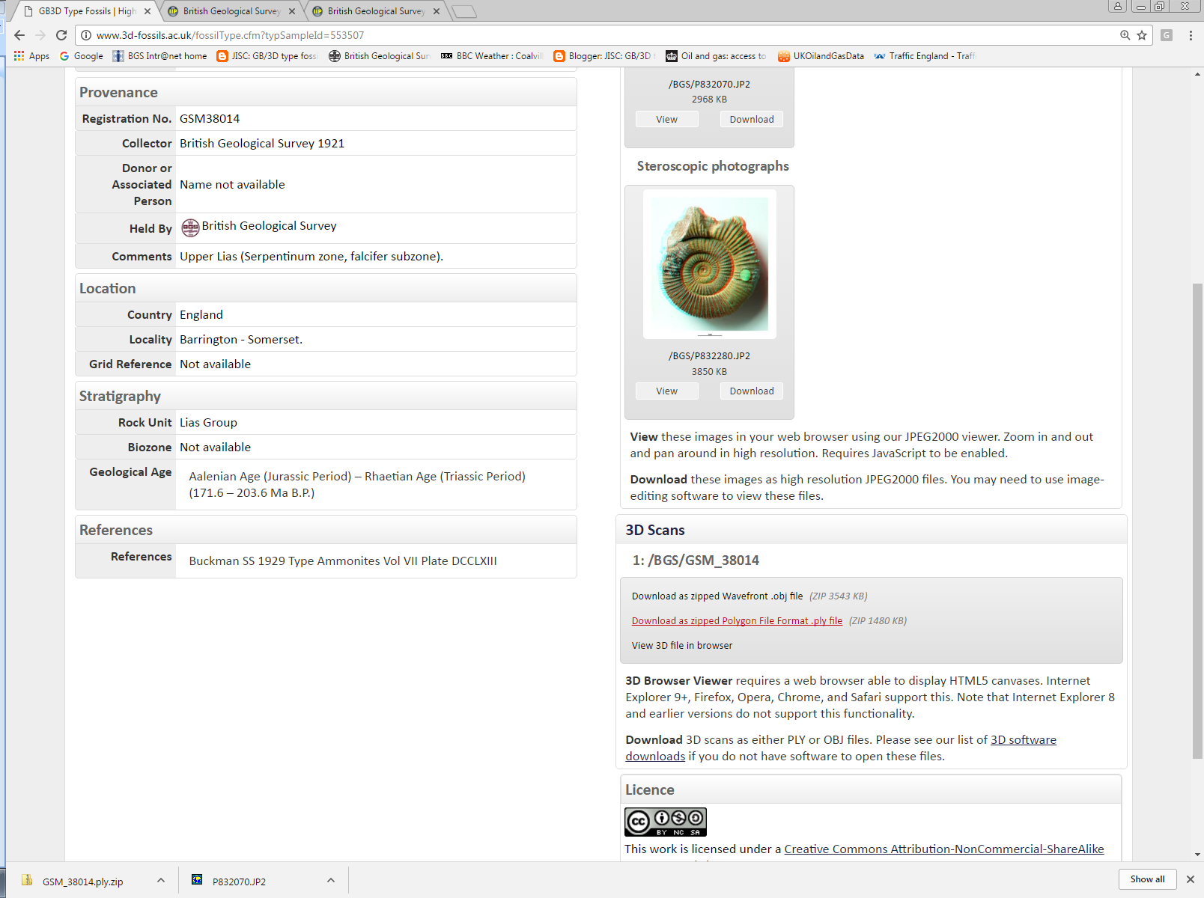

Slide 32
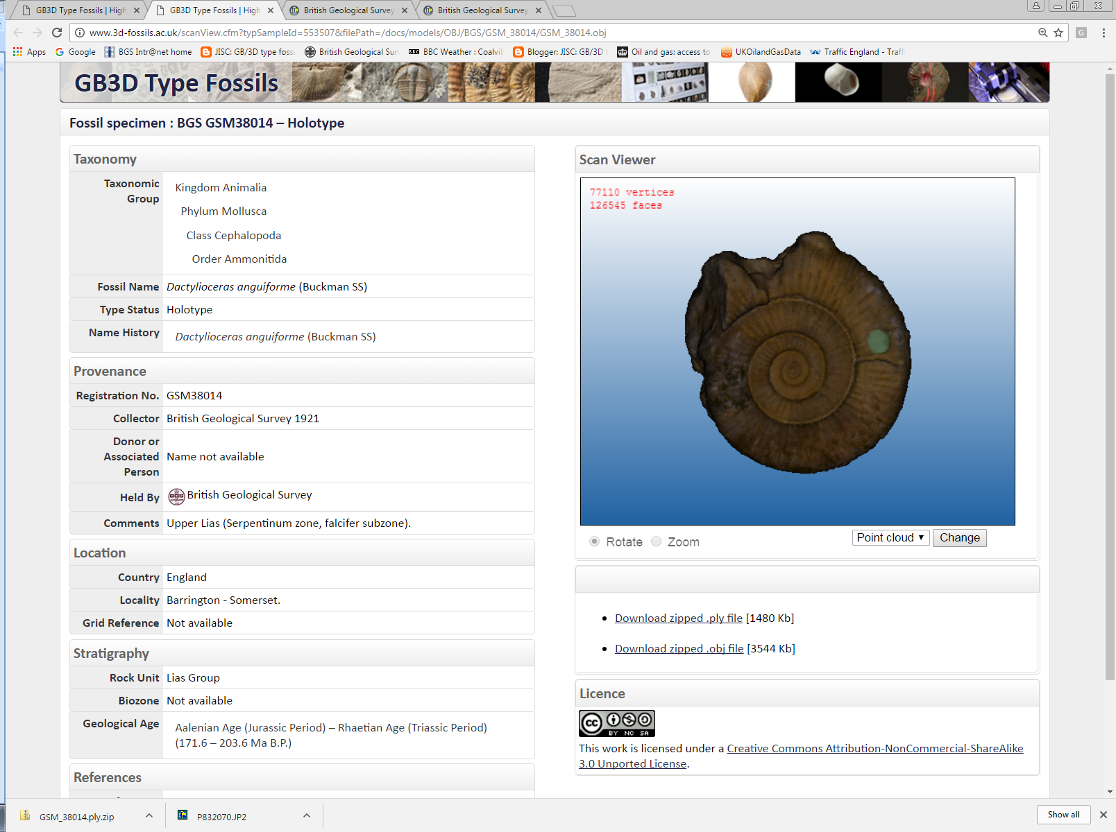

Slide 33
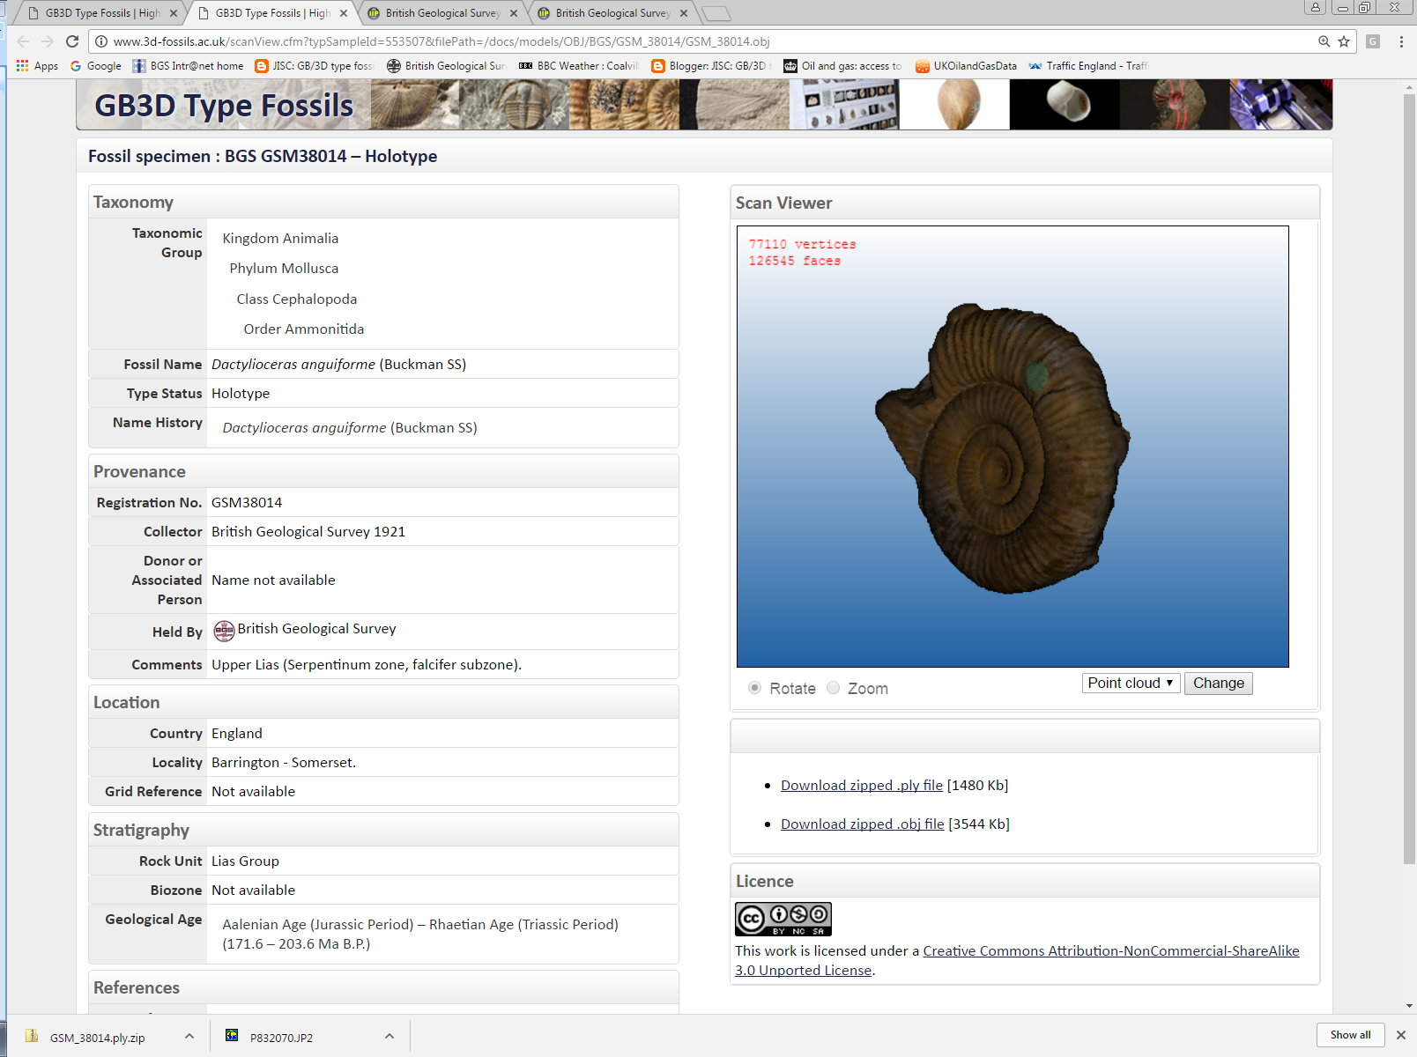

Slide 34
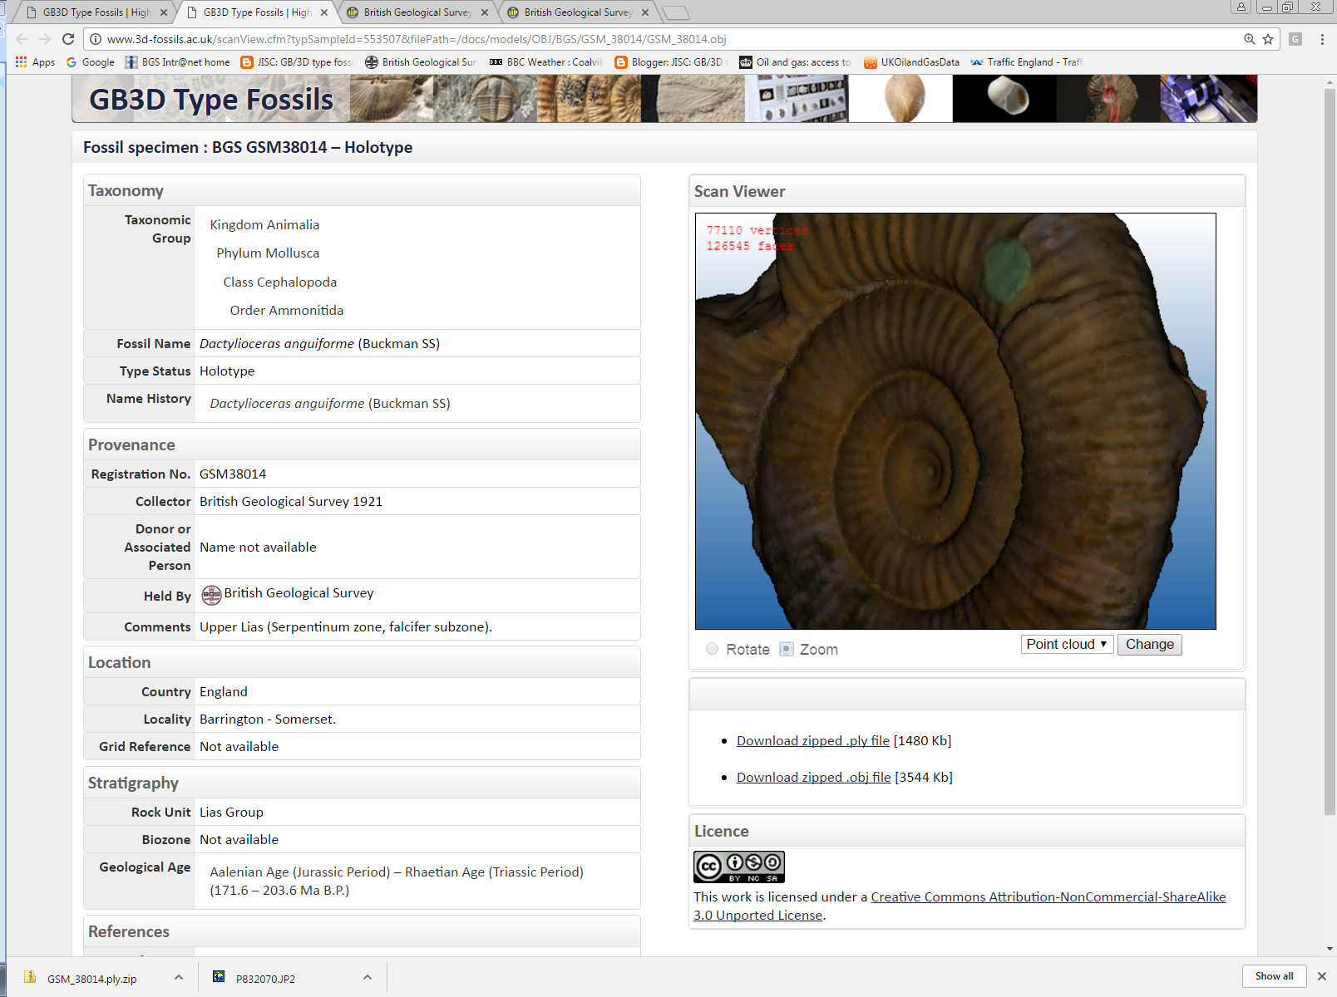

Slide 35
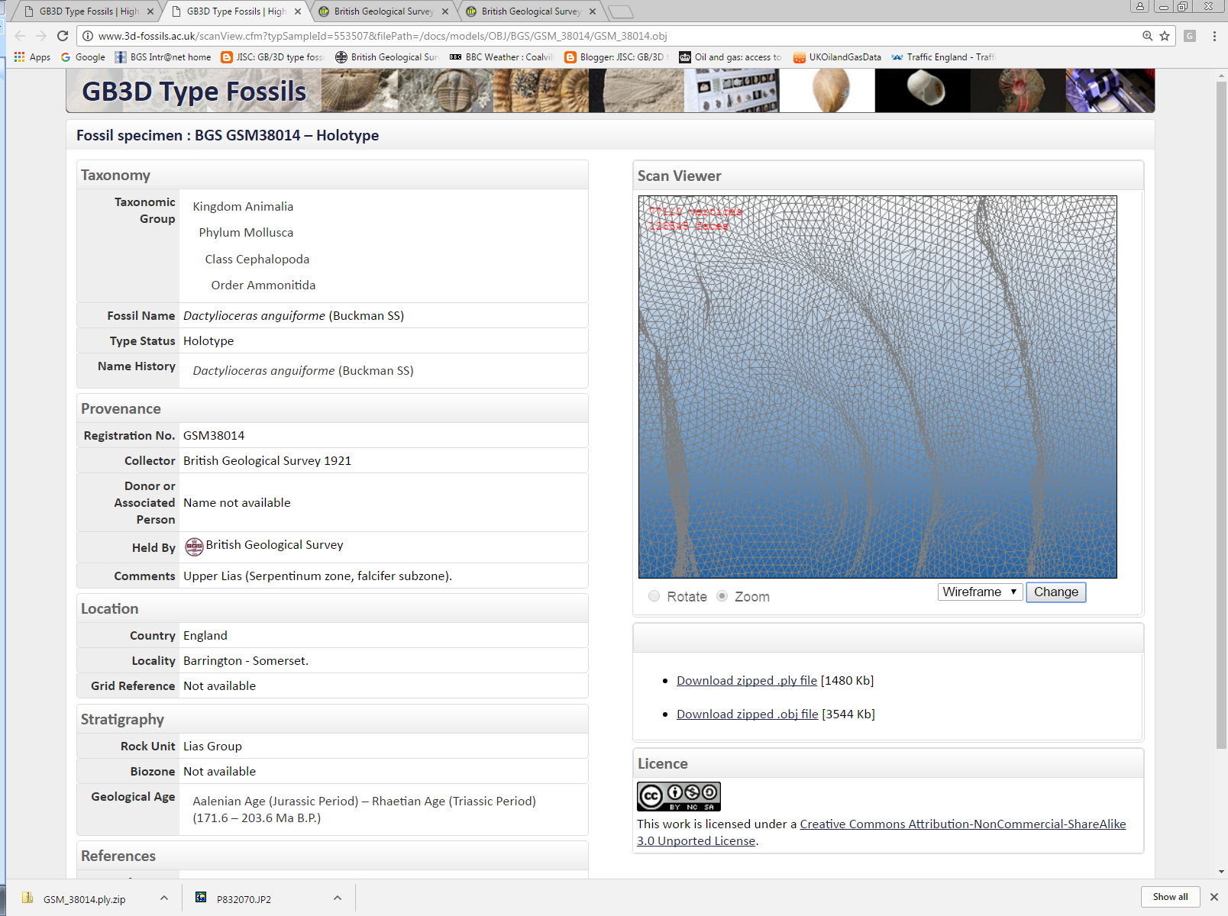

Slide 36
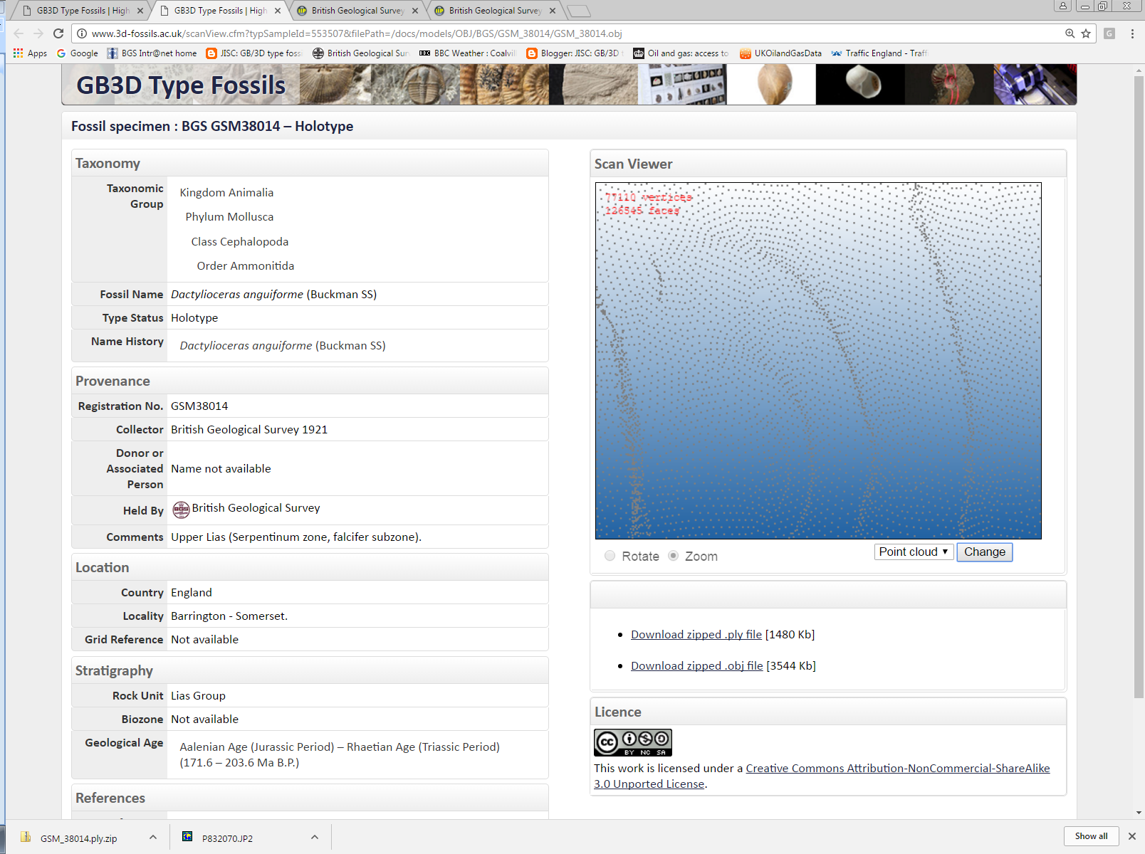

Slide 37
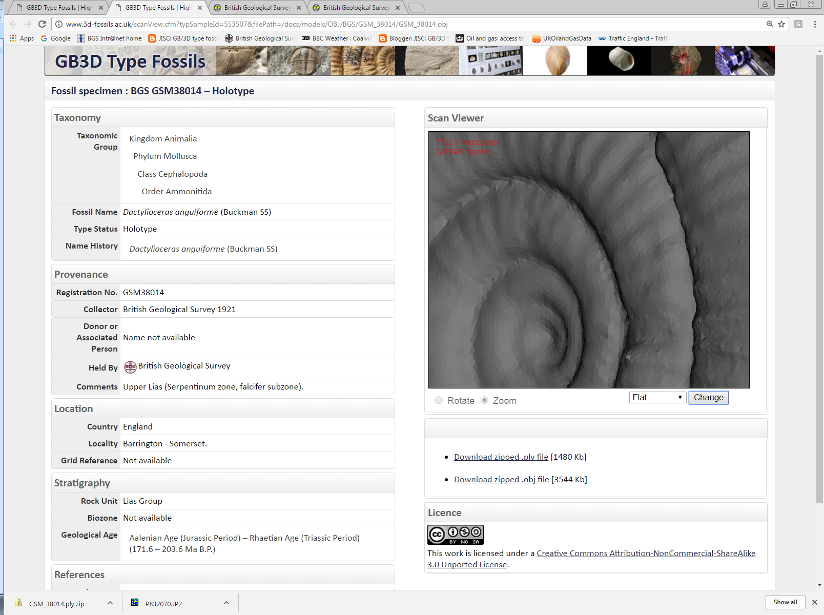

Slide 38
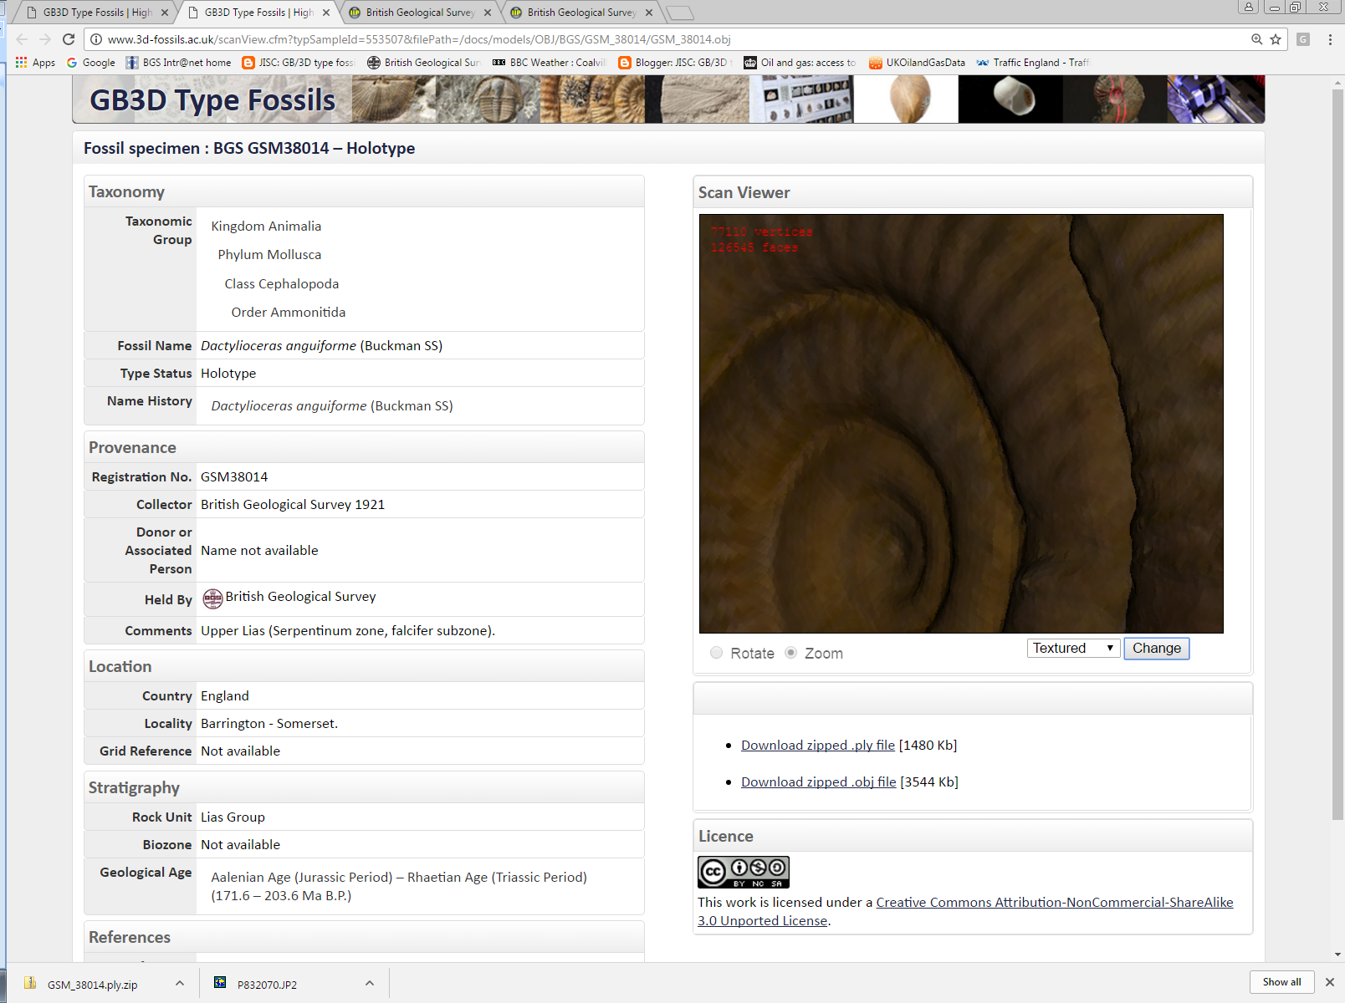

Slide 39
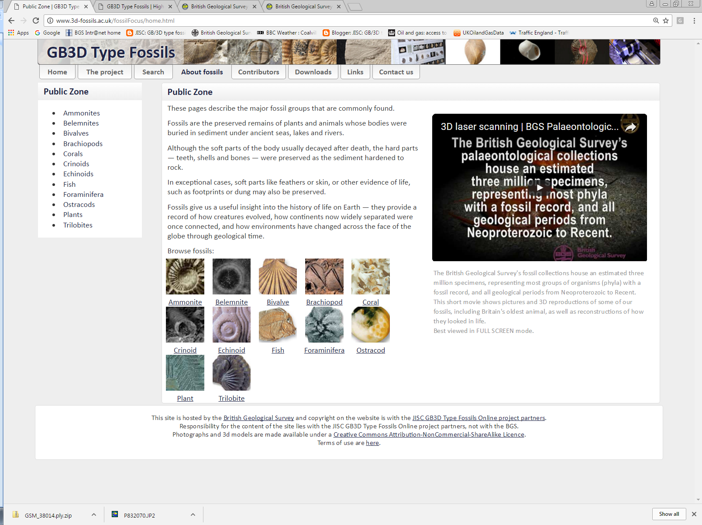

Slide 40

Press Launch to the Public –
BGS London Office
August 2013

Slide 41
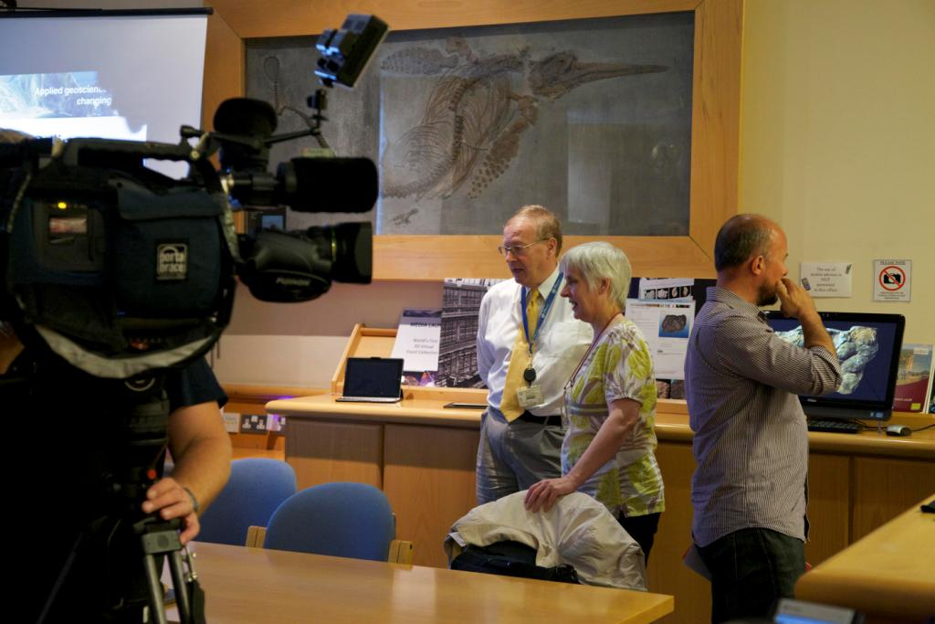

Slide 42
GB3D fossil types online project - impact

Slide 45
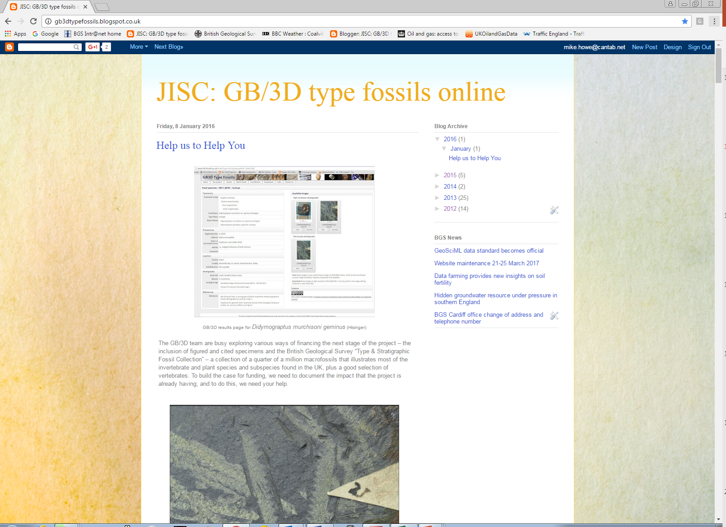

Slide 46
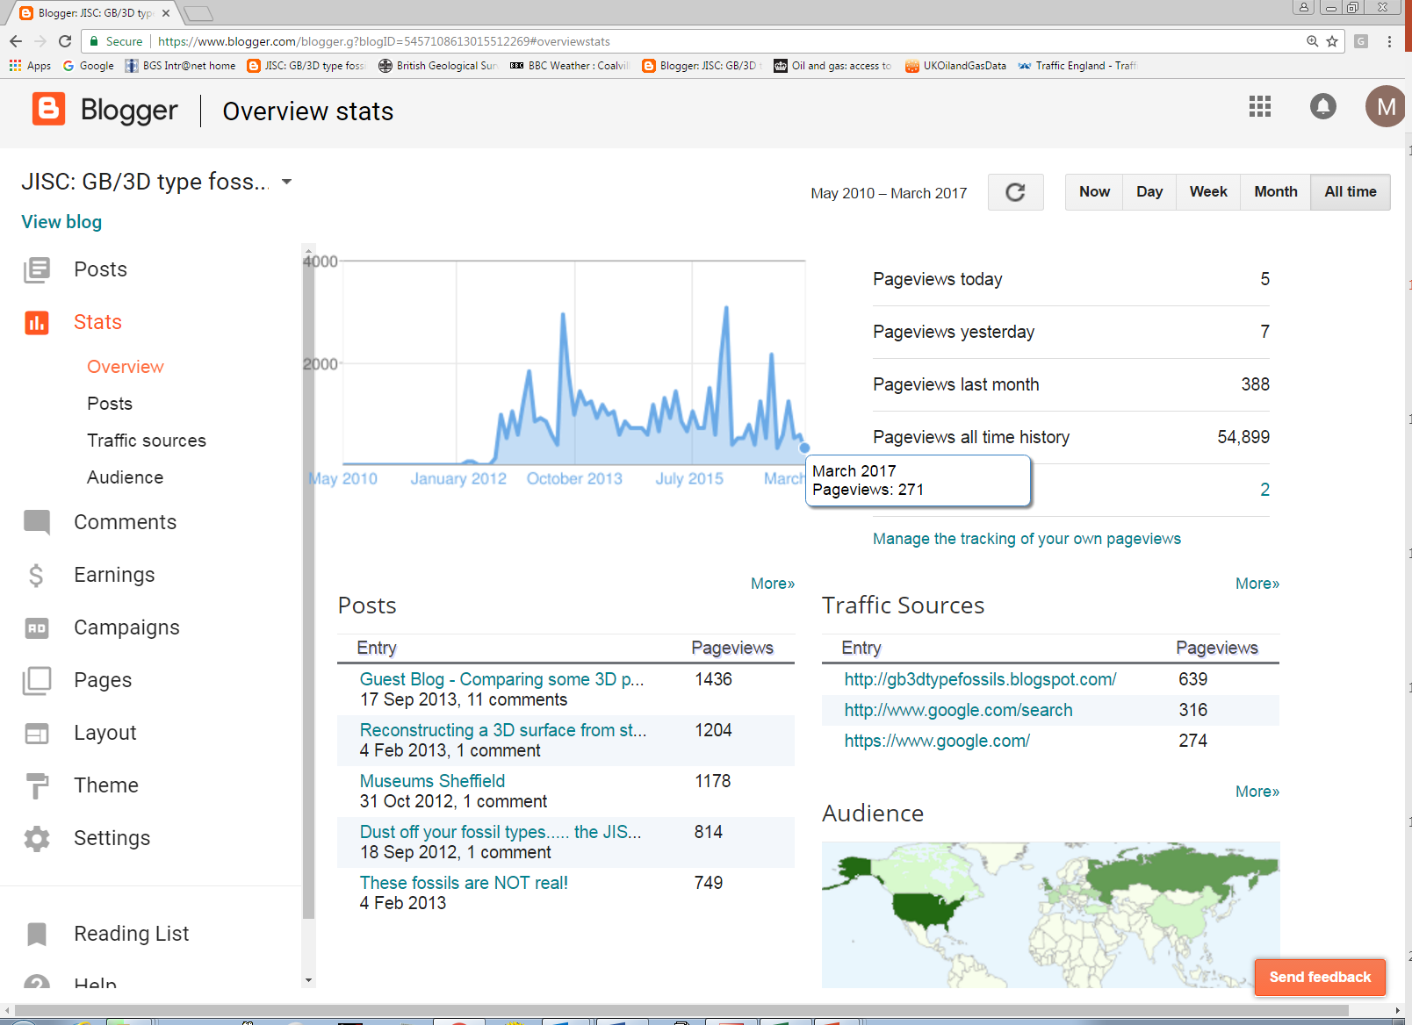

Slide 47
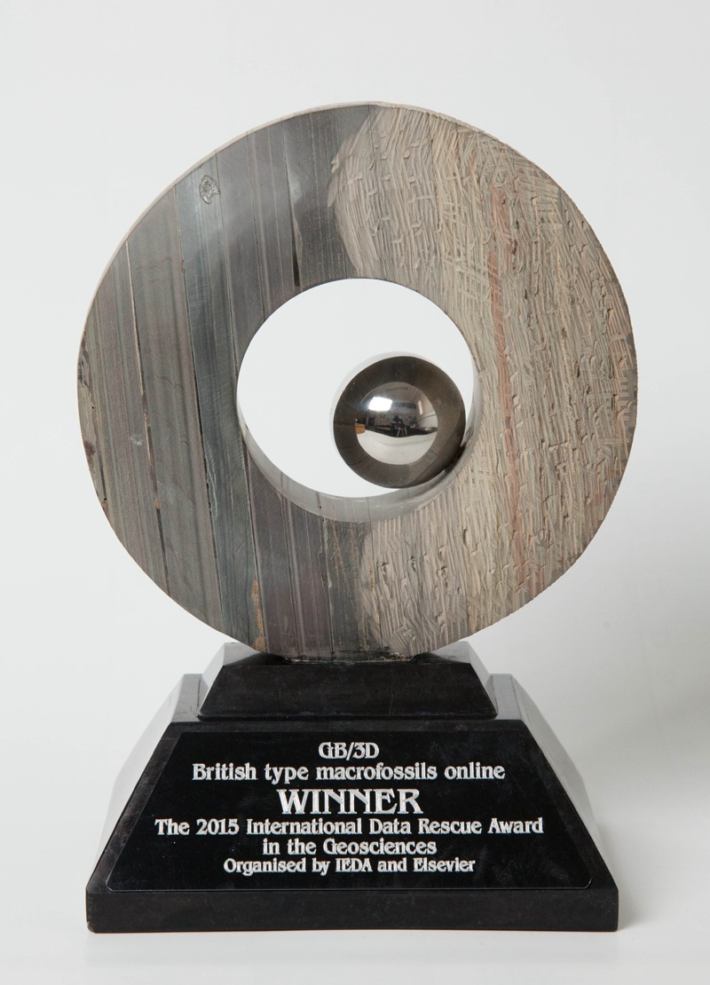

Slide 48
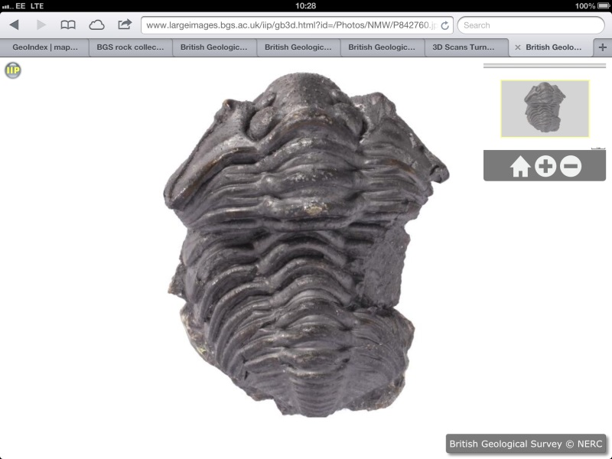
GB3D fossil types online project – future developments

Slide 49
Logon with enhanced facilities including label images

Slide 50
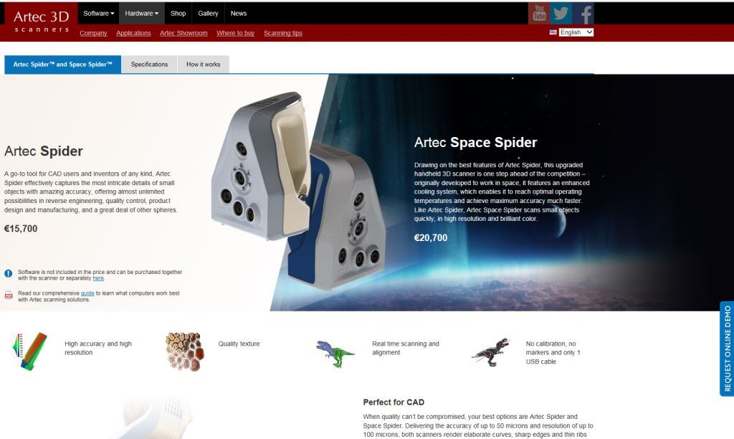

Slide 51


Slide 52


Slide 53

Lessons Learnt

Slide 54
Lessons learnt........(1 - Workflow)
Start the planning several months in advance
Consider alternative ways of resourcing the project – government grants, foundation grants, “business as usual”, volunteers
Consider outsourcing the digitisation
Develop workflows, standards, costings. (Does your organisation have standard workflows that are not ideal for your project? Do you have the best technology/software?)
Run a pilot project – find the problems before it’s too late
Database your specimens before you start – but see later
Consider use of barcodes and automatic renumbering to reduce errors

Slide 55
Lessons learnt........(2 - Resources)
Consider recruiting dedicated team
Consider a dedicated project manager
Remember partners and many team members will have other deliverables besides yours
If using other organisational services besides your own team, consider how you can ensure adequate control
Hope you don’t have 4 different Directors during the duration of the project

Slide 56
the really tricky bit …2,500 years of legacy data
Lessons learnt........(3 – Data, Databases, Schemas & Dictionaries)

Slide 57


Slide 58

Typical problems: Sample/Specimen Registration
Sedgwick Museum – One registration number per fossils specimen. A single block could have several numbers
Geological Survey – One registration number per block. Could refer to several specimens. Problems in then linking bibliographic information

Slide 59

Typical problems: Chronostratigraphy
Sedgwick Museum – Frequent use of Bala (= Caradoc + Ashgill) – Hangover from Sedgwick vs. Murchison?
International or UK standards? UK tend to be finer, but conversion problems when boundaries don’t coincide

Slide 60
Typical problems: Lithostratigraphy
M. triangulatus Band (Horizon D) - Biozone
Saltern Cove Goniatite Band - ? Biozone
Valentian – Legacy chronostratigrahic term
Middle Devonian - Chronostratigraphy

Slide 61
Typical problems: Similar Databases - differing implementations
Cambridge SNBase
Cardiff MicroMuseum
Both MobyDoc - but use different data structures
|Middle Arenig ~ Arenig ~ Canadian ~ Ordovician ~ Cambro-Silurian ~ Paleozoic ~ Phanerozoic ~ ../..
Aurelucian/Burrellian Stage
Some museums unable to provide .CSV export file

Slide 62
International Standards
Darwin Core
ABCDEFG (Access to Biological Collections Data – Extension For Geoscience)
Great for the future - but not so helpful in dealing with 2,500 years of legacy data

Slide 63
Solution:
Two fields for each attribute
Free text as per original registration – the definitive registration information
Dictionary controlled best current interpretation – possibly even crowd sourced. Current best interpretative discovery information

Slide 64
Website www.3d-fossils.ac.uk

Slide 65


Slide 66





