Slide 1
Practical use of aggregator data quality metrics in a collection scenario
Andrew Bentley
University of Kansas
Biodiversity Institute

Slide 2
Collections
Providers
Darwin Core or ABCD
IPT servers
Aggregators

Slide 3
Publishing data to aggregators
Benefits:
Visibility for collection and data
Exposure to larger research and end user community
Attribution for data usage
Comparison with other collections
Leads to collections advocacy and increased use of collections and data

Slide 4
Data Quality
TDWG Biodiversity Data Quality Interest Group
Standard set of Data Quality Tests and Assertions
Assertions about data quality based on backbone taxonomic and geographic authorities and Darwin Core requirements
Can be used by providers to check data quality, errors etc.
Three aggregators providing data quality metrics
GBIF, iDigBio and ALA – Vertnet (GitHub)
No standardization across aggregators as yet

Slide 5
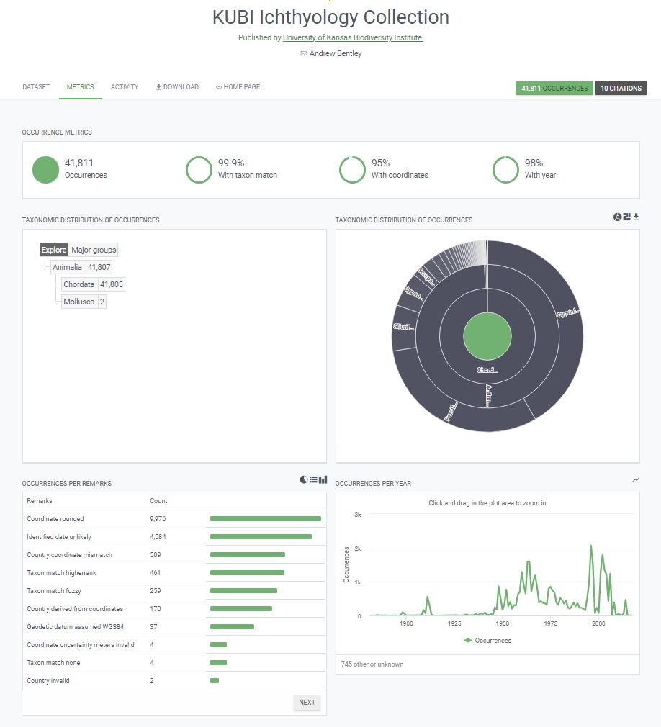
Global Biodiversity Information Facility (GBIF)

Slide 6
Atlas of Living Australia (ALA)

Slide 7
Integrated Digitized Biocollections (iDigBio)

Slide 8
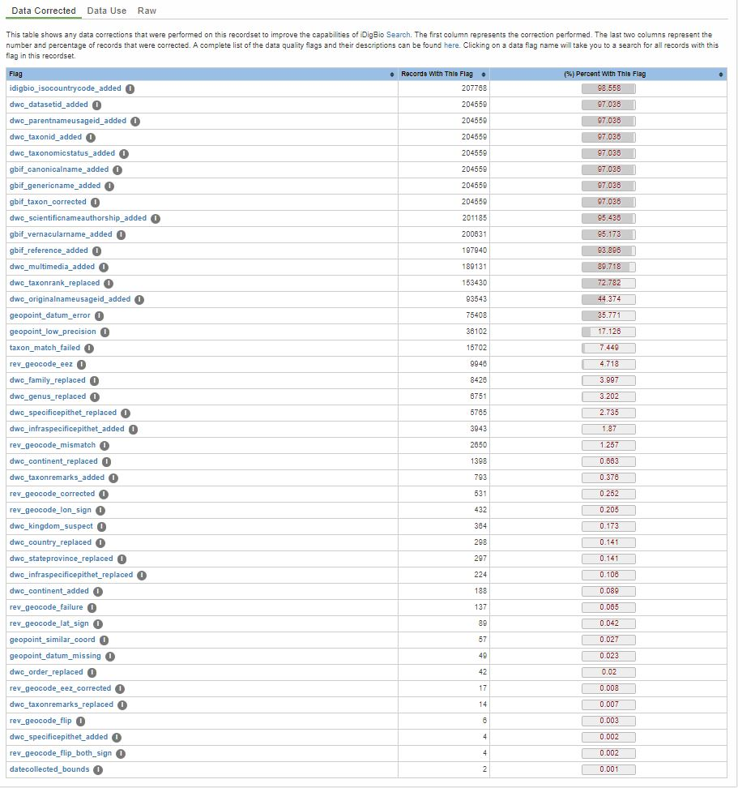
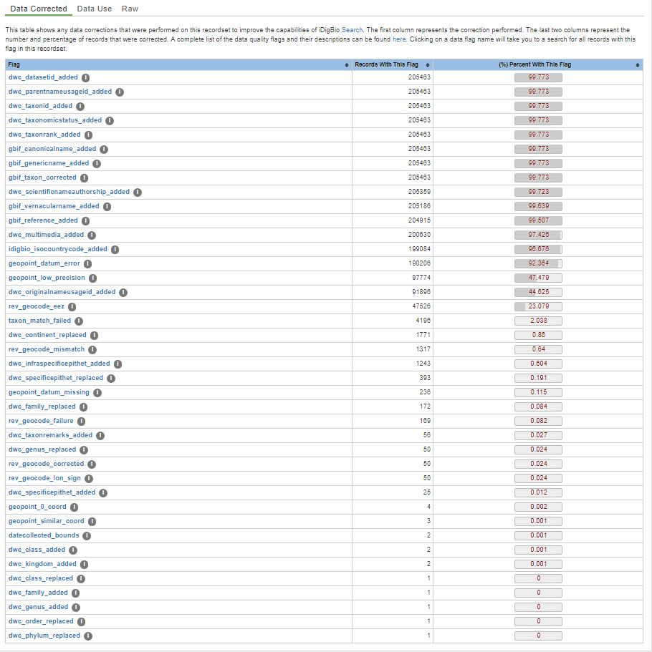
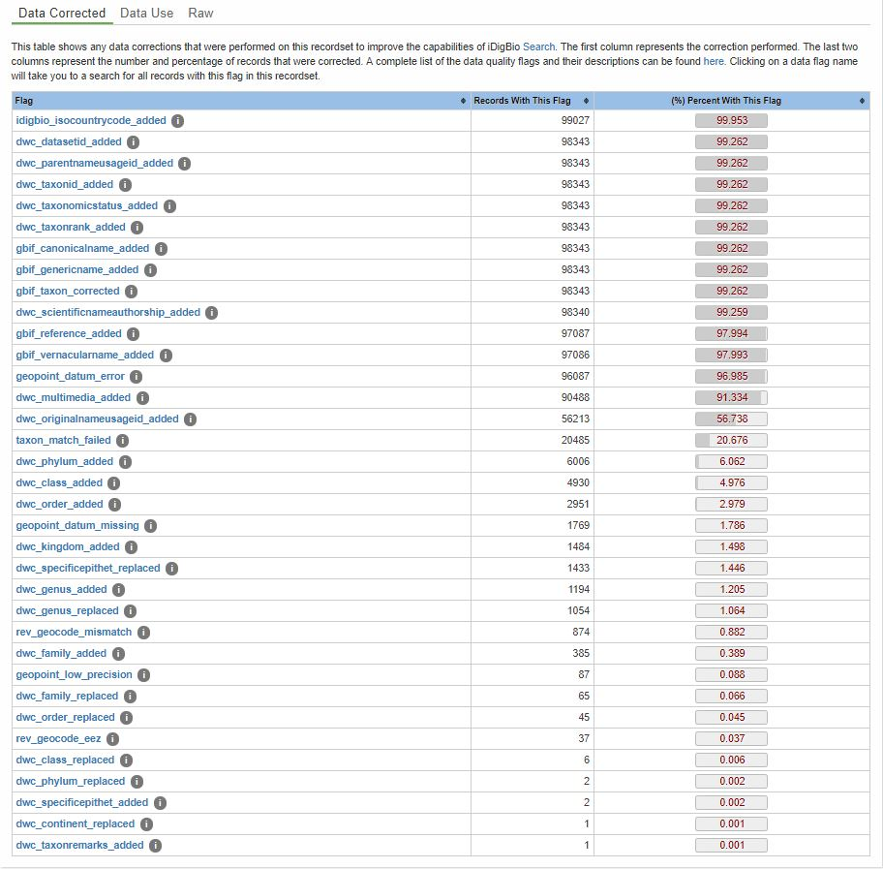
Is this normal? Comparison to other collections

Slide 9
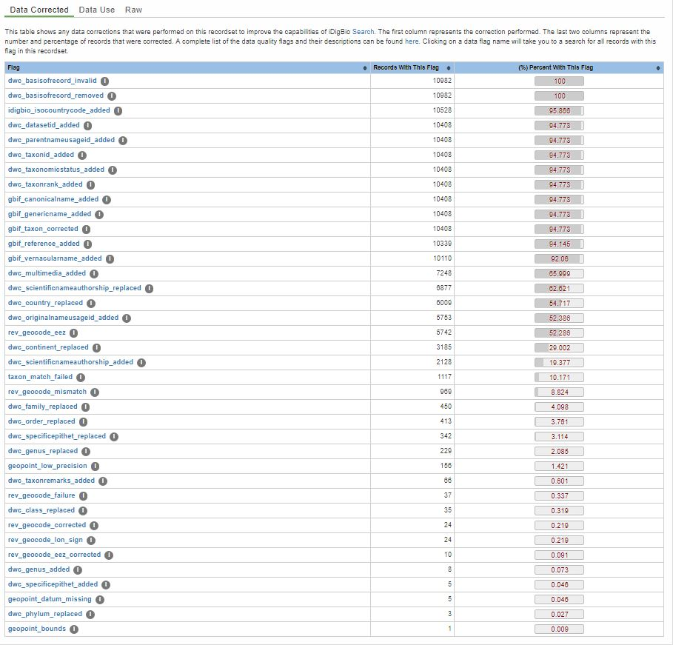
Data Metrics
Collection
Four categories
Collection specific
Taxonomic
Scientific names, higher level taxonomy common names, references, ranks etc.
Geographic
Continent/Country/State/Province/County, geocoordinates, datum etc.
Multimedia
Taxonomy
Geography
Multimedia

Slide 10
Logical categories
Metrics I can do “nothing” about
Aggregator specific augmenting fields
Fields I am unable or unwilling to map to in Darwin Core given my CMS
Metrics I can do something about
Things I can attend to short term – “easy”
Things I can attend to long term – “hard”
Differences of opinion or errors
Taxonomic and geographic authority anomalies or conflicts

Slide 11
Metrics I can do “nothing” about
idigbio_isocountrycode_added
dwc_datasetid_added
dwc_parentnameusageid_added
dwc_taxonid_added
dwc_taxonomicstatus_added
gbif_canonicalname_added
gbif_genericname_added
gbif_reference_added
gbif_vernacularname_added
dwc_originalnameusageid_added

Slide 12
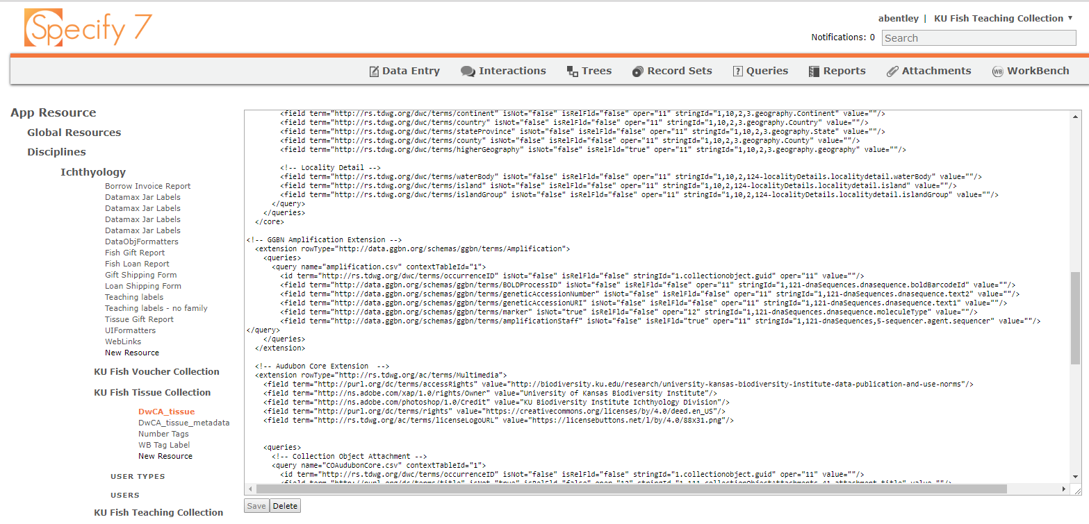
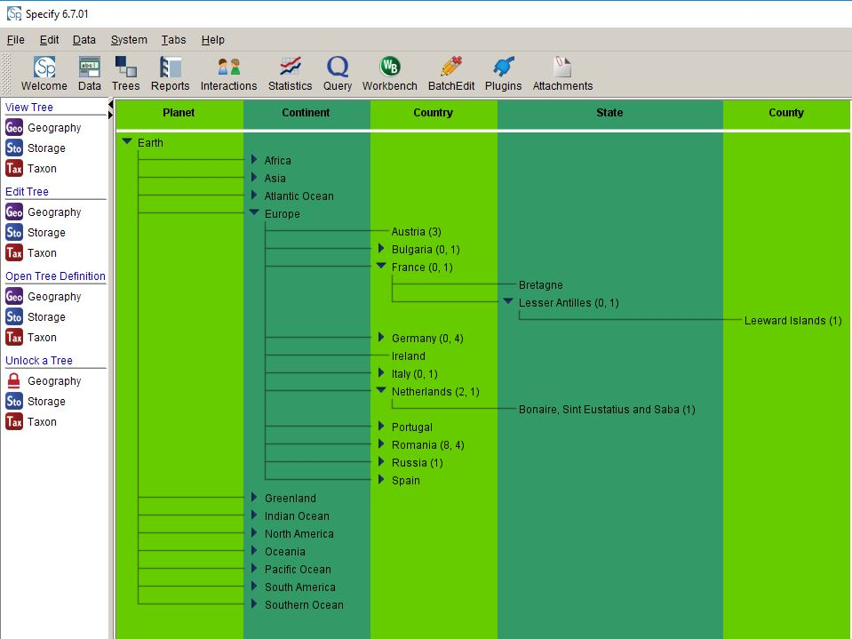
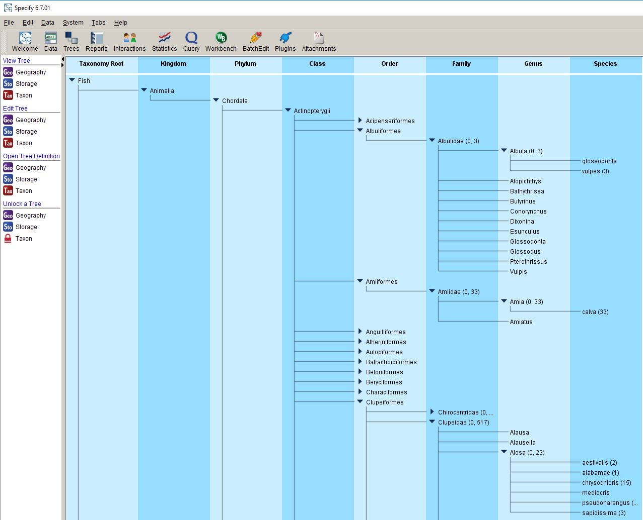
Metrics I can do something about
taxon_match_failed
dwc_class_replaced spelling errors
dwc_order_replaced taxonomic revision
dwc_family_replaced
dwc_genus_replaced
dwc_scientificnameauthorship_replaced, added
dwc_continent_replaced spelling errors
dwc_country_replaced oceans, higher geography
dwc_stateprovince_replaced
rev_geocode_mismatch, failure, both_sign, corrected, eez
dwc_multimedia_added extensions

Slide 13
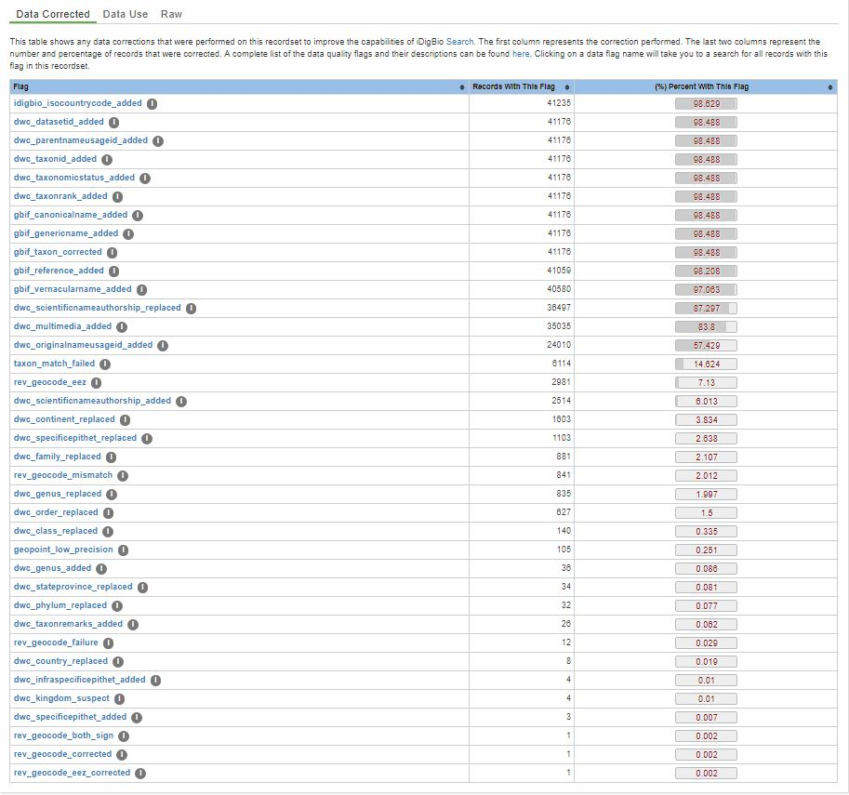
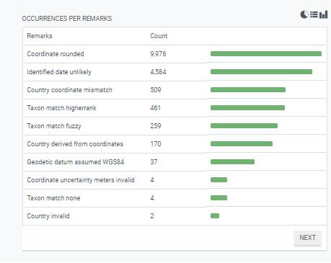
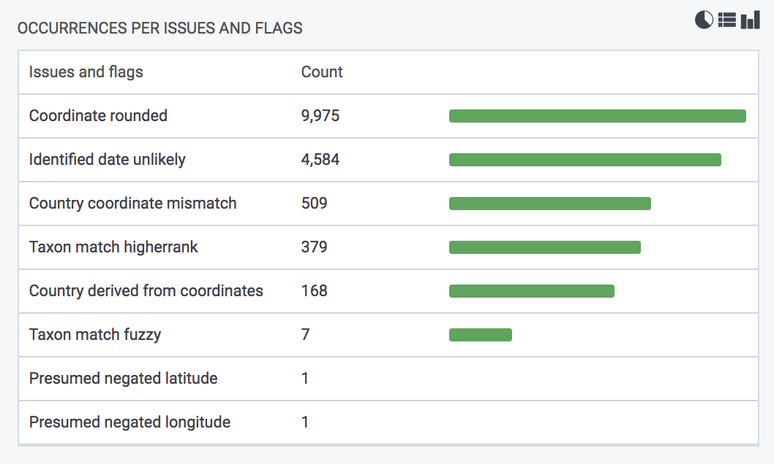
Metric | Before | After
dwc_country_replaced | 35958 | 8
dwc_family_replaced | 913 | 272
dwc_genus_replaced | 865 | 405
dwc_order_replaced | 767 | 242
geopoint_datum_missing | 37 | 0

Slide 14
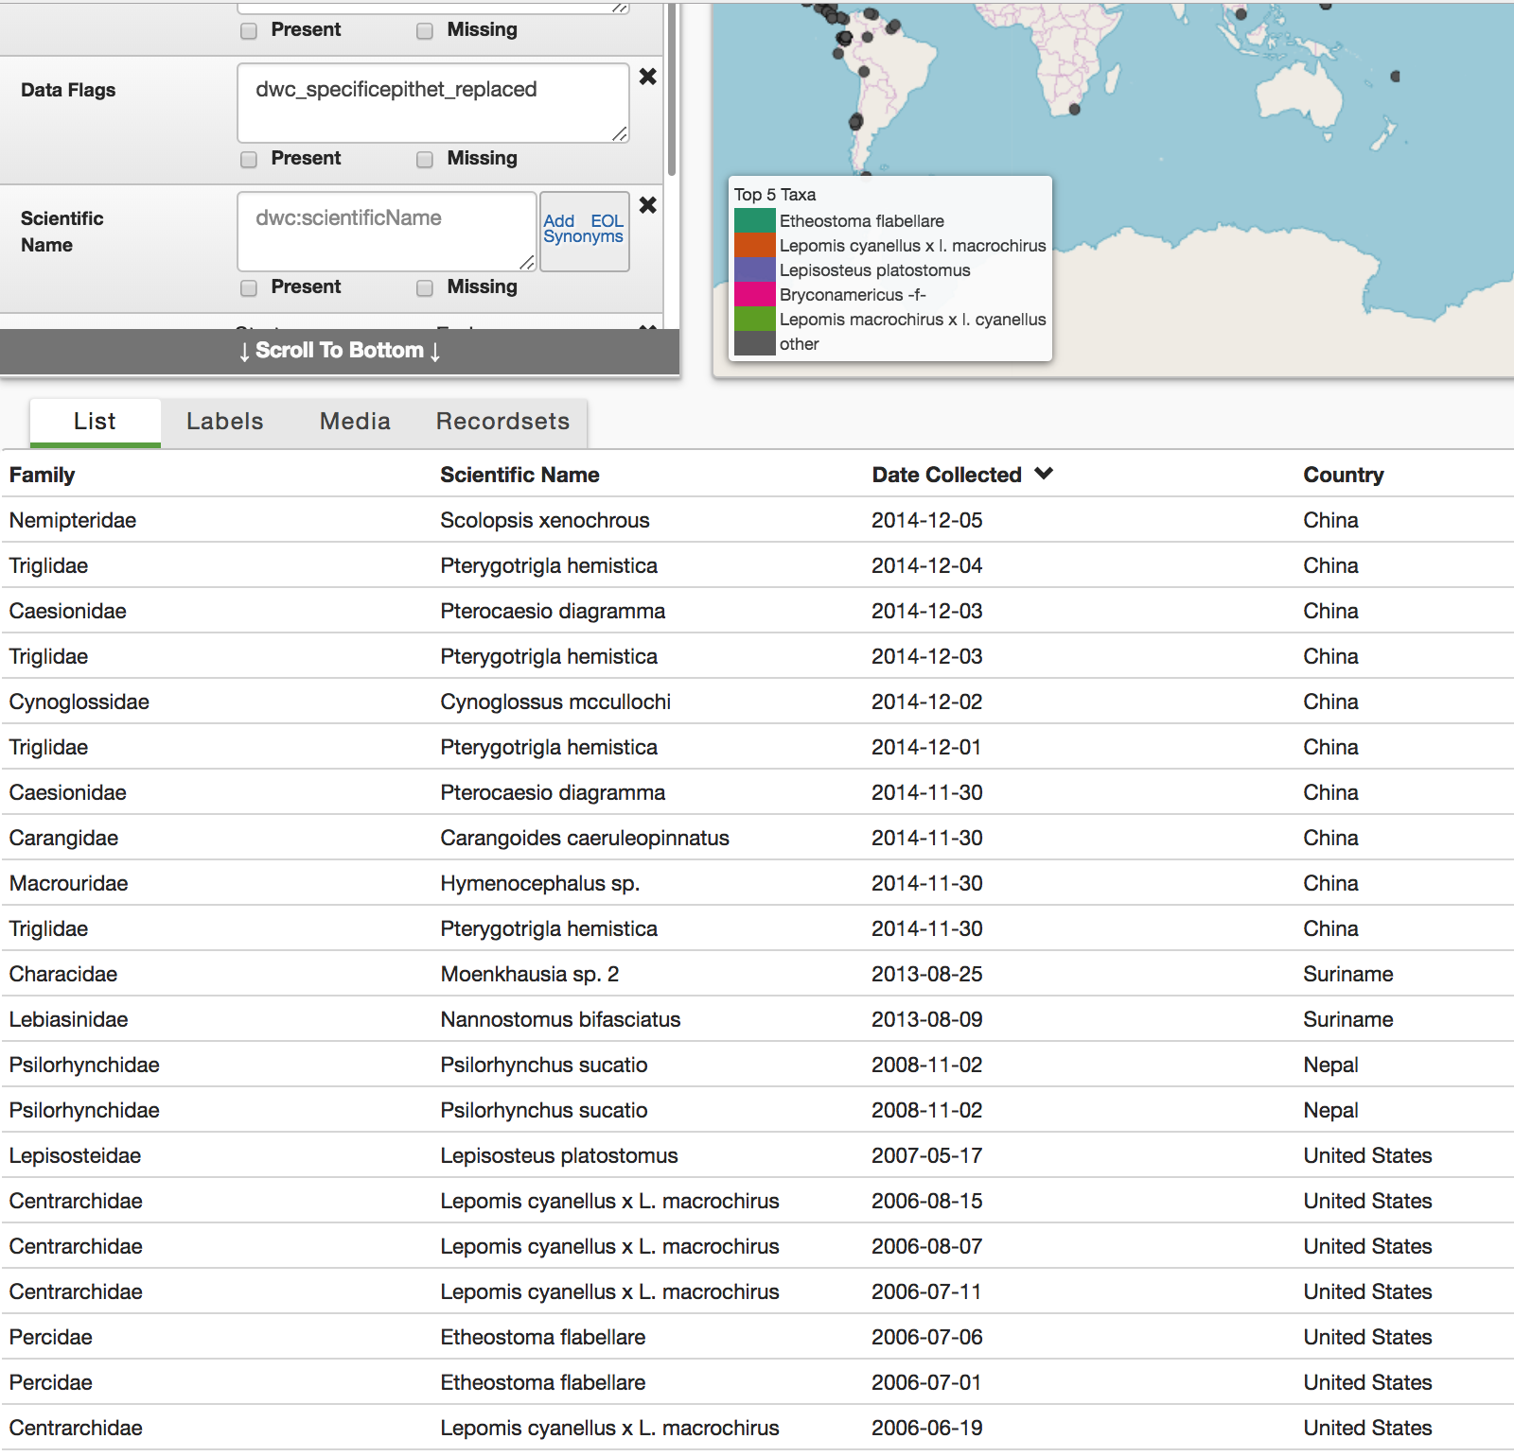
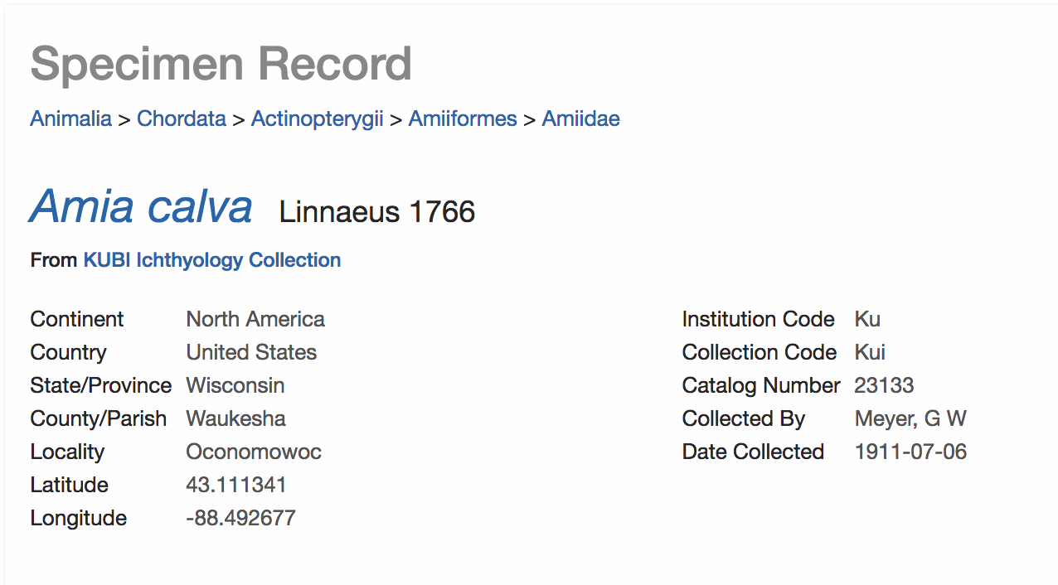
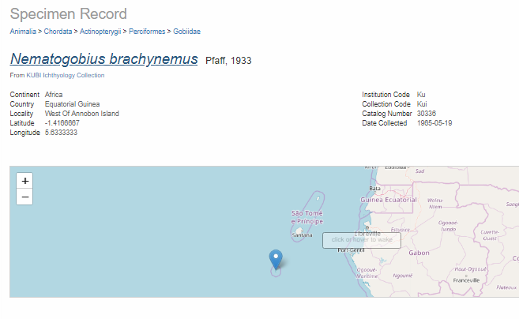
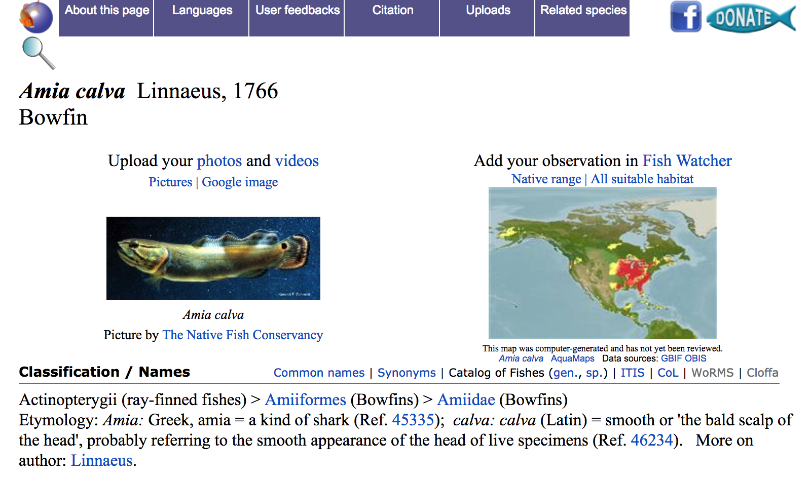
Differences of opinion or aggregator errors
dwc_basisofrecord_invalid – MaterialSample for tissues – GGBN?
dwc_phylum_replaced
dwc_kingdom_suspect
dwc_genus_added
dwc_infraspecificepithet_replaced
dwc_specificepithet_replaced
rev_geocode_failure, mismatch, eez
dwc_continent_replaced
rev_geocode_both_sign, corrected, eez corrected

Slide 15
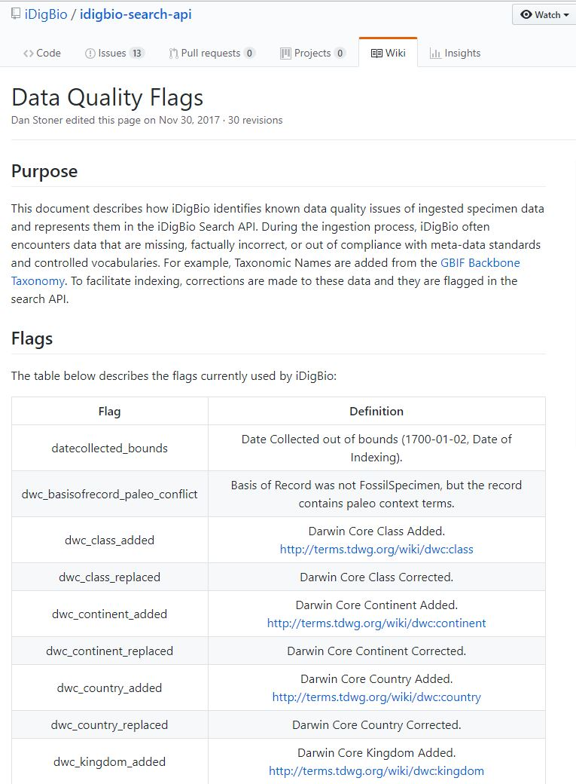
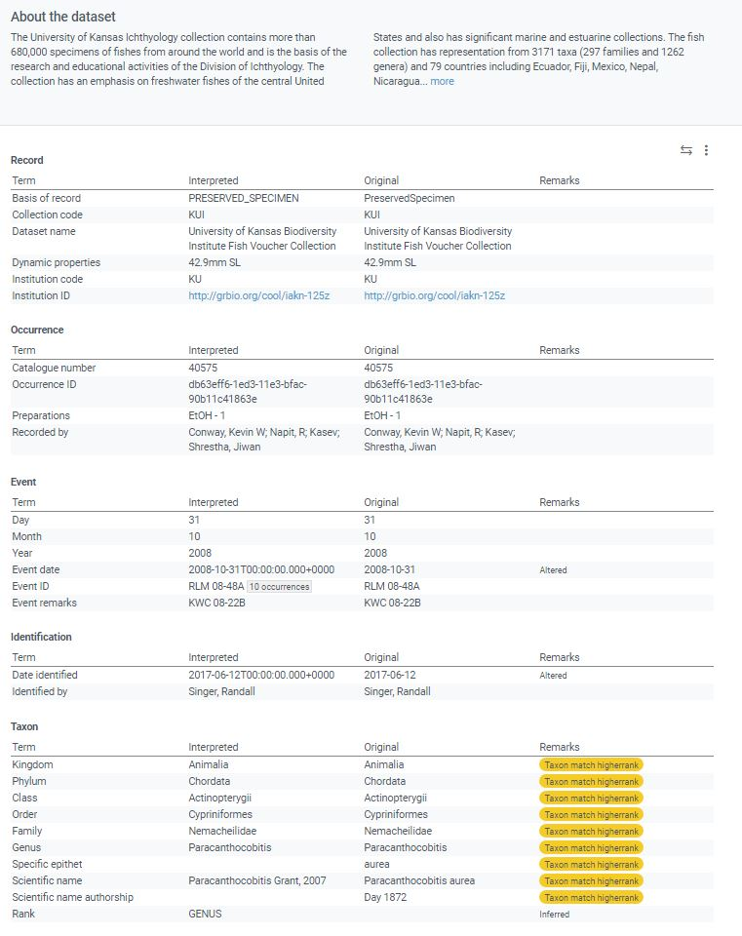
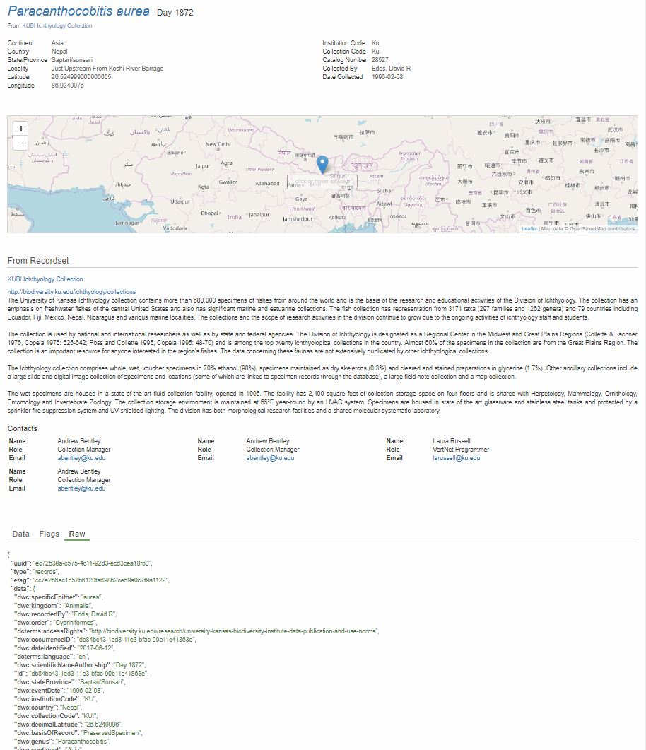
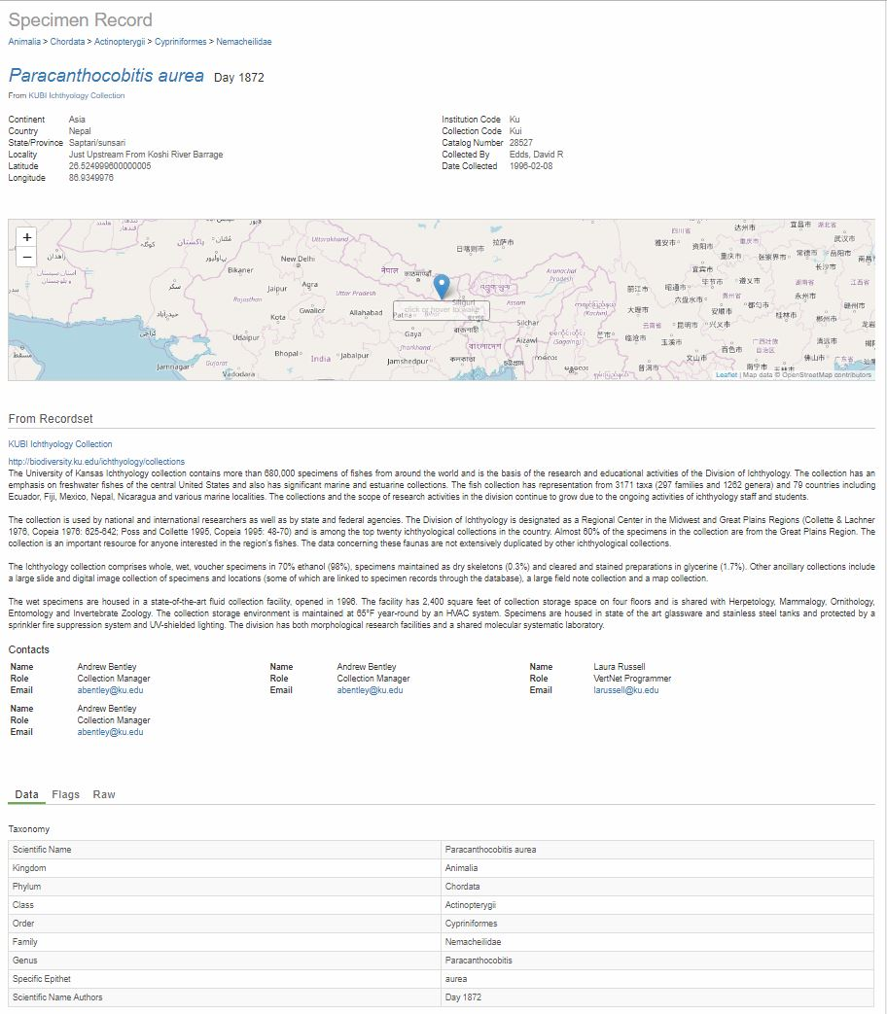
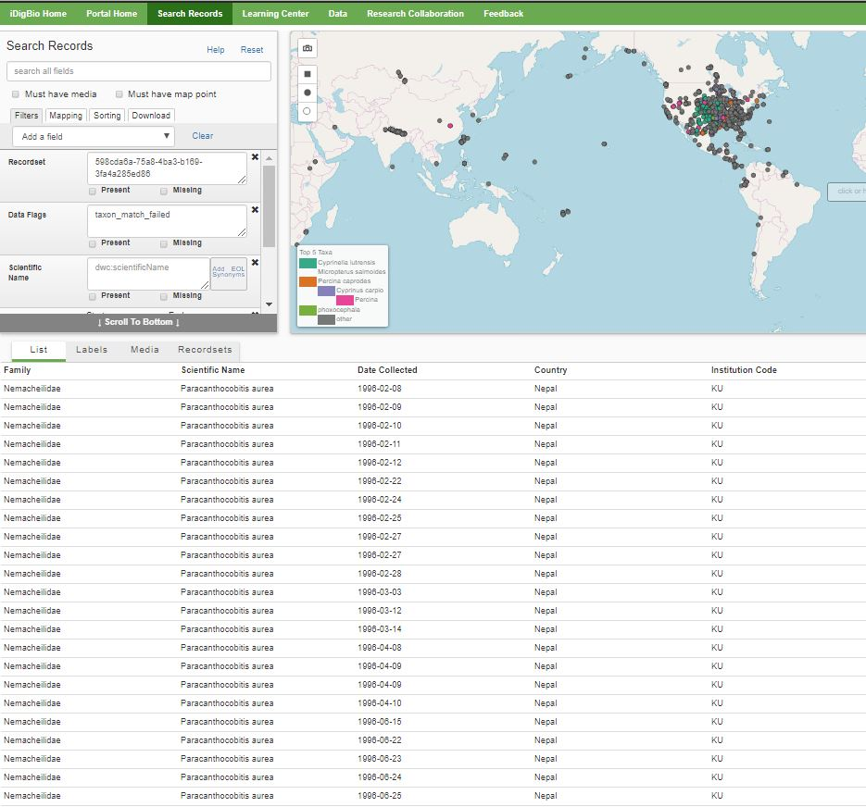
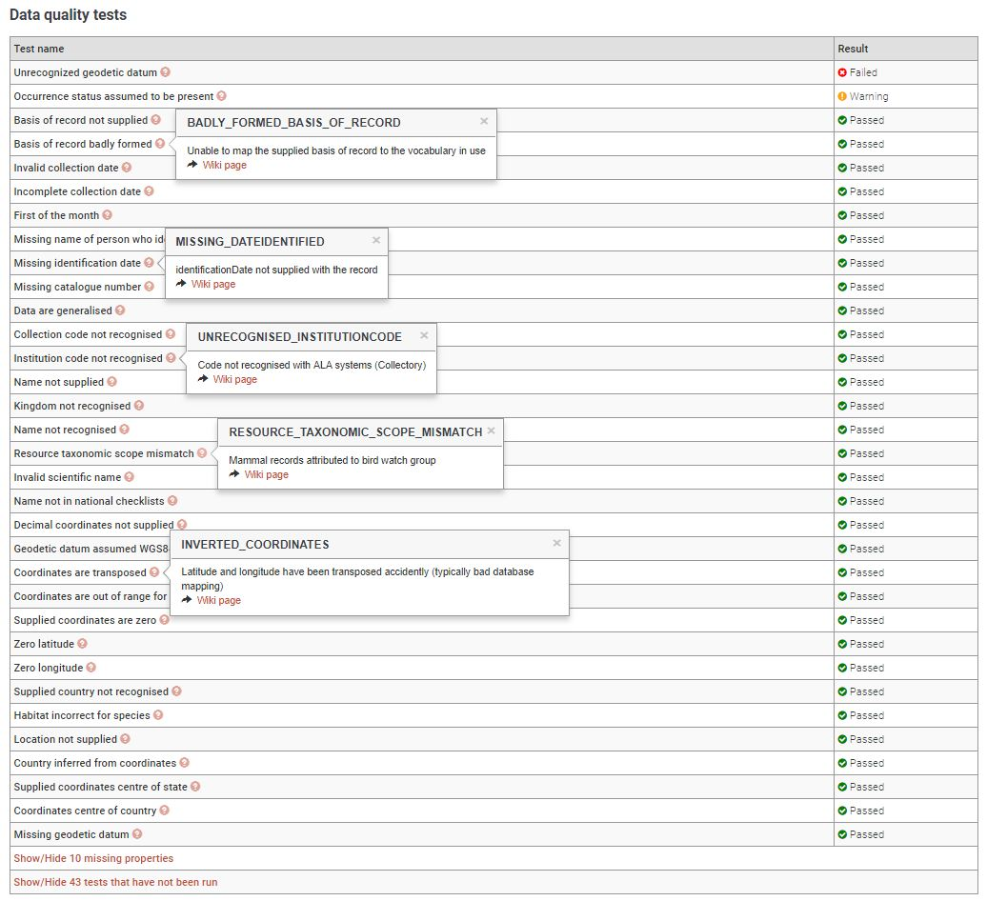
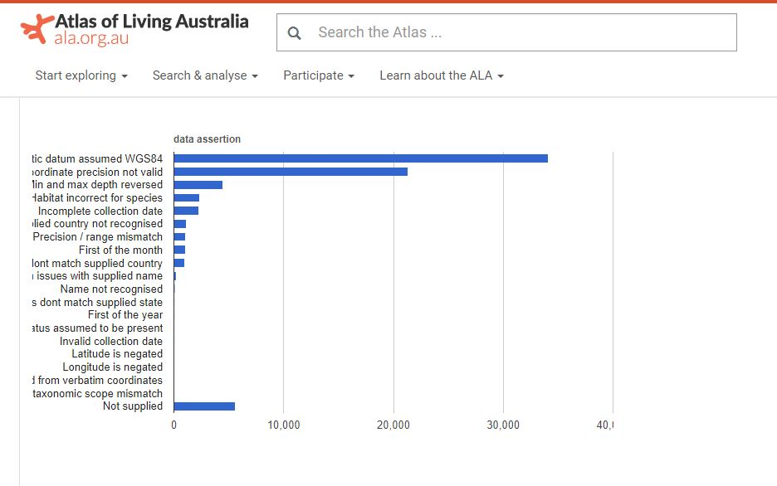
General problems/improvements
Problems with taxonomic backbone
Types, new species, hybrids, differing taxonomies
Marine geography – oceans
Sorting of metrics
Description of metrics
Standardization of metrics across aggregators
Individual record, batch and download
Audience for metrics – collections community
Collection
Taxonomy
Geography
Multimedia

Slide 16
Conclusions
Some DQ metrics very useful
Some DQ metrics not actionable
Some DQ metrics confusing – resolved through better descriptions
Take everything with a healthy dose of skepticism and use all available resources to assist in checking accuracy of metrics.
Would be great if we could take the best of each aggregators approach and create standardized metrics and UI representation.

Slide 17
How to get data back into database
Correcting records one-by-one very time consuming.
Specify Software in discussions with GBIF and others about possibility of incorporating data quality metric API into the database itself so that data quality checks could be performed before publishing and corrections made at the source in some semi-automated fashion.

Slide 18
Acknowledgements
GBIF
iDigBio
Deb Paul and Nicole Fisher

Slide 19
Thank you

