Slide 1
It’s About Data
iDigBio Wet Collections Digitization Workshop
March 4 – 6, 2013I
KU Biodiversity Institute, University of Kansas – Lawrence
Deborah Paul, Greg Riccardi, Joanna McCaffrey

Slide 2
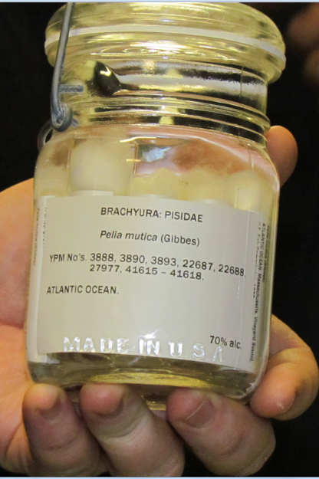
Overview
Identifiers
Darwin Core
Collaborating with TCNs and PENs
Contributing to iDigBio
Data Aggregators
Guidelines for selecting a database
Digitization Maturity

Slide 3
Identifiers
What good is identification?
How are identifiers used by consumers
Providing IDs
Annotations and Feedback

Slide 4
What good is identification?
Aggregation
If you get info from 2 sources that are about the same object, you can combine the info
Resolution (finding information about object)
Types of resolution
Determine where to get information
Determine how to get information

Slide 5
DOI example
The DOI is
10.3897/zookeys.209.3135
URI (for aggregating & display) is
doi:10.3897/zookeys.209.3135
A URL for information retrieval (proxy resolution) is
http://dx.doi.org/10.3897/zookeys.209.3135
Information fetched from
HTML:
http://www.pensoft.net/journals/zookeys/article/3135/abstract/five-task-clusters-that-enable-efficient-and-effective-digitization-of-biological-collections
Notes:
Not comingled. Identifier and resolution (proxy) are separate
The consumer has to know somewhere to look for info
Requires organization to manage allocation of id space and proxy resolution
Members pay for service

Slide 6
Zoobank Uses Identifiers
Consider web page
http://zoobank.org/NomenclaturalActs/4DFD6D95-C287-4AFF-8473-E073D8960EC6
Look for identifiers
urn:lsid:zoobank.org:act:4DFD6D95-C287-4AFF-8473-E073D8960EC6
HOLOTYPE: Deposited as No. 7113, Hancock Parasitology Collection, University of Southern California
Search in google for these
Notes:
For consumer:
NOTHING! No information
Use UUID
Can’t type it, remember it, parse it, resolve it
Useful for comparison and aggregation
Equal strings (persistence)
Different strings about the same object
fetching information
Send the ID somewhere for info
digression
Careful
Id1=id2 means same object
Id1!= id2 does not mean different objects
what is it exactly in the publication?
an id?, a guid? a link to more information?
what will be cited? searched for?

Slide 7
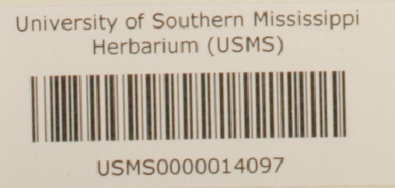
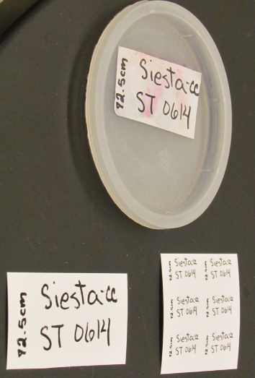
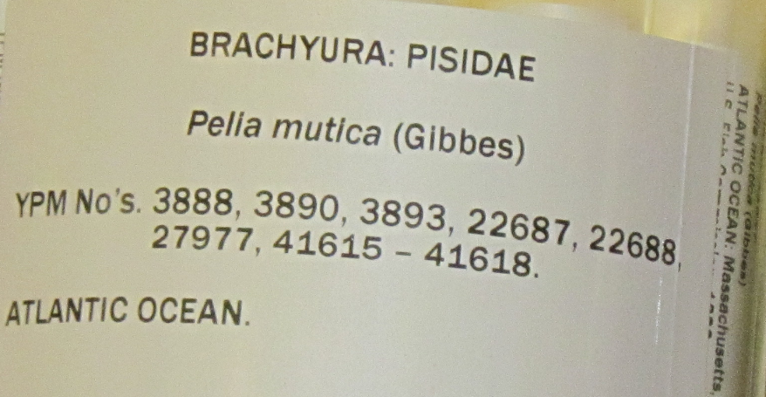
What about Specimen identifiers?
Identifier on the specimen?
readable text
encoded data
barcode is a contextual identifier
database record contains?
barcode = 0000014097
catalog number = ?
specimenId = urn:uuid:954c8760-e1a6-4b4b-ab82-6bf7311c25f3
record ID
persistent
unique (globally)
actionable (resolvable) maybe
Notes:
What are you providing / sharing?
The standard for identification advocated by W3C is to use Universal Resource Identifiers (URIs).
-- a URI is a string that begins with a scheme name (or protocol). (http, https, mailto, doi, ftp, urn).
Second URI has hex encoding of “0014097”
UUID (sometimes GUID)
Assured unique
E.g. d6610130-5248-11e1-b86c-0800200c9a66
Hard to type in
Not resolvable
Not always DB friendly
Opaque
apply a given id to only one object ever
if something happens and that object no longer exists in the physical collection –
never reassign the identifier to another object in the collection

Slide 8
What’s in an id for the provider?
record id 112234
uuid urn:uuid:954c8760-e1a6-4b4b-ab82-6bf7311c25f3
lsid urn:lsid:zoobank.org:act:8BDC0735-FEA4-4298-83FA-D04F67C3FBEC
http - uri http://ids.flmnh.ufl.edu/herb/abcd12345678
ezid ark:/87286/B2954c8760-e1a6-4b4b-ab82-6bf7311c25f3
doi doi:10.1038/ng0609-637
catalog urn urn:catalog:FSU:Herbarium:000023905
Proxy request
http://dx.doi.org/10.1038/ng0609-637
Notes:
The standard for identification advocated by W3C is to use Universal (uniform) Resource Identifiers (URIs).
-- a URI is a string that begins with a scheme name (or protocol). (http, https, mailto, doi, ftp, urn).
UUID (sometimes GUID)
definitely unique
E.g. 954c8760-e1a6-4b4b-ab82-6bf7311c25f3
Hard to type in
Not resolvable
Not always DB friendly
Opaque
urn:lsid:authority:namespace:identifier
http://lsid.tdwg.org/urn:lsid:authority:namespace:identifier
note that the http-uri could have any domain name (does not have to be resovlable) and the collection identifier
best practice would be to use one from biorepositories / biocollections index
this collection identifier needs to be stored in the providers database and
this collection identifier needs to be shared when the data is shared with aggregators.

Slide 9
Feedback with IDs
Annotations
Target of annotation
http://www.morphbank.net/818505
filtered PUSH
SGR
BiSciCol
linked data, aka the semantic web
updating the database
be(a)ware
store and share other IDs
Notes:
‘target’ is a property of the annotation

Slide 10
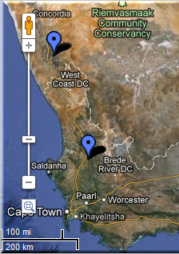
FilteredPUSH
Identifiers
GenBank ®
D I S C O V E R L I F E
Kepler Kurator
Cladistics ®
Notes:
Sharing Data.
GUIDs are the Key
specimen database
aggregators / portals – iDigBio, GBIF, EOL
ontologies- BioPortal
publications
maps
databases – GenBank, BOLD
provider websites – a museum may have their own portal
data repatriation, enhancement – Filtered PUSH
data cleaning / cleansing – Kepler Kurator, Google Refine
provider sites – http://herbarium.bio.fsu.edu
consortium websites through portals: http://symbiota.org/tiki/tiki-index.php?page=Data+Nodes
SERNEC, North American Bryophyte and Lichen Consortia, SEINet
Revisualization - discovery
Unforseen errors revealed
Taking it in stride
Opportunities, Benefits, Decisions
Specify’s Scatter-Gather-Reconcile (SGR)
duplicates found
dataset for checking is increasing in size
example, at least 50% dupes
lending credence to the skeletal dataset concept
Filtered PUSH (works with Specify, Symbiota and Morphbank)
finding dupes
the benefits of shared datasets
lending credence to the skeletal dataset
finding annotations (determinations, general comments)
to import or not to import

Slide 11
Overview
Identifiers
Darwin Core
Collaborating with TCNs and PENs
Contributing to iDigBio
Data Aggregators
Guidelines for selecting a database
Digitization Maturity

Slide 12
Darwin Core Standard
http://rs.tdwg.org/dwc/terms/
Darwin Core (often abbreviated to DwC) is a body of data standards which function as an extension of Dublin Core for biodiversity informatics applications, establishing a vocabulary of terms to facilitate the discovery, retrieval, and integration of information about organisms, their spatiotemporal occurrence, and supporting evidence housed in biological collections. It is meant to provide a stable standard reference for sharing information on biological diversity[1] .

Slide 13
Darwin Core Standard
http://rs.tdwg.org/dwc/terms/
Darwin Core (often abbreviated to DwC) is body of data standards which function as an extension of Dublin Core for biodiversity informatics applications, establishing a vocabulary of terms to facilitate the discovery, retrieval, and integration of information about organisms, their spatiotemporal occurrence, and supporting evidence housed in biological collections. It is meant to provide a stable standard reference for sharing information on biological diversity[1] .
Does Darwin Core cover every field possible? – No
Don’t panic! There are extensions and other options.

Slide 14
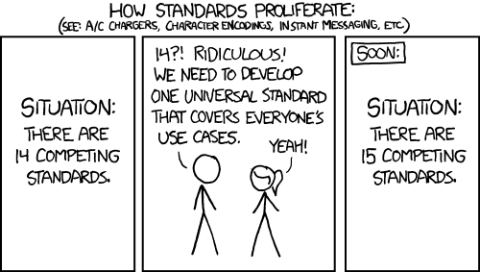
http://xkcd.com/927/

Slide 15
DwC-A and the IPT
DwC-A = Darwin Core Archive – contains 3 or more files
Identifiers make this possible
IPT = Integrated Publishing Toolkit creates the DwC-A
csv file – e.g. your specimen data records
meta.xml – a file that explains the contents of each column in the csv file
eml.xml – information about the data provider and what data is provided
extensions – extending what the IPT can do.
image records for the specimens
resource relationships
measurement or fact
http://tools.gbif.org/
http://tools.gbif.org/dwca-assistant/
Notes:
Ecological Markup Language – EML

Slide 16
DwC-A
mySpecimenData.csv
occurrenceID,recordedBy,scientificName,field name,field name,field name
http://www.ids.flmnh.edu/herb/123555,C L Barkley,Carex maritima,value,value,value
http://www.ids.flmnh.edu/herb/123556,Aaron Thompson,Carex maritima,value,value,value
http://www.ids.flmnh.edu/herb/123559,Marsha Corwin,Carex maritima,value,value,value,
eml.xml
https://code.google.com/p/gbif-indexingtoolkit/source/browse/trunk/harvest-webapp/src/test/resources/org/gbif/harvest/dwcarchive/ebird/eml.xml?r=1676
meta.xml
<archive xmlns="http://rs.tdwg.org/dwc/text/" xmlns:xsi="http://www.w3.org/2001/XMLSchema-instance" xsi:schemaLocation="http://rs.tdwg.org/dwc/text/ http://rs.tdwg.org/dwc/text/tdwg_dwc_text.xsd"> <core encoding="UTF-8" fieldsTerminatedBy="\t" linesTerminatedBy="\n" fieldsEnclosedBy='' ignoreHeaderLines="0" rowType="http://rs.tdwg.org/dwc/terms/Taxon"> <files> <location>taxa.txt</location> </files> <id index="0" /> <field index=“1" term="http://rs.tdwg.org/dwc/terms/recordedBy"/> <field index=“2" term="http://rs.tdwg.org/dwc/terms/scientificName"/> <field index=“3" term="http://rs.tdwg.org/dwc/terms/fieldName"/> <field index=“4" term=" http://rs.tdwg.org/dwc/terms/fieldName "/> <field index=“5" term="http://rs.tdwg.org/dwc/terms/fieldName"/> </core>
images.csv
occurrenceID,identifier, field,field name,field name,field name
http://www.ids.flmnh.edu/herb/123555,http://www.myimages.org/images/herb123555.jpg
http://www.ids.flmnh.edu/herb/123556,http://www.myimages.org/images/herb123556.jpg
http://www.ids.flmnh.edu/herb/123559,http://www.myimages.org/images/herb123559.jpg
http://www.ids.flmnh.edu/herb/123559,http://www.myimages.org/images/herb123560.jpg

Slide 17
Overview
Identifiers
Darwin Core
Collaborating with TCNs and PENs
Contributing to iDigBio
Data Aggregators
Guidelines for selecting a database
Digitization Maturity

Slide 18
Ways to Share Data
Thematic Collection Networks (TCNs)
have data ready to share?
fits a current TCN theme?
Partners to Existing Networks (PENs)
join the effort
Through an existing portal or repository
Symbiota
VertNet
Morphbank
iDigBio
GBIF
Help is everywhere!

Slide 19
Data Mapping & Export
Museum a |  | Museum b |  | Darwin Core
barcode | = | accessionNumber | = | catalogNumber
collectorNumber | = | collectionNumber | = | recordNumber
collector | = | collectedBy | = | recordedBy
All mapped up and ready to go – now what?
Data Export.
Export in standard format
May use IPT
Publish your data
Expect feedback
Notes:
http://www.slideshare.net/nielsklazenga/specify-6byandybentley-2

Slide 20
Sharing data with iDigBio
Custom export
CSV files
DwC-A files
DwC-Extensions
MeasurementOrFact
ResourceRelationship
AudubonCore
Specimen Identifiers
Record Identifiers

Slide 21
Data in iDigBio
goal to allow all possible data w/o limitations from a given standard
“if a field is valuable – it will someday be in a standard” (Schuh 2012)
standards

Slide 22
Overview
Identifiers
Darwin Core
Collaborating with TCNs and PENs
Contributing to iDigBio
Data Aggregators
Guidelines for selecting a database
Digitization Maturity

Slide 23
Choosing a database / collections management system
Establish institutional motivation to digitize specimens
earnest desire could be generated by a focus group with institutional stakeholders, funding generators, users of data, people who input data, data system supporters (curators), IT,
JMcCaffrey Chicago DROID 2 Workshop 2013
Notes:
Process can be summed up by
Motivate the system/work society – where there’s a will there’s a way
Define necessary vs desired features
Find and interview vendors
Test them with a realistic dataset, a month is a good amount of time
Select with all costs in mind

Slide 24
Considerations for selecting a collections management system
Document and agree on a priority feature set that is necessary versus desired:
system is extensible, customizable,
responsive vendor,
supports reports, auditing,
generates labels,
supports loans (partial returns, cataloged and uncataloged specimens),
supports pest management,
supports multimedia attachments (PDF loan forms, image, sound files, etc.),
supports web access and privacy,
JMcCaffrey Chicago DROID 2 Workshop 2013
Notes:
This is a sample list of desired features

Slide 25
Considerations for selecting a collections management system
all the input/output scenarios you might envision:
Import/export abilities, can it support DarwinCore field mappings
plan B scenario if software or the internal project becomes unfunded,
affordable user license costs: per seat, pool,
has basic, and easily customizable help,
Mac versus PC, perhaps an issue in your user population,
has a robust security model (passwords, users, groups, permissions, input and query defaults, controlled vocabularies),
supports accessibility, different character sets,
JMcCaffrey Chicago DROID 2 Workshop 2013

Slide 26
Considerations for selecting a collections management system
Proprietary, open source, hybrid, cloud-based
Who decides what features to develop?
Who does maintenance?
JMcCaffrey Chicago DROID 2 Workshop 2013

Slide 27
Considerations for selecting a collections management system
Interest in having what your peers have: economies of training, user community,
Beware of demo-ware,
JMcCaffrey Chicago DROID 2 Workshop 2013

Slide 28
Considerations for selecting a collections management system
Shop vendors and score them on their ability to meet necessary features above, with extra points for desired ones,
JMcCaffrey Chicago DROID 2 Workshop 2013

Slide 29
Considerations for selecting a collections management system
Get a full demo copy and enter data with a realistic test case dataset, score on ease of learning the system,
novice and expert user
JMcCaffrey Chicago DROID 2 Workshop 2013

Slide 30
Considerations for selecting a collections management system
When choosing preferred system, consider costs derived from these sources:
upfront software costs,
software maintenance,
long term costs (server space, server replacement, backup),
where it is hosted,
IT support of system without being the bottleneck,
hidden costs of conversion, cleansing, improvements,
institutional biodiversity informatics staff support to continue development of data, (‘data curator’).
https://www.idigbio.org/content/biological-collections-databases
JMcCaffrey Chicago DROID 2 Workshop 2013
Notes:
Some of these costs are specifically related to the vendor you selected, some are simply moving from one system to another, and maybe wanting to improve your collections data methods.

Slide 31
Overview
Identifiers
Darwin Core
Collaborating with TCNs and PENs
Contributing to iDigBio
Data Aggregators
Guidelines for selecting a database
Digitization Maturity

Slide 32
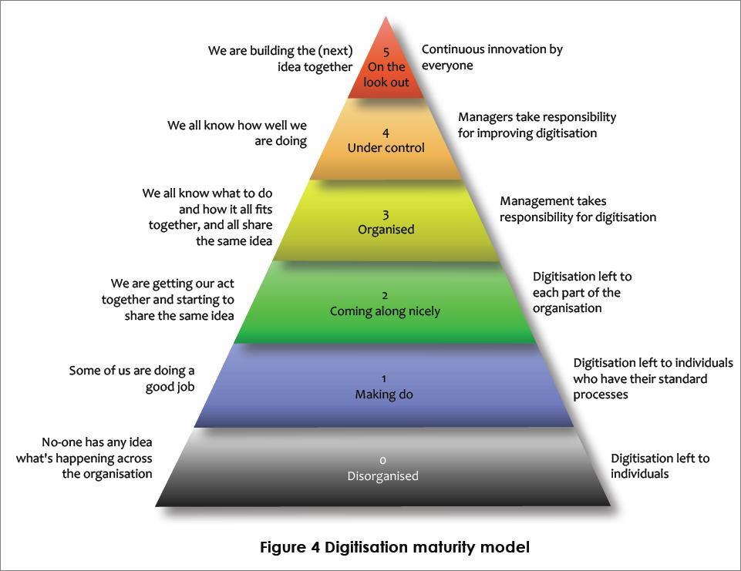
Digitisation Maturity?
http://tinyurl.com/digitizationala
Notes:
Bryan Kalm’s digitization maturity scale. useful for organizations looking to benchmark their overall maturity within and between collections.

Slide 33
Choose your level
http://tinyurl.com/digitizationala
0 No idea
No-one has any idea what's happening across the organisation
Digitisation left to individuals
1 Making do
Some of us are doing a good job
Digitisation left to individuals who have their standard processes
2 Coming along nicely
We are getting our act together and starting to share the same idea
Digitisation left to each part of the organisation
3 Organized
We all know what to do, how it all fits together, and share same idea
Management takes responsibility for digitisation
4 Under control
We all know how well we are doing
Managers take responsibility for improving digitisation
5 On the lookout
We are building the (next) idea together
Continuous innovation by everyone

Slide 34
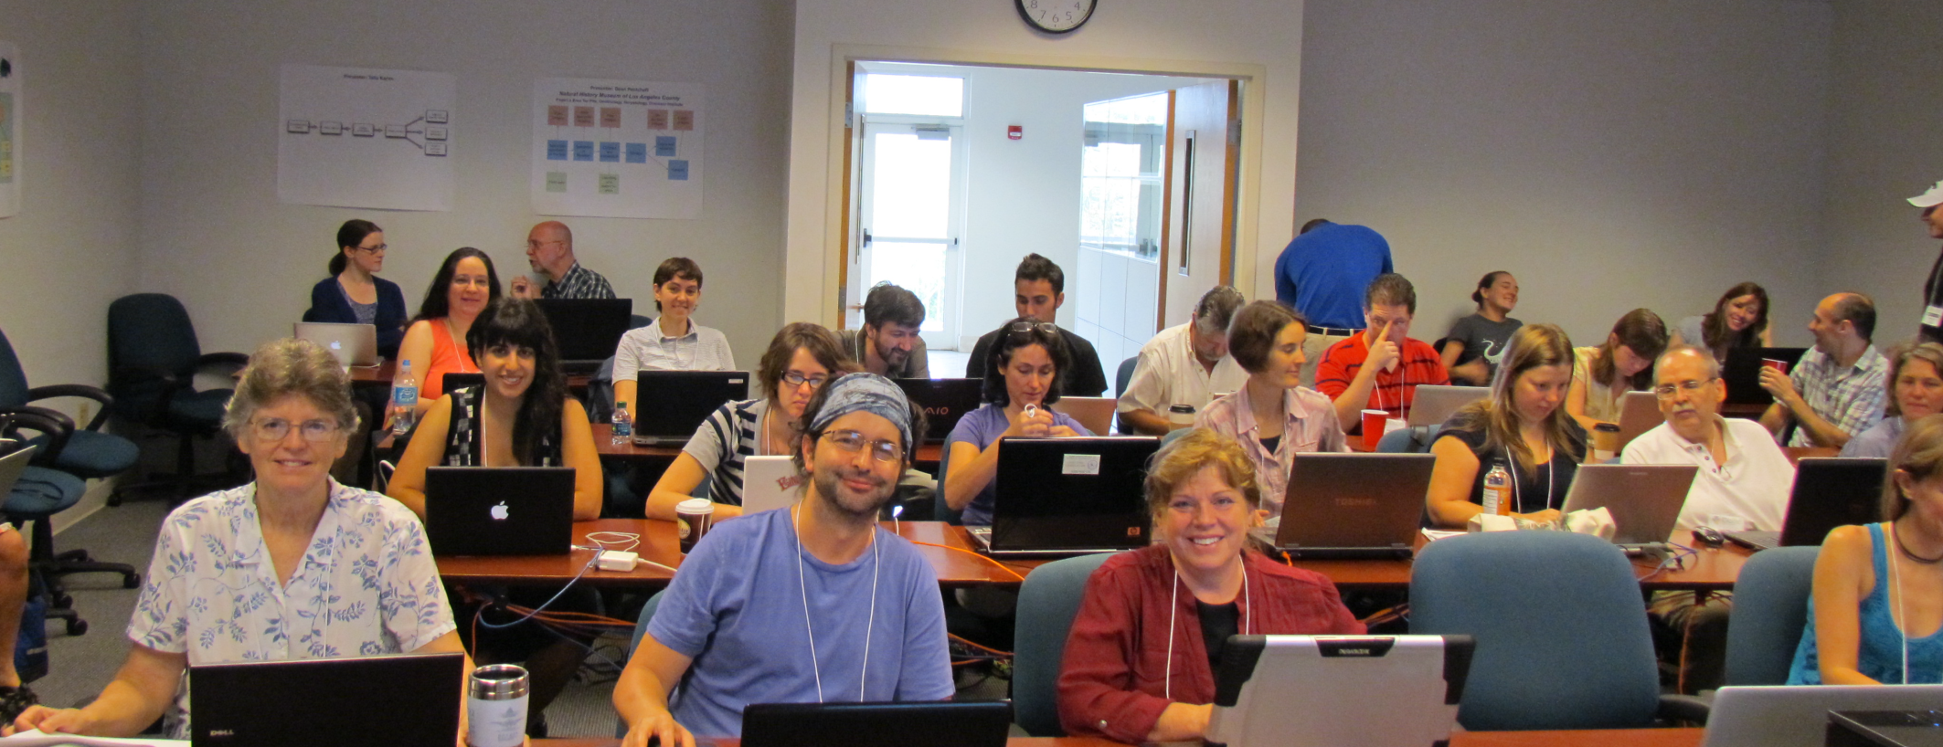
Thank you…
42!

Slide 35
Zoobank Uses Identifiers
Consider web page
http://zoobank.org/References/68376390-7809-46FF-9EC4-1371B4AAD0FF
Look for identifiers
urn:lsid:zoobank.org:pub:68376390-7809-46FF-9EC4-1371B4AAD0FF
HOLOTYPE: Deposited as No. 7113, Hancock Parasitology Collection, University of Southern California
Search in google for these
Notes:
For consumer:
NOTHING! No information
Use UUID
Can’t type it, remember it, parse it, resolve it
Useful for comparison and aggregation
Equal strings (persistence)
Different strings about the same object
fetching information
Send the ID somewhere for info
digression
Careful
Id1=id2 means same object
Id1!= id2 does not mean different objects

Slide 36
Data Mapping & Export
Museum a |  | Museum b |  | Darwin Core
barcode | = | accessionNumber | = | catalogNumber
collectorNumber | = | collectionNumber | = | recordNumber
collector | = | collectedBy | = | recordedBy
All mapped up and ready to go – now what?
Data Export Example.
How do you get your data out of your database?
Schema Mapper tool
Data Exporter tool > creates a temporary table in your database
Data Exporter > tab-delimited text file for import into IPT
Install IPT, Register at GBIF using the IPT
Use the text file with the IPT for upload to GBIF, some mapping may be required
Publish your data
Extensions for more data types: e.g. Audubon Core for Media files
Notes:
http://www.slideshare.net/nielsklazenga/specify-6byandybentley-2

Slide 37
Data Export
General users download occurrence data from search page as Darwin Core CSV files or raw Symbiota
Data managers
create backup file as a compressed set of Symbiota CSV files (occurrences, determination history, and image links)
IPT instances are set up for the portals on the Symbiota servers (lichens, bryophytes, SCAN, and MycoPortal).
each collection can choose to send data to GBIF themselves or
via the portal.
Future: Symbiota
automated packaging of data as Darwin Core archive files.
Control panel, collection managers refresh the DwC archive whenever they wish.
the ability to turn on or off publishing.
Notes:
From Ed Gilbert
General data users can download occurrence data from the search page as Darwin Core CSV files or raw Symbiota
Data managers can save a backup file as a compressed set of Symbiota CSV files (occurrences, determination history, and image links)
We (Symbiota) have setup IPT instances for the portals on the Symbiota servers (lichens, bryophytes, SCAN, and MycoPortal). We are now going to ask each collection if they want us to publish their data to GBIF in their name. Collections that are already publishing their data on their own will not be published again through the portal.
Future: Symbiota will have the built-in capability of packaging data as Darwin Core archive files. Through the control panel, collection managers will have the ability to refresh the DwC archive whenever they wish. They will also have the ability to turn on or off publishing.

Slide 38
Data Export
Each NHM client
initial mapping process with EMu staff
mapping to DwC 1.2 (aka v2)
use Automated Export to create desired file
CSV
text
Crystal Report
use DwC CSV file with IPT to create DwC-A file
DwC-A file is shared with GBIF
GBIF – harvests periodically and replaces an old dataset with a newer one.
data is replaced (a new cache) not stored and versioned.

Slide 39
Identifiers
What good is identification?
How are identifiers used by consumers
Providing IDs
Annotations and Feedback

