Slide 1

Data Cleaning, Validation and Enhancement
iDigBio Wet Collections Digitization Workshop
March 4 – 6, 2013
KU Biodiversity Institute, University of Kansas – Lawrence
Deborah Paul
Notes:
Notes included in this talk, and a dataset provided with this talk are designed to be used together to help the user trying out Open Refine (formerly Google Refine) for the first time. The links are all working at the time of this talk, first presented at iDigBio’s Wet Collection Workshop at KU in March 2013.

Slide 2
Pre & Post-Digitization
Exposing Data to Outside Curation – Yipee! Feedback
Data Discovery
  dupes, grey literature, more complete records, annotations of many kinds, georeferenced records
  Filtered PUSH Project
  Scatter, Gather, Reconcile – Specify
  iDigBio
Planning for Ingestion of Feedback – Policy Decisions
  re-determinations & the annotation dilemma
    to re-image or not to re-image
    “annotated after imaged”
    to attach a physical annotation label to the specimen from a digital annotation or not

Slide 3
Data curation / Data management
querying dataset to find / fix errors
kinds of errors
  filename errors
  typos
  georeferencing errors
  taxonomic errors
  identifier and guid errors
  format errors (dates)
  mapping

Slide 4
Clean & Enhance Data with Tools
Query / Report / Update features of Databases
  Learn how to query your databases effectively
  Learn SQL (MySQL, it’s not hard – really!)
Using new tools
  Kepler Kurator – Data Cleaning, Data Enhancement
  Open Refine, desktop app
    from messy to marvelous
    http://code.google.com/p/google-refine/
    http://openrefine.org/
    remove leading / trailing white spaces
    standardize values
    call services for more data
      just what is a “service” anyway?
    the magic of undo
  Google Fusion Tables

Slide 5
OpenRefine
A power tool for working with messy data.
Got Data in a Spreadsheet,…?
  TSV, CSV, *SV, Excel (.xls and .xlsx),
  JSON,
  XML,
  RDF as XML,
  Wiki markup, and
  Google Data documents are all supported.
the software tool formerly known as GoogleRefine

Slide 6
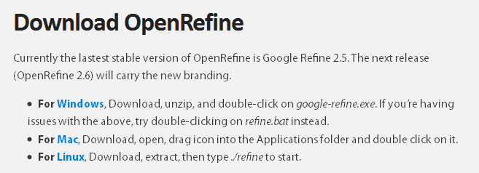
http://openrefine.org/
Install

Slide 7
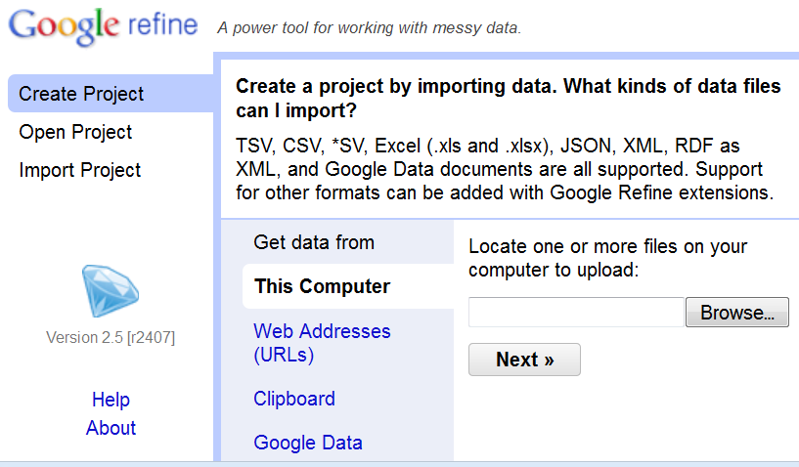
Notes:
Upload any CSV file and try it out!
A sample CSV file is posted with this power point on the Wet Collections Workshop Wiki if you want to try it now.

Slide 8
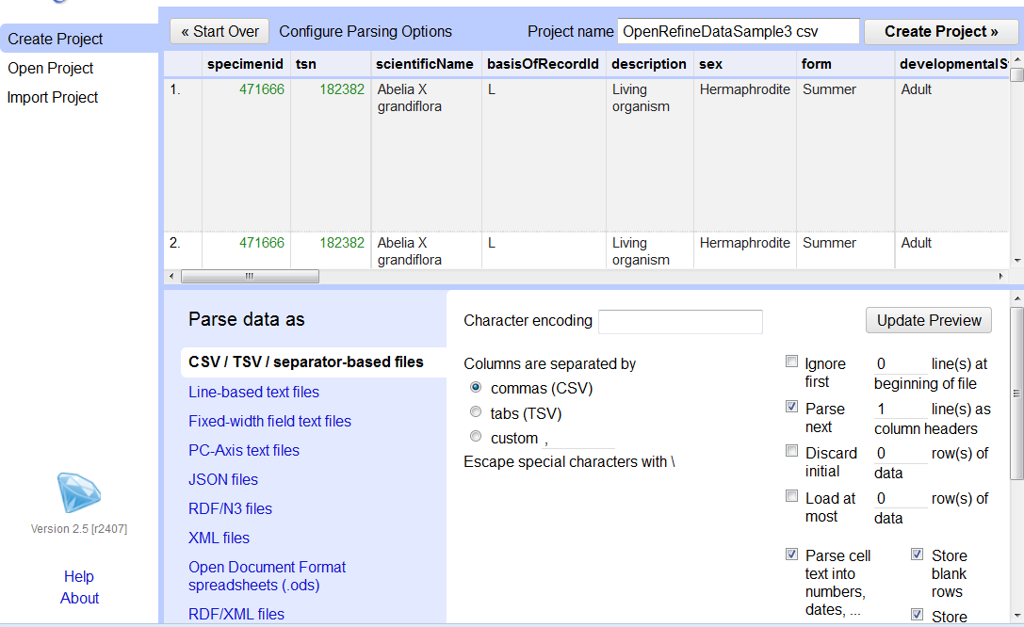
Notes:
Note here you can specify the “encoding” (do you have special characters like umlauted letters in your dataset? like ä or ü – choose “UTF-8” encoding
Simple to do, just click in the UTF-8 box, select UTF-8, done.
If your file is tab-delimited, or has a delimiter different than comma, specify the delimiter using the “custom” radio button under Columns are separated by
Next, note that you can discard rows, ignore rows, parse data, in this initial step to create a project.
Click Create Project in the top right-hand corner.

Slide 9
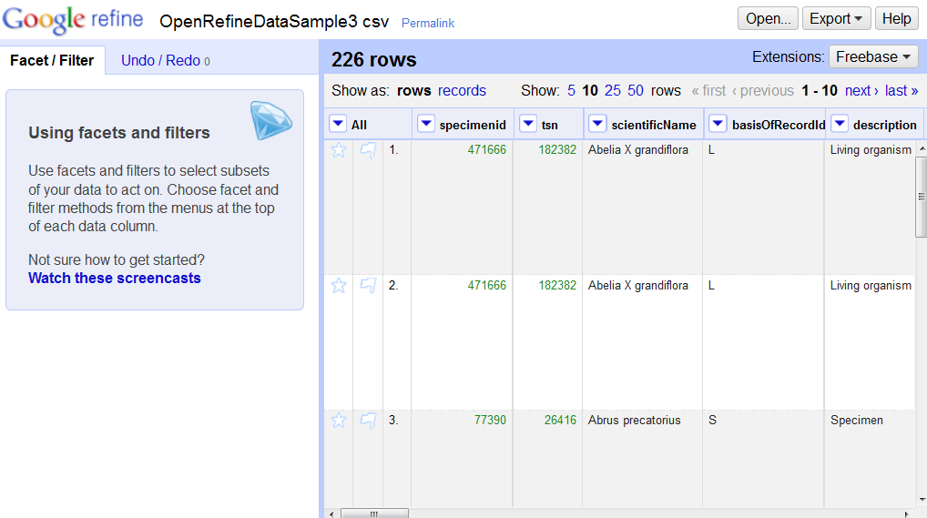
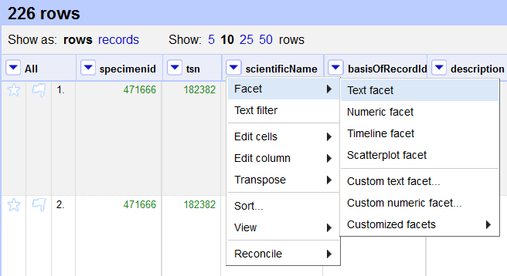
Notes:
Now you can play with, enhance, and over-all, improve your data with very powerful algorithms and formulas with the click of a button.
Want to see all the distinct scientificNames in the column?
Click on the down arrow > facet > text facet

Slide 10
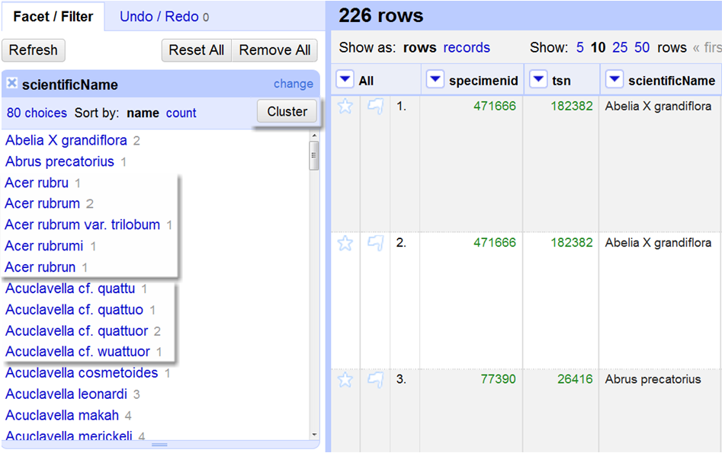
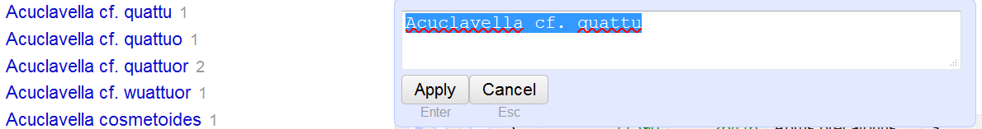
Notes:
Click on the down arrow > facet > text facet
the result in the left column is a box saying there are 80 distinct values in the column and in light gray you can see how many times each value occurs.
If you want to, you can click on count to sort by count instead of name.
In this window, if you want to fix a particular name, you can click on edit that appears next to each name if you move your mouse into the area to the right of each name.
A pop-up box appears and you can then edit that particular value.
IF you’d like to see all the names clustered (think DNA Blast Search), click on Cluster
(next slide)

Slide 11
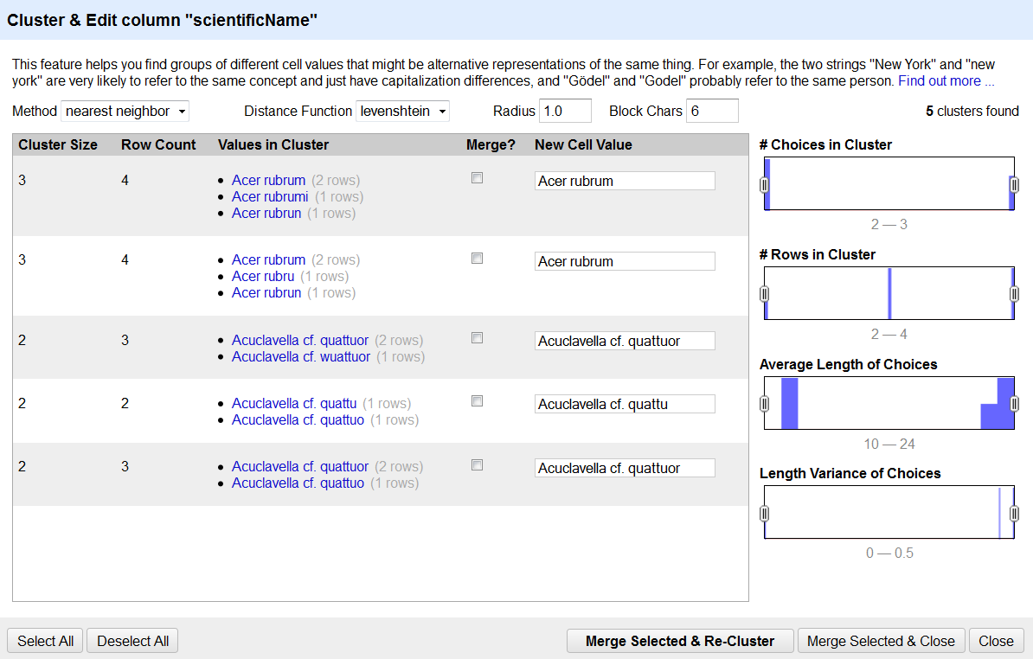
Notes:
After clicking on Cluster you may or may not get a result with the default algorithms.
Play with them to see what happens.
Here, nearest neighbor > levenshtein found 5 clusters.
Note the algorithms guess which value you might want. Just select “Merge” if the guess is correct.
If not, fix the value displayed in New Cell Value and then choose
Merge Selected and Close (or Merge Selected and Re-Cluster) – whichever is appropriate.
All these issues are now fixed.
You can do this with any column in the spreadsheet.

Slide 12
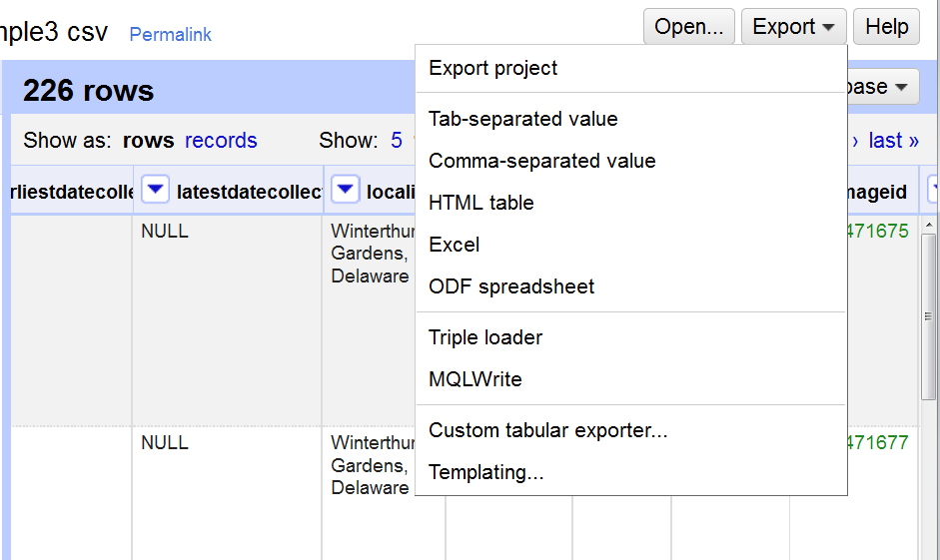
Notes:
Note here you can Export your data in several different formats, depending on what you want to do or what you need.

Slide 13
Enhance Data
Call “web services”
GeoLocate example
  your data has locality, county, state, country fields
  limit data to a given state, county
  build query
    "http://www.museum.tulane.edu/webservices/geolocatesvcv2/glcwrap.aspx?Country=USA&state=fl&fmt=json&Locality="+escape(value,'url')
    service returns json output
    latitude, longitude values now in your dataset.
Google Fusion tables
Notes:
Time to enhance your data!
You can call the back door of a server, you can call a “service.” Instead of going to the human user-interface of a web site, there are ways to get data from a server, back to you in a data-friendly way, for example, in a data set, rather than one record at a time on a web site through the public interface.
This is just one example of what a service is and how it might work.
While we can go through the front door of a website (the public user-interface) and type in a locality and get back latitude and longitude values, we’d like to send all our locality data at one time and get back points all at once, right? We’ll use GeoLocate web services for this example.
The http:// request above “calls” Geolocate web services. This “Application Programming Interface” (API) understands certain “parameters.”
See a simple list of parameters and sample queries at
http://www.museum.tulane.edu/geolocate/files/glcJSON.pdf
The http:// request has parameters
Country (set equal to USA)
state (set equal to Florida)
fmt (which is the format we’d like our data returned in, and at this web service, we have a choice of json or geojson. JSON=JavaScript Object Notation. (You can google this if you want to know more right now, else, keep reading).
Locality=“+escape(value,’url’)
What does this “+escape(value,’url’) mean for the locality parameter?
We want to send a query through http, but spaces and other characters need to be html-encoded else they (spaces, brackets, commas,…) mess up the query.
So we need to “escape” them so the service will understand what we want.
(Keep going and you’ll see an example of what this looks like).

Slide 14
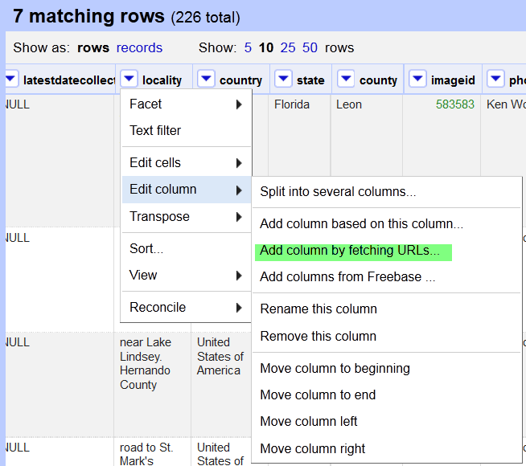
Notes:
First, make a small record set by doing the following:
Click state column facet > text facet
Click on Florida
Now, there are 7 records to send to Geolocate.
To “Call a URL” to get this data to add to your open project…
In the locality column > click edit column > add column by fetching URLs…

Slide 15
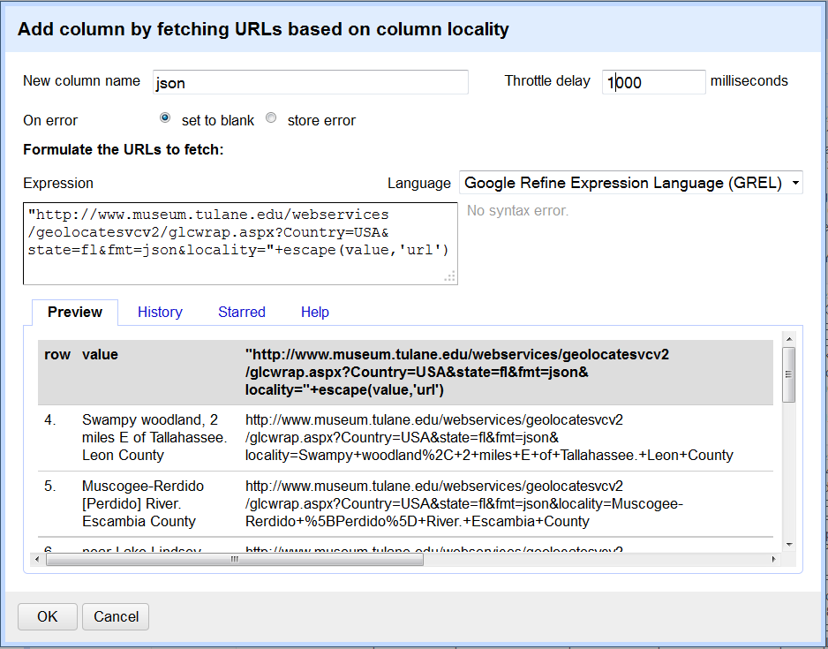
Notes:
In this pop-up, for this example, name the to-be-created column json
since that’s the data format we’re going to ask for from Geolocate web services.
Throttle delay? We don’t want to overwhelm the Geolocate server (we want to “play nice”), so set it to 1000 milliseconds or larger. This is how often we will “hit” the server with a request. If we go there to often or too many times in a given period – our “request” may be refused.
Now we need to Formulate the URLs to fetch:
"http://www.museum.tulane.edu/webservices/geolocatesvcv2/glcwrap.aspx?Country=USA&state=fl&fmt=json&Locality="+escape(value,'url')
Each part of this http request is explained in the notes of slide 13 above.
Note the Preview section, right column.
If the http query is “formed correctly” you’ll see an http request like the one above that you can read.
See the + signs and % signs in the query? These are the “escape” characters added to take care of the spaces and other characters that would not work in an http request.
(Note: if you cut-and-paste one of them from your example, you can paste it into your browser’s url and see the result for a single record)
You can try it here with:
http://www.museum.tulane.edu/webservices/geolocatesvcv2/glcwrap.aspx?Country=USA&state=fl&fmt=json&locality=Swampy+woodland%2C+2+miles+E+of+Tallahassee.+Leon+County
Click radio button “store error” if you are not getting a result and the error will display in the json column – and then you can try to decode from it, why it’s not working.
click OK and you’ll be sending all your http queries for these 7 records and you’ll get json data back for each record.

Slide 16
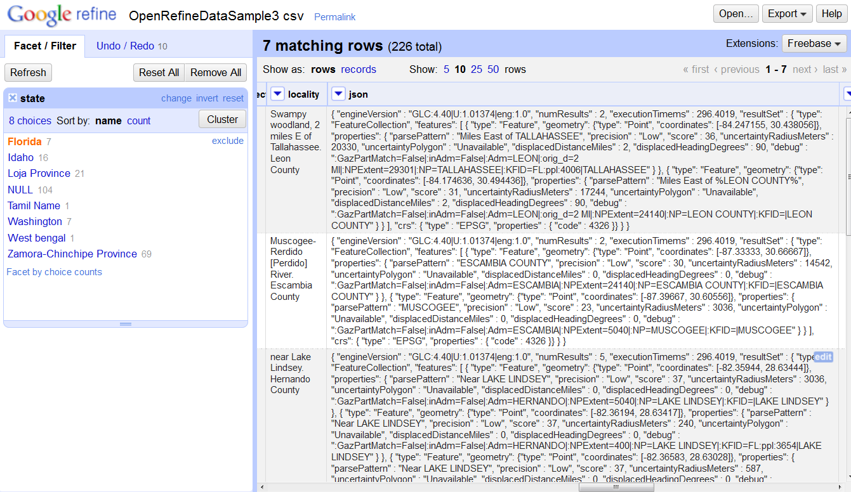
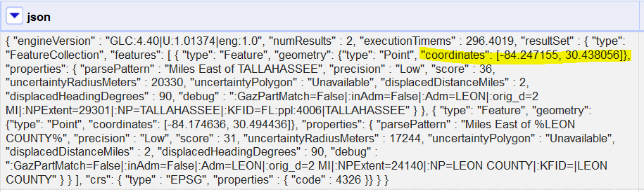
Notes:
Here I’ve cut-and-pasted one json return – and highlighted the coordinates.
Next, learning how to get the coordinates out of this list of elements and objects!

Slide 17
Parsing json
How do we get our longitude and latitude out of the json?
  Parsing (it’s not hard – don’t panic)!
Notes:
Parsing json: this part can seem quite esoteric, but if you walk through it, you will begin to see the logic.
First, try cutting-and-pasting the json output from your openrefine project into a json validator like:
http://jsonformatter.curiousconcept.com/
(see next slide)

Slide 18
Parsing json
Copy and paste the text below into
  http://jsonformatter.curiousconcept.com/
{ "engineVersion" : "GLC:4.40|U:1.01374|eng:1.0", "numResults" : 2, "executionTimems" : 296.4019, "resultSet" : { "type": "FeatureCollection", "features": [ { "type": "Feature", "geometry": {"type": "Point", "coordinates": [-84.247155, 30.438056]}, "properties": { "parsePattern" : "Miles East of TALLAHASSEE", "precision" : "Low", "score" : 36, "uncertaintyRadiusMeters" : 20330, "uncertaintyPolygon" : "Unavailable", "displacedDistanceMiles" : 2, "displacedHeadingDegrees" : 90, "debug" : ":GazPartMatch=False|:inAdm=False|:Adm=LEON|:orig_d=2 MI|:NPExtent=29301|:NP=TALLAHASSEE|:KFID=FL:ppl:4006|TALLAHASSEE" } }, { "type": "Feature", "geometry": {"type": "Point", "coordinates": [-84.174636, 30.494436]}, "properties": { "parsePattern" : "Miles East of %LEON COUNTY%", "precision" : "Low", "score" : 31, "uncertaintyRadiusMeters" : 17244, "uncertaintyPolygon" : "Unavailable", "displacedDistanceMiles" : 2, "displacedHeadingDegrees" : 90, "debug" : ":GazPartMatch=False|:inAdm=False|:Adm=LEON|:orig_d=2 MI|:NPExtent=24140|:NP=LEON COUNTY|:KFID=|LEON COUNTY" } } ], "crs": { "type" : "EPSG", "properties" : { "code" : 4326 }} } }

Slide 19
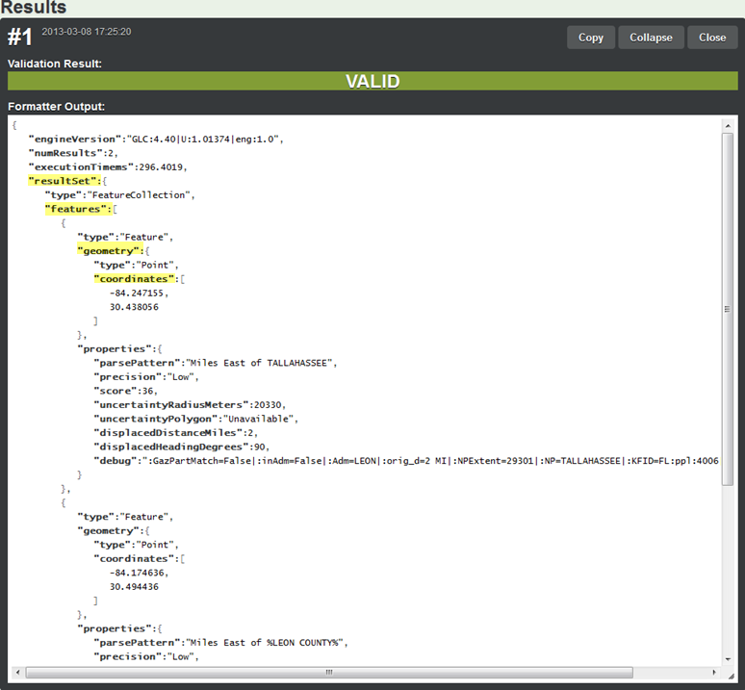
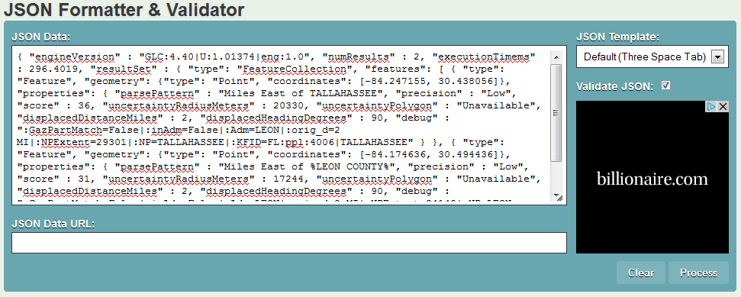
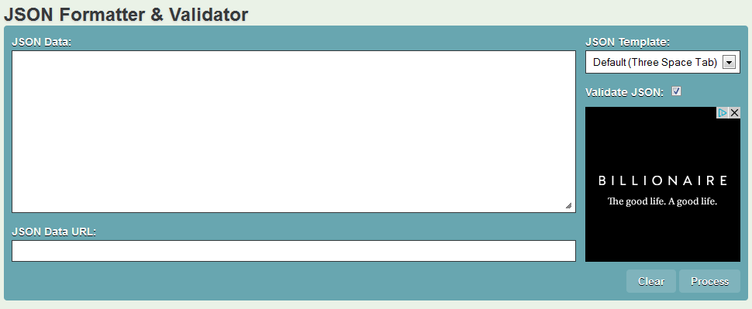
http://jsonformatter.curiousconcept.com/
http://jsonformatter.curiousconcept.com/
Copy json output in the spreadsheet, paste it here.
Click on process button (lower right of this screen).
Notes:
Go to http://jsonformatter.curiousconcept.com/
Paste in the contents of one JSON cell.
Click process.
Note the nice indentations, the json is now “formatted.”
Now we can see each element …that’s each term in quotation marks
and each object …that’s stuff between each set of curly braces
and each array …that’s the stuff between [brackets]
and we see key: value pairs in some of these different areas, …that is a field and an associated value for that field, example: “parsePattern”: “Miles East of TALLAHASSEE”
Follow the instructions in the next slides for how to get the latitude and longitude values out of the json and into their own columns.

Slide 20
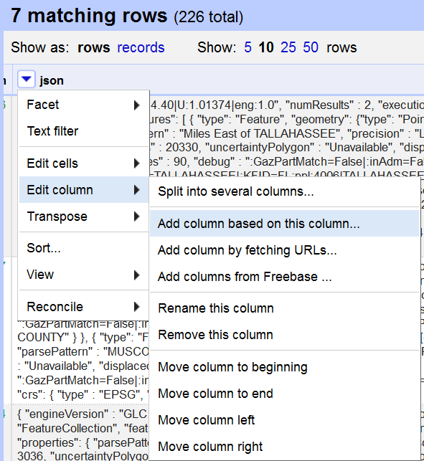
Parsing json
Notes:
In the json column
click edit column > add column based on this column
Now, we are creating a new column, we’ll call latitude
and then learn how to get the latitude coordinate out of the json and into the desired latitude column.

Slide 21
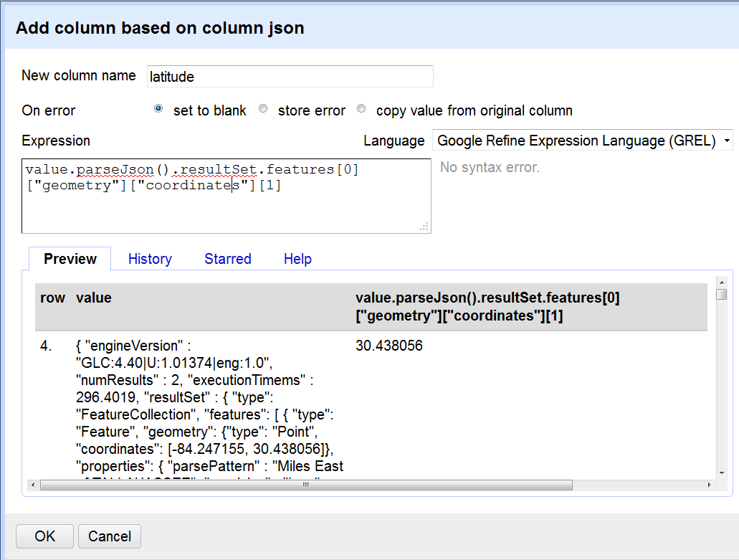
Parsing latitude
Notes:
Name the column latitude
Understanding the expression (you can copy-and-paste for now) that’s in the Expression box takes a few minutes, but is not! hard.
value.parseJson().resultSet.features[0][“geometry”][“coordinates”][1]
value is the contents of the cell (look in the Preview in the above screenshot).
.parseJson() is a “method” or “function” (a great tool someone wrote to help us get what we want from our json output from geolocate).
.resultSet says go to the “resultSet” element
.features says go to the “features” element (nested inside the “resultSet”)
[0] aha, we evidently have an array. In this example there is only one array in the features element – but we must be explicit and tell the program we want to go to the first array.
Weirdly enough, programs often begin counting with ‘zero’ instead of one.
So, we want the “zeroth” array, (the first array) and inside that array we want the
“geometry” element, and inside the “geometry” element we want the
“coordinates” element
There’s an array again, inside the “coordinates” element!
We want the second value, the latitude.
So, we ask for
[“coordinates”][1]
If you get your Expression correct, you’ll see the value you are hoping for on the right hand side of the preview screen.
(see above screen shot).
It will help you to look at slide 19 (and go to the JSON validator http://jsonformatter.curiousconcept.com/ when trying to follow this slide).
Once your Expression is working,
click OK
and you’ll get a new column with your latitude values in it.

Slide 22
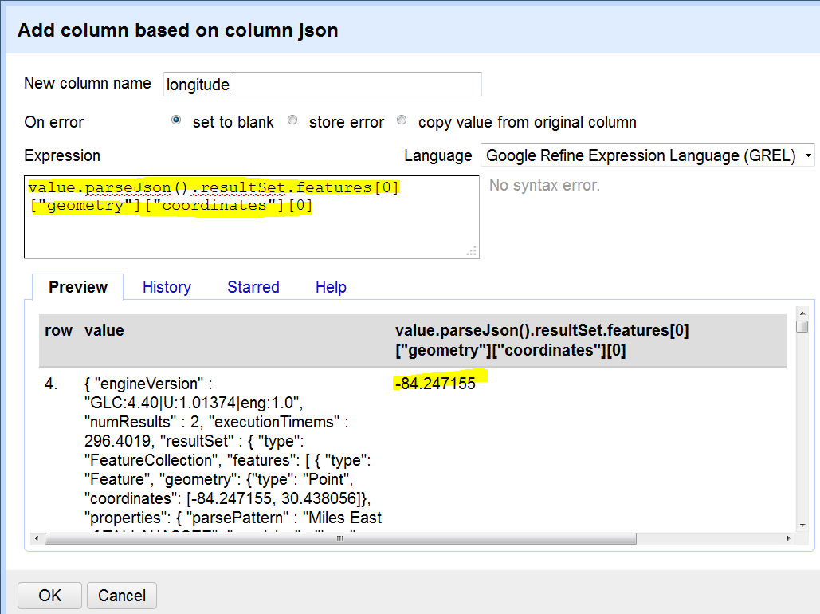
Parsing longitude
Notes:
Now, again from the json column
click edit column > add column based on this column
For New columne name: longitude.
For Expression:
value.parseJson().resultSet.features[0][“geometry”][“coordinates”][0]
This is identical to the previous slide except we now want the “zeroth” or first value in the coordinates array.
click ok
and the longitude column is created and values populated.
Now you’re ready to use another tool to send these values to a map to check them!
Don’t you feel powerful?
It is great to be able to manipulate data this way and add value to your existing data giving you a new way to check the data itself and its integrity.

Slide 23
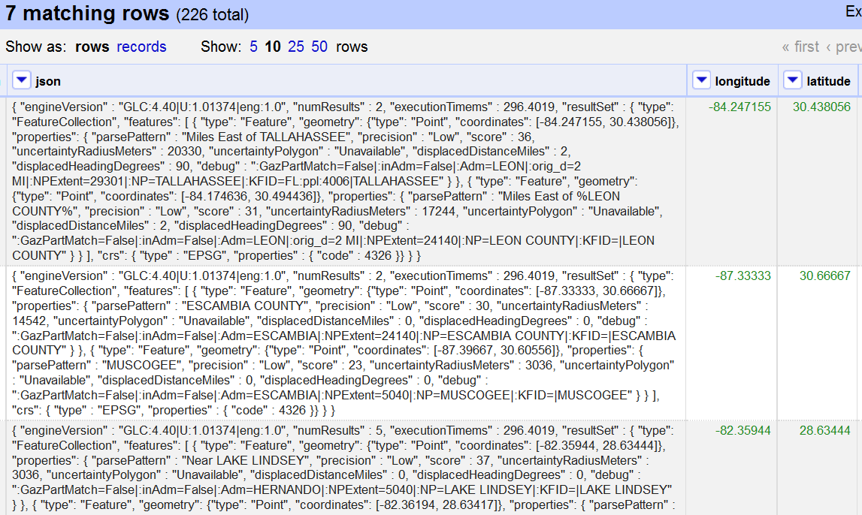
The Results!
Notes:
Here’s what the parsed output looks like in the longitude and latitude columns created.
You can parse out other bits from the json column by editing the
“regular expression” to pluck out the values for various elements.
Good luck, have fun and happy parsing, sorting, faceting, …
Deb.

Slide 24
How to begin?
This powerpoint
  and accompanying CSV
OpenRefine videos and tutorials
Join Google+ Open Refine Community
Google Fusion Tables
Coming soon @ iDigBio from the GWG
Teach others about these power tools
  Pay-it-forward!
  Data that is “fit-for-research-use”
  & fun

Slide 25

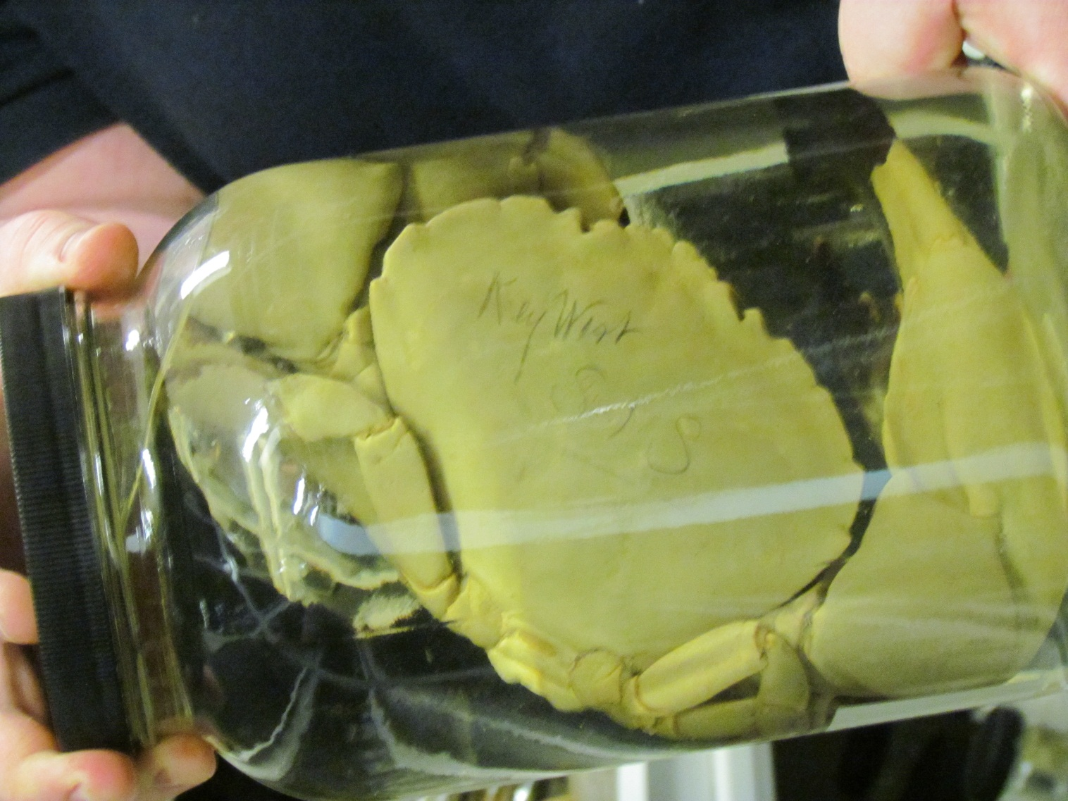





Have fun with the data no matter where you find it!

Slide 26
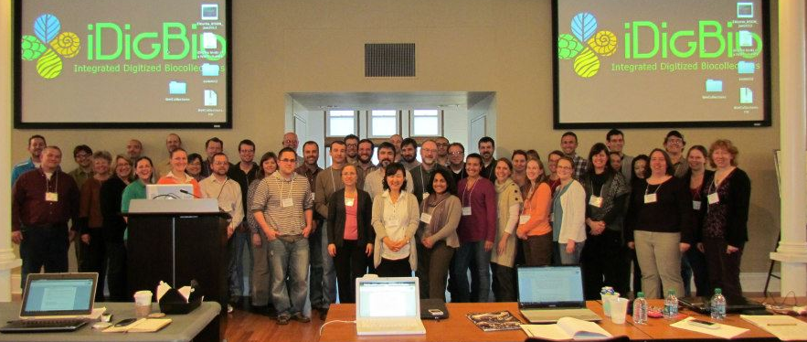
Thanks for coming!
Special thank you to Katja Seltmann, John Wieczorek, Nelson Rios, Guillaume Jimenez, Casey MacLaughlin, and Kevin Love for light and illumination, for teaching, mentoring, and helping me to empower others to get the most and very best out of the data – and have some fun at the same time!
iDigBio is funded by a grant from the National Science Foundation's Advancing Digitization of Biodiversity Collections Program (#EF1115210). Views and opinions expressed are those of the author not necessarily those of the NSF.

