Slide 1
iDigBio’s 2nd Train-the-Trainers Georeferencing Workshop (TTT2)
Participant Introductions: Lightning Talks
Project / Affiliation
What kinds of specimens?
How many specimens / localities?
Who will georeference?
What methods? (crowd-sourcing, automation, etc.)
Original presentations from participants at iDigBio’s 2nd Train-the-Trainers Georeferencing Workshop in August 2013, Gainesville, Florida. Post-processing by Deborah Paul in September 2013. This material is based upon work supported by the National Science Foundation under Cooperative Agreement EF-1115210. Any opinions, findings, and conclusions or recommendations expressed in this material are those of the author(s) and do not necessarily reflect the views of the National Science Foundation.

Slide 2

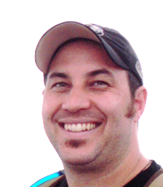
iDigBio Train the Trainers 2013 Ryan Allen Biodiversity Informatics Project Manager
Herbarium over 500,000 specimens.
Colorado Vascular Database 93,000 records.
MaPSTeDI geocoded ~30,000 records (2001-2004) (currently 44,000 geocoded).
Tri-Trophic TCN database 80,000 vascular plants and image 135,000.
Lichen and Bryophyte PEN will image and database 120,000 Lichens and Bryophytes

Slide 3

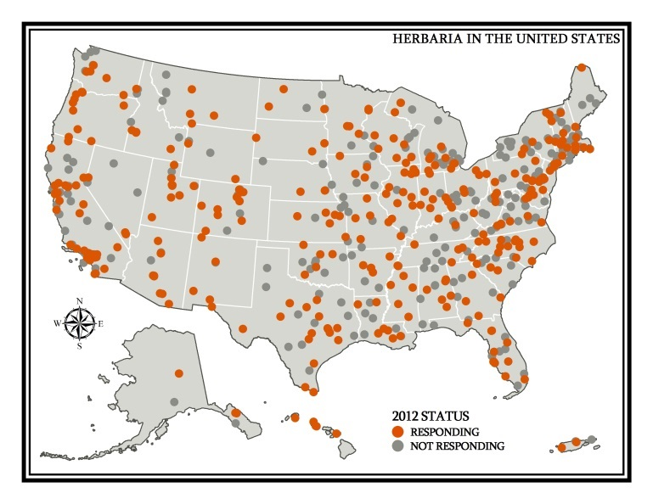
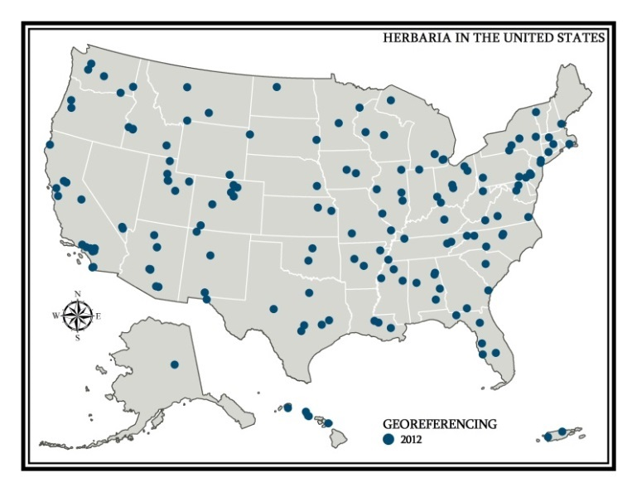
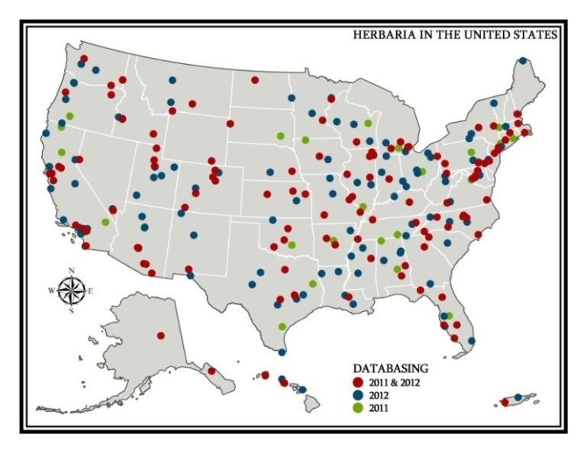
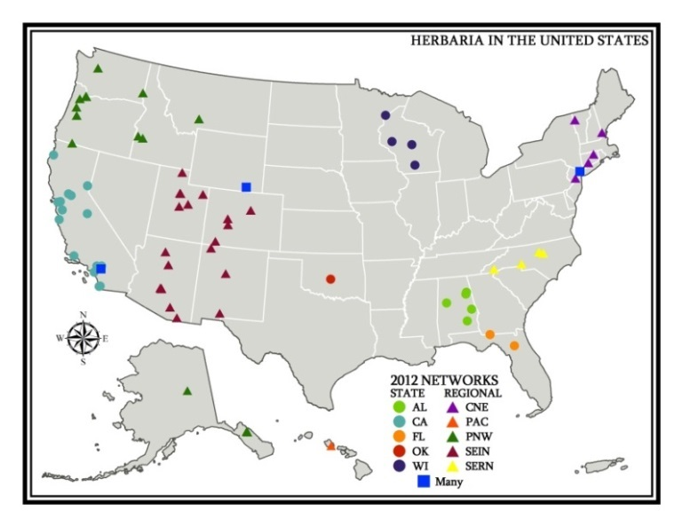
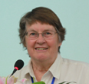
National Network Needed!
More efficient data capture, georeferencing, datacleaning
Contribute cleaner data to iDigBio
Better user experience
Herbaria
Lat/Long
2012
600 - 800 herbaria
~75 million specimens
~15% with lat/long
83 provide local access
71 in regional network
3 taxonomic networks
Mary Barkworth Co-chair USVH
Director, Intermountain
Herbarium
Databasing
Regional Networks

Slide 4

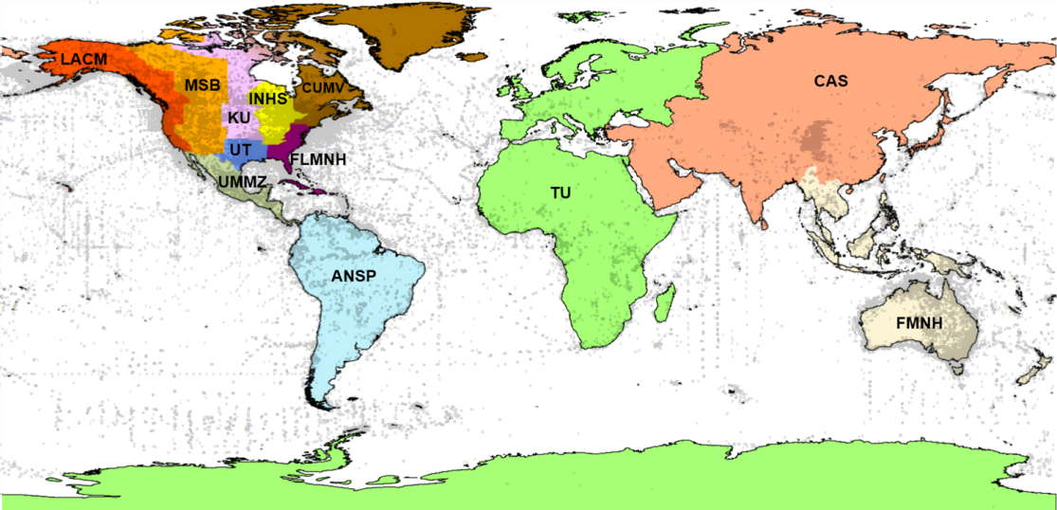
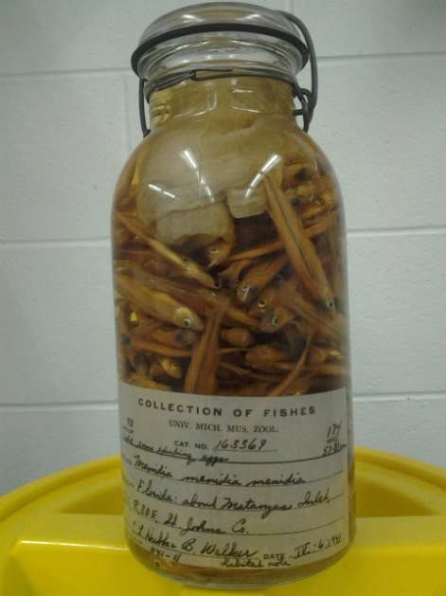

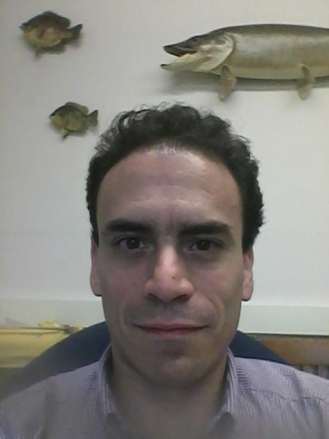
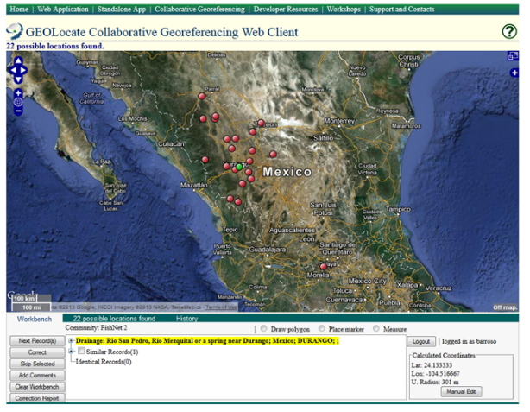
Global network of fish collections
54 data providers
3.3 million lots
30+ million specimens
57% georeferenced
~ 290,000 locality records
Diego Barroso
To Train:
Museum Collection Managers, Staff/Students
(reptiles & amphibians, birds, mollusks, plants)
EEB

Slide 5
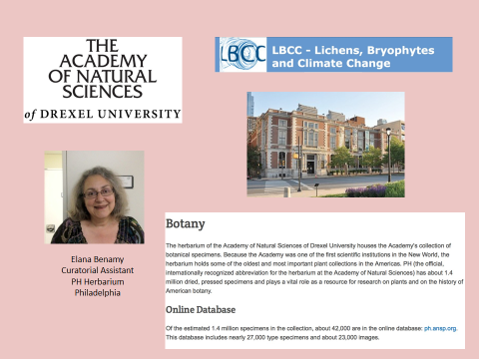

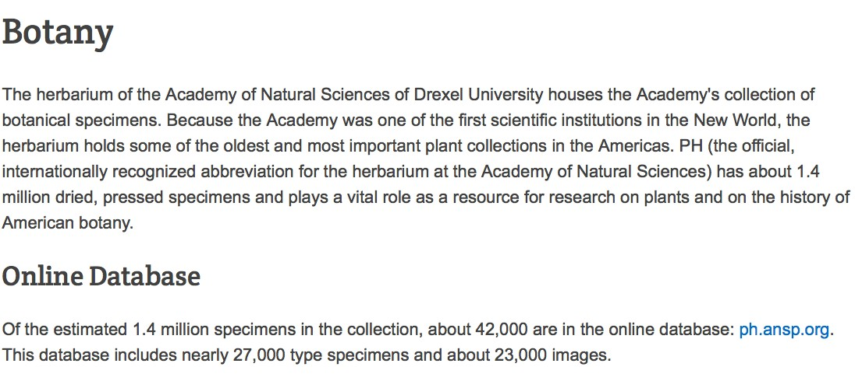
Elana Benamy Curatorial Assistant PH Herbarium Philadelphia

Slide 6
iDigBio Education and Outreach
Cathy Bester: E&O Coordinator
Objective 1: To observe an iDigBio training workshop and consider applications that could be used in planning other education-related workshops
Objective 2: To learn more about georeferencing training and its applications for education and outreach opportunities. Potential applications include utilizing georeferencing/specimen data from the iDigBio portal for use cases in education/curriculum development

Slide 7
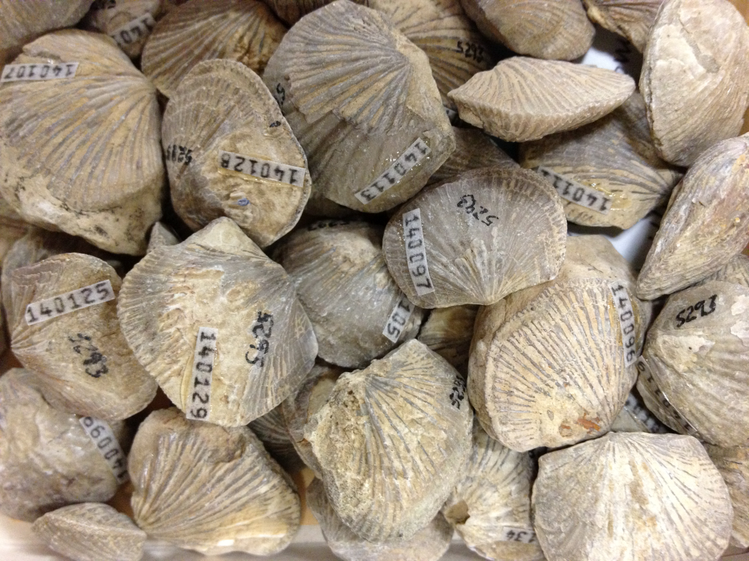
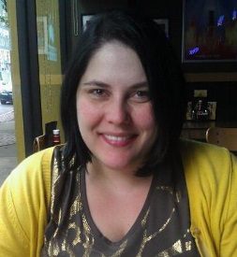



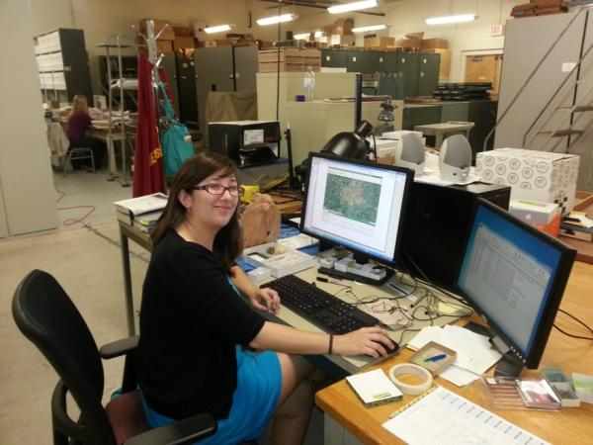
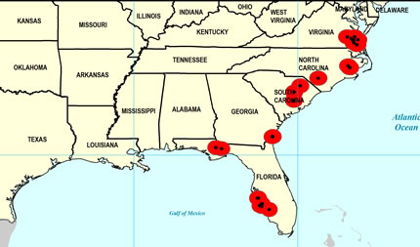
Paleoniches: Digitizing Fossils to Enable
New Syntheses in Biogeography
6 institutions, ~450,000 invertebrate fossil specimens, ~11,500 localities
Ordovician (485-443 Ma) – Cincinnati Region >1,500 localities
Pennsylvanian (323 -289.9 Ma) – Mid-continent ~7,000 localities
Neogene (23 – 2.6 Ma) – Gulf/Atlantic Coastal Plain >3,000 localities
Late Pliocene Ecphora quadricostata
Specify
GEOLocate
Google Earth
Notes:
Michelle Casey

Slide 8
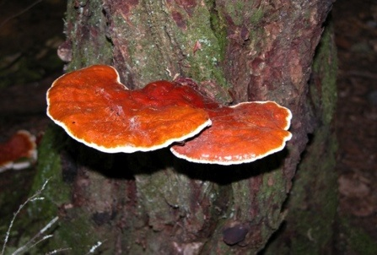
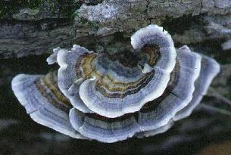
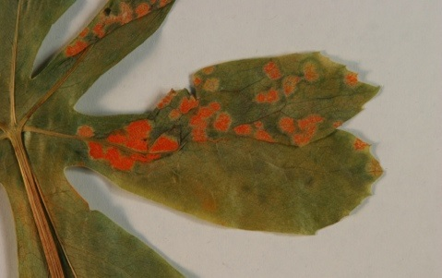
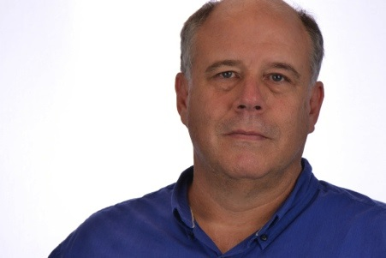
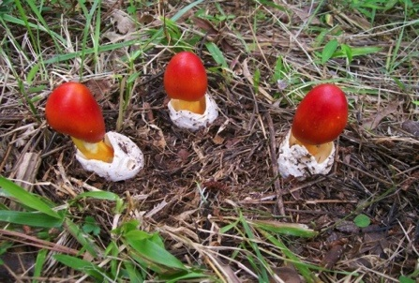
Larry F Grand Mycological Herbarium
DEPARTMENT OF PLANT PATHOLOGY
North Carolina State University
Research and Educational Use of North Carolina State University Mycological Herbarium Through Improved Computerization and Internet Presence & The Macrofungi Collection Consortium
> 8,000 Collections
Fungi (Wood Decay, Plant Pathogens, Jelly, Rust and Smut)
Undergraduate and graduate students, volunteers, high school teachers, staff and faculty
Specimen by specimen and automation
Notes:
Bryan Cody

Slide 9
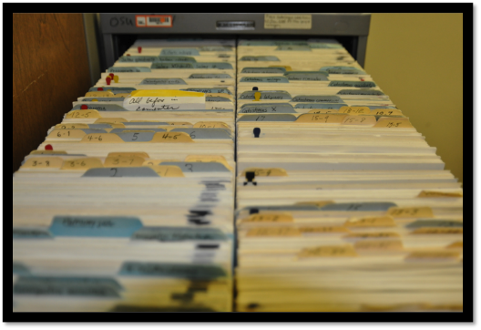
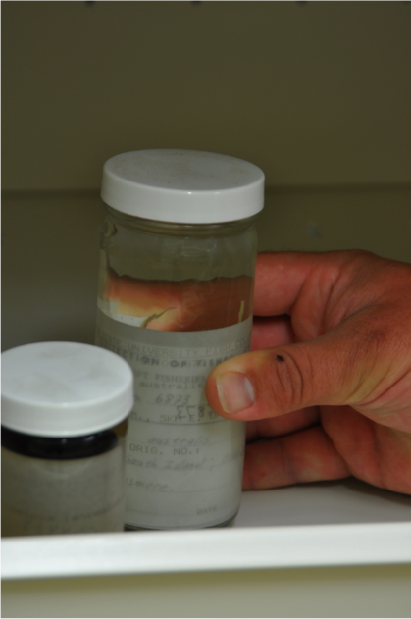
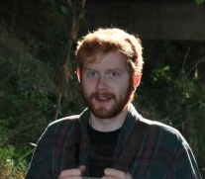
Ben Frable
Oregon State Ichthyology Collection
Georeferencing the Oregon State Ichthyology:
eight decades of backlog and paper records
10000 lots need to be georeferenced and 10000 more might as well!
The other collections have at least, 10000 mammals, 3000 birds
I will train undergraduate workers and volunteers and collection staff and professors in the other collections
We will probably use crowd sourcing

Slide 10
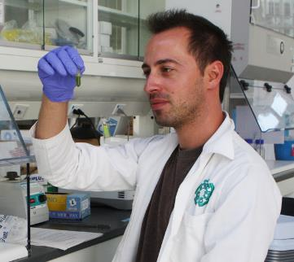


FLORIDA MUSEUM OF NATURAL HISTORY Georeferencing Training Project
Grant Godden
Botany PhD Candidate, Dept. of Biology
FLMNH Molecular Lab (Soltis)
iDigBio RA
30M+ Specimens
Butterflies & Moths, Fishes, Mammals, Mollusks & Marine Invertebrates, Reptiles & Amphibians, Plants
Invertebrate & Vertebrate Paleontology, Paleobotany, & Palynology
FLMNH Faculty, Staff, Students, & Volunteers
GEOLocate (Specify)

Slide 11
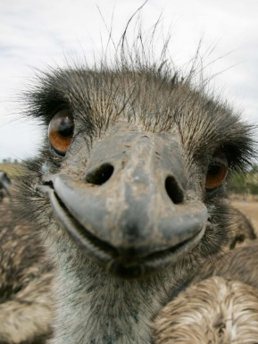


2,562,094 Catalogue records
430,945 Sites
53,184 With co-ordinates
Geo-referencing The Field:
One point at a time!
One collections manager at a time!
Or NOT!
Notes:
Title: “Georeferencing the Field – One point at time, one collection manager at a time or NOT.”
What kind of objects you are georeferencing: Cultural and biological specimens/artifacts (including, botanical, zoological, palaeontological, mineralogical and anthropological).
How many objects are there to be georeferenced: Approx. 2.5 million electronic records. Approx. 380,000 sites.
Whom you will train to do the georeferencing: Collections Managers; GIS students; Natural History interns; Public via crowd-sourcing.
What method(s) you're planning to use for georeferencing: Pre-processing of site data by project/collection staff followed by as many automated batch processes as possible.
Sharon Grant, The Field Museum

Slide 12

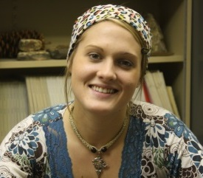
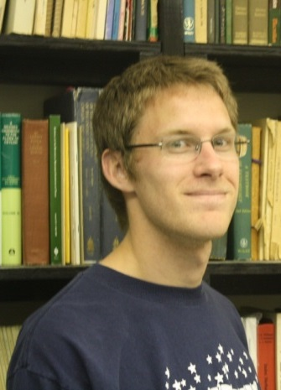
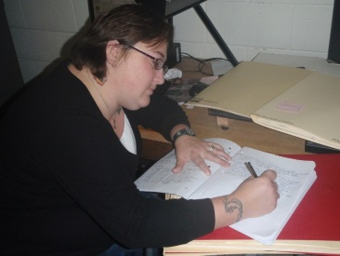
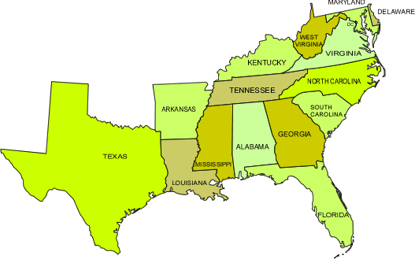
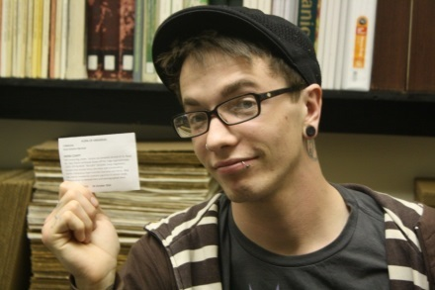

Digitizing the Arkansas State University (STAR) Herbarium
Kari M. Harris
About 20,000 specimens total
17,000 imaged, 1000 databased, 2 geofererenced
The Team:
The Extras:
Mammals, aquatic invertebrates,
fish, herps, birds….
Experiential Learning Fellowship (ELF)

Slide 13

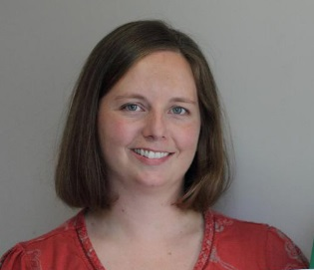
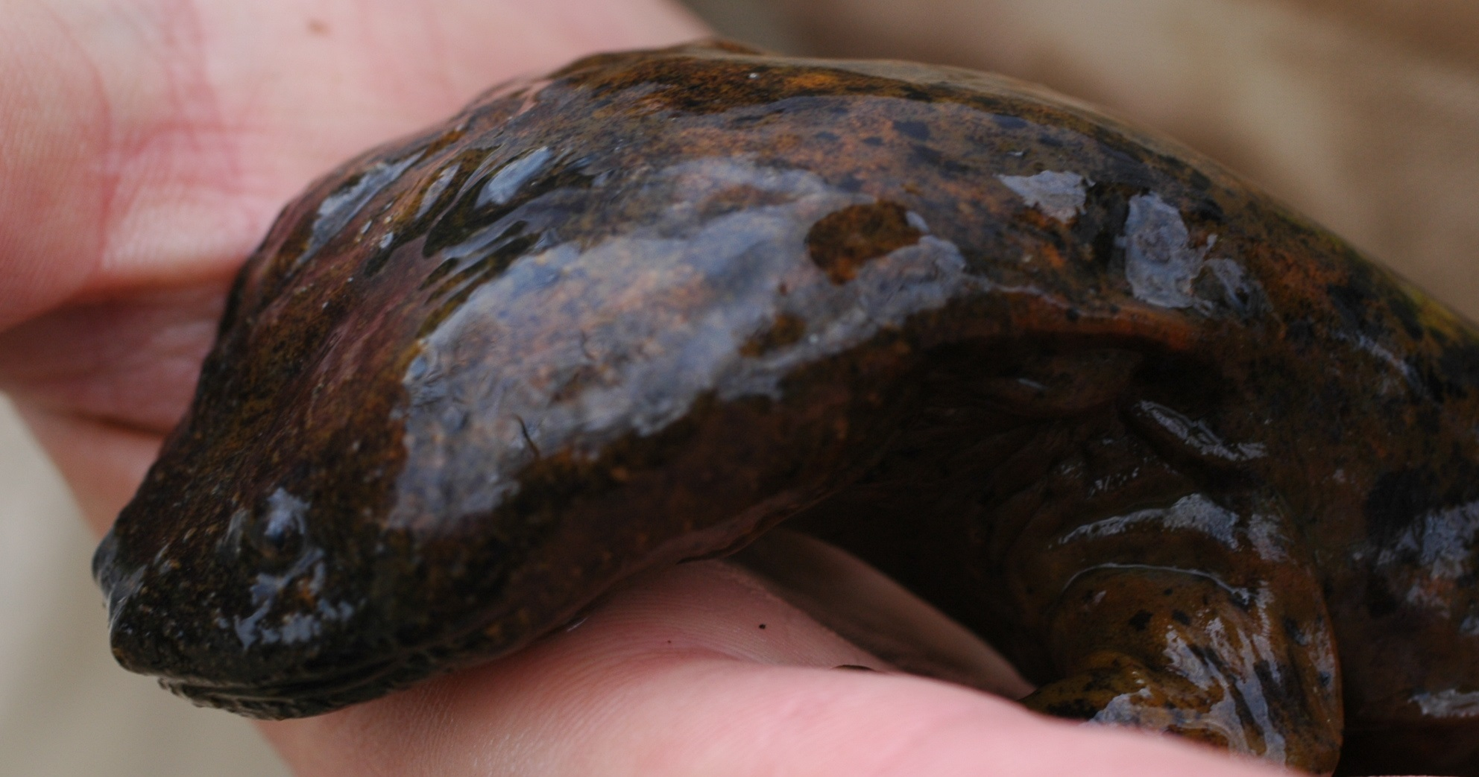
Improving Utility and Accessibility of the APSU
Natural History Collections
Collaborators/Curators: R. Blanton Johansen (Fishes),
L.D. Estes (Herbarium), C.M. Gienger (Herps)
140,000 cataloged specimens (vertebrates and plants) in APSU’s David H. Snyder Museum of Zoology and Herbarium
- Largest herp. and second largest plant collection in TN
- Data contained in several Access databases with limited to no online access
Approx. 50% not georeferenced; others require review/revision
- Generated from GPS, topo maps, and GEOLocate; lack measures of accuracy
- Herps, as single column: 351821N;900355W
Overall Goals:
1. Build single Specify database for collections
2. Georeference all specimens (as possible) and revise existing data for others using best current methods
3. Make database accessible online

Slide 14
Improving Utility and Accessibility of the APSU
Natural History Collections
Collaborators/Curators: R. Blanton Johansen (Fishes),
L.D. Estes (Herbarium), C.M. Gienger (Herps)
Also will provide foundation to improve existing online resources:
- The Atlas of Amphibians in TN; The Atlas of Reptiles in TN
- distributional maps of species currently “hand-made”; static content
- Tennessee Plant Community Website (in prep)
- Interactive mapping of plant communities (e.g., cedar glades in TN), etc.
Training:
- Collection curators (faculty), students assisting in collection management, and agency personnel using collections as a repository
- Lecture series provided to APSU BIO-GIS students in spring

Slide 15
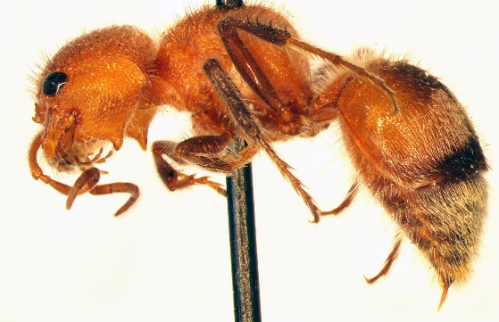
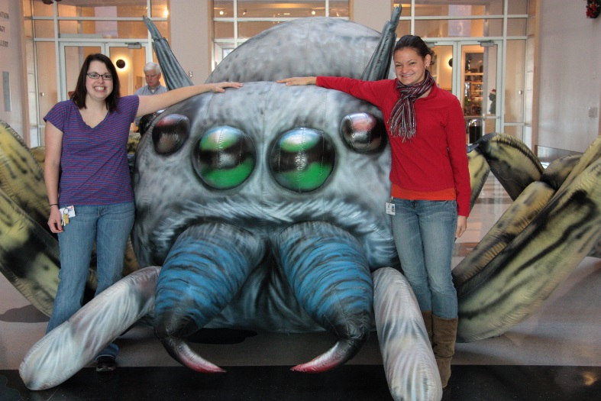
Sam Noble Oklahoma Museum of Natural History
Current Project: Mutillidae of Oklahoma
Specimens to be georeferenced: Historical specimens collected in the 1900s-1940s from our collection; important data points for distribution and ecological studies. Possibly extend to include georeferencing of some of Oklahoma State’s Collection. Project: 2,000 specimens. Total Collection: 500,000+ specimens.
Issues: georeferencing ambiguous localities; old localities
Goals: minimally georeference all our our Mutillidae records; use skills to georeference all of our other historically important material.
Trainees: undergraduate students, graduate students, Collection Manager
Methods: possible crowd-sourcing; digital recourses and software. Incorporate more georeferencing with Citizen Science project on iNaturalist.
Notes:
Katrina Menard

Slide 16
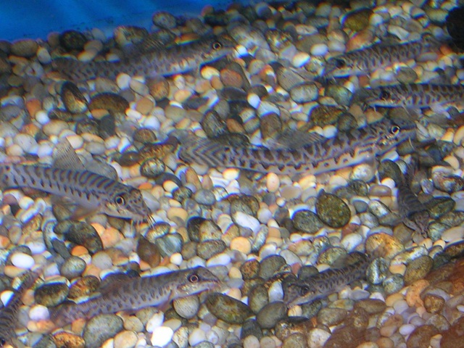
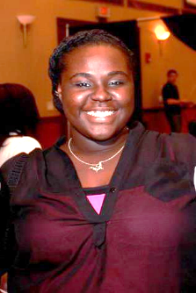
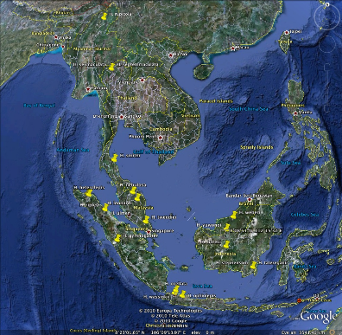
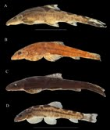
“Geographic variation in the Hillstream Loach”
By: Lunide Orleus
The collection that I am currently Georeferencing are a collection of Loaches (Homoloptera sexmaculata) that were brought over
from different localities and provinces in Thailand.
There are a total of 34 lots in this collection which means over 100 fishes.
UF :13
NIFI : 10
RLIKU: 4
Smithsonian: 3
ANSP: 3
Trainees would most likely be students and/or volunteers
For this project, the methods I use are usually Geolocate, Google Maps, Google Earth, and any other external sites that provide certain
Information on the country and provinces where these loaches are located.

Slide 17
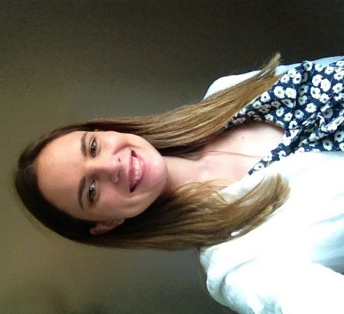
Tri-Trophic Thematic Collection Network
A Tri-Trophic Databasing and Imaging Project
Danielle Pace
American Museum of Natural History

Slide 18
What:
Our TCN focuses on one of the major herbivorous insect clades, the Hemiptera, their host plants, and their parasitoids.
Numbers and Statistics:
About 4 Million specimen records will be made available.
More than 7.8 Million records will be unified.
Total digitized plant bug specimens: 457,553.
Whom we would like to train:
Volunteers do a large majority of the Georeferencing work, however, it is our hope to hold events which would educate the public.
Georeferencing Methods:
Automation
Notes:
34 museums and institutions are working together and pooling their resources to input their various data into the database.
Hemiptera include Aphids, Scales, Hoppers, Cicadas, and true bugs.
Creating a collaborative database to be made available to researchers and other parties.
Information in the database includes pictures of each species, collection event/person, collection locality.
Total plant bug specimen number is by July 11, 2013.

Slide 19

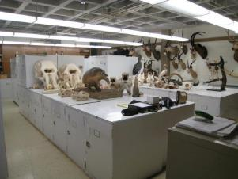
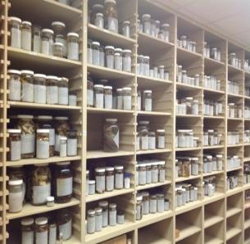
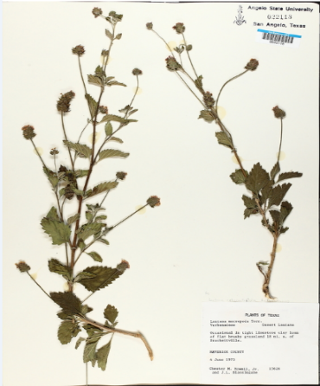
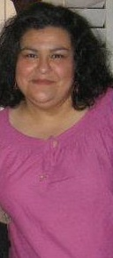



Modernization and Digitization of the Angelo State Natural History Collections
5 COLLECTIONS – 130,000 specimens
(vertebrates, genomics, herbarium)
Grant goals include:
Identify fields for database
Create standards
Data cleaning
Specify database
Georeferencing via Geolocate
Workshop Goals:
Learn new protocols and best practices
Train curators, faculty, students
Workshop at regional meetings
MARCY REVELEZ, COLLECTIONS MANAGER
Angelo State University, San Angelo, Texas
(Member, Texas Tech University System)
National Science Foundation
Collection in Support of Biological Research 2012-2014

Slide 20
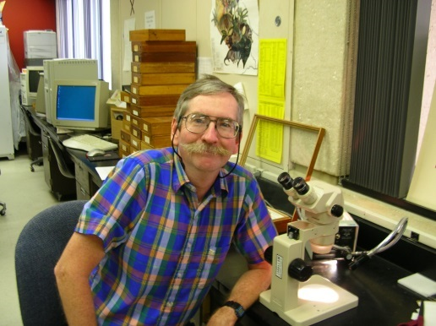
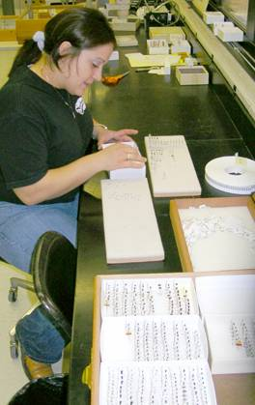

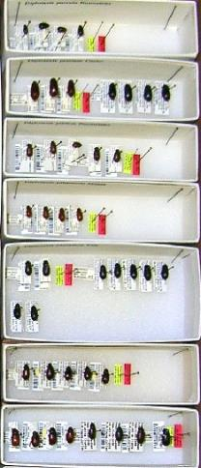
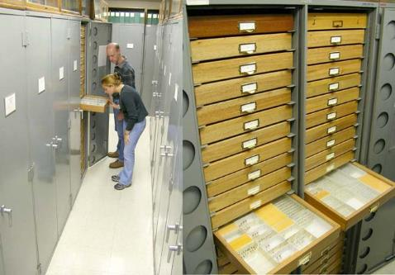
Texas A&M University Insect Collection
Contractor on two TCN Projects:
Tri-Trophic
SCAN (Southwestern Collections
of Arthropods Network)
Edward Riley
Associate Curator
Goal (TAMUIC): Capture for SCAN ca. 140,000 specimen records from pinned collections of ground-dwelling arthropods
Train: technical staff (1 part-time person),
student workers, other “locals” with interest and/or need for georeferencing datasets
Manual georeferencing: locality by
locality through locality table of
in-house database (ca. 80% complete now)
TTTII: 8/12/2013

Slide 21

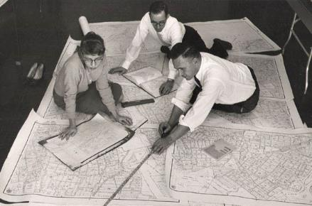
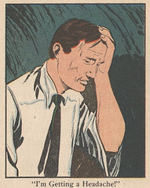


PROJECT: Georeferencing NYSM specimen and artifact localities
HOW MANY OBJECTS: a whole bunch …
department | collection | #objects / lots | #sites | #georef _sites
anthropology | Archaeology & Ethnology | 284,204 | 4,444
biology | Herpetology | 6,255 | 2,235
 | Malacology | 4,458 | 1,040
 | Mammalogy | 14,025 | 2,907 | 2,869
 | Ornithology | 12,634 | 4,258 | 1,981
 | Ichthyology | 72,872 | 20,935 | 10,000
botany | Bryophytes | 31,066 | 30,322
 | Fungi | 8,479 | 2,229
 | Lichens | 8,922 | 2,681
 | Vascular Plants | 33,369 | 18,000
geology | Mineralogy | 23,238 | 7,061
 | Paleontology | 19,070 | 3,266
 | Vertebrate Paleontology | 15,917 | 82
 |  | 534,509 | 99,460 | 14,850
NYS Education Department
Albany, NY
TRAINEES: Staff, Volunteers, Interns, Students or The Legion of Superheros……………..if available
METHODS: open to suggestions……….
Ellen Stevens
Collections Information Manager / Museum Scientist

Slide 22










Entomology Database snapshot:
> 1 million specimen records
> 30,000 Localities (37% georeferenced)
> 80,000 Collecting Events
Current digitization projects:
A specimen-level database of the world’s bees (Apoidea) at the University of Kansas: BRC
Tri-Trophic Associations: TCN
Invertnet: TCN
Who?
10 – 12 undergraduate students per semester
2-3 graduate students per semester
Crowd-sourced volunteers???
2 collection managers
How?
The slow old fashion way using a combo of techniques (google maps, google earth, fuzzy gazateer, geolocate, geonames-USGS, earth-info, etc)
Collaborative georeferencing with Geolocate?
Crowd sourcing via ALA or NFN?

Slide 23





Slide 24


Macroalgal Herbarium Consortium
Hannah Traggis

Slide 25

To Provide data to enable biodiversity research
Primary Digitization Center (PDC) for Northeast
49 herbaria across the country
1.2 million specimens collected across the globe over past 150 yrs
Georeference using GeoLocate to provide locality information for each speciment

Slide 26


Slide 27







Project Magnolia grandiFLORA
www.mississippiplants.org
Lisa Wallace
Lucile McCook
Mac Alford
Heather Sullivan
Nina Baghai-Riding
Digitizing collections from Mississippi herbaria
~250,000 specimens – primarily vascular plants
~90% of these specimens are not georeferenced
Training
PI’s on the project
Student workers (undergrads and grads)
Other collections – entomology, geology, MMNS
Workflow
Management of the collective portal – SilverBiology
Imaging – SilverImage
Label databases – Specify, FileMaker Pro, others
Georeferencing – GEOLocate; sourcing records by geography for editing
Funded by

Slide 28


FSU Robert K Godfrey Herbarium
We use human reasoning in concert with a set of online georeferencing tools.
Lawrence Weru
Senior at Florida State University studying art and biology. The herbarium uses GEOlocate for Georeferencing.
I will be training students and perhaps volunteers.
I will also be programming a web-based phenology map visualizer. Go ‘Noles.

Slide 29
iDigBio’s 2nd Train-the-Trainers Georeferencing Workshop (TTT2)
End of Participant Introductions
Original presentations from participants at iDigBio’s 2nd Train-the-Trainers Georeferencing Workshop in August 2013, Gainesville, Florida. Post-processing by Deborah Paul in September 2013. This material is based upon work supported by the National Science Foundation under Cooperative Agreement EF-1115210. Any opinions, findings, and conclusions or recommendations expressed in this material are those of the author(s) and do not necessarily reflect the views of the National Science Foundation.
Notes:
Centered
Text reduced in font / changed wording
Removed logos

