Slide 1
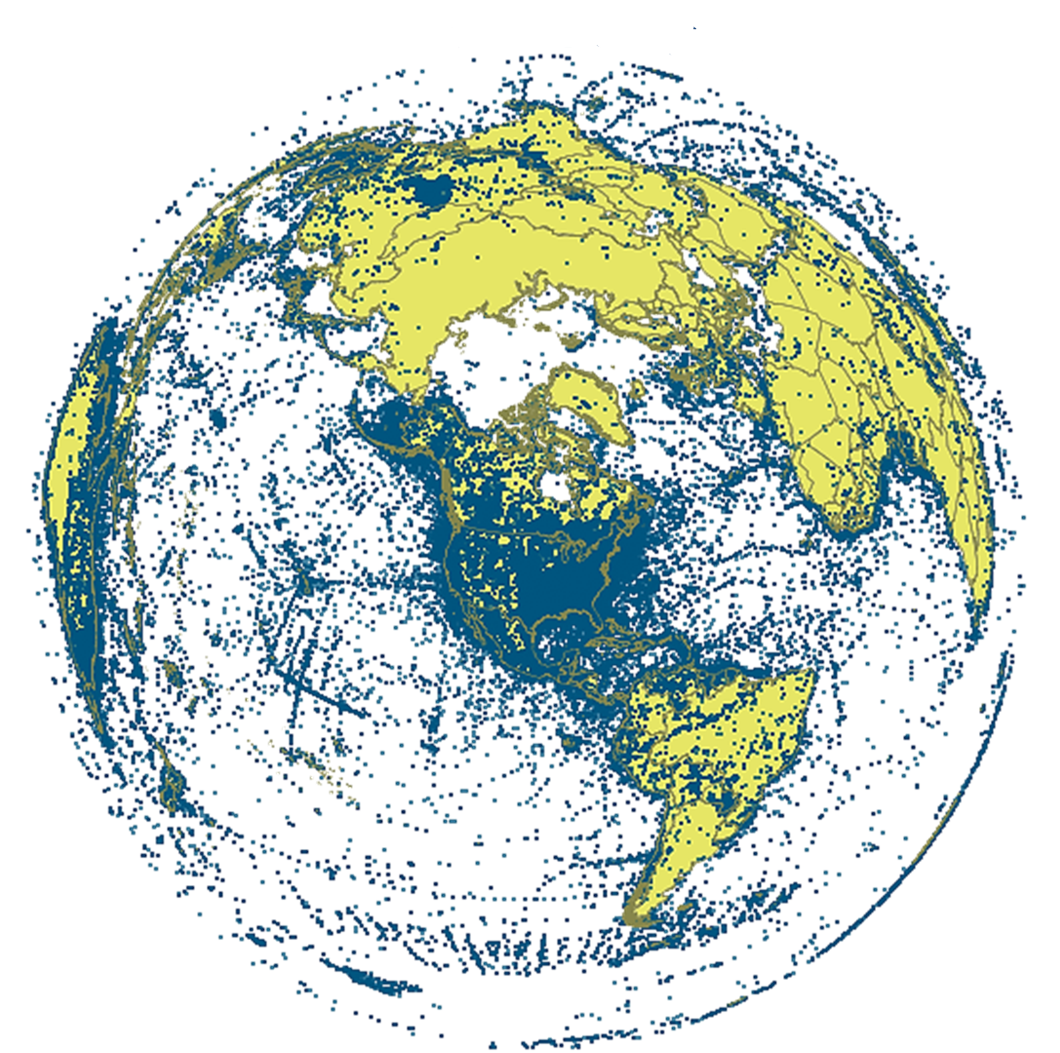
FishNet Workflow for Large Scale Collaborative Georeferencing
Nelson Rios
nrios@tulane.edu
iDigBio Train the Trainers 2 Georeferencing Workshop Gainesville, FL 12-16, Aug 2013

Slide 2
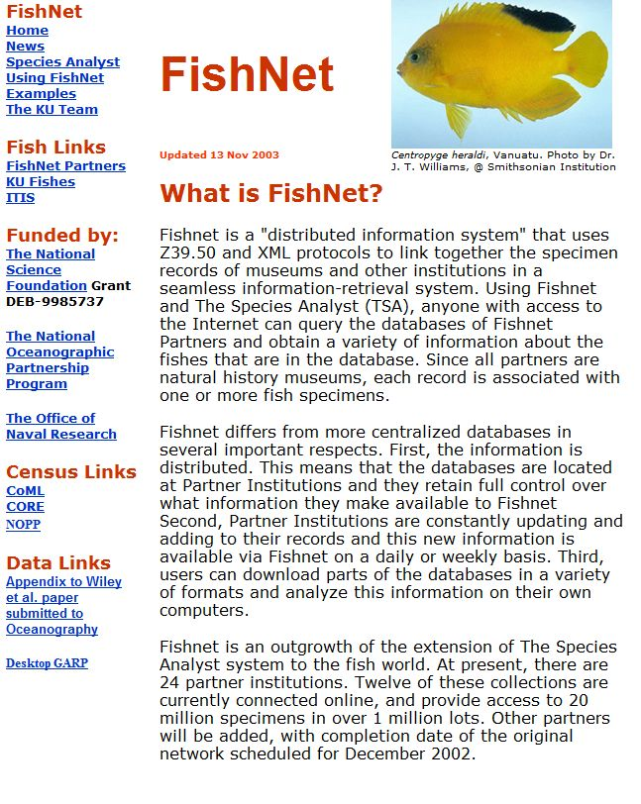
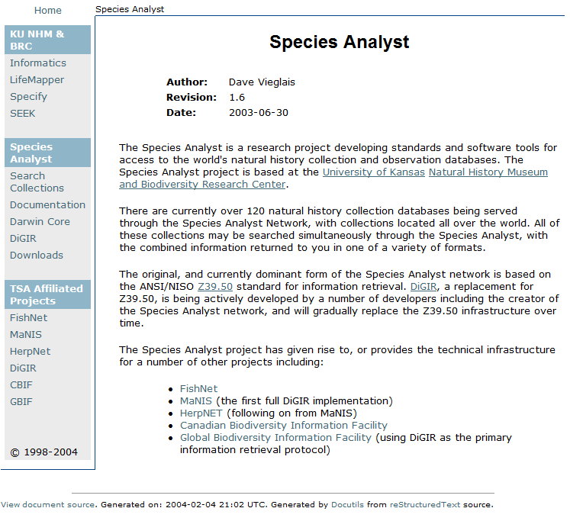
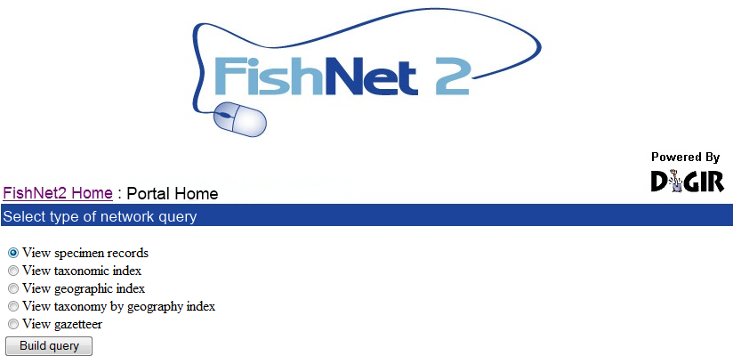
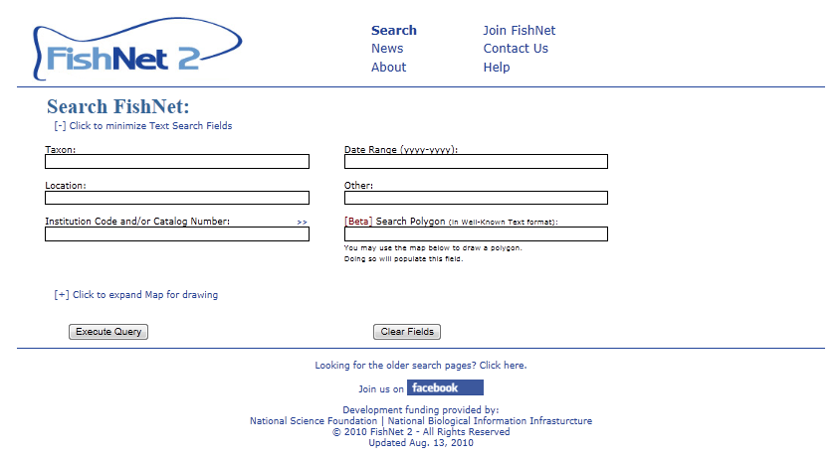
History
1999: Creation of original FishNet Network
Z39.50 protocol for sharing data
Search via Species Analyst (distributed query model)
2005: FishNet 2 created
Transition to DiGIR Protocol
Search via DiGIR Portal (distributed query model)
2010: FishNet 2 (centralized query model)
Harvesting of DiGIR, DwCA, IPT, Static Spreadsheets
Search via FishNet 2 Portal (centralized query model)
2012-2016: Portal & data expansion and enhancement

Slide 3
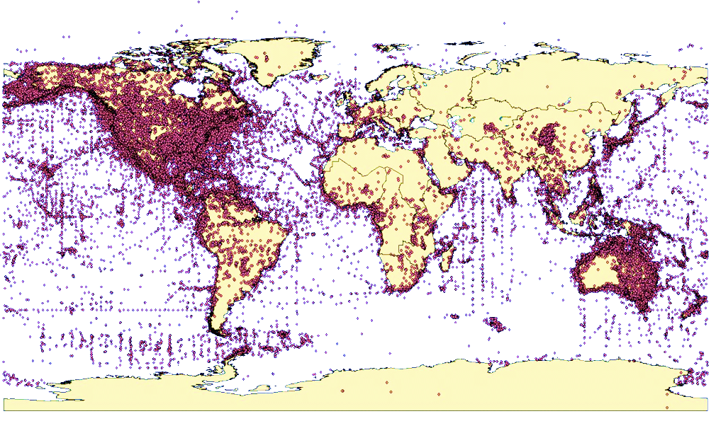
Global network of fish collections
71 data providers
3.7 million lots
35+ million specimens
57% georeferenced

Slide 4
Current Activity
To expand the number of records within FishNet to approximately 4 million lots representing over 30 million specimens
To georeference all "georeferencable" records lacking geographic coordinates
To repatriate results to source data providers
321,102 collecting events representing 1,568,695 specimen lots have been identified for georeferencing from FishNet2

Slide 5
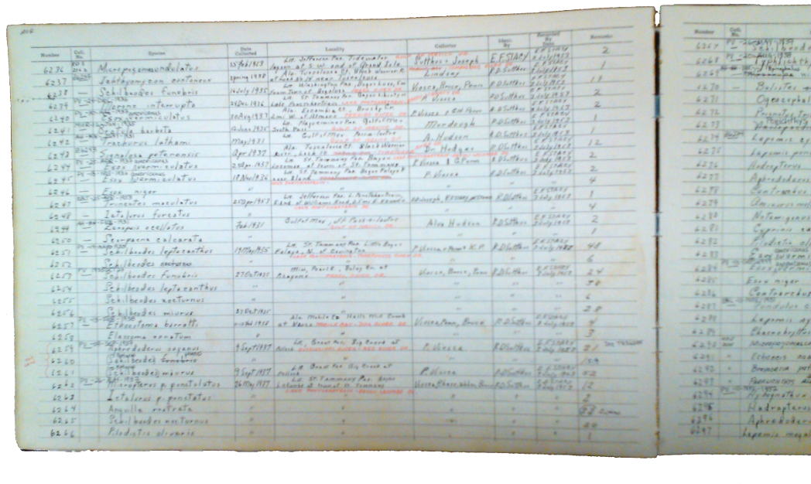
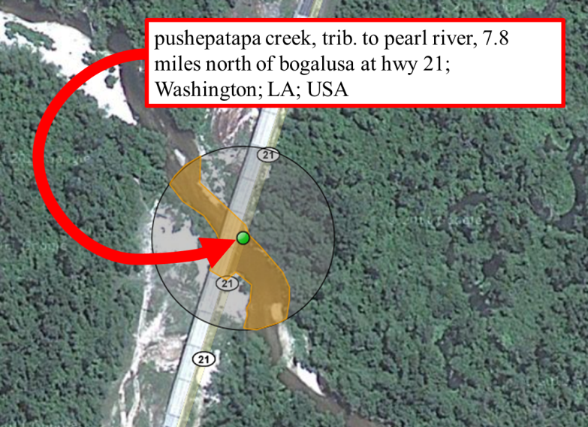
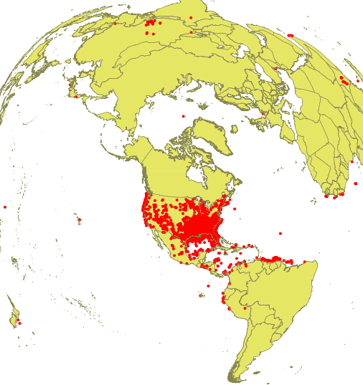
Georeferencing FishNet
250,000 collecting events
18 months
12 technicians
5+ volunteers
GEOLocate
Collaborative

Slide 6
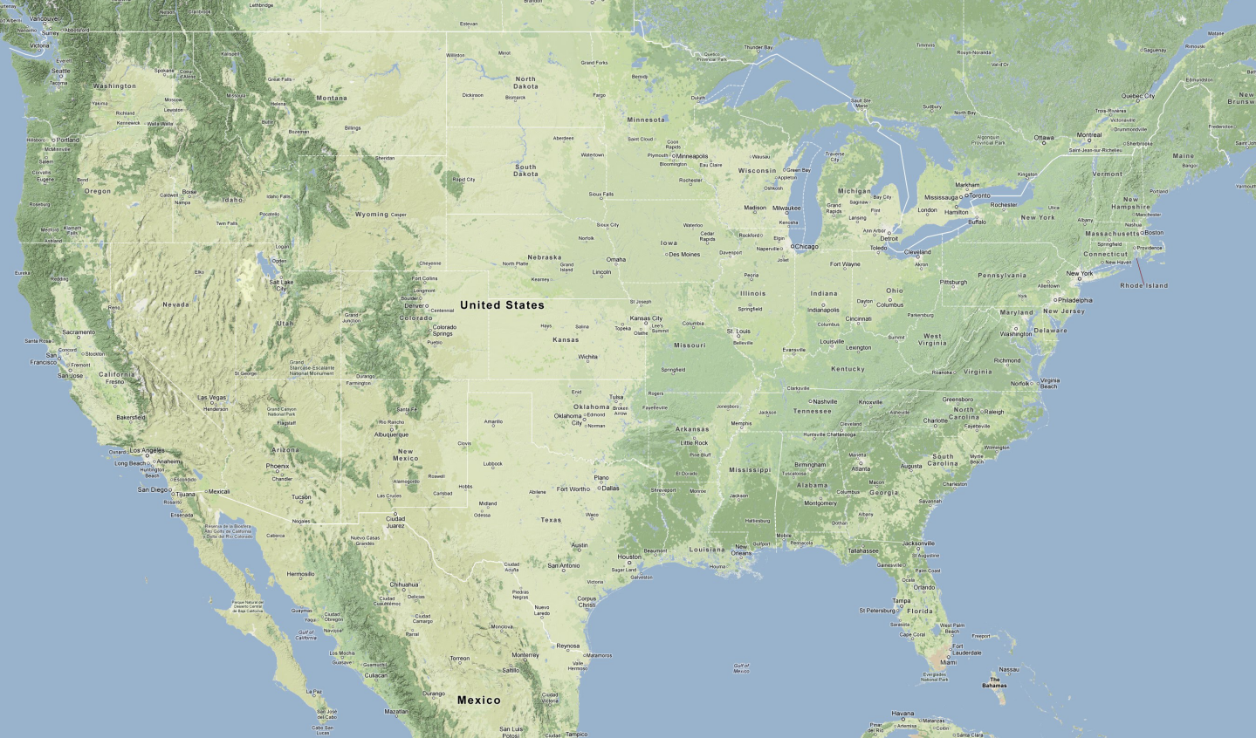
The Dirty Dozen

Slide 7
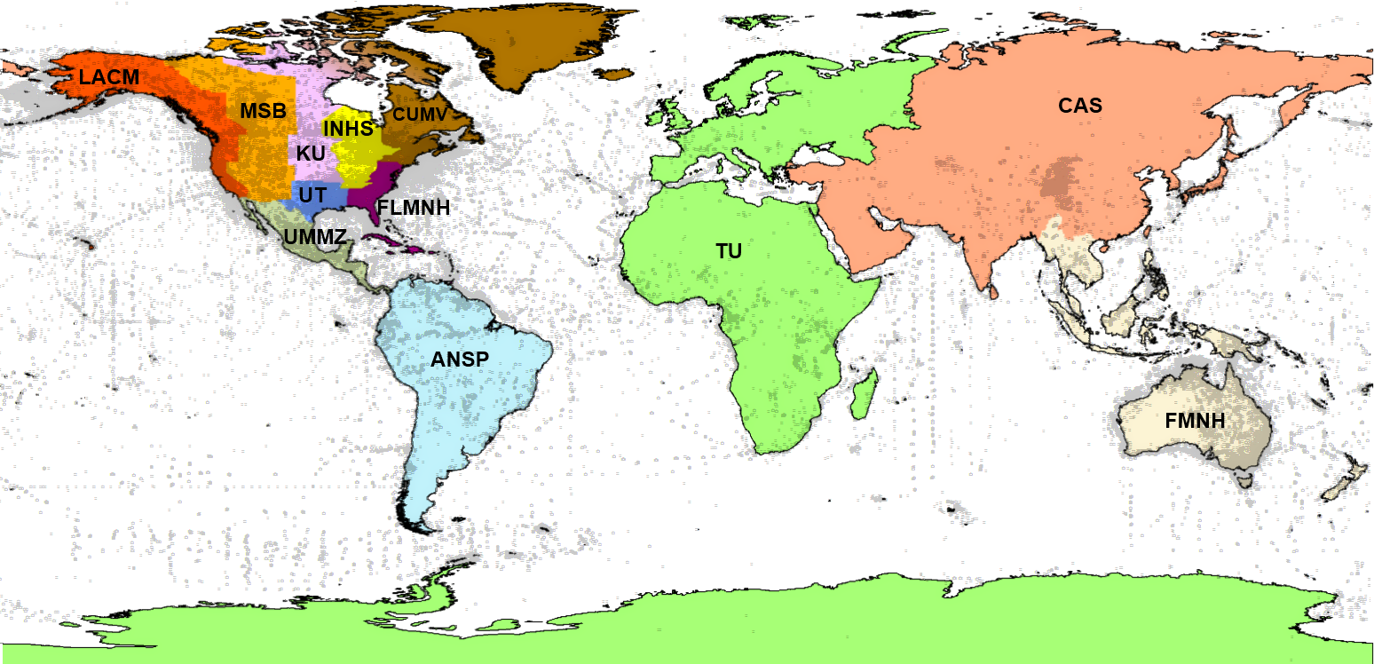
Preliminary Assignments

Slide 8
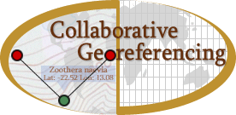
Leveraging Existing Technology and Expertise

Slide 9
Workflow: Integrating API’s
clean data, add to locality gazetteer & match against locality gazetteer
pre-georeference, assess verification difficulty, identify problematic records
produce datasets for CoGe based on institution and anticipated difficulty of verification
Assign workloads by institution, difficulty & region
repatriate
final review of results
verify, correct & annotate
data providers
http://geolocate.fishnet2.net/workflow.html

Slide 10
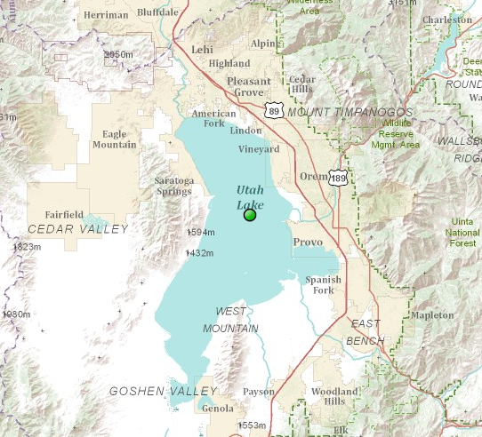
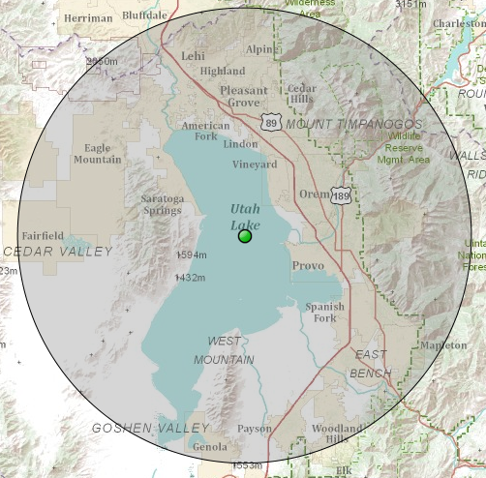
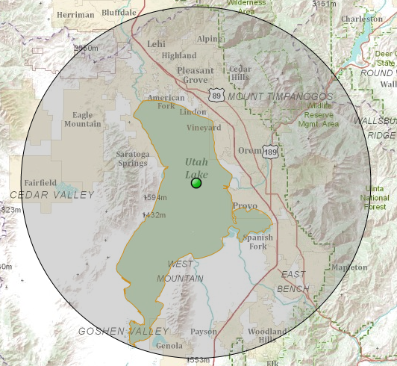
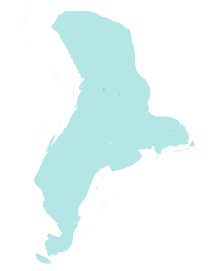
Measuring Uncertainty
Point
Point
Radius
Point
Radius
Polygon

Slide 11
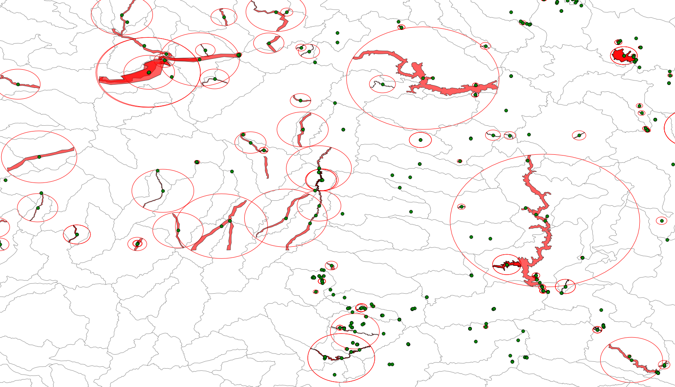
Georeferencing Output
Base Map - 1:2M 8-Digit HUCs

Slide 12
11 January - 12 June 2013 Stats
90,301 total locality verifications
6,009 verifications were re-evaluations
73,639 corrected
36,549 associated with polygons
10,653 skipped
Total: 84,292 localities “completed”

Slide 13
Georeferencing Efficiency
excluding volunteer data
11 January – 12 June 2013

Slide 14
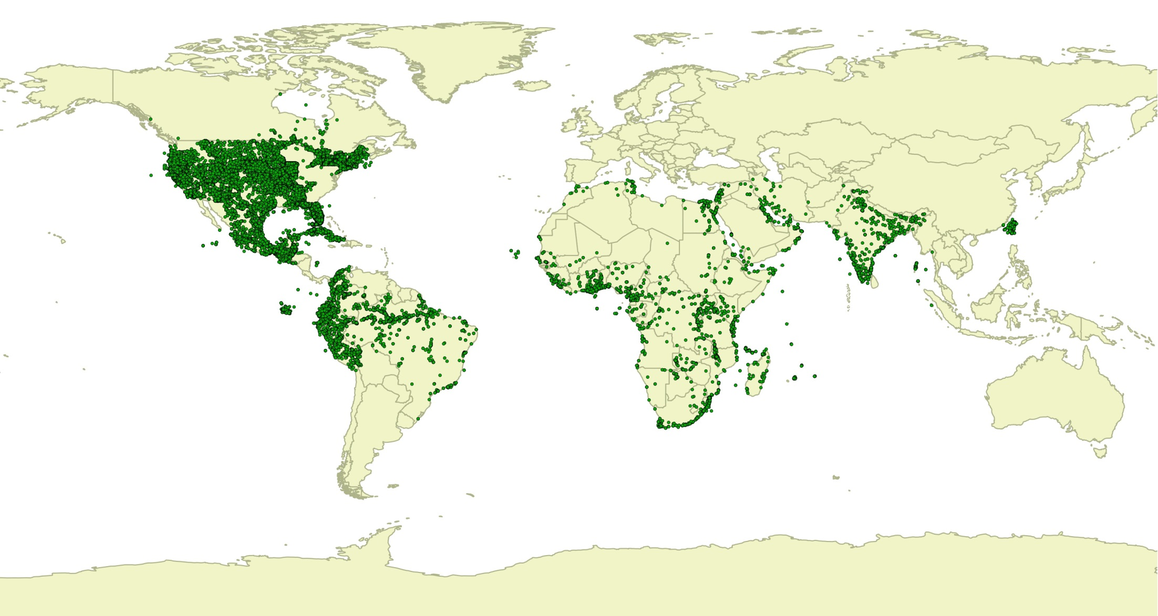
Georeferencing Status
366K Specimens / 84K Localities / 6 Months
11 January – 12 June 2013

