Slide 1
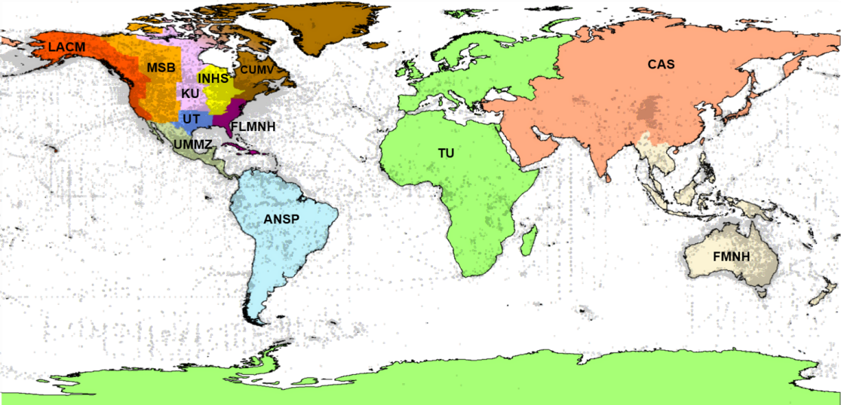
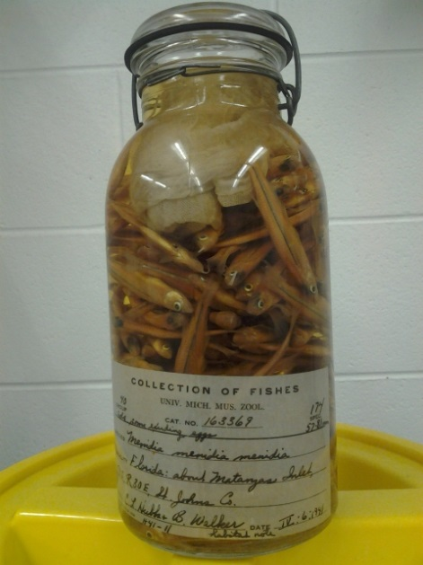
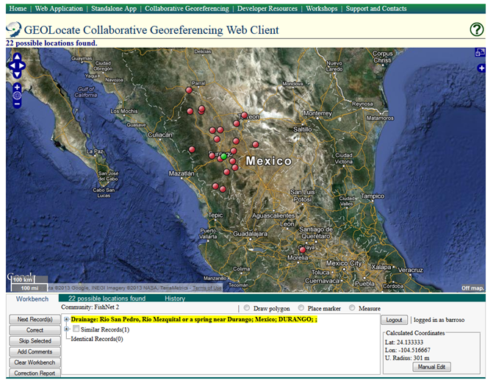
Global network of fish collections
54 data providers
3.3 million lots
30+ million specimens
57% georeferenced
~ 290,000 locality records
Diego Barroso
To Train:
Museum Collection Managers, Staff/Students
(reptiles & amphibians, birds, mollusks, plants)
EEB

