Slide 1
Digitizing Collections of the Angelo State Natural History Collections
Marcia A. Revelez
Collections Manager
Angelo State University

Slide 2
Export Data
Mammals
Birds
Reptiles & Amphibians
Tissues
Plans
Data Standards
Data Cleaning
Quality Check
Georeference
Export into Geolocate
Problem Localities
Quality Check
Georeferencing
Quality Check
Data capture: specimen tags, field notes
Education Modules
Inventory
Import into Specify
VertNet, GBIF, iDigBio

Slide 3
Quality Check
Export Data
Data Capture
Data Standards
Imaging
Data Cleaning
Bare Bones
Quality Check
Georeference
Export into Geolocate
Problem Localities
Quality Check
Georeferencing
Quality Check
Data capture: specimen tags, field notes
Education Modules
Inventory
Import into Specify
VertNet, GBIF, iDigBio

Slide 4
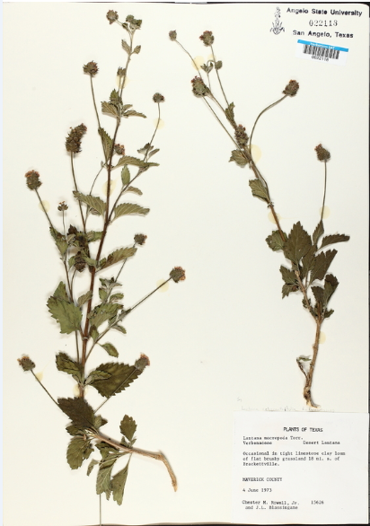
Quality Check
HERBARIUM
Data Capture
Imaging
70,000 specimes
½ databased
Bare Bones
VERBATIM LOCALITY:
Category used to capture the locality in the original format and spelling used on the original specimen tag.
INCLUDE UPPER GEOGRAPHY

Slide 5
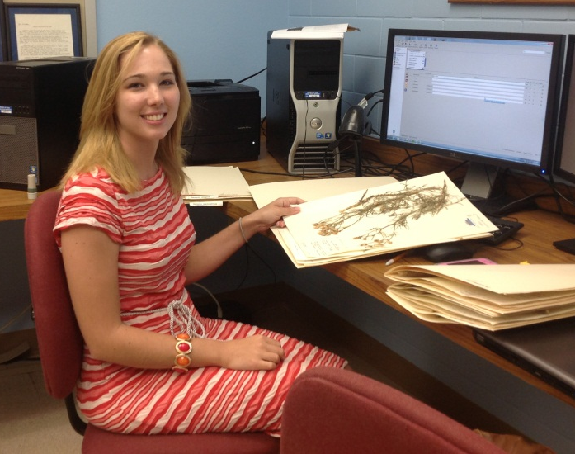
VERBATIM LOCALITY:
Terrell Co: Texas Nature Conservancy Preserve Chandler Ranch Independence Creek. Mouth of Independence Creek at Pecos River. Approximately 30 miles south of Sheffield, TX, 30 27' N 101 43' W. Above Independence creek in live oak grove and upper elevations on slope above live oak grove.

Slide 6
Quality Check
Export Data
Data Capture
Data Standards
Imaging
Data Cleaning
Bare Bones
DATA STANDARDS
Institutional Data – catalog number, special numbers, accession numbers, etc.
Taxonomic Data
Locality Data – Continent, Country, State/Province, Verbatim Locality, Locality, etc.
Specimen Data – Preparation type, Prep number, Collector, Reproductive Data, Measurements, etc.

Slide 7
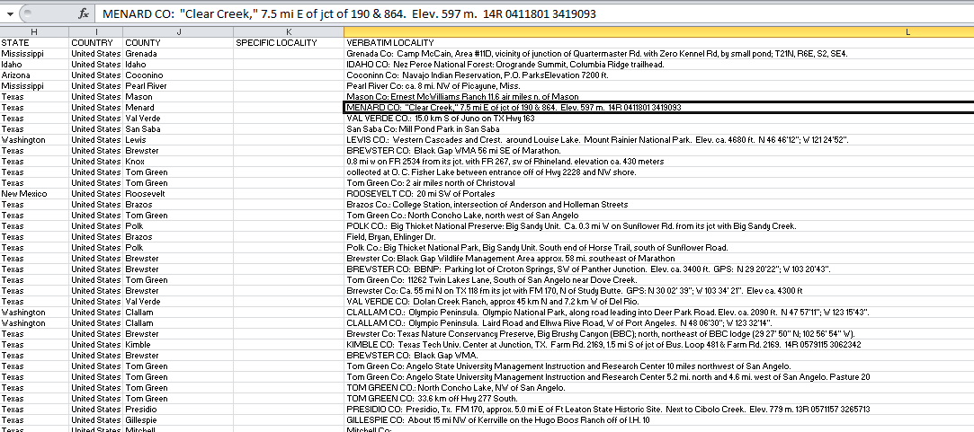
LOCALITY:
Category applies to the entire standardized record of the most specific designation of the collecting locality.
Distance N or S (first)
Distance E or W (second)
Reference point (township)
Secondary reference point (park, ranch, WMA, etc.)
Additional descriptions (pasture, rock face, etc.)
Additionally:
Standardized abbreviations (ex. north = N)
Periods (.) removed after abbreviations
Fractions converted
Leading zeroes added when appropriate (ex. .8 to 0.8)

Slide 8
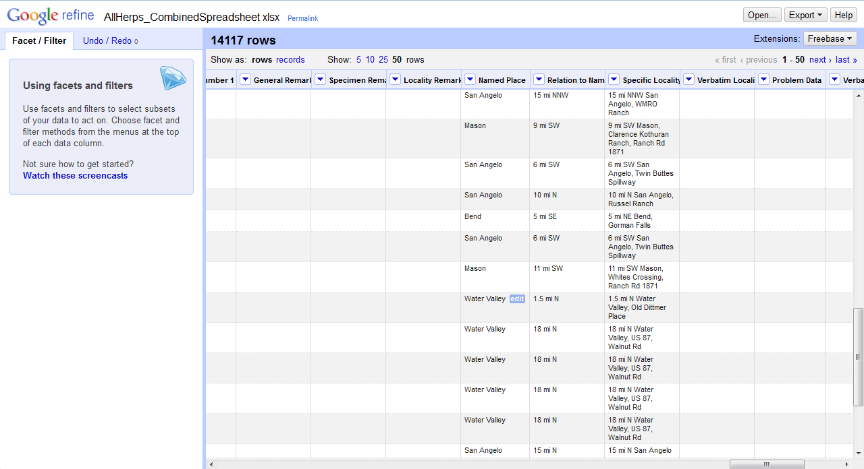
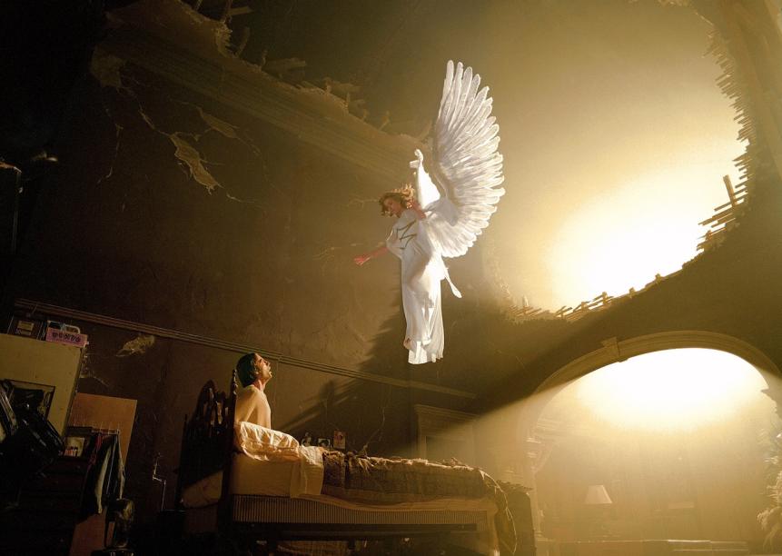
MARCY’S NEW FAVORITE TOY
Deb

Slide 9
VERBATIM LOCALITY:
Terrell Co: Texas Nature Conservancy Preserve Chandler Ranch Independence Creek. Mouth of Independence Creek at Pecos River. Approximately 30 miles south of Sheffield, TX, 30 27' N 101 43' W. Above Independence creek in live oak grove and upper elevations on slope above live oak grove.
LOCALITY:
Approx 30 mi S Sheffield, Texas Nature Conservancy Preserve, Chandler Ranch, Independence Creek; mouth of Independence Creek at Pecos River; above Independence creek in live oak grove and upper elevations on slope above live oak grove

Slide 10
Quality Check
Export Data
Data Capture
Data Standards
Imaging
Data Cleaning
Bare Bones
Quality Check
Georeference
Export into Geolocate
Problem Localities
Quality Check
Georeferencing
Quality Check
Data capture: specimen tags, field notes
Education Modules
Inventory
Import into Specify
VertNet, GBIF, iDigBio

Slide 11
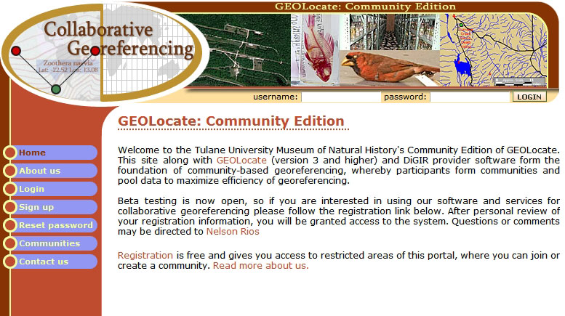
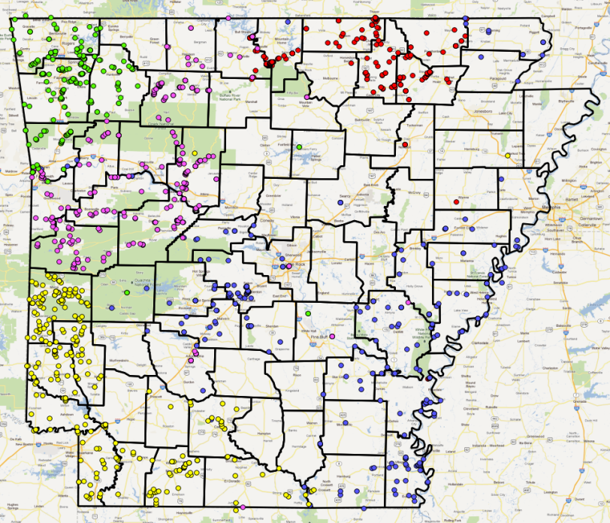
ALL COLLECTIONS
Export into Geolocate
Problem Localities
Georeferencing
Quality Check

Slide 12
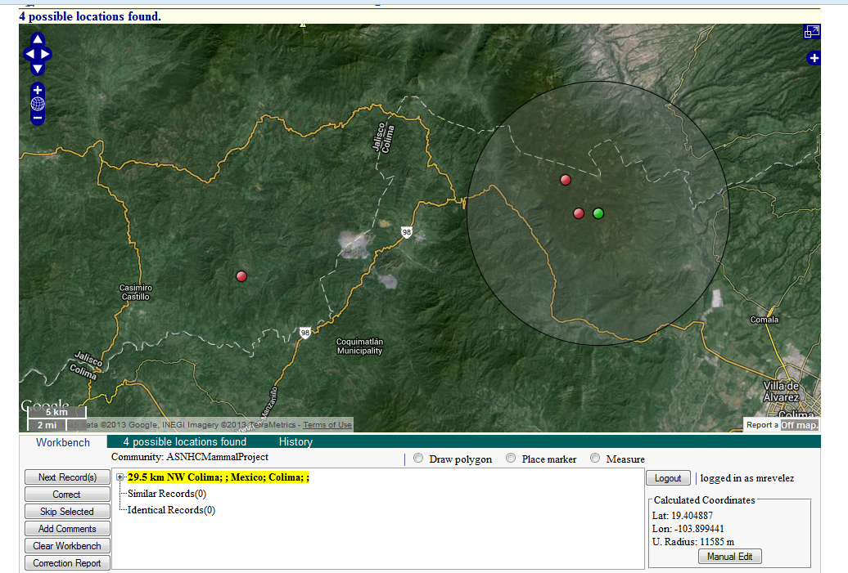
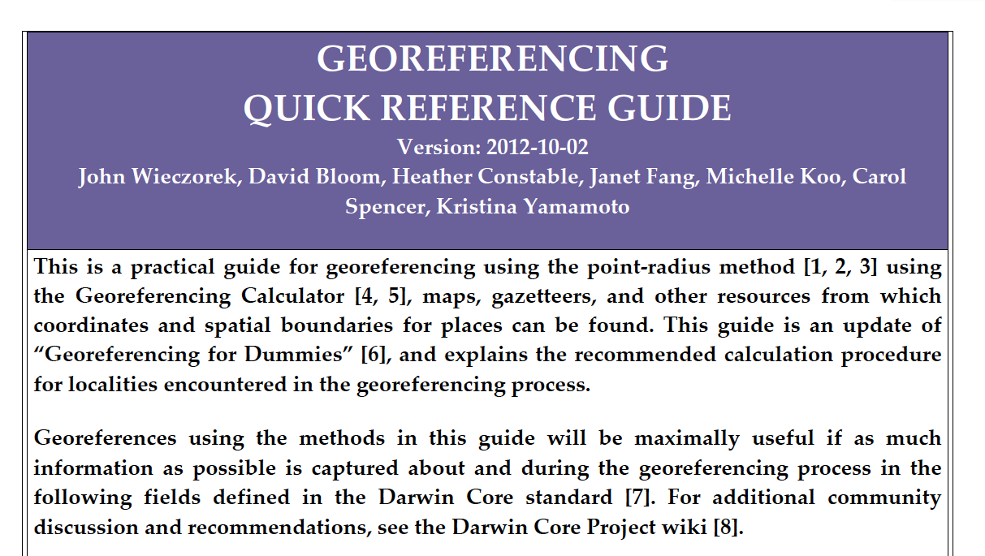
GEOREFERENCING LOCALITY TYPES:

Slide 13
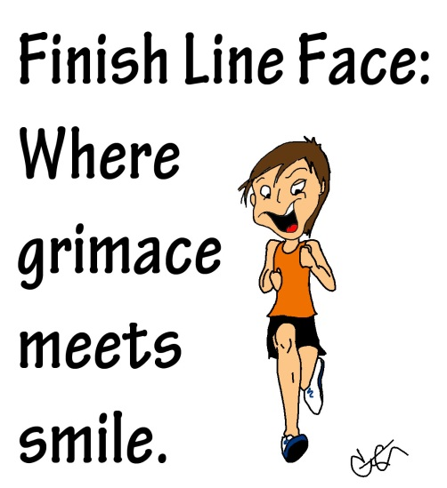
Quality Check
Export Data
Data Capture
Data Standards
Imaging
Data Cleaning
Bare Bones
Quality Check
Georeference
Export into Geolocate
Problem Localities
Quality Check
Georeferencing
Quality Check
Data capture: specimen tags, field notes
Education Modules
Inventory
Import into Specify
VertNet, GBIF, iDigBio

Slide 14
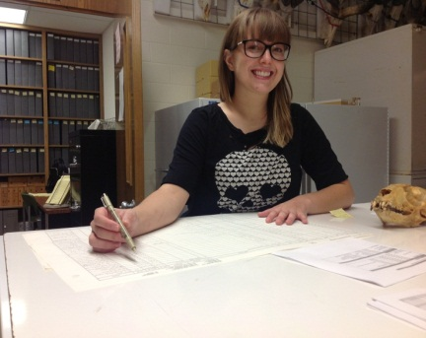
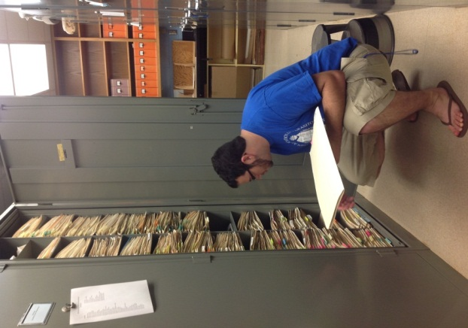
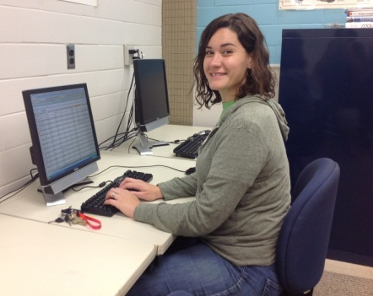
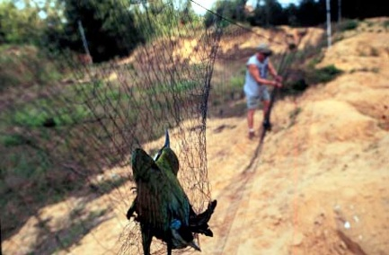
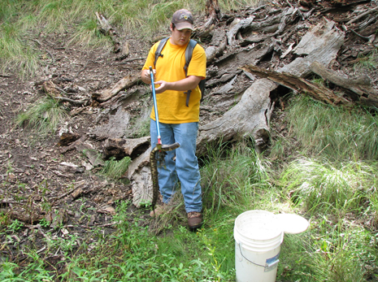
ARE WE DONE?
Cataloging backlog
Data Entry
Rearrangement of Collection
Field Collection
Research
Class collections

Slide 15
