Slide 1
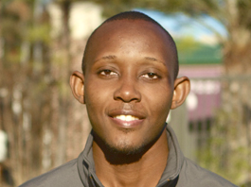
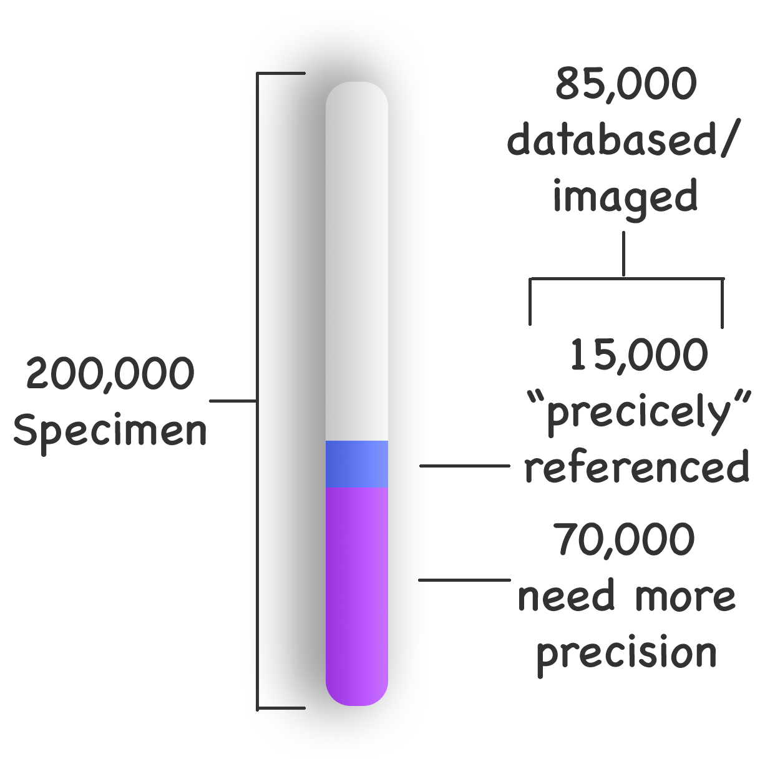
FSU Robert K Godfrey Herbarium
We use human reasoning in concert with a set of online georeferencing tools.
Lawrence Weru
Senior at Florida State University studying art and biology. The herbarium uses GEOlocate for Georeferencing.
I will be training students and perhaps volunteers.
I will also be programming a web-based phenology map visualizer. Go ‘Noles.

