Slide 1
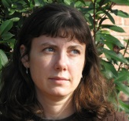






Project Magnolia grandiFLORA
www.mississippiplants.org
Lisa Wallace
Lucile McCook
Mac Alford
Heather Sullivan
Nina Baghai-Riding
Digitizing collections from Mississippi herbaria
~250,000 specimens – primarily vascular plants
~90% of these specimens are not georeferenced
Training
PI’s on the project
Student workers (undergrads and grads)
Other collections – entomology, geology, MMNS
Workflow
Management of the collective portal – SilverBiology
Imaging – SilverImage
Label databases – Specify, FileMaker Pro, others
Georeferencing – GEOLocate; sourcing records by geography for editing
Funded by

