Slide 1
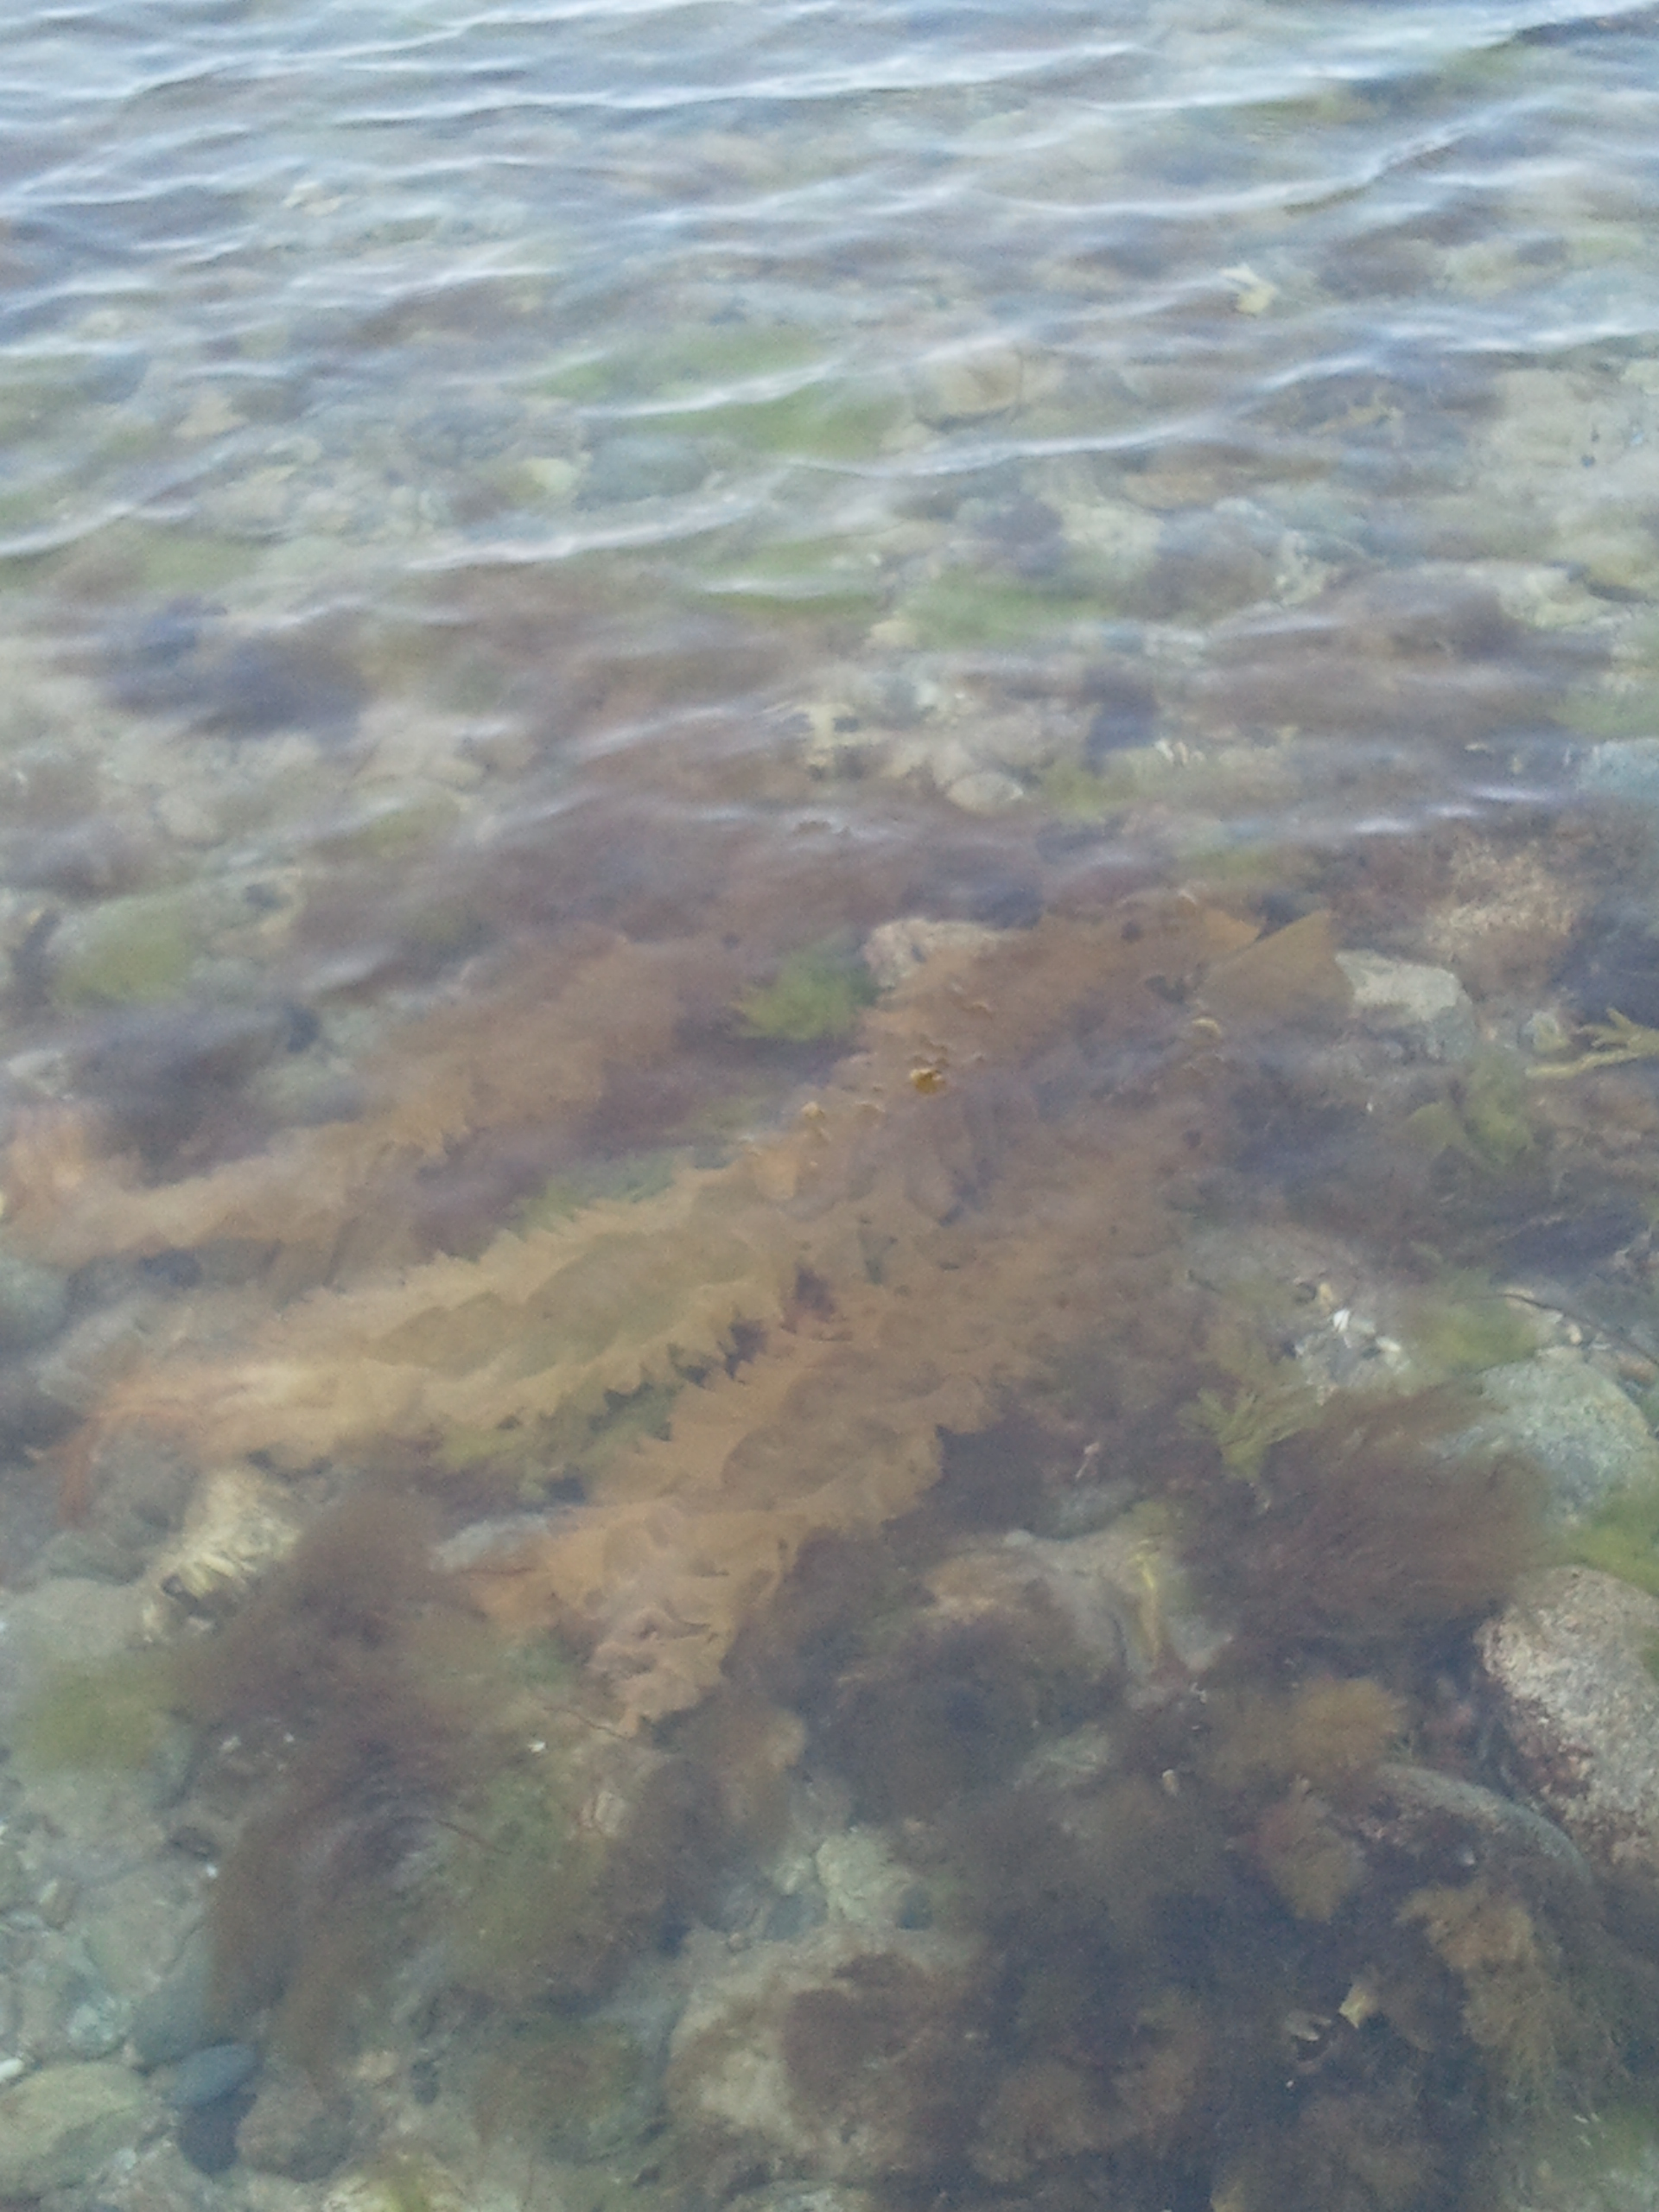
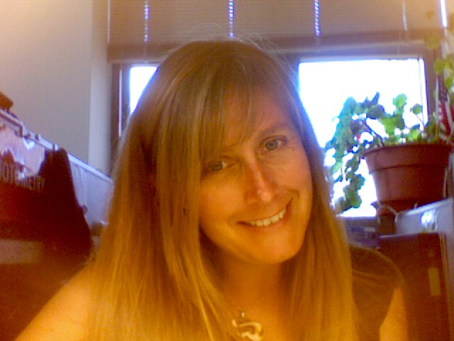
Macroalgal Herbarium Consortium
Hannah Traggis

Slide 2
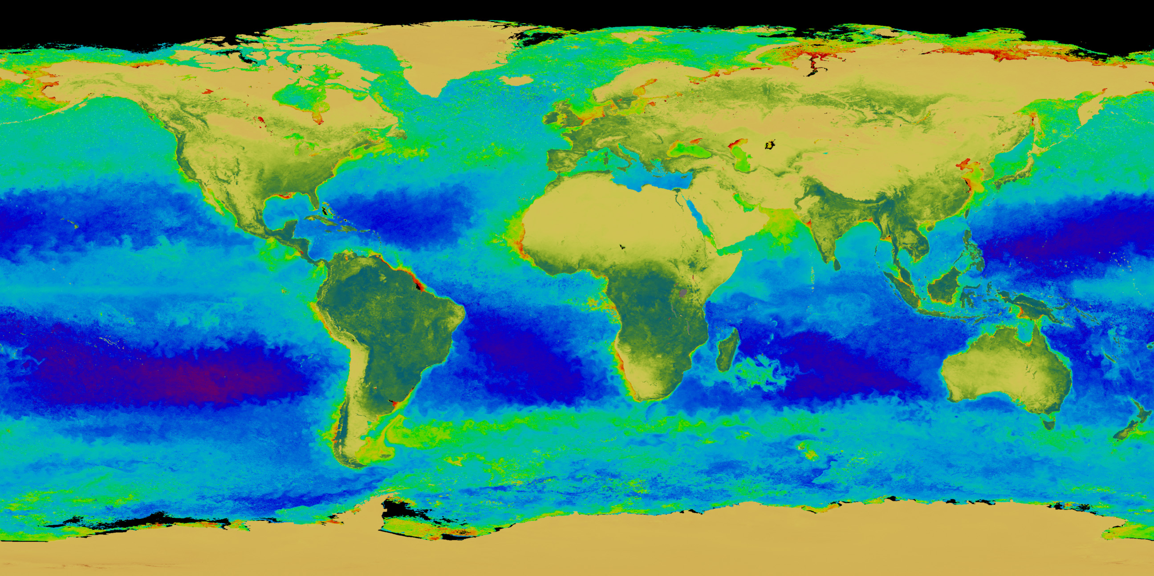
To Provide data to enable biodiversity research
Primary Digitization Center (PDC) for Northeast
49 herbaria across the country
1.2 million specimens collected across the globe over past 150 yrs
Georeference using GeoLocate to provide locality information for each speciment

