Slide 1
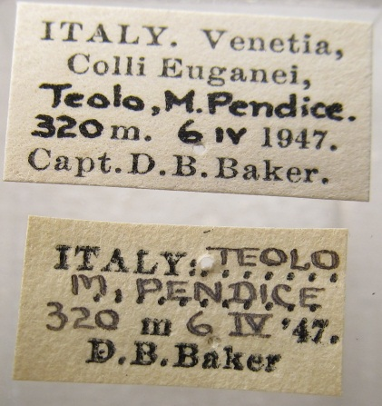
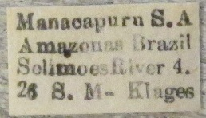
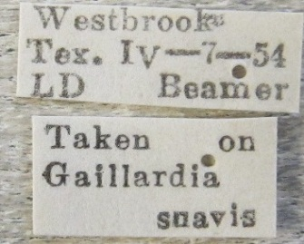
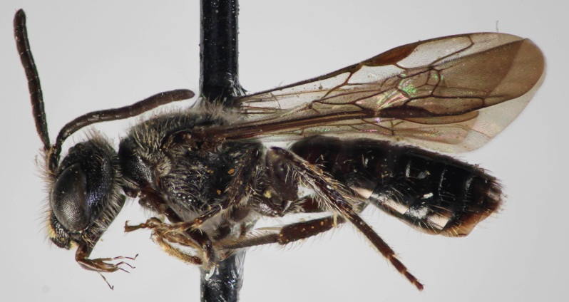
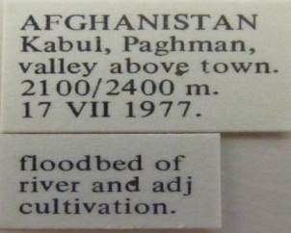
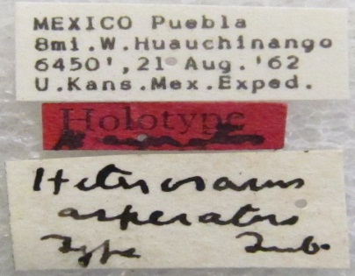
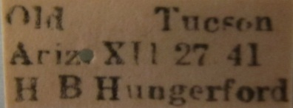
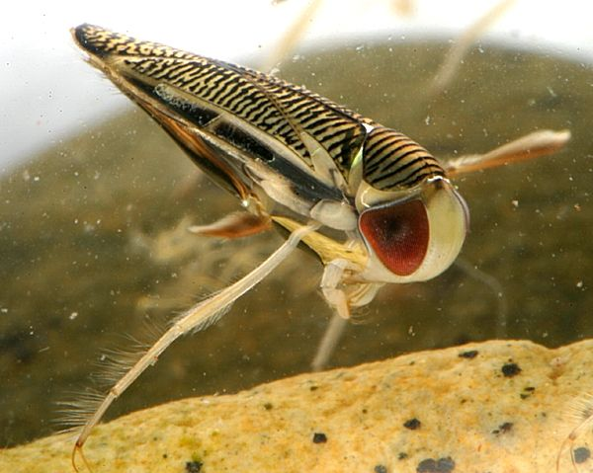
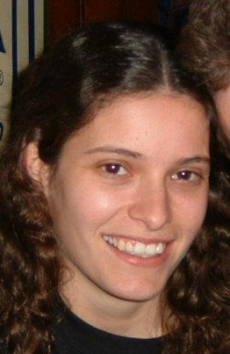
Entomology Database snapshot:
> 1 million specimen records
> 30,000 Localities (37% georeferenced)
> 80,000 Collecting Events
Current digitization projects:
A specimen-level database of the world’s bees (Apoidea) at the University of Kansas: BRC
Tri-Trophic Associations: TCN
Invertnet: TCN
Who?
10 – 12 undergraduate students per semester
2-3 graduate students per semester
Crowd-sourced volunteers???
2 collection managers
How?
The slow old fashion way using a combo of techniques (google maps, google earth, fuzzy gazateer, geolocate, geonames-USGS, earth-info, etc)
Collaborative georeferencing with Geolocate?
Crowd sourcing via ALA or NFN?

Slide 2
