Slide 1
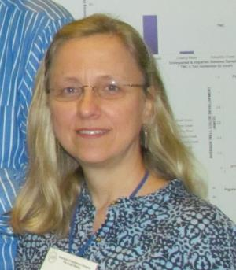
Introduction to iDigBio,
TCNs, PENs, RDCNs, the GWG and
Integrated Digitized Biocollections
Deborah Paul
(dpaul@fsu.edu)
(Florida State University, iDigBio, iDigInfo)
12 – 16 August 2013
2nd Train-the-Trainers Georeferencing Workshop
Gainesville, Florida

Slide 2
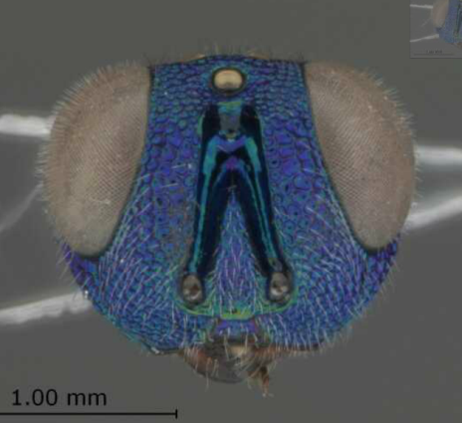




Advancing Digitization of
Biodiversity Collections
Network Integrated Biocollections Alliance
  NIBA http://tinyurl.com/NIBAimplementation
iDigBio and the TCNs & PENs
10 year $100M project of NSF
Overall goals
  enhance and expand the national resource of digital data documenting existing vouchered biological and paleontological collections
  advance scientific knowledge by improving access to digitized information (including images)
Notes:
Ingest all contributed data with emphasis on GUIDs, not only a restricted set of selected data elements
Maintain persistent datasets and versioning, allowing new and edited records to be uploaded as needed
Ingest textual specimen records, associated still images, video, audio, and other media
Ingest linked documents and associated literature, including field notes, ledgers, monographs, related specimen collections, etc.
Provide virtual annotation capabilities and track annotations back to the originating collection
Facilitate sharing and integration of data relevant to biodiversity research
Provide computational services for biodiversity research

Slide 3

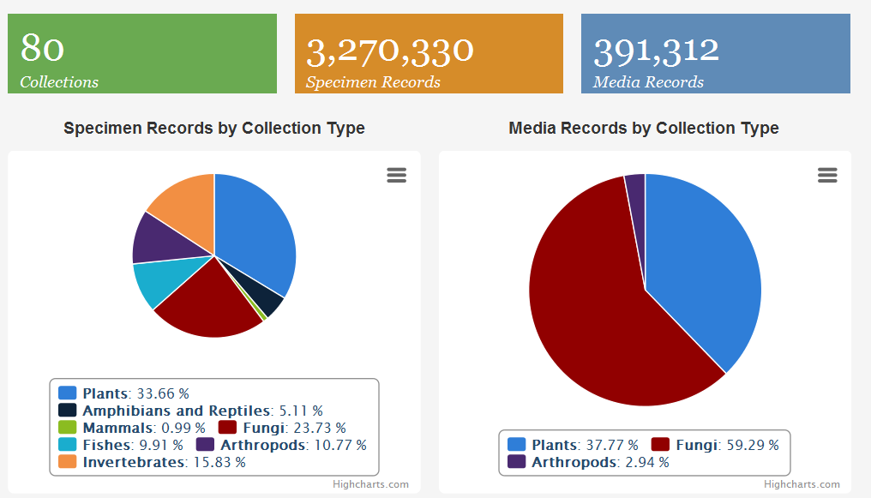
portal.idigbio.org

Slide 4
10 Thematic Collection Networks (TCNs) &
Partners to Existing Networks (PENs)
InvertNet > Invertebrates
Tri-Trophic TCN
  plant host+insect+parisitoids
LBCC > lichens and bryophytes
PaleoNICHES > fossils
MaCC
  macrofungi
NEVP
  vascular plants
SCAN
  ground-dwelling arthropods
Animal Communication Signals
  birds, frogs, fish and insects
Macroalgal Herbarium Consortium
Fossil Insect Collaborative
Magnolia grandiFLORA (CSBR – RDCN)
Some Research Themes
species discovery
species relationships
taxonomy
environmental change
host and host parasite relationships
biogeography
biotic interactions
nutrient cycling
ecology
deep-time to study diversification and response to environmental change
evolution and ecology of communication signals
change through time
human influence
Notes:
InvertNet: An Integrative Platform for Research on Environmental Change, Species Discovery and Identification (Illinois Natural History Survey, University of Illinois) http://invertnet.org
Plants, Herbivores, and Parasitoids: A Model System for the Study of Tri-Trophic Associations (American Museum of Natural History) http://tcn.amnh.org
North American Lichens and Bryophytes: Sensitive Indicators of Environmental Quality and Change (University of Wisconsin – Madison) http://symbiota.org/nalichens/index.php http://symbiota.org/bryophytes/index.php (plus 2 PENs)
Digitizing Fossils to Enable New Syntheses in Biogeography - Creating a PALEONICHES-TCN (University of Kansas)
The Macrofungi Collection Consortium: Unlocking a Biodiversity Resource for Understanding Biotic Interactions, Nutrient Cycling and Human Affairs (New York Botanical Garden)
Mobilizing New England Vascular Plant Specimen Data to Track Environmental Change (Yale University)
Southwest Collections of Anthropods Network (SCAN): A Model for Collections Digitization to Promote Taxonomic and Ecological Research (Northern Arizona University) http://hasbrouck.asu.edu/symbiota/portal/index.php
Fossil Insect Collaborative: A Deep-Time Approach to Studying Diversification and Response to Environmental Change
https://www.idigbio.org/wiki/index.php/Fossil_Insect_Collaborative:_A_Deep-Time_Approach_to_Studying_Diversification_and_Response_to_Environmental_Change
Developing a Centralized Digital Archive of Vouchered Animal Communication Signals
https://www.idigbio.org/wiki/index.php/Developing_a_Centralized_Digital_Archive_of_Vouchered_Animal_Communication_Signals
The Macroalgal Herbarium Consortium: Accessing 150 Years of Specimen Data to Understand Changes in the Marine/Aquatic Environment
https://www.idigbio.org/wiki/index.php/The_Macroalgal_Herbarium_Consortium:_Accessing_150_Years_of_Specimen_Data_to_Understand_Changes_in_the_Marine/Aquatic_Environment

Slide 5
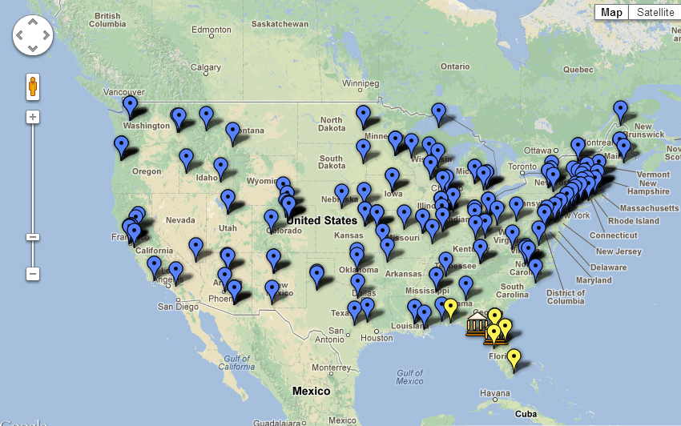
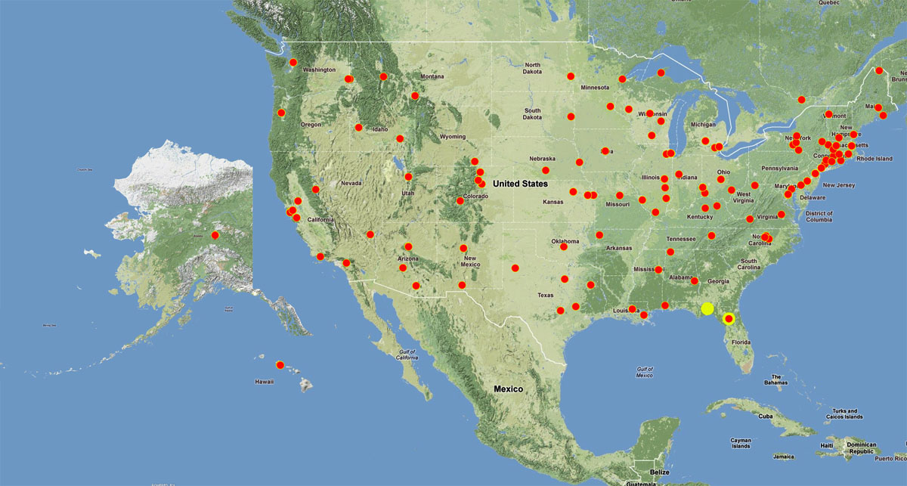
iDigBio and the TCNs
To date: 10 TCNs, 150+ participating institutions, all 50 states + a territory

Slide 6
Facilitate use of biodiversity data to address environmental and economic challenges
  Researchers
  Educators
  General public
  Policy-makers
Enable digitization of biodiversity collections data
  Develop efficient and effective digitization standards and workflows
  Respond to cyberinfrastructure needs
Provide portal access to biodiversity data in a cloud-computing environment
Plan for long-term sustainability of the national digitization effort
  Expand participation: partners and data sources
Notes:
Ingest all contributed data with emphasis on GUIDs, not only a restricted set of selected data elements
Maintain persistent datasets and versioning, allowing new and edited records to be uploaded as needed
Ingest textual specimen records, associated still images, video, audio, and other media
Ingest linked documents and associated literature, including field notes, ledgers, monographs, related specimen collections, etc.
Provide virtual annotation capabilities and track annotations back to the originating collection
Facilitate sharing and integration of data relevant to biodiversity research
Provide computational services for biodiversity research

Slide 7
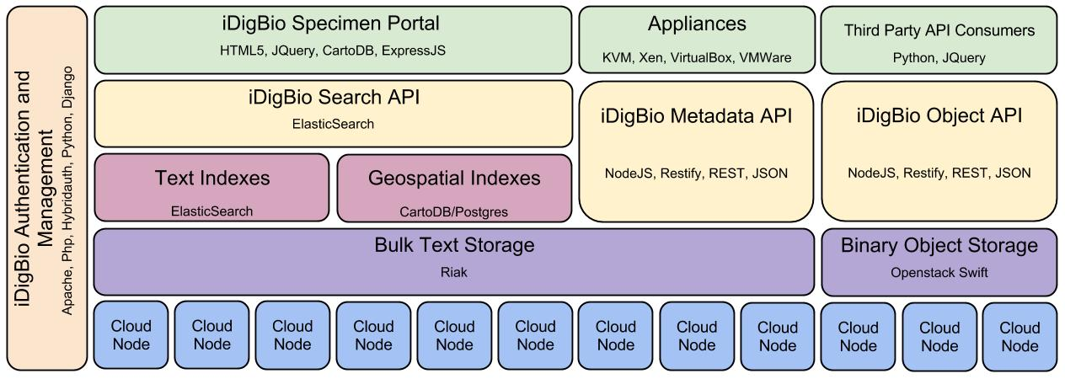
Building the iDigBio Cloud
Cloud-based strategy
  Providing useful services/APIs (programmatic and web-based Application
  Programming Interface)
  Federated scalable object storage and information processing
  Digitization-oriented virtual appliances
  Reliance on standards, proven solutions, and sustainable software
Continuous consultation with stakeholders
  Surveys, working groups, workshops, person-to-person
Notes:
iDigBio uses a cloud-based strategy for building its cyberinfrastructure.
The strategy is to build a federated scalable object storage and information processing that can be accessed through programmatic and web-based interfaces; always relying on standards, proven solutions and sustainable software that can be packaged in virtual appliances that facilitate the digitization workflow.
This process is transparent and with continuous consultation with stakeholders through surveys, working groups, etc.
The picture abstracts main components of the purpose-built iDigBio cyberinfrastructure
----------------------
If the presenter is asked about the details of the figure, it shows:
a) The physical hardware at the bottom layer (“Cloud Nodes”);
b) The storage of both text and binary objects (“Bulk Text Storage” and “Binary Object Storage”) on top of physical nodes;
c) Various types of customized indexing that accelerates searches of data (“Full-text and Faceted Indexing”, “Geo-spatial and Range Indexing)”;
d) The different types of Application Programming Interfaces (APIs) that will be exposed to the public (“Search API”, “Metadata API”, “Object API”). The APIs allow other applications, especially from other stakeholders, to ingest and retrieve the data in iDigBio in a programmatic fashion.
e) The “iDigBio Specimen Portal” provides a web-based user interface that also makes use of the exposed APIs.
f) Different types of “Appliances” and “Third Party Consumers” also interact with the exposed APIs with the purpose of facilitating the digitization process by packaging existing biodiversity tools.
g) All components will need to be integrated and managed securely (authentication, authorization, access control, auditing, the 4 ‘A’s ).
Decoding the colour scheme (AM):
All APIs have the same color and all user-facing components are green.
AAAA (Authentication, Authorizing, Auditing) is a different color because it is part of all components (not only the green ones, but a bit of blue, purple, pink yellow and green).
The majority of our users will interact only with the green fraction, a smaller group will interact with the yellow fraction, a very special group may interact with the pink fraction, and only internal users will interact with the purple and blue fractions.
The names in smaller fonts inside each box (e.g., Apache, Elastic Search) are particular software packages considered for delivering the expected capability.

Slide 8
What Makes iDigBio Unique?
Ingest all contributed data with emphasis on use of identifiers
  any data elements
Maintain persistent datasets and versioning,
  new and edited records to be uploaded as needed
Ingest textual specimen records
  plus associated still images, video, audio, and other media
Ingest linked documents and associated literature, including field notes, ledgers, monographs, related specimen collections, etc.
Provide virtual annotation capabilities and track annotations back to the originating collection
Facilitate sharing, integration and enhancement of data relevant to biodiversity research
Provide computational services for biodiversity research
Notes:
Storage and Services:
Provide computational services for biodiversity research: VPN e.g., (Symbiota instances, cloud platform available, GeoLocate)
Facilitate sharing and integration of data relevant to biodiversity research

Slide 9


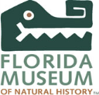
Recent and Ongoing Activities
Assessment of common and effective digitization practices (paper in ZooKeys)
Working groups http://tinyurl.com/idbworking
  Minimum information for scientific collections (MISC), DROID, Biodversity Informatics,
  Georeferencing Working Group (GWG)* - Train-the-Trainers
    http://tinyurl.com/idbgeowg
Workshops - year 2:
  > 150 institutions, 9 workshops, 3 symposia, 368 sponsored participants
  Video archives on Vimeo, live streaming for remote participation
  Series of digitization training workshops (herbaria, wet collections, entomology, paleontology, fluid-preserved invertebrate imaging)
  More workshops on-the-way: small herbaria digitization, primary source materials, …
Server hosting: 8 virtual machines, TCN support
Specimen data portal and website – improvements, and more on the way
Call for appliances, frequent opinion surveys

Slide 10
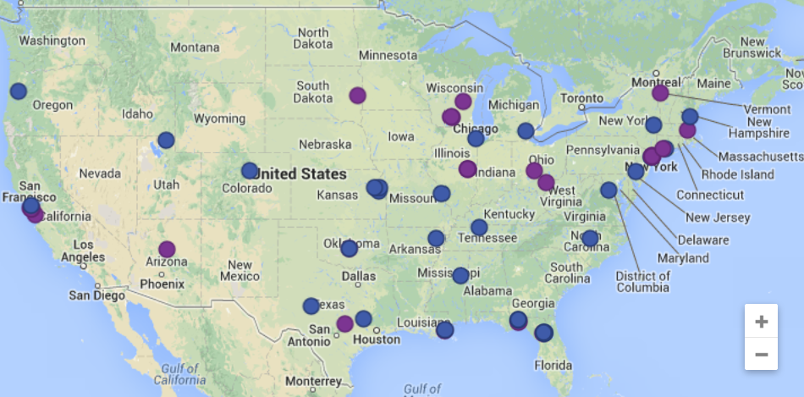
You’re on the map!
http://tinyurl.com/ttt1ttt2map

Slide 11
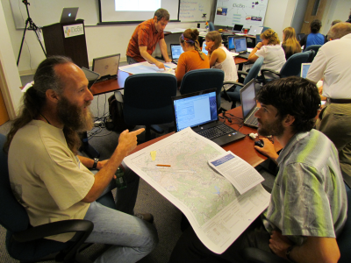
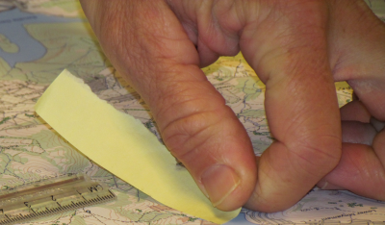
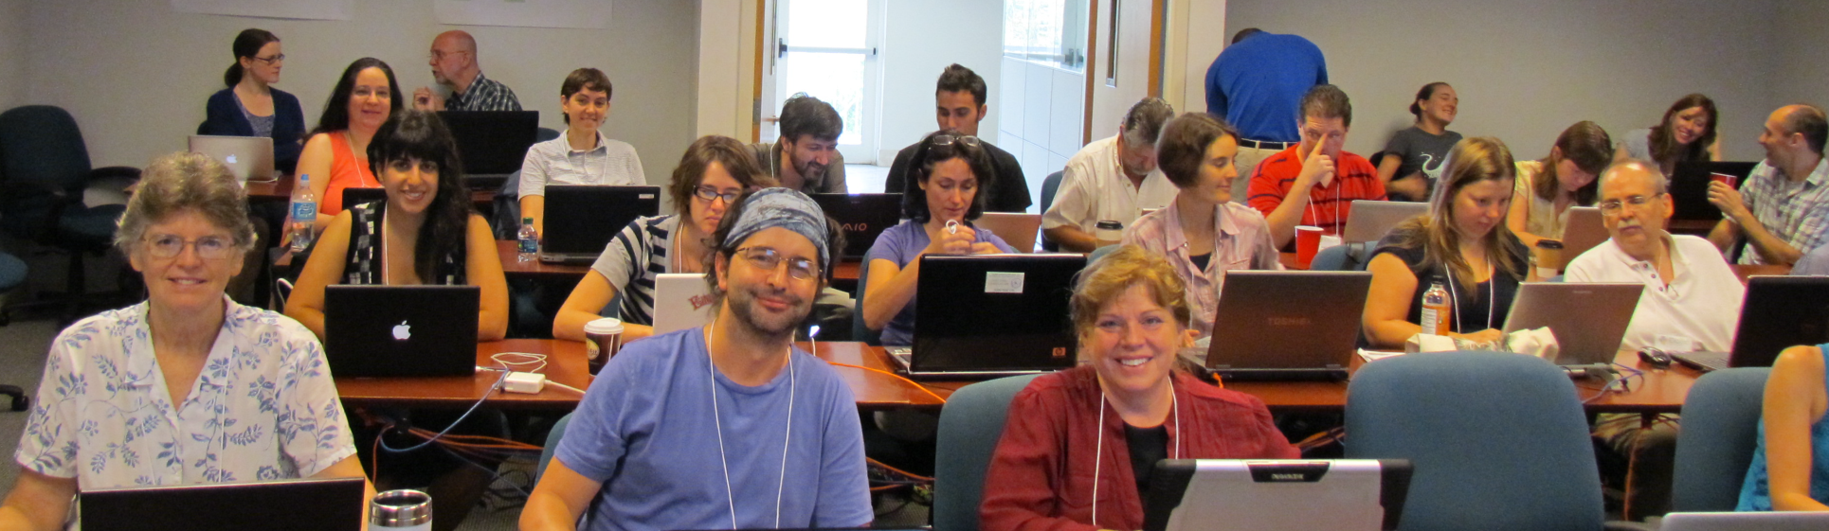
Let’s get started!
-the iDigBio GWG

Slide 12
On the board
Agenda
Logistics
Notes
AdobeConnect
iDigBio Geowiki
GWG Wiki
Georeferencing Forum
HerpNET georeferencing
http://tinyurl.com/idbttt2
http://tinyurl.com/idbttt2log
http://tinyurl.com/ttt2notes
http://idibio.adobeconnect.com/geotrain
http://tinyurl.com/idbgeowiki
    http://tinyurl.com/idbgeowg
idigbio.org > register
  Resources > Forums > Georeferencing Working Group
http://tinyurl.com/herpnetgeoref

Slide 13
R (?) Digitization Collection Networks (RDCNs)
When the thematic concept does not fit your proposal
Administered by CSBR
Here are some current ones -
  Consortium of California Herbaria
  Pacific Consortium of Herbaria
  Mississippi Herbaria – Magnolia grandiFLORA (Hi Lisa)
  Georeferencing US Fish collections
Notes:
From NSF (JS): Here’s an advantage to the RDCN designation. R might stand for Regional when it fits. It might also stand for Related, Relevant, Relational, Registered, Recognized, or something else pertinent to their situation. We can make it work. They are not actually receiving funds from ADBC, but they have federal funds and will be integrating their data into the national resource.
CSBR: https://www.idigbio.org/content/nsf-announces-collections-support-biological-research-csbr-solicitation - Collections in Support of Biological Research

