Slide 1
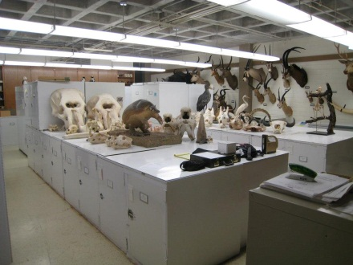
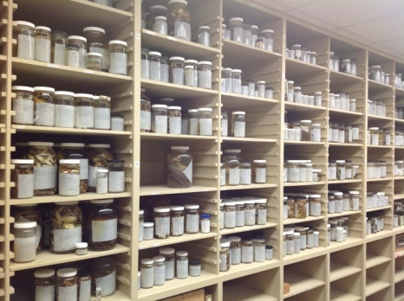
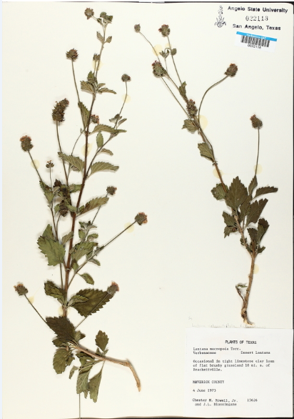
Modernization and Digitization of the Angelo State Natural History Collections
5 COLLECTIONS – 130,000 specimens
(vertebrates, genomics, herbarium)
Grant goals include:
Identify fields for database
Create standards
Data cleaning
Specify database
Georeferencing via Geolocate
Workshop Goals:
Learn new protocols and best practices
Train curators, faculty, students
Workshop at regional meetings
MARCY REVELEZ, COLLECTIONS MANAGER
Angelo State University, San Angelo, Texas
(Member, Texas Tech University System)
National Science Foundation
Collection in Support of Biological Research 2012-2014

