Slide 1
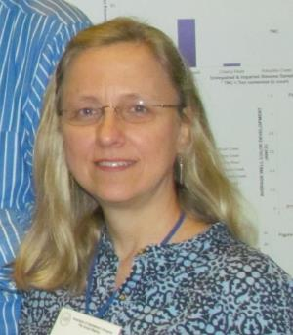
Of Workflows, Protocols and Expert or Novice?
Deborah Paul, Gil Nelson, Austin Mast
(dpaul@fsu.edu)
(Florida State University, iDigBio, iDigInfo)
12 – 16 August 2013
2nd Train-the-Trainers Georeferencing Workshop
Gainesville, Florida

Slide 2
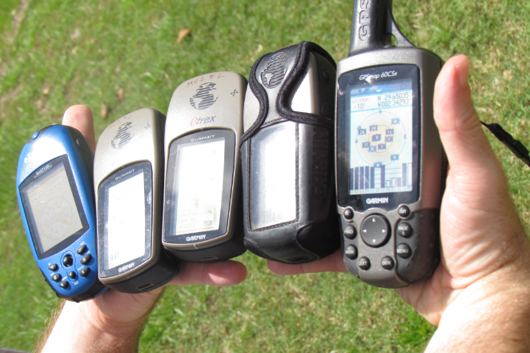
Workflows
Notes:
Digitization Resources
https://www.idigbio.org/wiki/index.php/Digitization_Resources

Slide 3
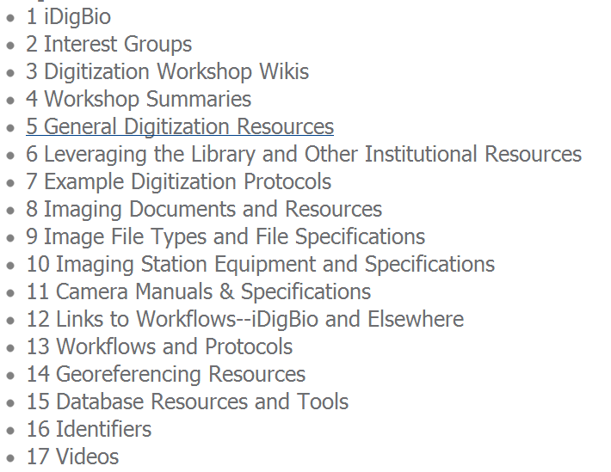
Digitization Resources
http://tinyurl.com/idigresources

Slide 4
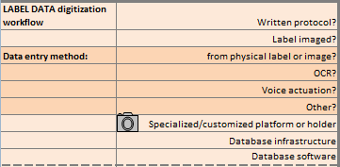
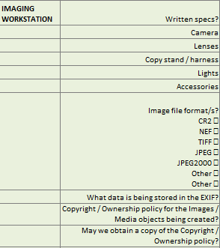
Informal Digitization Survey
iDigBio staff compiled a survey
collection type information
protocols
specimen handling logistics
imaging
specimen data entry
georeferencing
Community feedback: Survey helped
finding gaps in documentation
helping with writing of workflows & protocols
organizing workflows for sharing & archiving
Notes:
Our survey and feedback.
Note available online.
https://www.idigbio.org/sites/default/files/workshop-presentations/ttt2/ShortSurvey.xlsx
https://www.idigbio.org/sites/default/files/workshop-presentations/ttt2/LongSurvey.xlsx
We value your feedback to improve upon it.

Slide 5
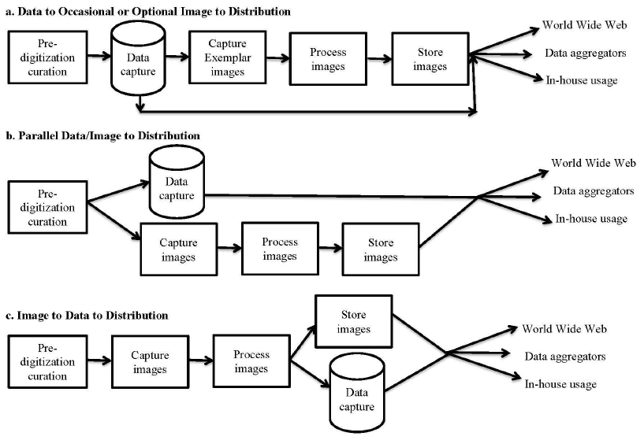
5 task clusters, + 1 3 workflow patterns
blue shading indicates specimen handling steps
Notes:
Susan Butts published a formula for figuring out how to decide what to digitize (move from the stratigraphic to the systematic collection).
Yale’s Entomology Department is an example of the first path.
We have seen herbariums utilizing the second path.
Necessitates keeping track of what is databased, but not imaged
and
what is imaged, but not yet in the database.
The last path minimizes specimen handling and is best suited to those collection types
where imaging the specimen (and the label) at the same time is feasible.
Herbarium specimens, and other specimen types (like bird skins) where the label can be placed
in the image field are well-suited to this flow.
The first 2 paths will at times mean the specimen has to be located and handled again to check data in the database.
The last path is to be studied more thoroughly in the upcoming iDigBio DROID workshop May 30-31, 2012.

Slide 6
Key Clusters
Image Capture
Georeferencing
Image Processing
Pre-digitization Curation or
Staging
Data Capture
Image / Data Storage
Personnel
Biodiversity Informatics Manager
Written
Workflows

Slide 7
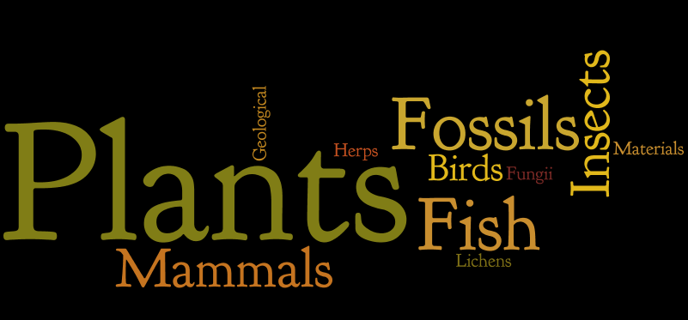
Workflows aka Protocols
Share, Review, Get input
Look for bottlenecks (people, equipment, software)
Notes:
What’s in it for you?
More specimens georeferenced
Greater accuracy
Data quality
Data integrity
Fit-for-research use data
Avoid N-I-H

Slide 8
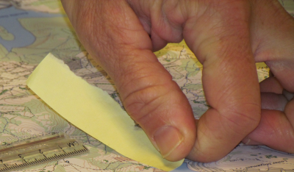




How “expert?” Just how much training does it take to accurately georeference a locality?
Gil Nelson (gnelson@bio.fsu.edu) Florida State University, iDigBio, iDigInfo
Austin Mast (amast@bio.fsu.edu) Florida State University
2nd Train-the-Trainers Georeferencing Workshop
12 – 16 August 2013
Gainesville, Florida

Slide 9
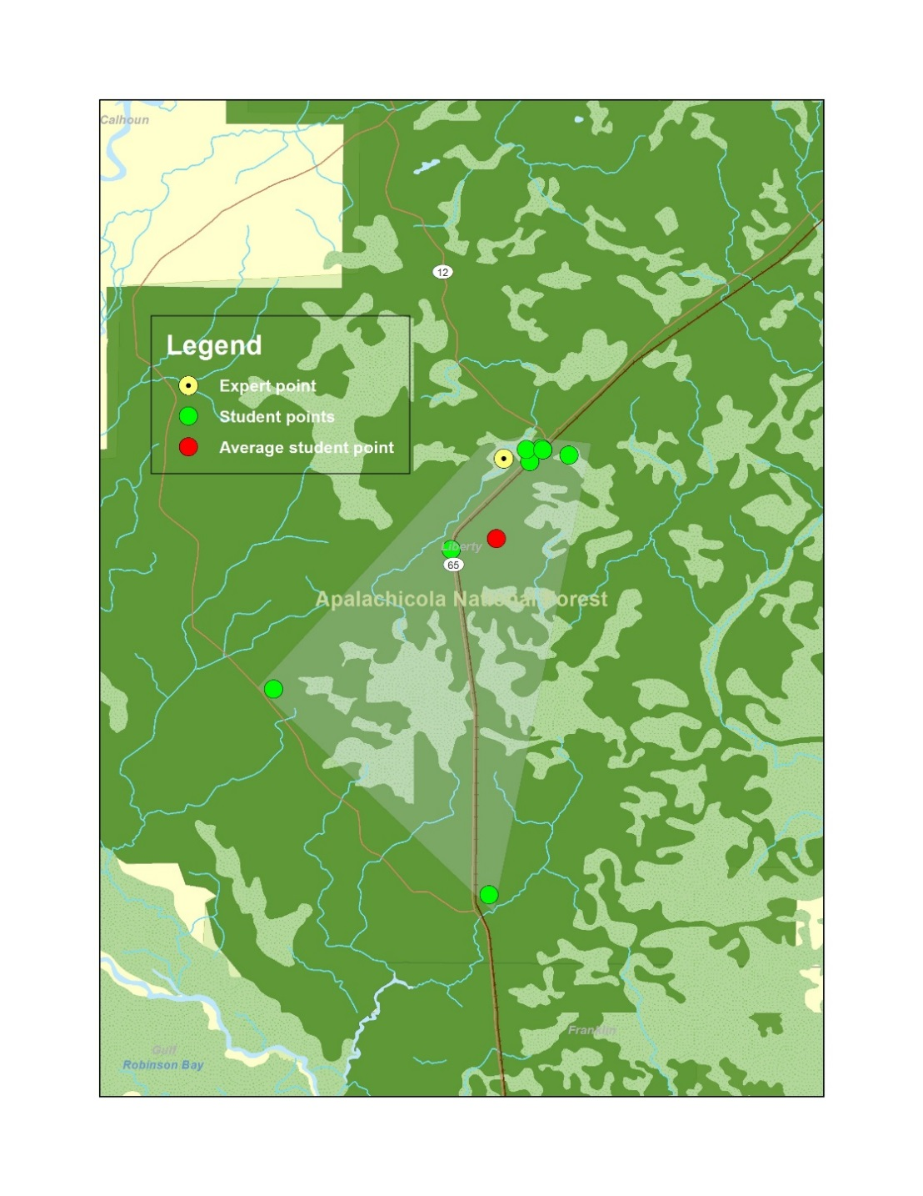
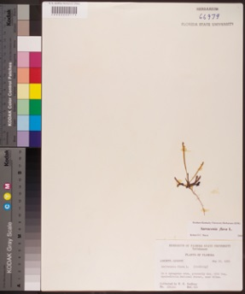
Experiment under way at
Florida State University:
How much training does it take to accurately georeference a locality?
Trained techs with regular communication.
Plant biology students with about 30 minutes of training.
Apalachicola National Forest.
Verbatim Locality: titi bog, Appalachia National Forest, near Wilma.
Habitat: in a sphagnous area, presently dry, titi bog.
Notes:
Experiment in progress.
30 minutes of georeferencing training.
9 (10)
6 are clustered
1 was default GEOLocate
red is arithmetic average of 9 green lat/lon shown here; not centroid of polygon
goal would be clustering algorithm – that would find clusters (tolerance of so many meters) and put point in center of this cluster.
Student points could be just at good as the expert point in this case – as they are also titi bogs and no east / west provided in description.
(land signature (DOQ) of titi bogs – not taught; impossible points, example of Stewartia in an extremely unlikely improbable place).
(256 points, 16 students)
-----------------
Training at FSU Herbarium
students read protocol before hand
Gil sits with one or two students: work through protocol: about 2 hours: intro to herbarium and also time in front of computer.
DIS students – more they did, fewer they skipped; Gil available to help (via email, skype).
Better (faster) with records from a given region (faster), than all same species, even faster from areas they knew.

Slide 10
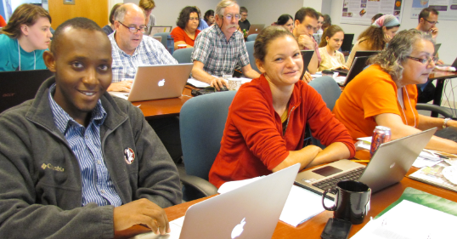
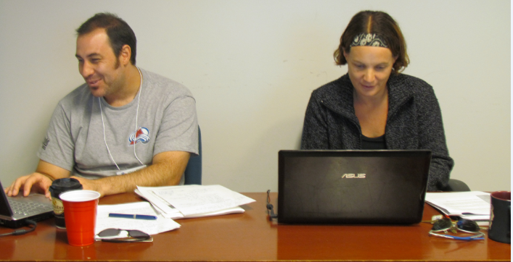
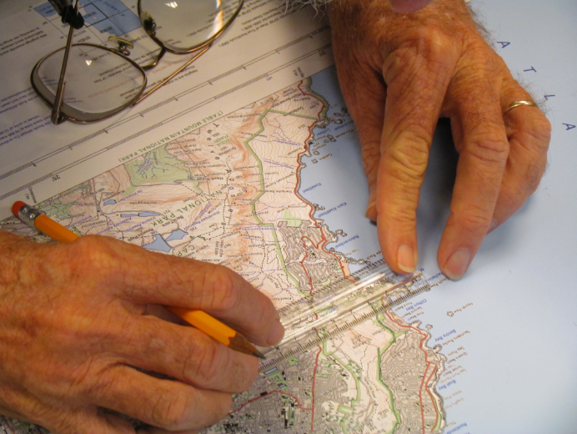
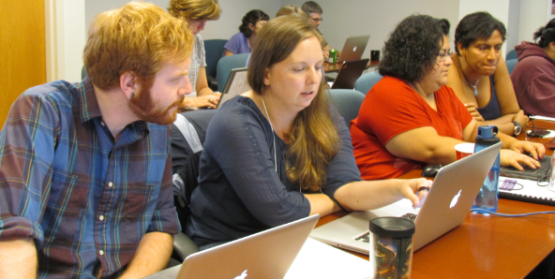
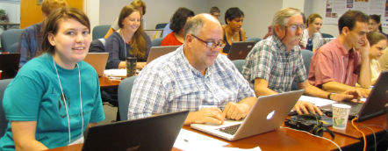

Slide 11
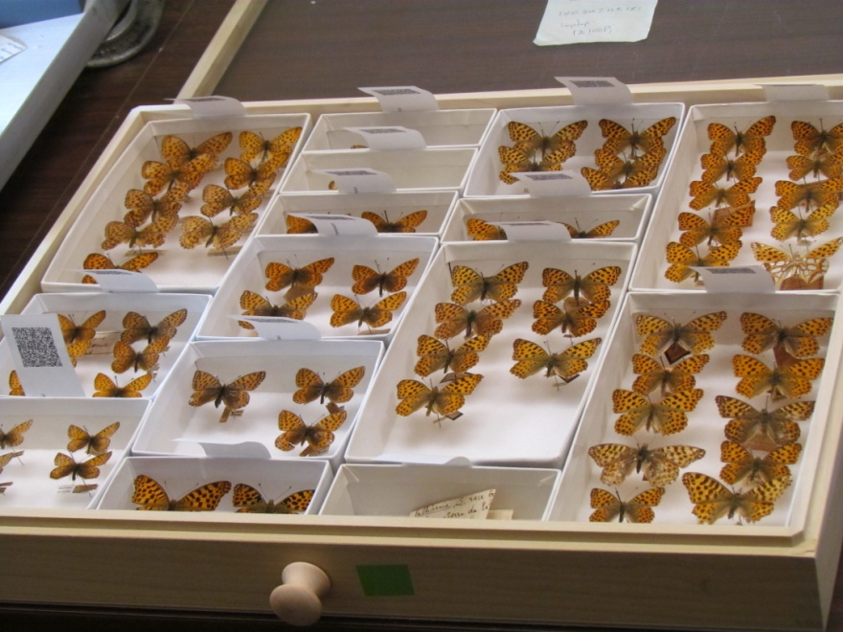
Evaluating a Workflow
Pre Digitization Curation Tasks | must be done before digitzation | could be done at or after digitization | Non expert | Crowd Source? | a step that could be automated | a task needing QA / QC | Can do with existing machine (Kirtas) | Authority file exists or would be useful | a physical tool exists | easy to compute time / costs for this task | formula exists
interview staff | ✓
hire staff | ✓
train staff | ✓ |  | ✓
decide what to digitize | ✓ |  |  |  |  |  |  |  |  |  | ✓
pull specimens | ✓ |  | ✓
sort specimens (e.g., by taxon, sex, geographic region, collecting event, collector) | ✓ | ✓ | ✓
add taxon names to database |  |  |  |  |  |  |  | ✓
update taxonomic identification on specimens (e.g., vet type specimens) |  | ✓ | ✓ | ✓
Workflow (WF)
Documentation of WFs
Improving WFs
Talking with others / comparing
Evaluating WFs
See WF Mockups – for DROID workshop
Notes:
Work Flow Mock up for Upcoming DROID workshop.
The left column is a list of all tasks at the pre-digitization step.
The top row is a list of criteria to on which to evaluate each step for a possible place to make improvements in some way.
The results of these will be posted to help the community compare tasks
and create a road map for using the data gathered to speed things up!

Slide 12
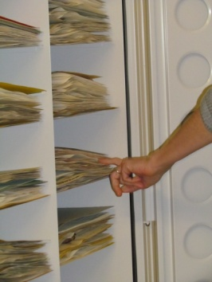
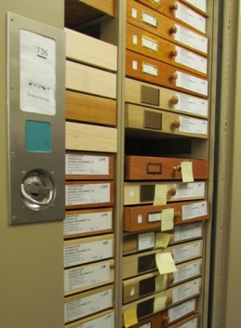
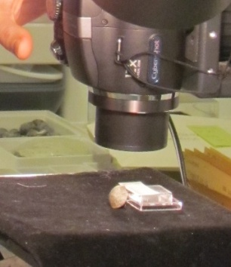
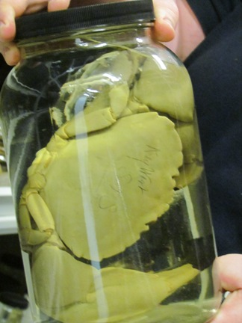
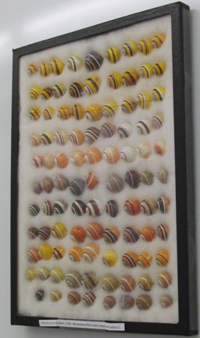
Observing Collections
iDigBio staff visited
28 Collections in 10 different museums
Collections varied in size, kind, staffing
entomology
invertebrate paleontology
invertebrate zoology
ornithology
botany
vertebrate paleontology
zoology
Notes:
Kinds of collections we visited

Slide 13
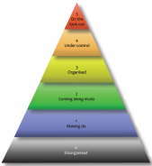
What’s your Digitization Maturity? Find out here …on page 67+
Digitisation: A strategic approach for natural history collections. Canberra, Australia, CSIRO, 2012.
Author: Bryan Kalms
Available at http://www.ala.org.au/wp-content/uploads/2011/10/Digitisation-guide-120223.pdf.

Slide 14
Assessing Digitization Workflows…
Reed Beaman, James Macklin, Michael Donoghue, James Hanken. 2007. Overcoming the Digitization Bottleneck in Natural History Collections: A summary report on a workshop held 7 – 9 September 2006 at Harvard University. [Accessed January 2012].
ĺñigo Granzow-de la Cerda and James H. Beach. December 2010. Semi-automated workflows for acquiring specimen data from label images in herbarium collections. Taxon 59 (6): 1830-1842
Bryan Kalms. Digitisation: A strategic approach for natural history collections. Canberra, Australia, CSIRO, 2012.
John Tann & Paul Flemons. 2008. Report: Data capture of specimen labels using volunteers. Australian Museum
Ana Vollmar, James Alexander Macklin, Linda Ford. 2010. Natural History Specimen Digitization: Challenges and Concerns. Biodiversity Informatics 7 (1): 93 – 112
iDigBio Developing Robust Object to Image to Data (iDigBio DROID) Workshop – May 30 – 31, 2012
Notes:
papers influencing our take on data we gathered and what we observed.

