Slide 1
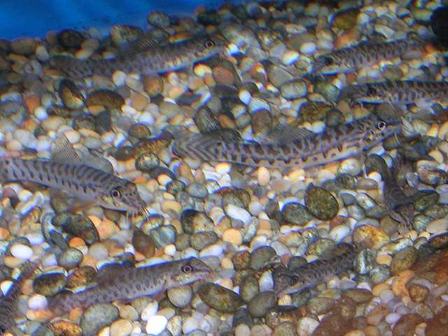
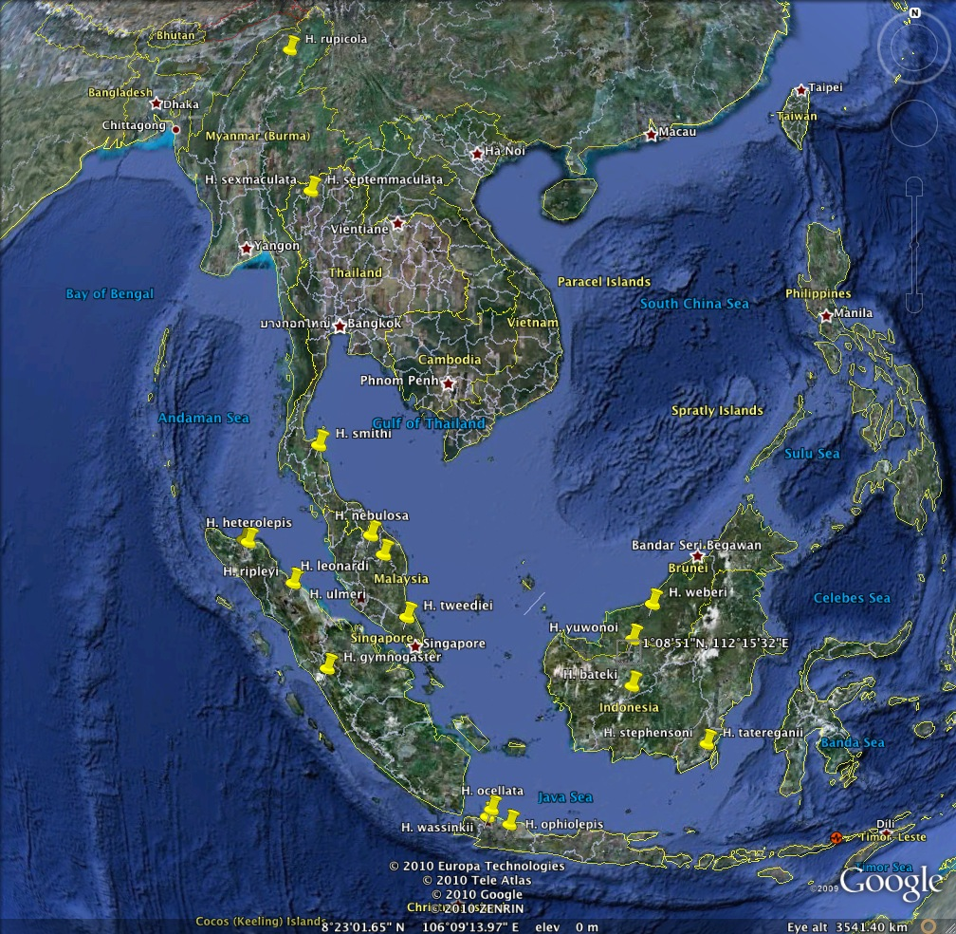
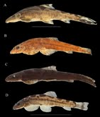
“Geographic variation in the Hillstream Loach”
By: Lunide Orleus
The collection that I am currently Georeferencing are a collection of Loaches (Homoloptera sexmaculata) that were brought over
from different localities and provinces in Thailand.
There are a total of 34 lots in this collection which means over 100 fishes.
UF :13
NIFI : 10
RLIKU: 4
Smithsonian: 3
ANSP: 3
Trainees would most likely be students and/or volunteers
For this project, the methods I use are usually Geolocate, Google Maps, Google Earth, and any other external sites that provide certain
Information on the country and provinces where these loaches are located.

