Slide 1
Online Resources for Georeferencing

Slide 2
Links with links
http://herpnet.org/Gazetteer/GeorefResources.htm
http://www.canadensys.net/georeferencing
https://www.idigbio.org/wiki/index.php/Georeferencing
Coming soon!....georeferencing.org
Notes:
What about unknown datum for UTM?
Online exercises: renewed file
Extent for MTM exercise (datum unknown)?

Slide 3
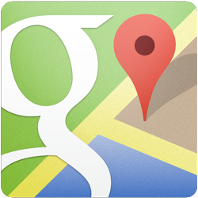
Google Maps
Search & directions
Free text search, depends on zoom level
Directions for travelling by car, bike, public transport and foot
Data compiled from different sources
Maps
Datum: WGS84
Views: map, satellite (= aerial photography), terrain, Google Street View + various layers of information
Data compiled from different sources (indicated at the bottom of each map)
New Google Maps?
http://maps.google.com

Slide 4
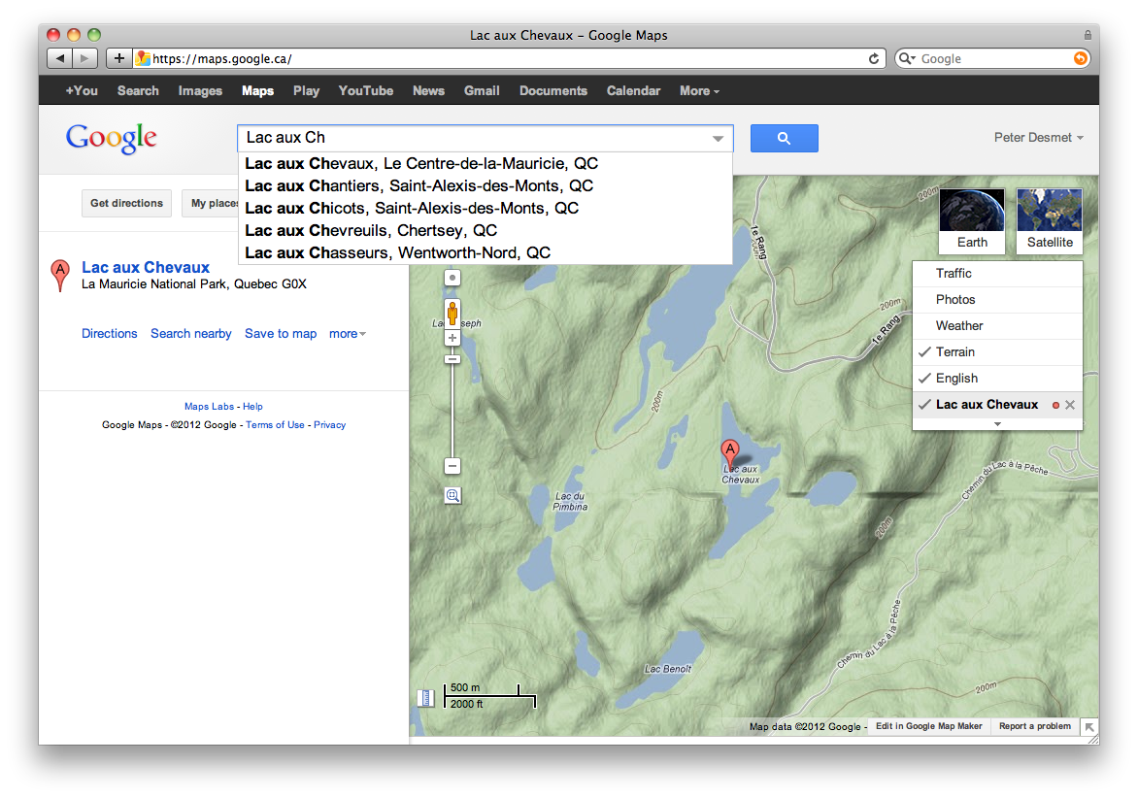
Google Maps – Search
Search with suggestions
Previous searches
Report a problem

Slide 5
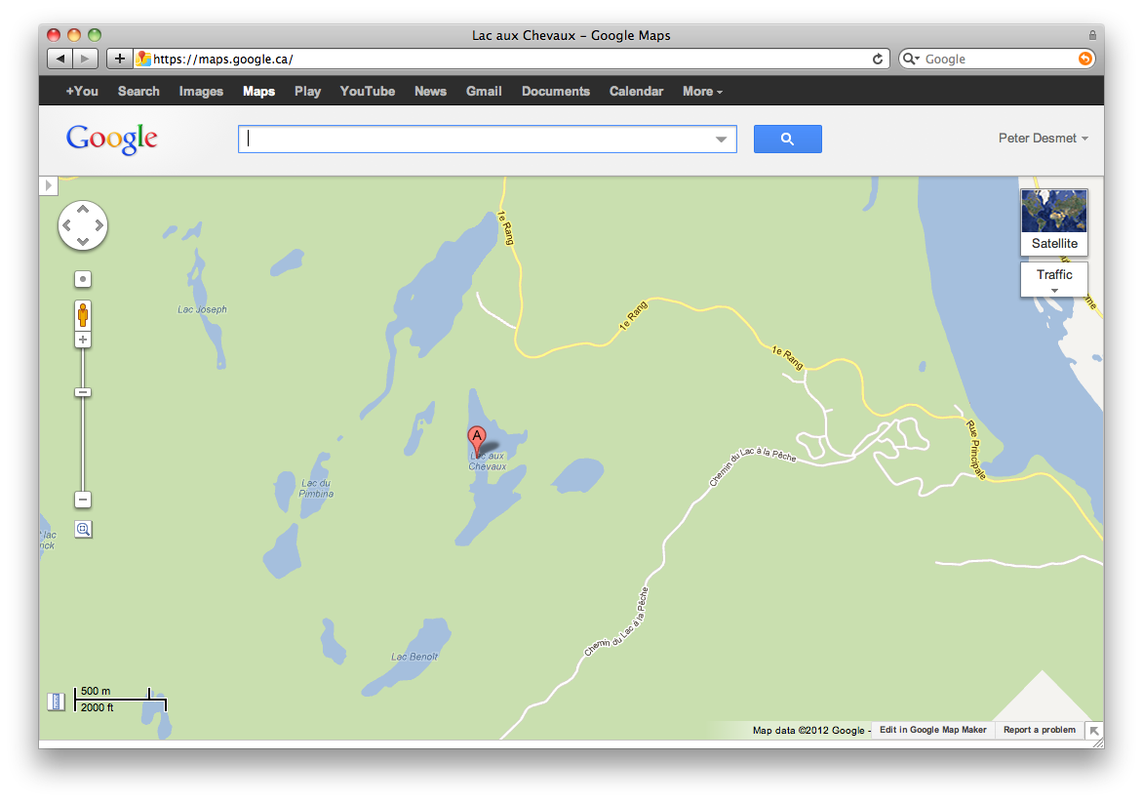
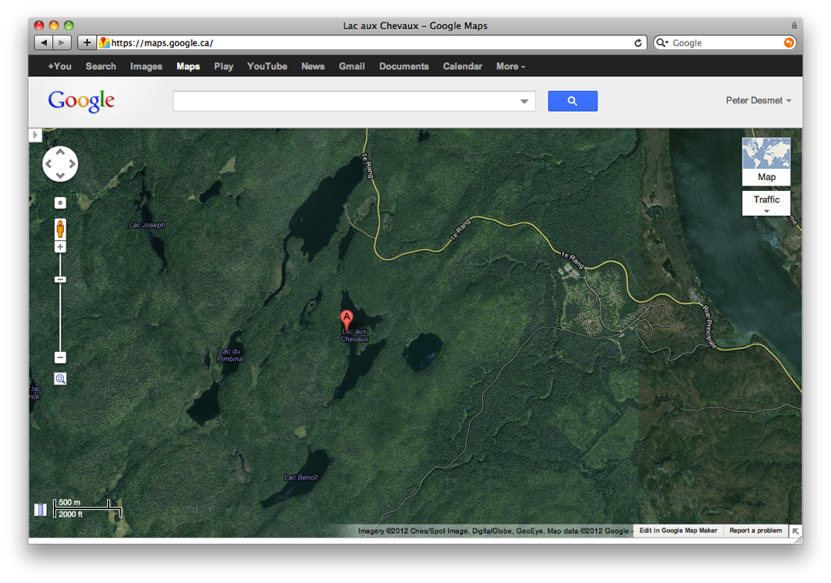
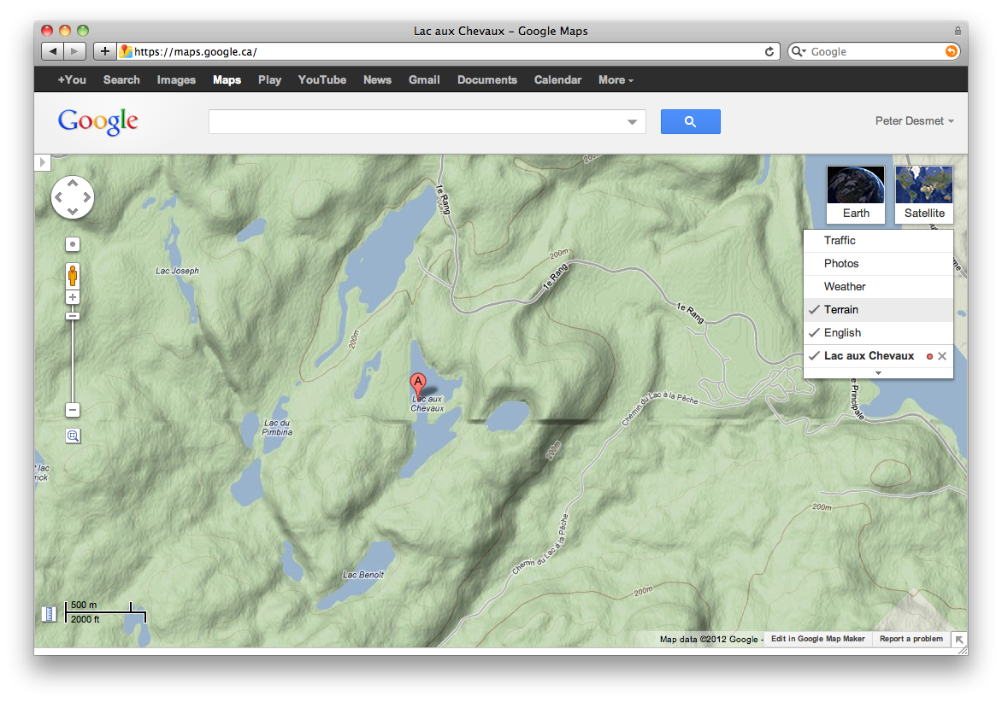
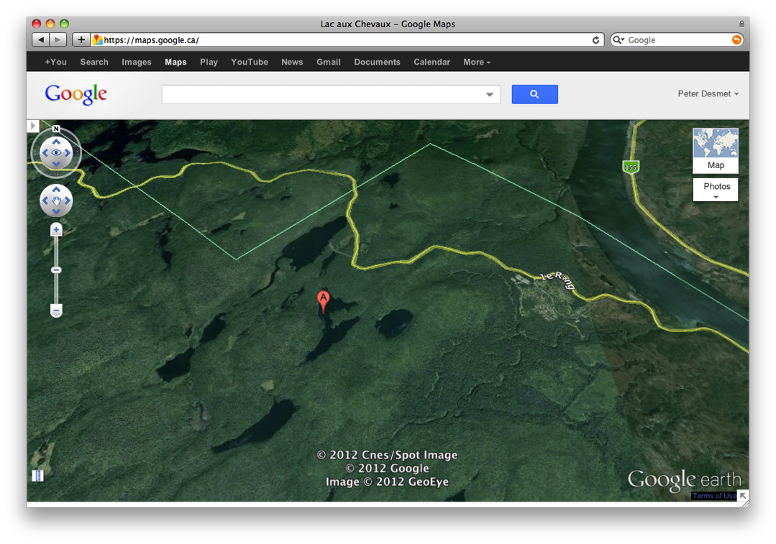
Google Maps – Views
Maps
Satellite
Terrain (under ‘Map’)
Earth (plugin required)

Slide 6
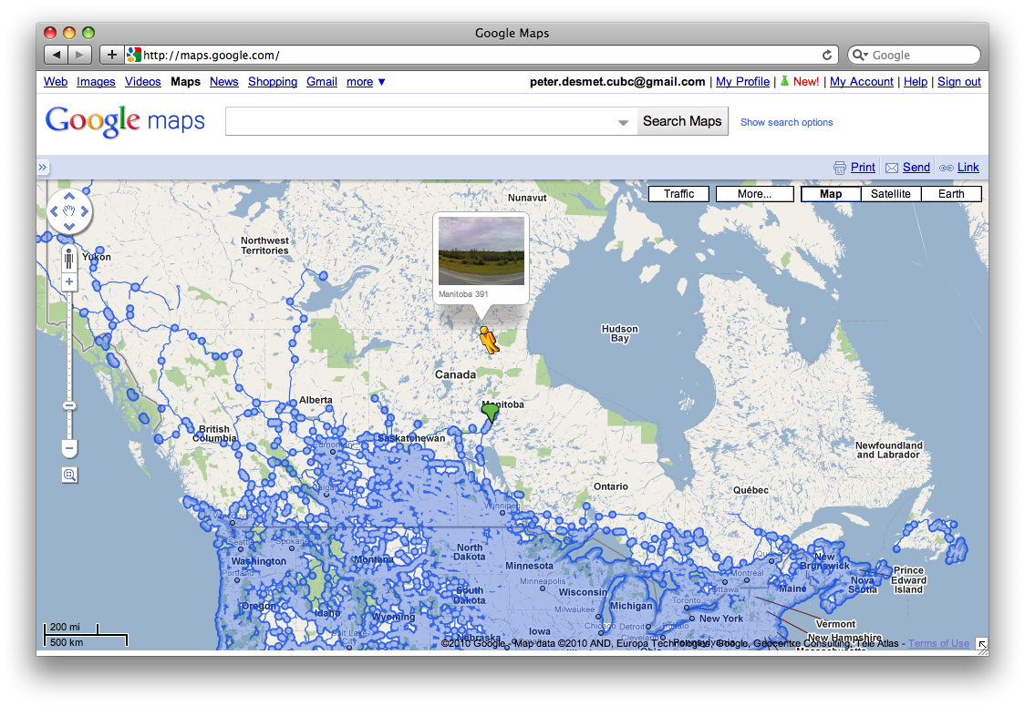
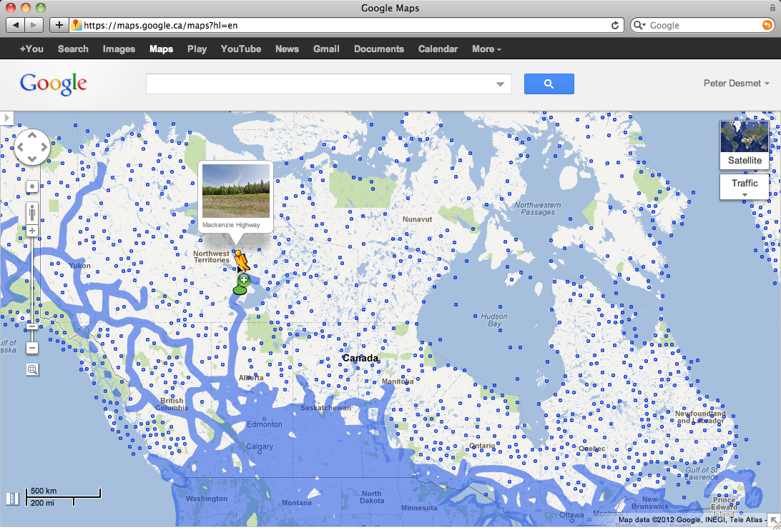
Google Maps – Street View
Street View

Slide 7
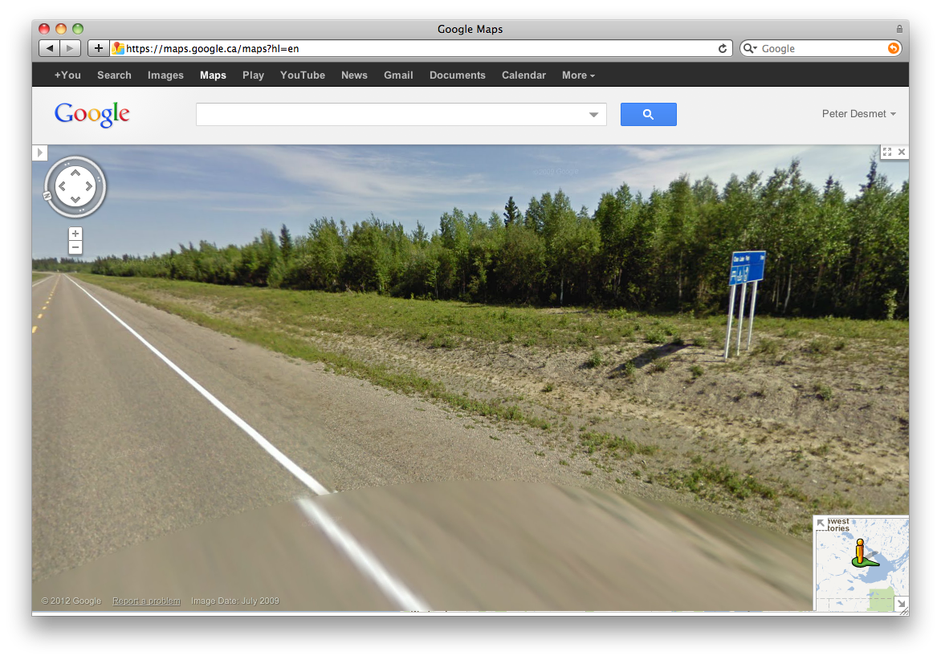
Google Maps – Street View
I collected here

Slide 8
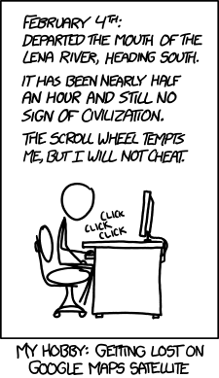
http://xkcd.com/1169/

Slide 9
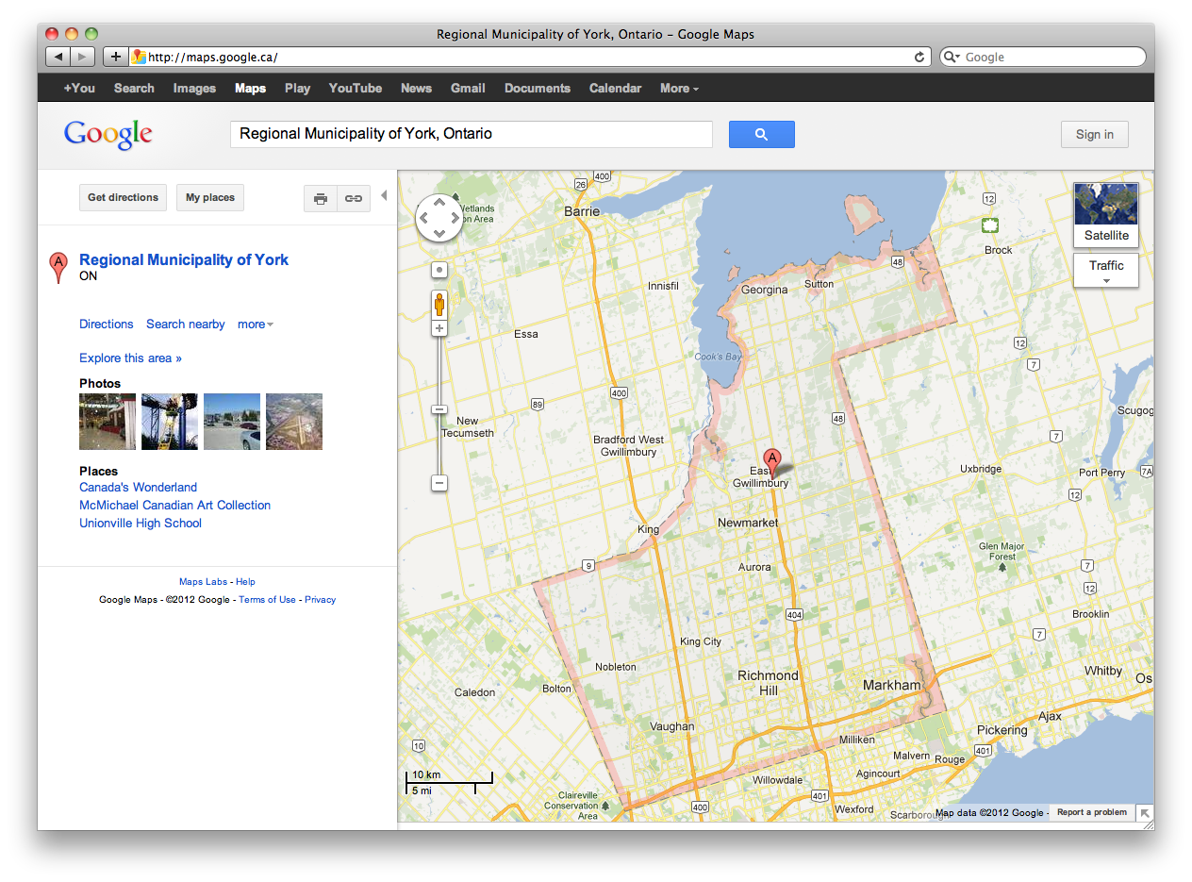
Google Maps – Shapes

Slide 10
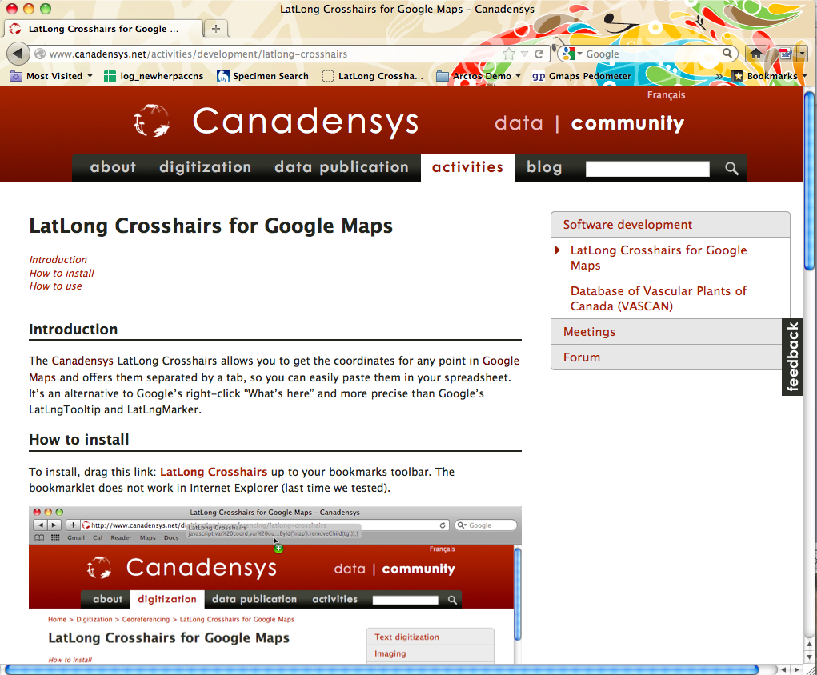
Google maps – get coordinates
http://www.canadensys.net/activities/development/latlong-crosshairs

Slide 11
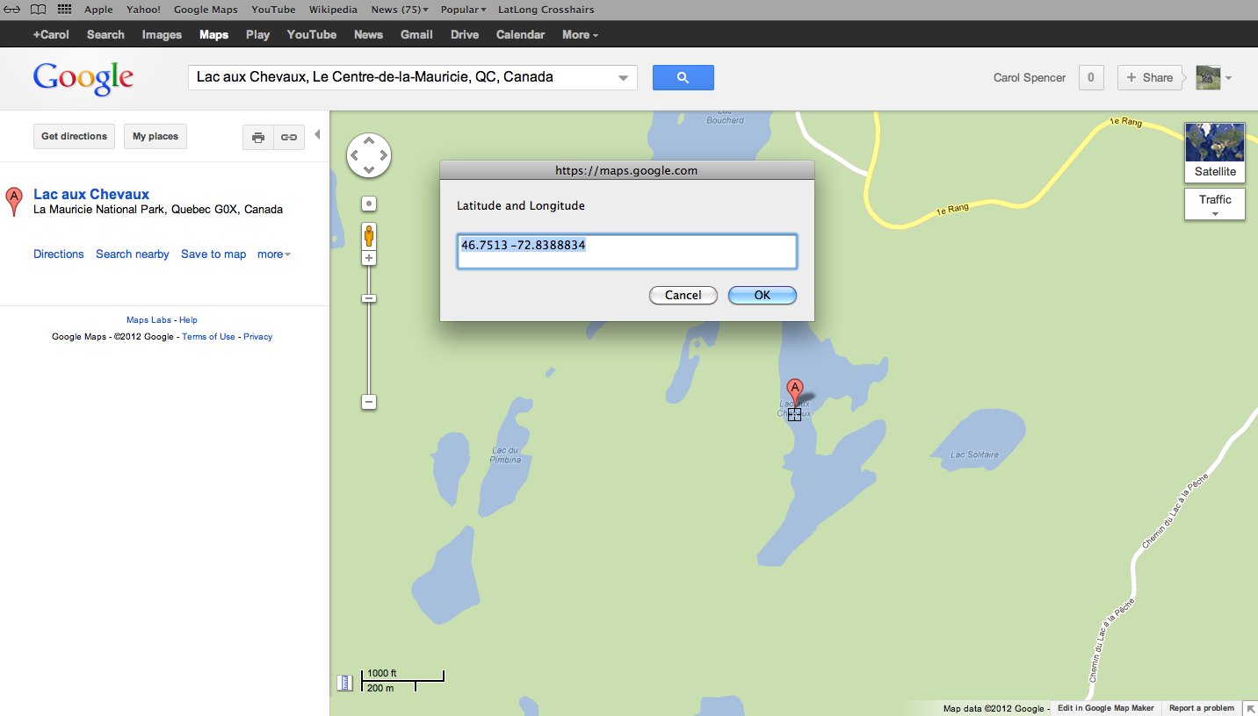
Google Maps – Get coordinates
Canadensys bookmarklet
Click to toggle
Crosshairs
Pan map to change position
Click to get coordinates

Slide 12
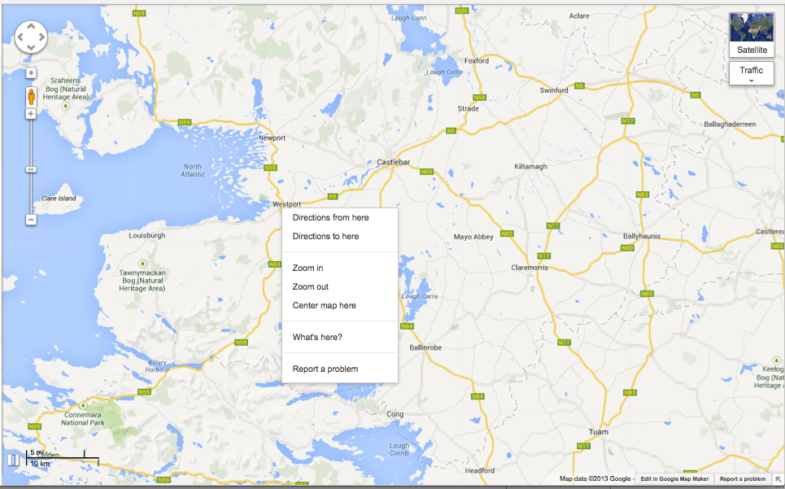
Google Maps – Get coordinates
Use Distance Measurement Tool to measure extent
Use My places to save markers, create maps and share with others (including kml import)

Slide 13
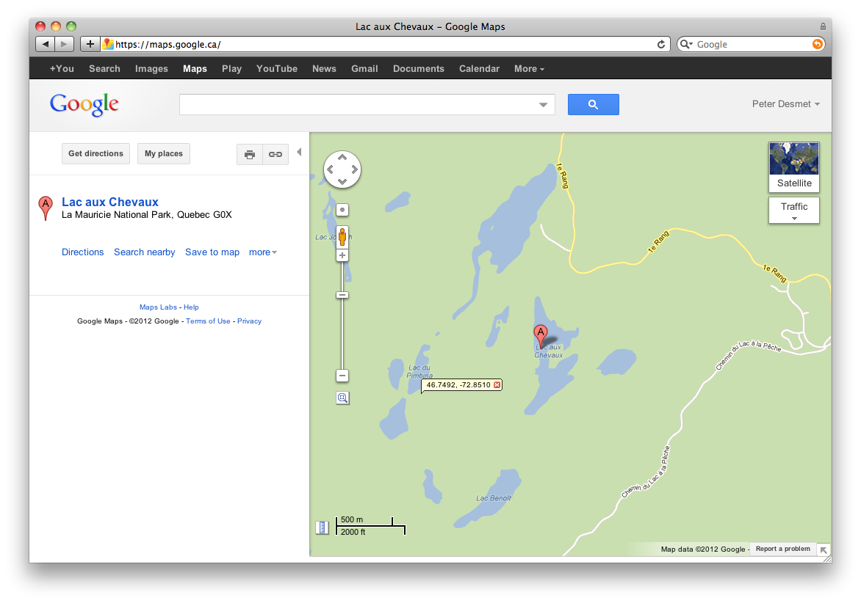
Google Maps – Get coordinates
My places
Google Maps Labs
LatLng Marker
Right-click and‘Drop LatLng Marker’
(activate in ‘Labs’ first)

Slide 14
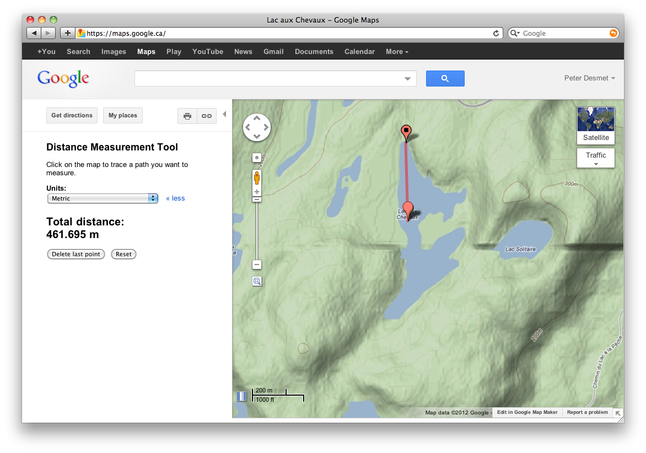
Google Maps – Measure extent
Distance Measurement Tool
(activate in ‘Labs’ first)

Slide 15
Google Earth
3D globe desktop application
Same data as Google Maps
Datum: WGS84
Similar functionalities as Google Maps
Add a placemark to get lat-long
Use ruler to measure extent
Use path to measure along a route
Several coordinate formats
Numerous information layers (format: kml, kmz)
Can flip views between Google Earth and Google Maps
Can save your plotted points
http://earth.google.com

Slide 16
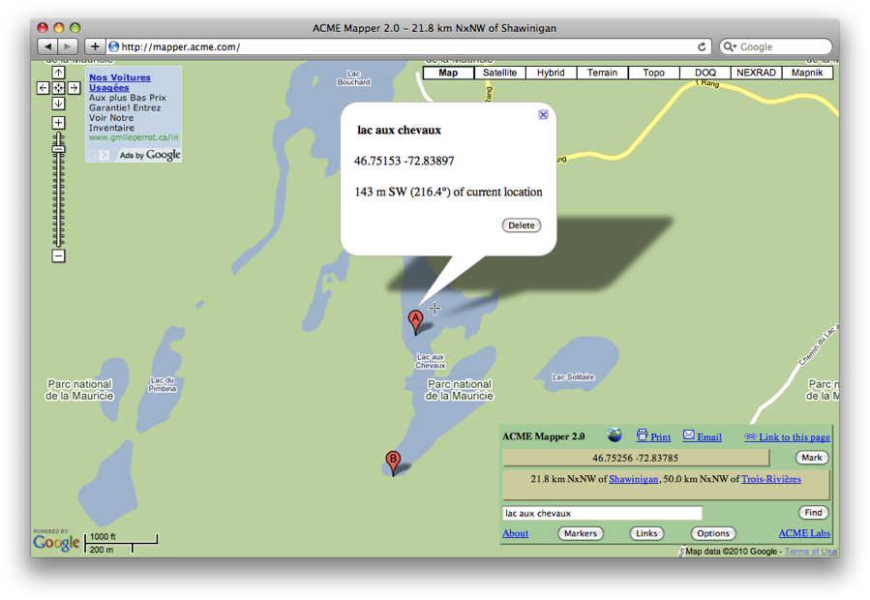
ACME Mapper
Google Maps interface
Datum: WGS84 (& NAD27)
Map, satellite, hybrid and terrain
Topo, DOQ, NEXRAD and Mapnik
Free text search not dependent on zoom level
Markers cannot be moved, but new markers can be placed at crosshairs (click ‘Mark’)
Several coordinate formats for each marker + heading and distance from crosshairs
Saves all markers automatically
Gives you a descriptive locality
http://mapper.acme.com/

Slide 17
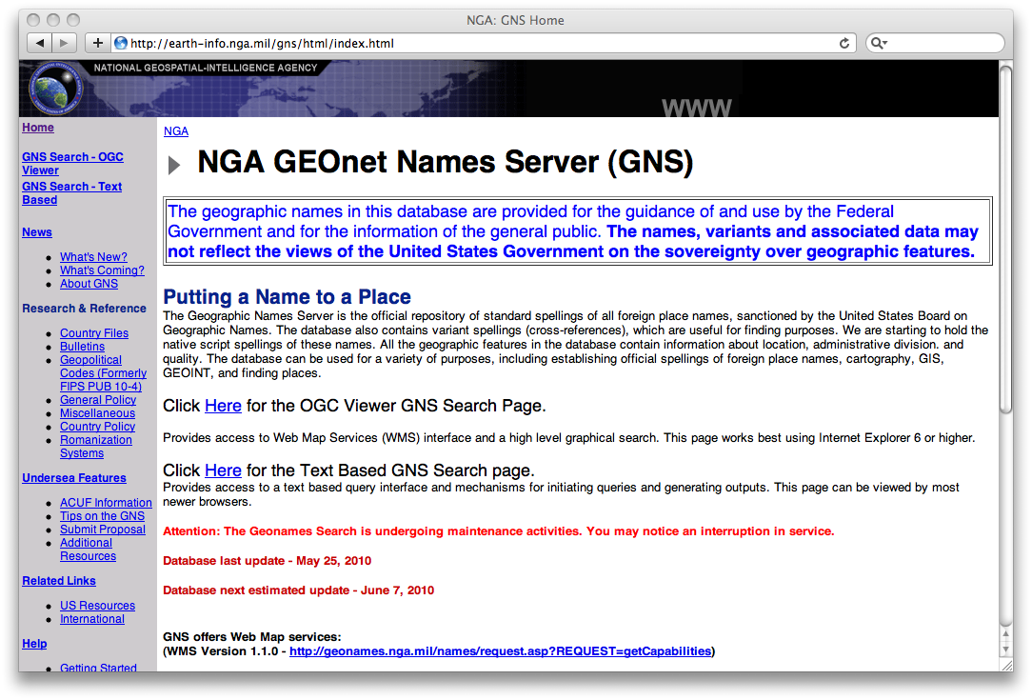
GEOnet Names Server (GNS)
Worldwide data from National Geospatial-Intelligence Agency (NGA) and US Board on Geographic Names (BGN)
NIMA = National Imagery and Mapping Agency
Datum: WGS84
Degrees minutes seconds, precision to nearest minute
Feature type
Used as a source for many gazetteer
http://earth-info.nga.mil/gns/html/
For US data, use Geographic Names Information System (GNIS)
http://geonames.usgs.gov/pls/gnispublic/
Notes:
GNS: GeoNet Names Server
NGA: National Geospatial-Intelligence Agency
US BGN: US Board on Geographic Names

Slide 18
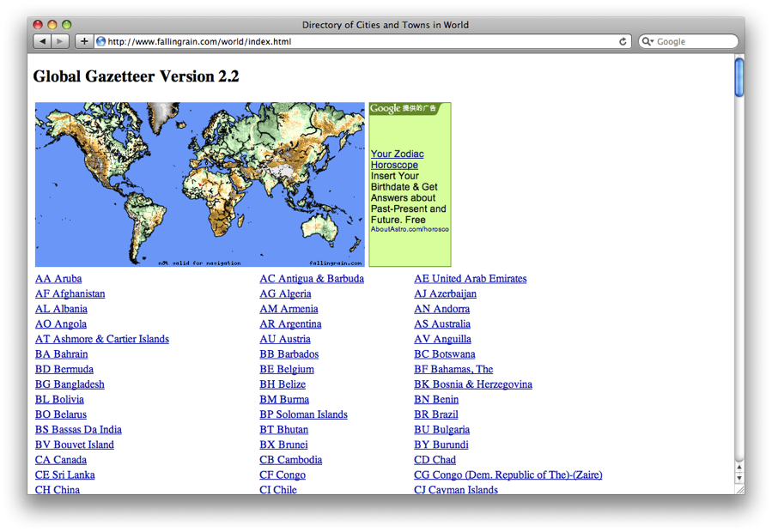
Falling Rain
Worldwide gazetteer for cities and towns
Great for hard to find localities, especially outside US
Datum: WGS84
Degrees minutes (seconds), based on NIMA
Browse to find locality (no search)
Provides hierarchy, alternative names, topo maps, altitude, weather information and location of nearby towns in nautical miles (nm). Use Georef. Calc. to translate nm into kilometers.
Example: Qaryeh-ye Gol`alam, Velayat-e Lowgar, AF
http://www.fallingrain.com

Slide 19
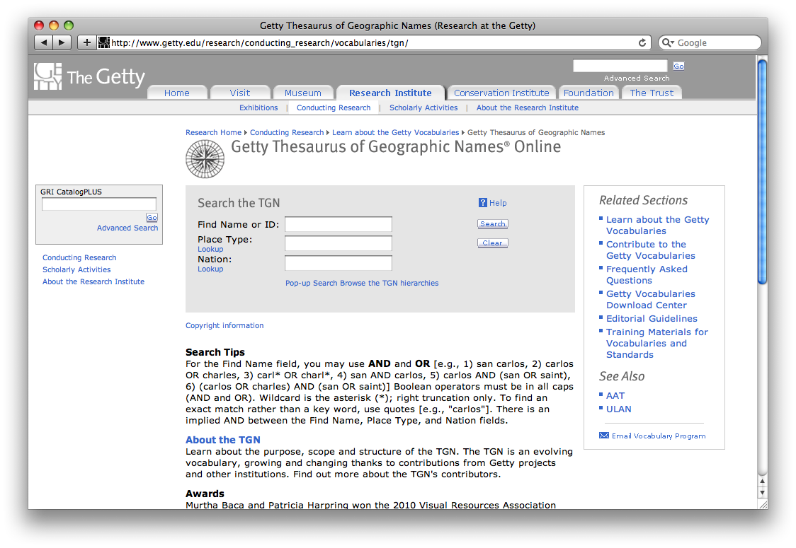
Getty Thesaurus of Geographic Names (TGN)
Worldwide gazetteer by The Getty
Useful for finding alternative and old names
Feature types
Geographical hierarchy
Degrees minutes or no coordinates! Use recent name and search in Google Maps
Example: New Amsterdam, US
http://bit.ly/Getty-TGN

Slide 20
FuzzyG – JRC Fuzzy Gazetteer
Worldwide gazetteer designed for bad spelling.
Useful for finding alternative, doubtful spelling and old names
Feature types, by continent
Degrees minutes or no coordinates
Use recent name and then search in Google Maps
Example: Narobi instead of Nairobi, Africa
http://dma.jrc.it/services/fuzzyg/

Slide 21
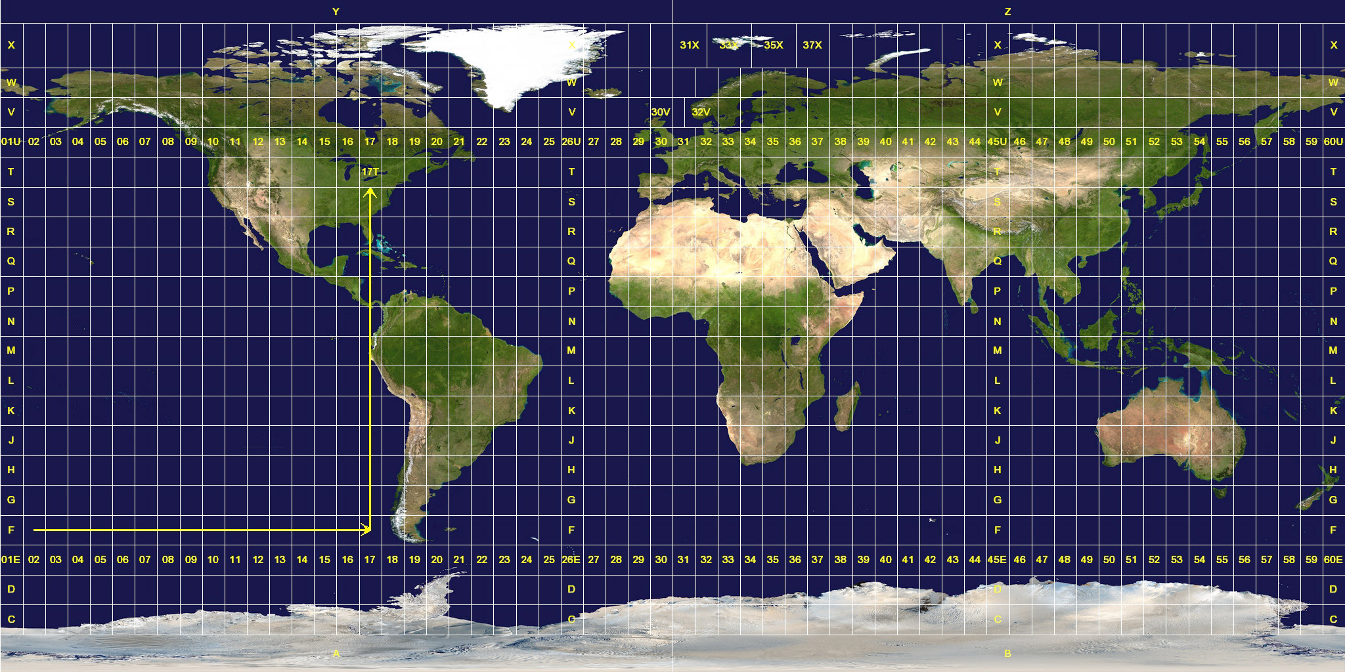
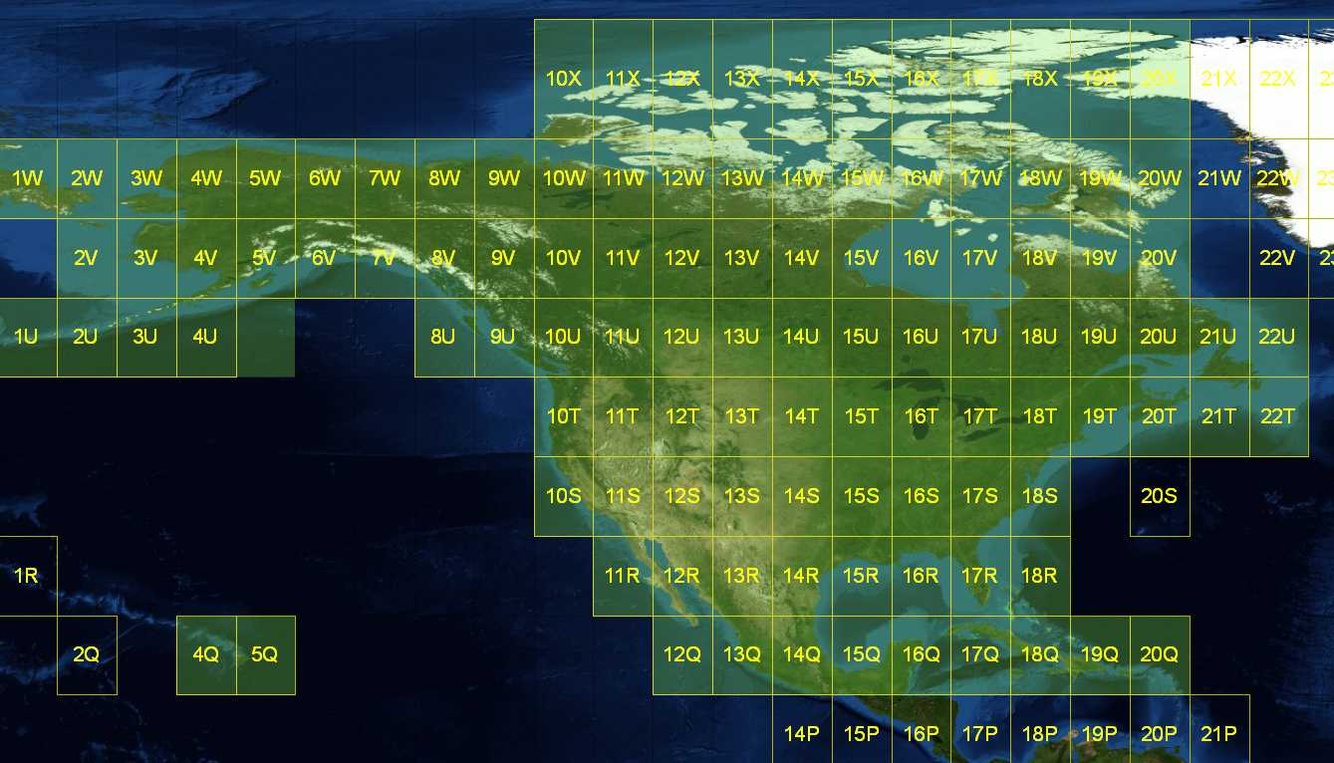
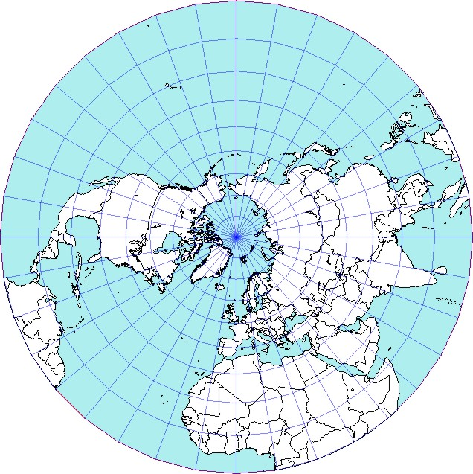
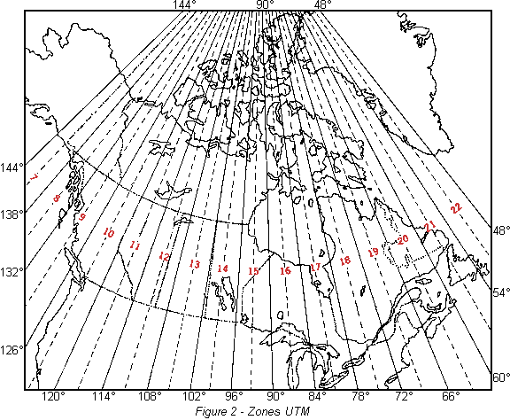
UTM (MGRS, UPS) and MTM
UTM = Universal Tranverse Mercator
Divides earth in 60 UTM zones = 6 deg per zone
Datum: WGS84 and others
Notation: Zone Easting Northing = 17N 630084 4833438
Zone includes hemisphere (17N) or latitude band (17T) Default extent: 30m (if recorded with GPS receiver)
MGRS: military grid reference system, based on UTM and UPS (universal polar stereographic coordinate system), different labeling
MTM = Modified Tranverse Mercator
Used in Canada: zones are 3 degrees, different codes, false easting and scale, etc.
Conversions: http://leware.net/geo/utmgoogle.htm (UTM/MTM to google), http://www.earthpoint.us/Convert.aspx

Slide 22
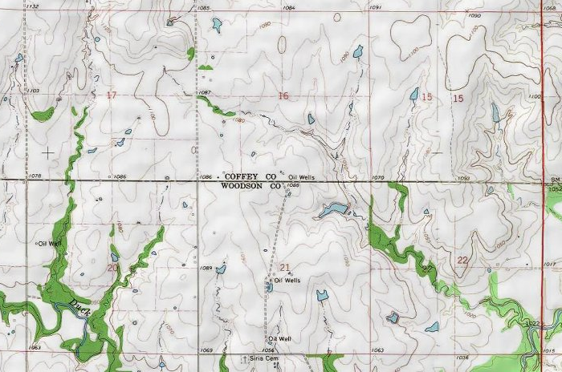
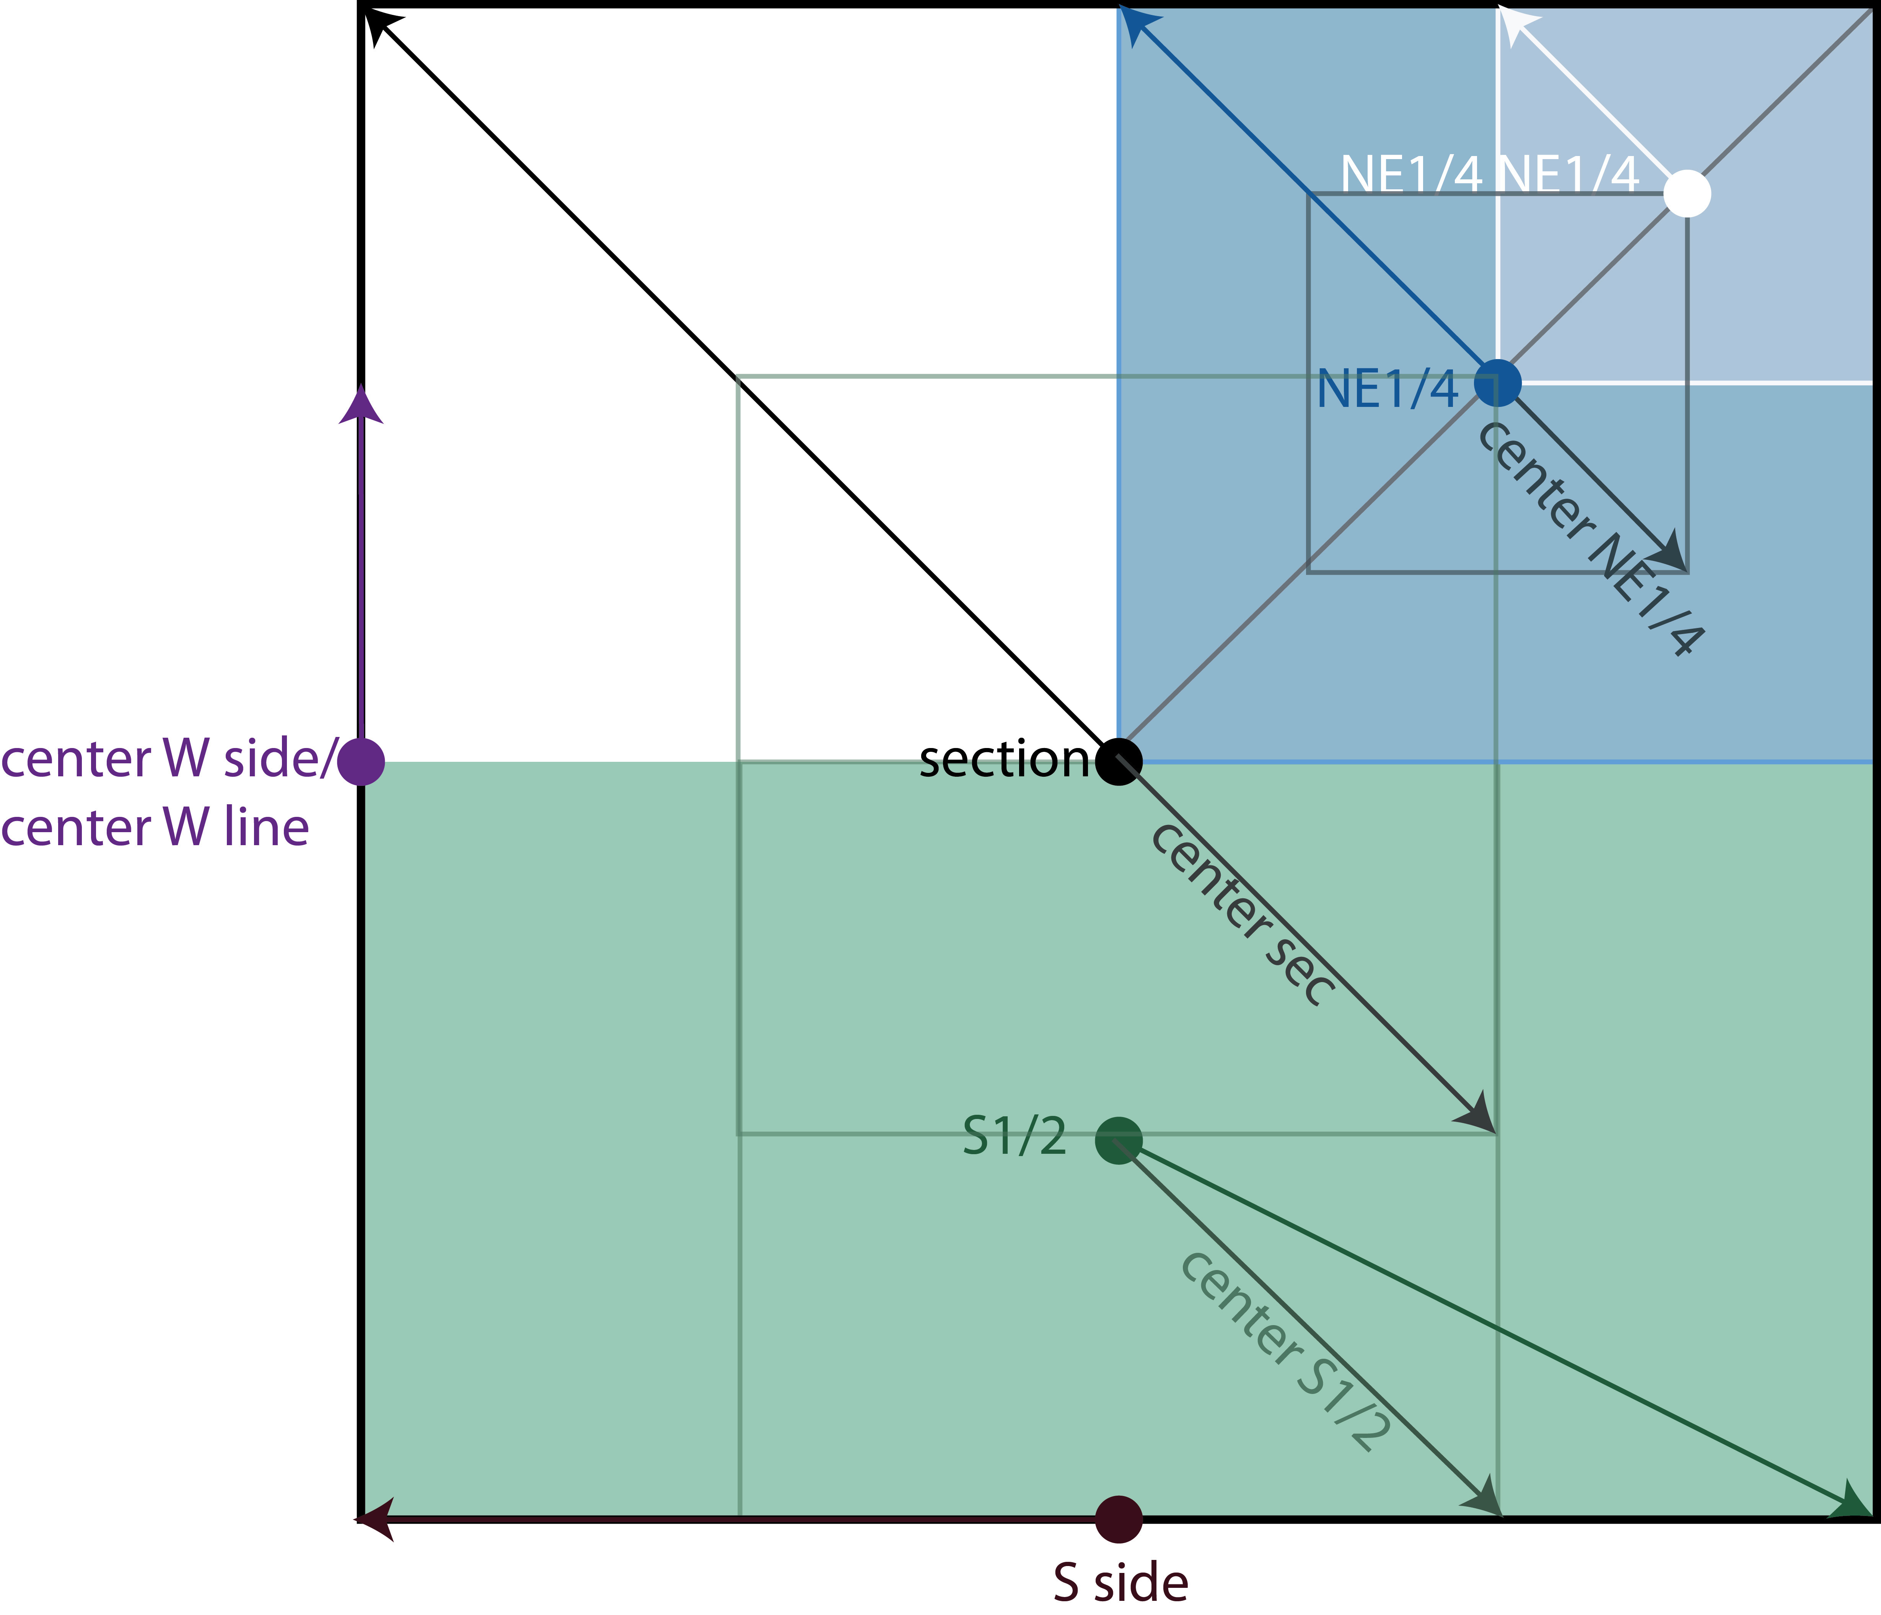
Public Land Survey System (PLSS)
Mainly used in the West, Midwest and some Southern states in the US
Uses Township-Range-Section (TRS): T13N-R14E-S15, Arizona, Coconino County
For extents: http://manisnet.org/ GeorefGuide.html
To get lat-long/plot on google earth: http://www.earthpoint.us/
Grid for Google Earth: http://www.metzgerwillard.us/plss/plss.html

Slide 23
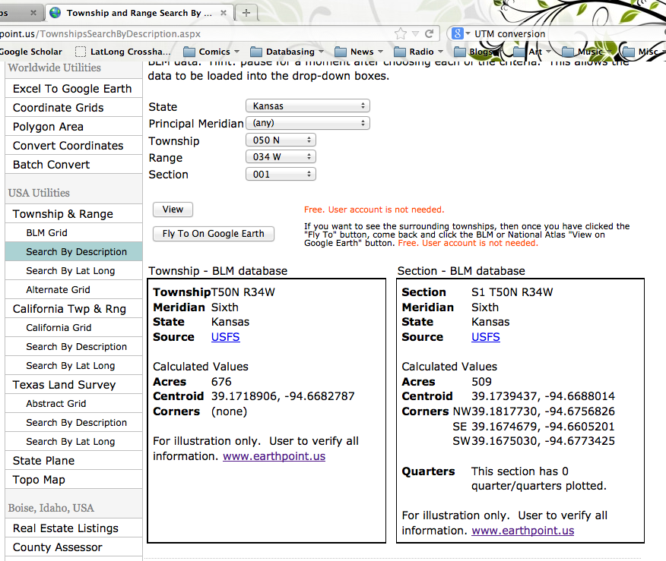
PLSS/TRS – Earth Point

Slide 24
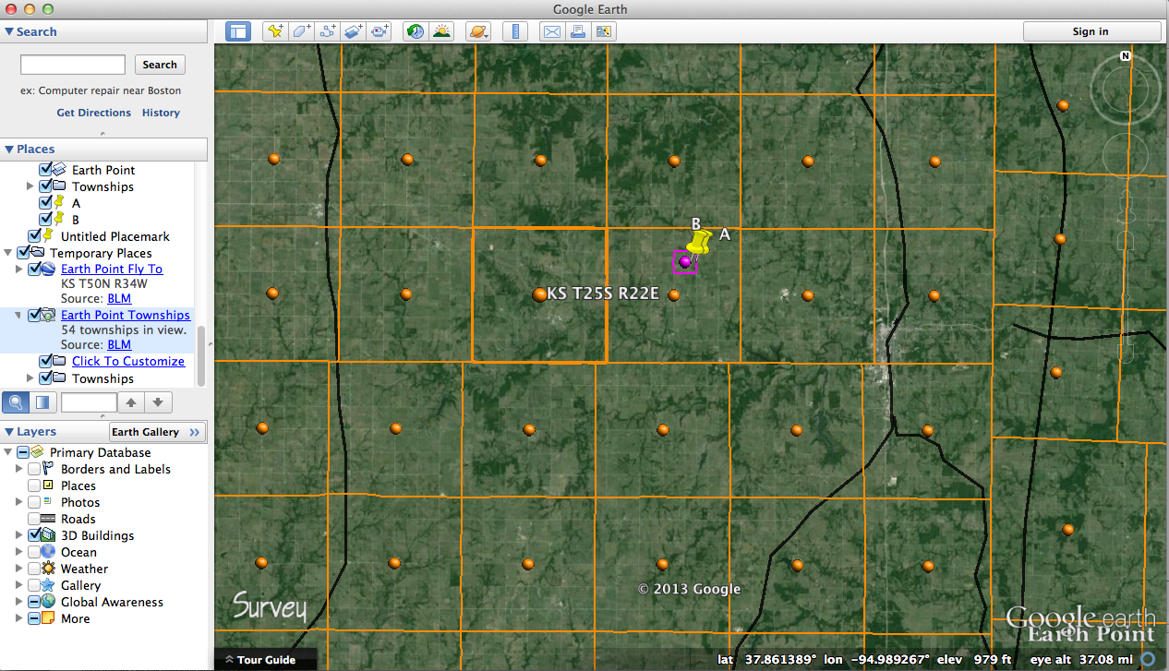
PLSS/TRS – Earth point to Google Earth

Slide 25
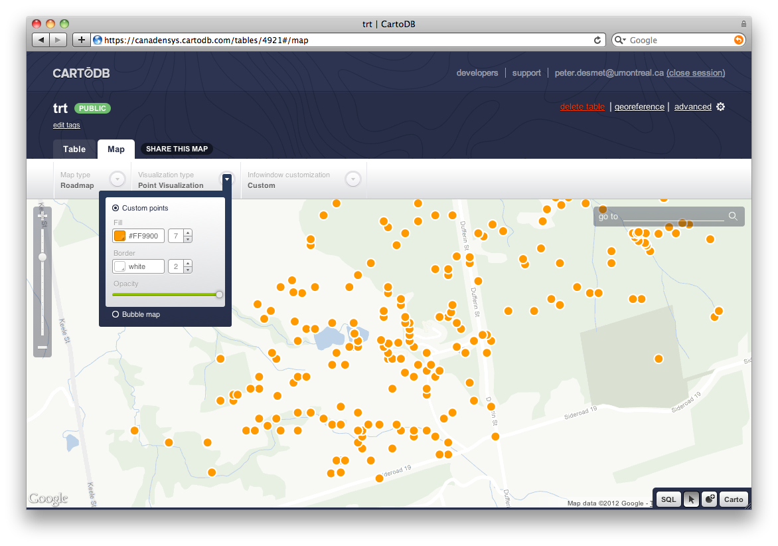
Other tools - Visualizing data
GPS Visualizer (http://www.gpsvisualizer.com/)
Use to translate a file with coordinates into kml or a picture
Simplemappr (http://www.simplemappr.net/)
Similar - for publication
CartoDB (http://cartodb.com)
Online geospatial database by Vizzuality
Useful for visualizing your data
Drag and drop CSV upload
Easy customization of your map
Share and embed your map
Powerful development tools
Free account = 5 tables / 5MB of data

Slide 26
Other tools
Wikimedia Commons Atlas of the World: (http://commons.wikimedia.org/wiki/Atlas)
An organized and commented collection of geographical, political, and historical maps
Statoids (http://www.statoids.com/)
Information about administrative divisions (provinces, counties) and their history, area, population, codes, etc.
No coordinates!
CIA World Factbook (http://bit.ly/dDtT1i)
Similar to Statoids

Slide 27
Links
Google Maps: maps.google.com
LatLong crosshairs: www.canadensys.net/latlong-crosshairs
Hard to find localities: www.fallingrain.com
Old & alt. names: bit.ly/Getty-TGN
PLSS/TRS: www.earthpoint.us
UTM map: www.dmap.co.uk/utmworld.htm
UTM calculator: http://www.earthpoint.us/Convert.aspx
Other tools: bit.ly/herpnet-georef-resources

Slide 28
Other links
ACME mapper: http://mapper.acme.com/
Google Earth: http://earth.google.com
GEOnet names server (GNS) for worldwide data: http://earth-info.nga.mil/gns/html/
Geographic Names Information System (GNIS) for US places:http://geonames.usgs.gov/pls/gnispublic/
For plotting data: http://cartodb.com, http://www.simplemappr.net/,
http://www.gpsvisualizer.com/

Slide 29
Even more links..
http://www.openstreetmap.org/: free, editable map of the world
http://global.mapit.mysociety.org/: can give you administrative boundaries if you have a lat-long (could be useful for verifying localities outside the US)
http://www.oldmapsonline.org/ and http://www.davidrumsey.com/: historical maps
http://www.gelib.com/ng-topo.htm: topo map overlay for Google Earth
http://mrdata.usgs.gov/geology/state/: geology layers for Google Earth
http://www.nrcan.gc.ca/earth-sciences/geography-boundary/geographical-name/11680: natural resources of Canada
http://www.lib.utexas.edu/maps/map_sites/cities_sites.html: Univ. of Texas at Austin Perry Castenada Map Library
http://www.gadm.org/: Global Administrative Boundaries Database
http://www.geody.com/ : Google Earth wiki
http://www.naturalearthdata.com/: for making maps
http://geo.data.gov/geoportal/catalog/main/home.page: various geographical datasetshttp://maps.nls.uk/: historical maps of Scotland/Great Britain/Ireland and Belgium
http://cidades-brasil-ibge-google-earth.softonic.com.br/download: cities in Brazil for google
http://www.topomapper.com/: compare topo and google maps side by side.
http://www.bl.uk/maps/, http://www.bl.uk/maps/georeferencingmap.html: British Library crowdsource project for historical maps
http://www.uwgb.edu/dutchs/usefuldata/ConvertUTMNoOZ.HTM: UTM and other useful resources

