Slide 1
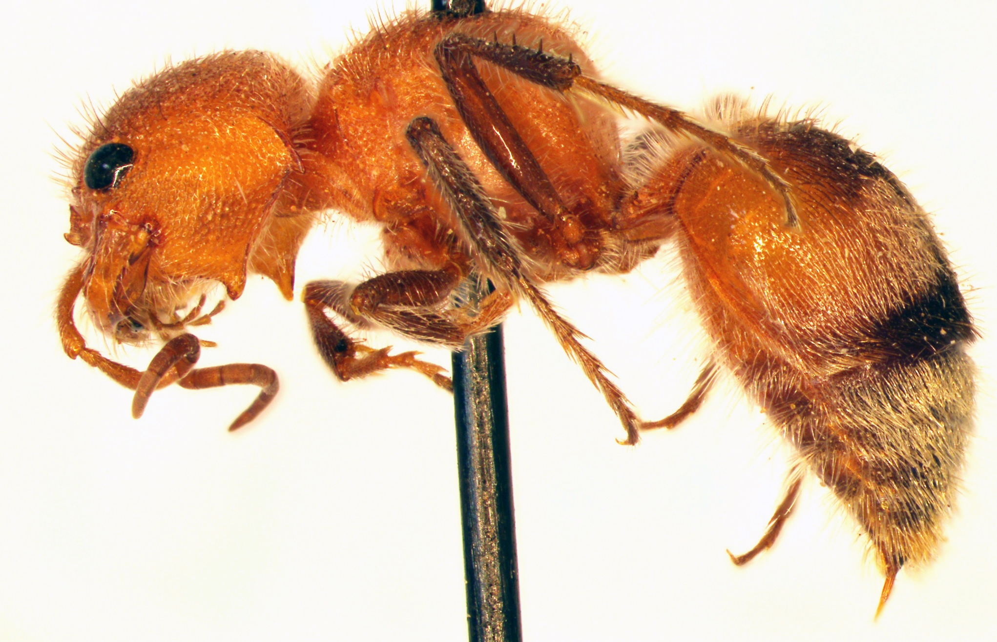
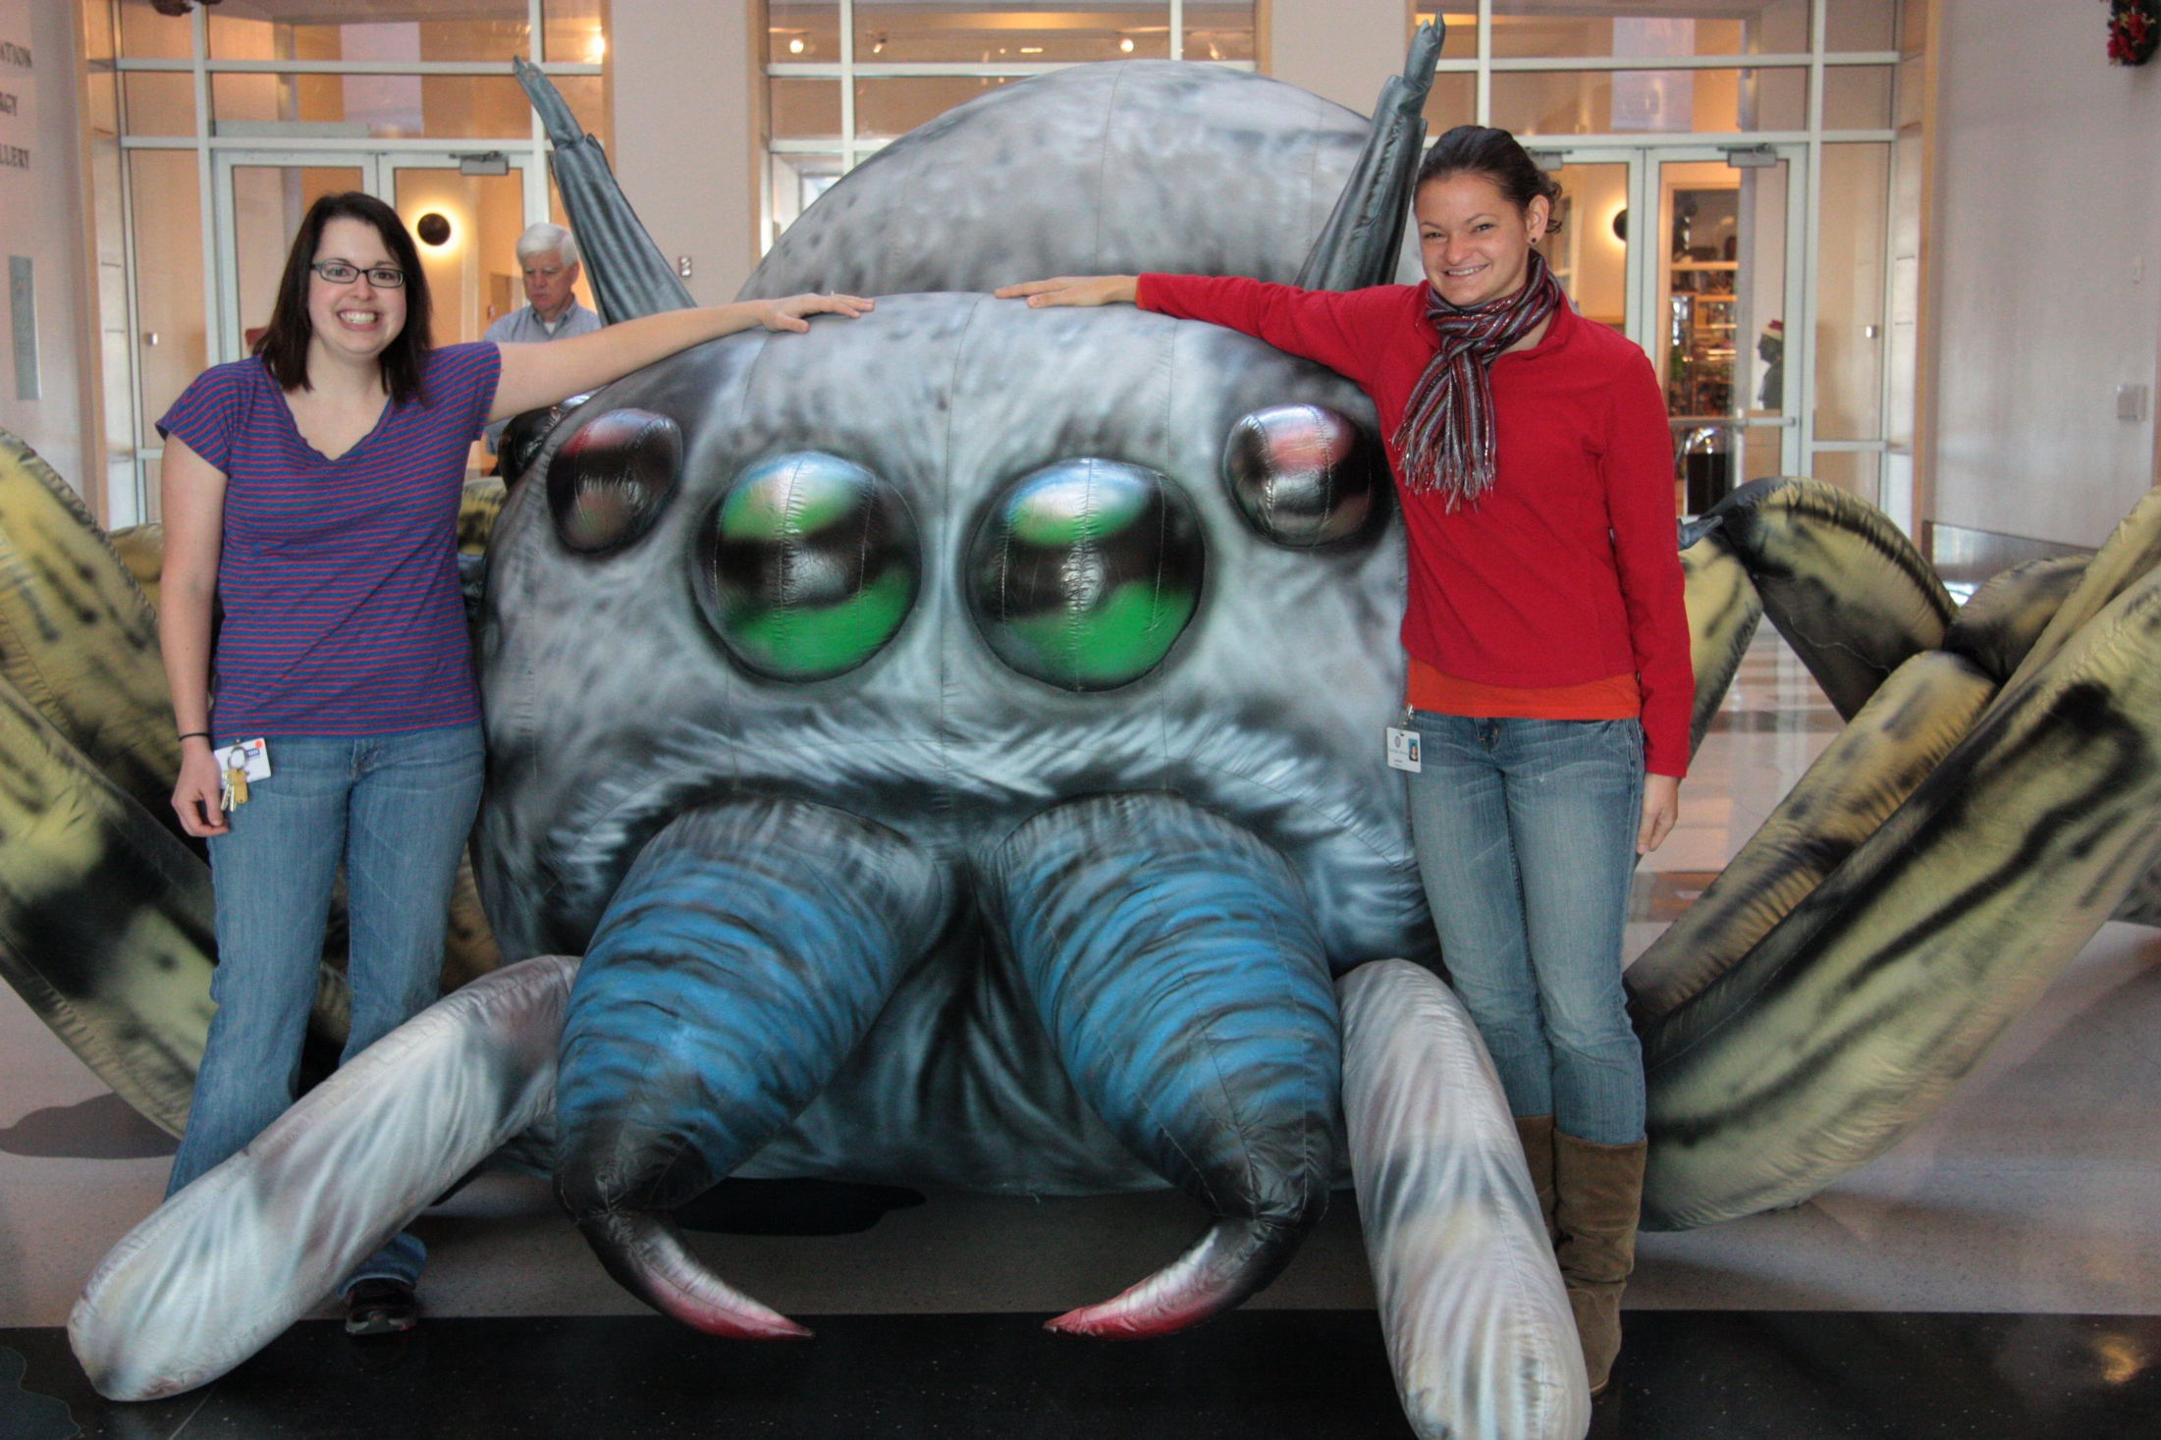
Sam Noble Oklahoma Museum of Natural History
Current Project: Mutillidae of Oklahoma
Specimens to be georeferenced: Historical specimens collected in the 1900s-1940s from our collection; important data points for distribution and ecological studies. Possibly extend to include georeferencing of some of Oklahoma State’s Collection. Project: 2,000 specimens. Total Collection: 500,000+ specimens.
Issues: georeferencing ambiguous localities; old localities
Goals: minimally georeference all our our Mutillidae records; use skills to georeference all of our other historically important material.
Trainees: undergraduate students, graduate students, Collection Manager
Methods: possible crowd-sourcing; digital recourses and software. Incorporate more georeferencing with Citizen Science project on iNaturalist.

