Slide 1
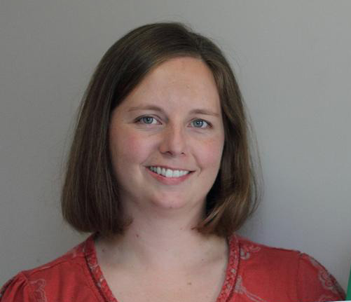
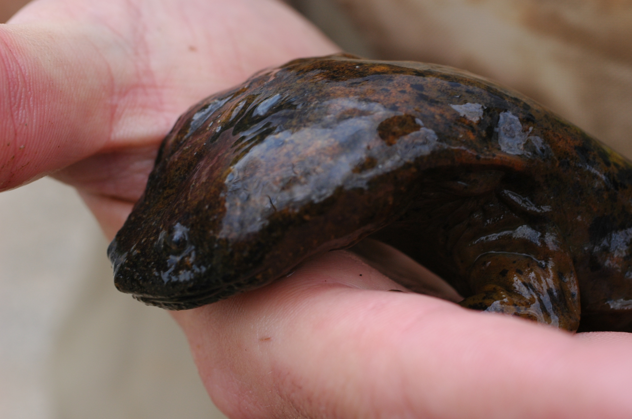
Improving Utility and Accessibility of the APSU
Natural History Collections
Collaborators/Curators: R. Blanton Johansen (Fishes),
L.D. Estes (Herbarium), C.M. Gienger (Herps)
140,000 cataloged specimens (vertebrates and plants) in APSU’s David H. Snyder Museum of Zoology and Herbarium
- Largest herp. and second largest plant collection in TN
- Data contained in several Access databases with limited to no online access
Approx. 50% not georeferenced; others require review/revision
- Generated from GPS, topo maps, and GEOLocate; lack measures of accuracy
- Herps, as single column: 351821N;900355W
Overall Goals:
1. Build single Specify database for collections
2. Georeference all specimens (as possible) and revise existing data for others using best current methods
3. Make database accessible online

Slide 2
Improving Utility and Accessibility of the APSU
Natural History Collections
Collaborators/Curators: R. Blanton Johansen (Fishes),
L.D. Estes (Herbarium), C.M. Gienger (Herps)
Also will provide foundation to improve existing online resources:
- The Atlas of Amphibians in TN; The Atlas of Reptiles in TN
- distributional maps of species currently “hand-made”; static content
- Tennessee Plant Community Website (in prep)
- Interactive mapping of plant communities (e.g., cedar glades in TN), etc.
Training:
- Collection curators (faculty), students assisting in collection management, and agency personnel using collections as a repository
- Lecture series provided to APSU BIO-GIS students in spring

