Slide 1
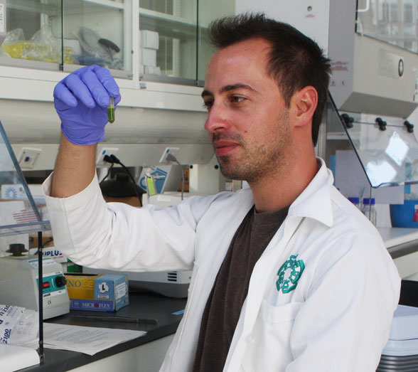
FLORIDA MUSEUM OF NATURAL HISTORY Georeferencing Training Project
Grant Godden
Botany PhD Candidate, Dept. of Biology
FLMNH Molecular Lab (Soltis)
iDigBio RA
30M+ Specimens
Butterflies & Moths, Fishes, Mammals, Mollusks & Marine Invertebrates, Reptiles & Amphibians, Plants
Invertebrate & Vertebrate Paleontology, Paleobotany, & Palynology
FLMNH Faculty, Staff, Students, & Volunteers
GEOLocate (Specify)

