Slide 1
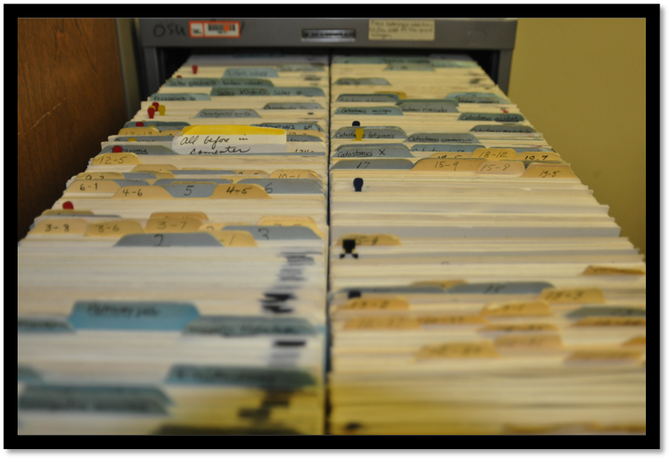
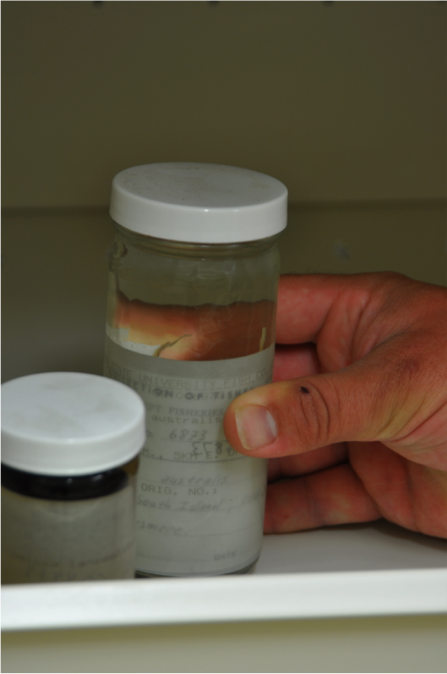
Ben Frable
Oregon State Ichthyology Collection
Georeferencing the Oregon State Ichthyology:
eight decades of backlog and paper records
10000 lots need to be georeferenced and 10000 more might as well!
The other collections have at least, 10000 mammals, 3000 birds
I will train undergraduate workers and volunteers and collection staff and professors in the other collections
We will probably use crowd sourcing

