Slide 1
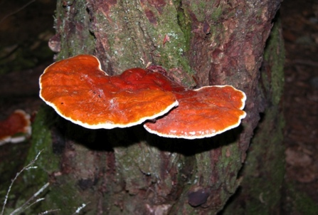
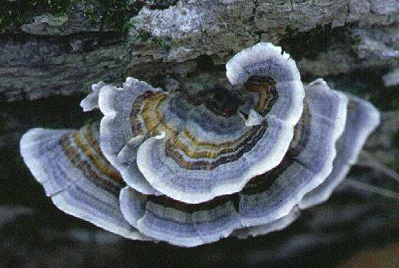
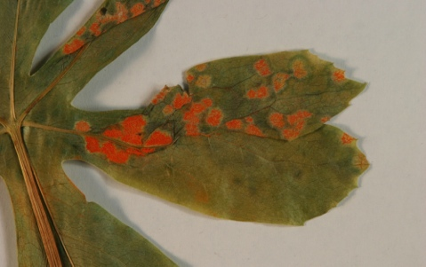
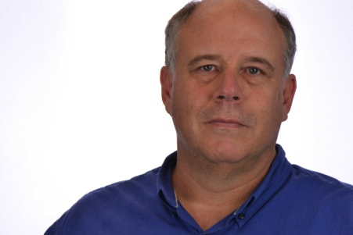
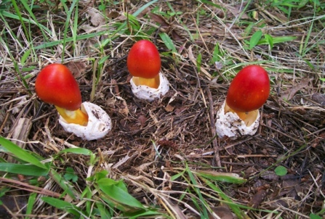
Larry F Grand Mycological Herbarium
DEPARTMENT OF PLANT PATHOLOGY
North Carolina State University
Research and Educational Use of North Carolina State University Mycological Herbarium Through Improved Computerization and Internet Presence & The Macrofungi Collection Consortium
> 8,000 Collections
Fungi (Wood Decay, Plant Pathogens, Jelly, Rust and Smut)
Undergraduate and graduate students, volunteers, high school teachers, staff and faculty
Specimen by specimen and automation
Notes:
Bryan Cody

