Slide 1
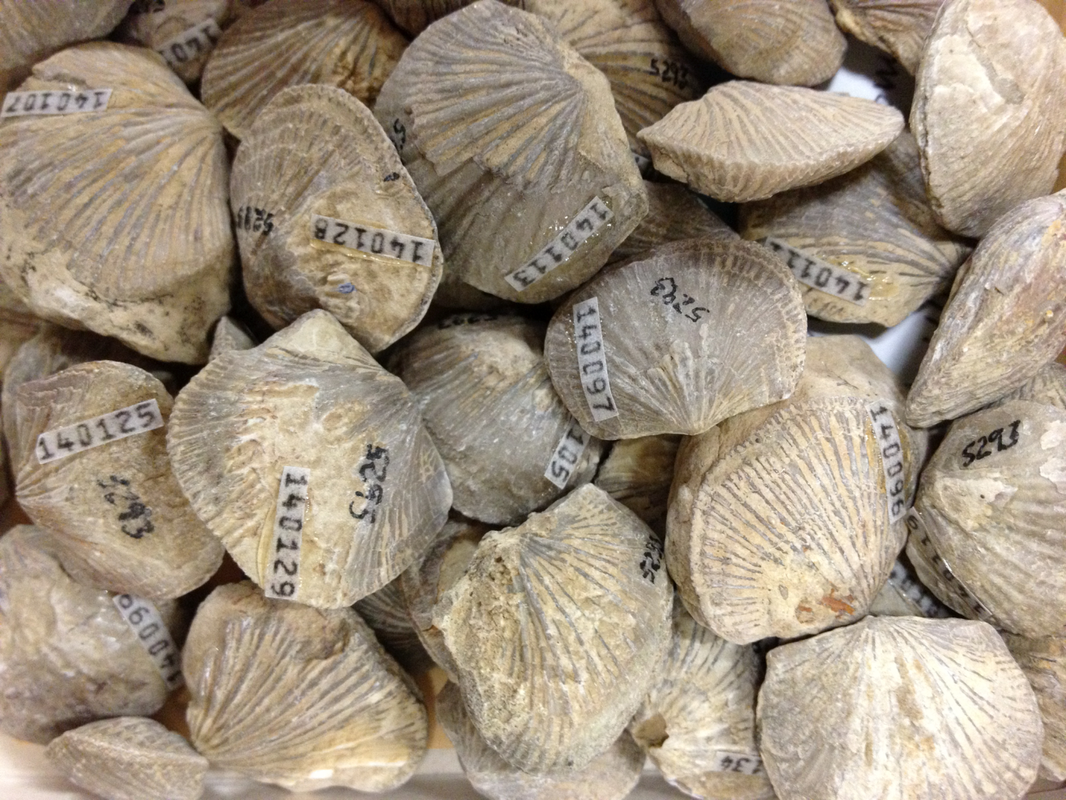
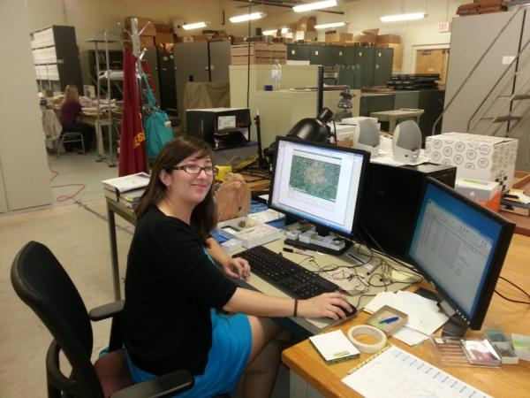
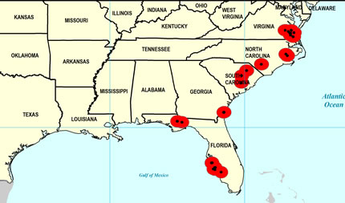
Paleoniches: Digitizing Fossils to Enable
New Syntheses in Biogeography
6 institutions, ~450,000 invertebrate fossil specimens, ~11,500 localities
Ordovician (485-443 Ma) – Cincinnati Region >1,500 localities
Pennsylvanian (323 -289.9 Ma) – Mid-continent ~7,000 localities
Neogene (23 – 2.6 Ma) – Gulf/Atlantic Coastal Plain >3,000 localities
Late Pliocene Ecphora quadricostata
Specify
GEOLocate
Google Earth

