Slide 1
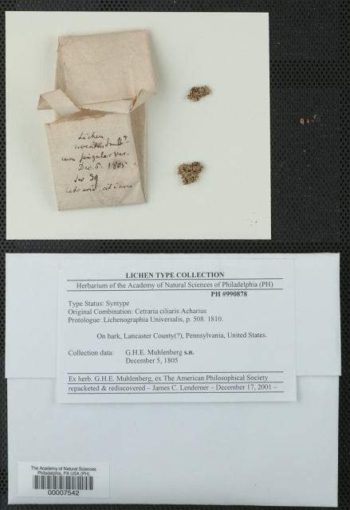

Lichens, Bryophytes and Climate Change
Project to image and transcribe label data of NA specimens from over 60 herbaria (http://lbcc.limnology.wisc.edu)
2.4 million to be imaged, ca. 30% will need to be Geo-referenced, as multiple specimens typically collected at one location (UW-Madison estimate ca. 105,000 specimens)
Supervised batch processing, crowdsourcing , etc. will be used.
Students, staff and volunteers to be trained. Online training to be implemented
Consortium of NA Lichens (lichenportal.org)
Consortium of NA Bryophytes (bryophyteportal.org)

