Slide 1
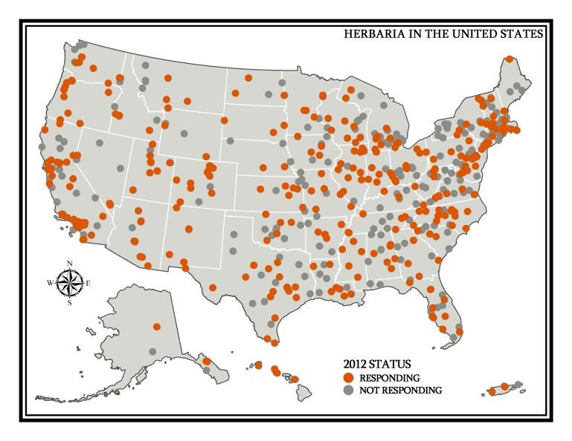
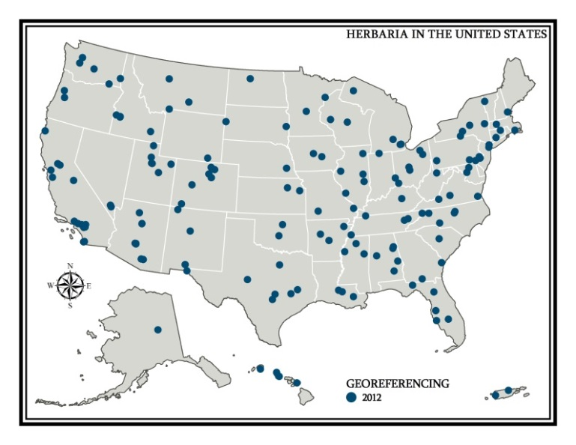
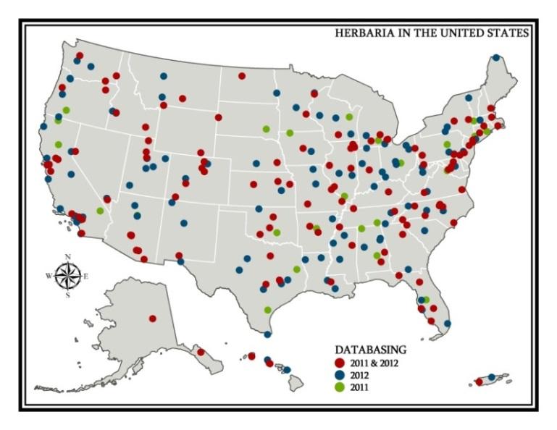
National Network Needed!
More efficient data capture, georeferencing, datacleaning
Contribute cleaner data to iDigBio
Better user experience
Herbaria
Lat/Long
2012
600 - 800 herbaria
~75 million specimens
~15% with lat/long
83 provide local access
71 in regional network
3 taxonomic networks
Mary Barkworth Co-chair USVH
Director, Intermountain
Herbarium
Databasing
Regional Networks

