Slide 1
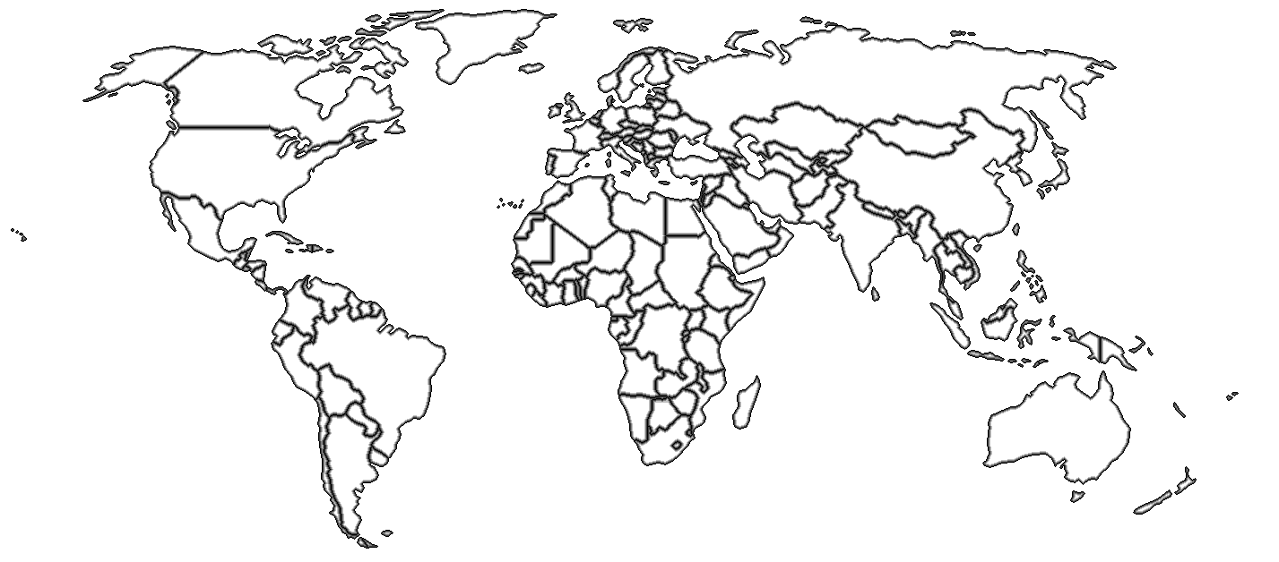
Train-the-Trainers 2
Workshop Overview
August, 2013
iDigBio, Gainesville, Florida
(What have we gotten ourselves into?)

Slide 2
Georeferencing
Collaborations
Automation
Notes:
testing slide 2

Slide 3

Georeferencing Concepts

Slide 4
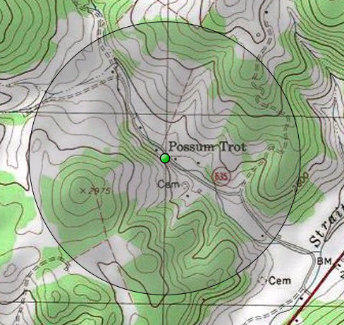
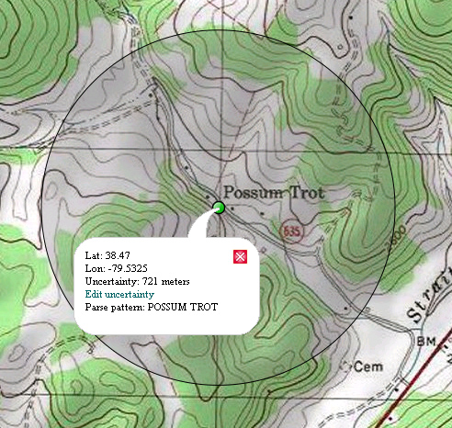
Point Radius Method
Uncertainty and Best Practices

Slide 5

Good and Bad Locality Descriptions
Elements and Examples

Slide 6
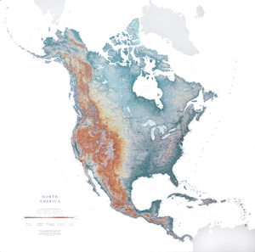
Georeferencing with Paper Maps
Map Basics
How to Georeference with Paper Maps
  Latitude and Longitude Mathematically
  Error Calculator

Slide 7
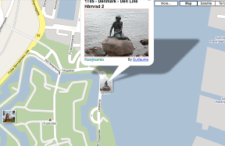
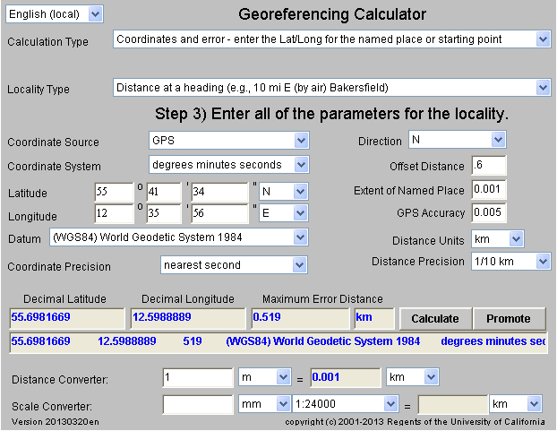
Georeferencing Error Calculator:
0.6 km N of Little Mermaid, Copenhagen, DK
55° 41' 34" N
12° 35' 56" E

Slide 8
Online Resources for Georeferencing

Slide 9
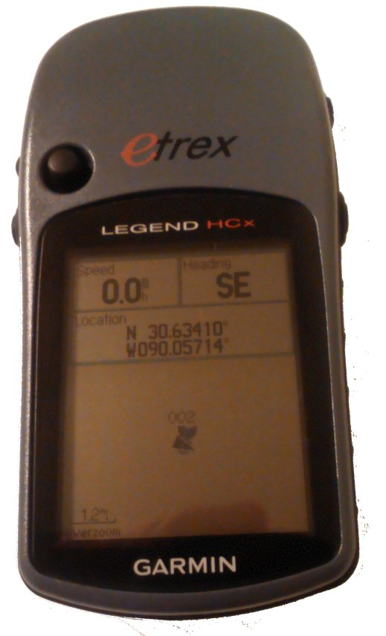
GPS

Slide 10

Georeferencing Natural History Collections Data:
The GEOLocate Project
Nelson E. Rios

Slide 11
Workflows
Data Cleaning
Becoming a Trainer
And more…
Notes:
testing slide 2

Slide 12
Why Georeference
Correct geographic and specimen identification data = dependable occurrence record.
Occurrence data validates the importance of biological collections, especially to non-taxonomists.
  Distribution of populations and species ranges
  Phylogeography
  Niche modelling
  Conservation planning and biodiversity management
Provides uncertainty data, which allows data to be evaluated with regards to its fitness for research application and resulting quality of output.

