Slide 1
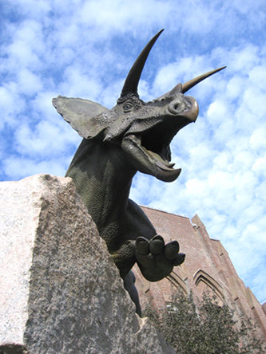
Georeferencing using KE EMu
A sample workflow from the Yale Peabody Museum of Natural History
Division of Invertebrate Paleontology

