Slide 1
Barcode of Wildlife Project: Potential Refinement of the BARCODE Data Standard for Forensic Application
David E. Schindel, Executive Secretary
National Museum of Natural History
Smithsonian Institution
SchindelD@si.edu; http://www.barcoding.si.edu
202/633-0812; fax 202/633-2938

Slide 2
Building eCollaborations that work for both Users and Providers

Slide 3
Two Example eCollaborations
BOLI: DNA Barcode of Life Initiative
Centrifugal: One idea applied in different applications and diverse users
United loosely by the BARCODE data standard
Compliance a challenge
BWP: Barcode of Wildlife Project
Centripetal: Different users converge around the a shared need and solution
Users demanding a stronger data standard
Compliance with data standards a core value

Slide 4
Definitions
DNA barcoding: Use of standardized, minimalist sequences for species ID
BARCODE: Reserved keyword in GenBank
CBOL: Consortium for the Barcode of Life
BWP: Barcode of Wildlife Project
COI: The 648 base Folmer region of cytochrome-c oxidase 1, the animal barcode
matK and rbcL: approved barcode regions for land plants
ITS: Approved barcode region for fungi

Slide 5
DNA Barcode History
Proposed in 2003
Consortium for the Barcode of Life (CBOL)
Established at Smithsonian Institution, 2004
BARCODE data standard, 2005
Community building, working groups
Outreach to developing countries
Promoting large-scale projects
Four international conferences
Engagement with government agencies
International Barcode of Life Project (iBOL)

Slide 6
BOLI Current Status
Primary support from research grants
Funding programs in several countries
1700+ journal articles, primarily taxonomic and ecological studies
Highly varied taxonomic coverage
2+ million records in BOLD workbench
Large portion not yet made public
Many released to GenBank without IDs
Uneven compliance with data standard

Slide 7
The Barcode of Wildlife Project
Global Impact Award from Google Giving, 2012
US$3 million to CBOL/Smithsonian, 2 years
Concrete goals and milestones
Management and funding by objectives
4 Phases:
Planning, assessment, selection of priority species
Training
Testing
Implementation

Slide 8
BWP Goals
Working with six Partner Countries:
Demonstrate use of DNA barcode evidence in investigations, prosecutions, convictions by November 2014
Construct a reference BARCODE library to support Partner Country priorities
~2000 Priority Endangered Species
~8000 closely related/look-alike species
Partner Countries will formally adopt, implement and sustain barcoding

Slide 9
BWP Current Status
Mexico, South Africa, Kenya, Nigeria completing Phase 1
Partner countries in SE Asia and South America being selected
200 Priority Endangered Species selected
Heavily trafficked, hard to identify
National workshops on legal standards for admissibility as courtroom evidence
Enforcement agencies, police, prosecutors, researchers involved, awaiting training

Slide 10
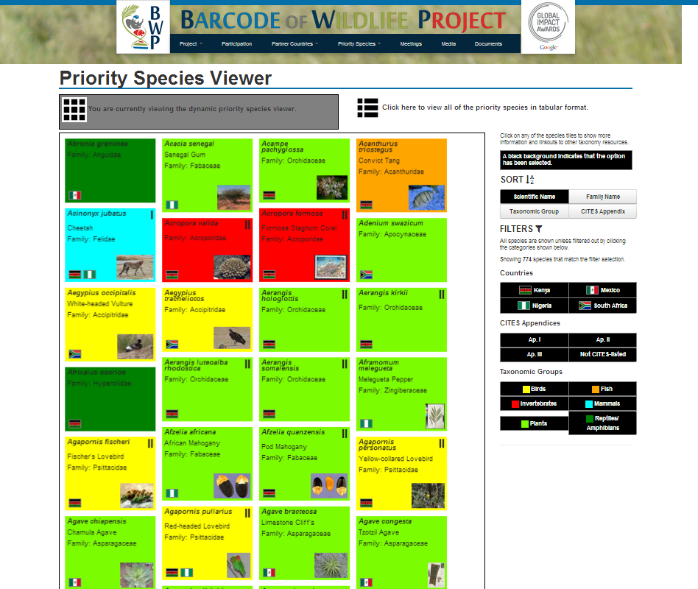
Priority Species Viewer
http://www.barcodeofwildlife.org/priority_species.html

Slide 12
BARCODE Data Standard
A set of required elements for a reserved Keyword (‘BARCODE’) in GenBank
Ensure data longevity by archiving in GenBank
Enable comparisons among records from approved BARCODE gene regions
Ensure minimum quality of sequences
Enable georeferencing
Provide traceability to voucher specimen
Ensure access to raw sequencer data
Pave the way for regulatory and forensic use

Slide 13
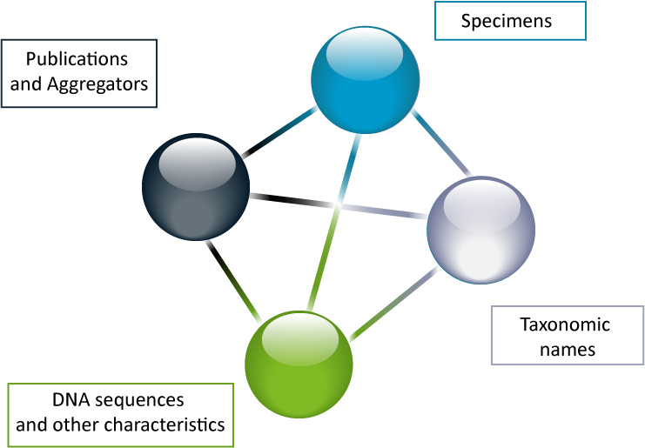
Publications

Slide 14
Required Elements
Voucher specimen ID in standard format (Darwin Core Triplet)
Taxonomic identification to formal or provisional species
Name of barcode region
Length, quality, 2 trace files
Forward/reverse primer sequences, names
Country/Ocean/Sea of origin

Slide 15
Highly Recommended Elements
Latitude/longitude
Name of Collector
Collection date
Name of identifier

Slide 17
Voucher specimen links constructed from Darwin Core Triplet:
http://collections.mnh.si.edu/services/resolver/birds/621682

Slide 23
How effective has the BARCODE data standard been?

Slide 24
2.6 million records in BOLD (50% public)
347,487 BARCODE records in GenBank
347,357 have an entry for voucherID, bio-material or culture collection
347,269 have Country/Ocean
287,058 have latitude/longitude
282,542 have two trace files
189,956 have a formatted VoucherID
149,114 have "sp." in taxonomic ID

Slide 25
Compliance with Standard
Categories of data records | Number of GenBank records | With Voucher or Culture Collection Specimen IDs | With Latitude/ Longitude
BARCODE | 347,349 | 347,077 (~100%) | 286,975 (83%)
All COI | 751,955 | 531,428 (71%) | 365,949 (49%)
All 16S | 4,876,284 | 138,921 (3%) | 461,030 (9%)
All cytb | 239,796 | 84,784 (35%) | 7,776 (3%)

Slide 26
BARCODE Records in GenBank

Slide 27
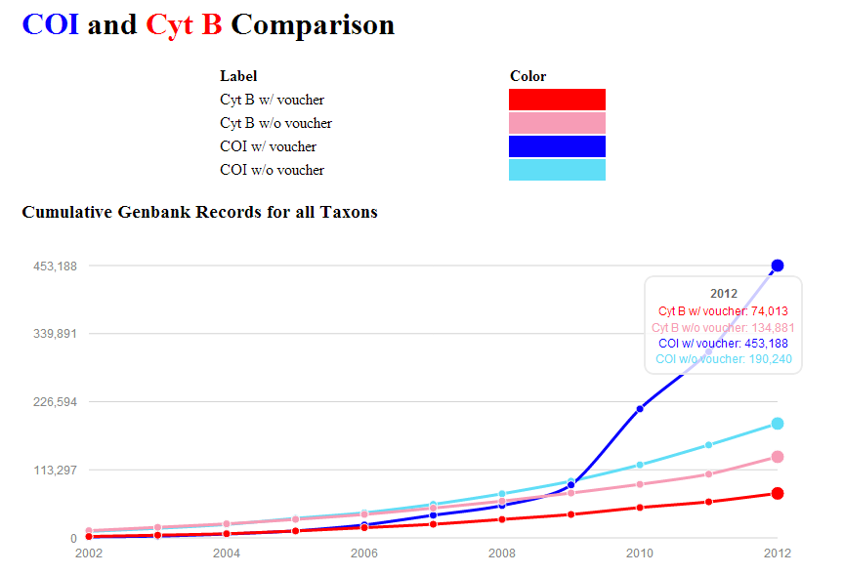

Slide 28
Rod Page’s ‘Dark Taxa’: How reliable are the identifications?
R. Page, iPhylo blogspot, 12 April 2011

Slide 29
Darwin Core Triplet Structured Link to Vouchers
Institutional ID
Collection ID
:
Catalog ID
:
:
:
NHMUK
ENT
123456
personal
:
DHJanzen
:
SRNP12345

Slide 30
Compliance with VoucherID
How traceable are the voucher specimens?
62% of BARCODE records have formatted voucher from
60 institutional repositories
38 (63%) confirmed in biorepositories.org
17 unconfirmed
4 not listed

Slide 32
Fitness for Use in Courtrooms
Default mentality from Human DNA IDs
“Are these two items from same individual?”
NOT “Is this item from that species?”
Larger sample size versus security of samples
Barcode IDs: Statistical results or opinions?
Chain of custody not compatible with museum/herbarium culture of openness
No background studies of wildlife DNA by Academies, Institute of Justice, Interpol

Slide 33
Taxonomic Reliability Data/Metadata
Additional datafields in GenBank for BWP:
Name of identifier
Date of identification
Type status of voucher specimen
Basis of identification
Confidence level

Slide 34
Expanding the Data Standard
BARCODE Platinum:
Voucher handled under chain of custody
Analyzed in police forensic lab
Includes all taxonomic reliability metadata
BARCODE Gold:
Based on a Platinum standard voucher
Analyzed in academic lab
Includes all taxonomic reliability metadata
BARCODE Silver:
Includes all taxonomic reliability metadata

Slide 35
Questions?

Slide 36
CBOL/GBIF/NCBI Registry of Biorepositories
www.biorepositories.org

Slide 37
Persistent URI Pattern
iDigBio recommendation:
USNM implementation:
http://collections.mnh.si.edu/services/resolver/resolver/birds/12345
\___/ \_____________________________________/ \___/ \____/

Slide 38
Ambiguous InstitutionIDs
AMNH | Icelandic Institute of Natural History, Akureyri Division | Akureyri | Iceland
AMNH | American Museum of Natural History | New York | USA
UNL | Universidad Autónoma de Nuevo León | Monterrey, Nuevo León | Mexico
UNL | University of Nebraska State Museum | Lincoln, Nebraska | USA
UNL | Centro de Estratigrafia e Paleobiologia da Universidade Nova de Lisboa | Monte de Caparica | Portugal
ZMK | Zoological Musem, Kristiania | Oslo | Norway
ZMK | Zoologisches Museum der Universität Kiel | Kiel | Germany
ZMK | Zoological Museum, Copenhagen | Copenhagen | Denmark

Slide 39
Biorepositories.org, 2012
Number of Institutions | 6702
Institutions w/ unique InstIDs | 6036 | 90.1%
Insts w ambiguous InstIDs | 666 | 9.9%
Ambiguous InstIDs | 299
Collisions with IH | 200

Slide 41
AMNH<IH>
AMNH
AMNH
 | Biorepositories.org, 2012 |  |  | GRBio, 2013
Number of Institutions | 6702 |  |  | 7014
Institutions w/ unique InstIDs | 6036 | 90.1% |  | 6738 | 96.1%
Insts w ambiguous InstIDs | 666 | 9.9% |  | 276 | 3.9%
Ambiguous InstIDs | 299 |  |  | 128
Collisions with IH | 200 |  |  | 0

Slide 42
Acronyms used by 2 institutions | 113
Acronyms used by 3 institutions | 13
Acronyms used by 4 institutions | 2 | CUMZ | MM
Acronyms used by 5 institutions | 1 | SM
SM | Sanford Museum Collections | Fort Mellon Park, Sanford, FL | USA
SM | Sarawak Museum | Kuching, Sarawak | Malaysia
SM | Schwegler Museum | Langenaltheim, Baveria | Germany
SM | Senckenberg Museum | Senckenberganlage 25, 60325 Frankfurt am Main | Germany
SM | Strecker Museum, Baylor University | Waco, Texas 76798 | USA

