Slide 1
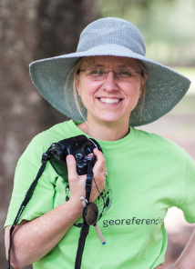

Success (and challenges) in broadening participation and engagement in digitization
Deborah Paul
Institute for Digital Information (iDigInfo)
Integrated Digitized Biocollections (iDigBio)
at Biodiversity Information Standards (TDWG) 2013 Conference
Florence, Italy October 28 – Nov 1
Notes:
Talk: Success (and challenges) in broadening participation and engagement in digitization
Abstract
Integrated Digitized Biodiversity Collections (iDigBio) provides an online database of vouchered specimen fit-for-research-use data aggregated from non-federal United States (US) collections. The Network Integrated Biocollections Alliance (NIBA) recommendations spurred the US National Science Foundation (NSF) to initiate the Advancing Digitization of Biological Collections (ADBC) program. ADBC funds 1) the digitization efforts of museum thematic collections networks (TCNs) centered on grand-challenge research questions and 2) a national hub to facilitate digitization activities and online access to integrated data from the TCNs, and others, in the iDigBio portal at http://portal.idigbio.org.
A core goal is to make digitization faster and more efficient. iDigBio staff began by first looking at what the current digitization practices are across collection types (doi: 10.3897/zookeys.209.3135). Now, through workshops and shared expertise across working groups, iDigBio is developing digitization resources, and conducting workshops to continue discovery and dissemination of digitization best practices and provide workforce training in museum digitization and data literacy. With over 30 workshops in the first two and half years of iDigBio, 14 more between now and May 2014, and others waiting to be scheduled, iDigBio is carving a niche centered at addressing some of the workforce training needs in the biodiversity specimen digitization community. In addition, iDigBio continues to engage our stakeholders to clarify their needs and facilitate development of new collaborations / new interactions. Some sample workshop topics so far include digitization workflows by collection object preparation type, information technology standards and cyberinfrastructure development, public participation in science, and workforce training through our georeferencing workshops.
The NIBA Implementation Plan (goal 3) articulates that international collaboration is an imperative for reducing duplication of digitization effort, associated costs, and increasing global interoperability at the same time. Another NIBA objective is to pursue international cooperative efforts in training in biodiversity science. These are just two examples from the NIBA implementation plan that suggest natural partnerships and opportunities for collaboration not only with TDWG, but other groups present here at TDWG.
Two tangential, but complementary goals in the ADBC community are, 1) the development of software user interfaces (UIs) and hardware configurations that hide the complexity from the user, and 2) encouraging opportunities and strategies for non-information technology scientists to meet IT professionals half-way. Stakeholders of every domain, if they are to get what they want in a timely and efficient manner, must have some of the vocabulary needed to communicate in a multi-disciplinary environment. It is important to continue to be inclusive and remember the potential that exists (and that we need) in human resources development to support the digital infrastructure being created around us, by us, for everyone.

Slide 2

Theme: Virtual Communities for Biodiversity Science
Symposium: Empowering International e-Collaboration for Sustainability
Notes:
Earth photo: http://ppt-bird.blogspot.com/2012/04/earth-day-2012-ppt-background-free.html
Our goals for this symposium (a forum for outreach and world-wide collaboration).
Discuss what it means to collaborate successfully and how to use what we have all learned to foster collaboration and sustainability. This includes sharing what has / has not worked. We’d like to broaden the conversation to what we can do to engage our projects with TDWG and TDWG with our projects.
Successful models of Collaboration
what are 2 (or 3) key points of why you think it's successful?
gauges of success?
any insights to share about what's been tried that did not work?
What are some challenges that you couldn't meet (that TDWG or other organizations here might address)?
What are the successful models of collaboration?
How do you know when a collaboration is successful?
Please tell us about one and what are 2 (or 3) key points of why you think it's successful? Do you apply /know of any gauges of success?
Do you have any insights to share about what's been tried that did not work?
What are some challenges that you couldn't meet (that TDWG or other organizations here might address)?
Can your models / examples be broadened to facilitate, encourage, and encompass attempts by those disciplines and geopolitical regions working on their own efforts to effectively and sustainably document and share information about biodiversity?
What is your vision for making these global collaboration world-wide digitization efforts sustainable?
Or, more narrowly, perhaps, what is your vision for making a (your) particular project integrated in the larger world-wide digitization efforts?
What is key (from your point-of-view) for interoperability efforts to succeed?
What are key ways we can get involved in / contribute to each other's efforts?

Slide 3

Overview
NIBA
What is ?
Issues and Trends
  Digitization
    Collaboration
    Workforce training and resources
    Rich(er) data, data discovery, and data citation
    Sustainability hints
    Working group thoughts
(Theme: Hiding complexity and meeting half-way)
Notes:
The keynote, sponsored by iDigBio, to enhance the collaboration discussion. What can science tell us about collaboration? (The toolkit). This symposium, to draw out what we know works, what doesn't, some ideas for moving forward and specifically how we can help TDWG and how TDWG can help all of us. Sustainability expertise (iDigBio)
NIBA > ADBC > iDigBio and the TCNs
NIBA Goals
Issues and Trends
Collaboration, Opportunities
TDWG, overlap = opportunities
(intersection, overlap)
how to collaborate
Collaboration, Opportunities
intersection, overlap
how to collaborate
Workforce Training: Communication, Literacy and Awareness
Are we saying the same thing?
Rich data, Data discovery & Data Citation
Sustainability
Hiding Complexity and Meeting Half-Way
A botanist and a programmer walk into a bar…
iDigBio Working Groups and Workshops
Digitization
Biodiversity Informatics?
Georeferencing
Workflows
Collaborate and Mind the Gap
Hide complexity and meet (more than) half-way
Rich(er) data wanted
Sustainability hints
Working group insights

Slide 4

The Acronyms…
NIBA: Network Integrated Biocollections Alliance
  vision: …a vibrant, virtualized community
    sharing data and digitization experiences
    collectively developing requirements for new tools
  NSF
    ADBC: Advancing Digitization of Biodiversity Collections
      iDigBio: Integrated Digitized Biocollections
      TCNs: Museum Thematic Collection Networks
Notes:
NIBA Strategic Plan
NIBA Implementation Plan http://www.aibs.org/public-policy/NIBA_Implementation_Plan.pdf
The Network Integrated Biocollections Alliance (NIBA) work, prompted the National Science Foundation's creation of the ADBC (Advancing the Digitization of Biodiversity Collections) program. As part of the ADBC, iDigBio (Integrated Digitized Biodiversity Collections) was funded to ?
The NIBA Implementation Plan, like the EU Commission (Horizon 2020, …), stipulates international collaboration and
recognizes that collaboration is one key to broader sustainability across projects.
Broad goals in the NIBA strategic plan …
NIBA Strategic Plan – 3 key objectives (Anne introduced NIBA)
digitize all US biological collections
integrate data for Web-access
develop new Web interfaces,
visualization and analysis tools,
data mining,
georeferencing processes
all available for using and improving NIBA resources
create real-time upgrades of biological data and
prevent more legacy (siloed) data
via tools, training, and infrastructure
6 NIBA Implementation Plan Goals
1 organizational governance for
implementing NIBA plans
2 advance US engineering of US biocollections cyberinfrastructure
3 enhance training of existing collections staff and biodiversity information managers
4 increase support for and participation in NIBA
5 establish a sustainable knowledge base
6 integrate specimen-based learning into formal / informal education

Slide 5
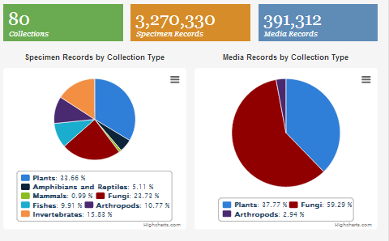
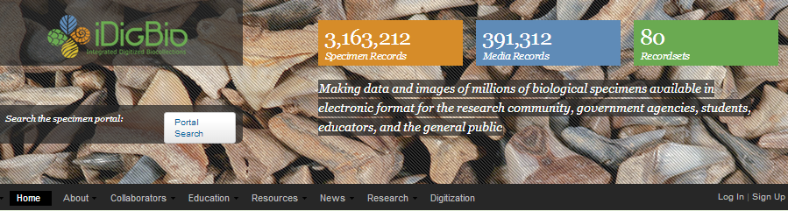
goals
build an accessible
aggregated, integrated,
scalable,
vouchered-specimen
database (USA collections)
facilitate and increase participation in digitization
enable researchers’ access to and use of the data
build partnerships to expand and enhance
Notes:
From NIBA
create a national database of vouchered specimen records from US institutions using existing national and international specimen data aggregation projects as models, specify the functional requirements of an aggregated US specimen data store.

Slide 6
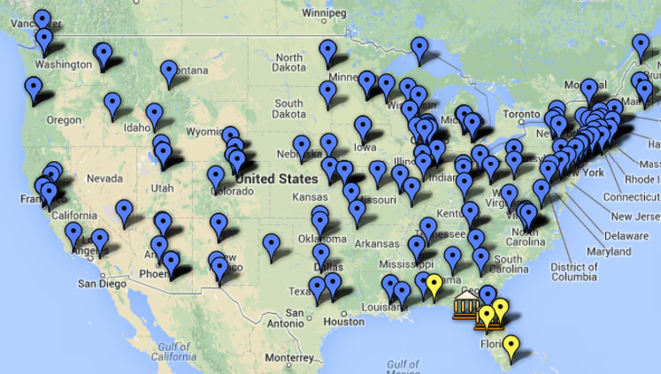
and the TCNs
Notes:
There currently 10 TCNs, each with a unique theme (for example) (Tri-Trophic). There are over 150 participating institutions and they include museums and collections from all 50 states and some US territories.

Slide 7
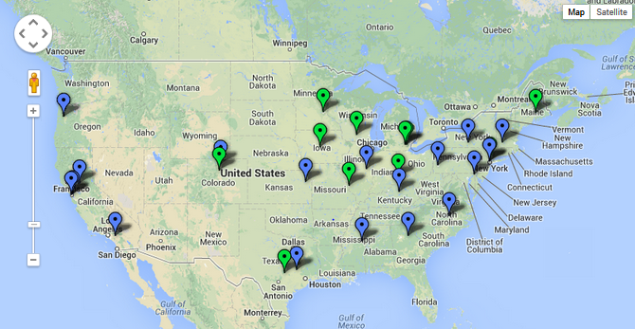
TCN: Plants, Herbivores and Parasitoids: A Model System for the Study of Tri-Trophic Associations

Slide 8
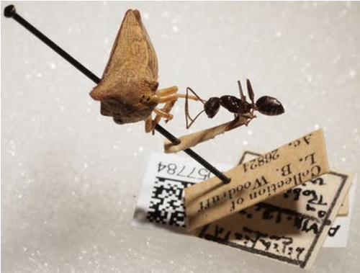
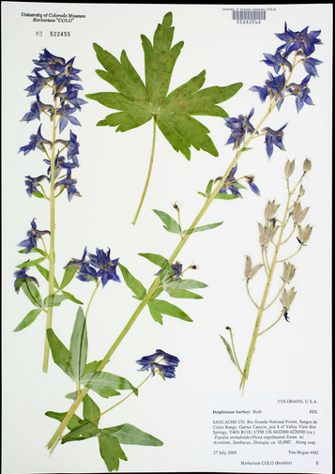
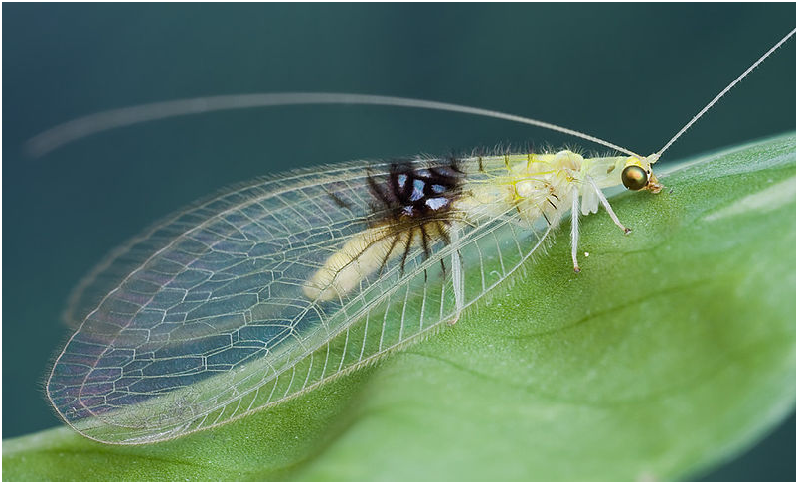
TCN: Plants, Herbivores and Parasitoids: A Model System for the Study of Tri-Trophic Associations
photo credit: Yon Visell
Notes:
http://tcn.amnh.org/updates/highlightsfromthecollectiontreehoppersandants

Slide 9


NIBA Implementation Plan - Goal 4
Increase participation in and support for NIBA from a broad spectrum of stakeholders, both nationally and internationally.
4.1. Align NIBA’s strategic plan with road-mapping exercises of other broad-based biodiversity initiatives in order to identify areas of overlap and synergy.
BIS (TDWG)
?
Notes:
H2020, BIH meeting, OpenUp!, Europeana, …
Many opportunities for collaboration. Your project?

Slide 10


Collaborate! The imperative case.
Cross Disciplinary Research (CDR) needs
Cross-Disciplinary Communication
“…practical approaches to enhancing collaboration have emerged slowly…”
tracking contacts and collaborations
examples needed in listener’s terms
Notes:
TREND, ISSUE (challenge and opportunity)
Cross-Disciplinary Communication http://www.cals.uidaho.edu/toolbox/
Michigan State University, University of Idaho, Boise State University,
University of Alaska, Anchorage & the National Science Foundation
From their web site:
Collaborative, cross-disciplinary science is an increasingly important part of responses to proliferating, complex problems. Complexity typifies certain problems facing human societies, such as poverty, infectious diseases, and the quest for sustainable use of natural resources. Improving the cross-disciplinary research (CDR) required to address such problems is a significant challenge. Meeting this challenge will alter contemporary science, dramatically changing how scientists think about science within and across disciplines and how they communicate in creating and applying new knowledge within collaborative scientific endeavors. Despite this challenge, practical approaches to enhancing collaboration have emerged slowly, lagging behind the initiation of collaborative projects and the increase in funding opportunities that encourage collaboration.
Example (from Gail Kampmeier): It took a 1 year cross-collaboration to agree on a shared vocabulary for micrometeorologists and entomologists to work on a project together. We need to speak the same language when we collaborate.
One needs to use (concrete) examples from the real world that are relevant to the person being addressed.
-------------------------------------------------------------------------------------------
From NEON
http://www.neoninc.org/news/big-data-part-iii
challenges for data use / re-use
Indeed, the context-dependent nature of ecological data is both an incentive for its preservation and a barrier to its re-use… the single most important prerequisite to re-using other researchers’ data was understanding enough about the data and how it was collected to confidently interpret its meaning and its usefulness in other analyses…technicians or researchers vary greatly in skill. The time and effort required to document, standardize, and explain a data set well enough to make it useful to someone else makes data sharing an unattractive proposition, …
As team science becomes more common and teams of scientists become larger, more professional scientists are beginning to recognize the need for the skills required to work well in larger teams, although these skills are still not accorded the same value as the ability to publish papers in prominent scientific journals. Science magazine, for one, offers a basic tutorial on Project Management for Scientists in its career advice section, and at least one business has developed project management software specifically for research labs. Opportunities for written and verbal communication training are increasingly being offered to scientists as specialized fellowships and workshops and as an integral part of academic training.
------------------------
Successful models of Collaboration
what are 2 (or 3) key points of why you think it's successful?
gauges of success?
any insights to share about what's been tried that did not work?
What are some challenges that you couldn't meet (that TDWG or other organizations here might address)?
What are the successful models of collaboration?
How do you know when a collaboration is successful?
Please tell us about one and what are 2 (or 3) key points of why you think it's successful? Do you apply /know of any gauges of success?
Do you have any insights to share about what's been tried that did not work?
What are some challenges that you couldn't meet (that TDWG or other organizations here might address)?
Can your models / examples be broadened to facilitate, encourage, and encompass attempts by those disciplines and geopolitical regions working on their own efforts to effectively and sustainably document and share information about biodiversity?
What is your vision for making these global collaboration world-wide digitization efforts sustainable?
Or, more narrowly, perhaps, what is your vision for making a (your) particular project integrated in the larger world-wide digitization efforts?
What is key (from your point-of-view) for interoperability efforts to succeed?
What are key ways we can get involved in / contribute to each other's efforts?
------------------------
Collaborations have at least 3 distinct levels:
Global Needs and Policies
Local Policies and Decisions
Specific Workflows

Slide 11
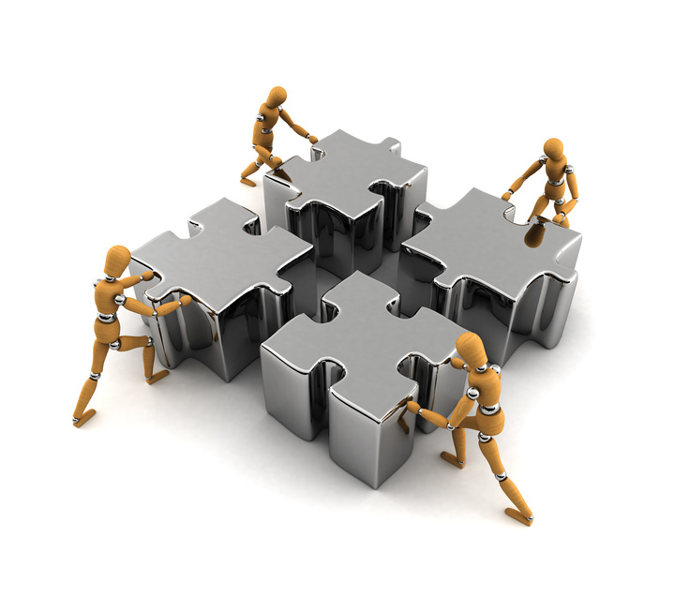
TDWG, iDigBio, your project?
identify areas of overlap and synergy
possible overlap
  cyberinfrastructure
  standards
  workforce training
  outreach
  education
  interoperability
vision and scope for cooperation and collaboration
Notes:
facilitate collaboration
Share my/iDigBio vision for making these global collaboration world-wide digitization efforts sustainable?
Or, more narrowly, perhaps, what is your vision for making a (your) particular project integrated in the larger world-wide digitization efforts?
What is key (from your point-of-view) for interoperability efforts to succeed?
What are key ways we can get involved in / contribute to each other's efforts?
Using existing national and international specimen data aggregation projects as models
Implement new training opportunities in biodiversity informatics.
Increase participation in and support for NIBA from a broad spectrum of stakeholders, both nationally and internationally.
(What is TDWG road map – where are the intersections)?
Collaborate with digitization efforts pursued by other countries
Recruit nonfederal (US and foreign) government agencies to join NIBA.
Accomplishing these strategic plan objectives requires the completion of the biodiversity informatics core architecture, additional workforce training, increased educational engagement, new government and private sector partnerships, and a viable economic model for sustainability. (Goals 3, 4, 5) all have sustainability components.
Accomplishing these strategic plan objectives requires the completion of the
biodiversity informatics core architecture,
additional workforce training,
increased educational engagement,
new government and private sector partnerships, and a
viable economic model for sustainability. (Goals 3, 4, 5) all have sustainability components.

Slide 12
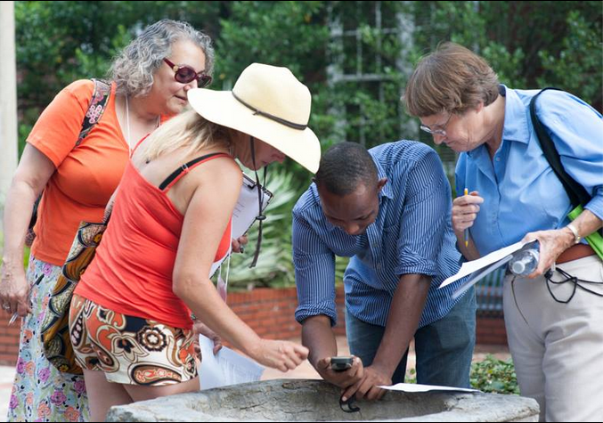
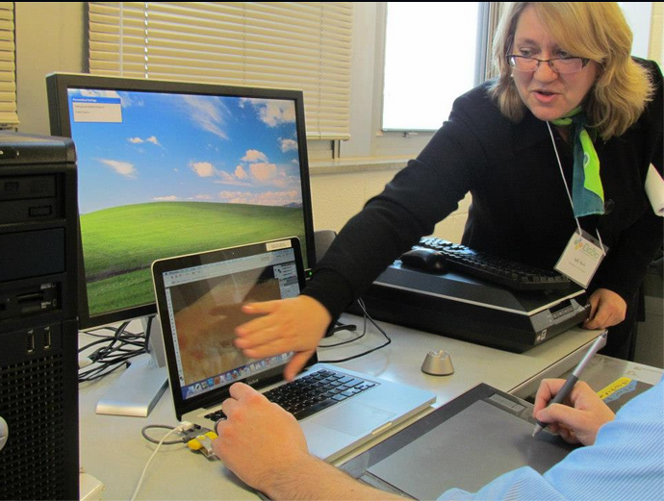
NIBA Implementation Plan - Goal 3
“…pursue international cooperative efforts in training in biodiversity science…”
  3.1. Implement new training opportunities in biodiversity informatics.
Notes:
Anne Maglia introduced the Strategic and Implementation plans from NIBA this morning.
I’d like to focus on Goal 3 and 4.
While a cooperative effort is not the same as a collaborative effort, a cooperative effort is a opportunity to share development of materials and maximize outreach (ripples in the water) compared to our efforts alone.
Develop opportunities for US students to gain international experience through biodiversity informatics training experiences using specimens and data that originated in other countries

Slide 13
You just saved me a month…
Workshops - just in year 2
  > 150 institutions, 9 workshops, 3 symposia
  528 sponsored participants
  Videos on Vimeo,
  remote participation
  Train the Trainer’s model
  Series of digitization training workshops (herbaria, wet collections, entomology, paleontology, fluid-preserved invertebrate imaging, small herbaria, )
“data curation time cut from 7 years to 3 months.”
batch process 30 images per night?

Slide 14
iDigBio Working Groups and Workshops
Augmenting OCR (aOCR)
Biodiversity Informatics Management Working Group
Cyberinfrastructure (CYWG)
Developing Robust Object to Image to Data (DROID1): Flat Things
DROID2: Pinned Things
DROID3: 3D Objects and Things in Spirits
Education and Outreach
Fluid-preserved Arthropod and Microscopic Slide Imaging Interest Group
Georeferencing Working Group (GWG)
International Whole-Drawer Digitization Interest Group (WDD)
Minimum Information Standards, Authority Files, & Semantics (MISC)
Paleo Digitization Working Group
Paleontology
Public Participation in Digitization
Strategic Communication Interest Group
Website Content Providers Editorial Board and Interest Group

Slide 15
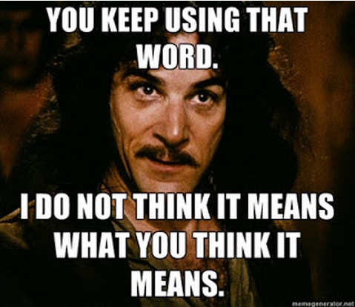
What’s in a name?
Biodiversity Informatics
Biological Informatics
Bioinformatics
Issues
Do we mean the same thing?
Where are students learning these skills?
What skills do they need?
Notes:
Ideas for how to make working groups more effective.
http://meyerweb.com/eric/thoughts/2006/09/15/w3c-change-outreach/
Rational for Working Group Liaison: reveal working group efforts and connect with stakeholders
one outreach member, 2-way communication
perhaps someone not versed in the field
their job
keep public informed about the working group activities
perhaps produce how-to’s
explaining to the world what the WG is doing and who is explaining to the WG what the world is doing, or at least trying to do.
perhaps a working group has a member of the public with no expertise.
to ensure the group explains their work in plain English. which is helpful to everyone.

Slide 16
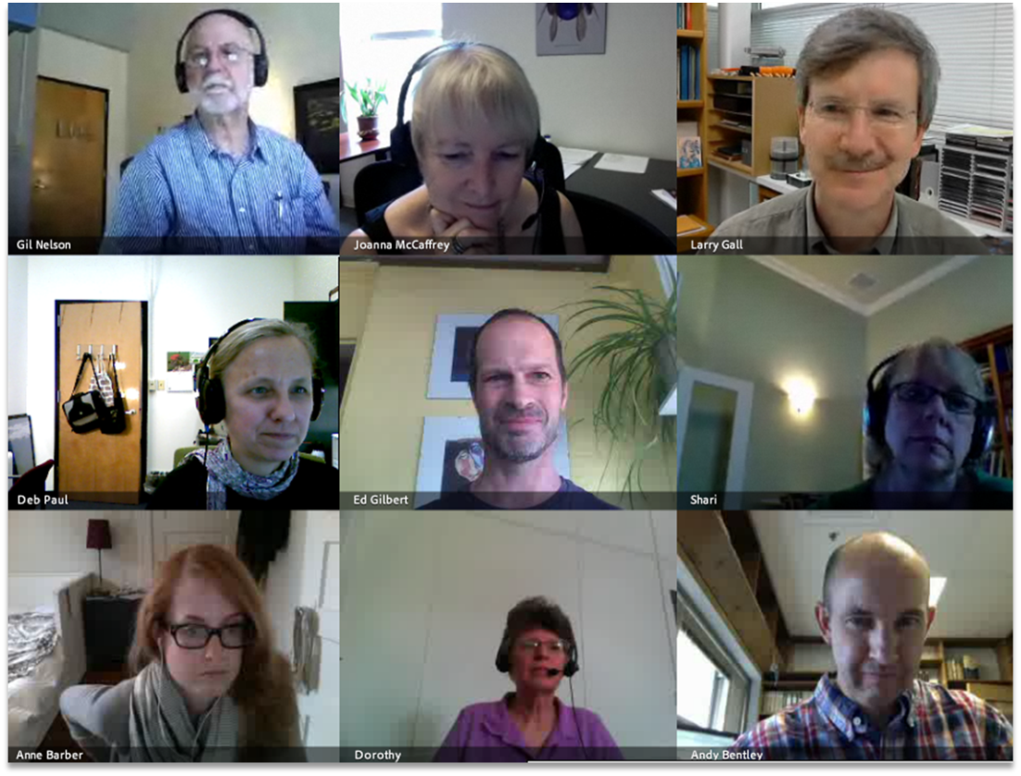
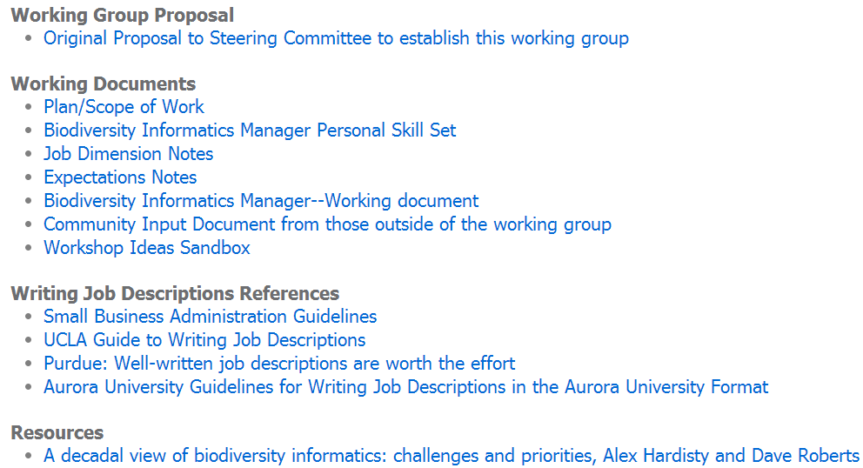
iDigBio Biodiversity Informatics Management
Working Group
https://www.idigbio.org/wiki/index.php/Biodiversity_Informatics_Management
Notes:
Mission
The mission of this working group is to circumscribe biodiversity informatics manager as a recognized career path within the natural history museum and biological collections communities, and to raise awareness of this career path to collections managers, museum directors, academicians, and potential biodiversity informatics managers and professionals.

Slide 17
iDigBio Biodiversity Informatics Management
Working Group Mission
Who
  bridges the potential gap between collection managers and IT staff?
  manages a digital resource, once it is created?
  coordinates digitization workflow development and documentation?
What socio-technical skills are needed?
Where do these skilled individuals come from?
Surveys in progress
digital collections need digital collections management
Notes:
A decadal view of biodiversity informatics: challenges and priorities, Alex Hardisty and Dave Roberts
https://www.idigbio.org/wiki/index.php/Biodiversity_Informatics_Management
There are three groups, including:
1) those currently serving in a biodiversity informatics manager role, regarding how they see their roles and job descriptions (this one is done, about ready to distribute results to working group),
2) curators and collections managers regarding their needs from biodiversity info managers (this one is almost ready),
3) museum and academic administrators who oversee biodiversity info managers as well as those who do not have this role filled within their organization (this one more likely to be via a limited number of targeted interviews than an online survey).

Slide 18
A botanist and a programmer walk into a bar…
“Make that a triple(t) please.”
Darwin Core Triplet
Resource Description Framework
(RDF) Triple
Subject A has property value B
http://www.morphbank.net/702617
  has Collector
    A. Parente
<rdf:Description rdf:about="http://www.morphbank.net/702617">
<darwin:Collector>A. Parente</darwin:Collector>
</rdf:Description>
intended to express relationships
Institution Code: Collection Code: Catalog Number
CAS:LOT:026789
intended to be a globally unique identifier
Notes:
real world examples of communication challenges.

Slide 19
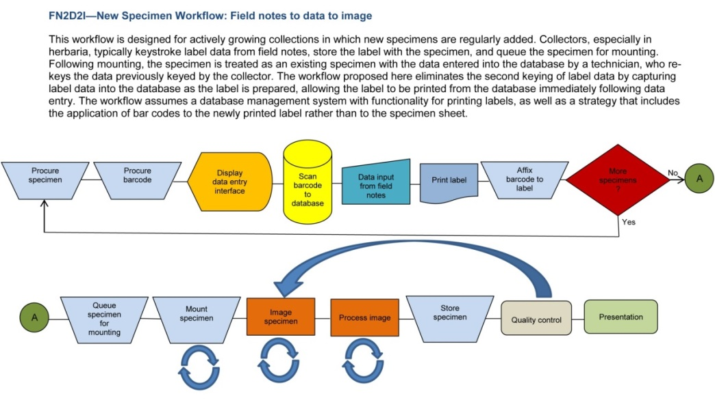
DROID Workflows
Working Groups
Modular Approach
The Flat Sheets and Packets Working Group completed modules and associated tasks for herbarium and related collections (October 2012).
The Pinned Things in Trays and Drawers finished and posted its work for entomology (January 2013).
3D Objects in Spirits in Jars and Vials completed and posted its workflows for fluid-preserved specimens (May 2013).
3D Objects in Drawers and Trays workflows group in process now.
Augmenting OCR WG and DROID in process to incorporate ocr tools and output
Preparation-independent workflows to follow (2013).

Slide 20
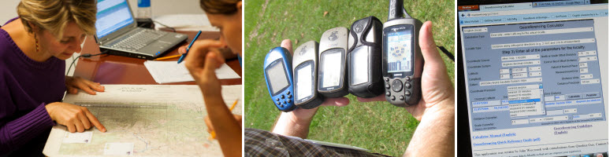
iDigBio Georeferencing Working Group (GWG)
Current Resources
Ongoing Work
Train-the-Trainers (TTT) I and II
  Online Workshop Resource
  Workforce Training
listserve and wiki
videos
More online training materials, collaborative development
  Webinars
  Georeferencing Workflows, Workshop Protocols and Help

Slide 21
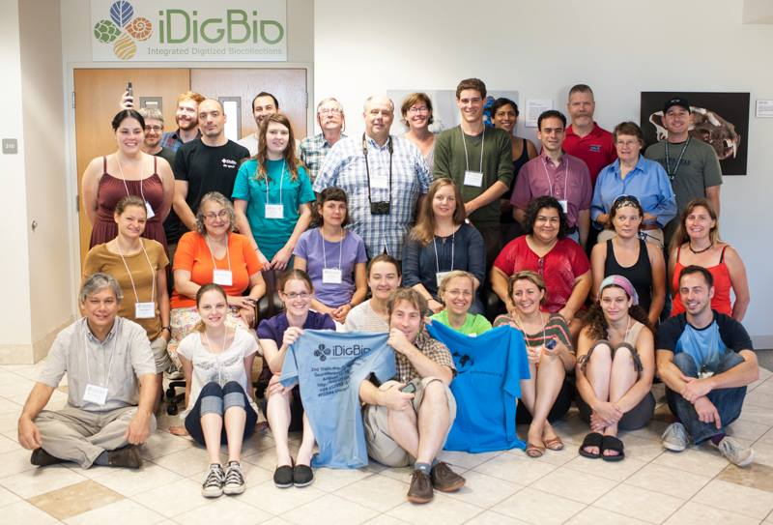
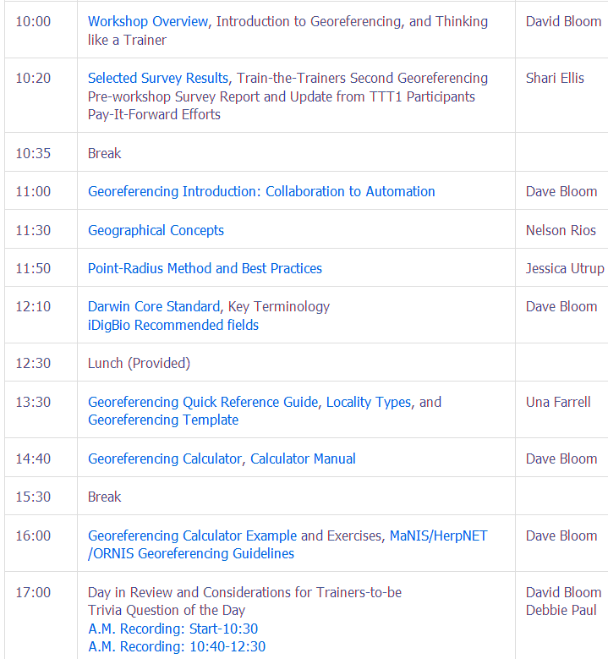
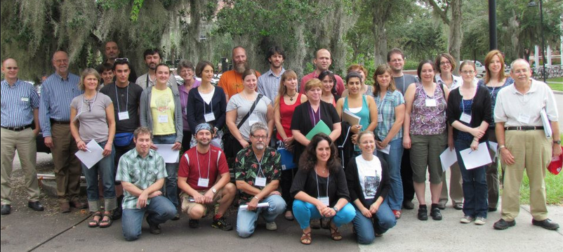
iDigBio GWG
Train the Trainers I and II
5 Days
Pay-it-forward
Community Resource

Slide 22
Rich(er) Data and Metadata: Wanted and Needed
Data Quality issues (in the next room)
Aggregators and Integrators
Proactive Digitization
Standards for field data collection
Data model and subsequent data base changes
Social issues of data re-use
Data citation <–> Data discovery
Hide complexity OR meet half-way?
Notes:
From http://www.biomedcentral.com/content/pdf/1472-6785-13-16.pdf
A decadal view of biodiversity informatics: challenges and priorities
Alex Hardisty1*, Dave Roberts2* and The Biodiversity Informatics Community3
Hardisty et al. BMC Ecology 2013, 13:16
http://www.biomedcentral.com/1472-6785/13/16
i) community agreement
on metadata standards for specific purposes and ii)
mechanisms to collect and append the necessary
metadata, automatically whenever possible, such as
the design of workflows that make use of standard
services to create data-recording templates
Recent Taxacom post and a familiar story.
Minimal data captured compared to what exists both
in the collection
and direct from the collector / researcher
How to get this data into the collection “up front”
“born digital”
Requires changes in collecting practices
“Proactive Digitization” (in the field)
directly into the database
changes in collection software to store more data and related objects (field notes)
possibly changes in the central object of a collection database
the “Gathering” (aka Collecting Event)
a specimen is just one part of what occurred and is a physical object representing a temporal occurrence.
This seems to be a trend, (in thinking, in actual databases, in collective practices). (KU ENT Andy Short; University of Finland NHM in Helsinki)
The aggregators cannot fix this alone. They can address standardization, validation and some enhancement. (Much discussion on Taxacom and elsewhere) on data quality.
Need researchers (collectors) updating collecting method
Need methods to easily import this rich data into collections (hiding complexity)
Software changes, culture changes, standards development, literacy (computational and data). (researchers meeting IT half-way)

Slide 23
Hints from Library Special Collections Digitization
Sustainability?
  permanence of a digital file
  engaged user base
  management supports resource
Key success factors?
understand needs of users / stakeholders
identify activities needed to support them
delegate responsibility to manage costs
  develop reliable sources of financial and non-financial support.
need an actively engaged manager to set and accomplish goals.
Association of Research Libraries Report, February 2013
Notes:
February 2013 report Association of Research Libraries (ARL)
3 part survey
Institutional perspective
Collections in aggregate
Specific collections
Interestingly, digitization budgets are not separate from the library budget – so very difficult to tease apart the specific cost of digitization
what does sustainable mean?
not yet firm in the library community
some consensus
Sustainability is certainly
permanence of a digital file, AND
presence of an engaged user base AND
management that allowed the resource to remain valuable to those users.
Key success factors
ability to understand needs of users and stakeholders of the project
identification of activities needed to support them, and
the delegation of responsibility to manage costs and develop reliable sources of financial and non-financial support.
the presence of an actively engaged manager to set and accomplish goals.
Key findings:
“digitization is critical to future, but updates and upgrades are not sufficient.”
management of digital resources often dispersed across departments
no department with dominant responsibility
could be okay, does present a challenge for budget and growth
spending is > on new digitization than on maintenance of existing digital resources
greater access is key motivator of digitization
but investments in understanding needs of the audience are low
oversight is needed (with no one department in charge)
IT team and collections department work together
are digitization projects (ever) finished?
budgeting / planning for enhancements

Slide 24
Hints from Library Special Collections Digitization
Key findings (a few)…
“digitization is critical to future, but updates and upgrades are not sufficient.”
  management of digital resources often dispersed across departments
are digitization projects (ever) finished?
    budgeting / planning for enhancements
Biggest challenges to long-term maintenance?
besides financial resources, technological capabilities, and staff time…
establishing / clarifying workflows and standards
expertise of staff
institutional culture
…
Association of Research Libraries Report, February 2013
Notes:
February 2013 report Association of Research Libraries (ARL)
3 part survey
Institutional perspective
Collections in aggregate
Specific collections
Interestingly, digitization budgets are not separate from the library budget – so very difficult to tease apart the specific cost of digitization
what does sustainable mean?
not yet firm in the library community
some consensus
Sustainability is certainly
permanence of a digital file, AND
presence of an engaged user base AND
management that allowed the resource to remain valuable to those users.
Key success factors
ability to understand needs of users and stakeholders of the project
identification of activities needed to support them, and
the delegation of responsibility to manage costs and develop reliable sources of financial and non-financial support.
the presence of an actively engaged manager to set and accomplish goals.
Key findings:
“digitization is critical to future, but updates and upgrades are not sufficient.”
management of digital resources often dispersed across departments
no department with dominant responsibility
could be okay, does present a challenge for budget and growth
spending is > on new digitization than on maintenance of existing digital resources
greater access is key motivator of digitization
but investments in understanding needs of the audience are low
oversight is needed (with no one department in charge)
IT team and collections department work together
are digitization projects (ever) finished?
budgeting / planning for enhancements

Slide 25

Working Group Thoughts
WG (Outreach) Liaison?
bridge the gap
  increase participation
  standards adoption
  digitization maturity
  proactive digitization
  public documentation
An outside member?
bridge the gap
  no expertise
Notes:
http://meyerweb.com/eric/thoughts/2006/09/15/w3c-change-outreach/
Rational for Working Group Liaison: reveal working group efforts and connect with stakeholders
one outreach member, 2-way communication
perhaps someone not versed in the field
job
keep public informed about the working group activities
perhaps produce how-to’s
explaining to the world what the WG is doing and who is explaining to the WG what the world is doing, or at least trying to do.
perhaps a working group has a member of the public with no expertise.
to ensure the group explains their work in plain English. which is helpful to everyone.

Slide 26
Summary and Outreach
Issues and Trends
  Digitization
  Collaboration and Sustainability hints
  Workforce training
  Rich(er) data, data discovery, and data citation
Your questions / issues / ideas
Theme: Hide complexity AND meet (more than) half-way
Notes:
workforce training: including communication, data and computational literacy, (project management, change management, motivation too).

Slide 27
Sources
Splashes and Ripples: Synthesizing the Evidence on the Impacts of Digital Resources
  Eric T. Meyer, Oxford Internet Institute at The University of Oxford & Oxford University Consulting
  http://www.jisc.ac.uk/media/documents/programmes/digitisation/Impact_Synthesis%20report_FINAL.pdf
A Strategic Plan for Establishing a Network Integrated Collections Alliance (NIBA)
  http://digbiocol.files.wordpress.com/2010/06/digistratplanfinalv1.pdf
Implementation Plan for the Network Integrated Biocollections Alliance (NIBA)
  http://www.aibs.org/public-policy/NIBA_Implementation_Plan.pdf
Cross-Disciplinary Communication
  http://www.cals.uidaho.edu/toolbox/
JISC infoNet: Tools
  A range of analytical tools and templates used across our infoKits. From pilot work and output from the workshop streams, it has been found that these tools can often be used interchangeably to deal with a variety of scenarios.
  http://www.jiscinfonet.ac.uk/tools/
Appraising our Digital Investment: Sustainability of Digitized Special Collections in ARL Libraries: A Report from Ithaka S+R and the Association of Research Libraries.
  Nancy L. Maron, Ithaka S+R, Sarah Pickle, Ithaka S+R. February 2013
  http://www.arl.org/storage/documents/publications/digitizing-special-collections-report-21feb13.pdf
A decadal view of biodiversity informatics: challenges and priorities
  Alex Hardisty, Dave Roberts and The Biodiversity Informatics Community BMC Ecology 2013, 13:16 doi:10.1186/1472-6785-13-16
  http://www.biomedcentral.com/1472-6785/13/16
iDigBio Working Groups
iDigBio Digitization Training Workshops
iDigBio Collections Digitization Workflows
iDigBio Workflow Modules and Task Lists
iDigBio Georeferencing Train the Trainer Workshops
Notes:
https://www.idigbio.org/wiki/index.php/Digitization_Training_Workshops
https://www.idigbio.org/wiki/index.php/Collections_Digitization_Workflows
https://www.idigbio.org/content/workflow-modules-and-task-lists
https://www.idigbio.org/wiki/index.php/Georeferencing#Workshops

Slide 28





Thank you TDWG, from all of us at iDigBio

