Slide 1



Long Live the Data
Dr Eric T. Meyer
Senior Research Fellow & DPhil Programme Director
eric.meyer@oii.ox.ac.uk
http://www.oii.ox.ac.uk/people/meyer
@etmeyer
TDWG Annual Meeting, Florence, Italy, 28 October 2013

Slide 2

What is the Oxford Internet Institute?

Slide 3
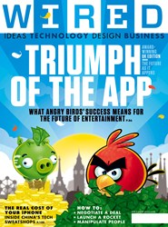

Technology and Society

Slide 4
Social Informatics
-
Socio
-
Technical
Socio
Technical
Examining the hyphen
Meyer, E.T. (2014, Forthcoming). Examining the Hyphen: The Value of Social Informatics for Research and Teaching. In Rosenbaum, H., Fichman, P. (Eds.) Social Informatics: Past, Present and Future. Cambridge: Cambridge Scholarly Publishers.

Slide 5
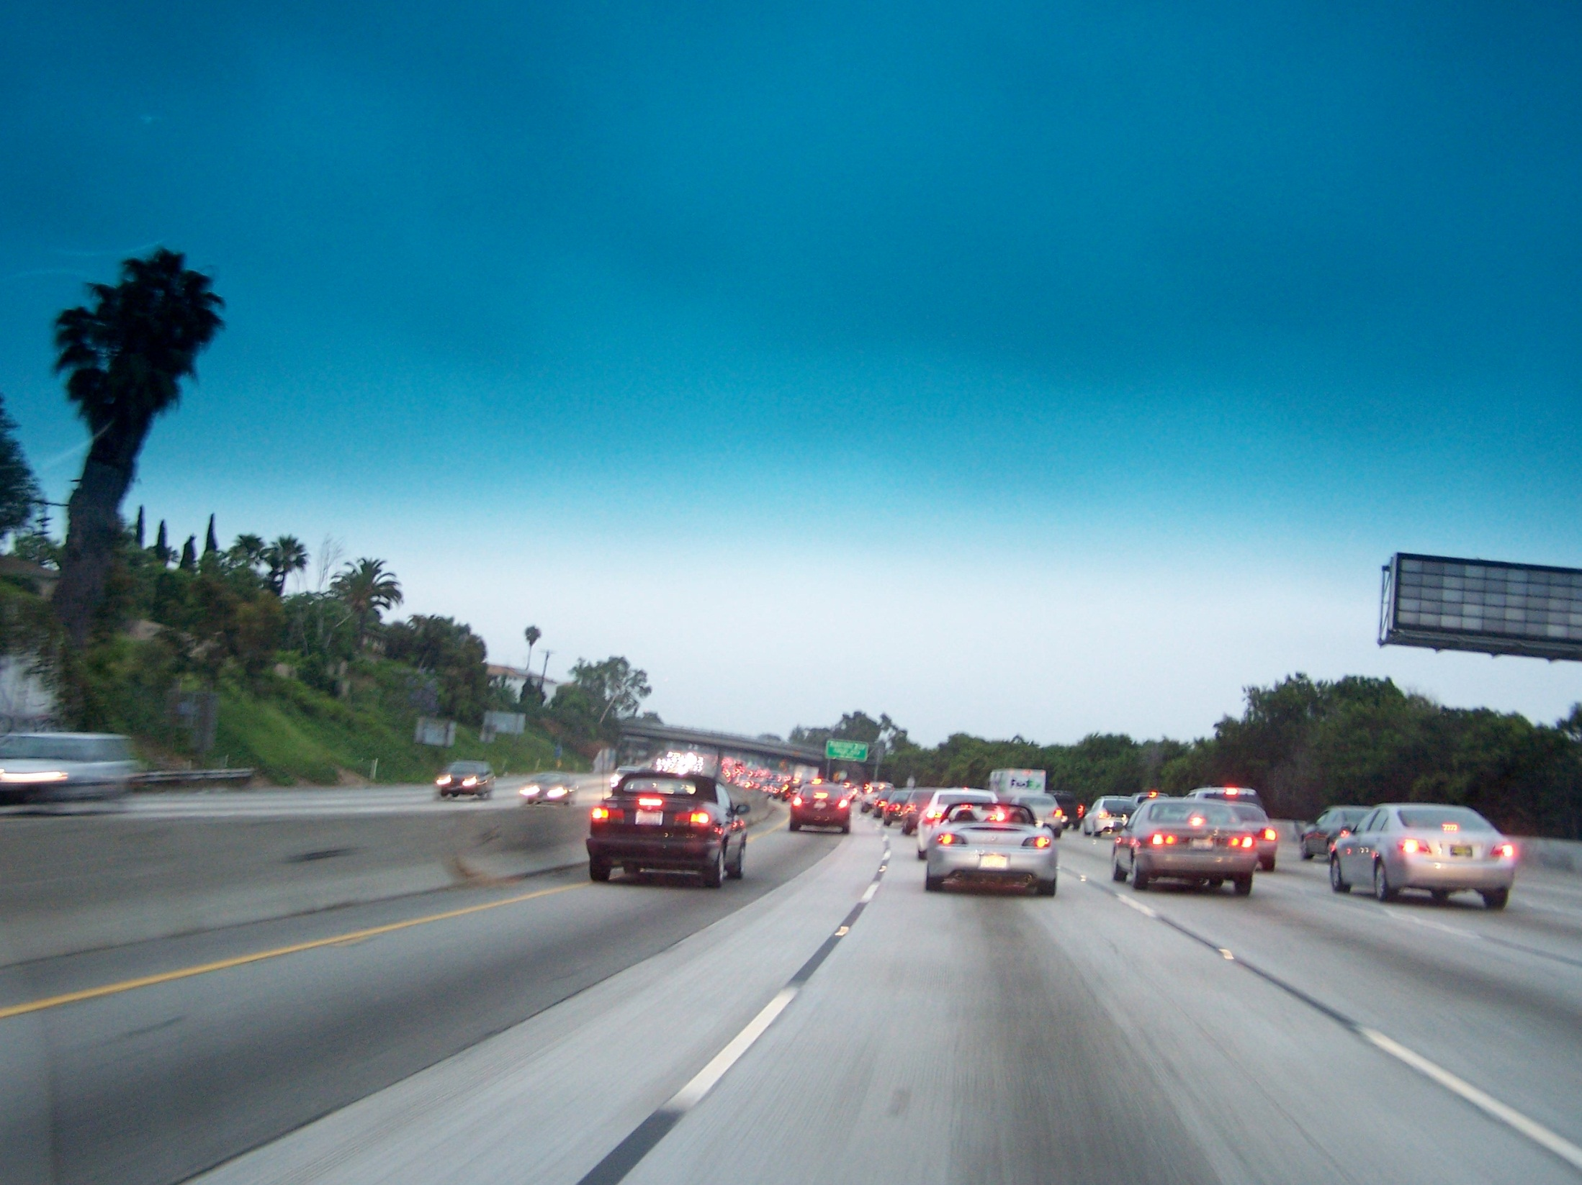
Source: http://www.flickr.com/photos/tommyc/163772266/

Slide 6
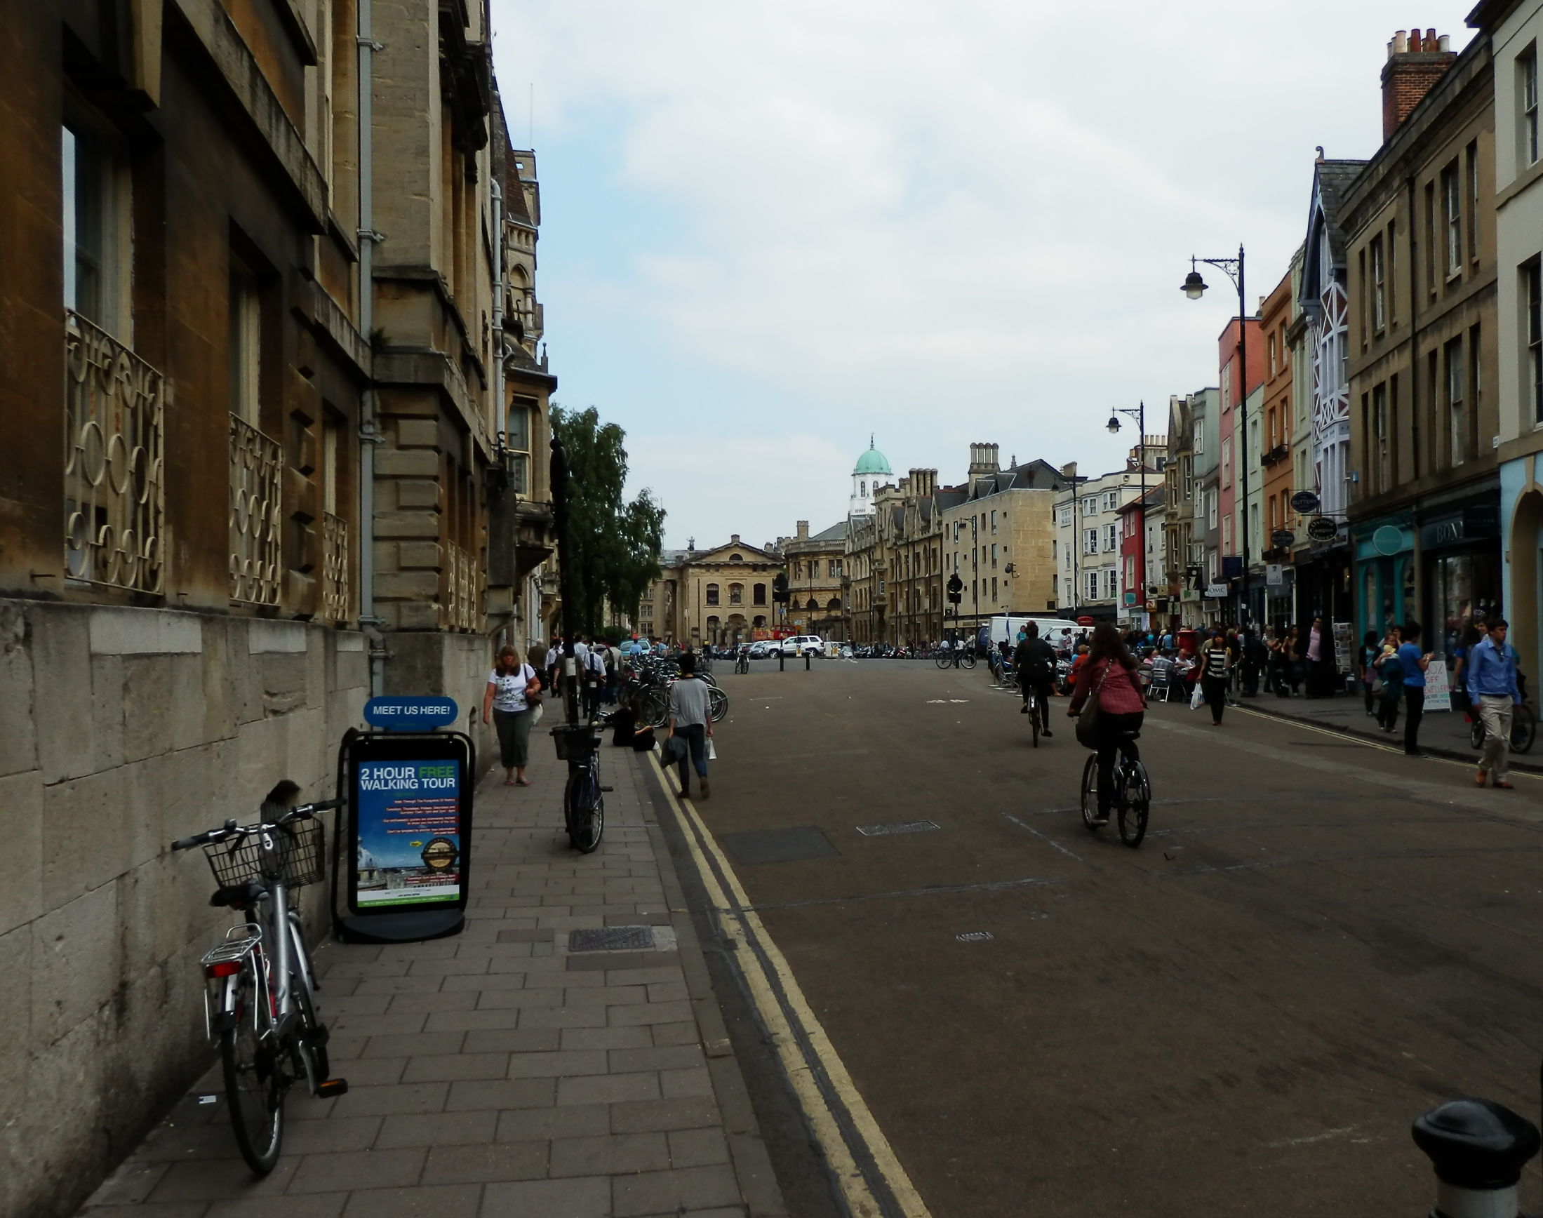
Notes:
Infrastructure can be socially and culturally shaped, but it is not infinitely flexible

Slide 7
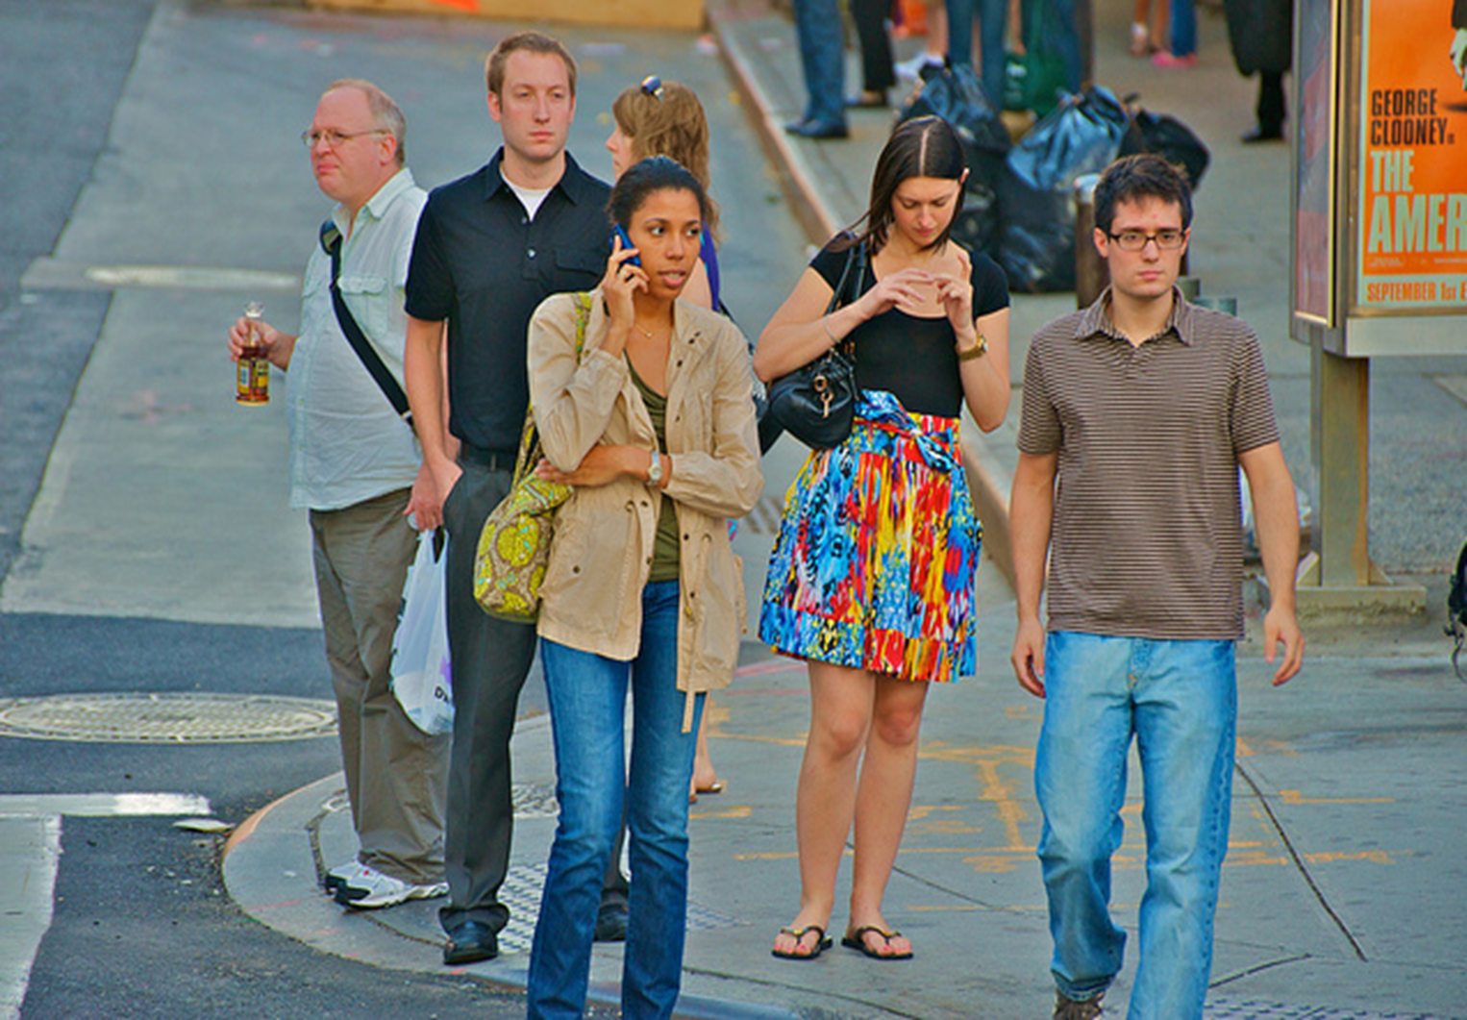
A Note on ‘Users’
‘Users’ is a potentially problematic concept, when passive use is not the primary value Internet or other technology participants/actors bring
  Big data requires the traces of people doing things
  Rules about personal data are relevant because people are not passive, but actively creating, selecting, viewing, moving, and re-transmitting information
  Trust is based on perceptions of active participants
  Social technologies require people who are being social with their friends and acquaintances
  Prioritization requires people identifying their priorities, both individually (e.g. paying extra for business-class wifi at the hotel) and societally (e.g. prioritizing emergency ambulance or credit card financial services)
  Games require active participants
Slide from SESERV Consortium (http://seserv.org)
See also Lamb, R. & Kling, R. (2003). Reconceptualizing Users as Social Actors in Information Systems Research. MIS Quarterly, 27(2), 197-235.

Slide 8
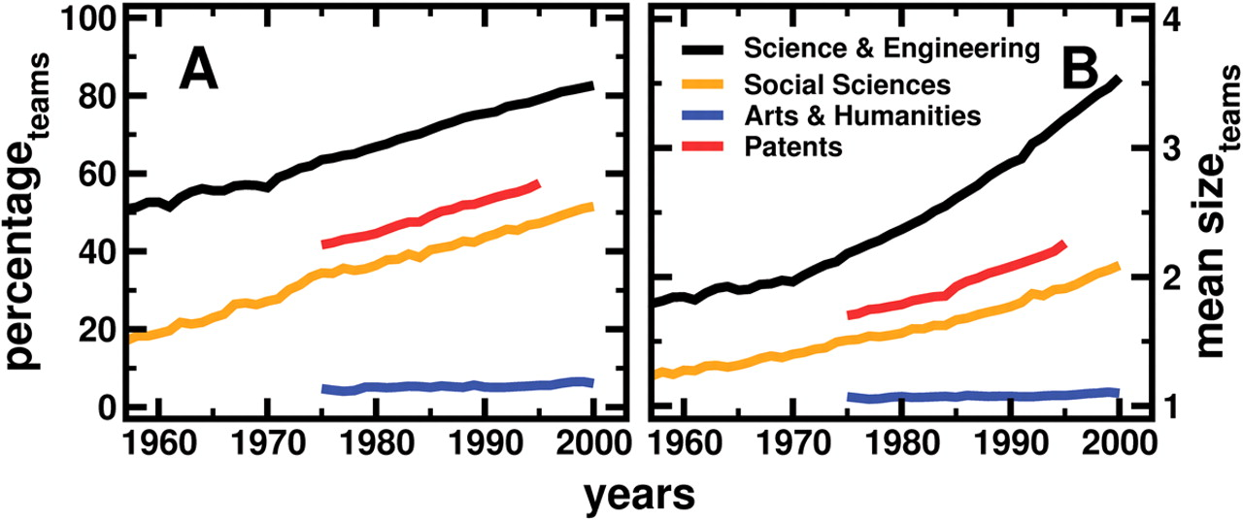

The Growth Of Teams
Source: S. Wuchty et al., (2007). The Increasing Dominance of Teams in Production of Knowledge. Science 316, 1036 -1039.

Slide 9
e-Research is defined as:
research using
digital tools and data
for the distributed and collaborative
production of knowledge

Slide 10
Research computing
Supercomputing
The Grid &
Cyberinfrastructure
Web 2.0
Business, Public,
Government
&
Academic Interest
Clouds
Big Data

Slide 11
Publications on collaborative computing topics, 1993-2012
Source: Scopus data compiled by Meyer & Schroeder

Slide 12

















e-Infrastructures
Barjak, F., Eccles, K., Meyer, E. T., Robinson, S., & Schroeder, R. (2013). The Emerging Governance of e-Infrastructure. Journal of Computer-Mediated Communication, 18(2), 113-136.

Slide 13
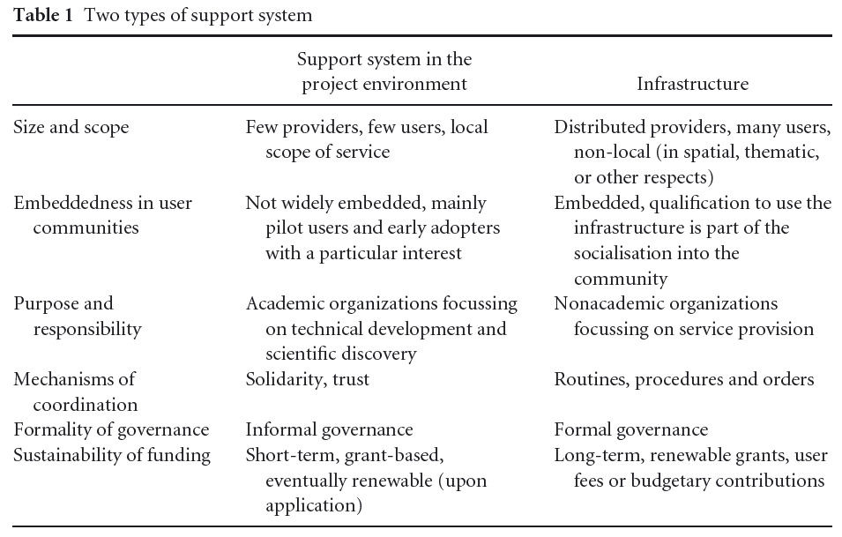
Transition from Projects to Infrastructures
Barjak, F., Eccles, K., Meyer, E. T., Robinson, S., & Schroeder, R. (2013). The Emerging Governance of e-Infrastructure. Journal of Computer-Mediated Communication, 18(2), 113-136.

Slide 14
Clusters of e-Infrastructures
Stable metaorganizations
Established communities
ICT Support
Systems in Flux
Ended Projects
Barjak, F., Eccles, K., Meyer, E. T., Robinson, S., & Schroeder, R. (2013). The Emerging Governance of e-Infrastructure. Journal of Computer-Mediated Communication, 18(2), 113-136.

Slide 15
Whitley
Mutual Dependence
Task (un)certainty
Whitley, R. (2000). The Intellectual and Social Organization of the Sciences (2nd ed.). Oxford: Oxford University Press.

Slide 16
Why is science and research growing more collaborative and computational?
Are funding mechanisms the cause?
Is technology driving it?
Or are there big scientific questions that cannot be answered otherwise?

Slide 17

Source: CERN, CERN-EX-0712023, http://cdsweb.cern.ch/record/1203203

Slide 18
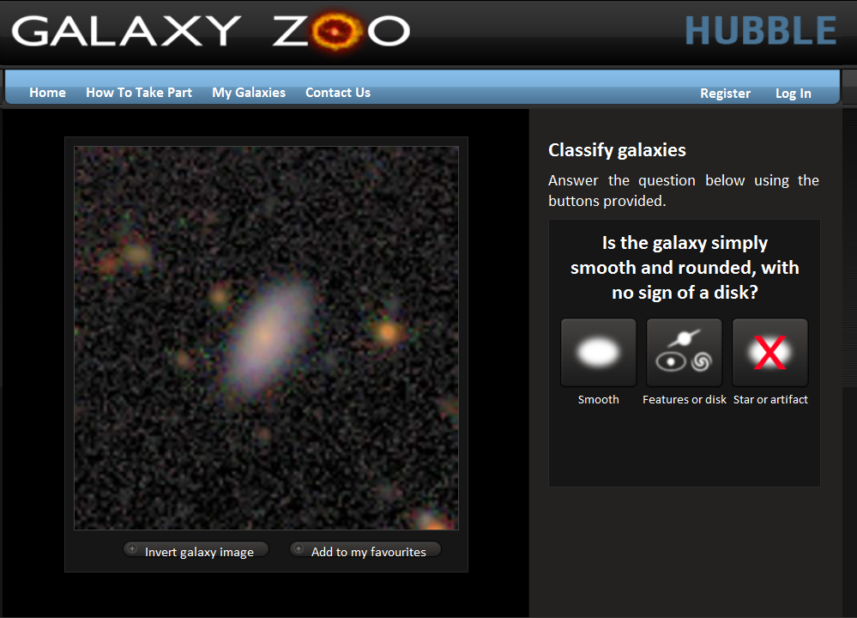

Slide 19
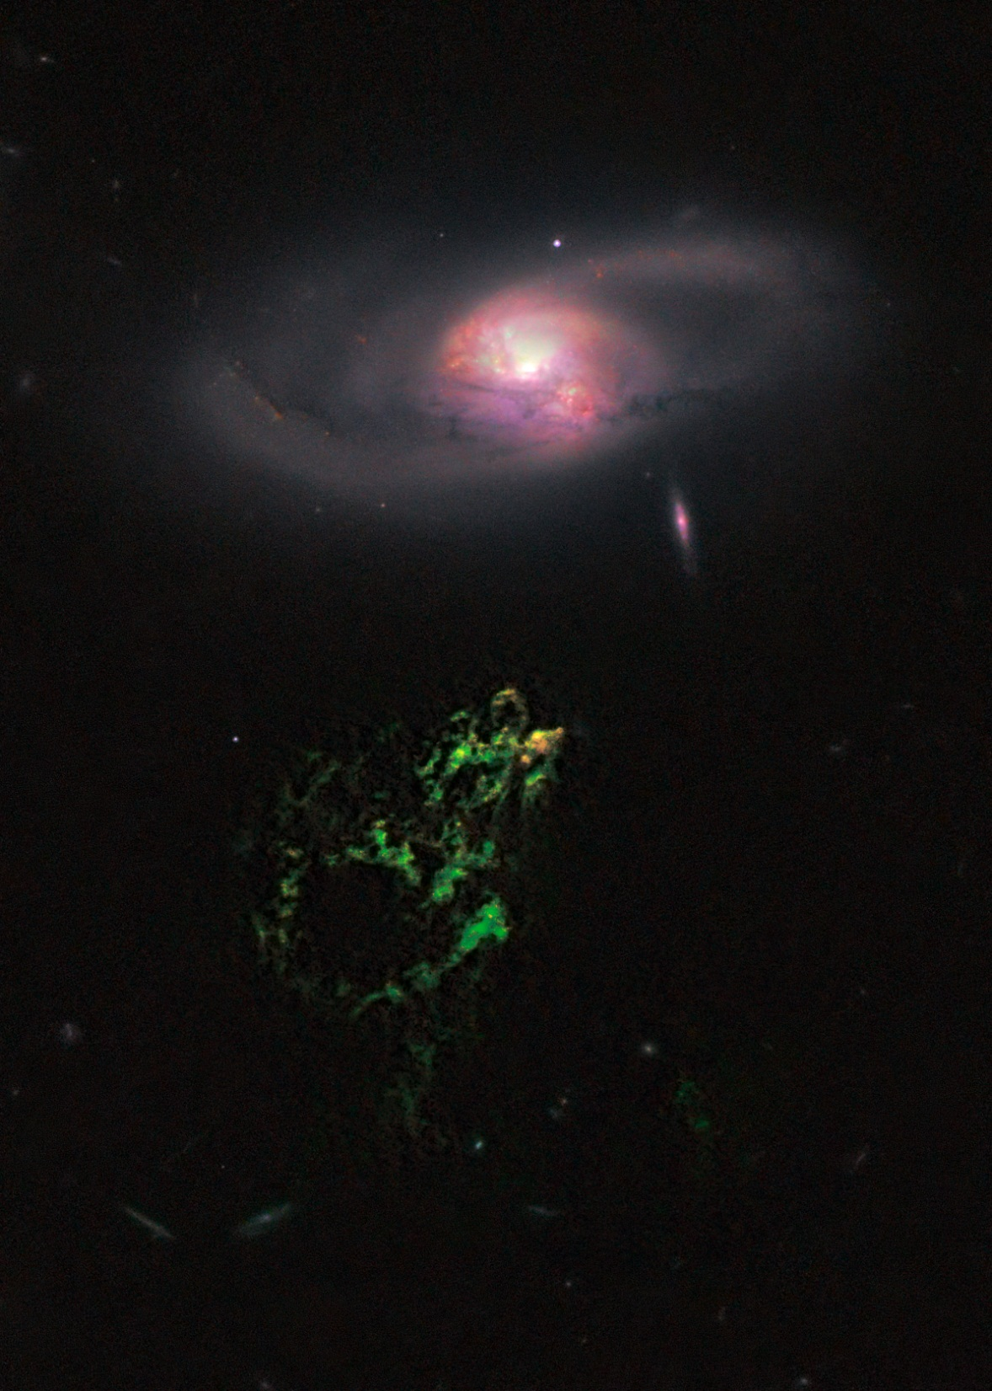
Hanny’s Voorwerp
Source: NASA, ESA, W. Keel (University of Alabama), and the Galaxy Zoo Team. http://hubblesite.org/newscenter/archive/releases/2011/01/image/a/

Slide 20
Long-Lived Data

Slide 21
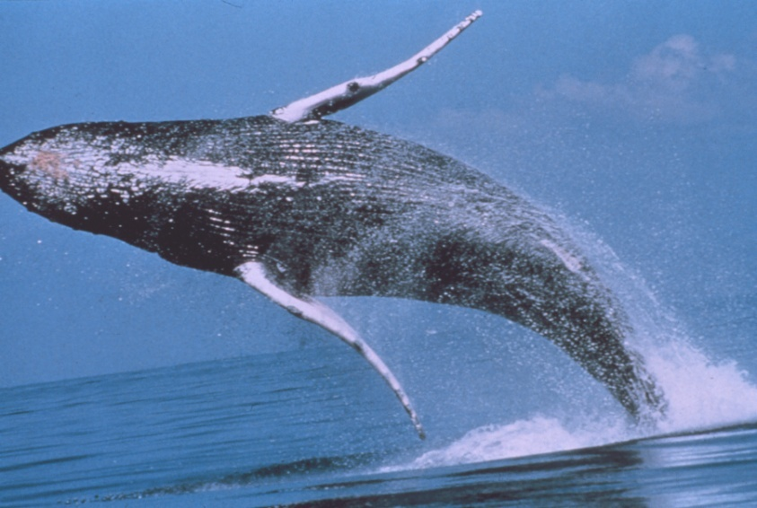
SPLASH
Structure of Populations, Levels of Abundance, and Status of Humpbacks
Meyer, E.T. (2009). Moving from small science to big science: Social and organizational impediments to large scale data sharing. In Jankowski, N. (Ed.), E-Research: Transformation in Scholarly Practice (Routledge Advances in Research Methods series). New York: Routledge.

Slide 22
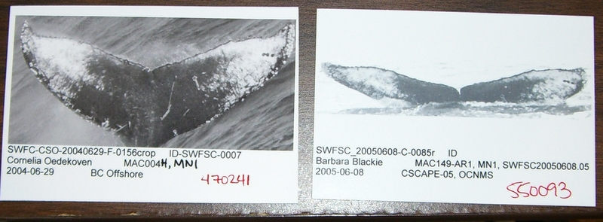
Photo-identification
Humpback whales

Slide 23
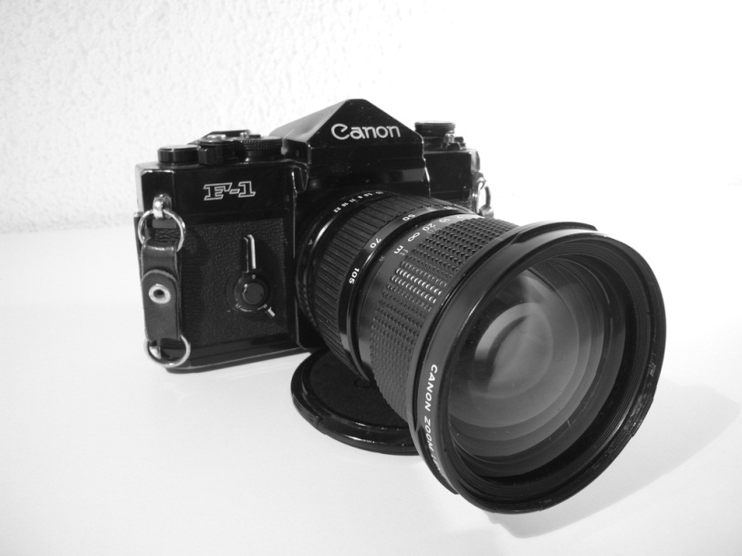
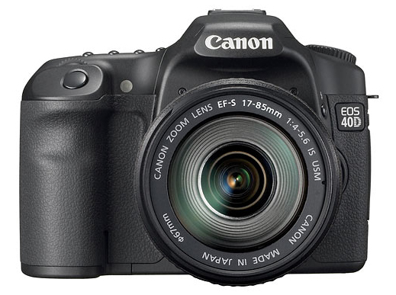
Switching From Film To Digital Cameras

Slide 24
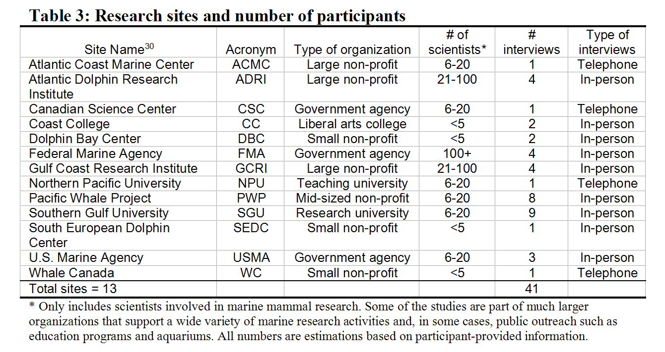
Organizations
Notes:
Challenges
Limited funds (~$6K)
Job responsibilities (7 wks paid time off, but not all at once)
Little awareness of laboratory studies among marine mammal scientists
Nobody has studied this group (with the exception of a little overlap with the late Roberta Lamb, and Frank Nutch)
Would be different if I do a follow-up study now that I have contacts
Remote field sites with small boats / airplanes
Encourage people to look at the reflexive methods section in the Appendix for a fairly honest take on what I did right and wrong

Slide 25
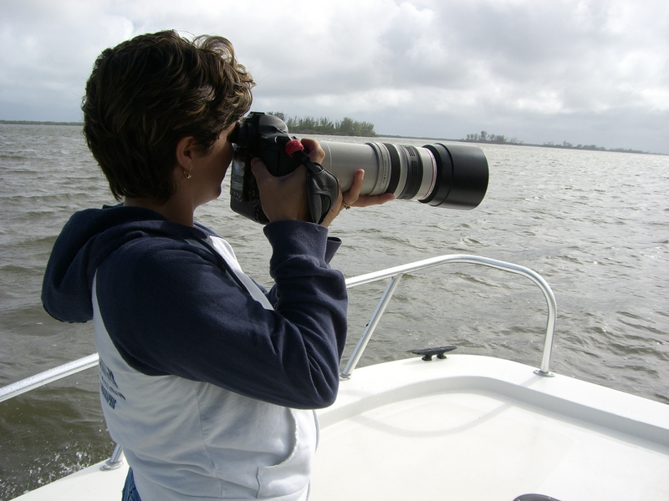
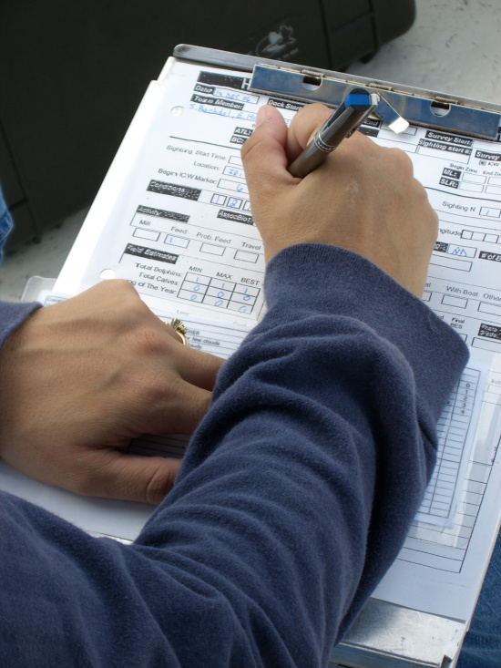
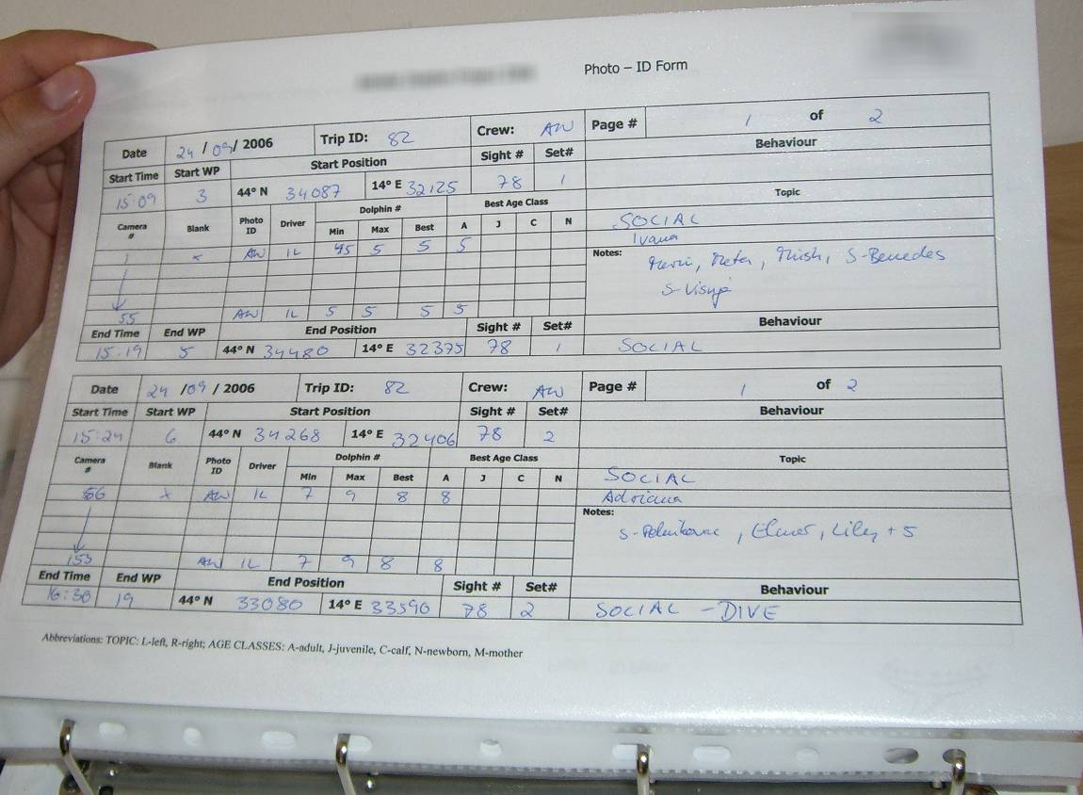
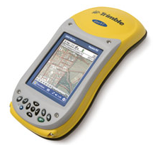
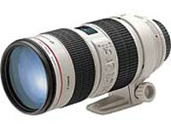
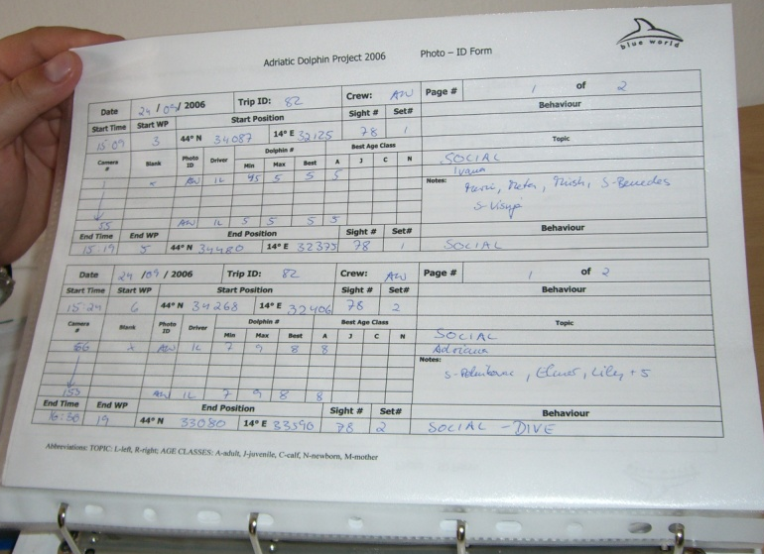
Data in the field

Slide 26
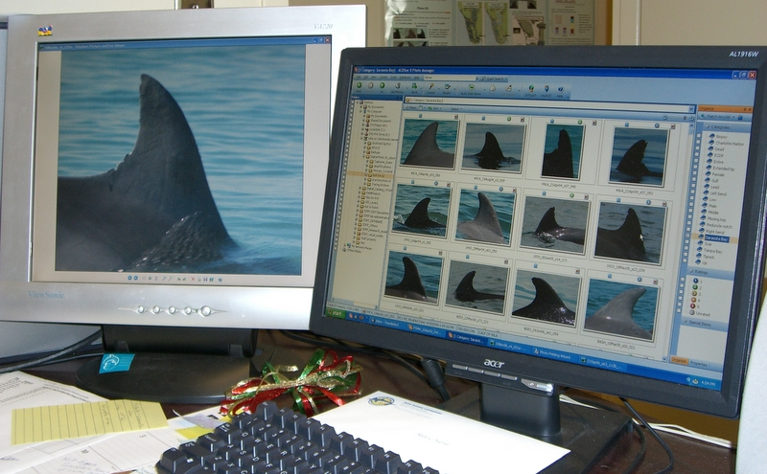
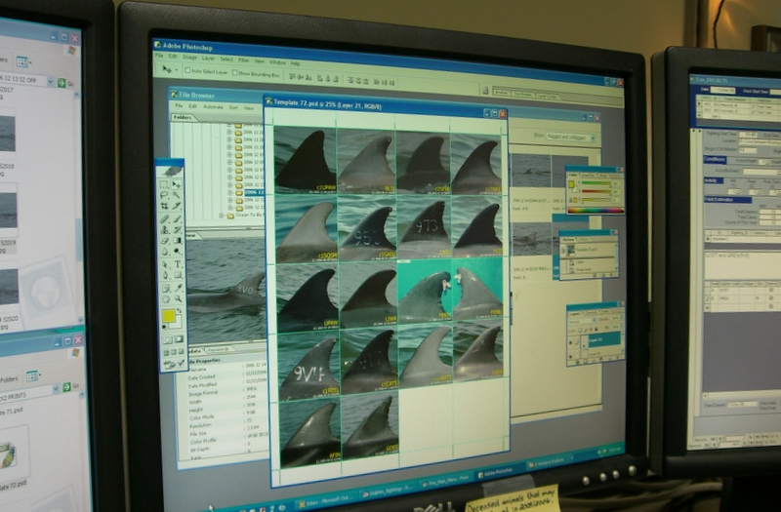
Matching techniques on screen

Slide 27
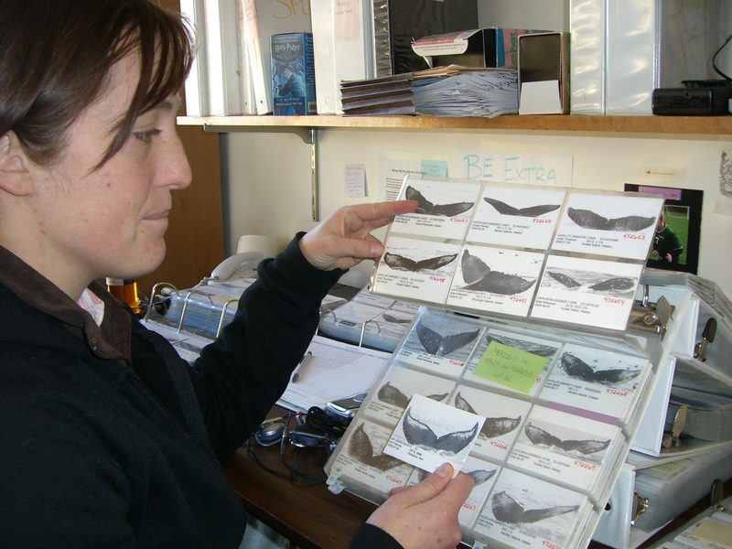
Matching techniques on paper

Slide 28
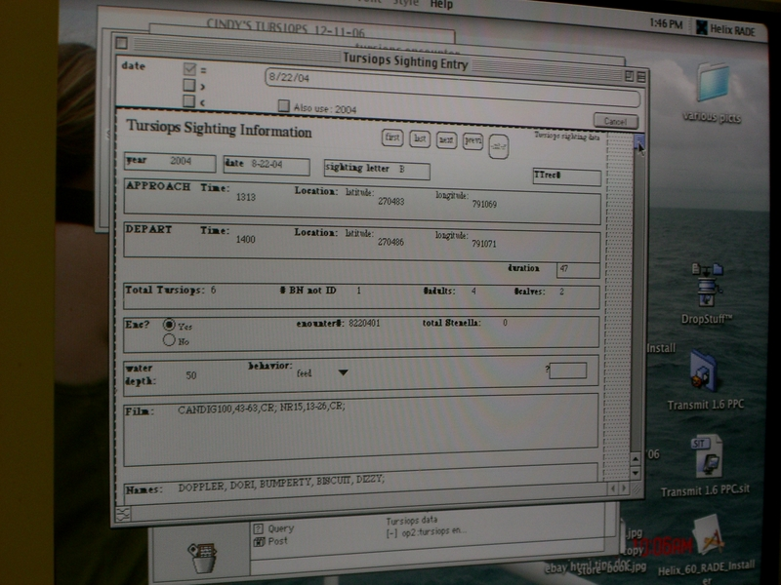
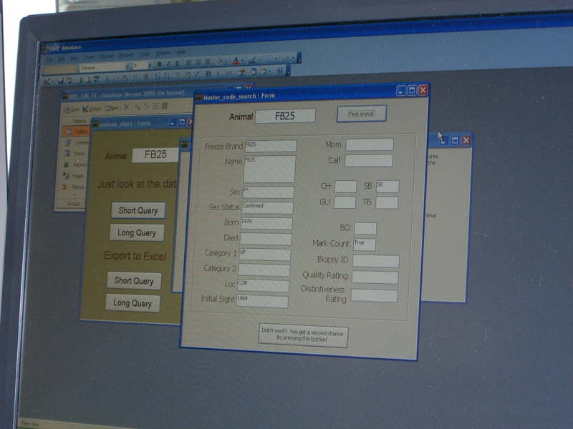
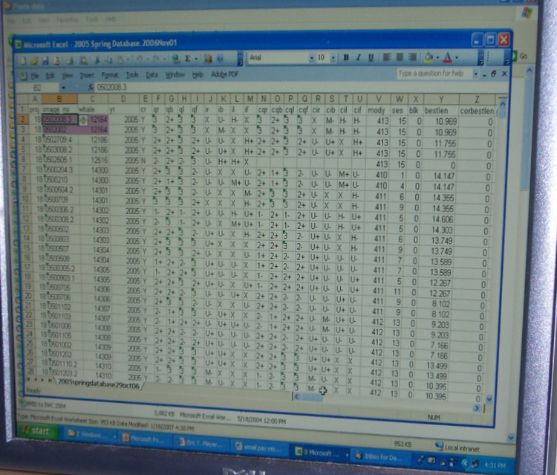
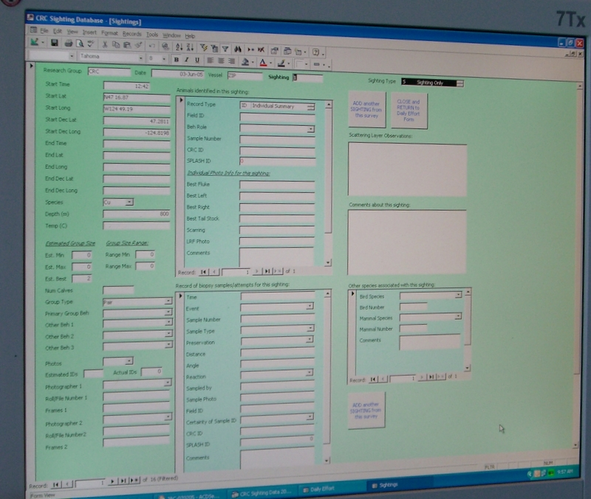
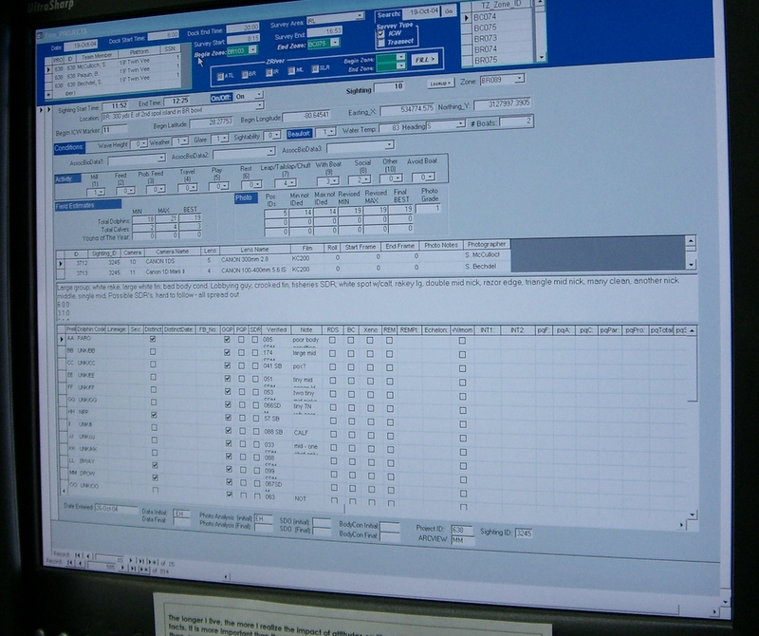
Idiosyncratic systems
Notes:
Some = well-documented and thorough procedures for filing, organizing, archiving, and moving photographs,
Others = more ad hoc approach
One of the studies even had several people working on different parts of their study, and each had invented their own personal system for organizing their data, and there was no consistency between them.
The sophistication of the data management system was directly tied to whether the study had someone with good organizational and also usually database design skills. Only one, however, had enlisted the aid of a trained database programmer; the others had found one of their biologists who happened to be able to learn database skills to design their data system.

Slide 29
The Standards Issue
Robert Newton: And if you don’t have a really good filing system standardized, that doesn’t change every time someone thinks it might be better done a different way. So I’m kind of waiting, I guess, to see it really stabilizes with a naming protocol and a filing protocol that is not going to wander every time someone comes up with a new software for digital pictures. That happens frequently and you’ll get, people send us pictures off a camera and they’ll be in files maybe a Canon software, or a Nikon one. And you can convert them all to jpegs and fart around with them but, basically, I don’t want to be a film processor.

Slide 30
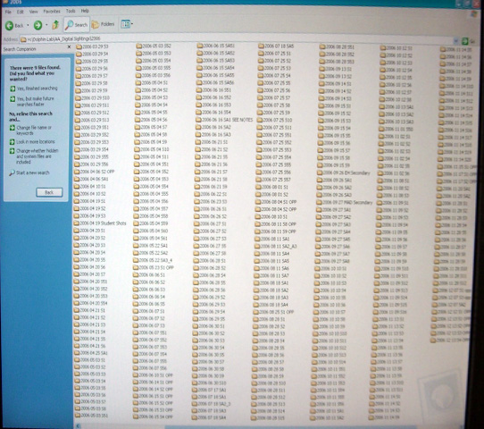
Organizing digital photos
Notes:
This is really one of the areas that the scientists are struggling with most

Slide 31
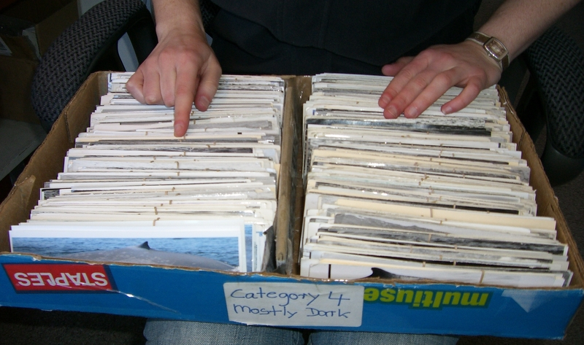
Organizing digital photos

Slide 32
Photo-id process: film
External lab film developing
Field photos
Printing or sleeving
Labeling
Organizing
Shot logs
LEGEND
Identification
Time = relative size of arrow (thick=longer time)
In field
At lab
Analysis
External to project

Slide 33
Photo-id process: digital
Printing (in some cases)
Download, backup, initial organizing
Labeling and organizing
Field photos
Data entry
Summary logs
LEGEND
Identification
Time = relative size of arrow (thick=longer time)
In field
At lab
Analysis
External to project

Slide 34
Photo-ID process: Changes
Instant feedback
Efficiency
Better coverage
Less selective shooting styles
Quick feedback
Less loss of data
More time at end of long days
Storage issues
More photographs
More complex info systems
Printing (in some cases)
Download, backup, initial organizing
Labeling and organizing
Field photos
Data entry
Summary logs
Database designers
IT staff
Skilled users
Less detail
Less tedium
LEGEND
Identification
Time = relative size of arrow (thick=longer time)
In field
More animals
Larger catalogs
Better health
At lab
Analysis
External to project
Notes:
As mentioned in the abstract and beginning of this dissertation:
The switch involved an apparently simple replacement of one 3 pound piece of equipment with a film plane with another 3 pound piece of very similar looking equipment with a image sensor and a memory card. The resulting changes were much more complex.

Slide 35
Who does the work?
Film
Often volunteer labor
Field photos
Printing or sleeving
Labeling
Organizing
Shot logs
Digital
Permanent employees
Download, backup, initial organizing
Labeling and organizing
Field photos
Data entry
Summary logs
Notes:
Complexity
Cost
Higher skill required, but also contribute more to the science than a pair of hands
Discuss number of unpaid intern to employee patterns I found
Faster, better data
Shorter learning curve in field
Less skill required to actually take photos
Still some technical limitations (focusing, for instance)
Somewhat surprised by variety of education levels (from high-school to Ph.D, but Ph.D.s less thick on the ground than I expected)
Somewhat surprised by route into permanent employment of unpaid year-long internships

Slide 36
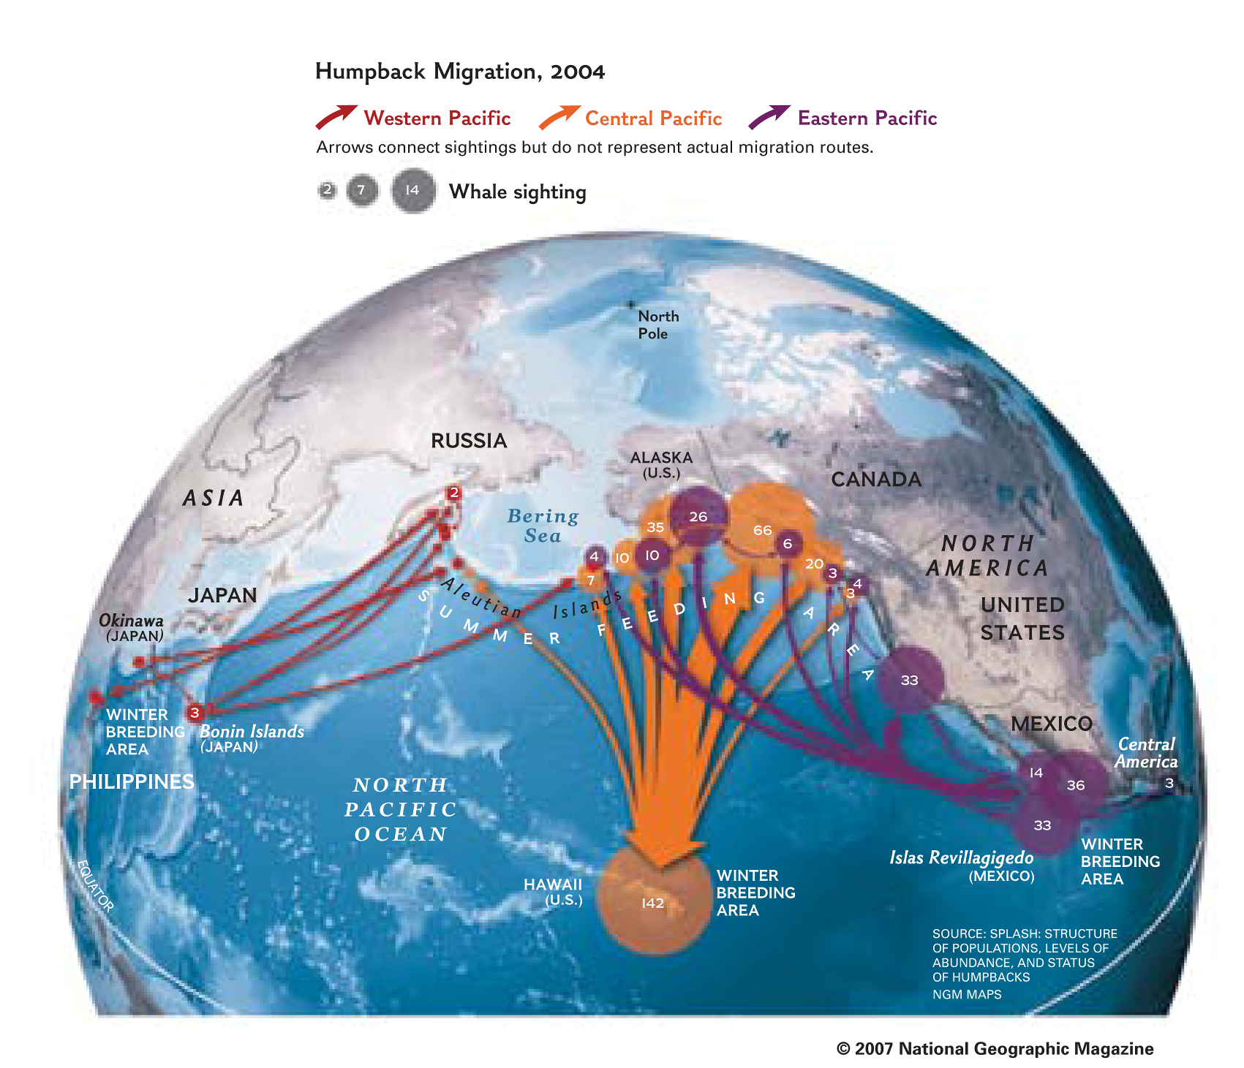

Slide 37

GAIN:
Genetic Association
Information Network
Ca. 2006-2007

Slide 38
Data needed to answer key questions in psychiatric genetics case study
Years | Type of study | Samples | DNA Sequencing | Scope of collaboration
1985-1997 | Family association / linkage | 300 | Hundreds of loci / candidate genes | 4 sites in USA
1997-2007 | Family association / linkage | 1,500 | 10,000 SNPs | 13 sites in USA
2007-2009 | Genome-wide association | 5,000 | 1,200,000 SNPs | Multiple multi-institution collaborations in USA
2010-? | Whole genome | 30,000 | Millions of SNPs | World-wide collaboration
Future | Whole genome sequencing | ? | Entire genome sequence | World-wide collaboration

Slide 39

Enhanced vision
Eden, G., Jirotka, M., & Meyer, E. T. (2012). Interpreting Digital Images Beyond Just the Visual: Crossmodal Practices in Medieval Musicology. Interdisciplinary Science Reviews, 37(1), 69-85.

Slide 40
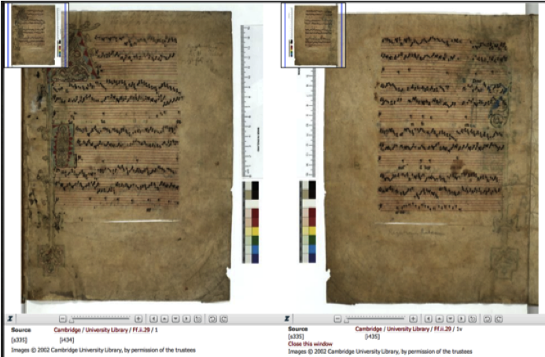
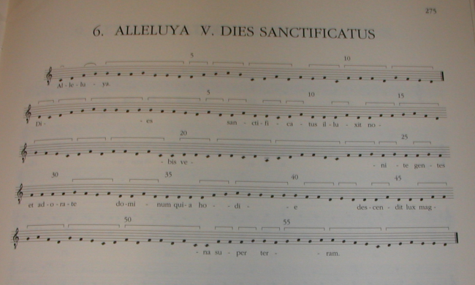
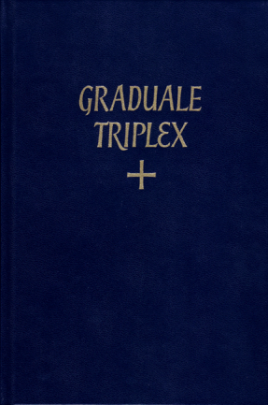
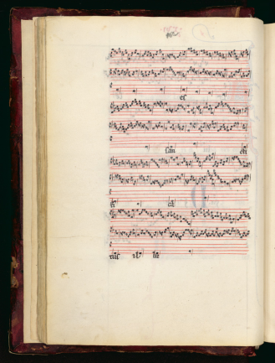
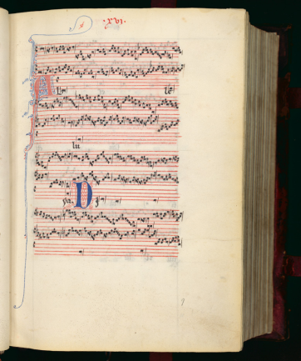
Cambridge polyphonic manuscript, 13th C.
Source: The Digital Image Archive of Medieval Music (DIAMM)
Graduale Triplex, 6/7th C.
Florence polyphonic manuscript, 13th C.
Source: Teca Digitale Ricerca (TECA)

Slide 41
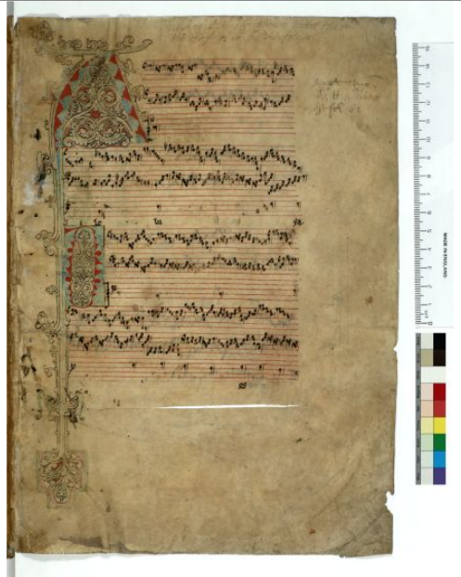
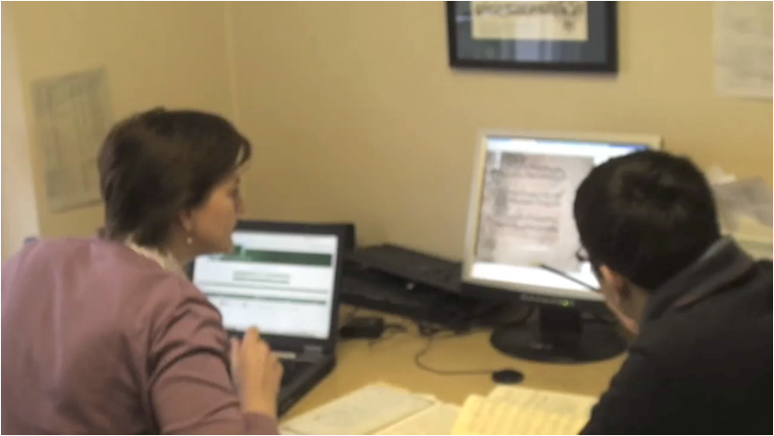
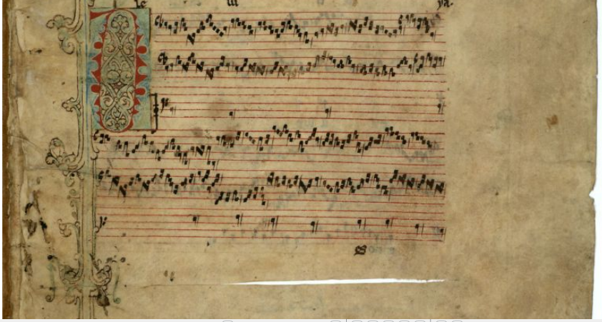
Reconstructing the materiality of digital objects
binder's knife
colours
S: That'a just a – it's not a note
H: I think it's part of the decoration isn't it?
I mean the colours would have been really vivid
wouldn't they - blues and greens, yellows
S: It's quite deteriorated
H: I'm guessing this is a sort of slice in the –
through the parchment isn't it?
S: Yeah
H: It's showing white there
S: Goodness only knows how it got there
H: These are binding fragments. They've
been man-handled into the binding of
another book and presumably a
binder's knife has sliced through the pages.
It's lucky in a way it’s only sliced through the
parchment
note or decoration?

Slide 42





SECT: Sustaining the EEBO-TCP Corpus in Transition
http://www.bodleian.ox.ac.uk/eebotcp/sect/
Siefring, J. & Meyer, E.T. (2013). Sustaining the EEBO-TCP Corpus in Transition: Report on the TIDSR Benchmarking Study. London: JISC.
Available online: http://ssrn.com/abstract=2236202
Bodleian Libraries
Notes:
Used mixed methods: interviews, observation, data analysis

Slide 43
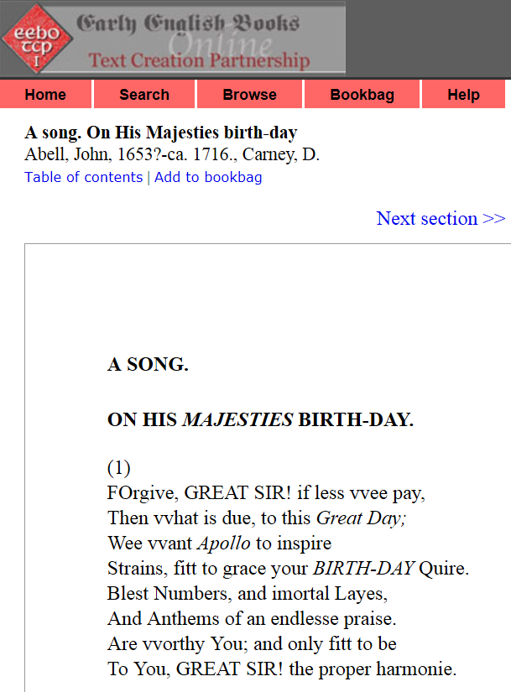
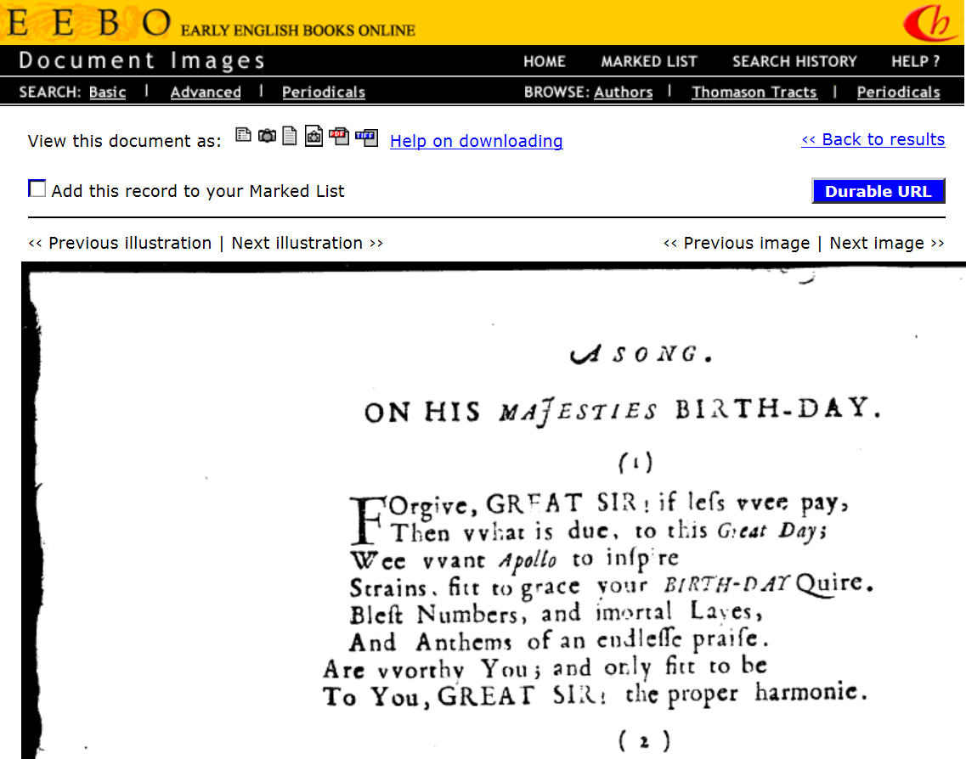

Slide 44
When accessing EEBO-TCP, which of the following interfaces have you used?
N=172

Slide 45
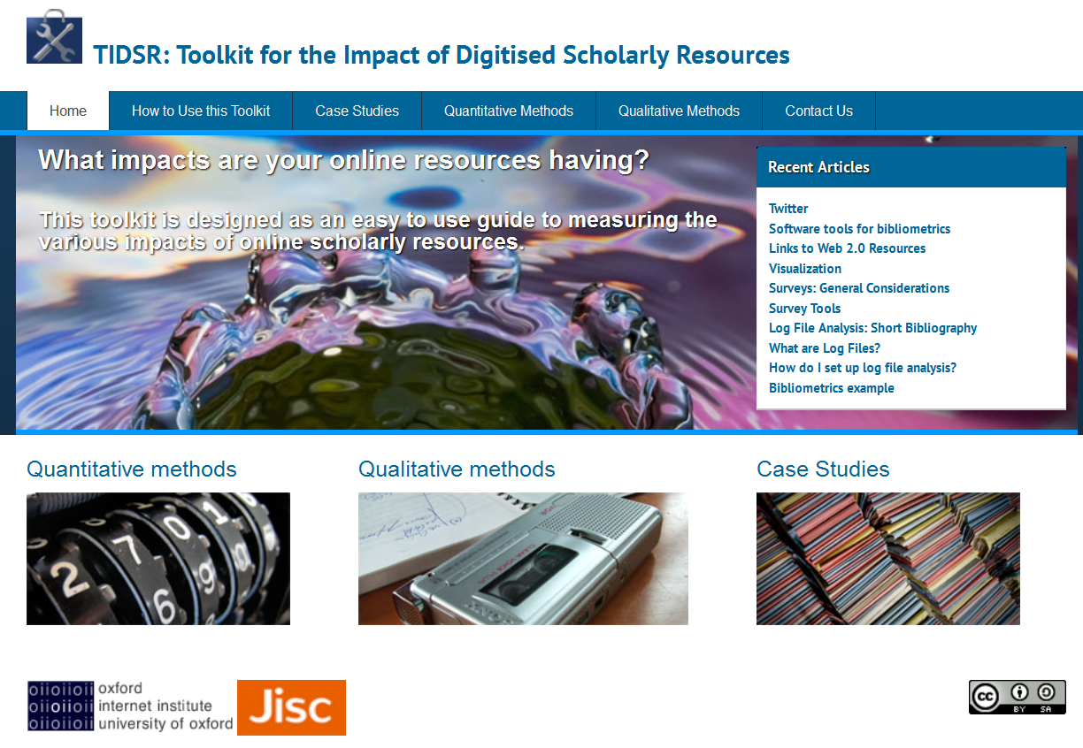
bit.ly/TIDSR
http://microsites.oii.ox.ac.uk/tidsr/

Slide 46
Digital Humanities? or
Humanities, Digital?

Slide 47
Digital Research? or
Research, Digital?

Slide 48
Interdisciplinarity
Notes:
Used mixed methods: interviews, observation, data analysis

Slide 49
The initial challenge
“
One of the things that technology projects say is, “We don’t know any social scientists. We don’t necessarily understand the value of it. The Commission tells us we should take these things into consideration” – but they shrug their shoulders a bit.
From the SESERV Oxford Focus Group (http://seserv.org)

Slide 50
“
So my level of understanding drops off at a certain point because I’m not a trained technical person, and that’s frustrating as a director of the organization, not really knowing how long something takes – that’s my own failing. On their part I think the technical-minded people have a certain… it’s hard to describe actually. Putting it not very generously there’s almost a know-it-all attitude that people who are trained in the social sciences don’t have, because I think they’re more accustomed to “There are many sides to an argument” whereas people who come out of engineering it’s like “There’s a right way and there’s a wrong way”.
Ron Deibert, Citizen Lab, University of Toronto, interviewed 21.11.2012
for Sloan Big Data Project (http://www.oii.ox.ac.uk/research/projects/?id=98)

Slide 51
“
I see some sociologists like [senior researcher on the project] and she always asks me, “Okay show me a code and explain to me which part of a code is doing which part, just very brief understanding okay how this computer program is working”. So I was learning some sociology from her and she is learning some computer science programming skills from me so it’s kind of mutual [laughing] influence which is how I learn something like that.
Ning Wang, OII, interviewed 10.30.2012 for Sloan Big Data Project (http://www.oii.ox.ac.uk/research/projects/?id=98)

Slide 52
Publication Type by Field

Slide 53
Publication Type by Field

Slide 54
Citation rates by field and type of publication
 | Publications (all types) |  |  | Articles |  |  | Conference Papers
 | N | % cited | Mean cites | N | % cited | Mean cites | n | % cited | Mean cites
Overall | 14064 | 49.7% | 5.9 | 4609 | 70.1% | 10.6 | 7962 | 40.3% | 2.3
Computer Science | 9123 | 47.6% | 4.4 | 2295 | 71.0% | 10.9 | 6102 | 41.5% | 2.0
Math and Physics | 4256 | 56.1% | 5.1 | 1470 | 74.0% | 9.7 | 2405 | 50.2% | 2.2
Engineering | 3774 | 47.2% | 5.8 | 1407 | 69.7% | 9.3 | 1984 | 34.8% | 2.9
Medical Fields | 2088 | 60.3% | 7.7 | 505 | 73.5% | 18.7 | 1271 | 55.2% | 2.3
Social Sciences | 1256 | 49.0% | 4.3 | 645 | 64.8% | 6.3 | 461 | 27.3% | 1.5
Natural Sciences | 1059 | 59.9% | 9.2 | 624 | 73.4% | 11.9 | 244 | 31.2% | 2.2
Arts & Humanities | 625 | 40.2% | 2.1 | 284 | 52.8% | 3.1 | 241 | 27.0% | 0.8

Slide 55
Publication Type by Field

Slide 56
Trust
“
…one computer scientist kept on questioning the domain experts, and the domain experts repeat the answer and provide more data, and repeat the answer and provide more data – nothing was satisfying the computer scientists. So I stepped in and I said, “If you don’t trust him as your domain expert, you need to get another domain expert, or you need to begin to trust him, because we’re not getting anywhere, and you’ve asked the same questions at least half-a-dozen times. You’ve gotten the answers. Those are the answers so-and-so can provide.” So he looked at me and said, “Oh, okay” and he stopped questioning that domain expert.
From the SESERV Oxford Focus Group (http://seserv.org)

Slide 57
“
I can find someone to optimise an algorithm, I can pay someone to build a website but what I want is someone that is going to be thinking the human side through every step of the way, and when you build an algorithm and when you write a line of code you ask, does this make sense in terms of the phenomena that I am trying to model or trying to interpret.
Joshua Introne, MSU, interviewed 26.7.13 for Sloan Big Data Project (http://www.oii.ox.ac.uk/research/projects/?id=98)

Slide 58
Finding a common language and bridgers
“
I have a technical background…and I also understand social science, and then I could bridge these two gaps….So I’m taking…research which is descriptive and analytic and not really meant for design, and then I’m extracting design requirements and making hypotheses that we actually can build and test in terms of our technology based on that body of [social science] knowledge. And it worked quite well because I could speak both languages
From the SESERV Aalborg Focus Group (http://seserv.org)

Slide 59
Data Science

Slide 60
-

Slide 61













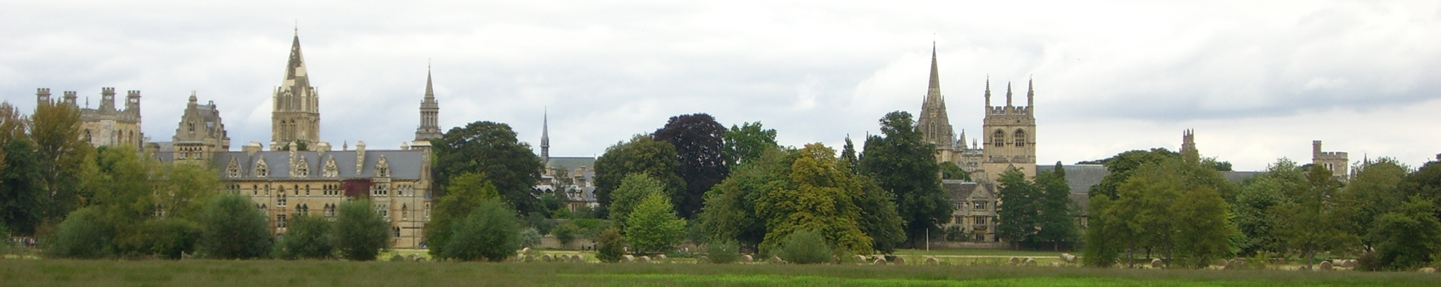
Dr Eric T. Meyer
Senior Research Fellow & DPhil Programme Director
eric.meyer@oii.ox.ac.uk
http://www.oii.ox.ac.uk/people/?id=120
@etmeyer
With support from:

