Slide 1
Strategies and Partnerships for Enabling Infrastructure Sustainability
Anne Maglia, PhD
Program Director, Division of Biological Infrastructure
US National Science Foundation
TDWG 2013 | 28 October 2013

Slide 2
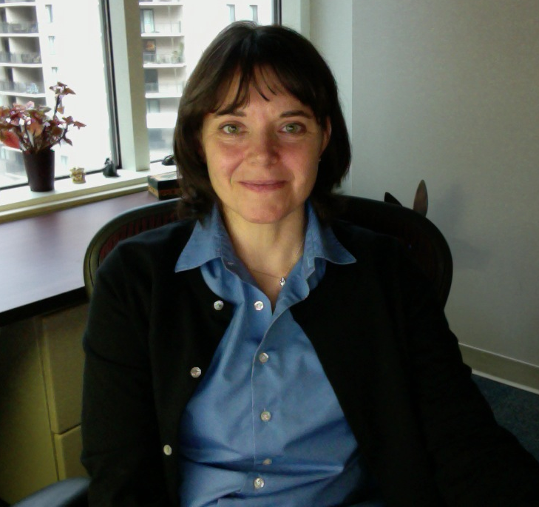
Strategies and Partnerships for Enabling Infrastructure Sustainability
Anne Maglia
amaglia@nsf.gov
@ammaglia

Slide 3
Outline
Challenges from funders perspective
Example: Biological Collections
Strategies
Award decisions
Leveraging
Partnerships
Opportunities for TDWG community

Slide 4
NSF’s Role
“…keep the United States at the leading edge of discovery in all fields of fundamental science and engineering…support "high-risk, high pay-off" ideas”
“Transformative Research”

Slide 5
Resource Competition
innovative
discovery
sustainable
infrastructure

Slide 6
Challenge
1) Infrastructure
=>
Innovation
2) Infrastructure
=
Innovation

Slide 7
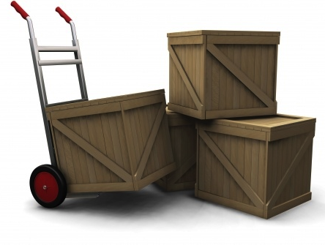
Ex: Biological Collections
Courtesy: SIO
Collections in Support of
Biological Research (CSBR)

Slide 8
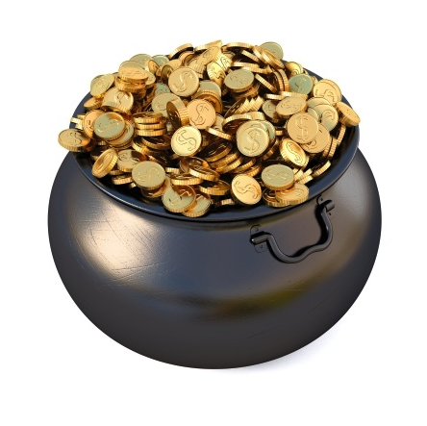
Advancing the Digitization of Biodiversity Collections (ADBC)
10 years, $10 million/year
iDigBio central hub, themed networks
Digitize as many US non-federal collections as possible

Slide 9
How to best facilitate building, sustaining, and using collections data resources?

Slide 10
1. Review criteria/Award decisions
Prioritization, sustainability plans
Networking, “social” sustainability
Innovative approaches
Most of $$ to equipment, training
Conditions of award

Slide 11
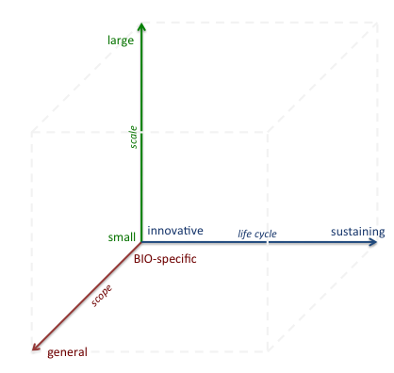
2. Resource leveraging

Slide 12
2. Resource leveraging
ADBC/iDigBio
CSBR
ABI*
v
*Advances in Biological Informatics

Slide 13
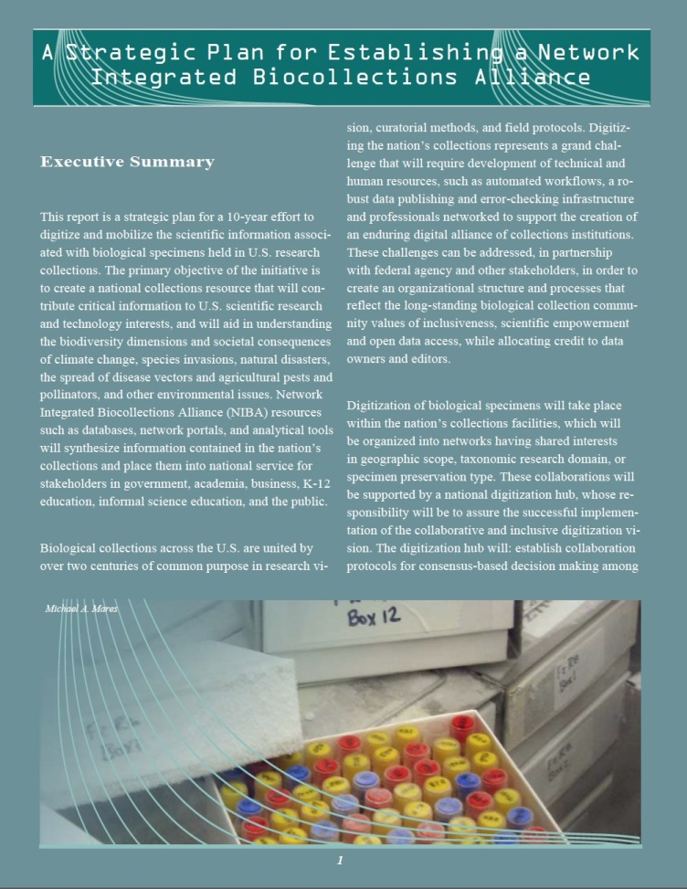
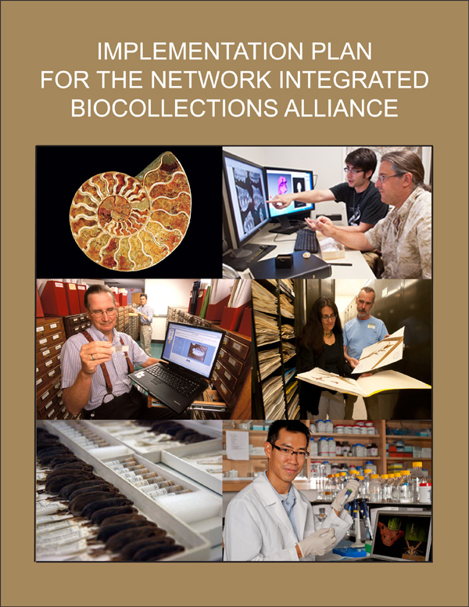
3. Strong Partners/Partnerships

Slide 14
NIBA Goals/Partnership opportunities
Establish governance structure for national leadership
Build biodiversity collections cyberinfrastructure
Train the current and future generations
Buy-in and partnerships nationally, internationally
Develop a sustainable knowledge base
Promote specimen-based learning, pedagogy

Slide 15
NIBA Goals/Partnership opportunities
Establish governance structure for national leadership
Build biodiversity collections cyberinfrastructure
Train the current and future generations
Buy-in and partnerships nationally, internationally
Develop a sustainable knowledge base
Promote specimen-based learning, pedagogy

Slide 16
Partnership opportunities
Build biodiversity collections cyberinfrastructure
R&D environment for methods, tools, techniques
Digitization standards and protocols
Mappings to other research communities
Accreditation, promotion of tools, services, data
Implementation plan for long-term data archiving
Robust web services for taxonomic names

Slide 17
Partnership opportunities
Buy-in/partnerships nationally, internationally
Develop collaborations around occurrence data
Market available collections data resources
Initiate international collaboration to deliver US collection data to a global resource
Document the role of US national specimen data standards, design for international interoperability beyond Darwin Core

Slide 18
Questions?
amaglia@nsf.gov @ammaglia

