Slide 1
Use it or lose it:
Crowdsourcing support and outreach activities in a hybrid sustainability model for e-infrastructures
The ViBRANT project case studies
Koureas D., Livermore L., Roberts D. & Smith V.
Biodiversity Informatics Group | Department of Life Sciences
Natural History Museum, London
@dimitriskoureas
doi: 10.6084/m9.figshare.830497

Slide 2
680
Biodiversity Information projects
Development phase
Project ends
Funding application
Maintenance
No further funding
or gap in funding
for development
?
Project starts
The ephemeral lifecycle of a project
Notes:
With around 680 projects it is obvious than the biodiversity information landscape is expanding at a higher rate than ever before. Every project usually starts on a brilliant idea and an equally good funding application, but most of the times the end of the project comes with the end of the funding, and if a systematic re-funding scheme was not previously established, the only legacy of the project is a wearing-off service and some good quality papers.
However as the goal of conceiving and implementing an e-infrastructure or a biodiversity information system is to create a long-term resource, development and maintenance should always come hand-in-hand.

Slide 3
“…telephones do not crash; power supplies do not fluctuate; and clocks do not halt (in general). Similarly, a computational tool (…) must be reliable across time, it must be maintained.”¹
¹ Ribes D., Finholt T.A. 2007 Proceedings of the third International Conference on e-Social Science
Notes:
Ribes and Finholt in 2007, describe that e-infrastructures should be as stable and reliable as any infrastructure.
Telephones do not crash; power supplies do not fluctuate; and clocks do not halt (in general). Similarly, a computational tool (…) must be reliable across time, it must be maintained

Slide 4
Transition from
Project Infrastructure
Discovery
Individualistic
Ephemeral
Optional
Risk taking
Implementation
Communal / agreed
Persistent
Essential
Robust & reliable
Adapted from Patterson D. 2013, Tempe, Arizona
Notes:
For many of our projects in biodiversity informatics world the vision still remains:
How to move from the level of a funded research project, which is based on discovery to a system that is communal and agreed, rather than individualistic. Covers for essential needs of the many rather than being optional. Is robust and reliable rather minimising the risk of failure. And most importantly is persistent rather than ephemeral.

Slide 5
Post-project sustainability is always a major concern
but…
Maturation indices?
Sustainability criteria?
Funding for maintenance?
so…
How can we secure the future of our projects?
Notes:
So the post-project sustainability is always a major concern when we plan and apply for funding. But, how can we predict whether a project’s product is going to be sustained in perpetuity? Are there established indexes that can accurately estimate an e-infrastructure project maturation? Are there any widely accepted criteria that need to be fulfilled in order to enhance the chances of our projects becoming self-sustainable in the future?
And finally if no further development is planned is there widely available funding to maintain the existing e-infrastructures?
So…
If non of the above is available, what can we do to help securing the future of our projects?

Slide 6
Shift in the way we think
of e-infrastructures and information resources
Stable/rigid system
Dynamic/open process
Outsource to and involve the
end user community
We need to set up the environment that will enable the community contribution
“An infrastructure must be taken as a process instead of a system.”
Koerten, H. & van den Besselaar P. 2013. Sustainable Taxonomic Infrastructures: System or Process?
Notes:
What if we could shift our approach to what can contribute to a sustainable infrastructure? Instead of looking to create a fixed solid system aim at maintaining infrastructures by transforming them to dynamic and open processes. This could be achieved by enabling the end user communities, that benefit from its use, to actively participate in further developing and provide support facilities.

Slide 7
For your community to support you
you first have to build one
Confidence
Agility
Marketing
Commitment
Longevity
Adaptability
User monitoring
Visibility
Intuitive interface
Notes:
If we were to plan towards this end, we would need to set up, during the development phase, the necessary environment that will attract and facilitate community participation. We will need to nurture this community throughout the project.
Arguably there are three major virtues that can attract and build a vibrant community of users:
Confidence that can be built

Slide 8
Is building your user base enough?
Not if you want to nurture a community based sustainability model
Infrastructure maintenance
Technical maintenance
User support
Open source & modular
Crowdsourcing support activities
Maximising support efficiency
Notes:
Is it enough to attract a large user base? No
To develop a community based sustainability model we will have to actively get each and every one of the users involved in the project.
Participation – Inspiration
In a community based model Crowdsourcing support activities and maximising the efficiency of the existing support structures can be considered as the two basic pillars that underpin a successful co-learning support schema.
Although a community based technical maintenance and development model is of equal importance, I will concentrate on the primary tools used that build these two pillars in Scratchpads.

Slide 9
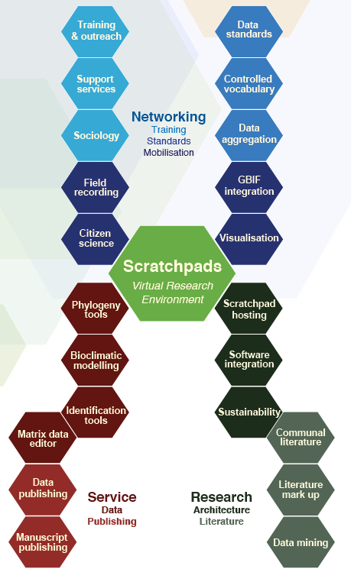
A network of compatible services
with no single point of failure
So… how did ViBRANT go?
Notes:
How easy is to build a community around an e-infrastructure?
Our experience in the ViBRANT project has demonstrated that building a solid user base is more difficult that it sounds.
The ViBRANT project was designed to be a network of compatible services rather than a single resource.
Such a design benefits from robustness of many linked nodes and no single point of failure. The research landscape in biodiversity informatics is accelerating, like so many others in modern science. This pace of
change means that a static design is likely to have a short useful life. It is therefore appropriate to review the
context within which the services developed by ViBRANT will be sustained.

Slide 10
Scratchpads
Xper2
Low
Medium
High
GeoCAT
CartoDB
NPT
PWT
GoldenGATE
Platform
for Cybertaxonomy
Biowikifarm
RefBank
OBOE
ESTABLISHED USER BASE

Slide 11
Factors for building a healthy user base
Supporting structures
Outreach activities
Time of service run
Low
Medium
High
ESTABLISHED USER BASE
Notes:
Although

Slide 12
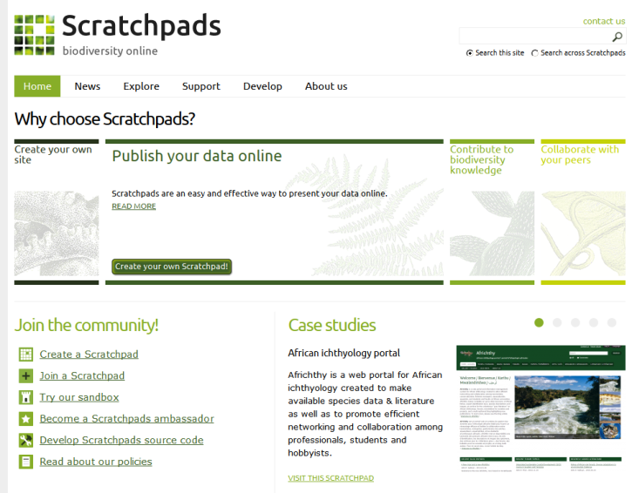
Scratchpads Virtual Research Environments
600 communities
7,100 active users
Notes:
The Scratchpads platform is being developed for the last 7 years under this framework. To provide researchers with the necessary tools to make taxonomy digital, open and linked!
To facilitate the development of virtual research environments
Simon’s talk on Thursday:
Scratchpads: The virtual research environment for biodiversity data
12

Slide 13
a
seamless
workflow
Data
collection &
generation
Data
publishing
Data
curation
One of the most successful
e-infrastructures under Vibrant
But why?
Data
analysis
Notes:
Scratchpads are built to facilitate the development of online communities through a single, integrated and open access environment and allow for handling biodiversity related data from the collection and generation stage to the online curation, analysis and publication.
Scratchpads can be considered as one of the most successful services supported in the ViBRANT project. And of course as the project comes to a completion it would be very useful to examine the whys and wherefores of this… In the next few slides I will summarise the primary practical elements that we believe underpinned this success

Slide 14
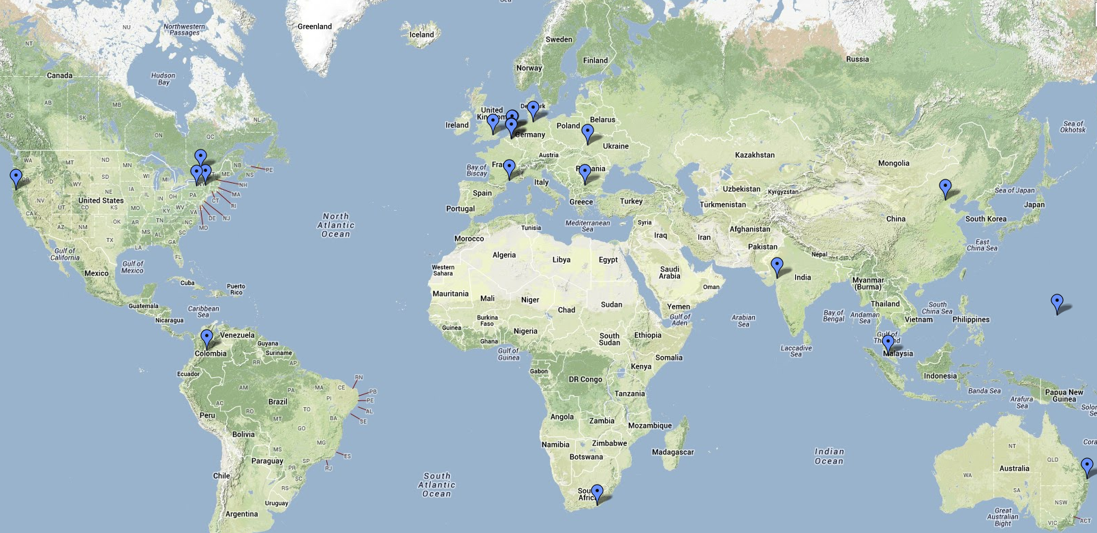
Crowdsourcing the support activities
Ambassadors programme
Share enthusiasm and vision
Usage experience
Geographically distributed and cross-domain
20 ambassadors in 16 countries
Notes:
Our ambassadors programme can be considered as the cornerstone to our efforts. Scratchpads ambassadors are experienced users that share the same enthusiasm and vision. Over the last years we have attracted 20 ambassadors spread across all continents (except Antarctica).
Most of them maintain more than one Scratchpads and have been actively participating in the commons culture of Scratchpads before they applied.

Slide 15
Crowdsourcing the support activities
Ambassadors programme
Give talks about Scratchpads
Arrange for or give training courses
Act as focal point of local Scratchpad expertise
Promote the use of Scratchpads in their community
Provide support to new local Scratchpad user communities
Provide support to local users in languages other than English
1
2
3
4
5
6
Notes:
Their contribution towards a post-funding sustainability model is arguably crucial as they:
1
2
3

Slide 16
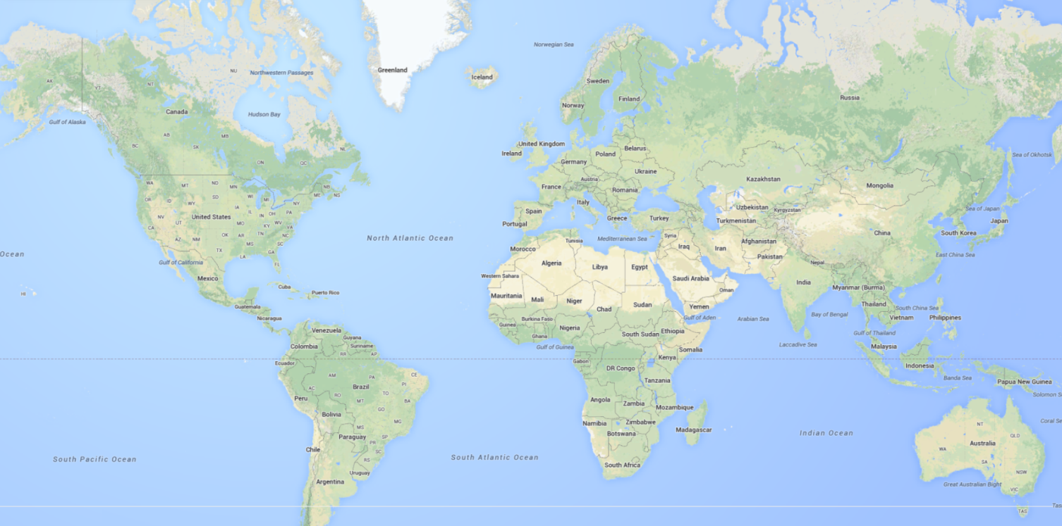
Crowdsourcing the support activities
Ambassadors programme
Planned and organised training courses by Ambassadors
Ukraine
Malaysia
Cameroon
Notes:
Their active involvement is also obvious by the fact that they plan and organise local training courses for their respective communities. During this year we already run 2, in Ukraine and Malaysia and next week another one is planned in Yaoundé, Cameroon

Slide 17
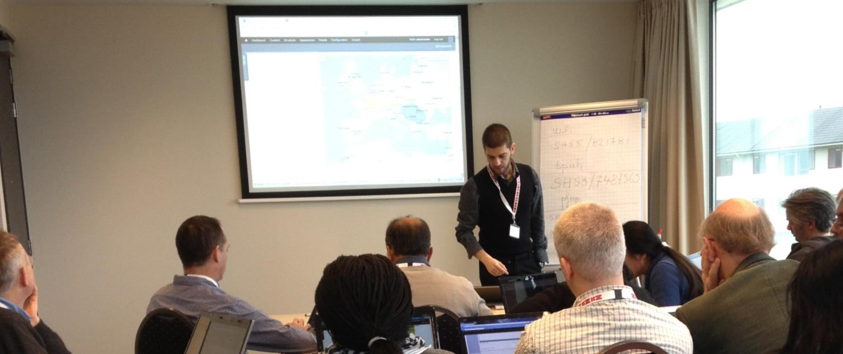
Crowdsourcing the support activities
Training
On-site
Raise awareness | Promote platform
Train users
16 courses in 2013
in 9 countries
Train trainers
Notes:
Training courses raise awareness and of course promote the platform to different communities. However they also play an important role in training users that eventually become trainers for their research group members of small communities.
On-site training is aimed at addressing different communities in different countries. In 2013 we’ve run (or are scheduled) 16 courses in 11 countries in Europe, Africa, Asia and America.

Slide 18
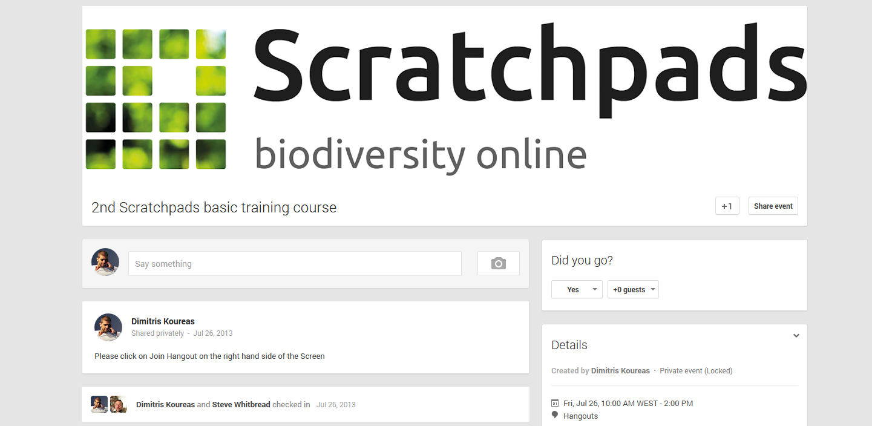
Crowdsourcing the support activities
Training
On-line
3 online courses in 2013
Participants from all continents
Global reach
Low cost
Notes:
Recently we’ve started organising online training courses. Online courses can have a global reach and are low in cost compared to on-site training. In the two previous courses we had participants joining from Australia, Africa and Europe. We’ve planned one more for next month.
The platform we use is Google hangouts and we keep the number of participants to a maximum of 8 people.

Slide 19
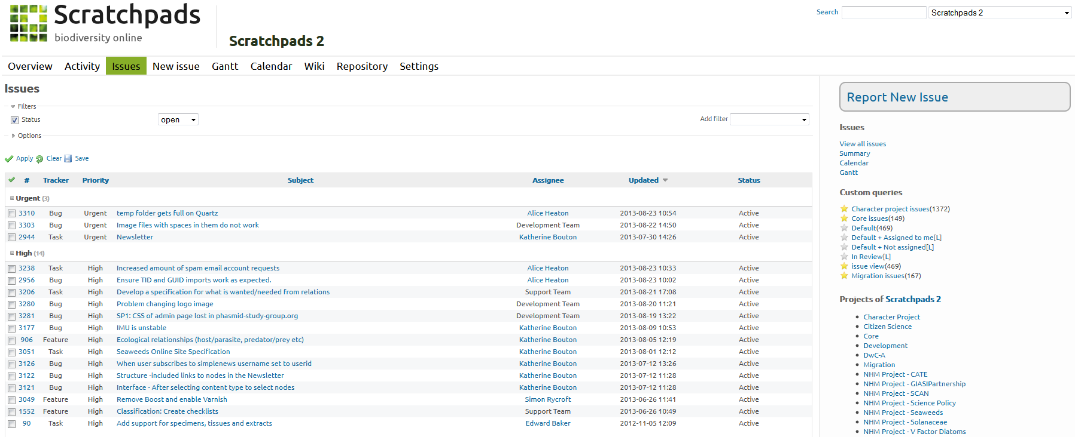
Maximising support efficiency
Project management – Issues queue
> 1,200 issues / year
Redmine
open source project management system
Bug reports
Feature requests
Support queries
61% processed within a day¹
81% processed within a week¹
¹ Brake I. et al. 2011. Zookeys 150 doi:10.3897/zookeys.150.2191
Notes:
In the front of maximising our support structures efficiency, our first step was to use an open sourced integrated project management system. Through this dedicated Issues queue platform we are able to track all Bug reports, feature requests and support queries through a single environment.
The efficiency of using a system like that has been previously documented for Scratchpads in a paper published in 2011. 61% of all tickets were processed within a day, while 81% within a week. Less than 5% of all raised issues have a processing time of more than 30 days.

Slide 20
Maximising support efficiency
Straight-forward workflow
Co-learning environment
Project management
Development Team
Issue
Team member
user
Support
Team
Notes:
The workflow facilitates fast processing time, provides the necessary metrics for performance monitoring and also enables users to act in a co-learning open environment.
[Describe the process and highlight user participation]

Slide 21
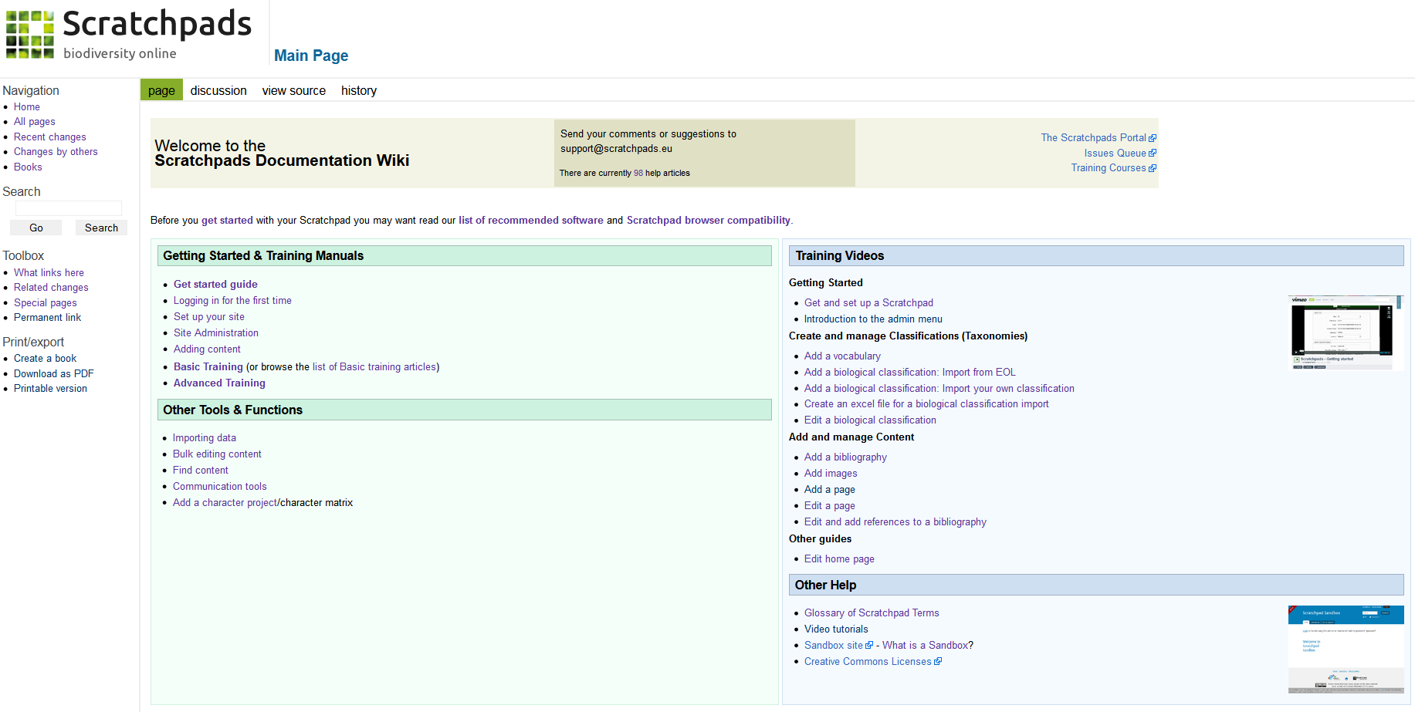
Maximising support efficiency
Documentation
Wiki based documentation site
ca. 100 articles
> 115,000 views
Notes:
In Scratchpads instead of the traditional documentation solution, all help material is organised through a mediawiki site. Team members, as well as users, can contribute to the wiki improving the quality of the information in a collaborative environment. Currently the site holds around 100 help articles organised in different content categories. Screencasts are also provided to facilitate the self-training process.

Slide 22
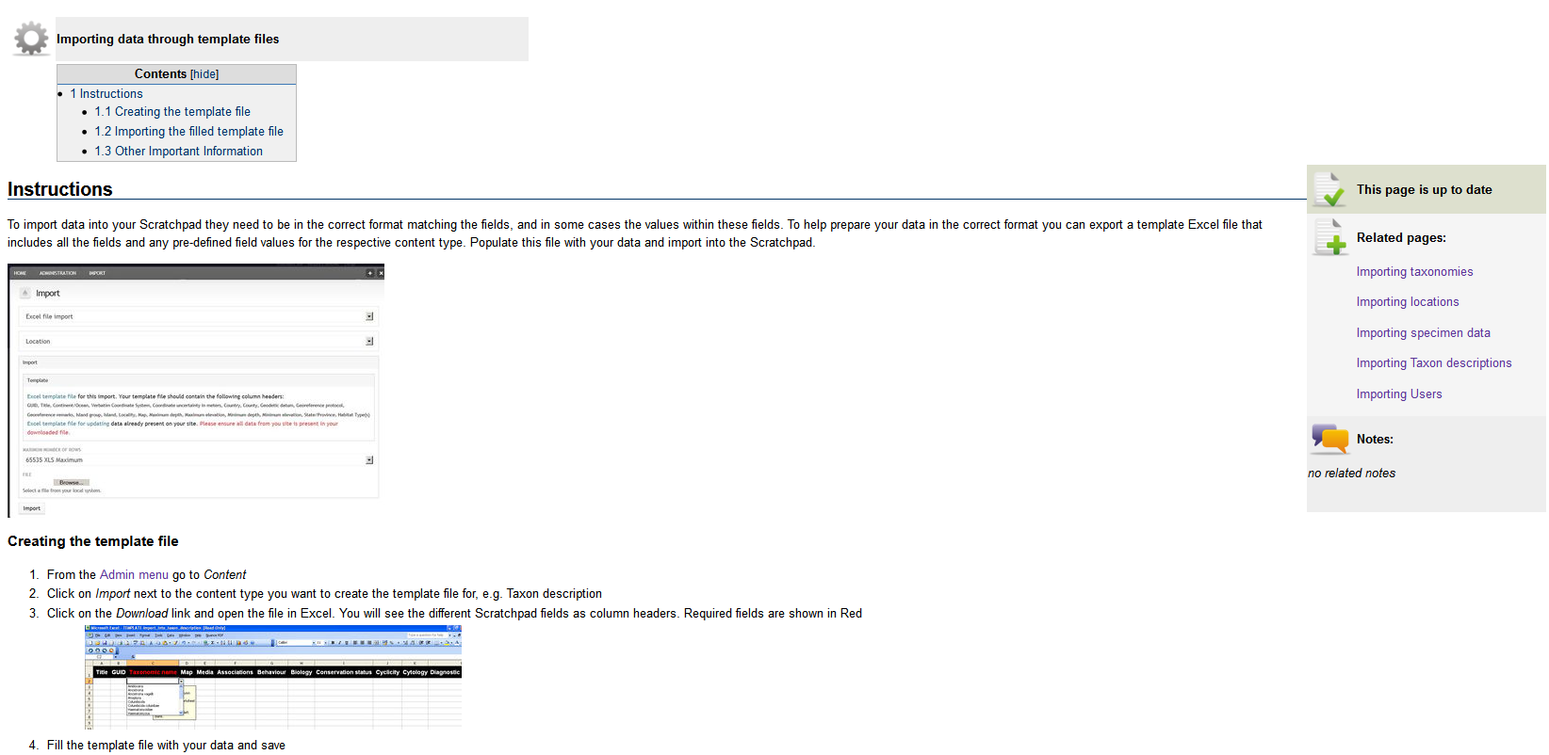
Maximising support efficiency
Documentation
Consistent theming | Constant update
Notes:
Consistent theming is important to maximise the efficiency of the tool. Pages than are outdated due to programmatic changes in Scratchpads are marked as such until they get updated. Related pages are also provided to help people browse through the content.
The wiki based documentation site is arguably contributing towards sustaining an efficient documentation resource, as new features, bug fixes and constant changes can be reflected to the documentation with the minimum of effort.

Slide 23
Maximising support efficiency
1 Embracing a commons philosophy
Adopt CC0/CC-BY licences for all support and outreach material
2 Improve cost/benefit ratio
Adopt open-source support software
3 Keep open communication channels
Sustain intuitive communication tools
4 Study your end-user base
Perform sociological studies

Slide 24
Conclusions
but…
Could a community support model on its own be the solution?
Could any our projects follow the Wikipedia business paradigm?
Probably not yet…

Slide 25
Hybrid models will need to be applied
Commons +
Combine with:
Maintain through development | Anchor to core funding | distributed scheme

Slide 26
“In order to support research, development and maintenance we must either
change reward structures or
incorporate new kinds of participants
in Cyber-infrastructure efforts.”
Ribes D., Finholt T.A. 2007 Proceedings of the third International Conference on e-Social Science
Notes:
Ribes and Finholt in their paper titled: Planning infrastructure for the long-term propose that In order to support research, development and maintenance we must either change reward structures or incorporate new kinds of participants in Cyber-infrastructure efforts.
However experience, at least from the Scratchpads project, suggests that balance between these two has to be pursued. New funding models need to compliment the development of a commons mentality in e-infrastructure projects.

Slide 27
Research
Development
Maintenance
Thank you

