Slide 1
NEON’s collections program: Developing a collaborative network of museums and a resource in support of biodiversity research.
Michael W. Denslow
Assistant Director for Scientific Research Collections
TDWG 2013
Empowering International e-Collaboration for Sustainability
The National Ecological Observatory Network is a project sponsored by the National Science Foundation
and managed under cooperative agreement by NEON Inc.

Slide 2
What is NEON?

Slide 3
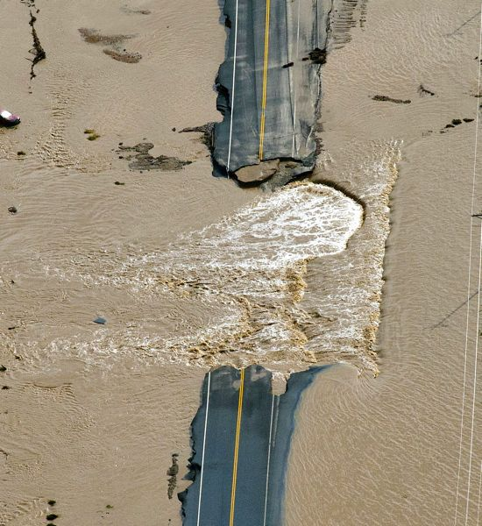
Causes of Change
Climate
Land Use
Invasive Species
Response to Change
Biodiversity
Biogeochemistry
Ecohydrology
Infectious Disease
AP Photos/John Wark
Notes:
… to enable understanding and forecasting of the impacts of climate change, land use change and invasive species on continental-scale ecology
…by providing infrastructure to support research, education and environmental management in these areas

Slide 4
Grand Challenge Questions
1. What are the impacts of climate change on continental scale ecology?
2. What are the impacts of land use change on continental-scale ecology?
3. What are the impacts of invasive species on continental-scale ecology?
4. What are the interactive effects of climate, land use change and invasives on continental-scale ecology?
5. How does transportation and mobility of energy, matter and organisms affect continental-scale ecology?

Slide 5
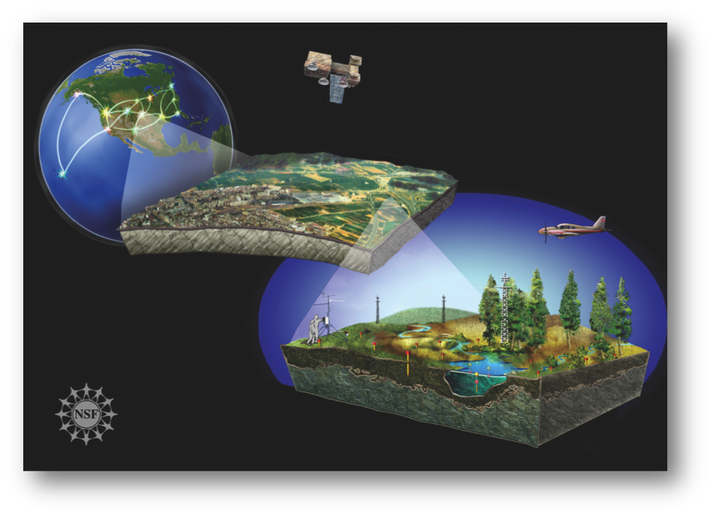

Slide 6
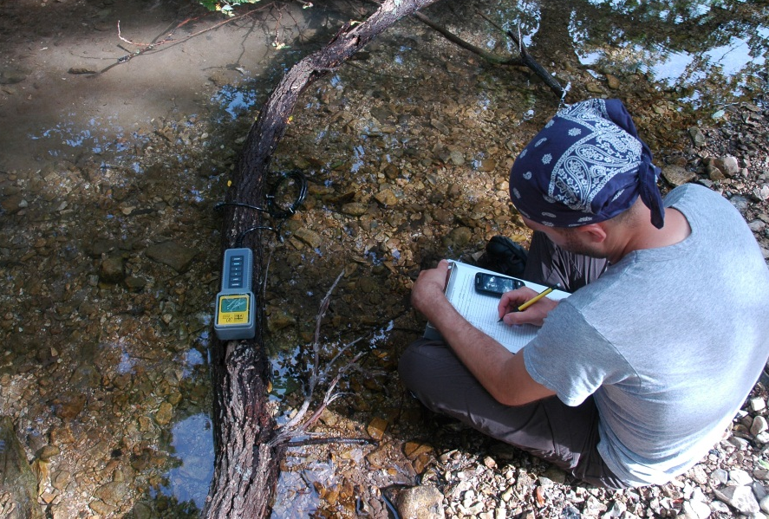
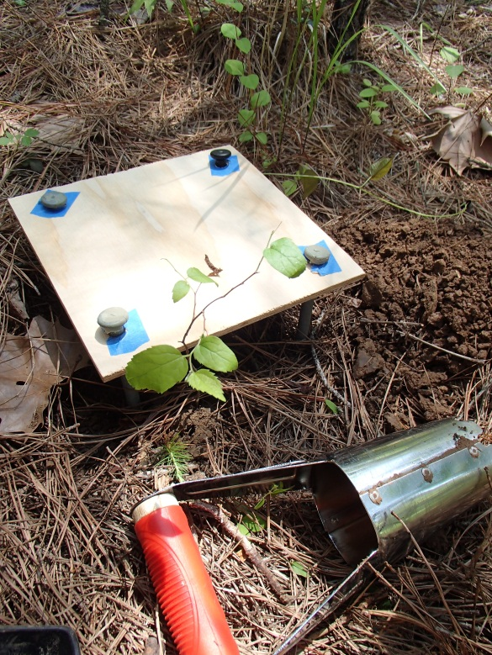
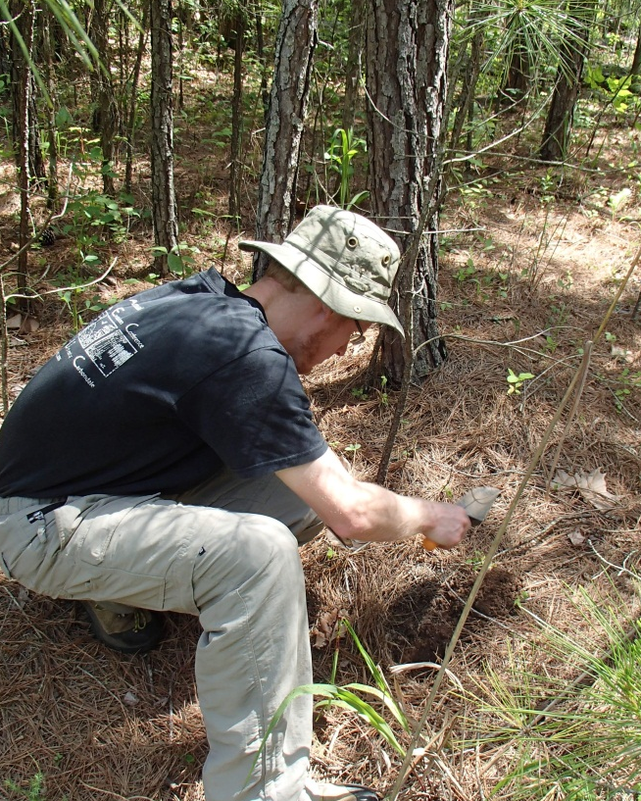
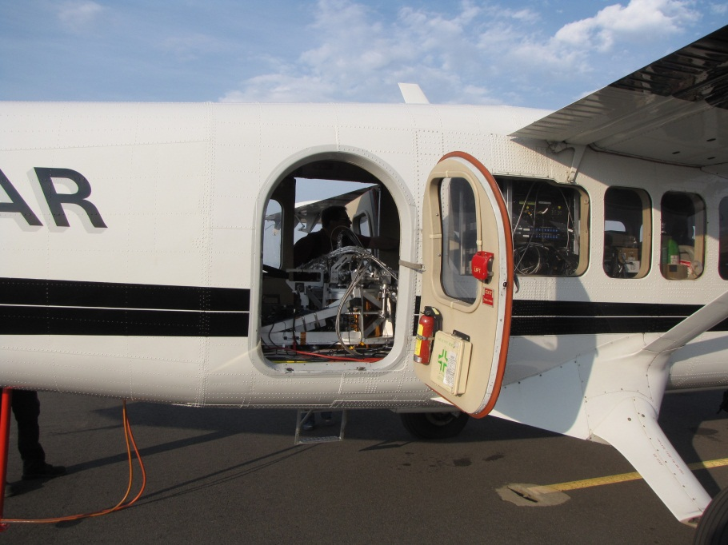
Notes:
Representative sampling
Comprehensive set of biological observations
Sentinel taxa -- terrestrial and aquatic
Field and lab analyses state-of-the-art
Standardized and transparent protocols
QA/QC -- data quality and uncertainty

Slide 7
Current Status
Active Sites
Harvard Forest, MA
Disney Wilderness Preserve, FL
Ordway-Swisher Biological Station, FL
North Sterling, CO
Central Plains Experimental Range, CO

Slide 8
Science Designs
Initial design
2010
Tiger teams &
Community workshops
Science Designs 1.0
Fall 2012
Technical Working Groups
Science Designs 2.0
Summer 2013
Internal & NSF review
Science Designs 3.0
Fall-Winter 2013-2014
Official Release

Slide 9
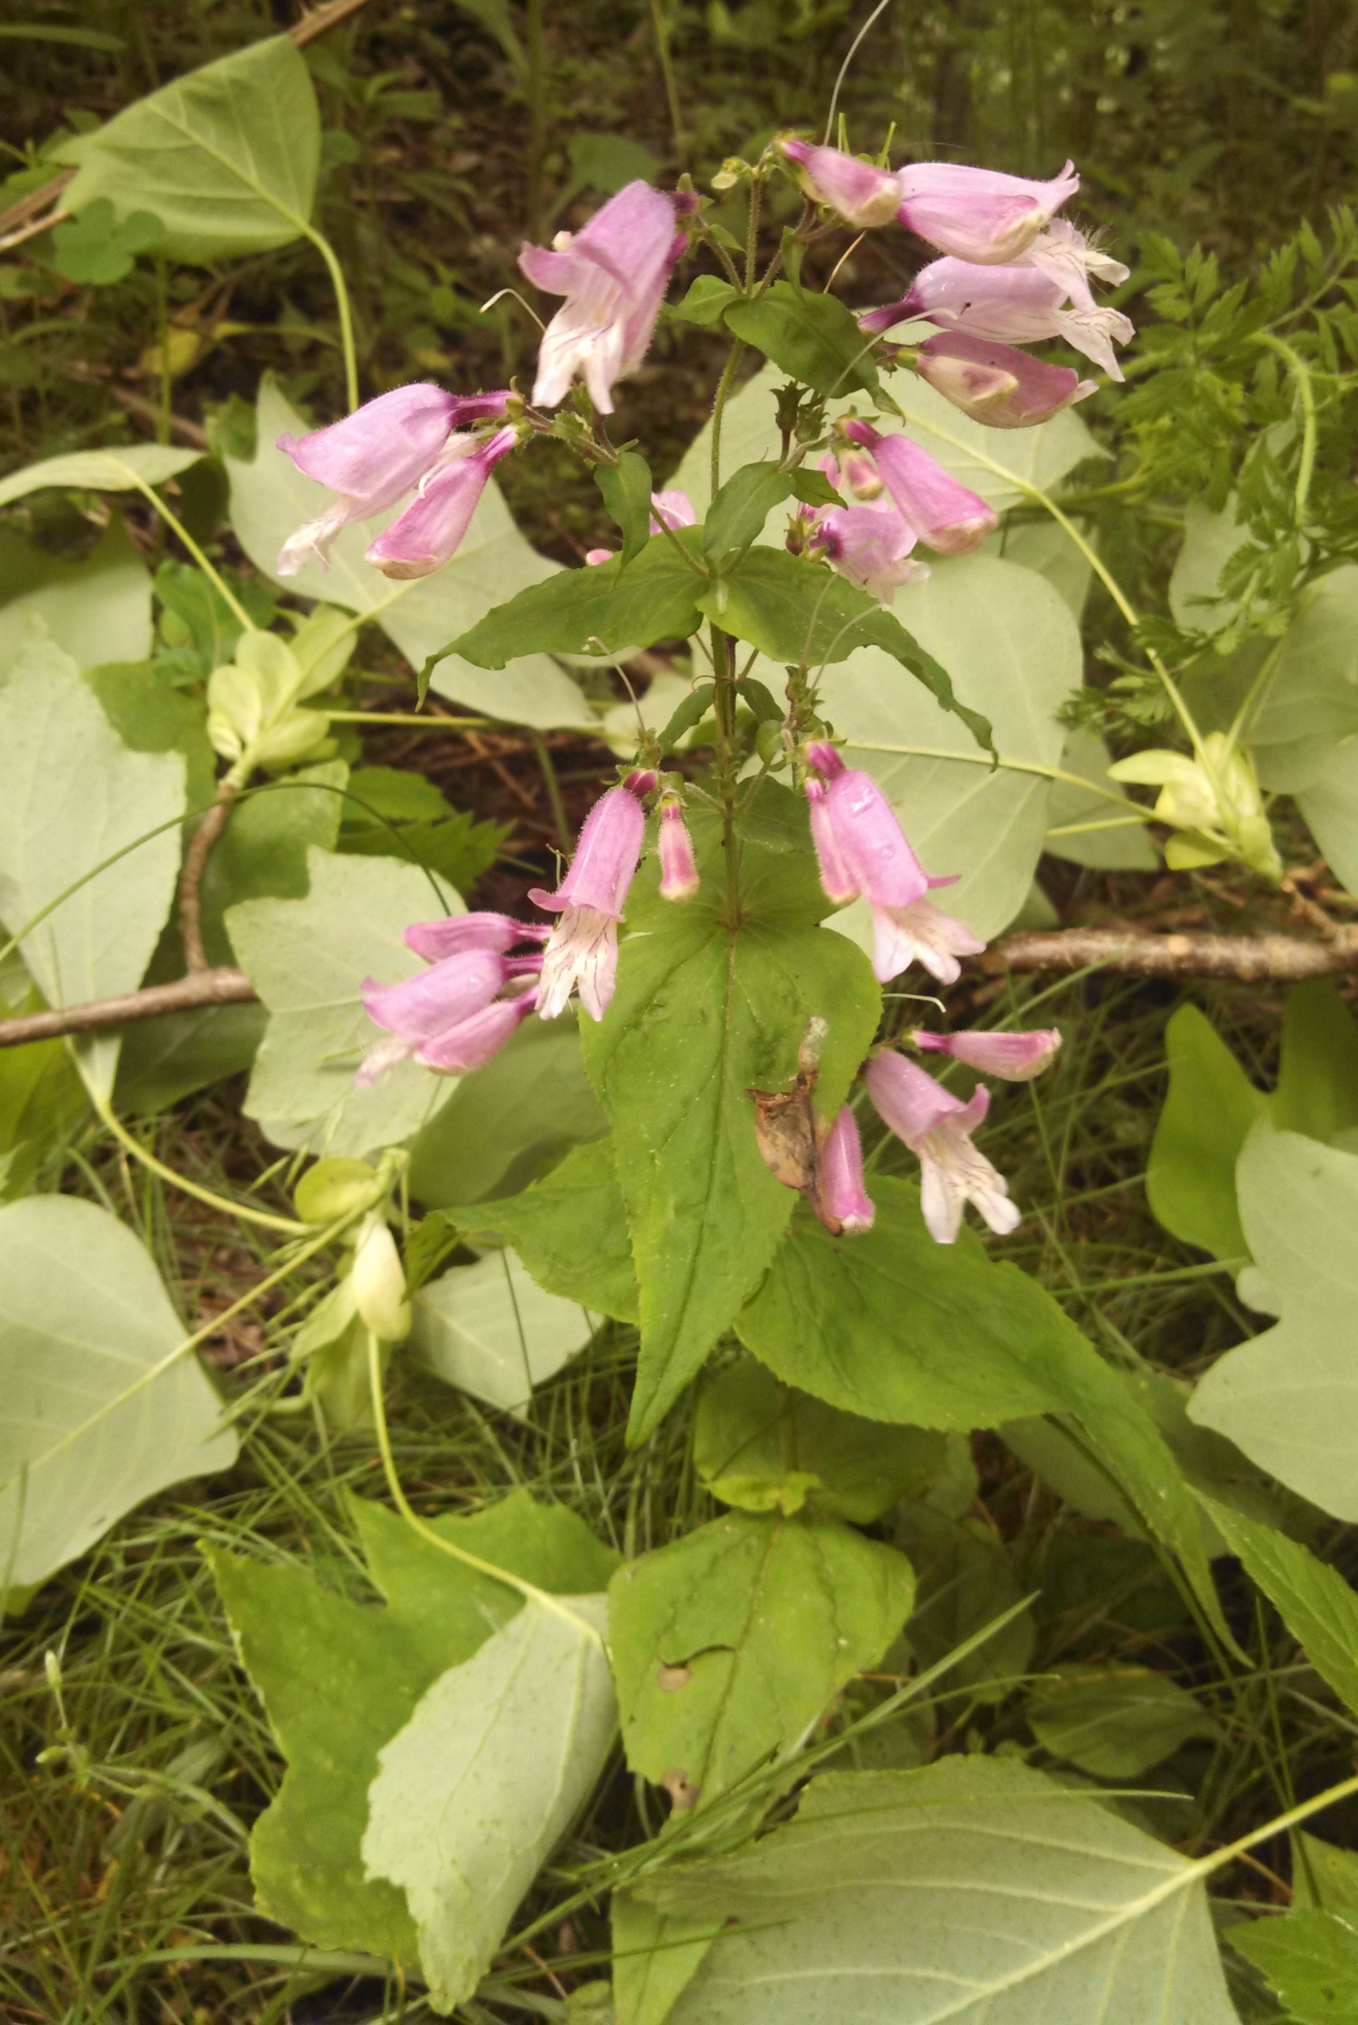
Systems Engineering
Requirements
Notes:
Grand Challenge (Tier 0)
Biodiversity: NEON shall improve the understanding of the factors affecting biological diversity and ecosystem structure and functioning, including the role of human activity.
Observatory Design (Tier 1)
NEON’s measurement strategy shall include coordinated and co-located measurements of drivers of environmental change …
System (Tier 2)
The Data Collection System shall provide the capability to:
a. detect differences and trends within and among its ecosystems, and among domains at the continental scale …
Data Collection System (Tier 3)
The system shall provide a Terrestrial Observation Systems (TOS) element to measure the effects of climate change, land use change and disturbance on ecosystem structure and function in the following measurement areas…
Terrestrial Observation System (Tier 4)
Data on plant abundance and richness shall be quantified based on successive surveys of sampling units...

Slide 10
International Collaboration
TERN (Terrestrial Ecosystem Research Network)
Memorandum of understanding to foster collaboration and interoperability
Science requirements
Sampling protocols
Data products
Education programs
Project management
COOPEUS
Bringing together NEON, LifeWATCH, ICOS, …

Slide 11
NEON Collections

Slide 12
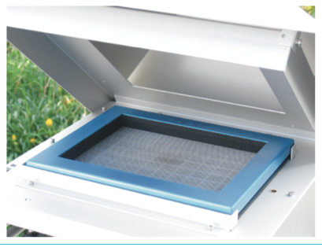
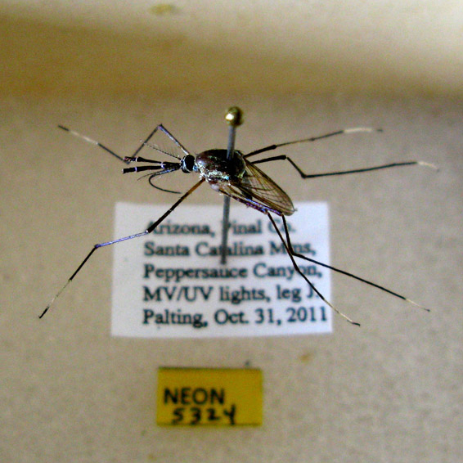
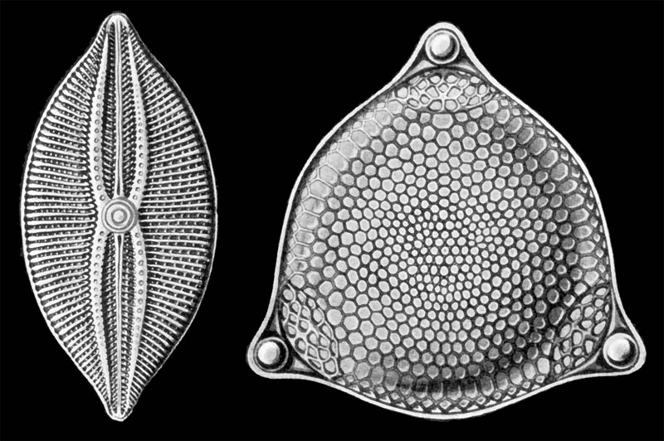
Aquatic
Non-organismal
Terrestrial
Algae
Macrophytes
Bryophytes
Microbes
Zooplankton
Invertebrates
Fish
Ground beetles
Mosquitoes
Ticks
Small mammals
Soil microorganisms
Plants
Soil
Wet Deposition
Dust

Slide 13
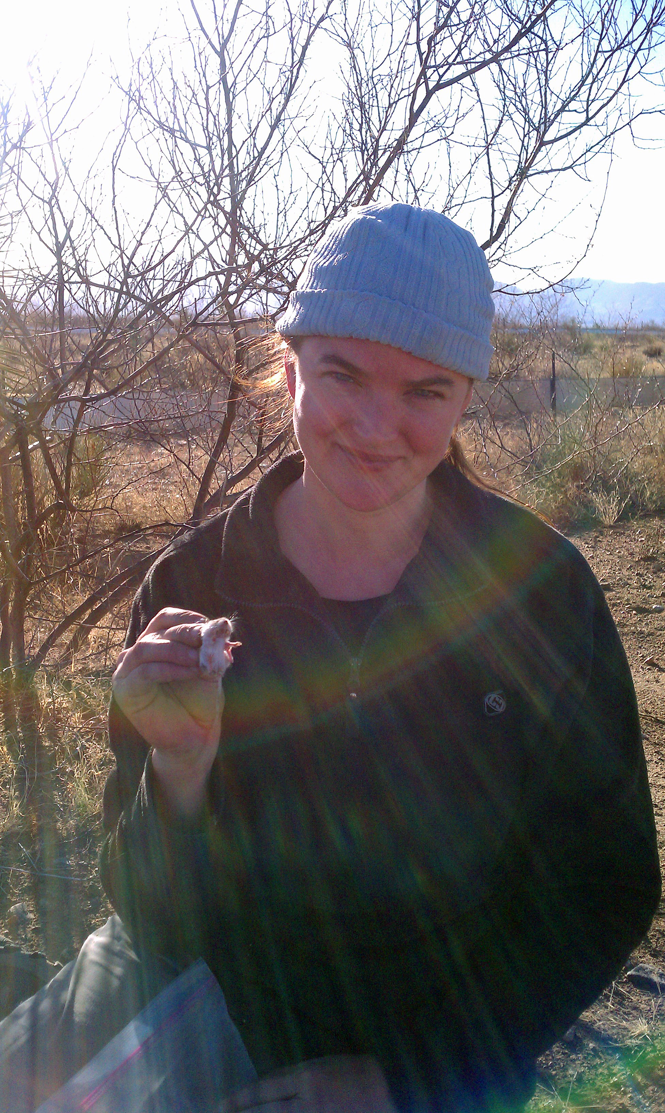
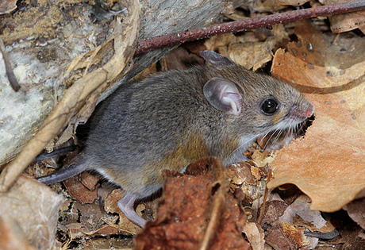
Mammal Collections
Small mammals
Whole
Hair/whiskers
Ear punch
Feces
Blood
Research uses
Taxonomy/Systematics
Infectious disease
Population Genetics
Endocrinology
Isotopic Analysis

Slide 14
Approach – Work with Existing Collections
Benefits to NEON
Greater efficiency afforded by using existing infrastructure
Fostering collaborations with external community
Expertise
Benefits to collections:
National exposure and promotion of collections
Value of collections institutions tends to increase with holdings
Financial support for museum costs
*** Early stages of development ***

Slide 15
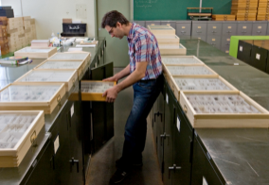
Community Resource
NEON collected specimens
Add additional value to human observations (vouchers)
Research resource for community use
Wide range of community uses
Resource for future analysis
Use with NEON data products
Example: Evolutionary Ecology

Slide 16
Standards AT NEON

Slide 17
Standards
Challenges
Identify Standards
Internal / External
Use of terms
Cross disciplines
Geospatial, specimens, genomics, multimedia, …
TDWG
Interest Groups
Documentation
Development of new standards

Slide 18
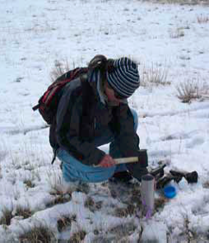
Soil & Aquatic Microbes
Abundance
Cell counts
qpcr
Activity
mRNA
Diversity
16S rDNA
ITS rDNA
Metagenomics
DNA metagonome
Community use
Link to place and time
Other Data Products
Notes:
Sampling occurs throughout a site
4 soil cores per plot (2.5” diameter x 30” depth), 4-10 plots are sampled monthly every year, Samples also used for soil nutrient analyses
40 plots sampled every 5 years
Although the mRNA approach costs more $, we are now not sampling as often, thus balancing the costs
qPRC would be on 16S and ITS; community currently devleoping high-throughput PLFA. PLFA has the advantage of measuring something different, so if had anomolies in the data, would not have bad data for both diversity and abundance.

Slide 19
NEON / TDWG Collaboration
Working within the scope of NEON project
Identify specific challenges
Multidisciplinary teams and issues
Resources
Community workshops
Technical effort
Standards / best practice development
Education / outreach activities
Challenges of sustainability

Slide 20
Thank you
mdenslow@neoninc.org
@mwdenslow
The National Ecological Observatory Network is a project sponsored by the National Science Foundation
and managed under cooperative agreement by NEON Inc.
20
Notes:
Introduce the different platfomrs

