Slide 1
The Elements of Collaboration in TDWG
Stanley Blum
California Academy of Sciences
@TDWG 2013 Florence, Italy

Slide 2
History of TDWG
Founded in 1985 to promote sharing of
biodiversity information, by:
Developing standards for recording and exchanging data about organisms
Serving as a forum for discussing how to share; create interoperability among biodiversity information resources
methods
best-practices
technologies

Slide 3
The evolving context
The need was recognized “pre-Internet”
The Internet “happened” making the potential for information sharing a reality, but requires a more sophisticated understanding of interoperability
How we develop standards
Nature of our standards

Slide 4
The evolving context
Build upon more generic standards
Frameworks for conceptual models
Libraries for manipulating standard data formats
Protocols for messaging and moving information between systems
We needed to modernize how we collaborate to achieve our goals.
TDWG was not born with a mailing list, web site wiki, version control system, etc.
The TDWG Infrastructure Project (TIP)

Slide 5
TDWG Infrastructure Project
Gordon & Betty Moore Foundation gave $1.5 M for 30 months; June 2005 – Dec 2007
PI: Donald Hobern, Program Officer GBIF Co-PI: Stanley Blum, TDWG Treasurer
Personnel:
Lee Belbin: Project Manager
Roger Hyam: Architect
Ricardo Pereira: Technical Lead

Slide 6
TIP Goals
Revise TDWG structure and standards process
Build TDWG’s collaboration infrastructure (comprehensive/unified)
Support TDWG subgroups in standards development
Develop framework for Globally Unique Identifiers (GUIDs)
Develop sustainable “business model” for TDWG

Slide 7
Accomplishments & Lessons Learned
TDWG Collaboration Infrastructure including “single sign-on” for:
Web site based on content management system
Wiki for collaborative document building
Open Journal System to support reviews of:
Charters
Standards
Abstracts for “Proceedings”
Mailing lists

Slide 8
Accomplishments & Lessons Learned
Structure and Process
Problems:
Process bound to annual meeting, particularly review and approval (voting)
Lack of visibility/transparency into standards development activities, lack of coordination
Results: revised Constitution and Process
No change to officers or kinds of members
Articulated roles for Interest and Task Groups, and the Technical Architecture Group (TAG)
Process designed to produce coordination and consensus through expert & public reviews

Slide 9
TDWG Process Formation of Interest and Task Groups
Birds of a Feather (IG)
Proposed IG Charter
Consultation with TAG promotes good design and compatibility
Charter = public interface
Purpose
Approach
Points to collaboration resources
Identifies key participants
Tells how to participate
Infrastructure broken
Executive Committee
Technical Architecture Group
Interest Group Charter
Interest Group
Proposed TG Charter
Executive Committee
Technical Architecture Group
Task Group Charter
Task Group

Slide 10
TDWG Process Review and Approval of Standard
Task Group
Working Draft
Expert and Public Review
Consultation with TAG ensures coordination with other standards
Based on consensus
No infrastructure for public review
Time consuming and a lot of effort for Rev Mgr
Coordinating Exec Com (volunteers) is hard
Executive Committee
No
Yes
Appoint Review Manager
Review Manager
Expert Review
Requested Revision
Recommendation
Executive Committee
No
Yes
Proposed Standard
Review Manager
Public Review
Recommendation
Executive Committee
No
Yes
TDWG Standard
Ratify Standard

Slide 11
Elements of Collaboration in TDWG (summary)
To collaborate in supporting biodiversity science
Organizational structure
Process for creating standards – consensus based specifications that support information interoperability
Infrastructure to support distributed collaboration for creating specifications
Annual meeting to serve as forum and build this community

Slide 12
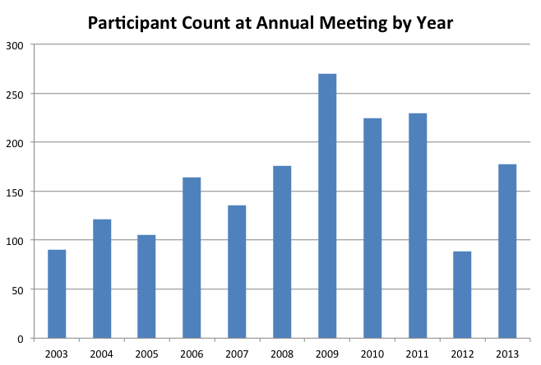
Participants at TDWG Meetings: the last 11 years
Year | Location
2003 | Lisbon, Portugal
2004 | Christchurch, NZ
2005 | St. Petersburg, Russia
2006 | St. Louis, Missouri
2007 | Bratislava, Slovakia
2008 | Perth, Australia
2009 | Montpellier, France
2010 | Woods Hole, Mass.
2011 | New Orleans, Louisiana
2012 | Beijing, China
2013 | Florence, Italy

Slide 13
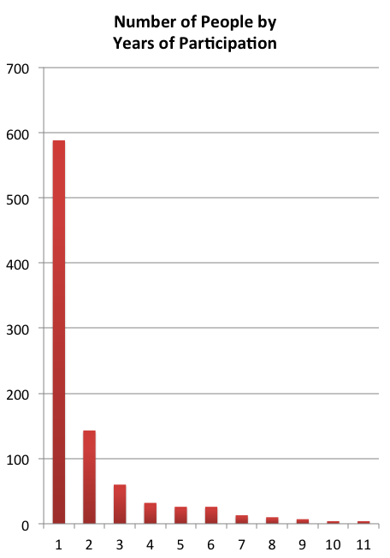
Participation in TDWG Meetings
Count | Frequency
1 | 588
2 | 143
3 | 60
4 | 32
5 | 26
6 | 26
7 | 13
8 | 10
9 | 7
10 | 4
11 | 4
People | 913
PersMtg | 1785

