Slide 1
Expanding and Sustaining Sub-Saharan African Participation and Collaboration with TDWG
Henry L. Bart Jr.
Tulane University Biodiversity Research Institute, Belle Chasse, Louisiana USA
hbartjr@tulane.edu
Patricia Mergen
Royal Museum for Central Africa, Tervuren, Belgium
patricia.mergen@africamuseum.be

Slide 2
Annual TDWG Conferences
The place to learn about the latest advances in biodiversity informatics (BI).
Attract a broad cross-section of the BI community (data providers, data aggregators, data indexers, IT experts, end-users)
Also taxonomists, ecologists, computer programmers, geographers, librarians, leadership and staff of BI mega projects and portals.
Participation of BI specialists from Sub-Saharan African countries has traditionally been low.

Slide 3
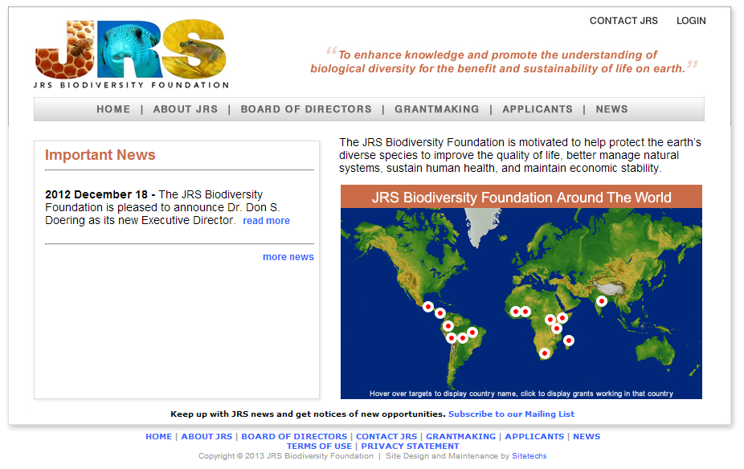
Formed in 2004 with sale
of BIOSIS to Thompson
-Reuters
Strategic interest: (1) collecting data, (2) aggregating, synthesizing, publishing data [from
the developing world], and making it more widely available to potential end users, and
(3) interpreting and gaining insight from data to inform policy-makers.

Slide 4
TDWG Travel Awards
Two JRS grants awarded to boost participation of BI specialist from Sub-Sarahan African countries in annual TDWG conferences (2011, 2012-14).
Aims of the Travel Awards are to:
engage Sub-Saharan African BI specialists’ in the activities of TDWG;
help BI specialists from Sub-Saharan Africa to build research capacity and collaboration with TDWG members.

Slide 5
Past TDWG Travel Awardees
JRS Biodiversity Foundation | Institution | Country | TDWG Conference
Innocent Akampurira | Uganda Biodiversity Information Facility (UgaBIF) | Uganda | New Orleans 2011
Sediqa Khatieb | South African National Biodiversity Institute (SANBI) | South Africa | New Orleans 2011
Philbert Nyinondi | Tanzania Biodiversity Information Facility | Tanzania | Beijing, 2012
Alex Asase | University of Ghana | Ghana | Beijing, 2012
Lucy Waruingi | African Biodiversity Conservation Center | Kenya | Beijing, 2012
Pierre Radjis | University of Lomé | Togo | Beijing, 2012
Belgium Development Cooperation
Albert Walanga | Center for Biodiversity Monitoring | D. R. Congo | Beijing, 2012
Mwanga Mwanga Ithe | Centre de Recherche en Sciences Naturelle | D. R. Congo | Beijing, 2012
Bhely Angoboy Ilondea | l’Institut National pour l’Etude et la Recherche Agronomiques | D. R. Congo | Beijing, 2012
Prosper Karame | Cardiff University | Rwanda | Florence, 2013
Tantely Raminosoa | Missouri Botanical Garden Madagascar Project | Madagascar | Florence, 2013
Kudzai Mafuwe | Natural History Museum, Bulawayo | Zimbabwe | Florence, 2013
Ghana, Democratic Republic of Congo, Kenya, Madagascar, Rwanda,
South Africa, Tanzania, Togo, Zimbabwe

Slide 6
2013 TDWG Travel Awardees
Opening up African Savannah Biodiversity Information, Kudzai Mafuwe, Curator of Entomology for The Natural History Museum, Bulawayo, Zimbabwe.
The Use of Plants Database to Identify Gaps in Biodiversity Conservation Network in Madagascar, Tantely Raminosoa, Missouri Botanical Garden Madagascar Program.
A bioinformatics journey towards biodiversity information availability and use in Rwanda, Prosper Karame, Biological Sciences, Cardiff University, Wales, UK (Rwanda).
Mobilizing biodiversity information in Sub-Saharan Africa Wednesday, October 30th, 16:30-18:00.

Slide 7
Survey of Past TDWG Travel Awardees
Asked how strongly they agree or disagree with 25 statements about their engagement with TDWG through conference participation.
Preliminary highlights:
Were not familiar with/involved in activities of TDWG prior to their participation in an annual conference.
Could not have participated without a travel award.
Opportunity benefitted their own work in BI and is stimulating others in their organization to participate.
Participation has not (yet) resulted in direct collaboration with TDWG members.
Interested in sustaining their engagement with TDWG by whatever means necessary…

Slide 8
Building Capacity for BI Collaboration in Sub-Saharan Africa
Royal Museum of Central Africa
Belgian Development Cooperation
Central African Biodiversity Information Network
Fishbase taxonomy training
Fish Biodiversity Research in Kenya
How I became engaged in work in Africa
Mutual benefits of the collaboration
How I am sustaining my engagement (roadmap others can follow)

Slide 9
Royal Museum of Central Africa (MRAC)
Belgian Development Cooperation (Directorate General Development Cooperation - DGD) plays a crucial role in financing activities of MRAC in the area of development cooperation.
The Museum takes part in the sustainable development of Africa by supporting African institutions to carry out their assignments and to undertake scientific research.

Slide 10
Royal Museum of Central Africa
Training courses and educational programs for Africans
By organizing training courses for professionals and students from African universities and scientific institutions, MRCA aspires to build local capacity and to satisfy the demand for training in fields of MRCA expertise.
Biodiversity Informatics training (Pan-African)
Training program video

Slide 11
Royal Museum of Central Africa
Making digital information sources and systems accessible to Africans for development cooperation :
Knowledge Centre: dissemination of information and knowledge regarding Central Africa via, among other means, the Internet
Central African Biodiversity Information Network (CABIN): aims to develop a network of databanks on biodiversity, to be installed and supported in collaboration with institutions in the DRC, Rwanda and Burundi
Distribution of RMCA publications in the DRC (libraries).
FishBase Taxonomy Training (All of Africa)

Slide 12
Central African Biodiversity Information Network (CABIN)
Presentation on CABIN by Franck Theeten:
Coping with the technical and institutional
changing context in cooperation development
projects
Mobilizing biodiversity information in Sub-
Saharan Africa session, Wednesday afternoon,
October 30th.

Slide 13
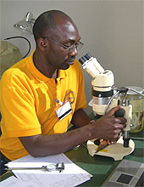
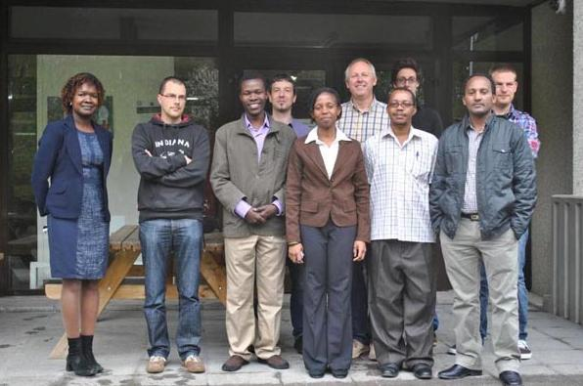
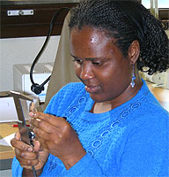
MRAC Fishbase Taxonomy Training
Three month training course in taxonomy of African fishes for scientists and students.

Slide 14
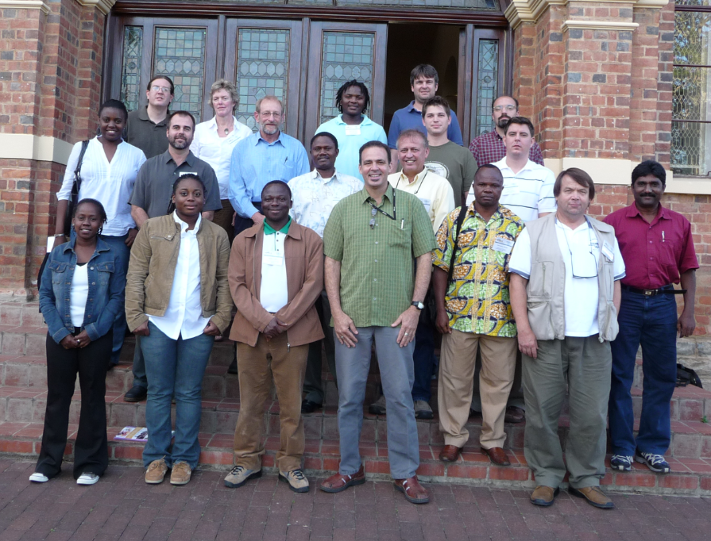
African Freshwater Fish Diversity Workshop Rhodes University, Grahamstown, South Africa, 2008
Nelson Rios

Slide 15
71 institutional providers
3.7 million specimen lots
35+ million specimens
57% georeferenced

Slide 16
Africa Data in Fishnet2

Slide 17
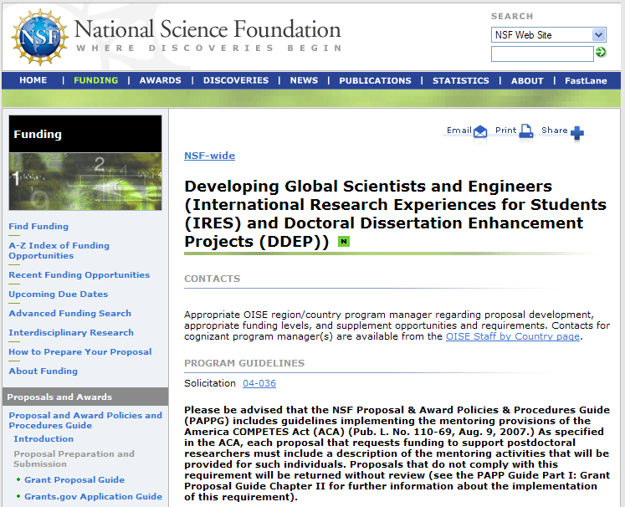
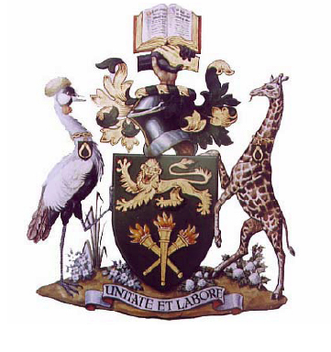
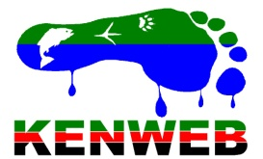
Fish Biodiversity Research in Kenya
UNIVERSITY OF NAIROBI

Slide 18
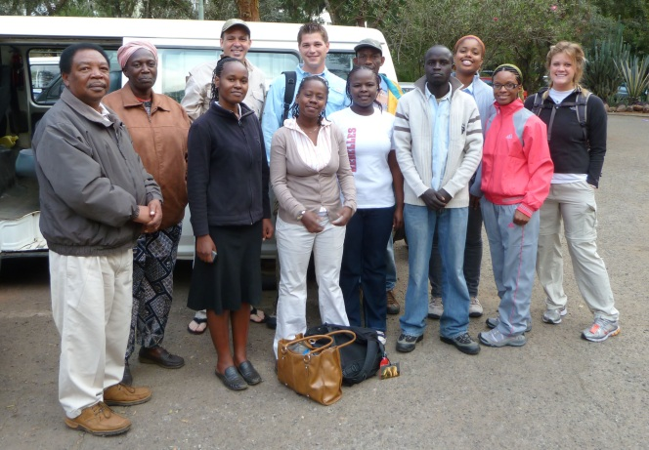
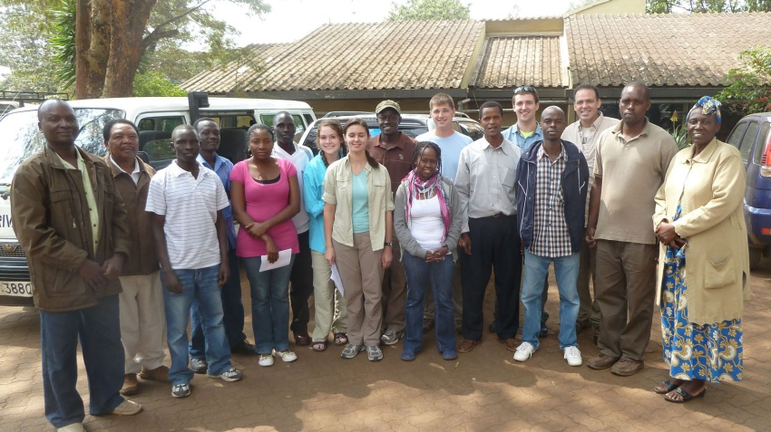
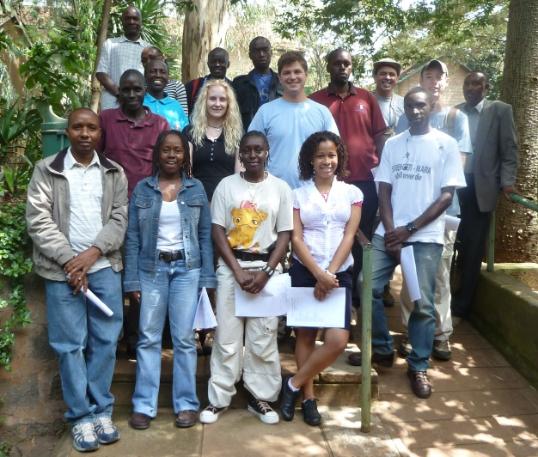
Three Trips to Kenya (2010-2012)

Slide 19
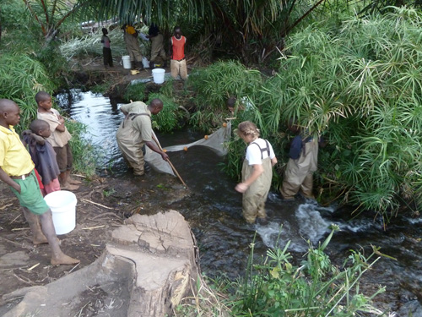
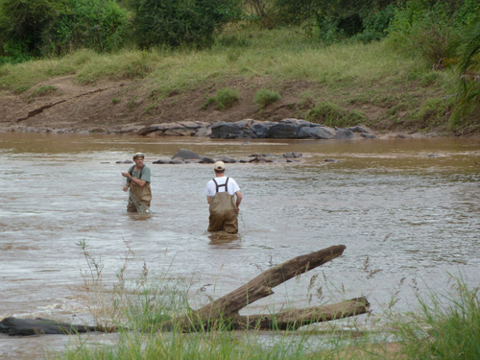
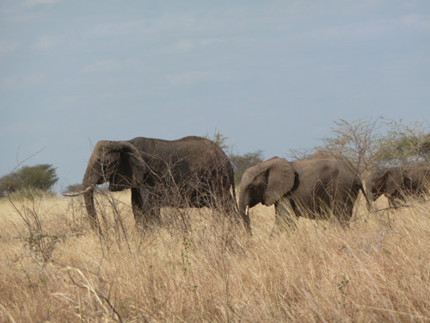
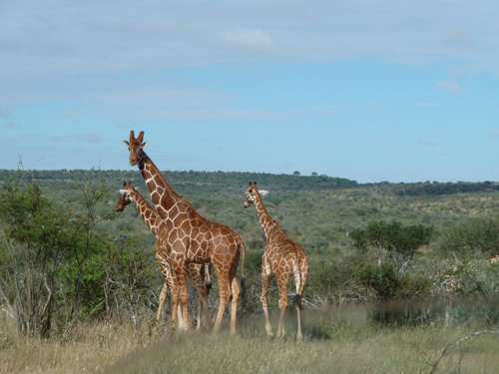
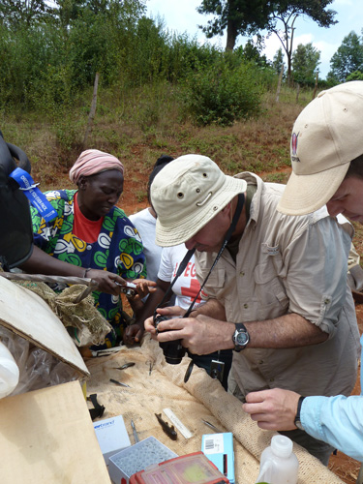
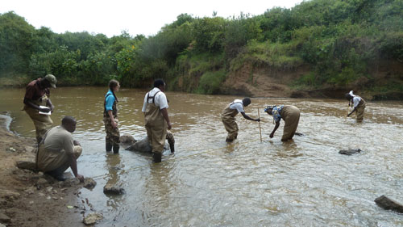
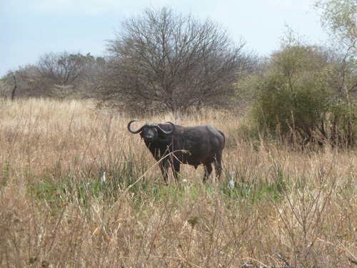
Sampling in the Field

Slide 20
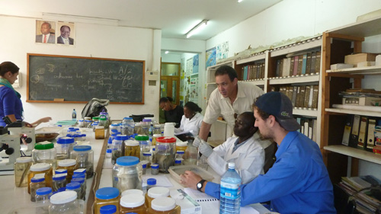
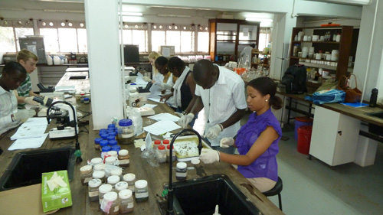
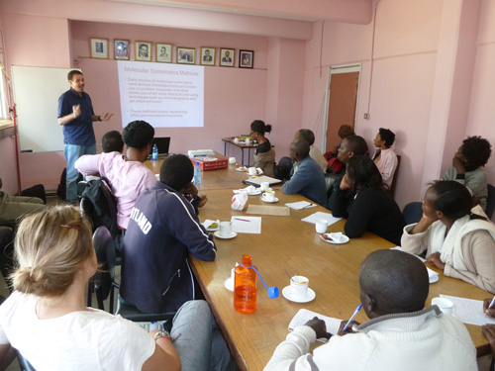
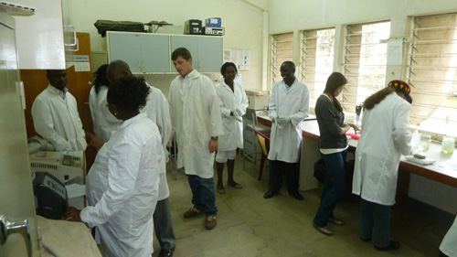
Work in the Laboratory

Slide 21
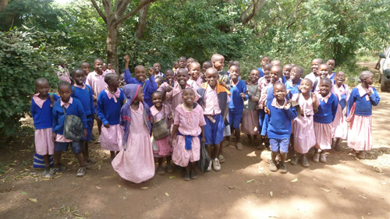
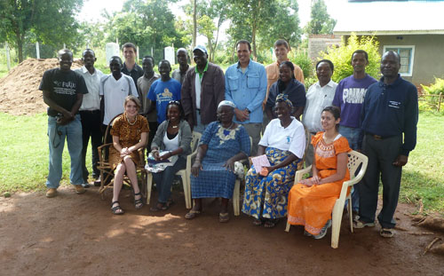
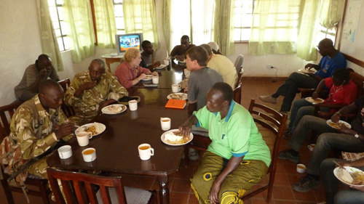
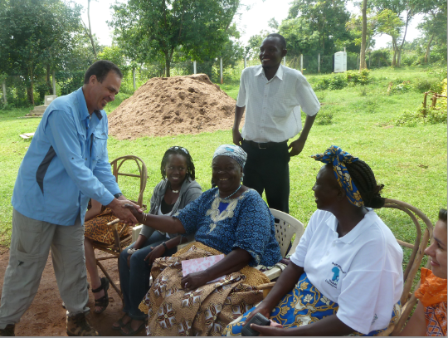
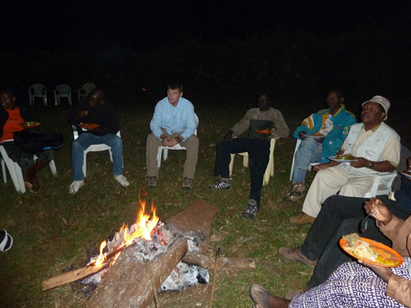
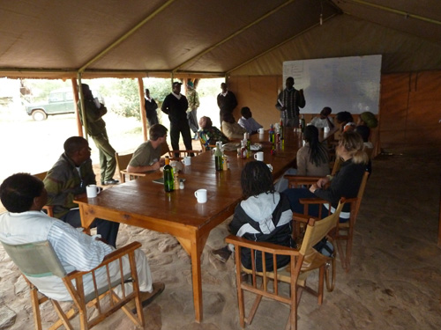
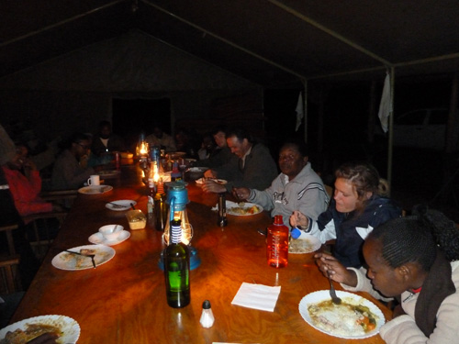
Social and Cultural Activities

Slide 22
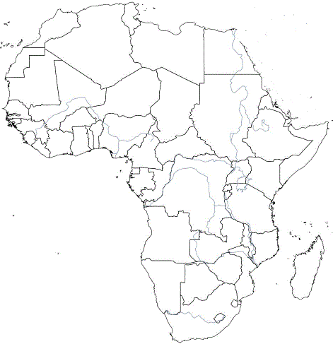
Barbus kerstenii Peters 1868
Redspot Barb
Type Locality – “Along the route from Zanzibar to Mount Kilimanjaro, Tanzania” (Pangani River Basin).
Eastern and Central Africa, including rivers draining into the Indian Ocean (Tana River of Kenya to Zambezi River of Mozambique) and lakes of the Great African Rift Valley (Lake Victoria to Lake Tanganyika).

Slide 23
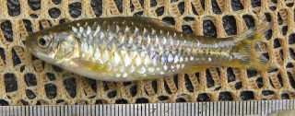
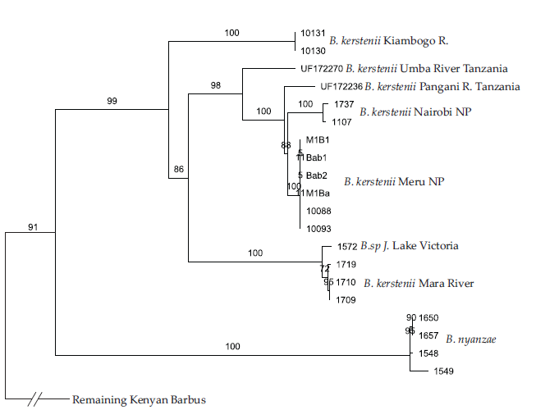
Molecular Phylogeny of B. kerstenii clade

Slide 24
Fish Biodiversity Discovery in Kenya
All fish groups studied thus far are 3-4 times more diverse than previously thought.
Actively engaged in describing this diversity with our Kenyan collaborators (professionals and students).
Building the capacity of Kenyans to do their own biodiversity discovery research by providing resources (for field sampling, museum archiving, molecular laboratory) and training.

Slide 25
Sustaining Engagement in Kenya
Kenya IRES project is ending.
Looking for opportunities to sustain our work in Kenya.
Will be pursuing a NSF PIRE project on Kenya’s Tana River system in 2014.
TDWG is holding its annual conference in Kenya in 2014…

Slide 26
TDWG in Kenya
TDWG conference in Kenya gives all of us the opportunity to engage in work in Sub-Saharan Africa.
Seeking additional JRS/Belgian Cooperation funding to support an even larger contingent of Africans in the Kenyan conference.
Organizing BI training activities in association with the conference.
Let us know if you are interested in participating.
Please engage with our 2013 Travel Awardees.

Slide 27
Acknowledgements
Organizers of TDWG Firenze 2013.
Organizers of e-Collaboration Symposium.
JRS Biodiversity Foundation and Belgian Development Cooperation for financial support.
US National Science Foundation and US Agency for International Development for their support of work in Kenya.
All of you for your attention!

