Slide 1
Application of the BARCODE Data Standard: The Barcode of Wildlife Project for Endangered Species
David E. Schindel, Executive Secretary
Consortium for the Barcode of Life (CBOL)
National Museum of Natural History
Smithsonian Institution
SchindelD@si.edu
http://www.barcodeofwildlife.org
202/633-0812; fax 202/633-2938

Slide 2
OR… Integrating Scientific and Legal Data Standards and their Fitness for Use

Slide 3
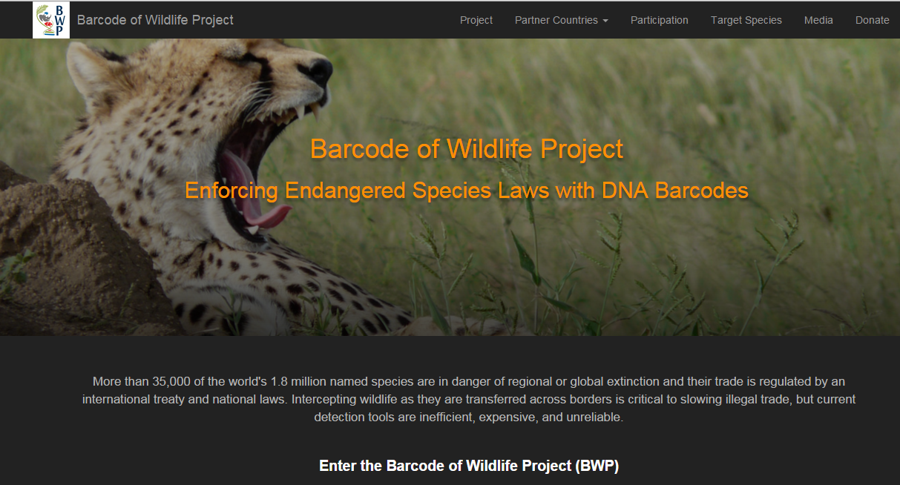
www.barcodeofwildlife.org

Slide 4
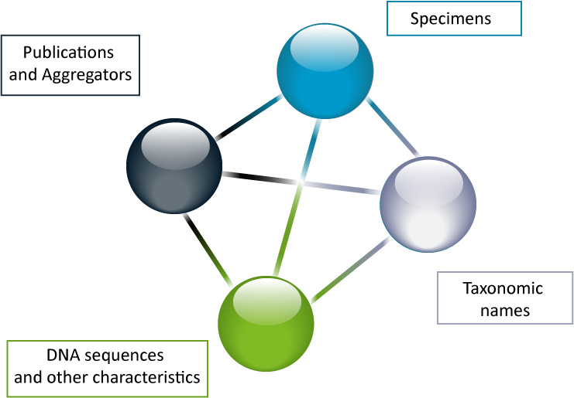
Publications

Slide 5
A DNA barcode is a short gene sequence taken from standardized portions of the genome, used to identify species, OR…
Notes:
The definition of a DNA barcode

Slide 6
…another GPS (A Genetic Positioning System)
Notes:
The definition of a DNA barcode

Slide 7
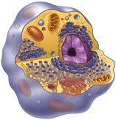
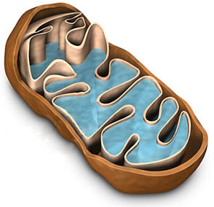
An Internal ID System for All Animals
The Mitochondrial Genome
DNA
Small ribosomal RNA
D-Loop
Cytochrome b
ND1
ND6
Typical Animal Cell
ND5
COI
ND2
COI
mtDNA
L-strand
H-strand
ND4
ND4L
ND3
COII
COIII
ATPase subunit 8
Mitochondrion
ATPase subunit 6
Notes:
Our work aims to set the stage for an effort to gather barcodes for all animal species. This task will be substantial; it will require some 100 million analyses if we seek 10 barcode records for each of the expected 10 million species.
<rd>illustrate the diversity → amount of work ahead</rd>
<rd>Collage to be finished…</rd>

Slide 8
Non-COI regions for other taxa
Land plants:
Chloroplast matK and rbcL approved Nov 09
70-75% resolving ability, higher in angiosperms
Non-coding plastid and nuclear regions as supplements
Fungi:
Nuclear ITS region including coding and non-coding regions
72% effective at species level; supplementary regions used
Protists:
CBOL Working Group PLoS Biology Community Page

Slide 9
BARCODE Records in INSDC
Specimen Metadata
Voucher Specimen
Species Name
Georeference Habitat Character sets Images Behavior Other genes
Indices - Catalogue of Life - GBIF/ECAT
Nomenclators - Zoo Record - IPNI - NameBank
Publication links - New species
Barcode Sequence
Other Databases
Trace files
Primers
Literature (link to content or citation)
Phylogenetic Pop’n Genetics Ecological
Databases - Provisional sp.
Notes:
The BARCODE data standard: Developed over an 18-month consensus-building process and accepted by GenBank, EMBL and DDBJ. Database records that meet this standard have the reserved keyword BARCODE. The standard requires linkage to a voucher specimen, a known species name, primer sequences, and trace files.

Slide 10
Required Elements for BARCODE
Taxonomic identification to species
Voucher specimen ID in Darwin Core Triplet format
Name of barcode region
Country/Ocean/Sea of origin
Minimum sequence length and quality
Forward and reverse 2 trace files in NCBI
Forward/reverse primer sequences, names

Slide 11
Highly Recommended Elements
Latitude/longitude
Name of Collector
Collection date
Name of identifier

Slide 12
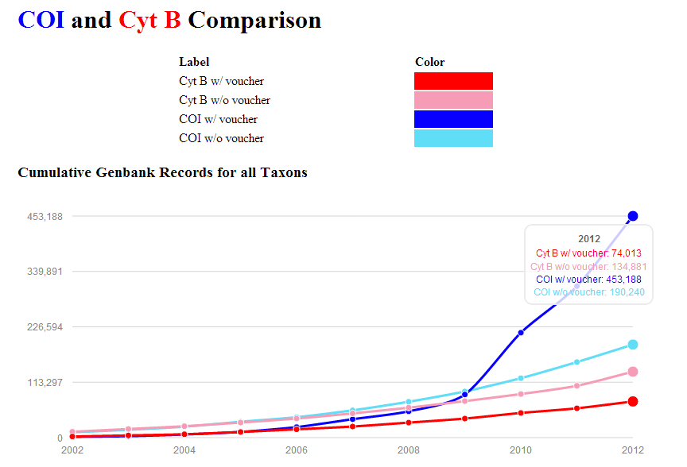

Slide 13
BARCODE Data Standard in INSDC Darwin Core Triplet Structured Link to Vouchers
Institution Code
Collection Code
:
Catalog Number
:
:
:
NHMUK
LEP
123456
personal
:
DHJanzen
:
SRNP12345

Slide 14
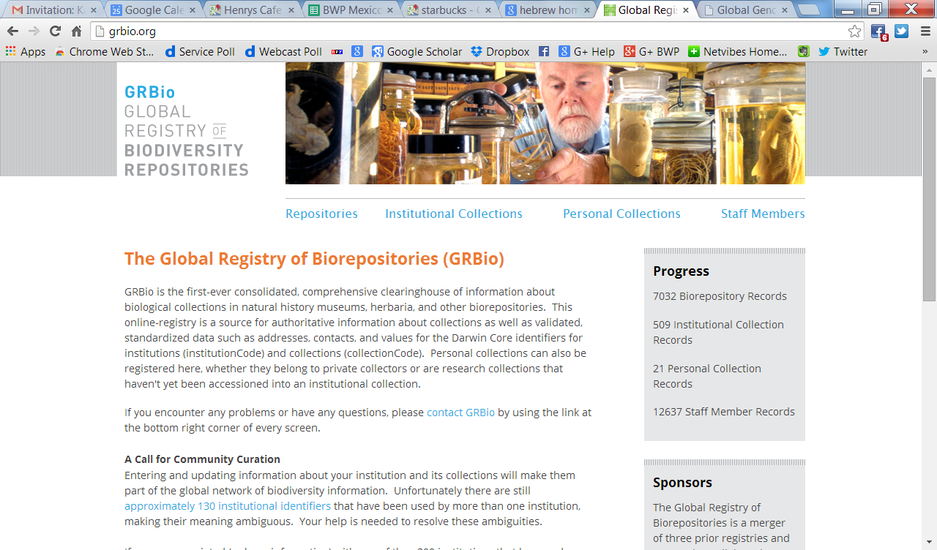

Slide 15
Our results strongly suggest that Darwin Core Triplets that have not been carefully curated are not currently serving a useful role for relinking data.

Slide 16
Compliance with Standard
Categories of data records | Number of GenBank records | With Voucher or Culture Collection Specimen IDs | With Latitude/ Longitude
BARCODE | 347,349 | 347,077 (~100%) 192, 902 (50.3%) | 287,058 (83%)
COI, non-BARCODE | 404,606 | 184,351 (46%) | 78,974 (20%)
All 16S | 4,876,284 | 138,921 (3%) | 461,030 (9%)
All cytb | 239,796 | 84,784 (35%) | 7,776 (3%)

Slide 17
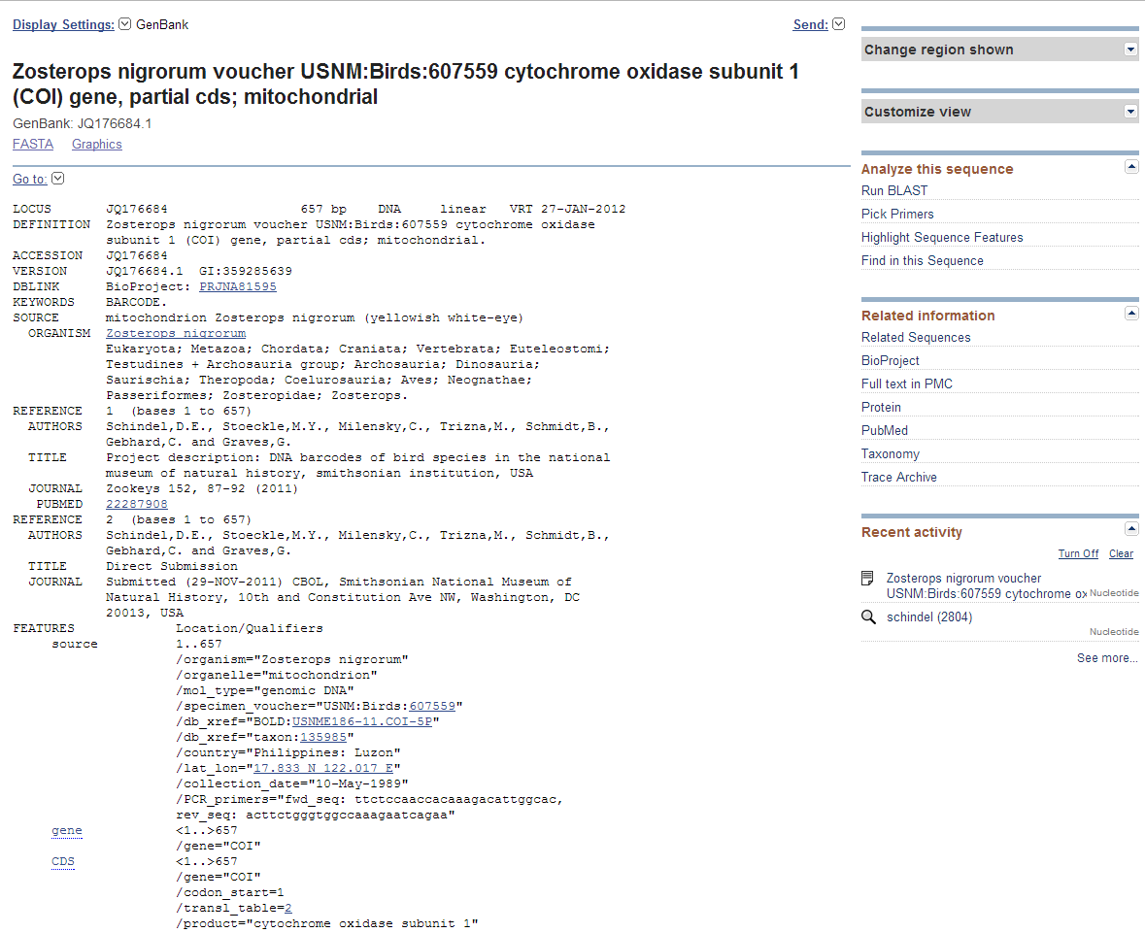

Slide 18
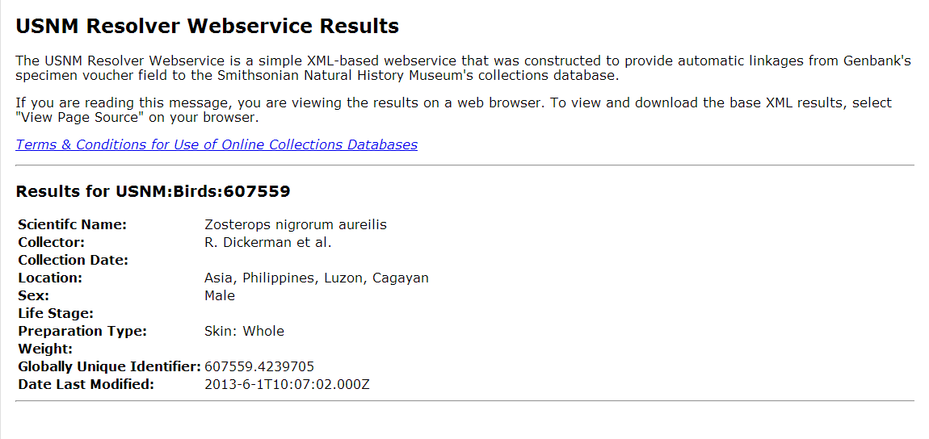
Voucher specimen links constructed from Darwin Core Triplet:
http://collections.mnh.si.edu/services/resolver/birds/621682

Slide 19
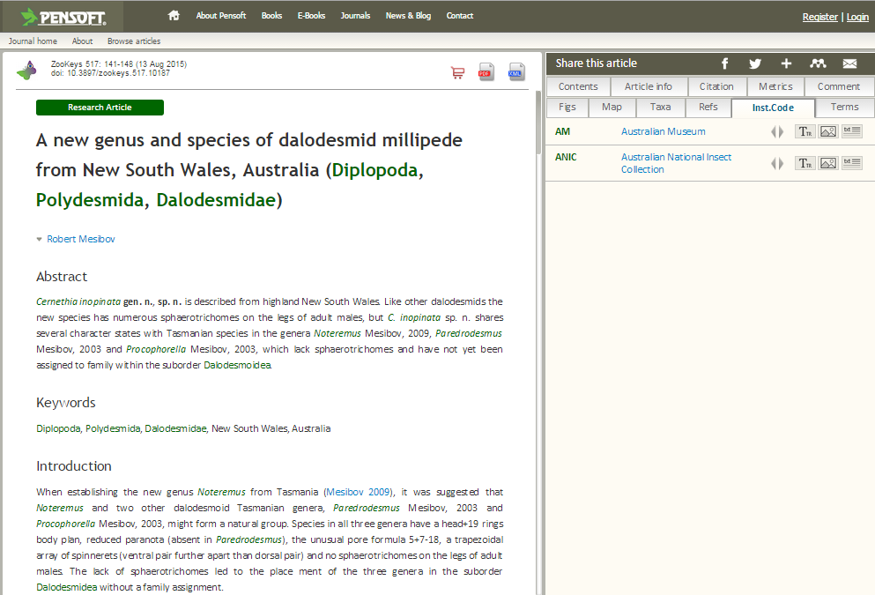

Slide 21
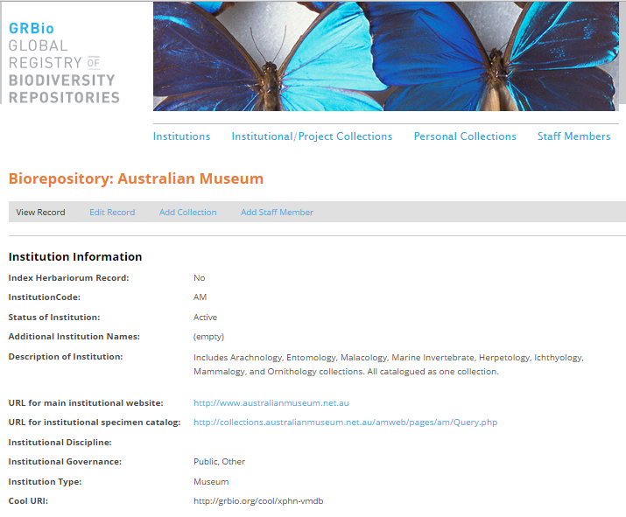

Slide 22
Adoption by Regulators
U.S. Food and Drug Administration
Environmental Protection Agency
EU and FAO International Plant Protection Commission
NOAA/NMFS
Federal Aviation Administration
CITES, National Agencies, Conservation NGOs
Notes:
US government agencies are now testing barcoding and considering its adoption for regulatory and enforcement purposes.

Slide 24
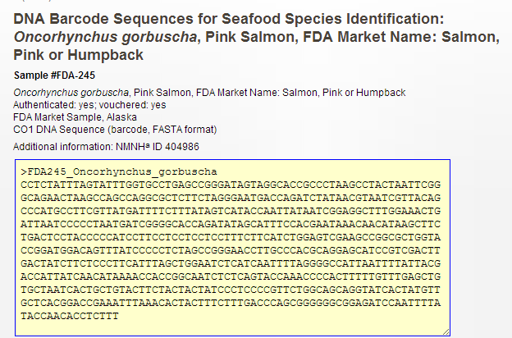
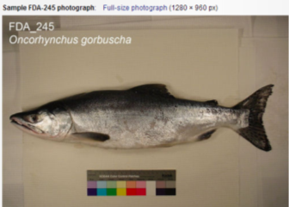
US Food & Drug Administration Reference Fish Encyclopedia

Slide 25
Mickevich & Collette, 2000 MARBID Marine Database
Comprehensiveness:
How complete was the examined material?
Did it include the original type specimens?
Quality of Analysis:
How reliable are the species being studied?
How objective is the quantitative analysis of the species’ data?
Is there at least one diagnostic character?

Slide 26
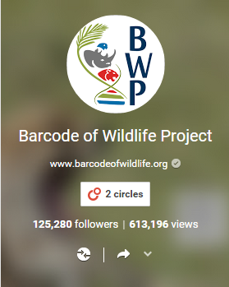
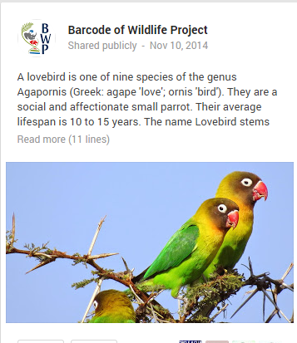
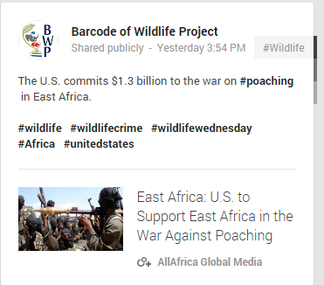
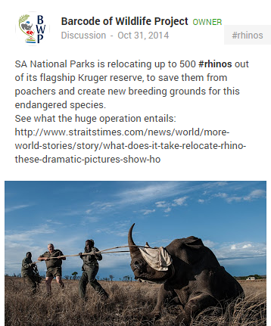
Barcode of Wildlife on Google+

Slide 27
BWP Goals
Working with six Partner Countries:
Demonstrate use of DNA barcode evidence in investigations, prosecutions, convictions by November 2014
Construct a reference BARCODE library to support Partner Country priorities
~2000 Priority Endangered Species
~8000 closely related/look-alike species
Partner Countries will formally adopt, implement and ‘mainstream’ DNA barcoding

Slide 28
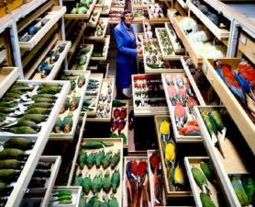
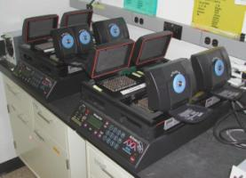
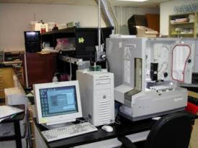
Creating the Reference Library
Identified Museum Specimens
Extract and Amplify DNA
Sequence DNA
Publish Reference BARCODE Record

Slide 29
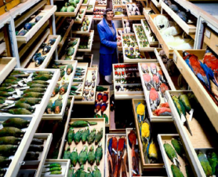
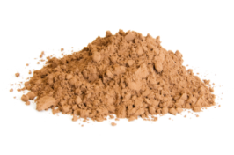
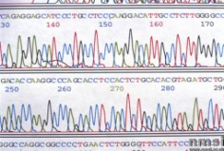
Identifying Unknowns
Identified Museum Specimens
Crime Scene Samples
Extract and Amplify DNA
Unidentified DNA Barcode Sequence
Sequence DNA
Cluster Unidentified Sequence with Reference Library
Publish Reference BARCODE Record

Slide 30
Typical Defense Challenges
Handling of exhibits: crime scene to lab
Qualifications of forensic lab technician, expert witness
Accreditation of the forensic lab
Calibration of lab instruments
Reliability of selected DNA method
For BARCODE data:
Reference database completeness/reliability
Potential tampering/contamination of reference database

Slide 31
BWP Defense Challenges
Voucher specimens/reference library meet scientific but not forensic standards
No chain of custody linking vouchers to frozen tissues to DNA sequences
No certification of voucher identifications
Possible labeling errors in open access collections
Lab processing subject to contamination in academic labs

Slide 32
BWP Prosecutor Response
Densely populated reference library
Vouchers identified with confidence
Vouchers traceable, IDs can be repeated
“Barcode gap” between species
Crime sample clusters clearly with endangered species
No sample mix-ups, handled under chain-of-custody
No lab contamination, processed in clean forensic lab with controls

Slide 33
Required BWP Data/Metadata
Additional datafields in GenBank for BWP:
Name of identifier
Date of identification
Type status of voucher specimen
Basis of identification
Confidence level
Collected under chain of custody? (Y/N)

Slide 34
Basis of Identification
The type of information used:
Overall similarity
Diagnostic characters
DNA BARCODE comparison
The form of the identified voucher specimen:
Living organism: Juvenile/Immature
Preserved specimen: Incomplete adult
Digital Image: Complete adult
The references against which the voucher specimen was compared

Slide 35
Levels of Confidence
High confidence: There is an extremely high probability that the species-level identification is correct. This level of confidence can be entered only by professional taxonomists with experience in the group to which the voucher specimen has been assigned. Only well-preserved voucher specimens that display diagnostic features can be assigned to this level of confidence.
Medium confidence: There is a high probability that the genus-level identification is correct but a lower likelihood that the species-level identification is correct. Experienced non-professionals can assign this level of confidence after making comparisons with taxonomic publications.
Preliminary identification: The genus and species names are uncertain and a more expert identification is needed.

Slide 36
Thank you.
Questions?

