Slide 1




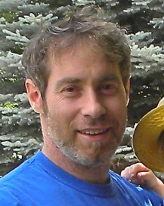
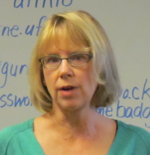
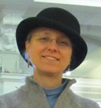
iDigBio Georeferencing Working Group (GWG)
Summit 2012
October 23 – 24
reporting: David Bloom, Shari Ellis, Debbie Paul
Notes:
iDigBio Summit 2011
input from initial members

Slide 2
GWG Overview
iDigBio IT Standards Meeting March 2012
GWG Initial Road Map
forming the working group
items in scope
expanding the georeferencing community
what’s next?
how to get involved…
Notes:
GWG road map from initial meeting at the iDigBio IT Standards meeting in March 2012
http://tinyurl.com/GwgInitialRoadMap

Slide 3
GWG Formation & Road Map http://tinyurl.com/gwgInitialRoadMap
iDigBio IT Standards Meeting March 2012
GWG Initial Road Map
policy and strategy
training
design
infrastructure
scope items
hard problems
Notes:
GWG road map from initial meeting at the iDigBio IT Standards meeting in March 2012
Participants in the initial meeting:
Elizabeth Martin, USGS
John Wieczorek, UC Berkeley Information Architect
Nelson Rios, Manager of Collections and Bioinformatics,Tulane
Dennis Xu, iDigBio IT RA
Deborah Paul, iDigBio User Services
Reed Beaman, iDigBio Senior Personnel
See notes: http://tinyurl.com/gwgInitialRoadMap

Slide 4





iDigBio GWG +
David Bloom, VertNet Coordinator, Berkeley
Nelson Rios, GEOLocate Developer, Tulane
John Wieczorek, Information Architect/VertNet, Berkeley
Carol Spencer, Staff Curator/VertNet, Berkeley
Reed Beaman, FLMNH
Una Farrell, Co-PI, Paleoniches TCN, Kansas
Paul Heinrich, Co-PI, SCAN TCN, NAU
Mary Barkworth, Utah State University
Gil Nelson, iDigBio Digitization
Deborah Paul, iDigBio User Services
Paleoniches TCN
SCAN TCN

Slide 5
GWG Goals
organize and update georeferencing resources
http://tinyurl.com/geotrainQuick
list experts available
collaboratively develop e-learning materials
conduct workshops to expand the georeferencing trainers community
evaluate workshops to improve course contents and training materials
develop and share georeferencing workflows

Slide 6
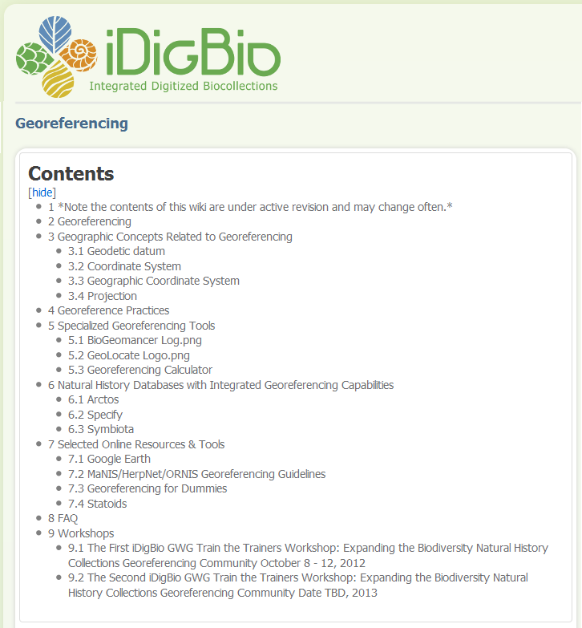
one-stop shop for georeferencing resources
http://tinyurl.com/geotrainWiki
Notes:
http://tinyurl.com/geotrainWiki

Slide 7
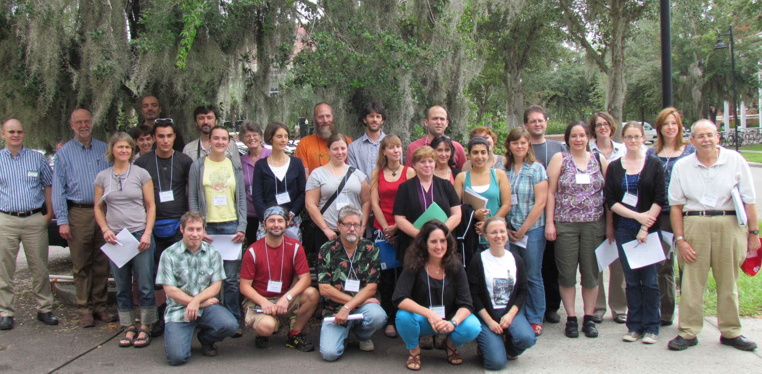
iDigBio’s 1st Georeferencing Train the Trainers Workshop
October 8 – 12, 2012
Notes:
Left to right (back row to front row), asterisk indicates they are members of the working group.
Photographer: Andrea Matsunaga, iDigBio IT
David Jennings, iDigBio Project Manager
*Gil Nelson, iDigBio User Services
*Nelson Rios, GEOLocate Developer, Tulane
Dmitry Dmitriev, Illinois Natural History Survey, Champaign Illinois
Dorothy Allard, Pringle Herbarium, Vermont
*John Wieczorek, Information Architect, VertNet
Stephen Gottschalk, Curatorial Assistant NYBG
Ryan Moraski, Graduate Student, iDigBio RA
Clare MacLoughlan, Jessup Herbarium
Jacob Higgins, SCAN TCN
Hanna Braeme
Kimberly Watson, Curatorial Assistant NYBG
Julie Smith
Brendan Morris
Jessica Utrup
Angelika Nelson
Shannon Asencio
Rita Velez
Liath Appleton
Nina Abdohollian
Jennifer Zaspel
Margaret Landis
*Una Farrell
Mark Allen Wetter
*David Bloom, VertNet Coordinator, UC Berkeley
Benito Santos, NYBG
Kevin Cummings, Illinois Natural History Survey, Champaign Illinois
*Carol Spencer, HerpNET Coordinator, UC Berkeley
*Deborah Paul, iDigBio User Services

Slide 8
iDigBio’s 1st Georeferencing Train the Trainers Workshop
course syllabus development
pre workshop survey
course syllabus adjustment 1
post workshop survey
course syllabus adjustment 2
multiple in-flight adjustments
Notes:
David’s turn to explain the history of their workshop development and the course taken to design this workshop.
Shari presents the survey results here.

Slide 9
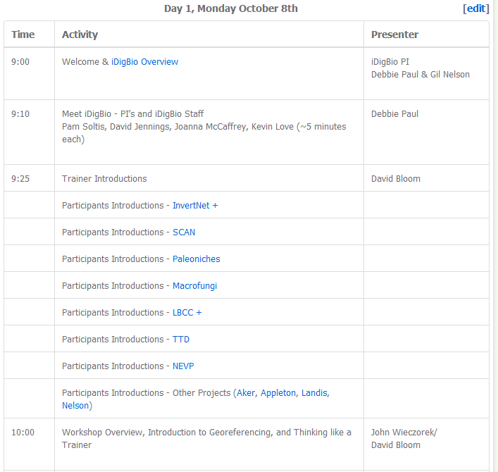
Train the Trainers Workshop #1
http://tinyurl.com/geotrainAgenda

Slide 10
Post-Workshop Survey
Approximately 50% of participants responded
All reported their georeferencing skills and ability to train others were “higher” or “much higher” following the workshop (pre-workshop skill levels ranged from very low to high)
The majority are either already training others on georeferencing or will be within the next 3 months
Notes:
#608CB8 R:96 G:140 B:184

Slide 11
Post-Workshop Survey
Overall, this was one of the best professional development workshops I have ever attended. The instructors were incredibly knowledgeable and patient. I am really grateful for all the time and effort they put into this workshop. There were some topics that were covered extensively that probably won't be included in my TCN, but it was good that they were covered for the benefit of those who needed to learn this information.
I think attending this workshop [was]worth my time because the instructors have a wide knowledge about the topic so[it has] been a dense topic and a very long week, due to the amount of topics to cover, they made it fun and very interesting!
Thank you very much for your time and effort in preparing this week-long workshop. I feel much more informed and equipped for georeferencing for a large-scale project, as well as, for training others to georeference.
The workshop was great. I wish I had attended sooner. Such training should be included in the basic education of all who are or may be involved with anything that could be put on a map.
Notes:
#608CB8 R:96 G:140 B:184

Slide 12
Coming up next
Further review of 1st post-workshop survey
e-learning materials development
coordinated with GBIF
Train the Trainers Workshop #2
spring or summer of 2013
Notes:
#608CB8 R:96 G:140 B:184

Slide 13
Go Geo! Get involved…
take a course
offer a course
co-host a workshop at your next professional meeting
share your geo-workflows ~ iDigBio Wiki
share your best geo resources
you?
one-of-a-kind maps?
authority files of localities?
georeferencing protocols?

Slide 14
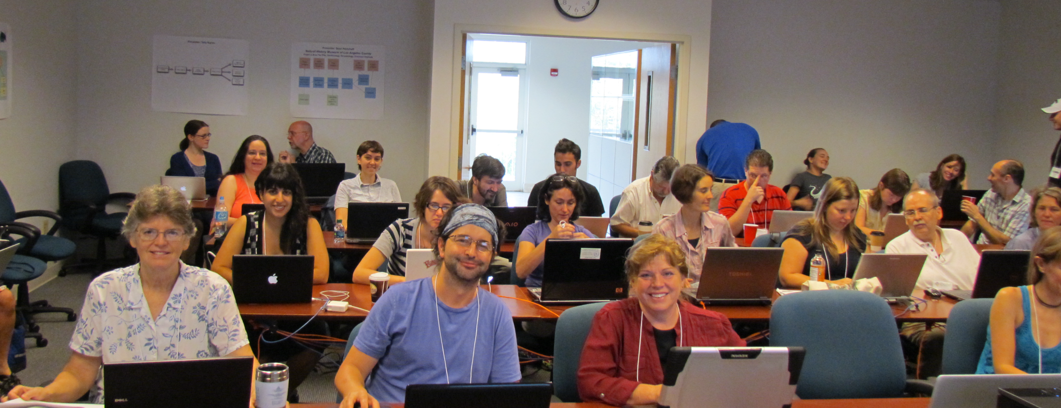
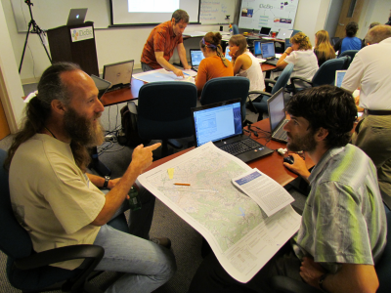
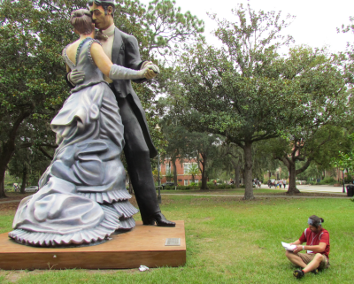
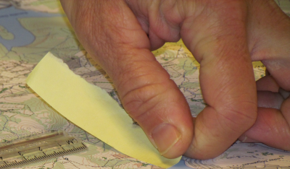
Thanks from the iDigBio GWG

