Slide 1
Mobilizing New England vascular plant data to track environmental change
P.W. Sweeney
Yale Peabody Museum of Natural History
Notes:
I’m here to speak about a TCN that was funded during the second ADBC funding round. The title of our project is Mobilizing New England Vascular Plant Specimen data to Track Environmental Changes.
I’m going to talk about the rationale for the project, give an overview of our plans, and talk about progress to date.

Slide 2
Outline
Objectives
Rationale
Digitization Plan
Organizational Structure
Workflow
Mobilization
Training & Outreach
Timeline

Slide 3
Objectives
Digitize 1.3 million N.E. vascular plant specimens from 15 regional herbaria
Notes:
The primary objective of the project is to digitize 1.3 million N.E. vascular plant specimens from 15 regional herbaria. By digitize we mean, capture an image, capture a subset of label data, some data about the specimen itself, and georeference.
This map shows the location of the participating institutions.

Slide 4
Rationale
The main goal of this TCN is to provide data to support the study of the consequences of climate change and land use history in the New England region over the last two centuries
Notes:
The main goal of digitizing all of these specimens is to provide data to support…

Slide 5
Rationale: NeW England
Why New England?
Herbaria
Landscape
History
Scientists
Notes:
Its herbaria include some of the world’s oldest and most comprehensive collections of varying size and scope. For example, the region includes Harvard University Herbaria with over 5 million specimens and which contains many historically important specimens (e.g., the Thoreau herbarium) and smaller collections that comprised largely of specimens representing localized areas.
The New England landscape has a diversity of habitats from maritime islands and broad river valleys to sub-boreal forest and alpine tundra.
its coastal location and importance to colonial settlers have exposed it intense ecological pressure for hundreds years.
And its scientists have been at the forefront in applying historical plant collections to evaluating the impact of environmental changes.

Slide 6
Rationale: Theme
Climate Change
Plant phenological observations play an important role in the effort to understand the effects of rising temperatures
Our project will cater to climate-change studies by capturing phenology (flowering and leafing-out stage) data
We will develop controlled vocabularies for flowering stage and leafing-out stage

Slide 7
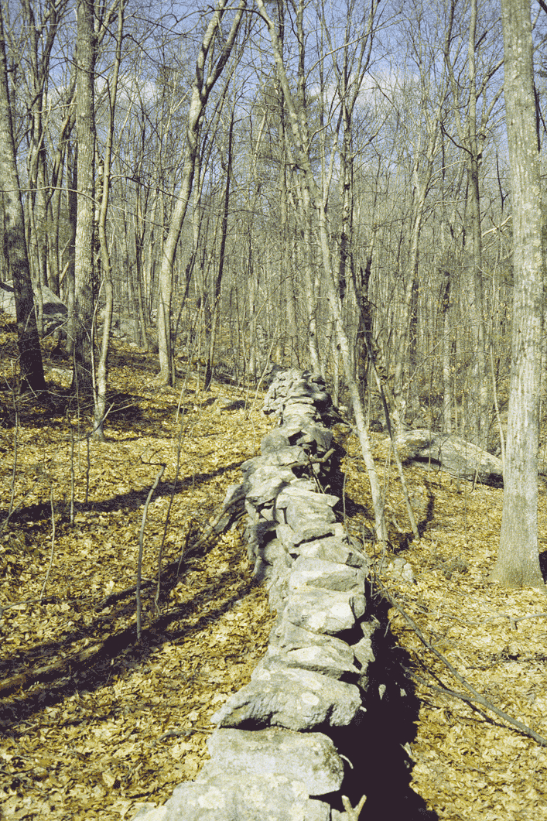
Rationale: Theme
Land-use history
Herbarium specimens, representing thousands of species with diverse ecological ranges and tolerances can add critical insights into the long-term consequences of past land-use
We will capture habitat data for a subset of taxa targeted for their particular importance to land-use studies, and we will develop a controlled vocabulary for habitat

Slide 8
Digitization Plan: Organization
Brown University (BRU)
Harvard University (HUH)
U. of New Hampshire (NHA)
U. of Massachusetts Amherst (MASS)
U. of Vermont (VT)
Yale University (YU)
Bartlett Arboretum (BART)
Berkshire Museum (BERK)
Boston University (BSN)
Central Connecticut State U. (CCSU)
Connecticut College (CCNL)
Harvard Forest (HF)
Keene State (KESC)
Western Connecticut State U. (WCSU)
Westfield State U. (WSCH)
University of Oklahoma
Notes:
Now I’ll move from talking about the Rationale to talking about the Digitization Plan.
15 collections will have their collections digitized.
University of Oklahoma is subcontracting with Yale to develop hardware and software for the project – I’ll talk more about their role later.

Slide 9
Digitization Plan: Organization
MASS
WSCH
HF
BRU
YU
BART
BSN
KESC
CCNL
WCSU
CCSU
BERK
HUH
NHA
VT
Notes:
The digitization effort will be organized as a hub and spokes, with a few of the larger institutions serving as digitization and organizing centers for the smaller collections.
In particular, six institutions will digitize their holdings – these are in grey.
The remaining nine institutions, shown in gold, will have their collections digitized either at Yale or U. Mass. HUH, VT, NHA, and BRU will be responsible for digitizing their collections alone.

Slide 10
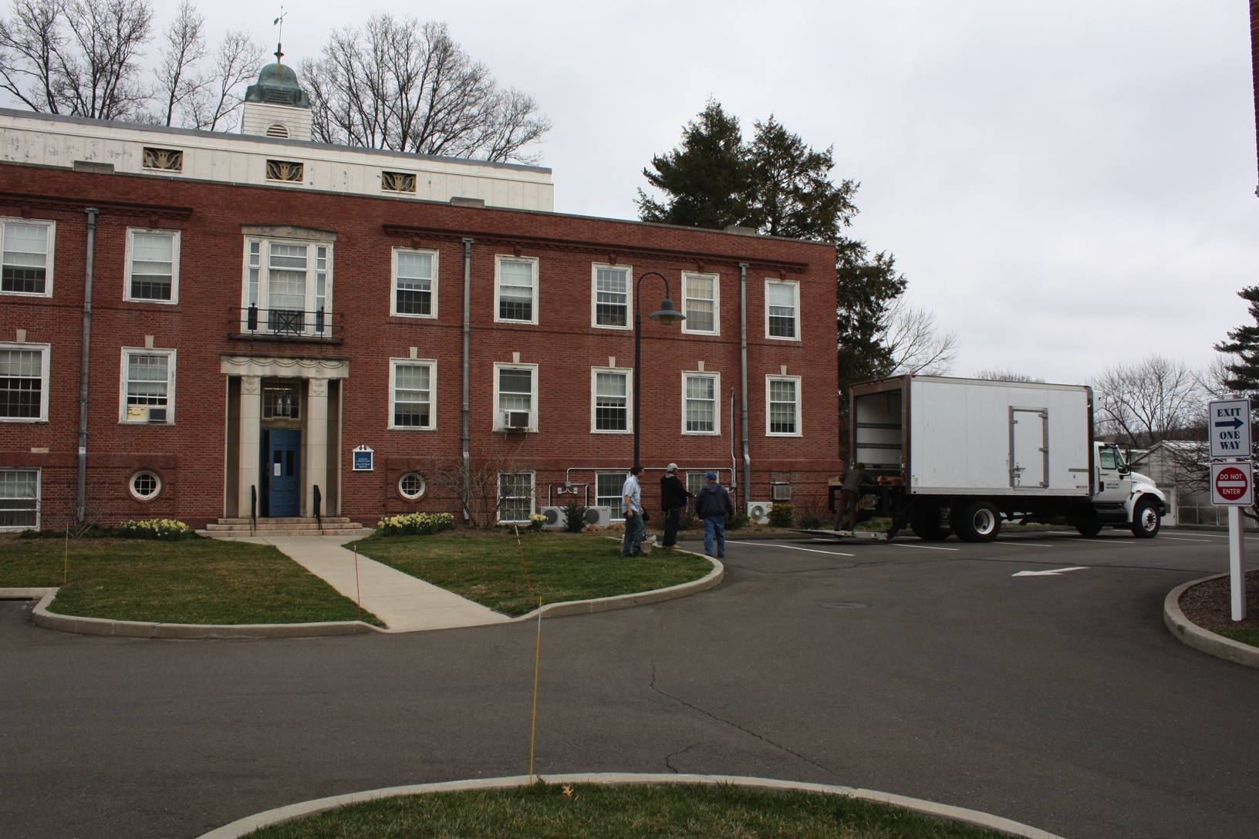
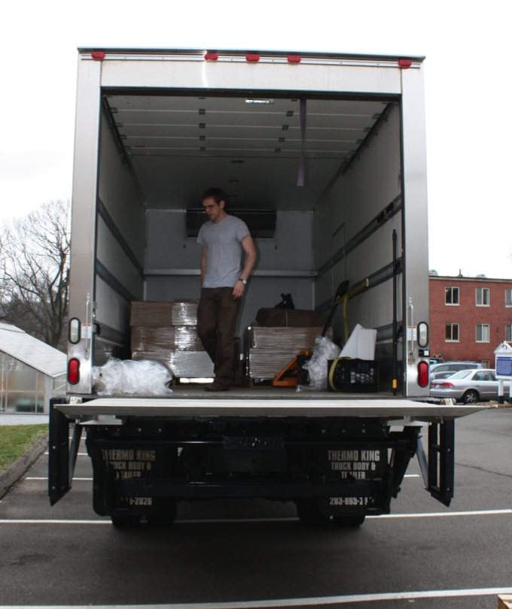
Digitization Plan: Organization
Notes:
The smaller collections will be shipped or packed up and moved to Yale or U. Mass where they will be digitized.
Pictured here is the Yale Peabody Museum’s box truck, which will be used to transport the specimens.

Slide 11
Digitization Plan: Organization
HUH & YU
BRU
MASS
NHA
VT
BART
BERK
BSN
KESC
CCNL
CCSU
WCSU
WSCU
HF
Notes:
Harvard and YU will act as key resource hubs that provide informatics assistance to all of the collections.

Slide 12
Digitization Plan: workflow
Collection Preparation (Pre-capture)
Primary digitization
Data Enhancement (Secondary Digitization)
Notes:
Now I’ll give you an overview of our workflow. We are thinking of the workflow as having three main components or stages.
A Collection Preparation or “Pre-capture” stage
A Primary Digitization stage
Data Enhancement or “Secondary” digitization stage
I’ll talk about each of these phases now.

Slide 13
WORKFLOW: PRE-cAPTURE
In herbaria, sheets are often organized into folders by genus or species, with a single identification applying to all specimens in that folder. Often organized by geography, as well
Capture data that reflects the physical storage structure of the collection before imaging and data basing individual specimens
Associate this pre-captured data with specimen records at a later stage

Slide 14
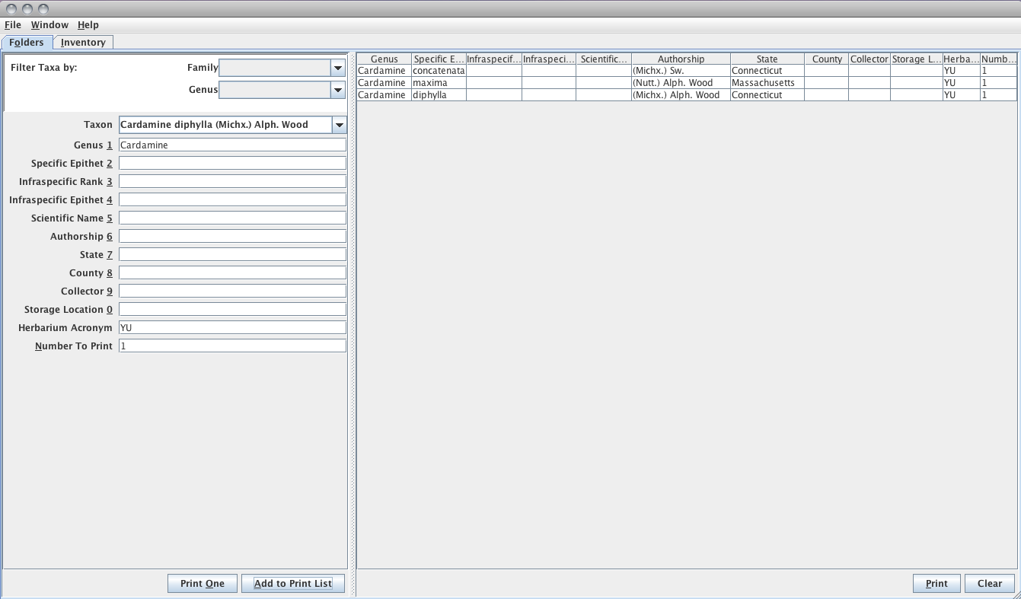
WORKFLOW: PRE-cAPTURE
Notes:
To do this we will use a very simple java application, which will be used to capture current identification (at family, generic, or specific rank) and state (when available).

Slide 15
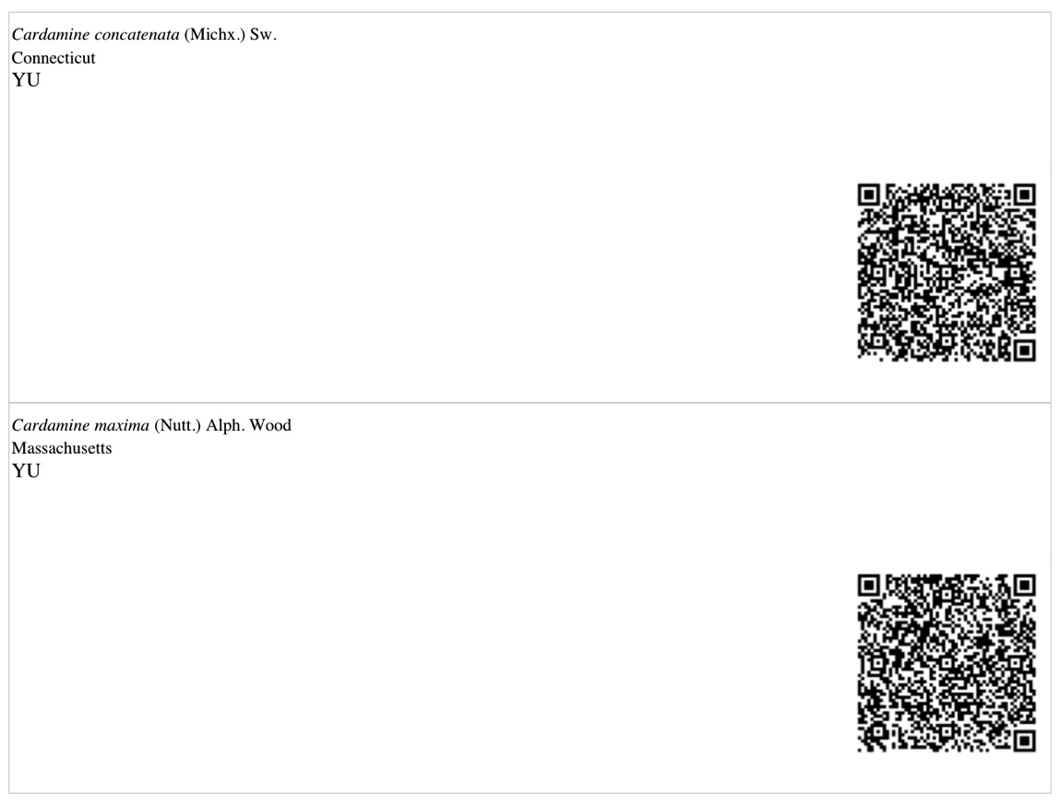
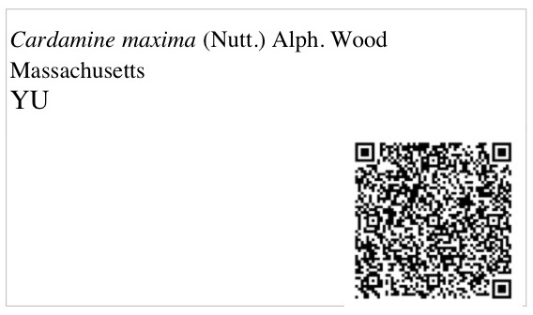
WORKFLOW: PRE-cAPTURE
Notes:
This information will be printed onto labels in human readable and barcode form and associated with the folder housing the specimens for later scanning at the primary digitization stage when this information will be associated with specimen- level records.

Slide 16
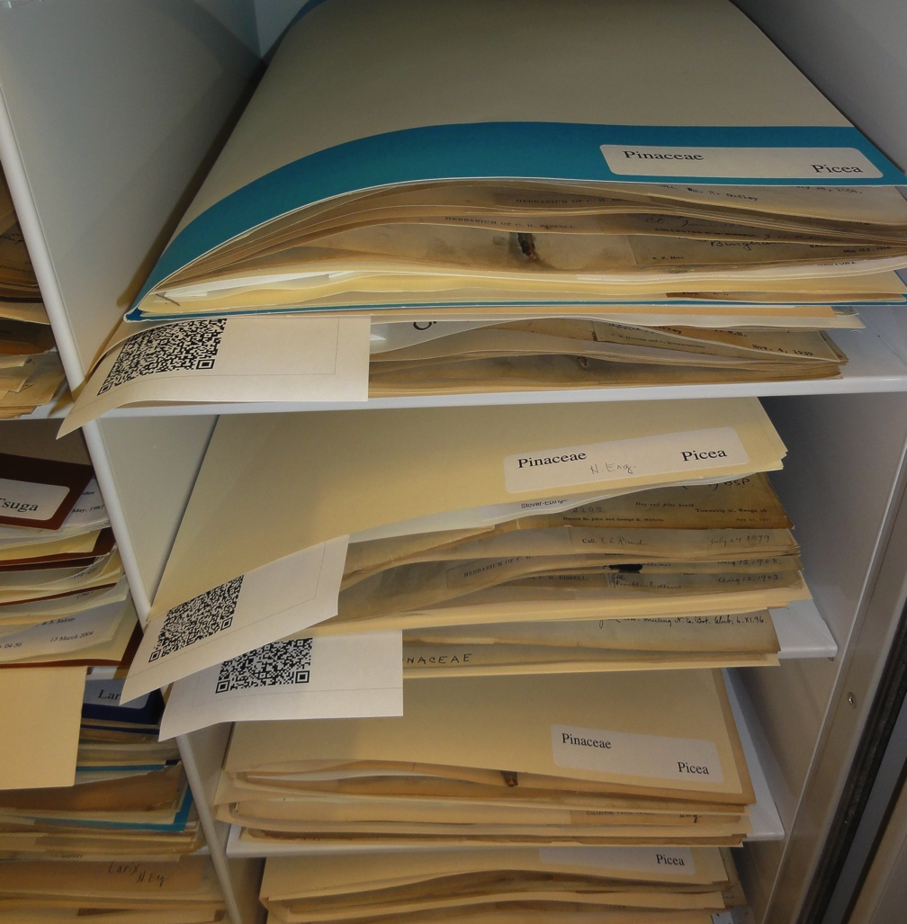
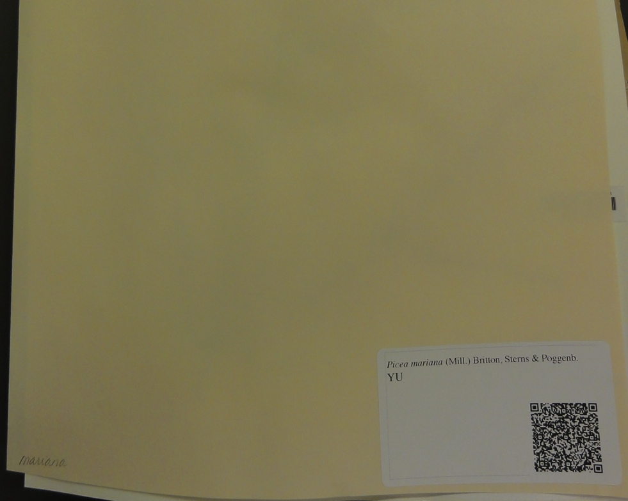
WORKFLOW: PRE-cAPTURE

Slide 17
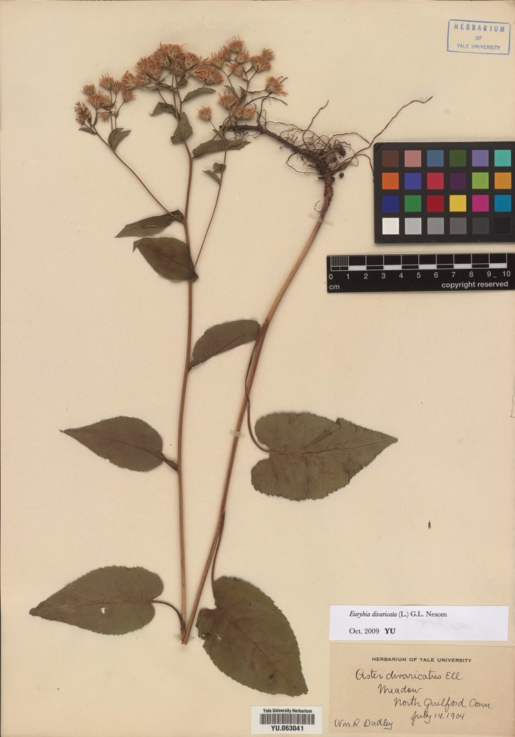
Workflow: primary digitization
Capture an image, a barcode number, a subset of label data & associate pre-capture data with specimen occurrence records
Notes:
In the primary digitization, we will capture: an image, a barcode number (catalog number), current identification and state where the specimen was collected barcodes generated during the pre-capture phase, collector, collection date, and town where the specimen was collected.

Slide 18
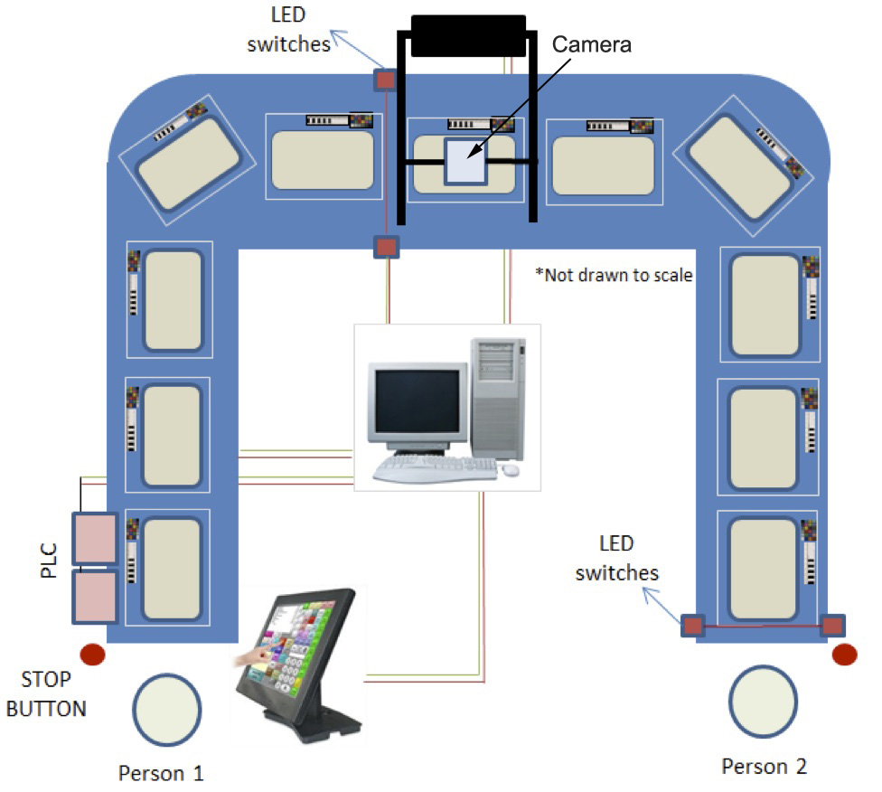
Workflow: primary digitization
To increase the efficiency of capturing an image and specimen-level data, we will develop and test an high throughput digitization apparatus
Notes:
To increase the efficiency of capturing an image and specimen-level data, we have teamed-up with Dr. Binil Starley, Assistant Professor in the School of Industrial Engineering, at the University of Oklahoma (subcontracting with Yale), to develop and test an industrial-scale, high throughput digitization apparatus, which will mediate the entire primary digitization process.
This figure shows the overall system layout and sub-system components.
The basic idea to achieve the required throughput rate is to separate the imaging step from the manual loading and unloading of specimens. The separation of these steps will be made possible by an automated conveyor belt specimen handling system, which will allow image capture and specimen handling simultaneously. The basic components of the digitization platform are: 1) a cleated low profile conveyor belt in either a straight line or ‘U’ shaped configuration of pre-defined lengths; 2) a high resolution digital camera with lighting system and a central computer system; 3) Light Emitting Diode (LED) switches to index the motion of the conveyor belt; 4) input devices such as touch screen monitors, bar-code scanners, and voice input hardware; and 5) Programmable Logic Controllers (PLC’s) that control and synchronize signals from the conveyor belt motion control, digital camera, and LED switches.
Apparatuses will be shared and moved around among the digitizing institutions.

Slide 19
Workflow: Primary Digitization
Digitization Stations
Symbiota
TACC
Specimen Data
Images
Notes:
Specimen data will be transported from the Digitization Stations to a Symbiota instance.
Batch builder -> transport -> batch unpacker (SPARQL queries on the packages to put records into Symbiota's relational database)
rdf/xml formatted batch file, batch unpacker in Symbiota
rdf/xml formatted batch file, batch unpacker -> Filtered Push -> AnnotationProcessor -> Specify
FilteredPush project is working on a rdf handler that would handle this
Images will be transported to TACC.
batches
tables with urls & catalog numbers/collection used for ‘batch’ linking of images to specimen records in Symbiota

Slide 20
Workflow: secondary digitization
The secondary digitization stage will involve humans capturing (via keystroking) habitat and phenology data from images of specimens and labels.
Notes:
Controlled vocabularies for habitat and phenology

Slide 21
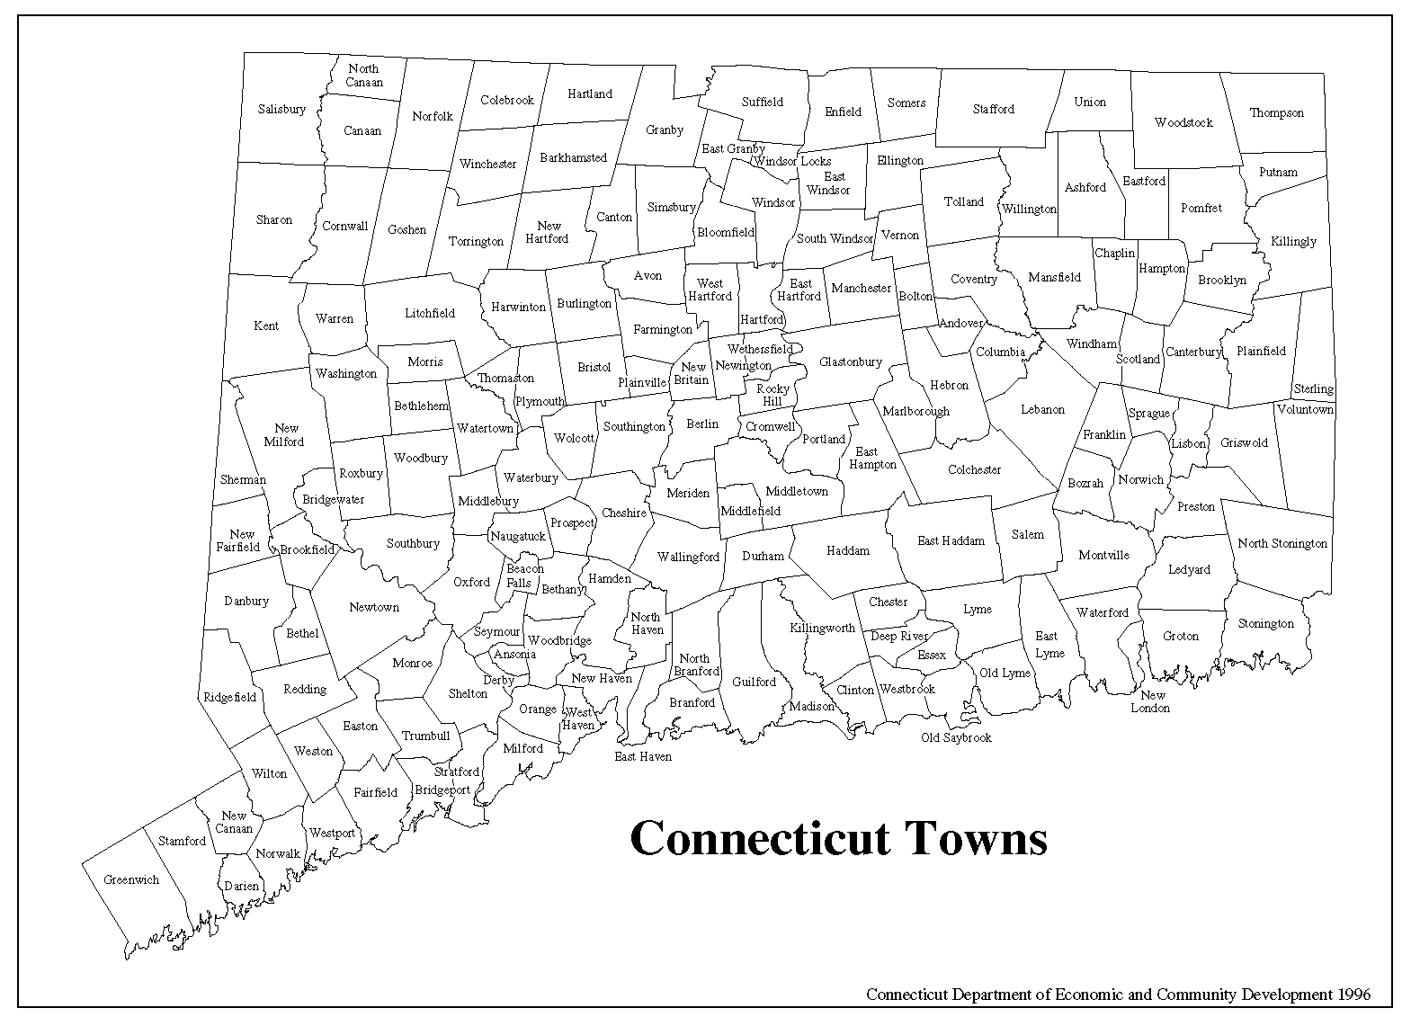
Workflow: secondary digitization
Georeference to at least town level
Notes:
States in New England are small and all areas of a state lie within a town. So we will used town centroids for latitude and longitude and for the uncertainty the radius of smallest circle enclosing the town polygon

Slide 22
Workflow: Enhancement
Filtered Push
Morphbank
Collection Databases
(Specify)
Symbiota
Notes:
In addition to enhancing records with phenology and coordinates, we have partnered with the FilteredPush project to connect Symbiota, Specify, and Morphbank to promote annotation of specimen records and their images by knowledgeable users.

Slide 23
Mobilization
All of the data and images will be available to public through Consortium of Northeastern Herbaria (CNH) Symbiota portal(neherbaria.org/CNH)
Notes:
Within the CNH instance individual specimen records can be viewed with images, and the specimen occurrence data will be downloadable.

Slide 24
Training & outreach
Undergraduates and graduate students engaged in digitization & collections activities
Collection internships to teens
Notes:
In addition to the usual education and outreach activities that take place within our collections, training is integrated into the project in several ways.
At four institutions (BRU, HUH, YU, and VT) undergraduate and graduate students will be directly involved in digitization activities by conducting much of the actual work. These students will learn about collections management (e.g., handling and care of specimens, best practices) and biodiversity informatics.
Our project will collaborate with the Yale Peabody Museum's after school program for high school students, "Evolutions" ("EVOking Learning and Understanding Through Investigations Of the Natural Sciences") to offer internships to six students. This program engages a diverse group of teens from the New Haven Public School district in a rigorous 'for credit' academic program focused on science and science careers. New Haven schools and the Evolutions program are characterized by a large percentage of students from historically underserved populations.

Slide 25
Training & outreach
We will establish a network of citizen science observers to provide information on flowering and leafing-out times across the New England region
Notes:
Using networks of citizen scientists has provided a way for scientists to develop a dense concentration of observations in a cost-effective manner.
Many of the herbaria in New England have strong representation of specimens from the late 19th century through the 1940s. Some herbaria have abundant collections through to the present time, but many have relatively few specimens collected over the past 50 years.
A baseline of information is needed on flowering times and leafing-out times across the New England region today.
To a large degree this can be provided by properly monitored citizen scientists who submit on-line their observations on particular phenological phases for a specified list of plant species for which we will also gather data from herbarium specimens.
A number of citizen science networks already exist in New England and Nationally.
We will build on these networks (see Collaboration Letters) to include more (or even all) of the species and stages that we will be evaluating, and to recruit more participants to these networks.
A significant effort will be required to train and communicate with the citizen scientist volunteers to insure that they are gathering data correctly and remain motivated.

Slide 26
Timeline
Year 1
Year 2
Year 3
Year 4
Informatics Infrastructure
Set-up infrastructure and digitization workflows
Develop & test digitization apparatuses at OU
Continued development, testing, and fine- tuning
Pre-capture
Conduct pre- capture stage at primary institutions
Pre-capture of small collections (at MASS & YU)
Primary Digitization
Conduct Primary digitization
Secondary Digitization
Conduct Secondary digitization.
Notes:
Focus on tasks…

Slide 27
PROGRESS
Publicity website, management site (Open Atrium), and portal in place (Symbiota)
Pre-capture
Pre-capture application and workflow developed
Process underway at participating collections
Kick-off meeting in early September
Pre-capture application and workflow demonstration
Digitization apparatus in development
Deployment in spring
Citizen Science project beginning recruitment process

Slide 28
Acknowledgements
National Science Foundation
iDigBio
Symbiota Project
FilteredPush
Texas Advanced Computing Center (TACC) & The iPlant Collaborative
Notes:
Think more about this…

