Slide 1
DROID
DEVELOPING ROBUST OBJECT TO IMAGE TO DATA WORKFLOWS
Gil Nelson
(on behalf of the WG)
iDigBio Summit, Gainesville
October 23- 24, 2012

Slide 2
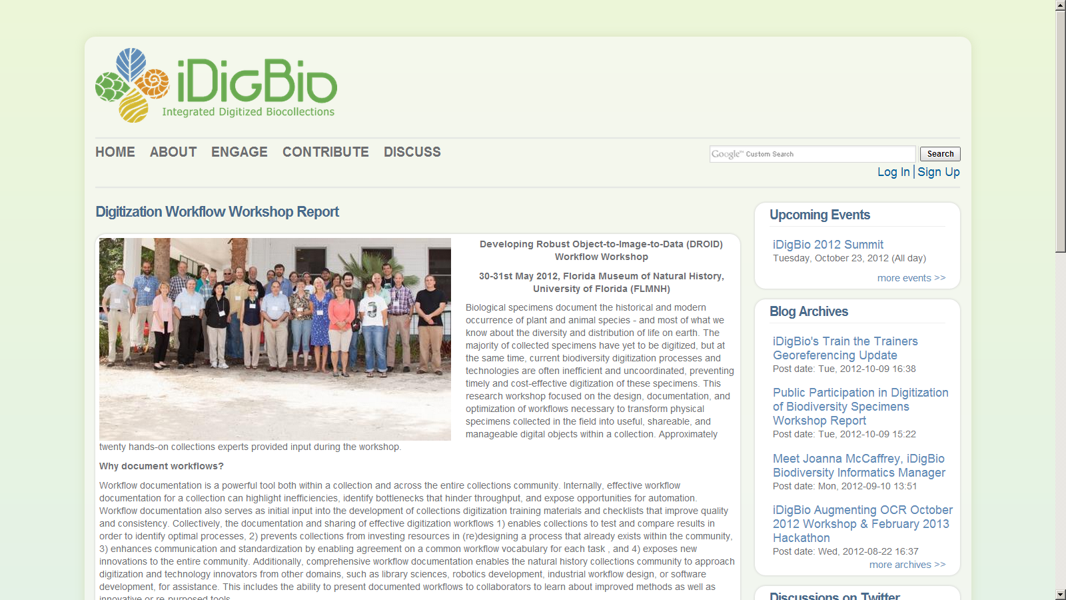
Sponsored by:
iDigBio
Software Infrastructure for Sustained Innovation (S2I2)
Botanical Research Institute of Texas (BRIT)
Yale Peabody Museum
Biodiversity Institute, University of Kansas

Slide 3
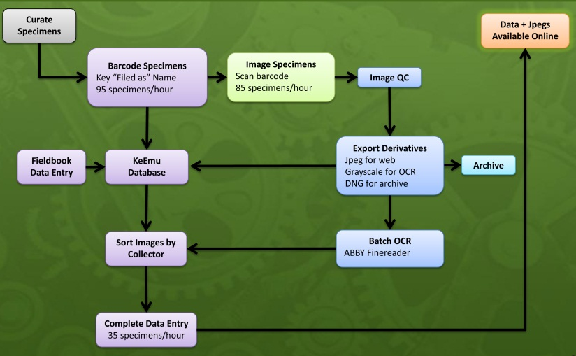
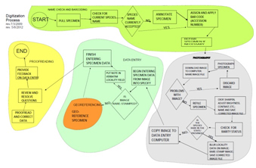
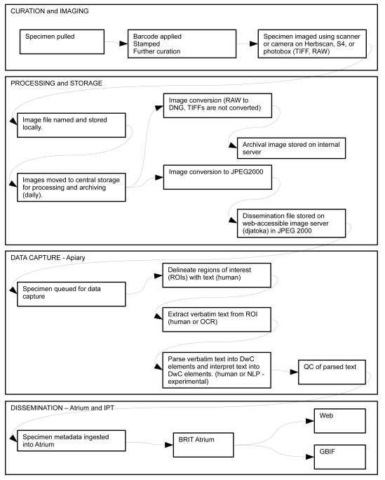
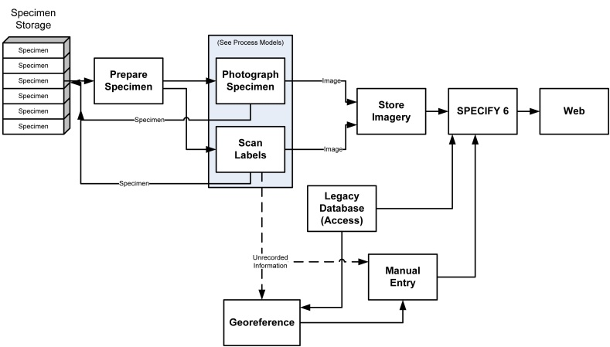

Slide 4
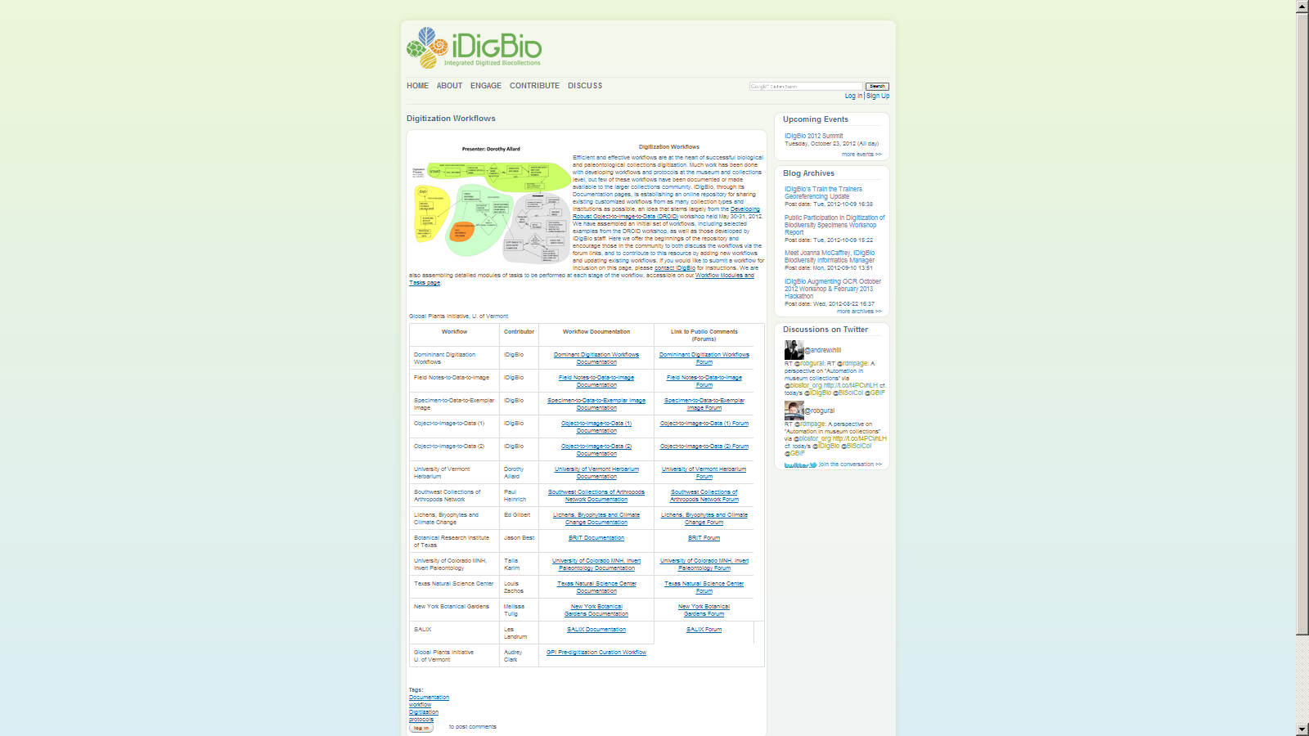
https://www.idigbio.org/content/digitization-workflows

Slide 5
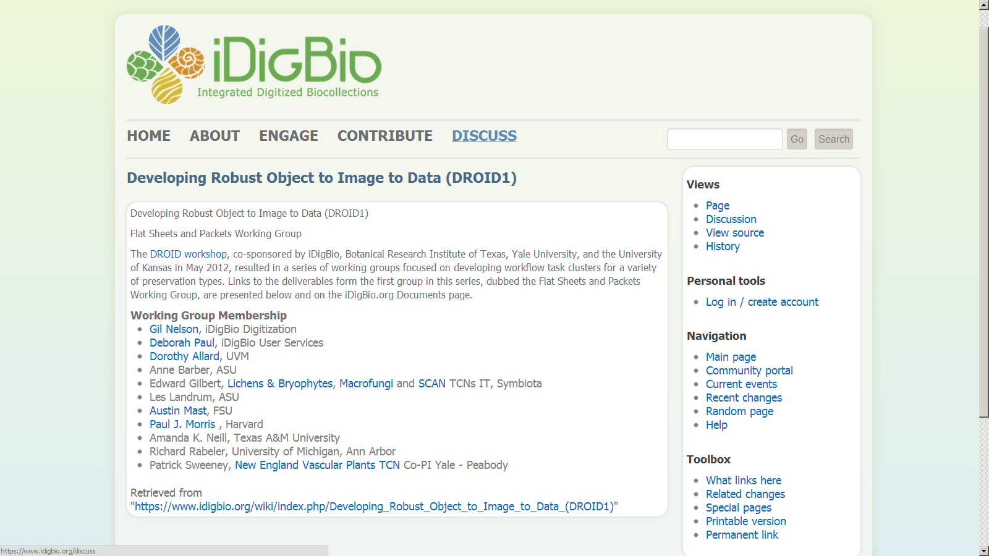

Slide 6
Taking a Modular Approach
Module 1
Pre-digitization curation
Module 2
Imaging station setup/camera
Module 3
Imaging station setup/scanner
Herbarium Digitization Modules
Module 4
Image capture
Module 5
Image processing
Module 6
Data capture
Module 7
Data enrichment

Slide 7
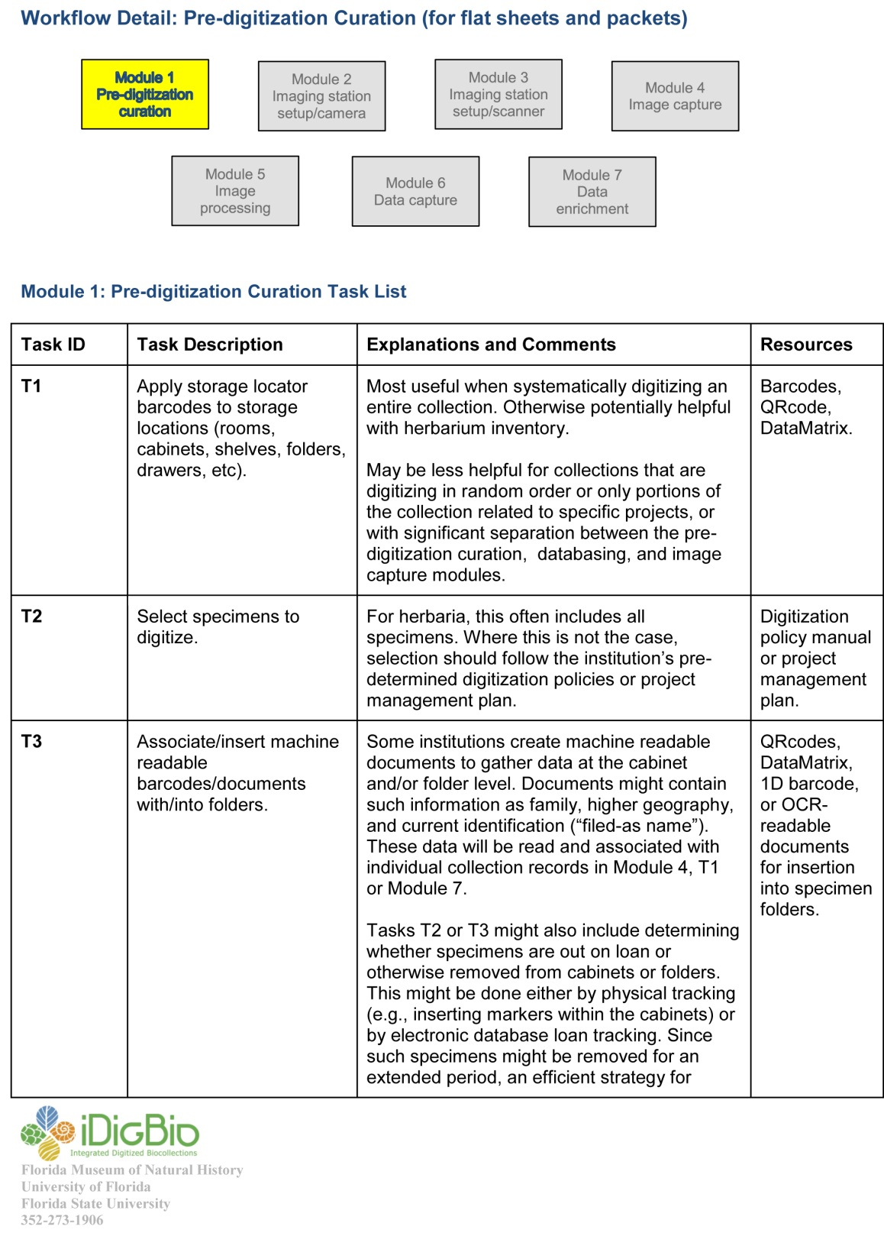

Slide 8
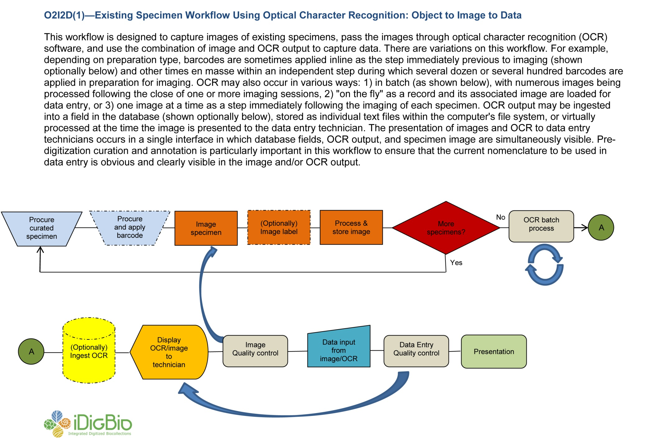

Slide 9
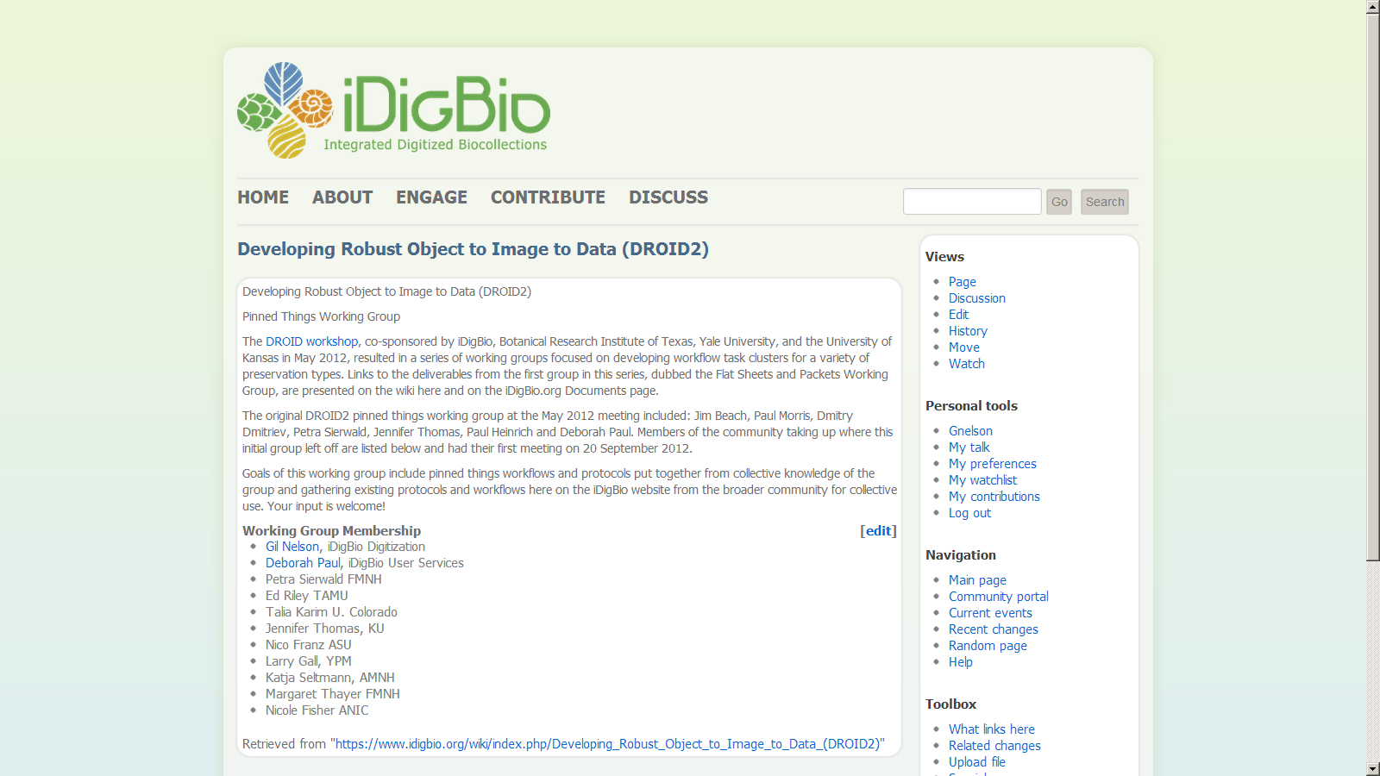

Slide 10
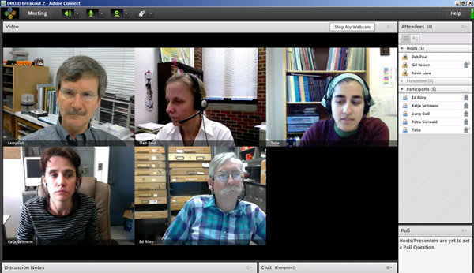
Just another happy day designing workflows!

Slide 11
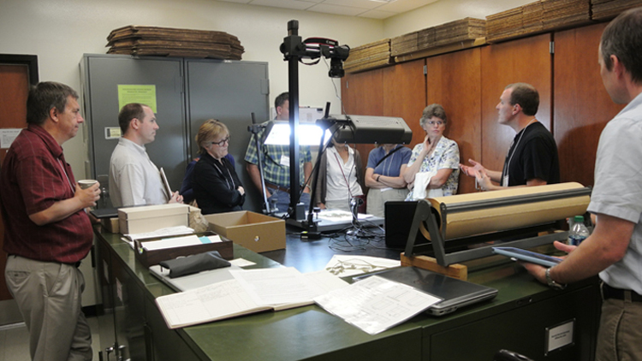
Digitization Training Workshops

Slide 12
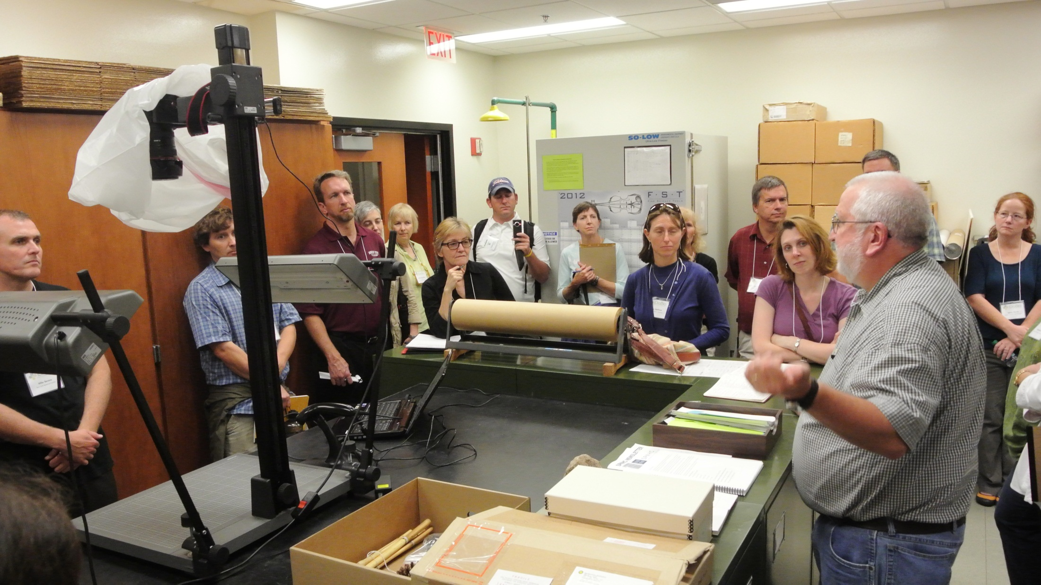
Digitization Training Workshops

Slide 13
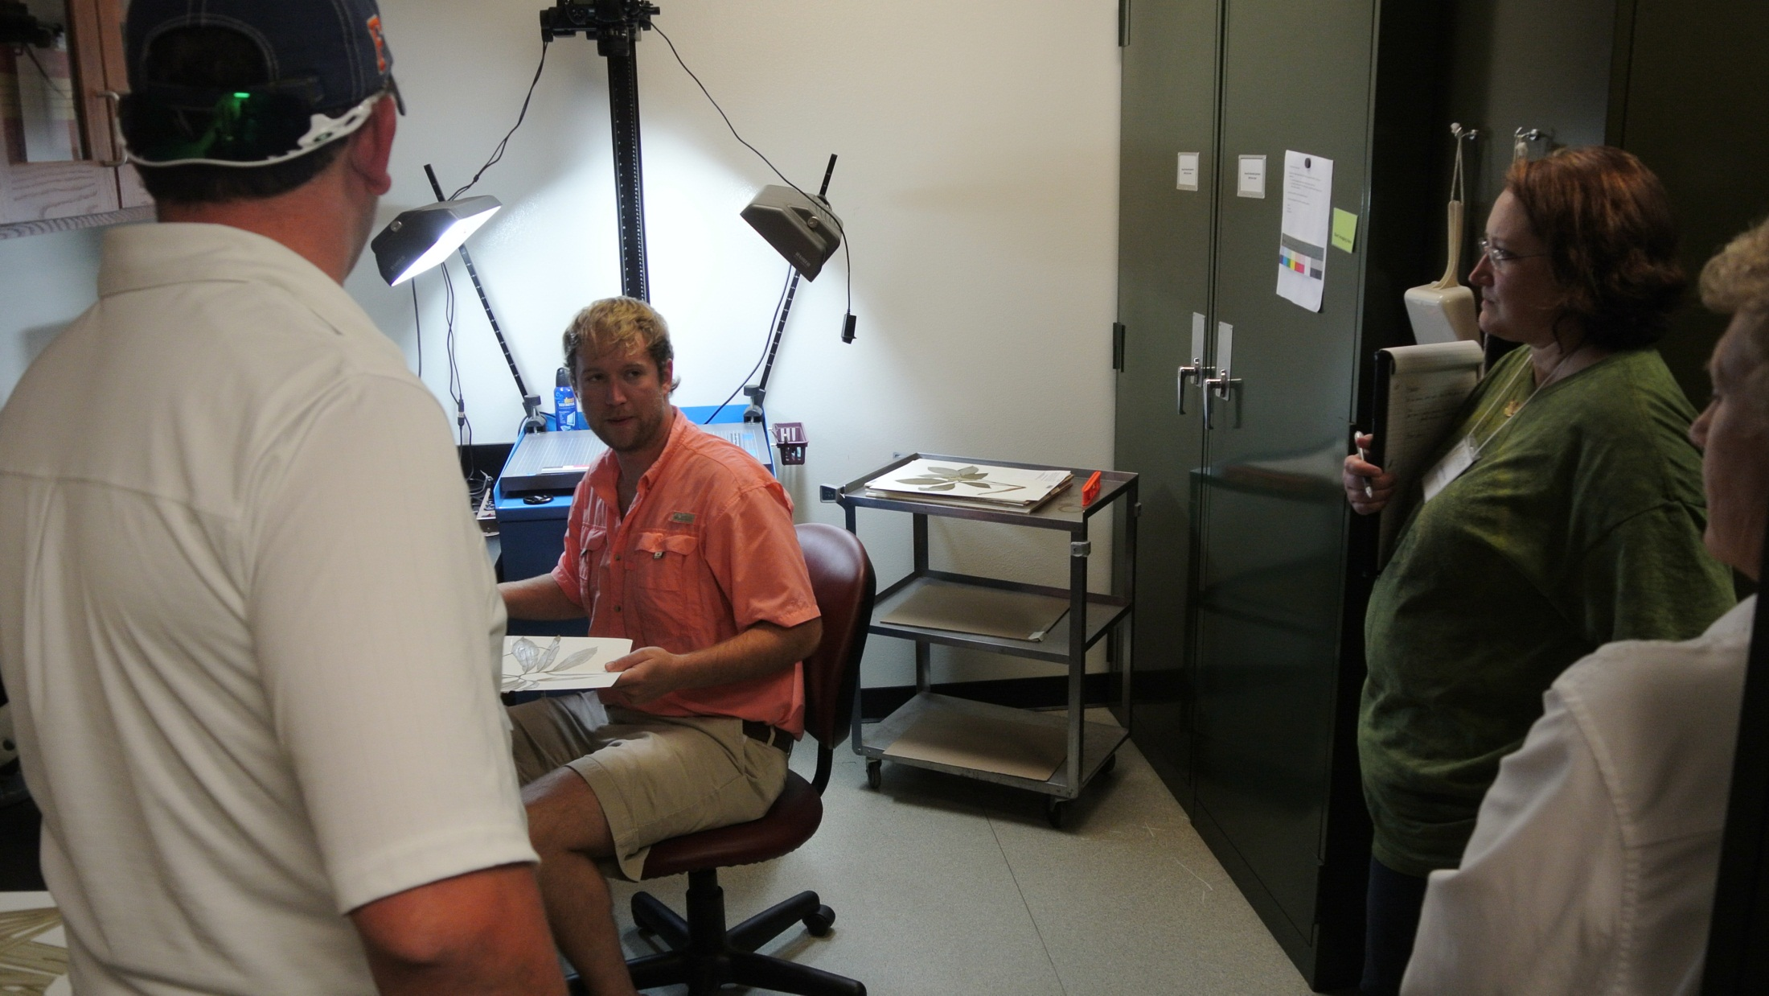

Slide 14
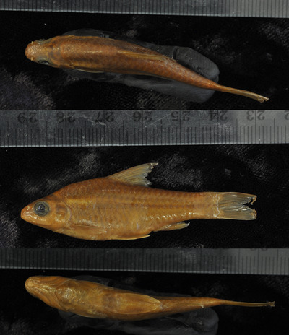
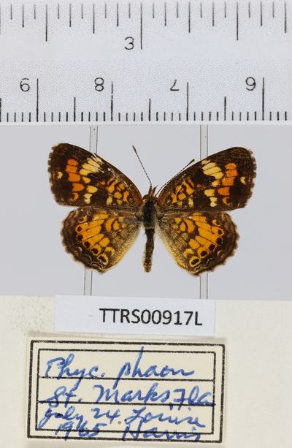
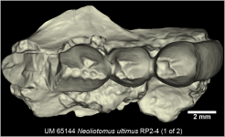
Wet Collections
March 2013
Pinned Insects
April 2013
Paleontology Collections
September 2013

Slide 15
THANK YOU!

