Slide 1
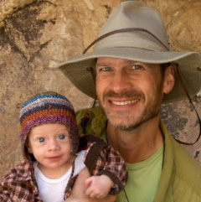
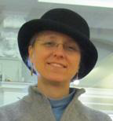
iDigBio Augmenting OCR Working Group (AOCR)
Summit 2012
October 23 – 24
reporting: Edward Gilbert, Debbie Paul
Notes:
iDigBio Summit 2011
input from initial members

Slide 2
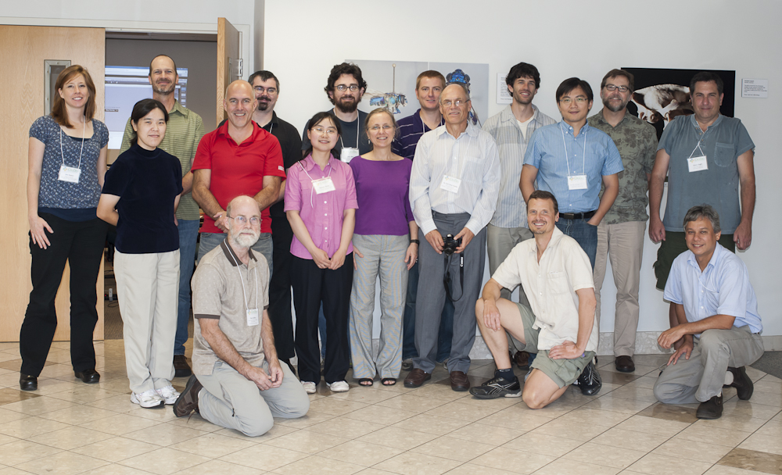
Overview
iDigBio Augmenting OCR Working Group Meeting: October 1 – 2, 2012
Notes:
Left to right, asterisk indicates they are members of the working group.
*Kimberly Watson, Curatorial Assistant NYBG
*Edward Gilbert, Symbiota Developer
*Alex Thompson, iDigBio Developer
*Jason Best, Director Bioinformatics, Botanical Research Institute of Texas
Sean Murphy, Systems Administrator, Botanical Research Institute of Texas
*Stephen Gottschalk, Curatorial Assistant NYBG
*Bryan Heidorn, Director – School of Information Resources and Library Science, Information University of Arizona
*Robert Anglin, Symbiota Developer
Andrea Matsunaga, iDigBio Senior Personnel
*Peter Lang, Pre Sales Engineer, ABBYY
*Qianjin Zhang, Graduate Student, University of Arizona
*Deborah Paul, iDigBio User Services
Karl-Heinz Steinke, Engineer and Professor, Hochschule Hannover
Hsin-Hui Wu (Elvis), Post Doc Associate, Florida Museum of Natural History
Daryl Lafferty, SALIX Developer
Peter Oboyski, Collections Manager and Sr. Museum Scientist, Essig Museum
Reed Beaman, iDigBio Senior Personnel, FLMNH

Slide 3
AOCR Working Group
Bryan Heidorn, Director, School of Information Resources and Library Science, University of Arizona
Robert Anglin, LBCC TCN Developer
Reed Beaman, iDigBio Senior Personnel, FLMNH
Jason Best, Director Bioinformatics, Botanical Research Institute of Texas
Renato Figueiredo, iDigBio IT
Edward Gilbert, Symbiota Developer, LBCC and SCAN TCNs
Nathan Gnanasambandam, Xerox
Stephen Gottschalk, Curatorial Assistant, NYBG
Peter Lang, Pre Sales Engineer, ABBYY
Deborah Paul, iDigBio User Services
Elspeth Haston, Royal Botanic Garden, Edinburgh
Anna Saltmarsh, Royal Botanic Gardens, KEW
Nahil Sobh, Developer, InvertNet
Alex Thompson, iDigBio Developer
Kimberly Watson, Curatorial Assistant NYBG
Qianjin Zhang, Graduate Student, University of Arizona

Slide 4
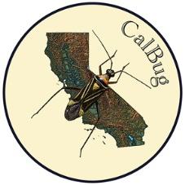
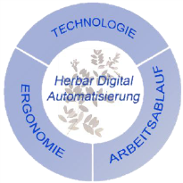
AOCR Working Group +
MaCC TCN
SALIX
Notes:
Representing visually, the organizations and affiliated groups for each of the working group members as well as the groups we have been collaborating with to date…

Slide 5
AOCR Overview
AOCR Working Group
Goals
Working Group Meeting
Coming Up Next
How to get involved

Slide 6
AOCR Goals
known effective practices
known issues
research and report findings
outreach and collaboration
OCR / NLP resources
OCR / NLP workflows
optimizing OCR results

Slide 7
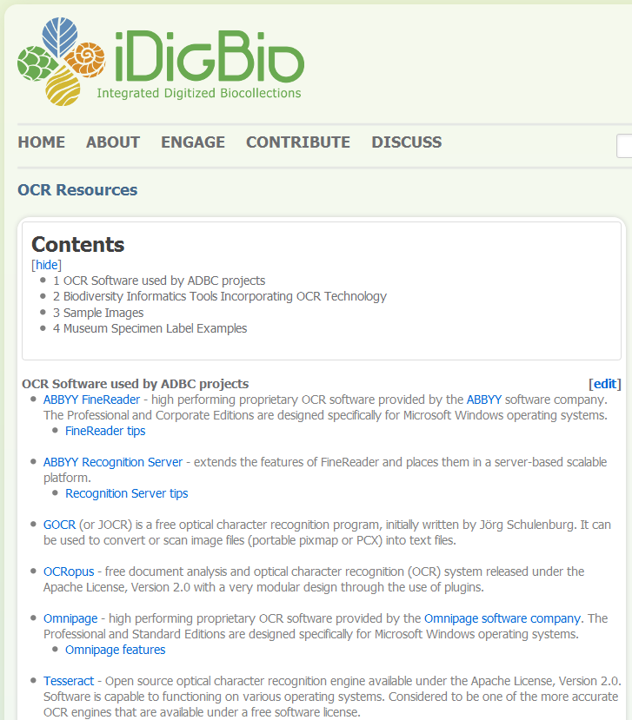
http://tinyurl.com/aocrWiki
effective practices
issues
workflows

Slide 8
AOCR Working Group Meeting
state of the art ~ learning from each other
Karl-Heinz Steinke: Herbar Digital and BGBM
Elspeth Haston, Ron Cubey, Robin Drinkwater: OCR within the digitisation workflow at RBGE, & OpenUp!
Jason Best: Demo of The Apiary Project
Edward Gilbert, Corinna Gries, Thomas H. Nash III, Robert Anglin: Lichens, Bryophytes and Climate Change
Kimberly Watson, Tri-Trophic Digitization: Putting the OCR in Workflow, NYBG
Stephen Gottschalk, OCR implementation in The Caribbean Plants Digitization Project, NYBG
Daryl Lafferty, OCR and SALIX Parsing
Bryan Heidorn & Qianjin Zhang, Herbis / LABELX Demo
Peter Oboyski, Phuc Nguyen, Serge Belongie, Rosemary Gillespie: Digitization California Arthropod Collection CalBug Project, Essig Museum

Slide 9
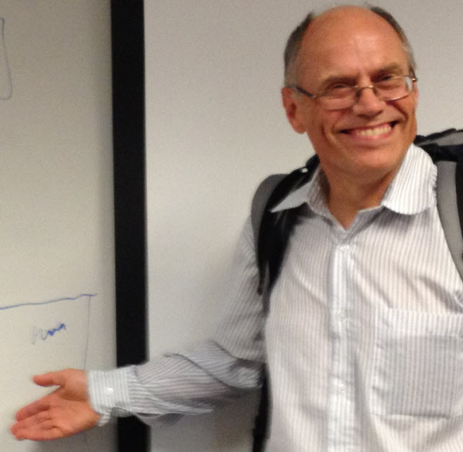
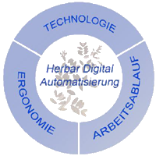

Slide 10
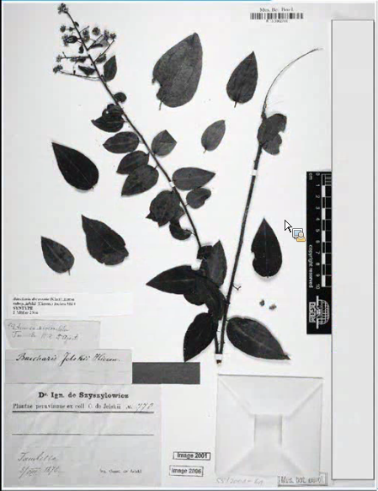
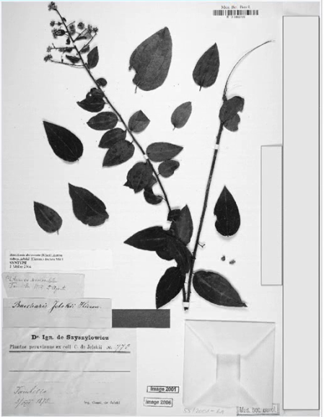
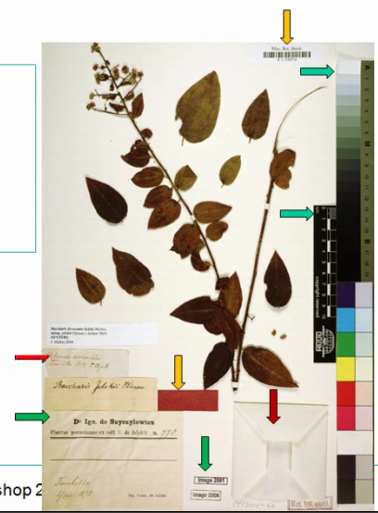

Slide 11
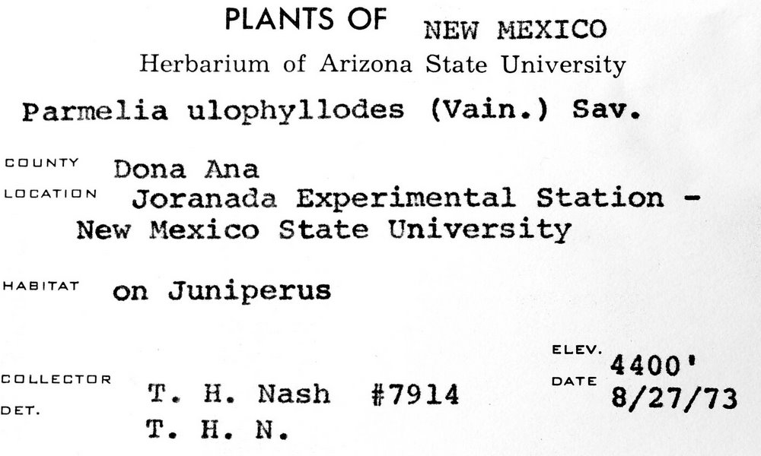
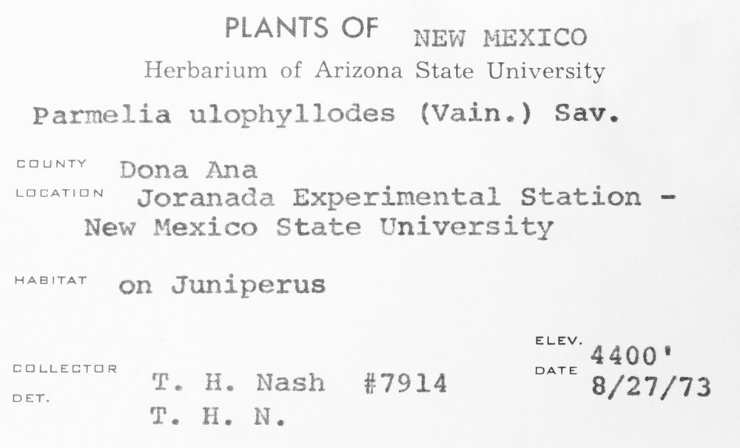
OCR Challenges
Issues
Handwriting
Old fonts
Faded labels
Form labels
Misaligned text
Solutions
Treatments
Dictionaries
Multiple OCR
Â¢_].L.|Â»â€˜Â¢ .'Â».f.'._..â€˜~,(.J
fin-xâ€˜*\'a:"511z:1 wf .~\:'i/.onli State University
P.â€™~.r"~2= ,_. gg J:.2 " J*J*" â€ (=:\â€˜-â€œax "Â»..'\-12
â€˜ â€œ "â€˜ ;T~;â€˜~7i?Â»-1_1_\f;>sf`;,' ESX
ZÂ»ie+â€˜-Â». â€œ~'.Â»te;~:i_.t<Â» ff`t;~f3":.f.â€œ
Â» Â»4 xx, ,
"""â€˜â€œâ€T"â€™ <1;-.rs f3'a,1.z>.t;;aÂ¢f~rus â€™
V4 J 'if . rÂ°'Â° M '1?nies ivain.) Sav.
neutal Station - " '1 ~Â»r';;4-\P ` 1.
T11 ./P.. ,J ..-.
ELEV. ' `.fJL_\ LATL Q _â€˜ 1 _ Yâ€™ DATE
_ ,. W5. (> f- , -:â€˜; i f>i_T ~~ . A 1:
Â». v\ .-v Â»~. 4. a xvala 8/27/73
PLANTS OF NEW r~1ExIco
Herbarium of Arizona State University
Parmelia ulophyllodes (Vain.) Sav.
COUNTY â€œÂ°â€â€œâ€œ
Joranada Experimental Station -
New Mexico State University
"â€œâ€œâ€œ' on Juniperus
ELEV. ‘ 4400
EEILLEETUR DATE
DU T. H. Nash #7914 8/27/73
T. H. N.

Slide 12
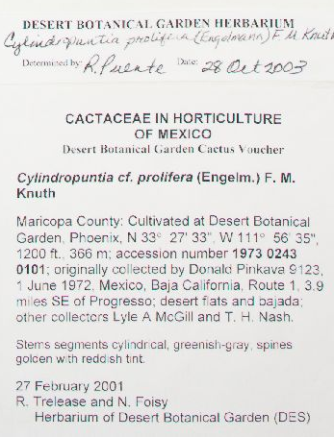
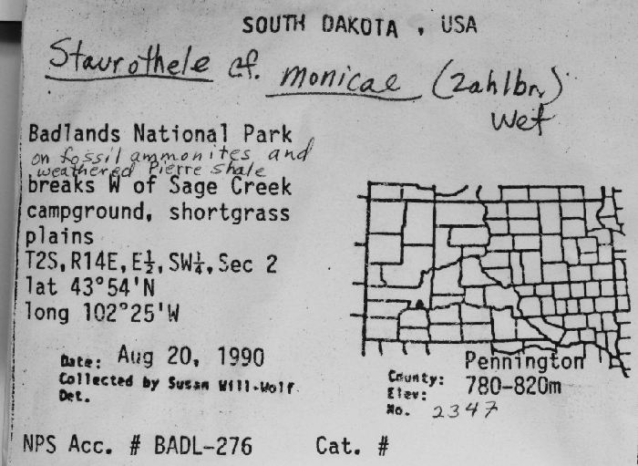
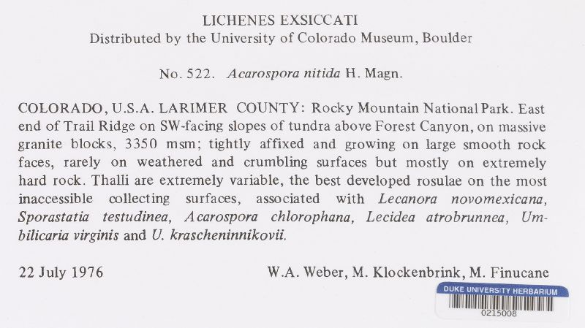
NLP Challenges
Issues
Variable layouts
Loose standards
OCR error
Solutions
Authority tables
Levenshtein distance
Word stats
Format recognition
Parsing profiles
Duplicate harvesting

Slide 13
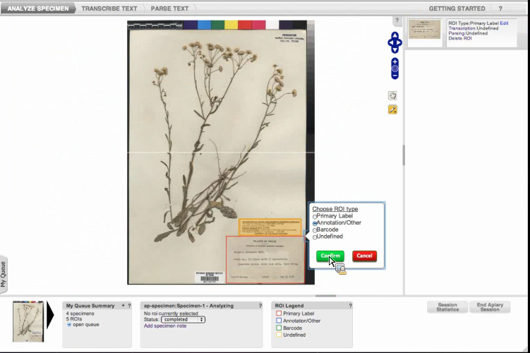
The Apiary Project, BRIT

Slide 14
AOCR Working Group Meeting
plan a hackathon
picking a topic, outlining a course
http://tinyurl.com/aocrHack
outreach and education
iSchools 2013, 4 submissions
iDigBio Wiki OCR effective practices
testing the AOCR VM
remote participants
Notes:
Barbara Thiers, NYBG
Ben Brumfield, FromThePage.com
Michael Denslow, Notes from Nature
Chris Neefus, University of New Hampshire, NEVP TCN
Elspeth Haston, Robyn Drinkwater, Robert Cubey, RGBE
James Cokendolpher, Curator of Invertebrates, Museum of Texas Tech University
“curious about OCR and the potential to read data labels”
Michael Heaney, UF Graduate Student, FLMNH
William Ulate, BHL
Drew Prescott
DFK, Rupert, Stan, “guest”

Slide 15
AOCR Remote Participation
Barbara Thiers, NYBG
Ben Brumfield, FromThePage.com
Michael Denslow, Notes from Nature
Chris Neefus, University of New Hampshire, NEVP TCN
Eduardo Rudas-Burgos, Coordinador Informática de la Biodiversidad, Instituto de Ciencias Naturales, Universidad Nacional de Colombia
Elspeth Haston, Robyn Drinkwater, Robert Cubey, RGBE
James Cokendolpher, Curator of Invertebrates, Museum of Texas Tech University
“curious about OCR and the potential to read data labels”
Michael Heaney, UF Graduate Student, FLMNH
William Ulate, BHL
Drew Prescott
DFK, Rupert, Stan, “guest”

Slide 16
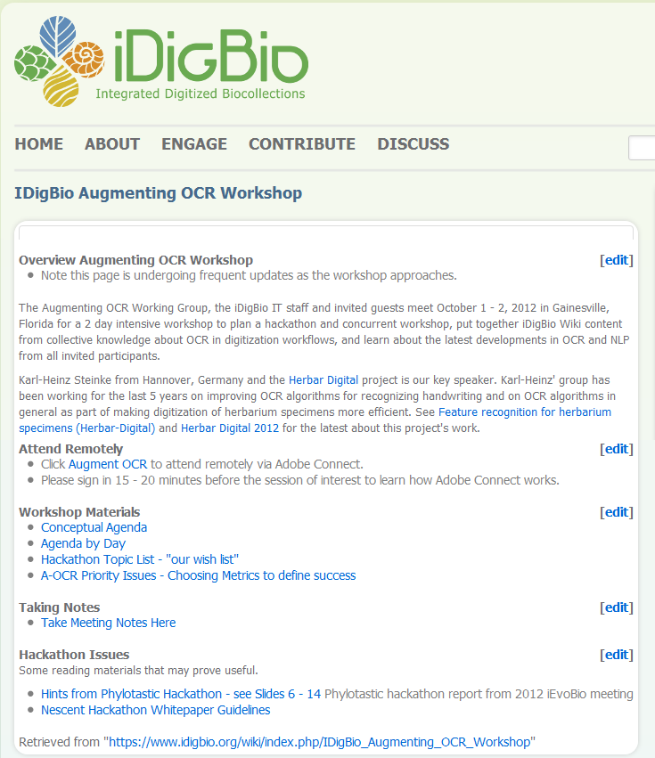
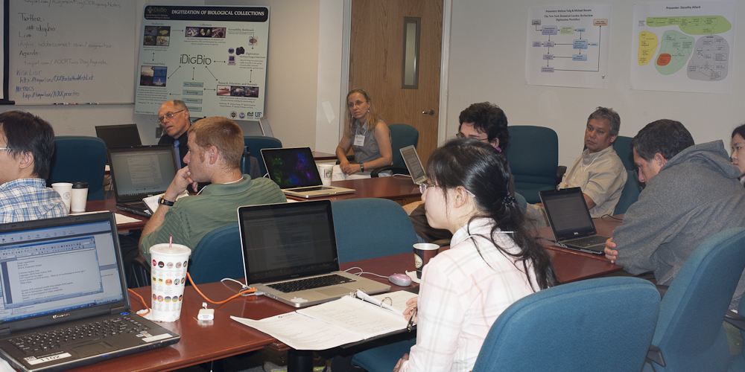
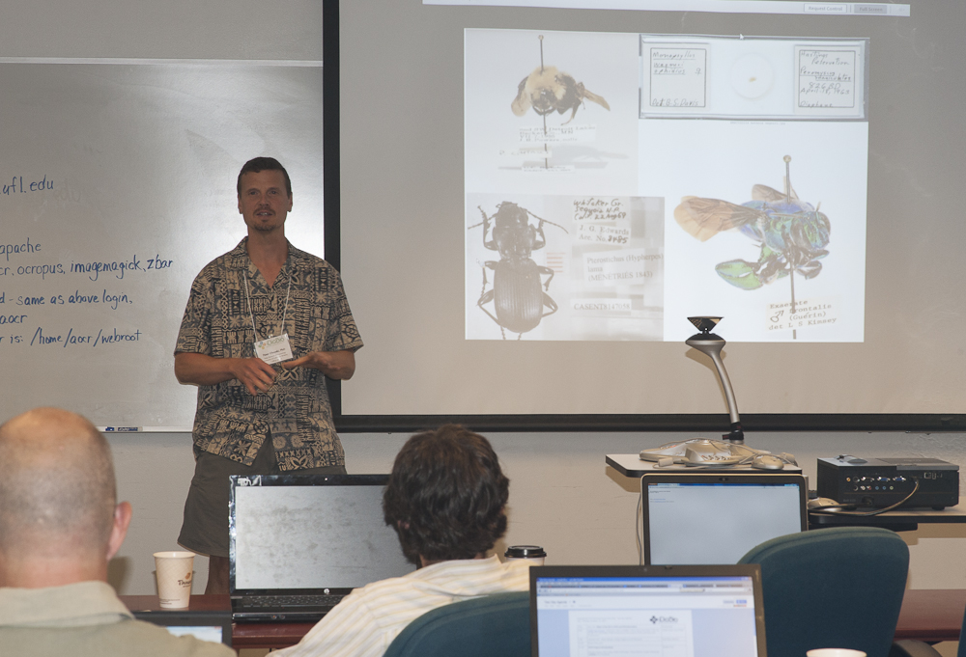
http://tinyurl.com/aocrws

Slide 17
iSchools Conference, February 2013 Help iDigBio Reveal Hidden Data: iDigBio Augmenting OCR Working Group Needs You
workshop panel with break out groups
Jason Best, BRIT
Edward Gilbert, Symbiota
Bryan Heidorn, Herbis / LABELX
William Ulate, BHL
?
report back after hackathon
Notes:
http://www.ischools.org/iConference13/2013index/

Slide 18
AOCR Hacakthon I http://tinyurl.com/aocrHack
When: February 13 – 14, 2013
Where: Botanical Research Institute of Texas (BRIT)
Who: 20 participants, 10 invitees, 10 selected*
What and Why: 2 + goals
compare OCR software 1° output
parsing challenge
collaboration and feedback
insights & solutions to known problems
insights & solutions to OCR limitations
Notes:
Hilmar Lapp, Matt Yoder, Dean Pentcheff,

Slide 19
How to get involved…
Programmers?
Need an OCR workshop or tutorial?
Wondering how OCR might work for your project?
Got a question about OCR, NLP, OCR output, OCR software or images best for OCR?
http://tinyurl.com/aocrForum
Try the software on the AOCR VM?

Slide 20
Thank you from the iDigBio AOCR Working Group
Notes:
#608CB8 R:96 G:140 B:184

Slide 21
Optical Character Recognition
Tesseract V3
Dual cycle
Automatic
Manual review
Expected hurtles
Handwritten labels
Old fonts
Faded labels
Form labels
Adjustable image variables
Â¢_].L.|Â»â€˜Â¢ .'Â».f.'._..â€˜~,(.J
fin-xâ€˜*\'a:"511z:1 wf .~\:'i/.onli State University
P.â€™~.r"~2= ,_. gg J:.2 " J*J*" â€ (=:\â€˜-â€œax "Â»..'\-12
â€˜ â€œ "â€˜ ;T~;â€˜~7i?Â»-1_1_\f;>sf`;,' ESX
ZÂ»ie+â€˜-Â». â€œ~'.Â»te;~:i_.t<Â» ff`t;~f3":.f.â€œ
Â» Â»4 xx, ,
"""â€˜â€œâ€T"â€™ <1;-.rs f3'a,1.z>.t;;aÂ¢f~rus â€™
V4 J 'if . rÂ°'Â° M '1?nies ivain.) Sav.
neutal Station - " '1 ~Â»r';;4-\P ` 1.
T11 ./P.. ,J ..-.
ELEV. ' `.fJL_\ LATL Q _â€˜ 1 _ Yâ€™ DATE
_ ,. W5. (> f- , -:â€˜; i f>i_T ~~ . A 1:
Â». v\ .-v Â»~. 4. a xvala 8/27/73
PLANTS OF NEW r~1ExIco
Herbarium of Arizona State University
Parmelia ulophyllodes (Vain.) Sav.
COUNTY â€œÂ°â€â€œâ€œ
Joranada Experimental Station -
New Mexico State University
"â€œâ€œâ€œ' on Juniperus
ELEV. ‘ 4400
EEILLEETUR DATE
DU T. H. Nash #7914 8/27/73
T. H. N.

