Slide 1
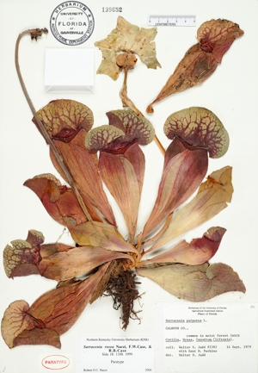
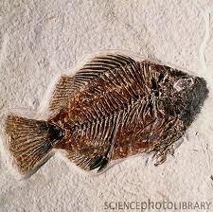
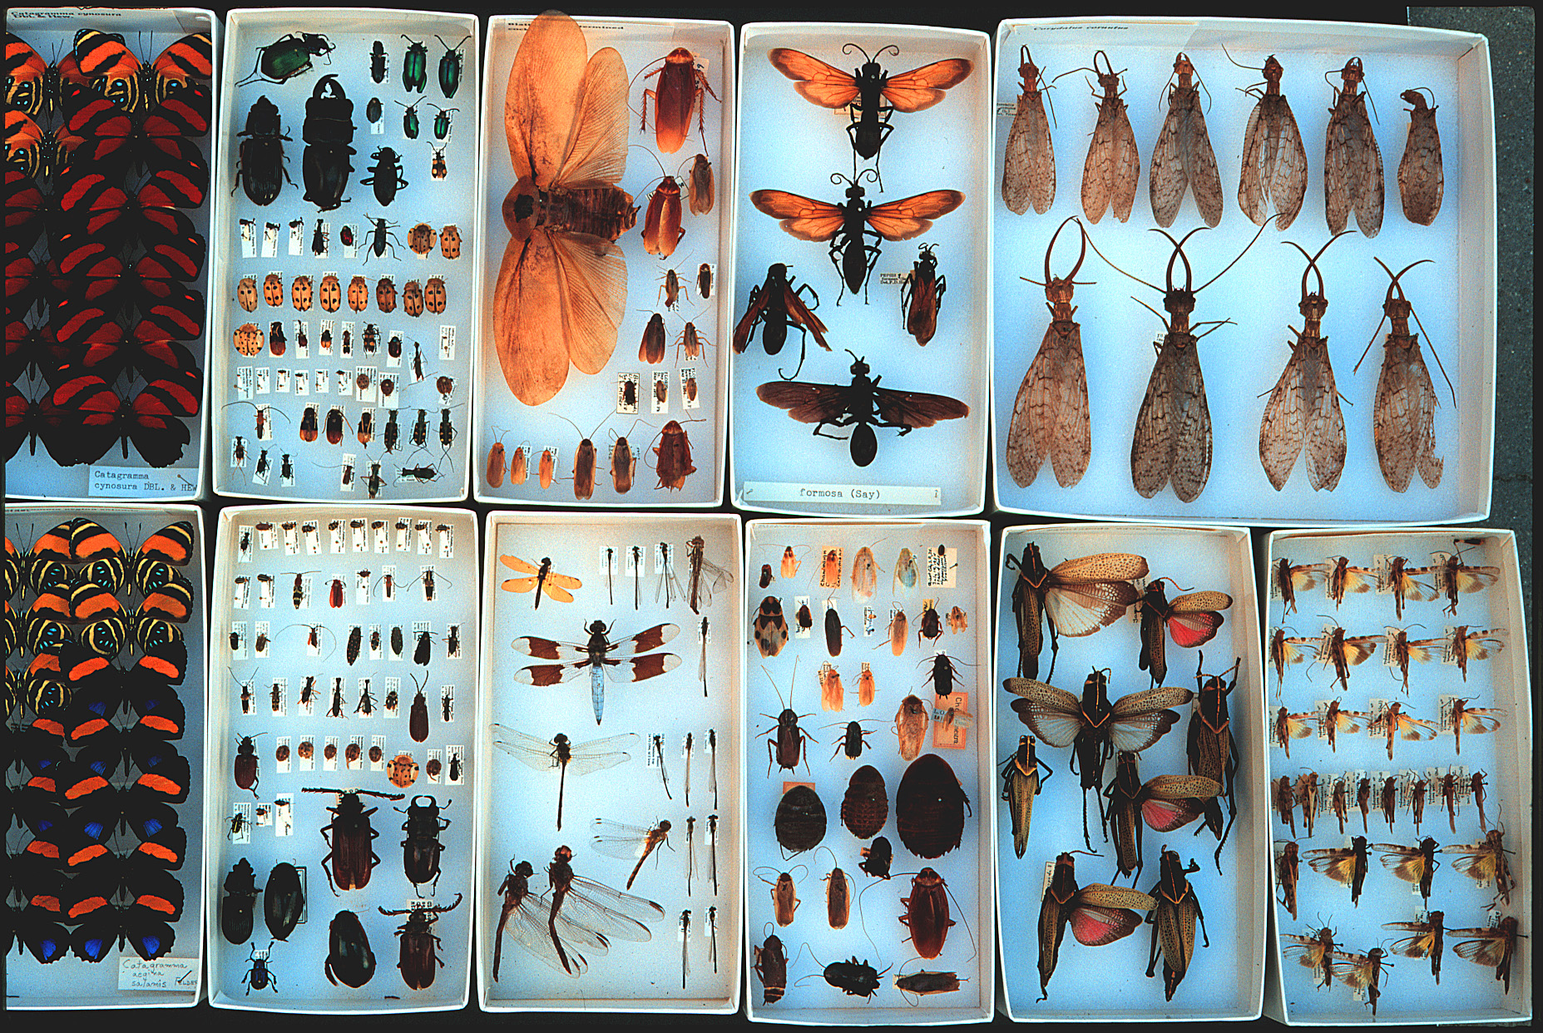
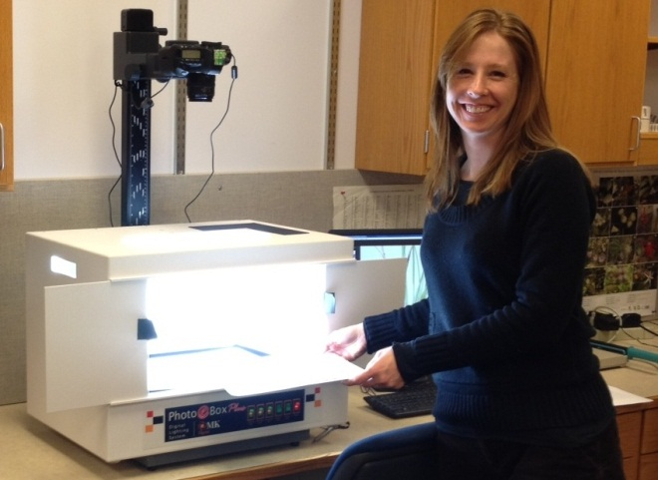
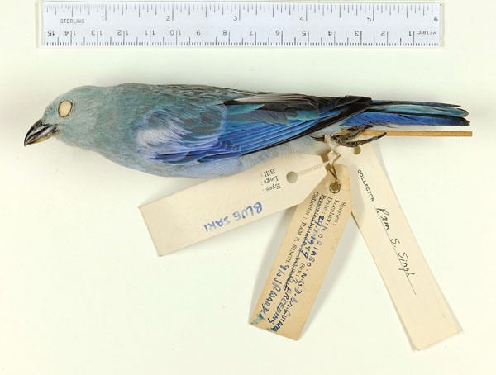
Welcome to
Summit II
University of Florida
Florida State University
NSF EF-1115210

Slide 2
Welcome to
Summit II
University of Florida
Larry Page
Jose Fortes
Bruce MacFadden
Pam Soltis
Florida State University
Greg Riccardi
NSF EF-1115210

Slide 3
Advancing Digitization of Biodiversity Collections
Facilitate use of biodiversity data to address environmental and economic
challenges
Researchers
Educators
General public, citizen scientists
Policy-makers
Enable digitization of biodiversity collections data
Develop efficient and effective digitization standards and workflows
Respond to cyberinfrastructure needs
Provide portal access to data in a cloud-computing environment
Develop research, education and outreach collaborations
Plan for long-term sustainability of the national digitization effort
Expand participation: partners and data sources

Slide 4
Advancing Digitization of Biodiversity Collections
Facilitate use of biodiversity data to address environmental and economic
challenges
Researchers
Educators
General public, citizen scientists
Policy-makers
Enable digitization of biodiversity collections data – Greg Riccardi
Develop efficient and effective digitization standards and workflows
Respond to cyberinfrastructure needs
Provide portal access to data in a cloud-computing environment
Develop research, education and outreach collaborations
Plan for long-term sustainability of the national digitization effort
Expand participation: partners and data sources

Slide 5
Advancing Digitization of Biodiversity Collections
Facilitate use of biodiversity data to address environmental and economic
challenges
Researchers
Educators
General public, citizen scientists
Policy-makers
Enable digitization of biodiversity collections data – Greg Riccardi
Develop efficient and effective digitization standards and workflows
Respond to cyberinfrastructure needs – Jose Fortes
Provide portal access to data in a cloud-computing environment
Develop research, education and outreach collaborations
Plan for long-term sustainability of the national digitization effort
Expand participation: partners and data sources

Slide 6
Advancing Digitization of Biodiversity Collections
Facilitate use of biodiversity data to address environmental and economic
challenges
Researchers
Educators
General public, citizen scientists
Policy-makers
Enable digitization of biodiversity collections data – Greg Riccardi
Develop efficient and effective digitization standards and workflows
Respond to cyberinfrastructure needs – Jose Fortes
Provide portal access to data in a cloud-computing environment
Develop research, education and outreach collaborations – Bruce MacFadden & Pam Soltis
Plan for long-term sustainability of the national digitization effort
Expand participation: partners and data sources

Slide 7
Advancing Digitization of Biodiversity Collections
Facilitate use of biodiversity data to address environmental and economic
challenges
Researchers
Educators
General public, citizen scientists
Policy-makers
Enable digitization of biodiversity collections data – Greg Riccardi
Develop efficient and effective digitization standards and workflows
Respond to cyberinfrastructure needs – Jose Fortes
Provide portal access to data in a cloud-computing environment
Develop research, education and outreach collaborations – Bruce MacFadden & Pam Soltis
Plan for long-term sustainability of the national digitization effort
Expand participation: partners and data sources – L. Page, et al.

Slide 8
iDigBio TEAM
Larry Page, Lead PI
Greg Riccardi, Director for Informatics
Jose Fortes, Director for Cyberinfrastructure
Bruce MacFadden, Director for Education and Outreach
Pam Soltis, Director for Research
David Jennings, Project Manager
Joanna McCaffrey, Biodiversity Informatics Manager
Austin Mast, Senior Personnel
Renato Figueiredo, Senior Personnel
Andrea Matsunaga, Senior Personnel
Alex Thompson, Kevin Love, Matt Collins, IT Experts
Gil Nelson & Deb Paul, Digitization Specialists
Betty Dunckel, Informal Science Education
Shari Ellis, Evaluation

Slide 9
Seven Thematic Collections Networks (TCNs)
InvertNet: An Integrative Platform for Research on Environmental Change, Species Discovery and
Identification (Illinois Natural History Survey, University of Illinois) http://invertnet.org
Plants, Herbivores, and Parasitoids: A Model System for the Study of Tri-Trophic Associations (American Museum of Natural History) http://tcn.amnh.org
North American Lichens and Bryophytes: Sensitive Indicators of Environmental Quality and Change (University of Wisconsin – Madison) http://symbiota.org/nalichens/index.php http://symbiota.org/bryophytes/index.php
Digitizing Fossils to Enable New Syntheses in Biogeography-Creating a PALEONICHES-TCN (University of Kansas)
The Macrofungi Collection Consortium: Unlocking a Biodiversity Resource for Understanding Biotic Interactions, Nutrient Cycling and Human Affairs (New York Botanical Garden)
http:/www.nybg.org/science/new_20120723.php
Mobilizing New England Vascular Plant Specimen Data to Track Environmental Change (Yale University)
http://herbarium.peabody.yale.edu/NEVP
Southwest Collections of Arthropods Network (SCAN): A Model for Collections Digitization to Promote
Taxonomic and Ecological Research (Northern Arizona University) http://scanbugs.org/index.html

Slide 10
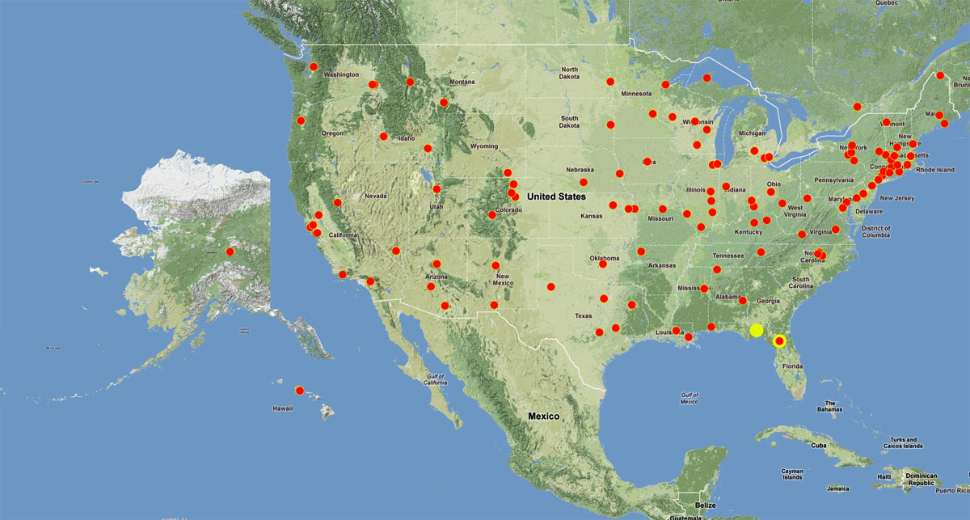
130 institutions
in 48 states

Slide 11
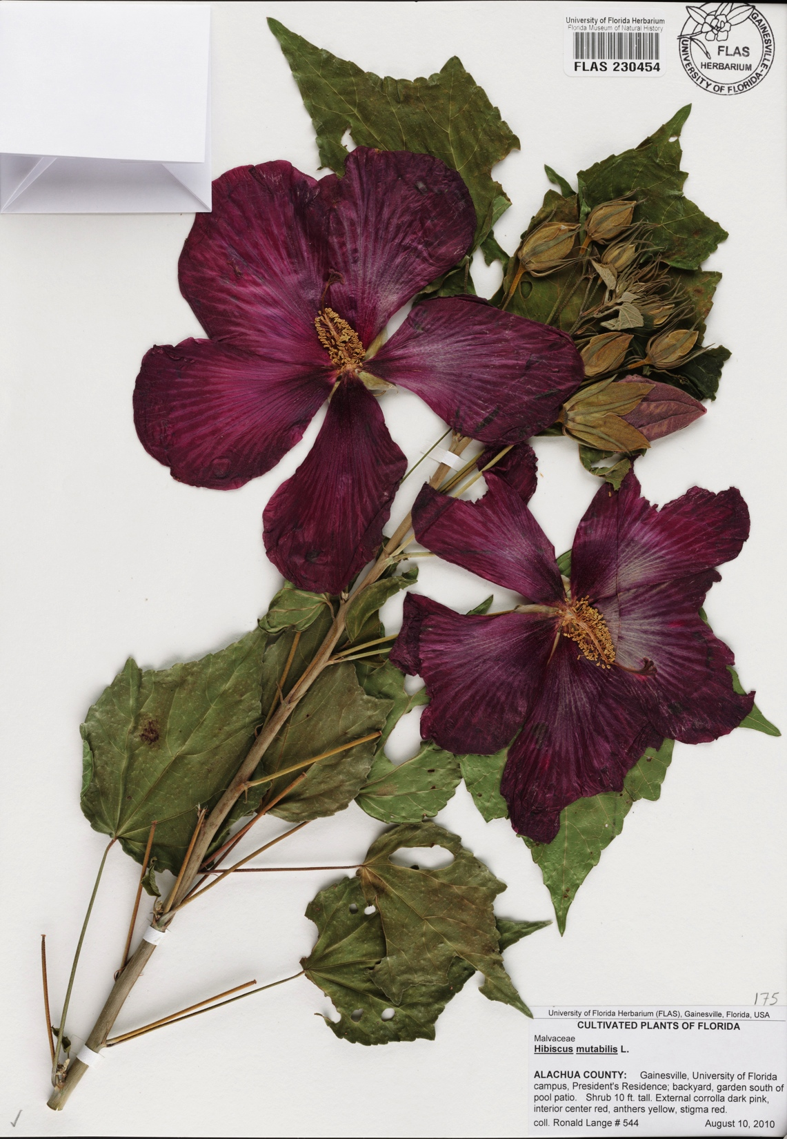
iDigBio: Year 1 Building Teams and Cyberinfrastructure
Collections Community & IT Experts
Surveys, working groups, workshops, person-to-person
Reliance on standards and proven solutions
Continuous consultation with stakeholders
4 workshops in Year 1
6 workshops already in Year 2
a total of 239 individuals from 126 institutions
9-11 workshops proposed

Slide 12
Active Working Groups
1. Augmenting OCR (aOCR)
2. Cyberinfrastructure
3. Developing Robust Object to Image to Data (DROID1)
4. Developing Robust Object to Image to Data (DROID2)
Developing Robust Object to Image to Data (DROID3)
Georeferencing Working Group (GWG)
Minimum Information Standards, Authority Files
Paleocollections
Public Participation in Digitization

Slide 13
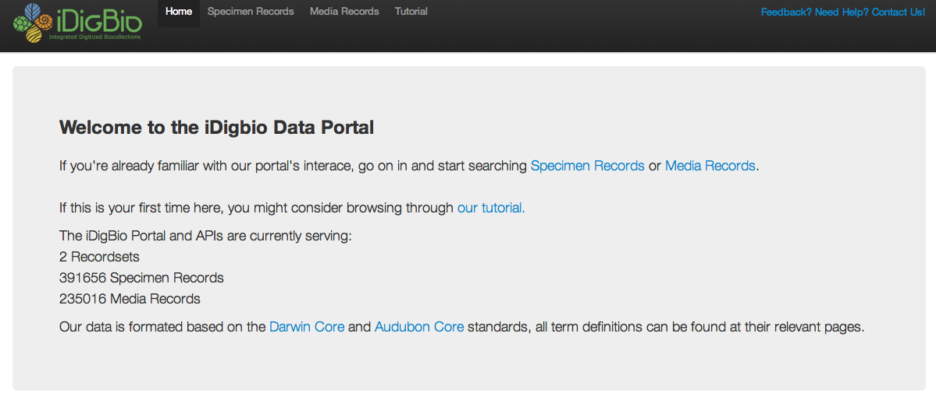
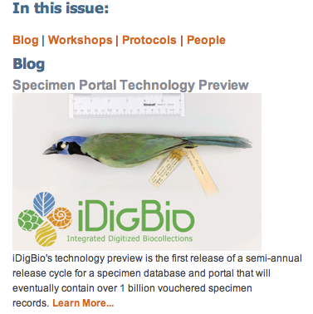
iDigBio Data Portal v.0

Slide 14
iDigBio: Year 2
Continue Emphasis on Digitization and Cyberinfrastructure
And -
Develop research, educational, outreach opportunities
and collaborations
Work to integrate with federal collections
Explore international opportunities
Long-term sustainability of national digitization effort

Slide 15
iDigBio: Year 2
Continue Emphasis on Digitization and Cyberinfrastructure
And:
Develop research, educational, outreach opportunities
and collaborations
Work to integrate with federal collections
Explore international opportunities
Long-term sustainability of national digitization effort
Increasing activities with collections community
Symposium co-sponsored by NSCA at SPNHC in June

Slide 16
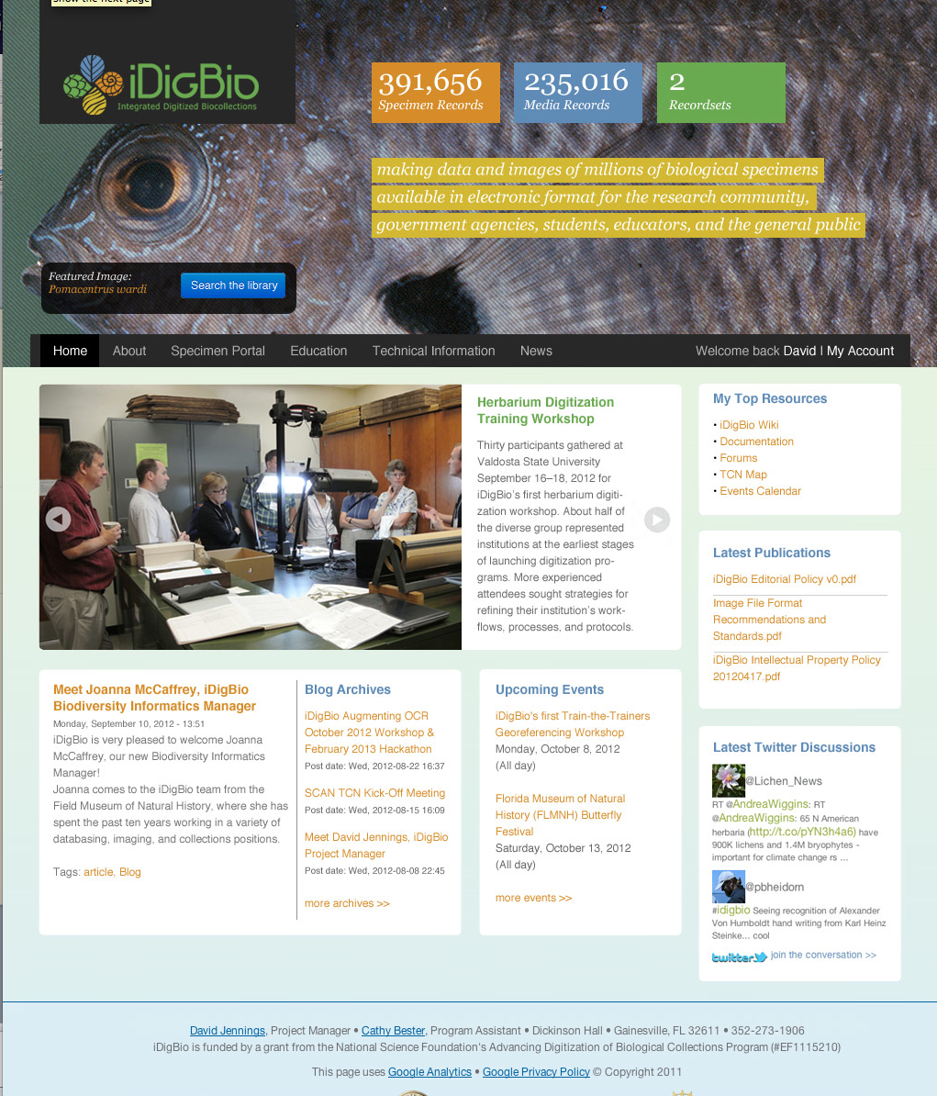

Slide 17
‘Grand Challenges’
in science and in society

Slide 18
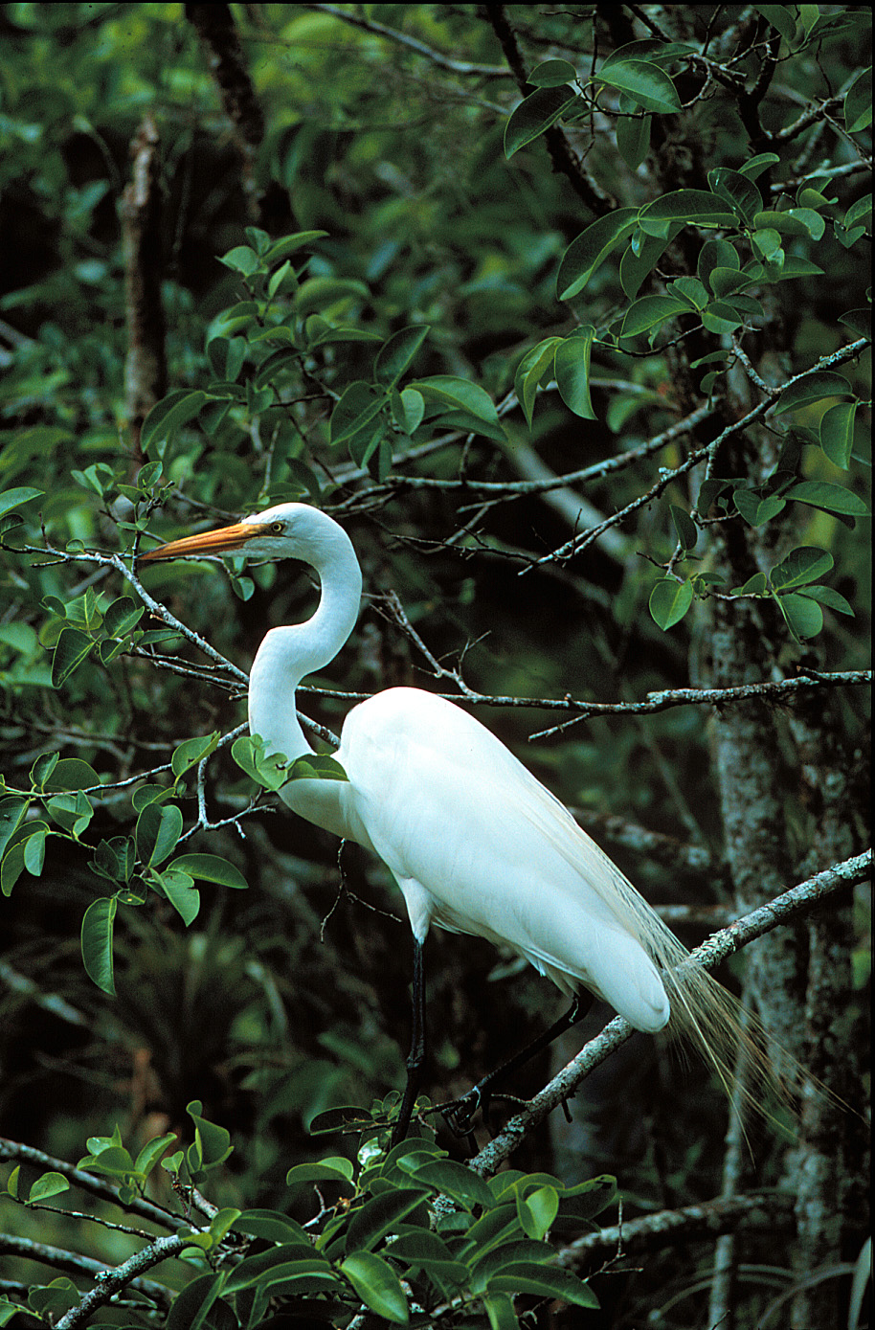
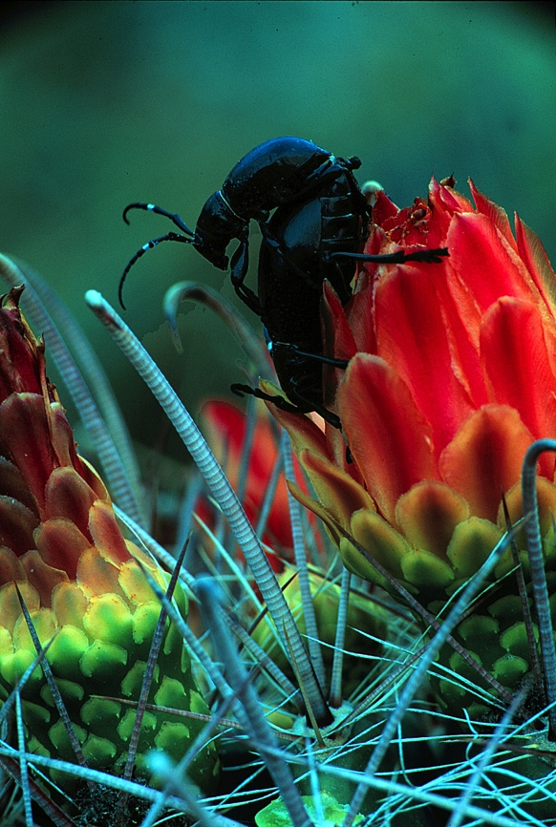
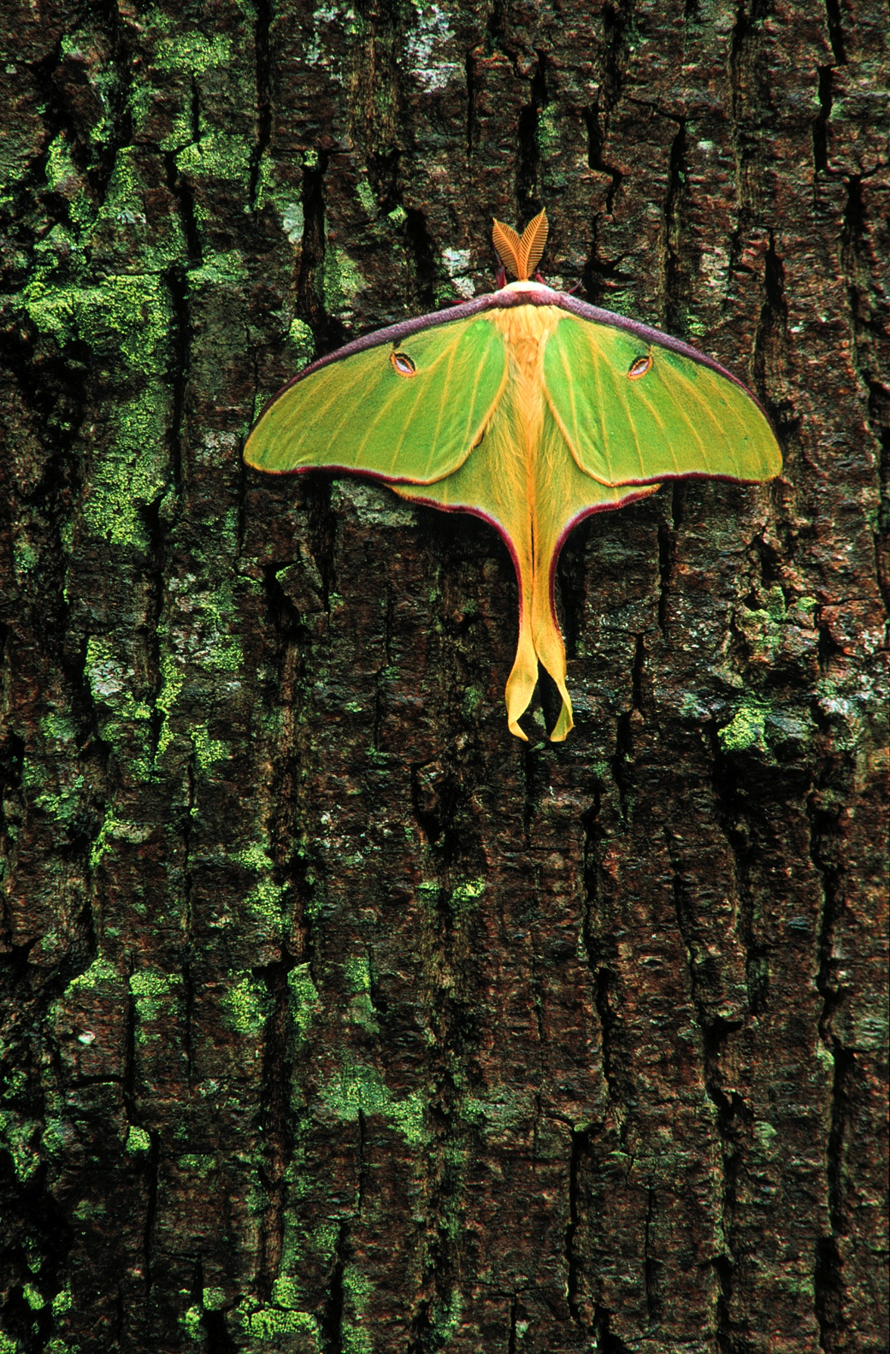
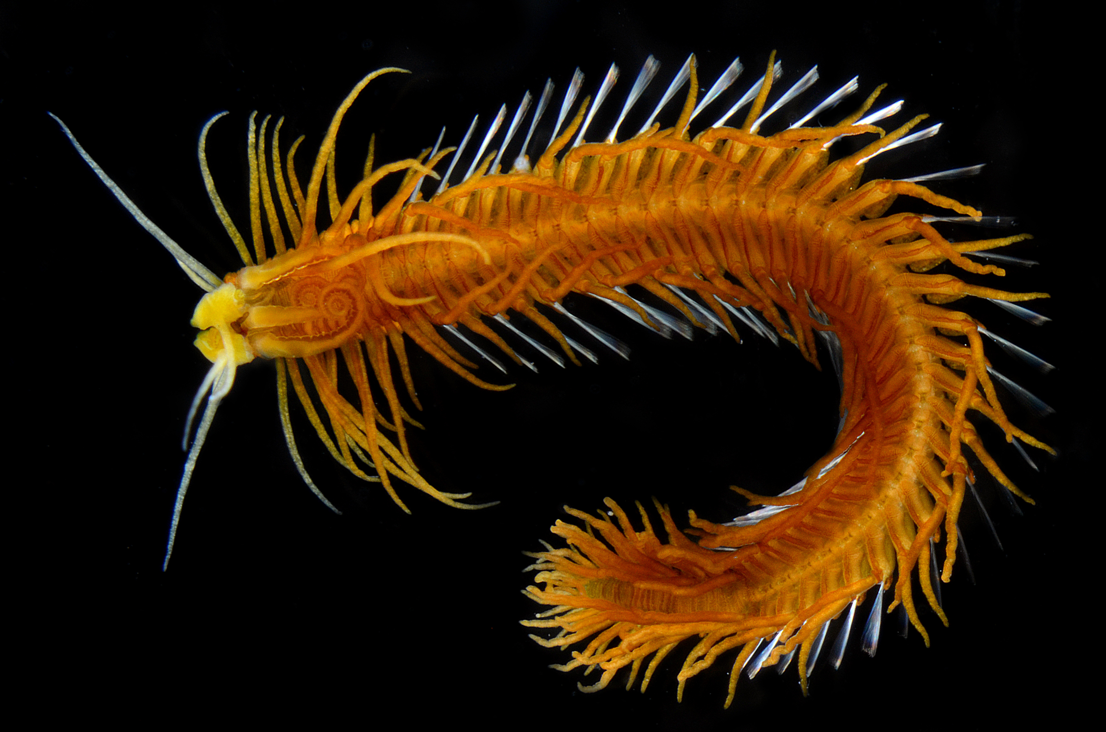
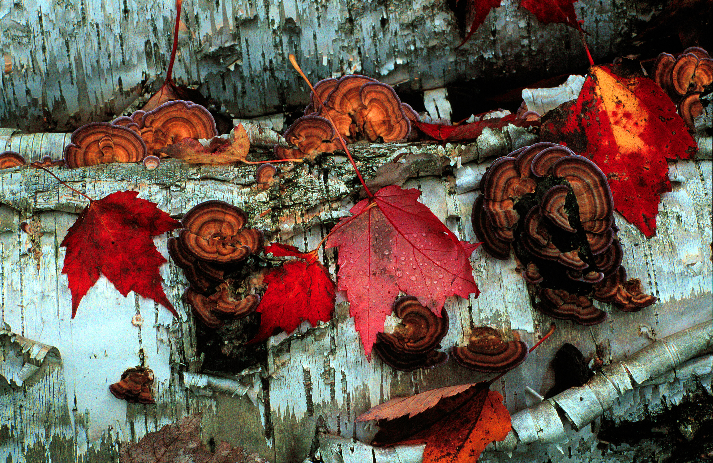
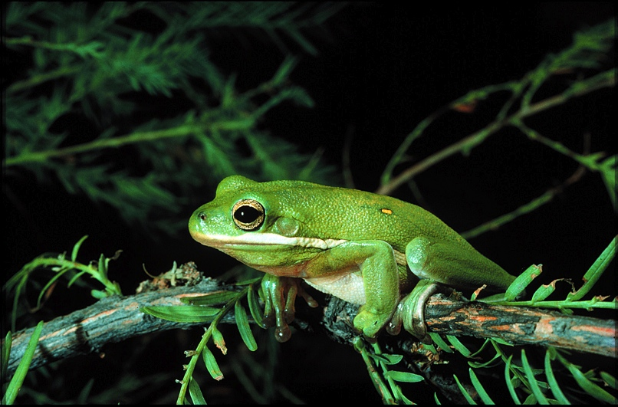
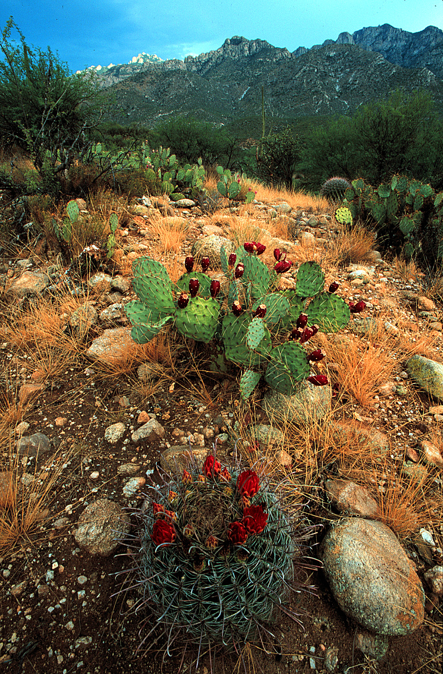
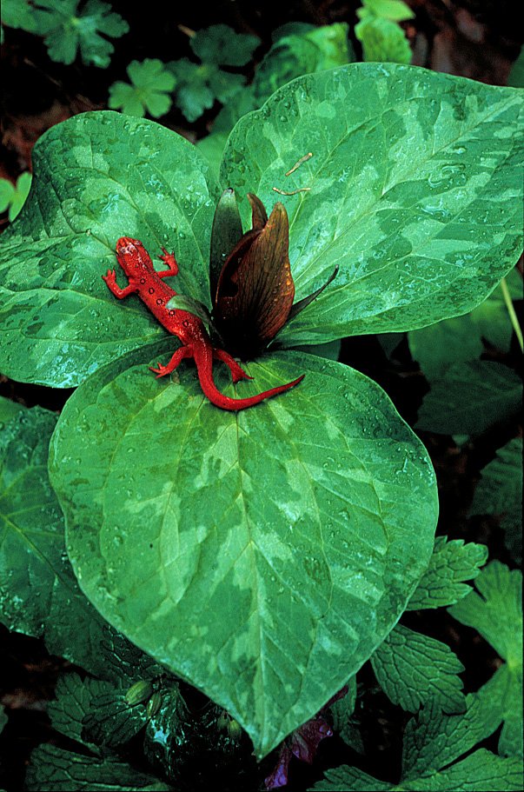
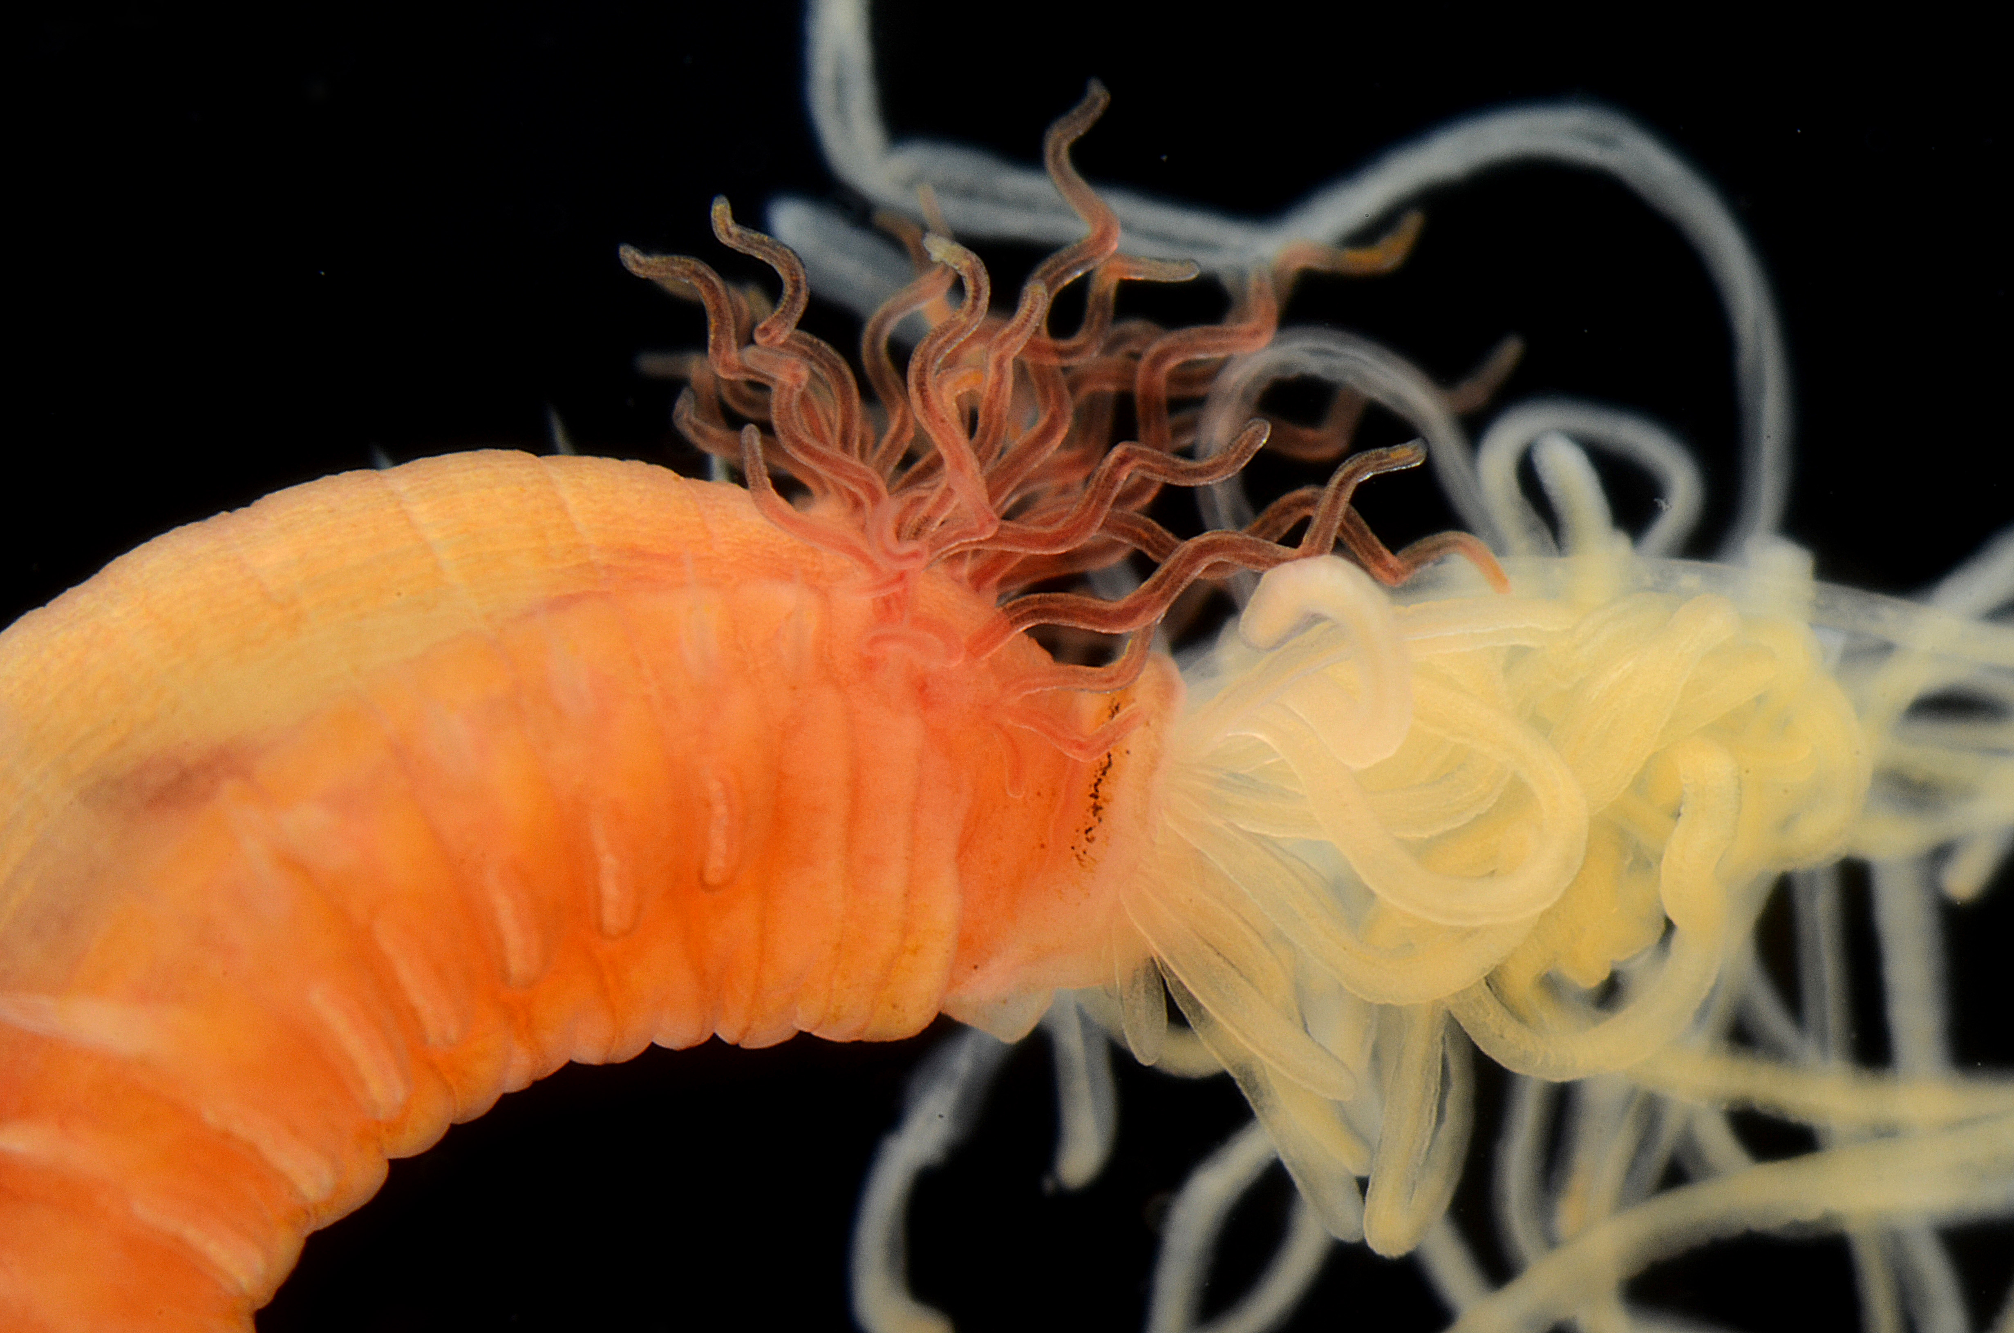
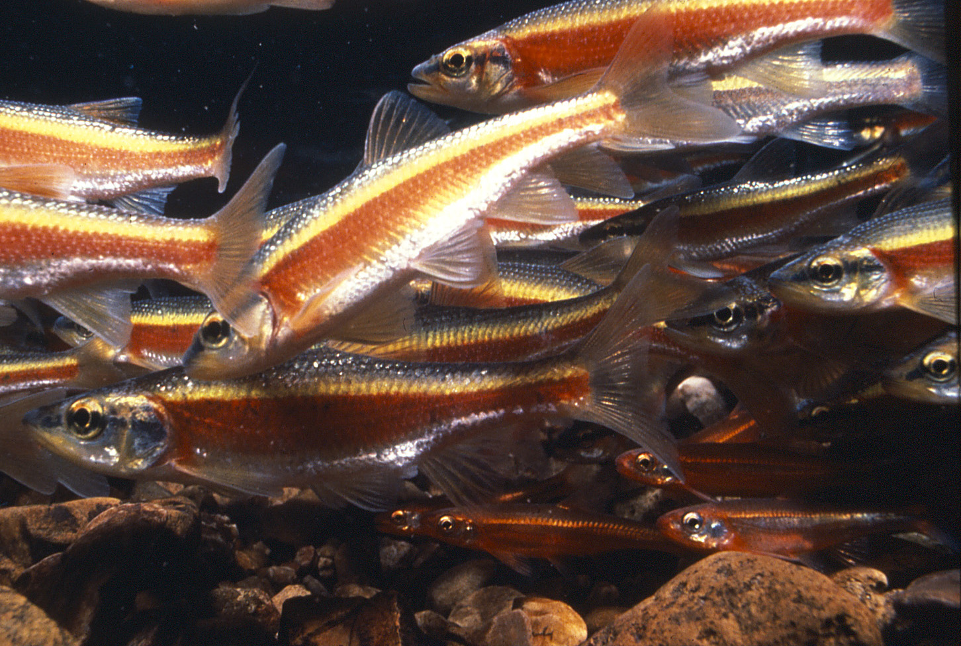
BIODIVERSITY
Photos: M. Jeffords
& G. Paulay

Slide 19
‘Grand Challenges’
in science and in society
Species extinction and the degradation of ecosystems
are proceeding rapidly -- and the pace is accelerating.
The world is losing species at a rate that is 100 to 1000
times faster than the natural extinction rate.

Slide 20
‘Grand Challenges’
in science and in society
Species extinction and the degradation of ecosystems
are proceeding rapidly and the pace is accelerating.
The world is losing species at a rate that is 100 to 1000
times faster than the natural extinction rate.
“The biodiversity crisis: Worse than climate change”
United Nations 2012

Slide 21
Advancing Digitization of Biodiversity Collections
Provide access to information that clearly and directly
documents the value of biodiversity to humans

Slide 22
Advancing Digitization of Biodiversity Collections
Provide access to information that clearly and directly
documents the value of biodiversity to humans
UN established a new Biodiversity Panel equivalent to the UN
panel on climate change
IPBES (Intergovernmental Platform for Biodiversity and Ecosystem Services)

Slide 23
Advancing Digitization of Biodiversity Collections
Provide access to information that clearly and directly
documents the value of biodiversity to humans
Document the value of biological collections as a primary
source of that information
iDigBio – Collections Community – AIBS – NSCA – SPNHC

Slide 24
iDigBio TEAM
Larry Page, Lead PI
Jose Fortes, Director for Cyberinfrastructure
Greg Riccardi, Director for Informatics
Bruce MacFadden, Director for Education and Outreach
Pam Soltis, Director for Research
David Jennings, Project Manager
Joanna McCaffrey, Biodiversity Informatics Manager
Austin Mast, Senior Personnel
Renato Figueiredo, Senior Personnel
Andrea Matsunaga, Senior Personnel
Alex Thompson, Kevin Love, Matt Collins, IT Experts
Gil Nelson & Deb Paul, Digitization Specialists
Betty Dunckel, Informal Science Education
Shari Ellis, Evaluation
Thank you
This material is based upon work supported by the National Science Foundation under Cooperative Agreement EF-1115210. Any opinions, findings,
and conclusions or recommendations expressed in this material are those of the author(s) and do not necessarily reflect the views of the NSF.

Slide 25
Year 2
University of Florida
Florida State University

