Slide 1


Optimizing Digitization
Gil Nelson
(on behalf of the WG)
iDigBio Summit, Gainesville
October 23- 24, 2012

Slide 2
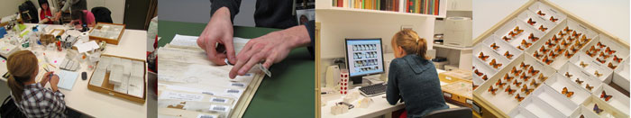
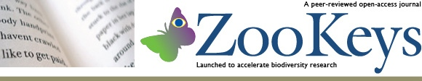

Digitizing Biological Collections
Assessing Digitization Practices in Biological and Paleontological Collections
28 Collections
10 Museums
Spanning biological and paleontological collections
Insects and other invertebrates, plants, birds, mammals
Wet, dry
Five task clusters that enable efficient and effective digitization of biological collections
Gil Nelson, Deborah Paul, Gregory Riccardi, Austin R. Mast
Institute for Digital Information & Scientific Communication – Florida State University

Slide 3
Digitizing Biological Collections
Personnel
Task Clusters
(modules)
Georeferencing
OCR
Image Capture
Image Processing
Pre-digitization Curation
or “Staging”
Data Capture
Image/Data
Storage
Written
Protocols
Biodiversity informatics Manager
Institute for Digital Information & Scientific Communication – Florida State University

Slide 4
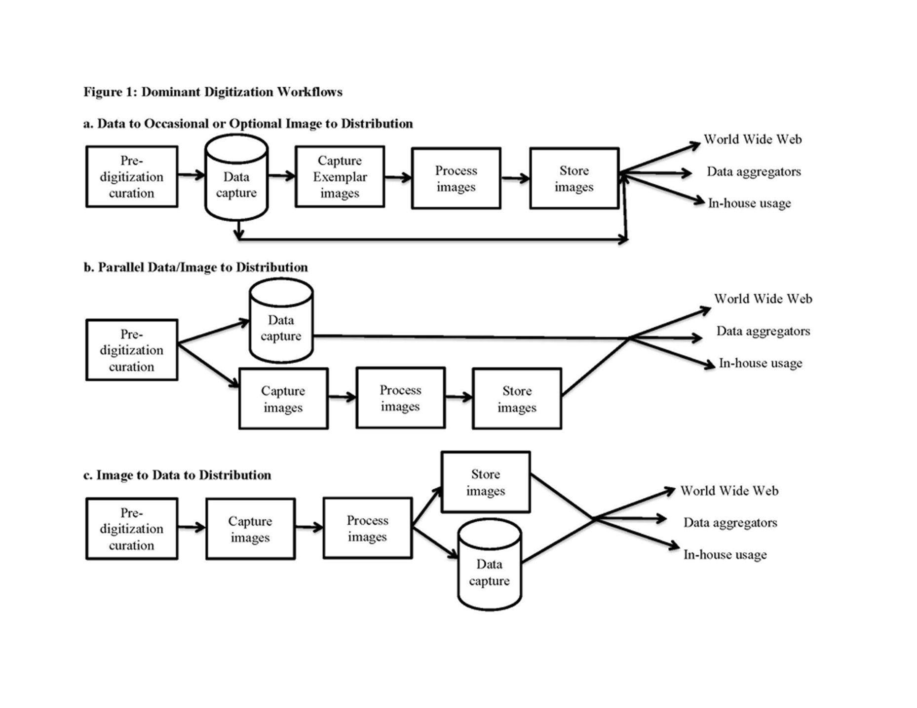
Digitizing Biological Collections
Dominant Digitization Patterns Observed
Institute for Digital Information & Scientific Communication – Florida State University

Slide 5
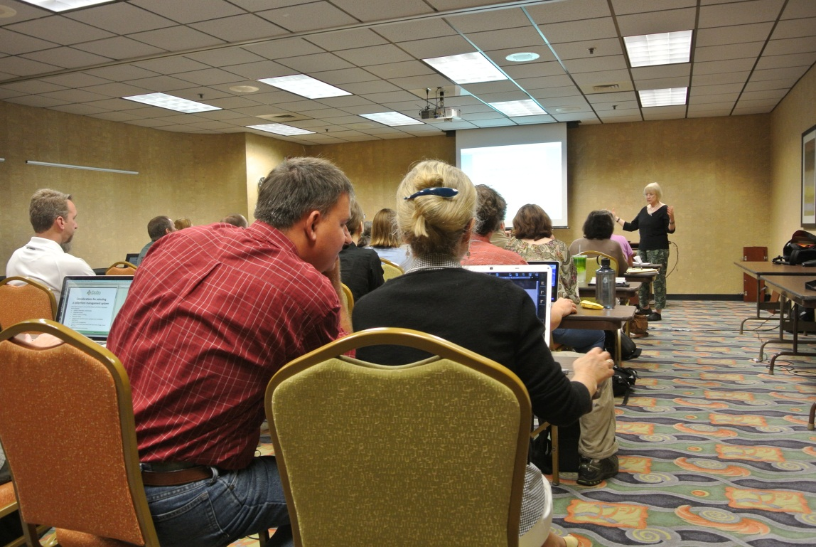
Digitization Workshops and Working Groups
• DROID workshop began development of workflow modules and tasks.
• Initiated a series of workflow working groups, segmented by preparation type.
• The Flat Sheets and Packets Working Group has completed modules and associated tasks for herbarium and related collections.
• The Pinned Things in Trays and Drawers working groups is now developing workflow modules and tasks.
• Conducted the first of five digitization training workshops focused on helping collections managers to get started with digitization.
• Developed a digitization training workshop Wiki to provide digitization resources for all discipline types.
• Supporting digitization workshops in the use of field books for rapid digitization.
• Supporting digitization workshop at the Association of Southeastern Biologists meeting.
Institute for Digital Information & Scientific Communication – Florida State University

Slide 6
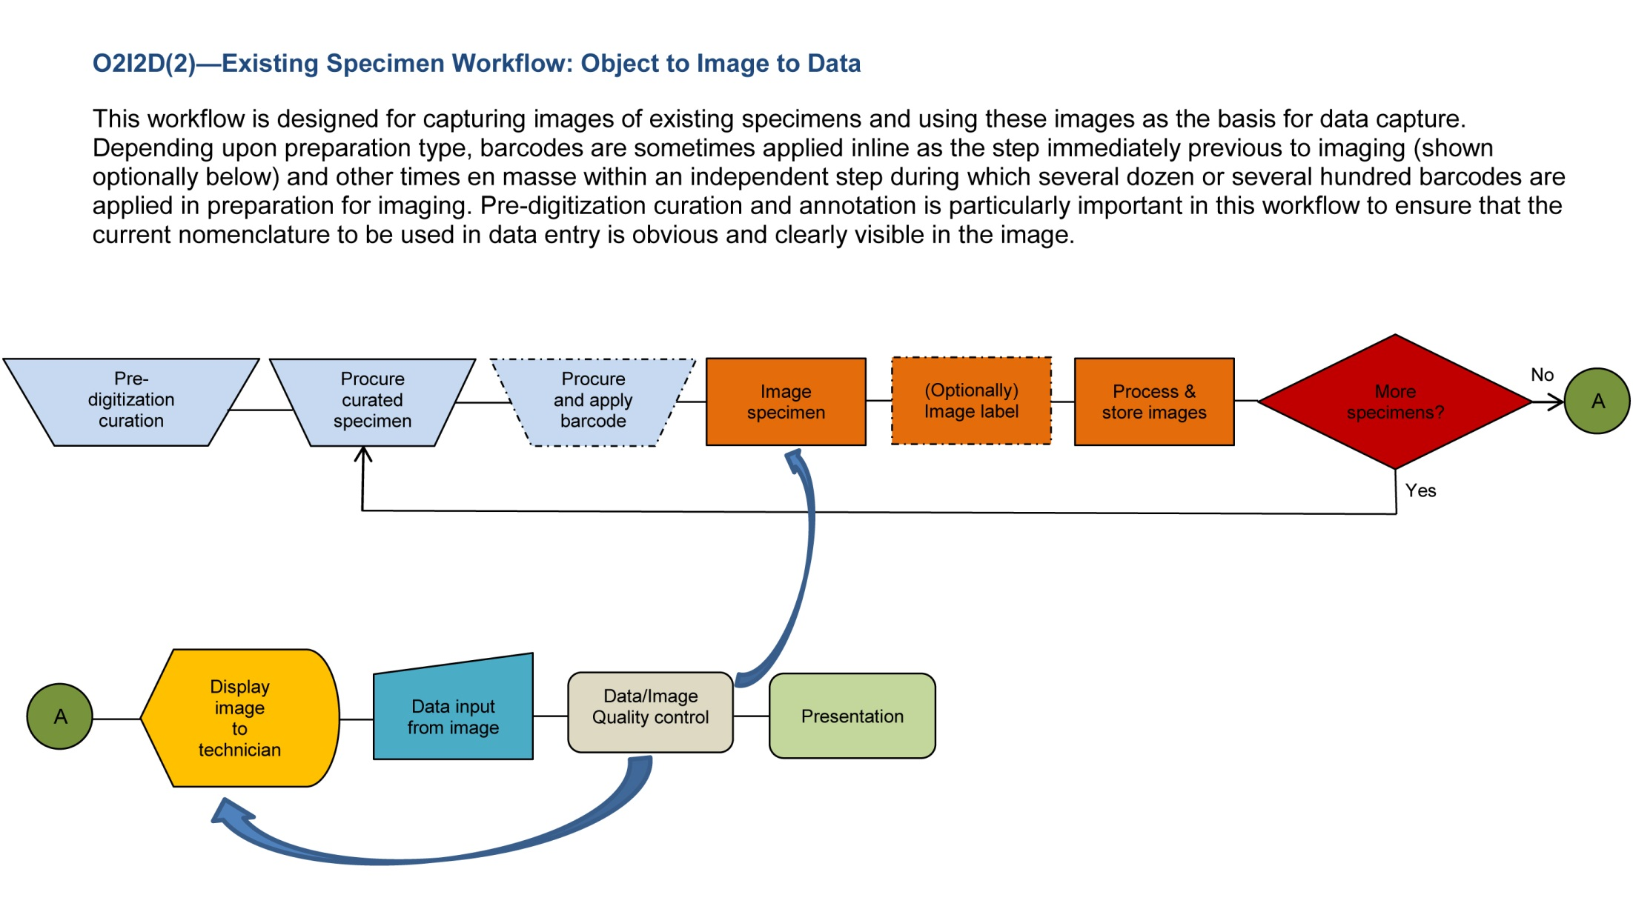
Herbarium Digitization Workshop
Institute for Digital Information & Scientific Communication – Florida State University

Slide 7
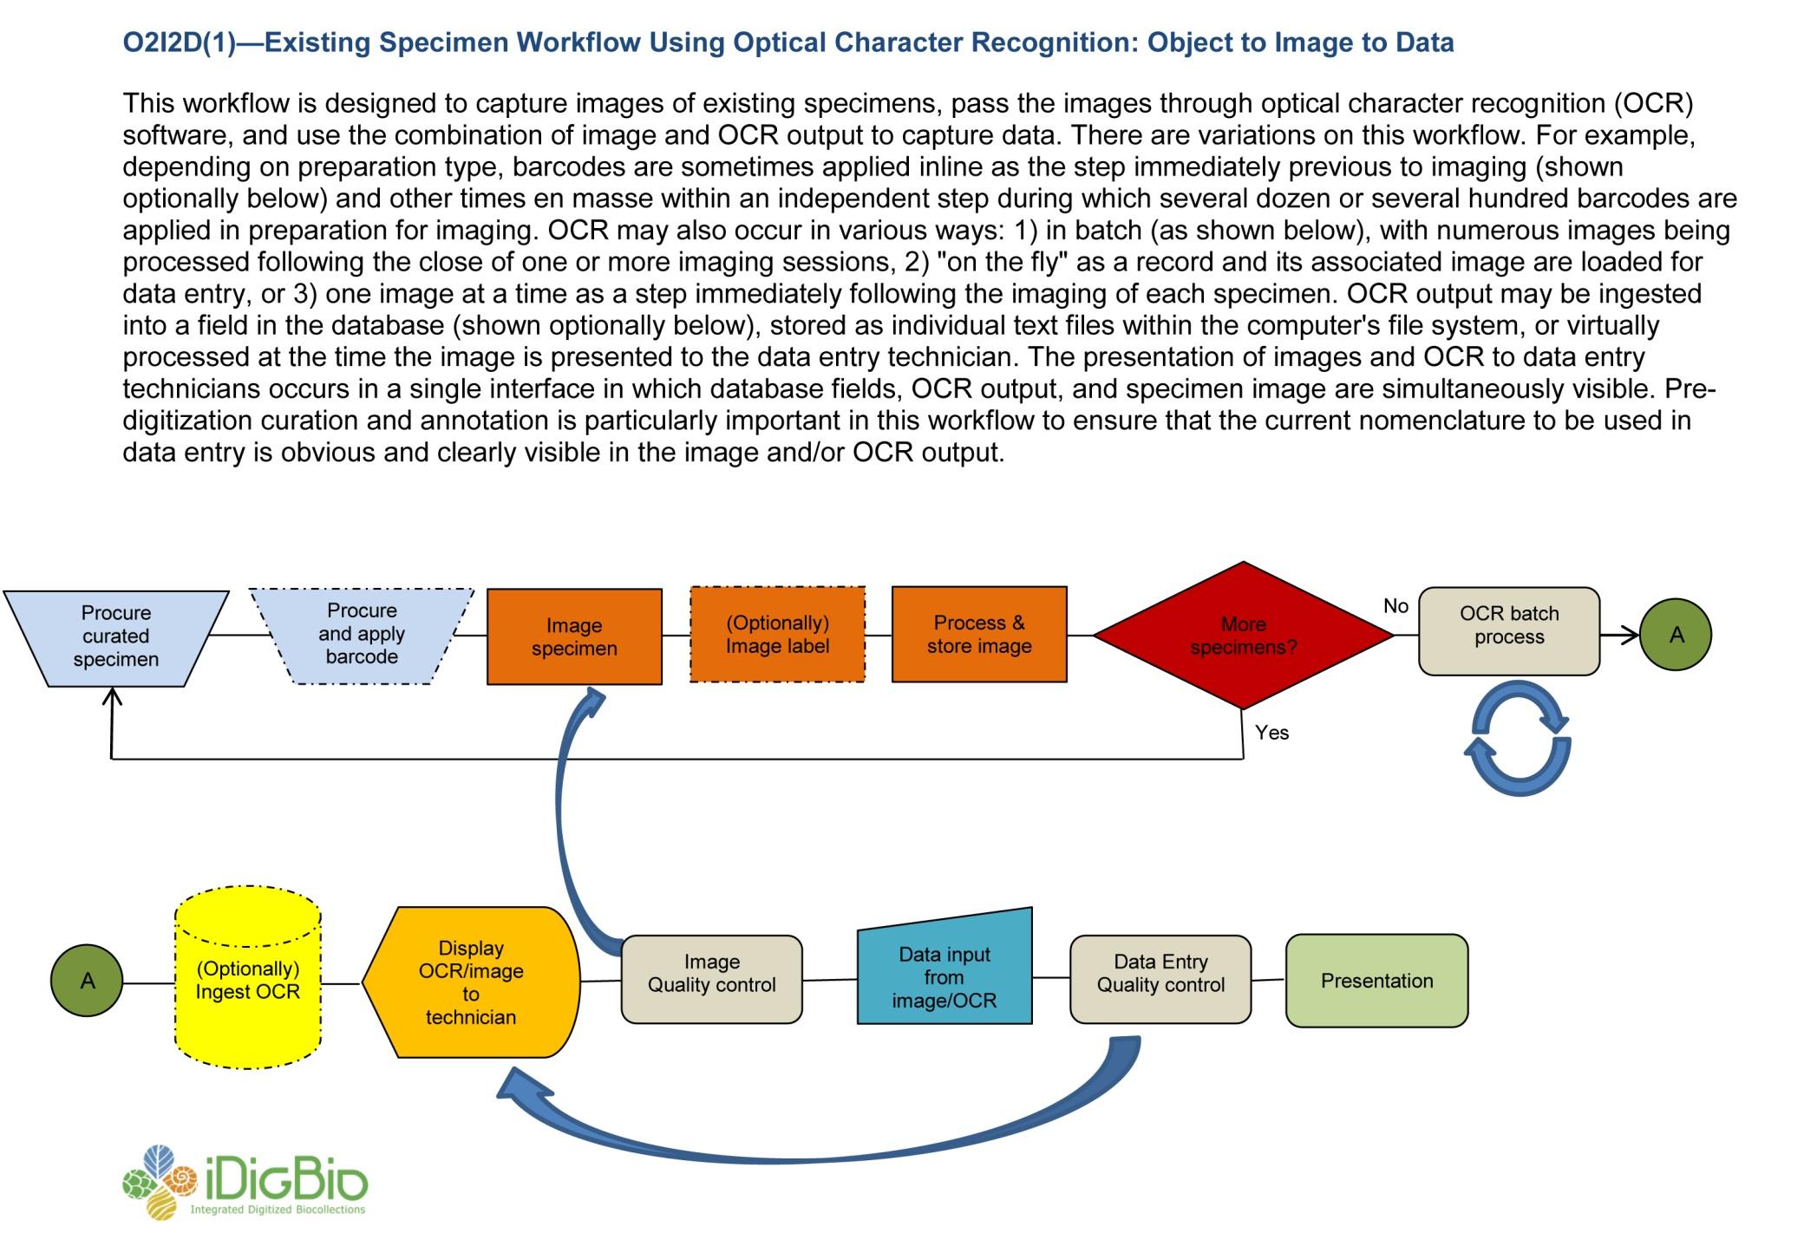
Herbarium Digitization Workshop
Institute for Digital Information & Scientific Communication – Florida State University

Slide 8
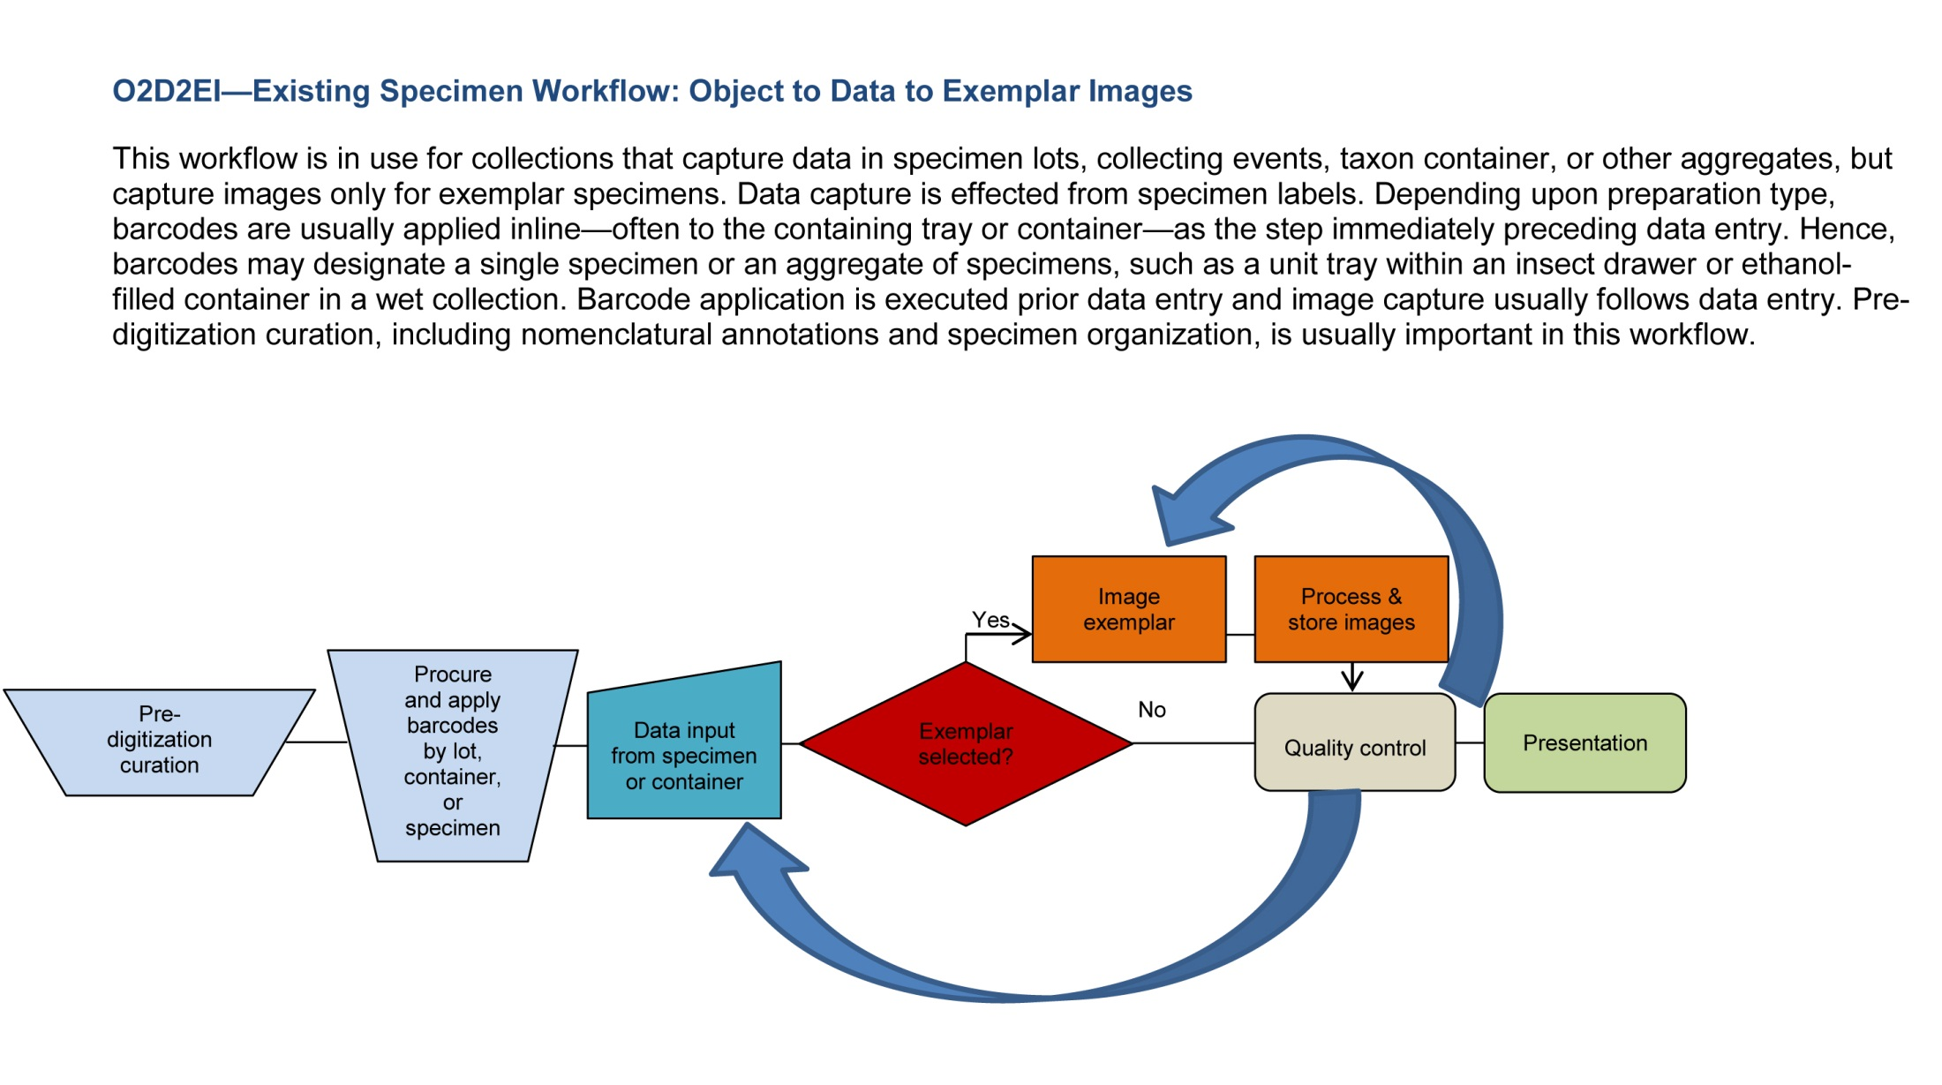
Herbarium Digitization Workshop
Institute for Digital Information & Scientific Communication – Florida State University

Slide 9
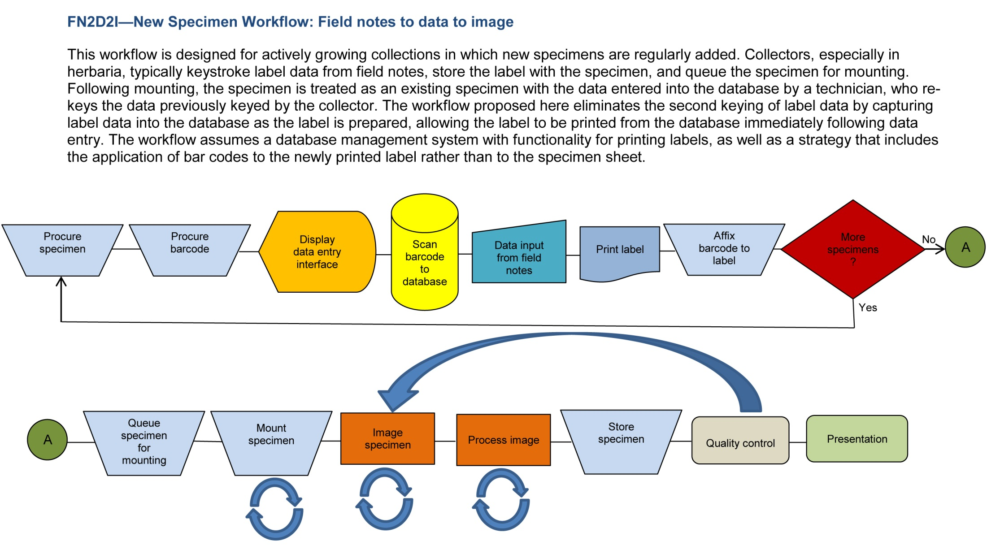
Herbarium Digitization Workshop
Institute for Digital Information & Scientific Communication – Florida State University

Slide 10
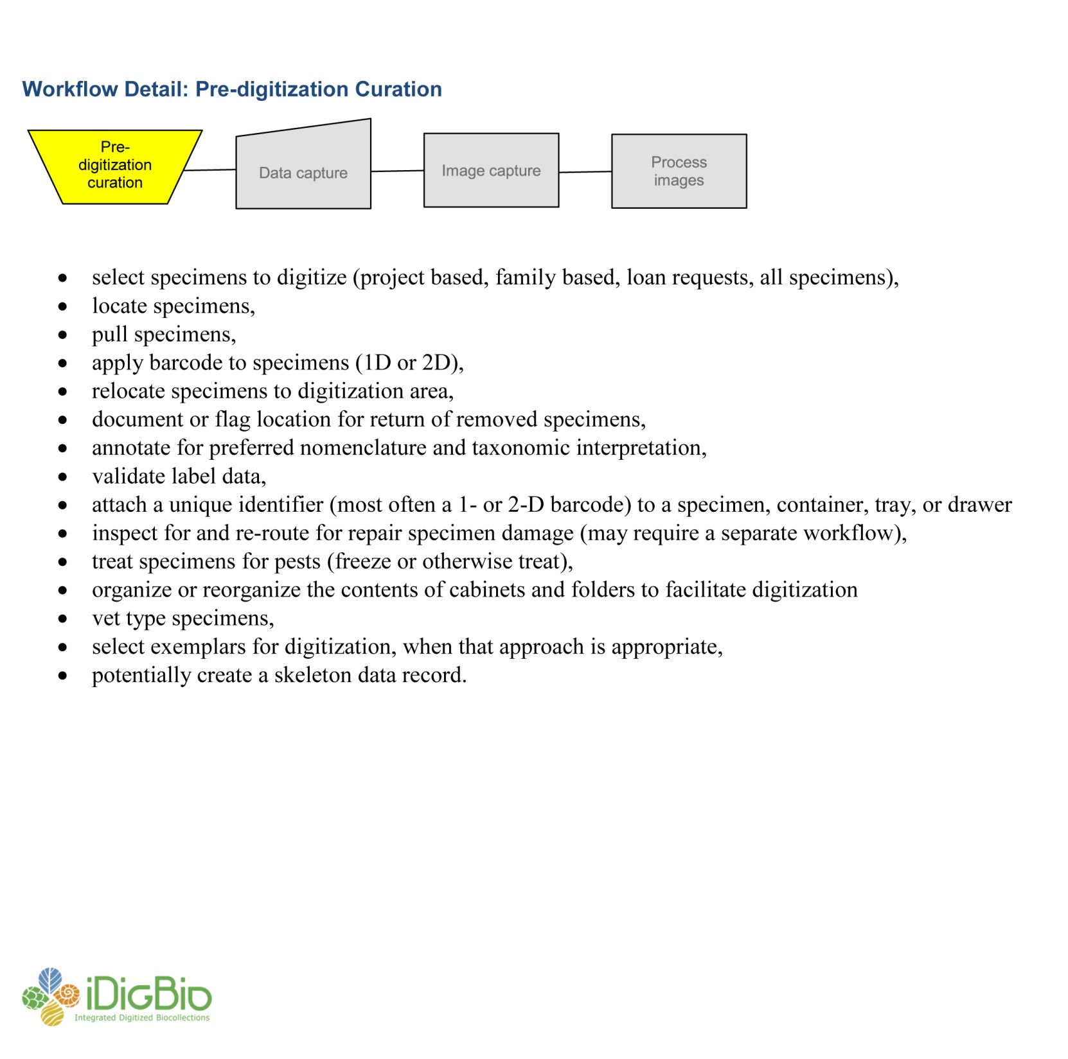
Herbarium Digitization Workshop
Institute for Digital Information & Scientific Communication – Florida State University

Slide 11
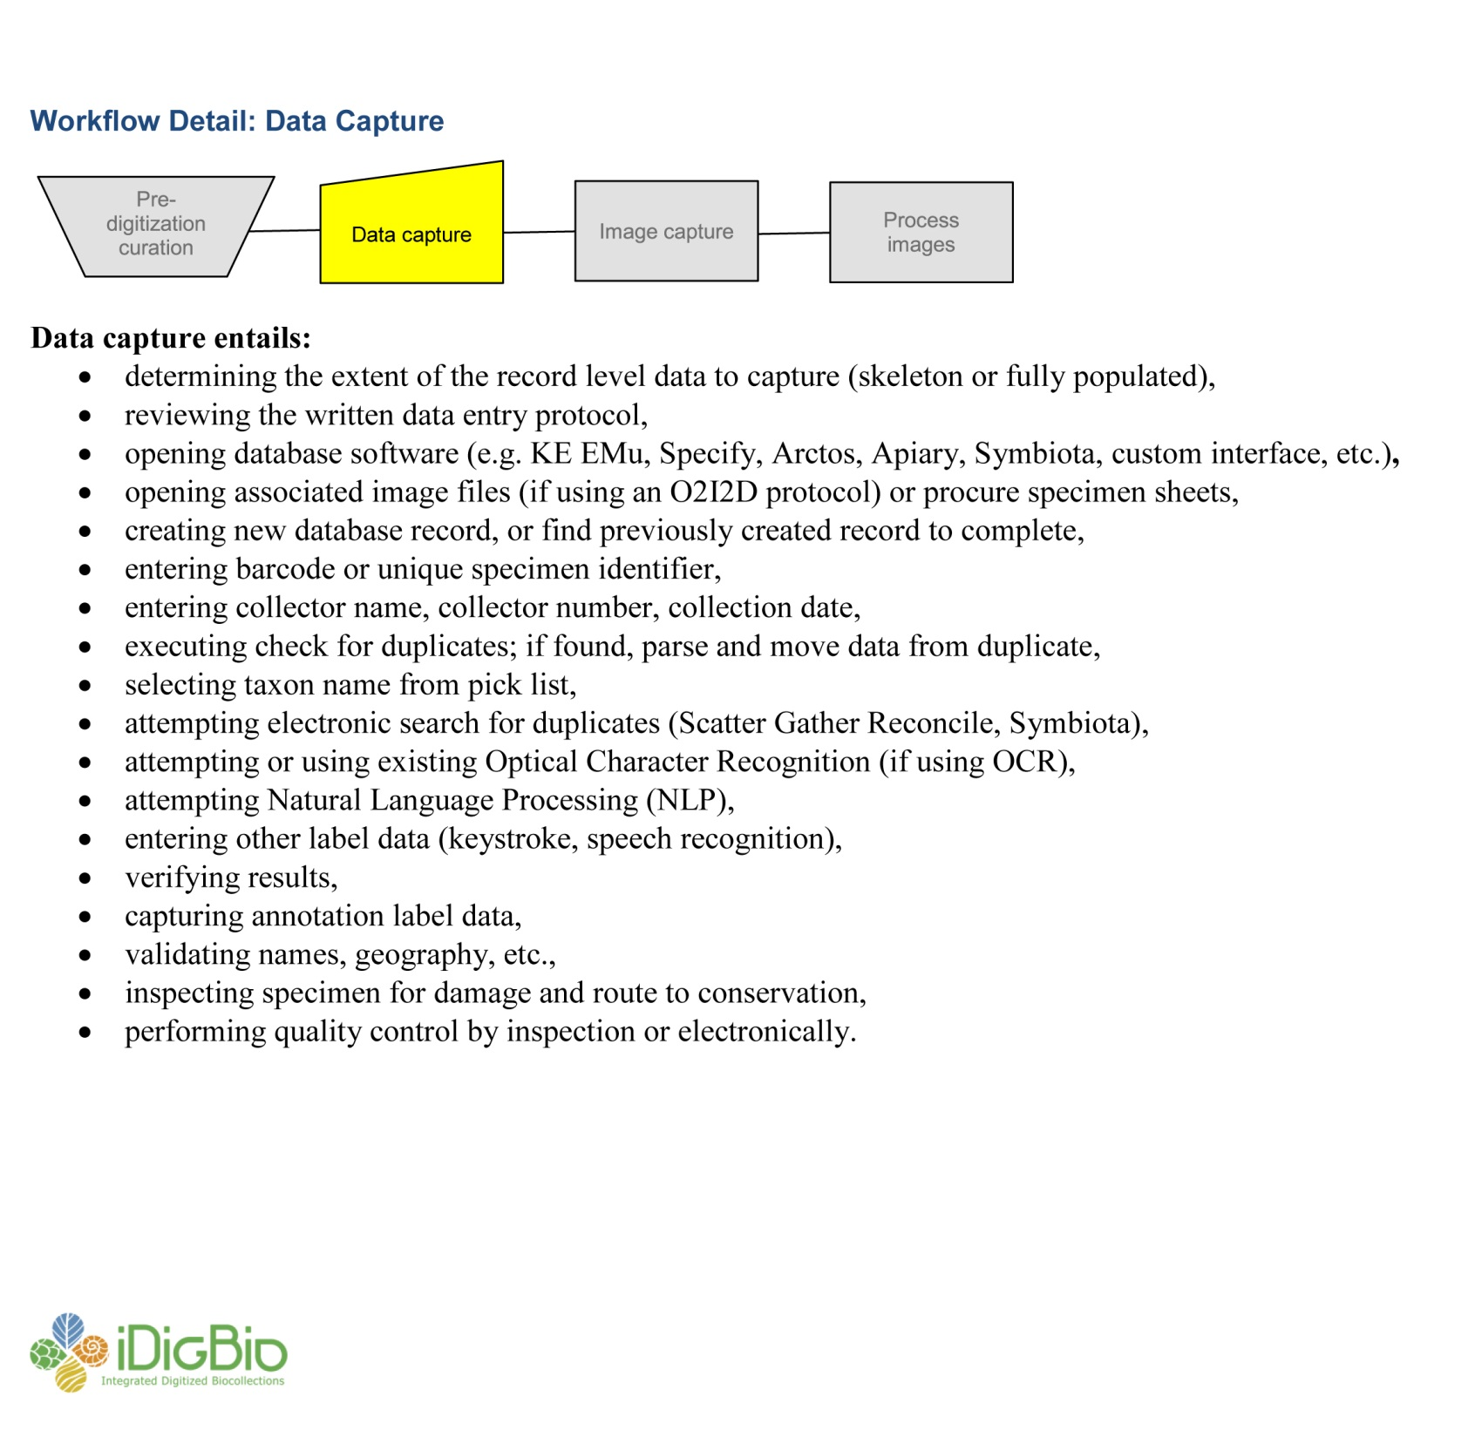
Herbarium Digitization Workshop
Institute for Digital Information & Scientific Communication – Florida State University

Slide 12
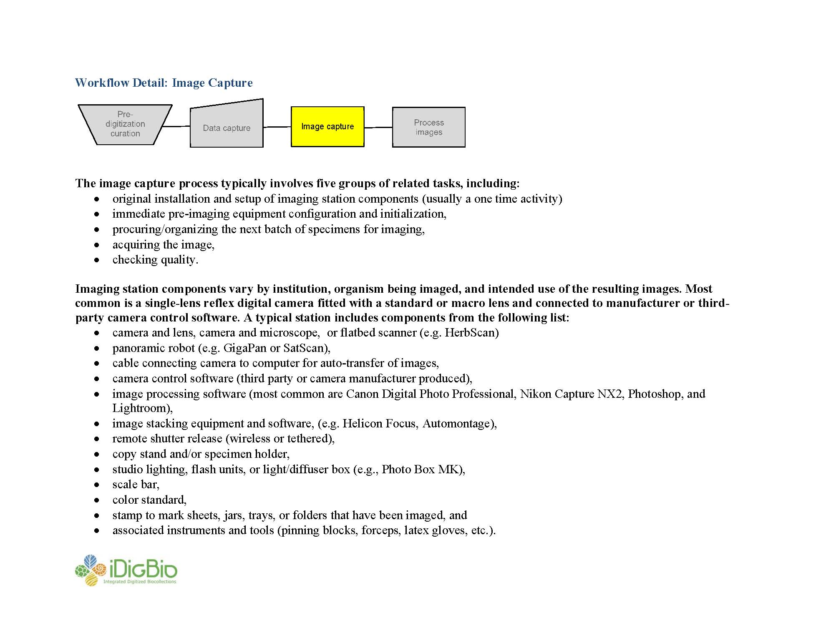
Herbarium Digitization Workshop
Institute for Digital Information & Scientific Communication – Florida State University

Slide 13
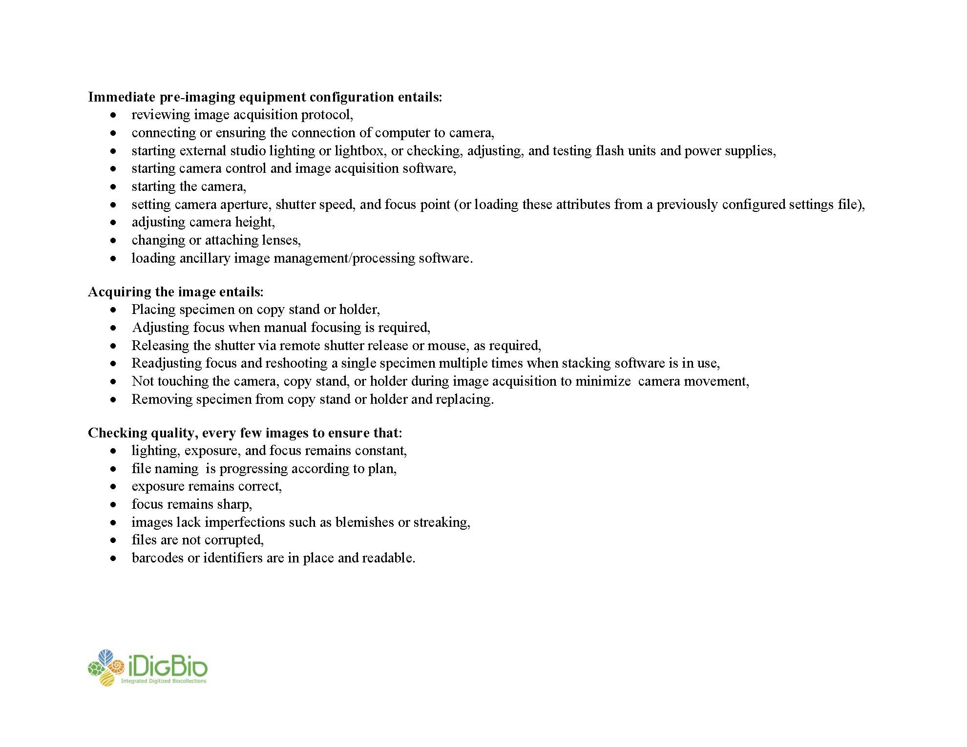
Herbarium Digitization Workshop
Institute for Digital Information & Scientific Communication – Florida State University

Slide 14
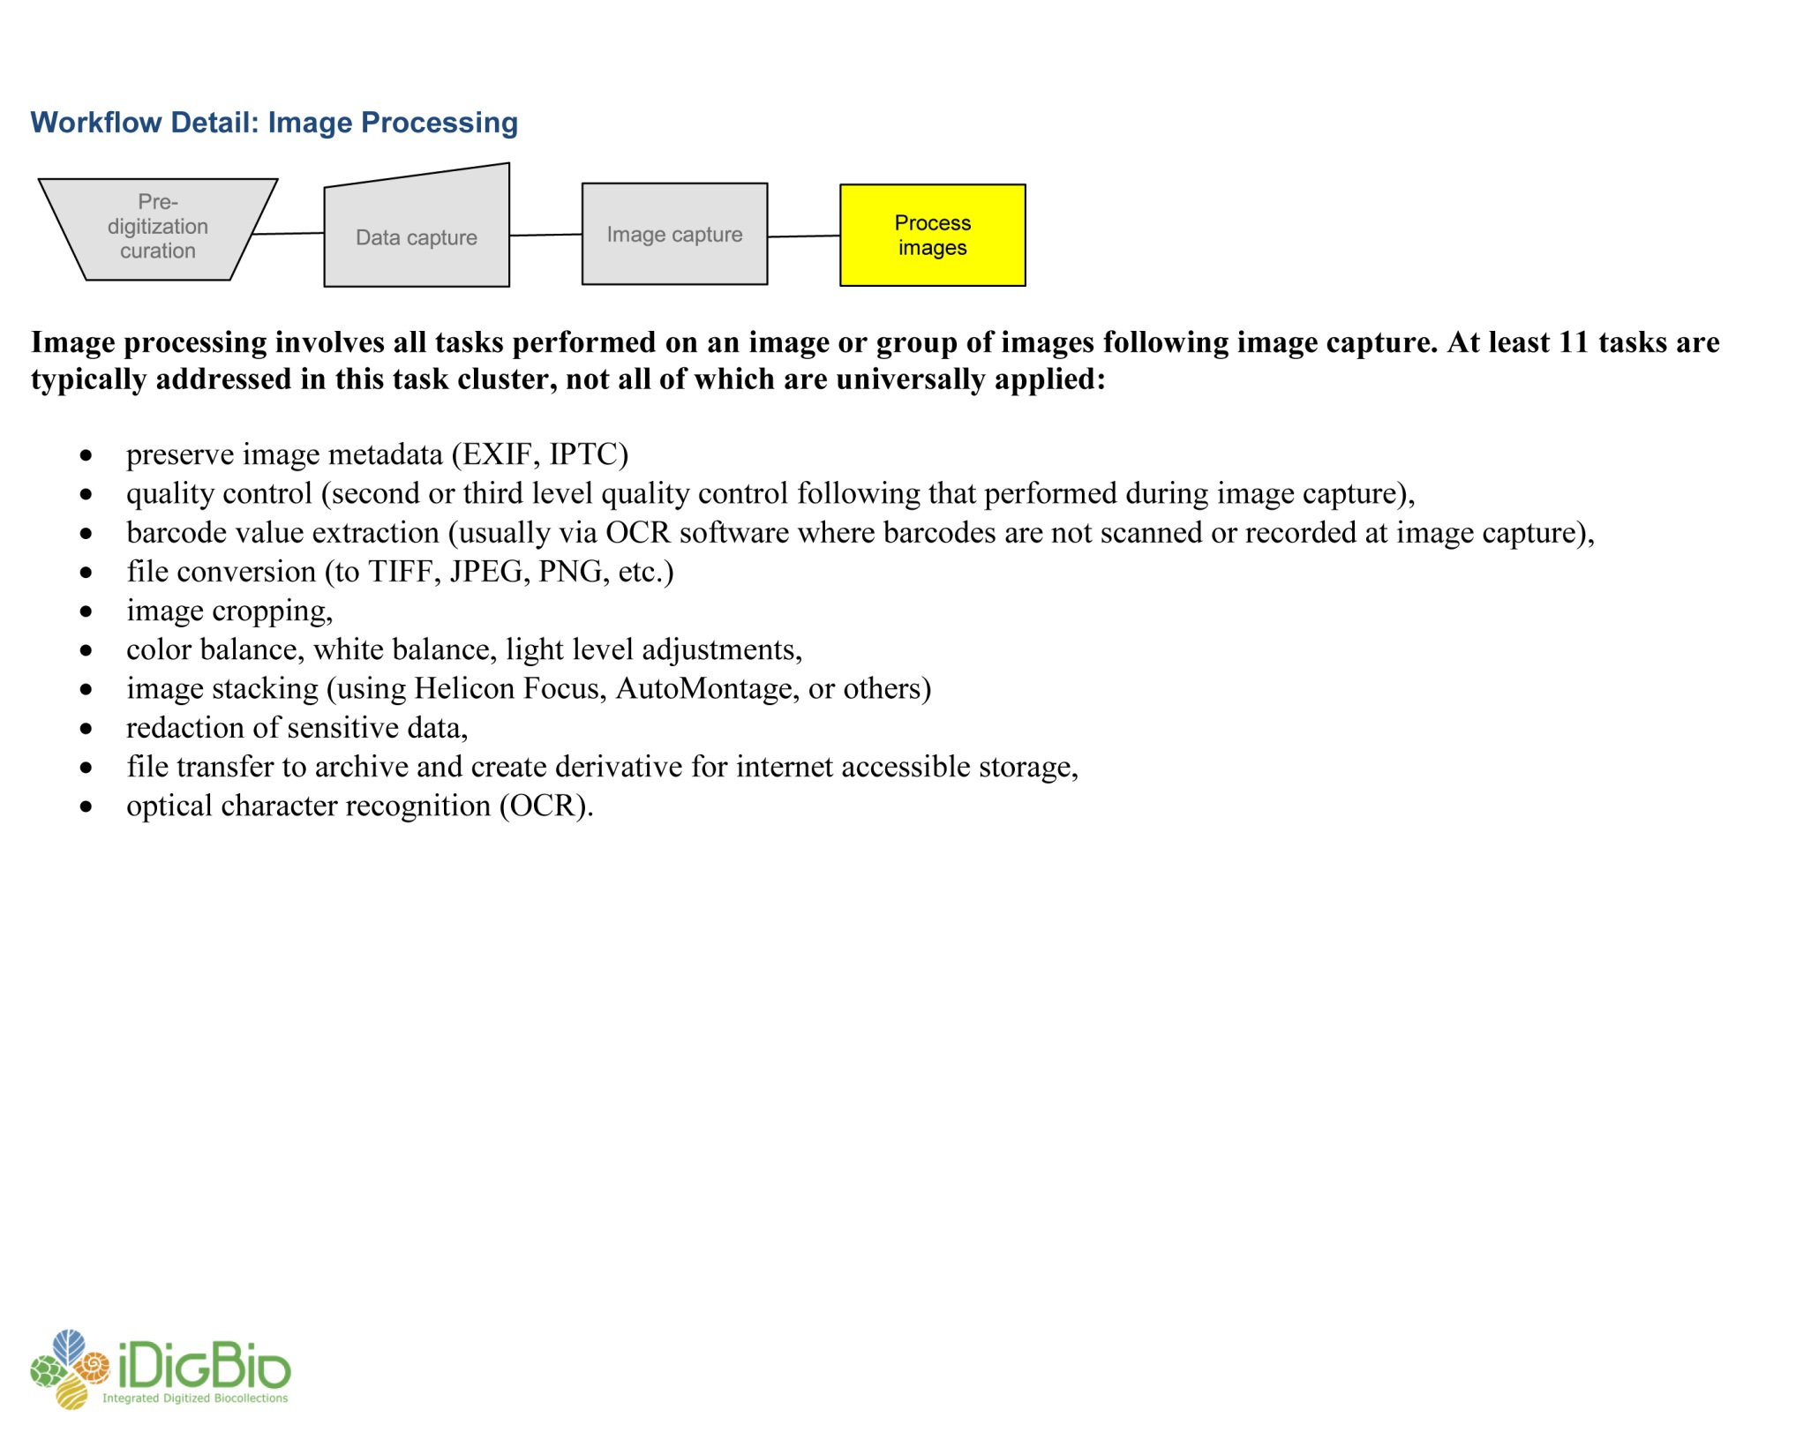
Herbarium Digitization Workshop
Institute for Digital Information & Scientific Communication – Florida State University

Slide 15
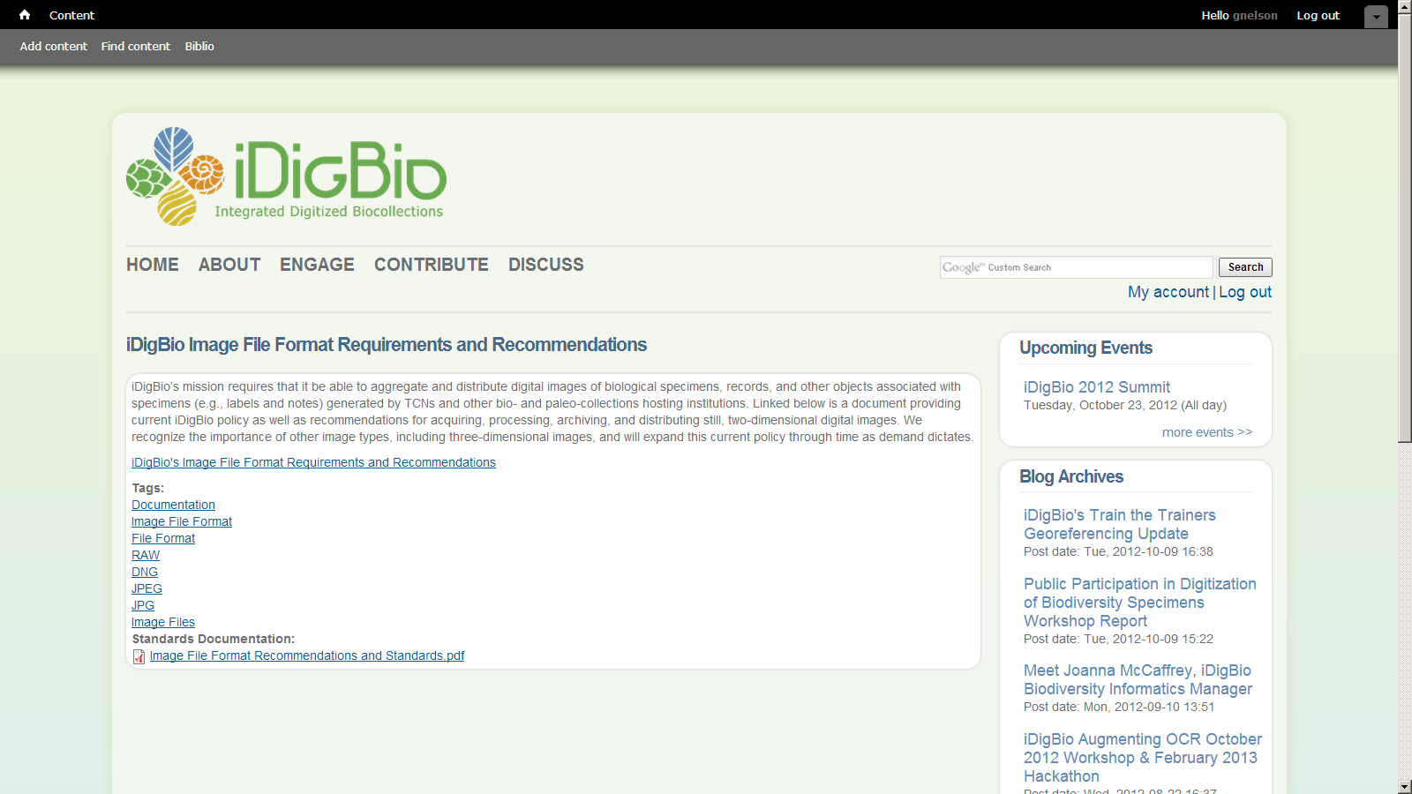
• Completed and published iDigBio’s Image File Format Requirements and Recommendations, based on work of the Workflows Working Group
Institute for Digital Information & Scientific Communication – Florida State University

Slide 16










iDigBio Intellectual Property Licensing Policy
CC0 1.0
CC BY 3.0
CC BY-SA 3.0
CC BY-NC 3.0
CC BY-NC-SA 3.0
No Rights Reserved
Attribution — You must attribute the work in the manner specified by the author or licensor (but not in any way that suggests that they endorse you or your use of the work).
Share Alike — If you alter, transform, or build upon this work, you may distribute the resulting work only under the same or similar license to this one.
Noncommercial — You may not use this work for commercial purposes.

Slide 17
Presence at Major Digitization Venues
• Participated in Entomological Collections Network at Entomology Society of America.
• Presented digitization practices at the SERNEC meeting held with the Association of Southeastern Biologists Association at UGA, Spring 2012.
• Engaged the recently funded Mississippi herbarium collaborative to ensure their attendance at Summit II.
• Participated in kick-off meetings of InvertNet, SCAN, and NEVP to explore community-based strategies for digitization.
• Engaged and incorporated Filtered-Push into the iDigBIo infrastructure, to begin testing in V1 of the protal.
Institute for Digital Information & Scientific Communication – Florida State University

Slide 18
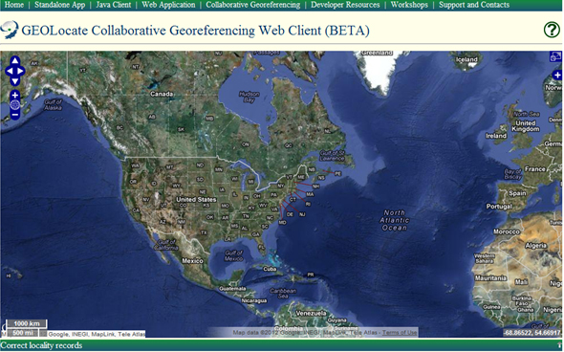
Digitization Enrichment Activities
• Sponsored a 1-day workshop at FSU on georeferencing for iDigBio staff, followed by a collaborative georeferencing project with student technicians at the Godfrey Herbarium to assess the use of GeoLocate; a part of this is to determine the best ways to create and assign specific record sets to technicians to ensure efficient and rapid georeferencing.
• OCR Working Group looking at better ways to integrate into the digitization program.
• Georeferencing working group expanding training and finding effective ways to integrate georeferencing into the digitization workflow; first train the trainers workshop conducted.
Institute for Digital Information & Scientific Communication – Florida State University

Slide 19
Expectations?
• What digitization services would you like to see iDigBio provide?
• Are task-specific training workshops needed? If so, what topics are important?
• What digitization task or activity are you most unclear about implementing?
• What is the most challenging digitization task you face?
Institute for Digital Information & Scientific Communication – Florida State University

Slide 20
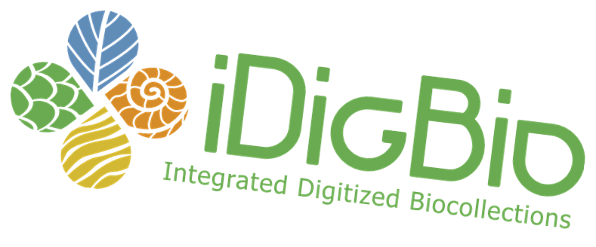
Thank you!

