Slide 1
iDigBio 2012 Visiting Scholar: Organizing, Executing and Utilizing a Digitized Regional Herbarium
Anna Monfils
CMC Herbarium
Central Michigan University

Slide 2
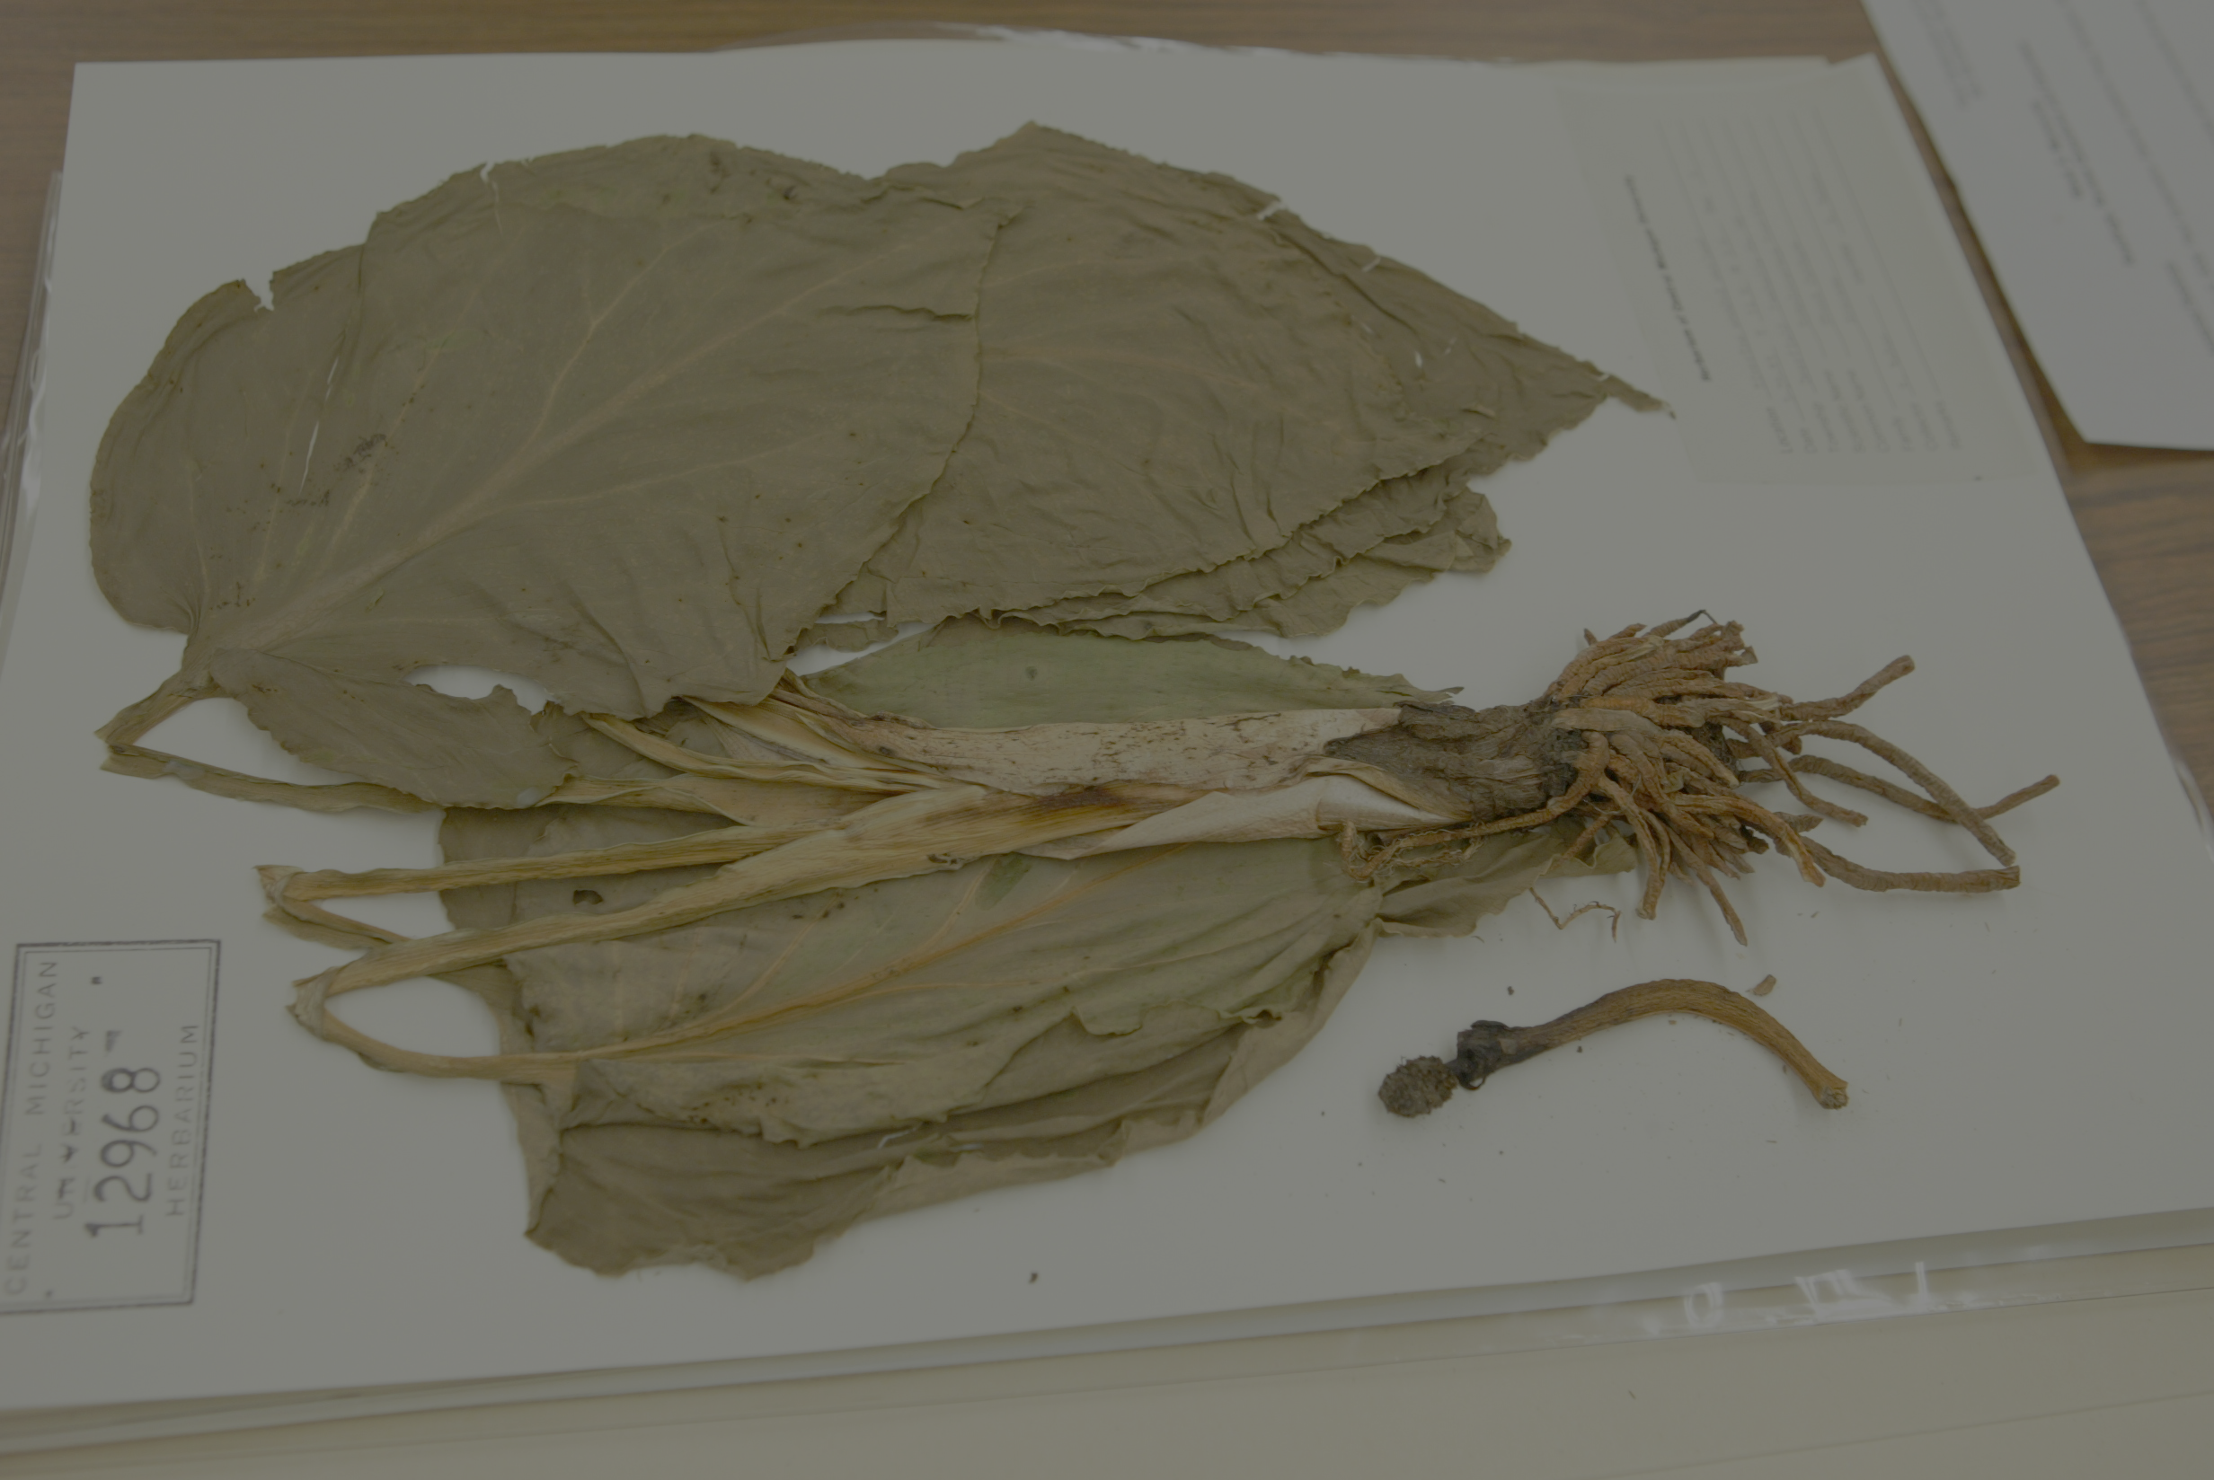
Focused Efforts
Advance digitization efforts at CMC
Workshop to expand digitization efforts for regional collections in MI and the Great Lakes
Interactive web based educational module integrating field, virtual and museum experiences

Slide 3
CMC Herbarium http://cmcherbarium.bio.cmich.edu/
Notes:
25000 specimens
Primarily Aquatic Vascular Plants
History of collections representing the BI Archipelago

Slide 4
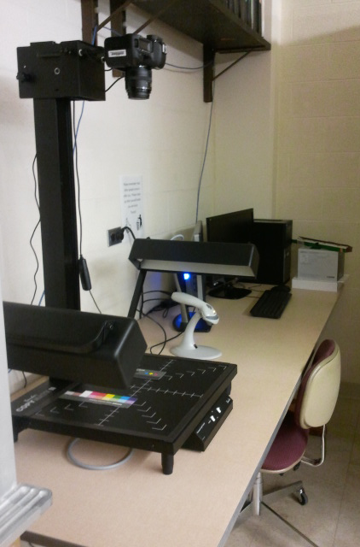
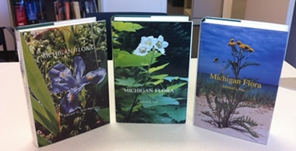
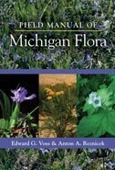
Digitization at CMC
Institutional Support
Administrative
Financial
Information technology
Electronic/Construction technician
Michigan Flora and Voss database
Notes:
Dean Story

Slide 5
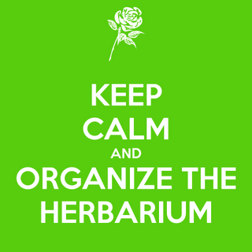
Digitization Challenges
Pre-digitization curation
Optimizing workflow (iterative process)
The right student for the right job!
Communication
Space limitations
Herbarium shut down
Time

Slide 6
Digitization Progress http://cmc-herbarium.blogspot.com

Slide 7
Small Collections Herbarium Workshop http://micob.org/
Notes:
2004 (Trock and Rabeler) held a meeting at MSU to investigate formation consortium for the Western Great Lakes Region
I attended as Post-doc
Deb left, I got faculty position
Meetings in Chico to work with Rich on moving this forward
Rich and I – start in MI, surveyed botanist, applied for funds, first meeting of Michigan Consortium of Botany 2010
communication and shared resources
Funding for meetings and website
Revisit initial goal and examine herbaria
MiCOB – Time Evans and Anna Monfils
Goal – Bring small and regional collections “up to speed” on digitization initiatives

Slide 8
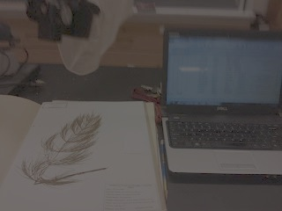
Getting “up to speed” on opportunities and initiatives…
What does it mean to digitize or database?
Why is it important to digitize our collection?
How do we get our institution to support this initiative?
How do we get our small/unfunded/unstaffed collections ready for digitization?
What are the “need to know” basics?
What can we do with digitized data?
Notes:
Questions led to format
Go through folders

Slide 9
Funders and Sponsors
Hanes Foundation
Institute for Great Lakes Research

Slide 10
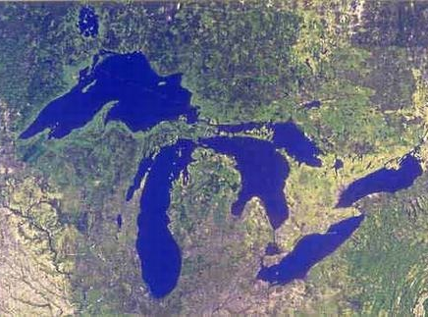
32 participants from Great Lakes Region
4 states
16 collections
19 directors and/or curators
3 herbarium volunteers
2 graduate students
7 undergraduate students
1 Dean!

Slide 11
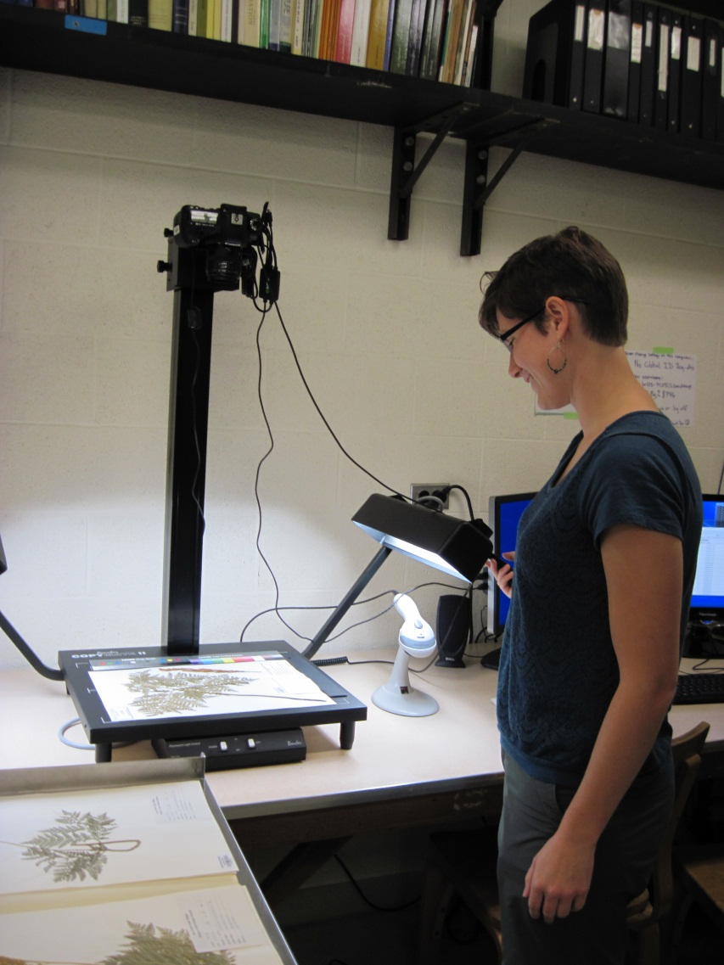
Workshop Highlights
Community building
Orientation to “Alphabet Soup”
Dean speaks on “garnering institutional support”
Hanes Foundation proposal for regional collections in MI
Demystify digitization through program presentations
Examples and experiences from fellow curators
Students presentations and “lessons learned”

Slide 12
Field
Herbarium
Database
Notes:
Web based interactive module about natural history collections

Slide 13
Goals of Educational Module
Students will be able to…
Describe raw data available in physical natural history museums and on-line databases
Compare and contrast types of information obtained from physical and online sources.
Extract data from on-line databases and convert into meaningful information
Apply information to a key issue related to scientific discovery, biology and the living world
Appreciate the value of natural history collections in creating useful understanding of the living world around us.

Slide 14
TourGuide http://tourguide.cal.msu.edu
Collaboration with Stephen Thomas and Alan Prather
Funding through MSU Herbarium and CollectionsWeb
Pilot of student guide in FW 417: Wetland Ecology and Management
Notes:
Three modules

Slide 15
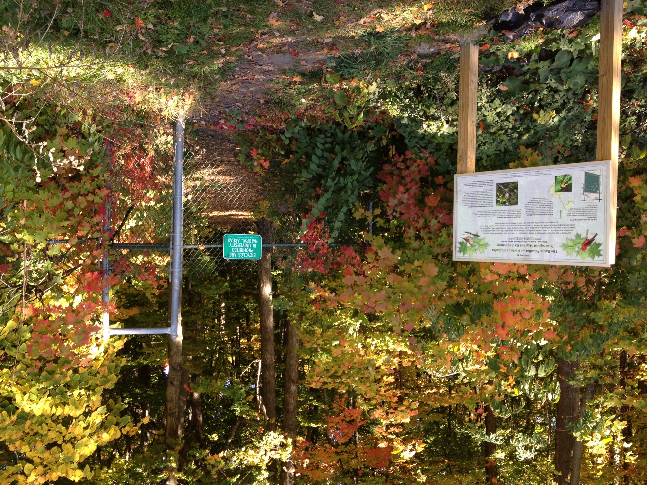
Baker Woodlot: Explore how natural communities change over time
Notes:
78 acre natural area on MSU campus
Sat down and thought of cool stories…must have specimen

Slide 16
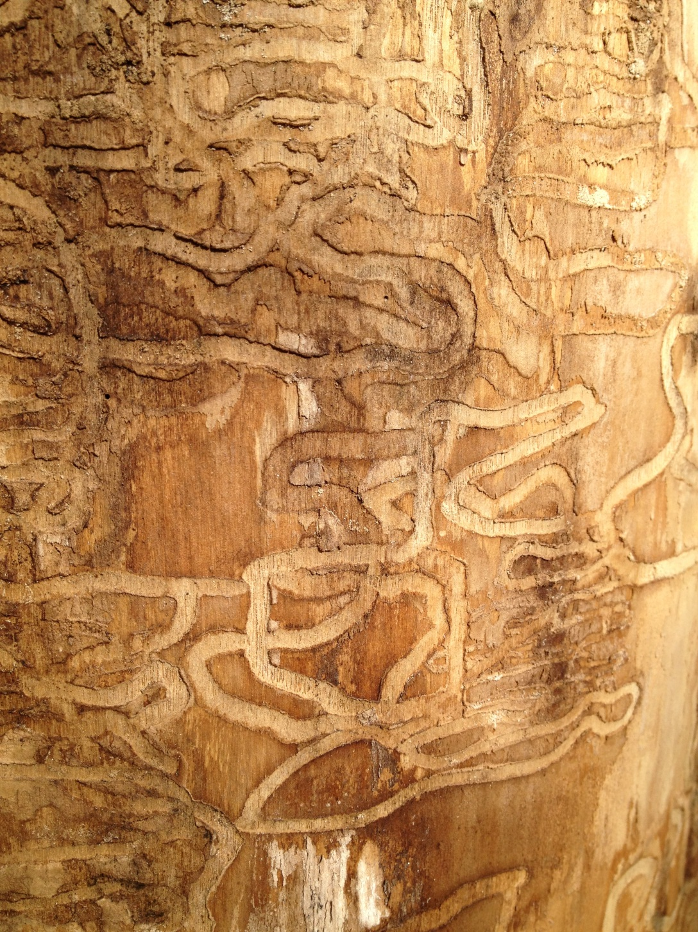
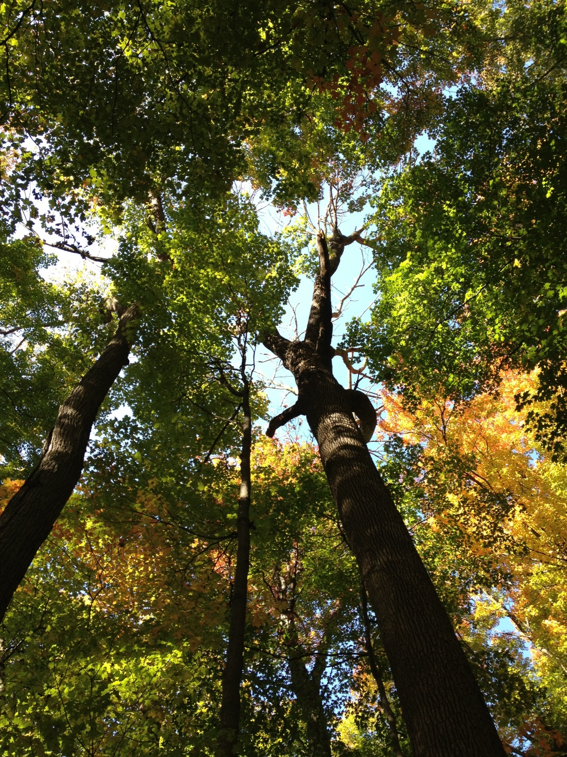
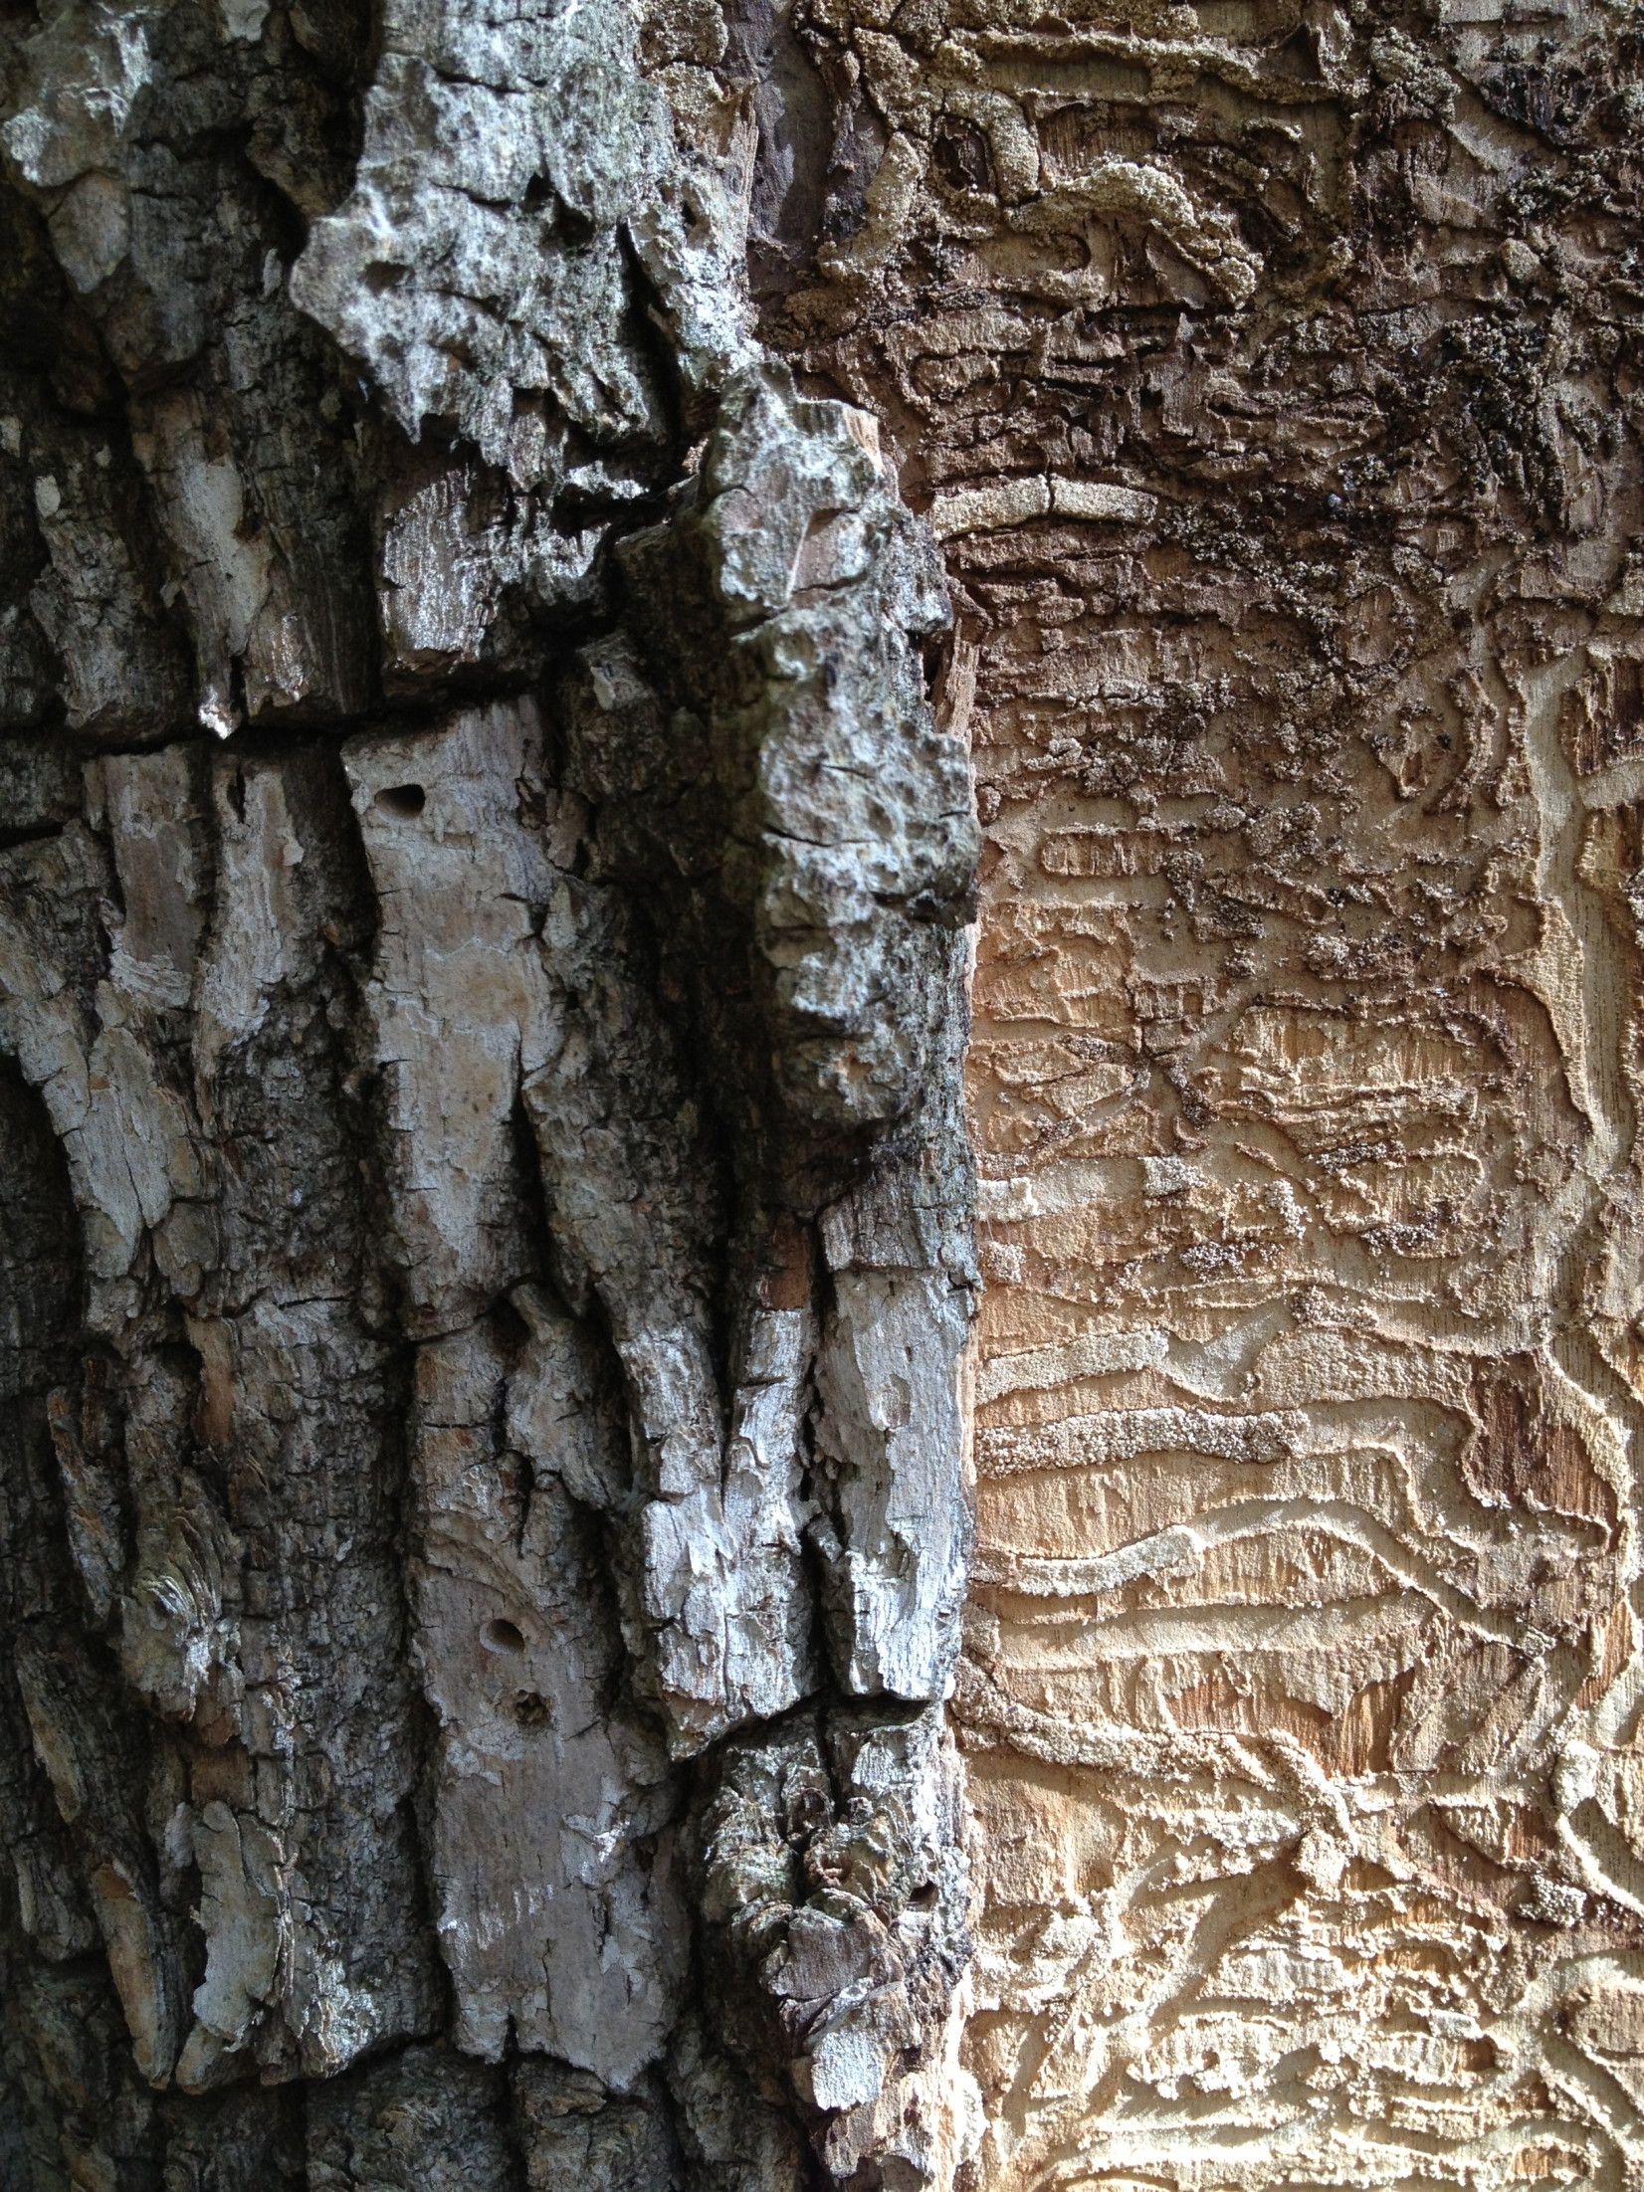
What is going on in Baker Woodlot with Fraxinus americanus?
Ash Borer Galleries
Dead Ash
“D” shaped scars when
beetles emerge
Notes:
Dead ash. See “D” shaped scars on left in bark where beetles emerged
White Ash, black ash gone…some sickly green ash

Slide 17
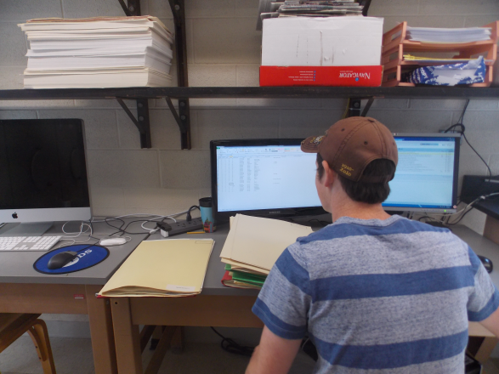
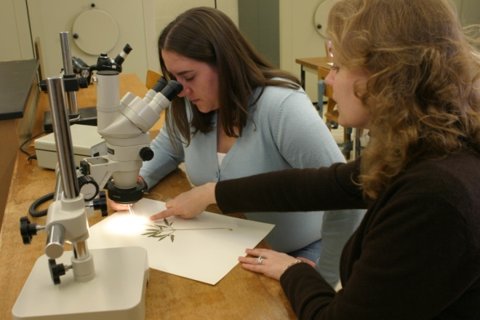
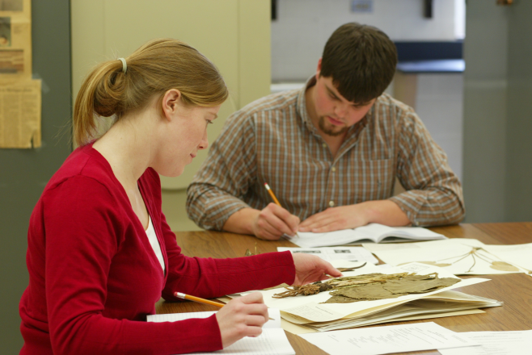
“If you give people tools and they use their natural ability and their curiosity, they will develop things in ways that will surprise you very much beyond what you might have expected.”
Bill Gates

