Slide 1
iDigBio Cyberinfrastructure Working Group
Andréa Matsunaga
(on behalf of the WG)
iDigBio Summit, Gainesville
October 23- 24, 2012

Slide 2
Cyberinfrastructure WG
https://www.idigbio.org/wiki/index.php/Cyberinfrastructure_Working_Group
Established as an outcome of the iDigBio IT Standards Workshop
The focus of the initial group will be on the iDigBio data ingestion procedures related to Application Programming Interface (API) or appliance specification, implementation and test
Produce material with concrete data ingestion use cases from TCNs, provide input about the existing cyberinfrastructure, produce data ingestion requirements, and help evaluate iDigBio services and appliances implementation

Slide 3
iDigBio Data Portal v0 API
Retrieval-only operations (REST GET operations)
Endpoints:
List all endpoints: http://api.idigbio.org/v0
List collections: http://api.idigbio.org/v0/recordsets
List specimens: http://api.idigbio.org/v0/records
List media metadata: http://api.idigbio.org/v0/mediarecords
List media objects: http://api.idigbio.org/v0/mediaaps
Individual records:
Example: http://api.idigbio.org/v0/records/eac2e4ec-5dbb-4c34-b56f-231ed28a5bca
{"idigbio:data":{
"dwc:county":"Liberty",
"dwc:recordedBy":"Loran C. Anderson",
"dwc:scientificNameAuthorship":"(Nees) Small",
"id":"http://www.morphbank.net/586214",
”dwc:eventDate":"2009-06-30 00:00:00.0",
"dwc:scientificName":"Yeatesia viridiflora"},
"idigbio:etag":"c3113b3aa2612ce8af46cde267c355ba18325719",
"idigbio:links":{
"thumbnailurl":"http://api.idigbio.org/v0/mediaaps/f43df2a6-22e8-4783-a998-39a12d7784ef/media",
"mediarecord":"http://api.idigbio.org/v0/mediarecords/3409722c-9c23-4a62-808b-7ae684ad2046",
"recordset":"http://api.idigbio.org/v0/recordsets/b4372b49-c7cc-42db-b1a3-f1c001de0f18"},
"idigbio:uuid":"eac2e4ec-5dbb-4c34-b56f-231ed28a5bca"}

Slide 4
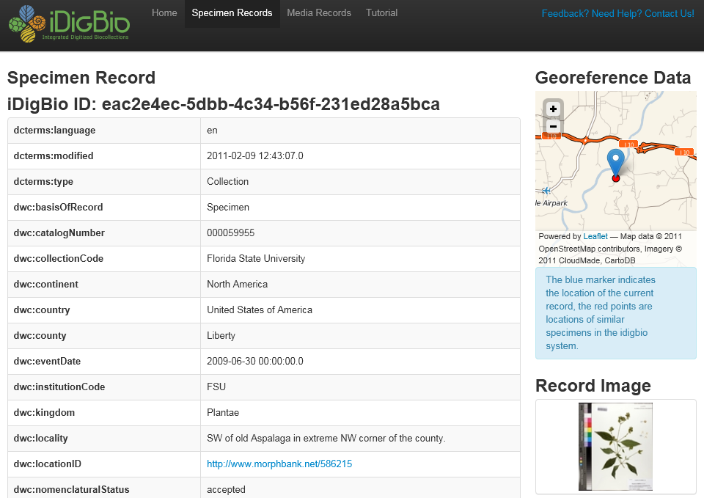
iDigBio Data Portal v0 Presentation
http://portal.idigbio.org/record-view.shtml#eac2e4ec-5dbb-4c34-b56f-231ed28a5bca

Slide 5
Virtual Private Server (VPS)
Total: 7 VMs, 17 cores, 39GB RAM, 1.7TB storage
Symbiota: 2VMs
1 production, 2 cores, 8GB RAM, 200GB disk, 1 pub IP, apache, php, java, MySQL, SVN, tomcat, 1user
1 for FP testing/development, 2 cores, 8GB RAM, 200GB disk, 1 pub IP, apache, php, java, MySQL, SVN, tomcat, 3 users
FilteredPush: 2VMs
1 core, 1024MB RAM, 40GB storage, fp-lite SCAN testbed
2 cores, 4GB RAM, 80 GB storage, mysql, apache, php, tomcat for Symbiota, Morphbank, and FilteredPush
Vertnet: 1VM
2 cores, 2 GB RAM, 500 GB storage, 1 pub IP, CentOS6, 5 users, Tomcat, IPT
Biogeomancer: 1VM
4 core, 8GB RAM, 500GB storage, 1 public IP, apache, tomcat, postgres and postgis, 3 users
aOCR hackathon: 1VM
4 cores, 8 GB RAM, 250 GB storage, Linux (Ubuntu 12.04), Java, PHP, Python, Perl, MySQL, Apache HTTP server, FTP server, ImageMagick, Tesseract, OCRopus, GOCR/JOCR , ZBar

Slide 6
Databases/DwC-A Examined
Dataset | Date | Format | Occurrences | Media | Taxon
TCN-Bryophytes | Jun/01/2012 | Symbiota-MySQL | 961881 | 56217 | 49882
TCN-Lichens | Jun/01/2012 | Symbiota-MySQL | 691967 | 59438 | 10647
TCN-Mycology | Jun/01/2012 | Symbiota-MySQL | 279529 | 1179 | 415812
TCN-InvertNet | Mar/14/2012 | DwC-A | 631388 | 0 | 0
TCN-TTD-AMNH | Jun/21/2012 | AMNH-MySQL | 785134 | 4195 | 61655
TCN-TTD-NYBG | Apr/26/2012 | CSV | 1469089 | 905 | 0
TCN-PALEONICHES | Jul/12/2012 | Specify-MySQL | 96079 | 0 | 6128
FLMNH-Ichthyology | Dec/19/2011 | DwC-A | 213361 | 0 | 0
FLMNH-Ichthyology | Apr/27/2012 | DwC-A | 214487 | 0 | 0
Valdosta | Apr/16/2012 | Specify-MySQL | 14827 | 12291 | 96817
Morphbank | Nov/22/2011 | DwC-A | 193704 | 250442 | 0
Morphbank | Jun/29/2012 | DwC-A | 194015 | 252303 | 0
Total |  |  | 5,338,396 | 386,528 | 640,941

Slide 7
Relational Databases
Symbiota
Collection
omcollections
TTD-AMNH
CollectingEvent
colevent
parent
Person
omcollectors
Dataset
Exsiccati title, number, links
Person
collector
Geography
locality
Specimen
omoccurrences
Taxon
taxa
Specimen
omoccurrences
Media
Images
parent
hostFor
detHis
subfamily
tribe
genus
species
Media
images
Taxon
mnl U flora_mnl
Collection
institution
Specify
CollectingEvent
colevent
parent
EMu
CollectingEvent
ecollectionevents
Geography
Locality U geography
Geography
esites
Person
agent
Person
eparties
Specimen
collectionobject
Specimen
ecatalogue
Geology
esites
Media
attachments
Taxon
taxon
detHis
Collection
collection
Geology
paleocontext
Taxon
etaxonomy
Media
emultimedia
parent
hybrid

Slide 8
Image ingestion appliance
First instance of an application built upon the iDigBio APIs
Enables easy, reliable bulk-ingestion of media records
User selects image directory folder; appliance takes care of
Traversing sub-directories
Uploading individual images through iDigBio API
Transparently recovering from various failure conditions
Providing to user the mapping of file name to iDigBio URLs
Ingested images can be accessed by the URLs
Appliance runs a lightweight Web server to expose a Web-based UI to users

Slide 9
Image Ingestion APIs Used By Appliance
Create RecordSet
URL: RecordSet collection level endpoint
e.g. POST http://idb-websrv1-dev.acis.ufl.edu:9197/v1/recordsets
Request content: JSON
["idigbio:data"]["ac:variant"]: "IngestionTool"
["idigbio:providerId"]: Currently, client generated random UUID
Response content: JSON
["idigbio:uuid"]: RecordSet iDigBio UUID

Slide 10
Image Ingestion APIs Used By Appliance
Create MediaRecord
URL: MediaRecord collection level endpoint
e.g. POST http://idb-websrv1-dev.acis.ufl.edu:9197/v1/mediarecords
Request content: JSON
["idigbio:data"]["ac:variant"]: "IngestionTool"
["idigbio:data"]["dc:rights"]: One of {"cc0", "cc-by", "cc-by-sa", "cc-by-nc", "cc-by-nc-sa"}
["idigbio:data"]["idigbio:localpath"]: Full local path
["idigbio:data"]["idigbio:relationships"]["recordset"]: The iDigBio UUID of the RecordSet the media record belongs to, from the previous step.
["idigbio:providerId"]: User defined GUID prefix + (full local path or file name)
["idigbio:data"]["idigbio:relationships"]["owner"]: Organizational owner of the record, otherwise the signed-in user is saved as the owner. (Optional)
Response content: JSON
["idigbio:uuid"]: iDigBio MediaRecord UUID

Slide 11
Image Ingestion APIs Used By Appliance
Upload Media Object
URL: API sub-collection level endpoint
e.g. POST http://idb-websrv1-dev.acis.ufl.edu:9197/v1/mediarecords/8c7ae0c3-a3b8-4ddd-b433-ab99141ed405/media (the UUID in the middle is the “iDigBio MediaRecord UUID" returned in the previous step)
Request content: Binary multipart/form-data with the image as the "file"
Response content: JSON
["idigbio:links"]["media"]: The URL where the image is accessible online
['idigbio:uuid']: The Media Access Point UUID
['idigbio:data']['idigbio:imageEtag']: The hash (MD5) of the image stored at the server, which is compared with the MD5 of the local image to verify the success of the upload

Slide 12
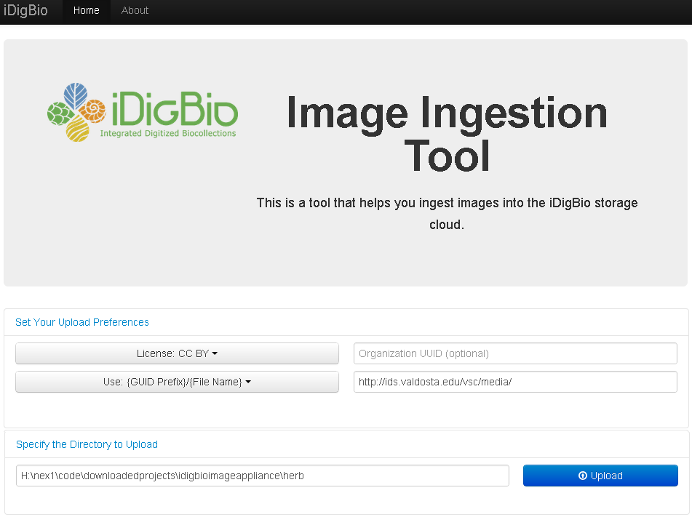
Image Ingestion v1 – Call for beta-testers
Features already implemented
Reliable uploads
Automatically retry of failed upload of individual files
Keep local record of unsuccessful transfers ; resume after failure of network or service
Skip already uploaded files when the same directory is uploaded multiple times
Allow user to specify a license for the media object being uploaded
Save, Export (local path : URL) mappings for individual files in the batch upload
Features to add
Integrated user authentication
Currently , application keys can be provided to beta testers
Improved user interface, error reporting, and encoded best practices on the UI
Feedback from early adopters
Help guide UI improvements and prioritize features to be incorporated
Help fine-tune performance (e.g. parallel uploads) and failure handling
Contact: Andréa Matsunaga (ammatsun@ufl.edu)

Slide 13
Current Members
Andréa Matsunaga (Co-Lead), iDigBio IT
Joanna McCaffrey (Co-Lead), iDigBio Program Manager
Renato Figueiredo, iDigBio IT
Alex Thompson, iDigBio IT
Jiangyan Xu, iDigBio IT
Guillaume Jimenez, iDigBio IT
Casey McLaughlin, iDigBio IT
Michael Bevans, NYBG Photographer
James Beach, Paleoniches TCN IT/Co-PI, University of Kansas, Specify
Andrew Brown, KE Software
Edward Gilbert, Lichens & Bryophytes and SCAN TCNs IT, Symbiota
Corinna Gries, Lichens & Bryophytes TCN, PI
Tony Kirchgessner, Tri-trophic TCN IT, NYBG
Nahil Sobh, InvertNet TCN IT, Co-PI
Omar Sobh, InvertNet TCN IT
Ex Officio: José Fortes, iDigBio Director for Computational Activities
Thank you!

