Slide 1
iDigBio Minimum Information Standards for Scientific Collections (MISC)/Authority Files Working Group
Gil Nelson
Andréa Matsunaga
(on behalf of the WG)
iDigBio Summit, Gainesville
October 23- 24, 2012

Slide 2
MISC Working Group – Mission and Scope
Document basic assumptions underpinning a minimal information for scientific collections expectation
Develop a document outlining and providing a rationale for required, minimal, desired, and supplementary data elements to be provided by iDigBio contributors, including an enumeration of these elements with user friendly labels
Develop guidelines for algorithmic data validation and cleaning tools that can be distributed as an appliance or via an API or web service
Develop guidelines for offering training and assistance to iDigBio contributors for configuring data for ingestion into the iDigBio portal
Make all work of the committee available for comment to the community

Slide 3
MISC Working Group – Data Model Concepts
Geology
Collection
Person
hostFor
Geography
hostFor
Taxon
Specimen
Media
detHis
hostFor
Morphology
Reference
CollectingEvent
Genetics
Sample

Slide 4
iDigBio Guidelines for Managing Persistent Identifiers
Requirement: TCNs and other institutions ensure that all identifiers provided to iDigBio are unique and persistent.
Persistent identifiers are those that are assigned once, only once, and are associated with a single object. Once assigned to an object, an identifier cannot be assigned to a different object.
URI pattern recommendation:
http://ids.flmnh.ufl.edu/herb/co/abcd12345678
Domain name registered and owned by the TCN or institution
Locally unique identifier

Slide 5
MISC Goals
At its core, the product of the MISC working group is iDigBio’s attempt to:
put flesh on the bones of the data model presented earlier,
bring a biologist’s or collection manager’s perspective to the data elements iDigBio ingests,
ensure that we account for all data currently or potentially stored in collections databases (hence, MISC may be a misnomer),
narrowly (and perhaps selfishly?) focus on data elements iDigBio should be prepared to ingest over the long haul, to prioritize these elements with respect to whether they should be treated as required, highly desired, or supplementary, and to recognize that the list of these elements might grow over time,
take a scientific perspective on data fitness,
start with Darwin Core as a foundation and augment this standard from the many other schemas currently in use in our community,
map MISC data elements to as many existing schemas as possible to facilitate ingestion.

Slide 6
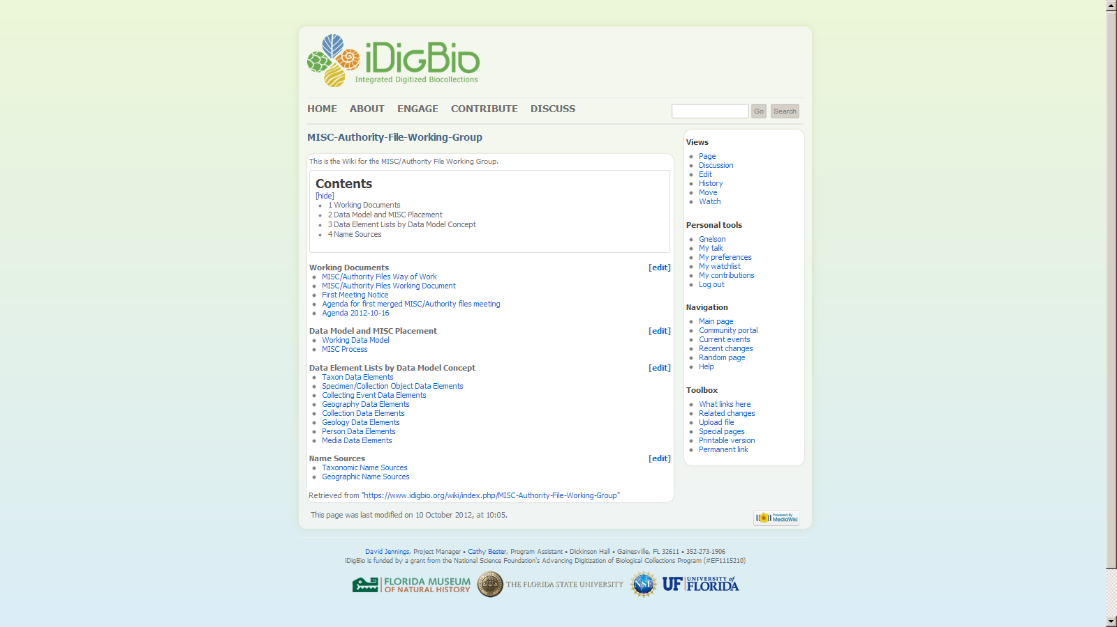
https://www.idigbio.org/wiki/index.php/MISC-Authority-File-Working-Group

Slide 7
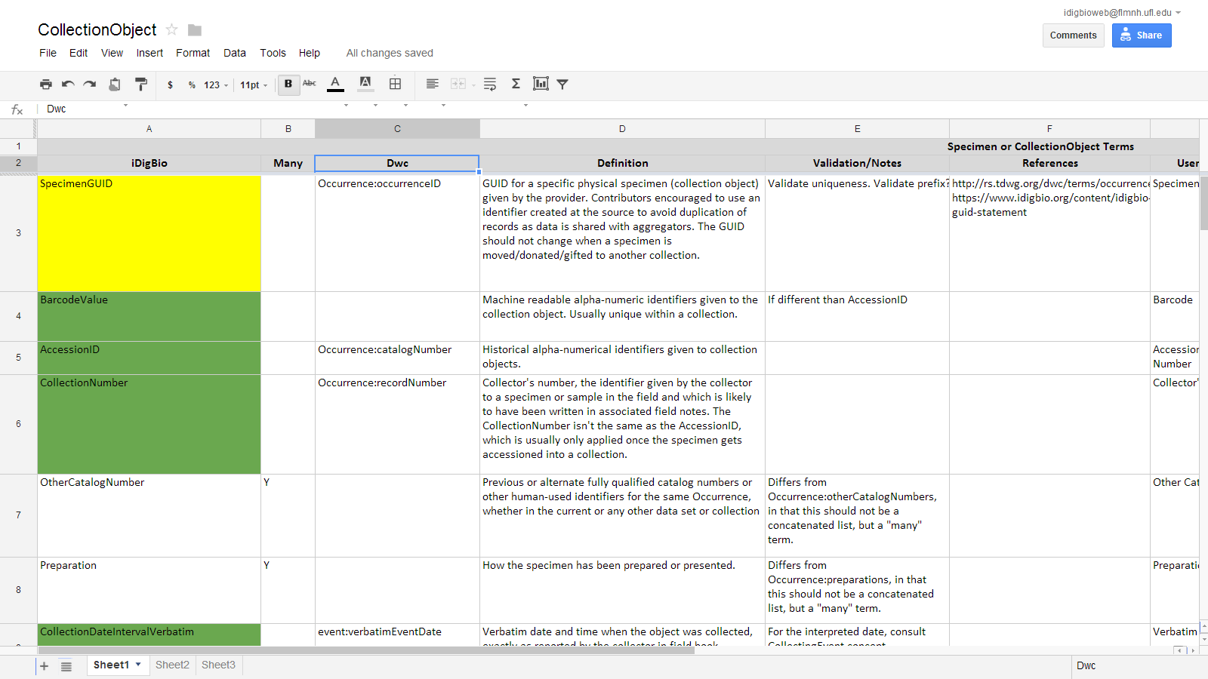
MISC Working Group – Terms for Data Model Concepts
Community input is invited!

Slide 8
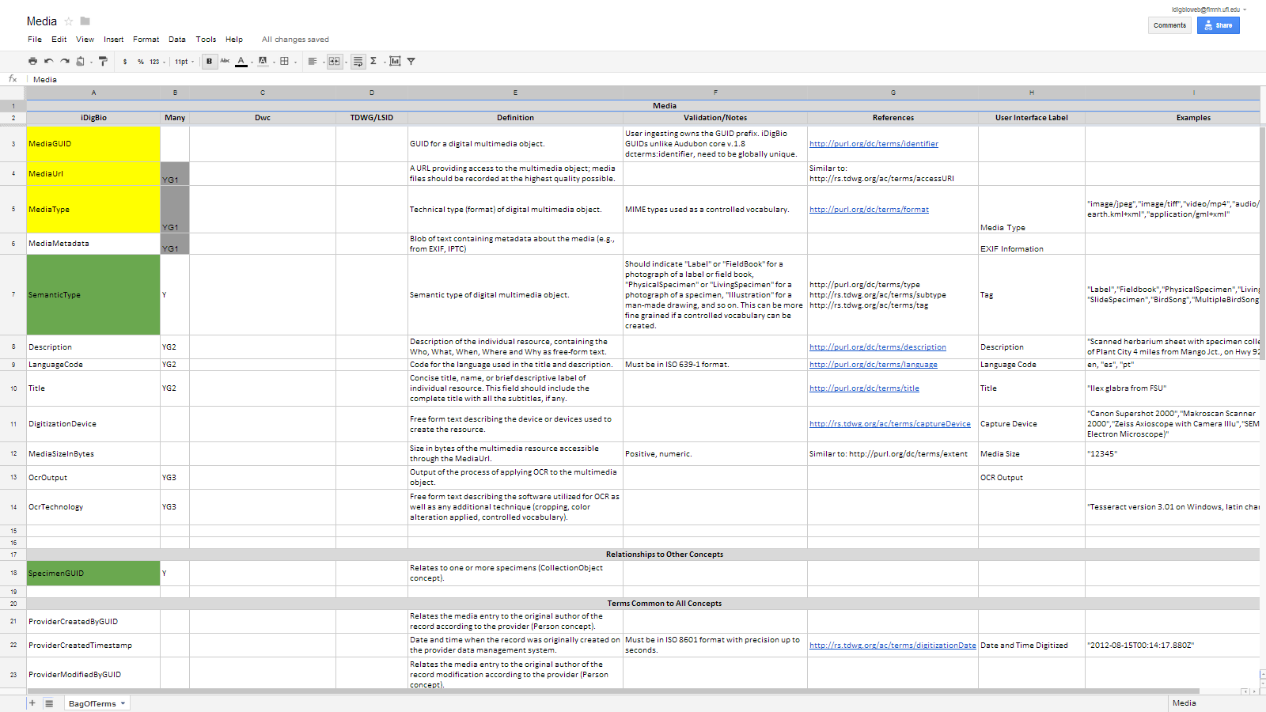

Slide 9
EMu
Symbiota
Specify
Custom+
(e.g. PBI)
Contributors
iDigBio
Ingestion/Feedback
MISC
Repository
Query Support
iDigBio
Consumer
MISC Relationships
Presentation (templates, views)
Specimen + Taxon + Media
Specimen
Taxon
Media
Taxon
Lat
Lon
Collector
Date
No.
…..

Slide 10
MISC Working Group – Members
Gil Nelson, iDigBio Digitization (Co-Lead)
Katja Seltmann, AMNH (Co-Lead)
Dorothy Allard, UVM
Reed Beaman
Stan Blum
John Deck
Andrea Matsunaga, iDigBio IT
Joanna McCaffrey, iDigBio Biodiversity Informatics
Paul J. Morris
Deborah Paul, iDigBio User Services
Dean Pentcheff
Petra Sierwald, FMNH
Ex Officio: Greg Riccardi
Thank you all!

