Slide 1




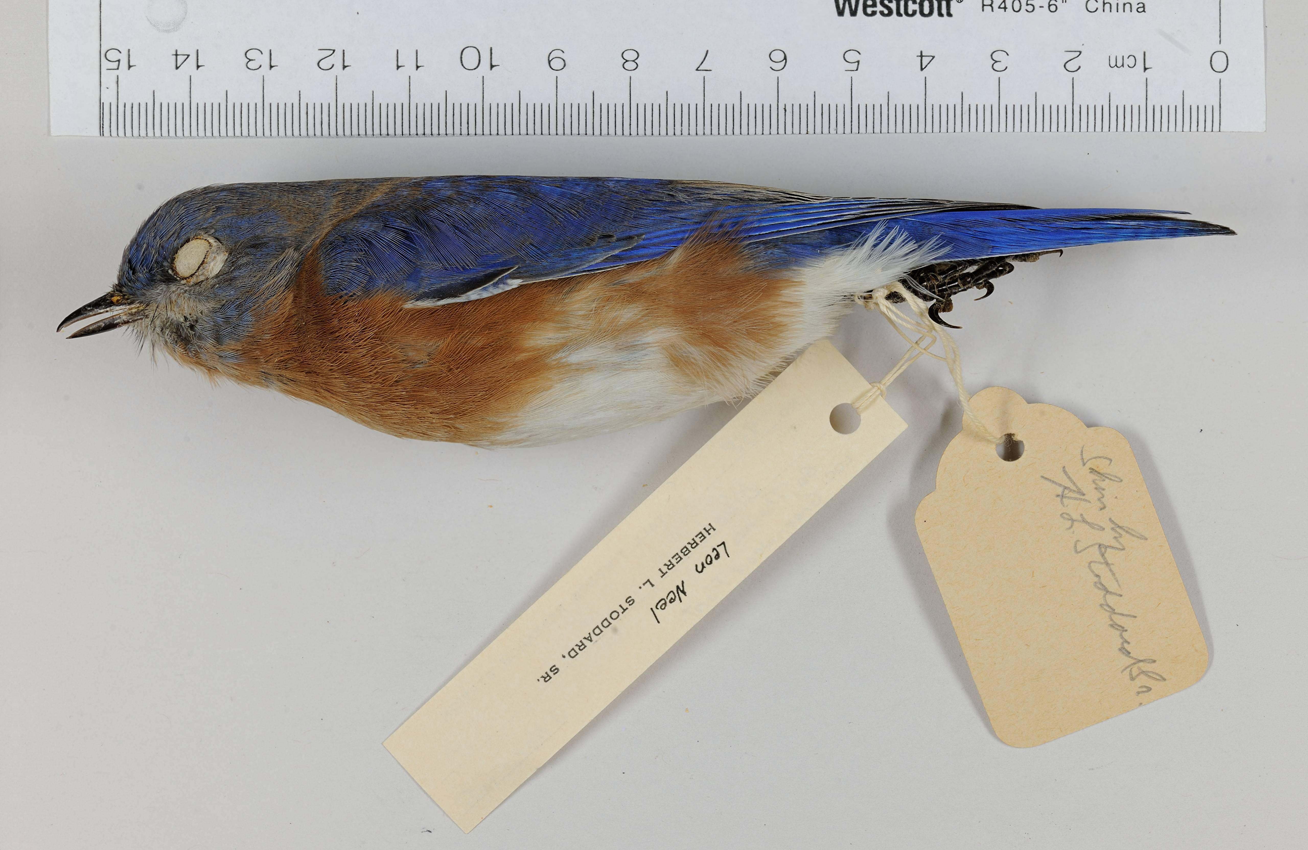
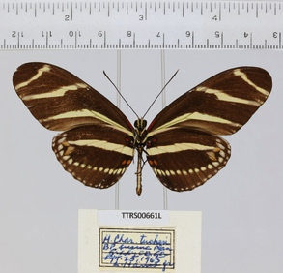
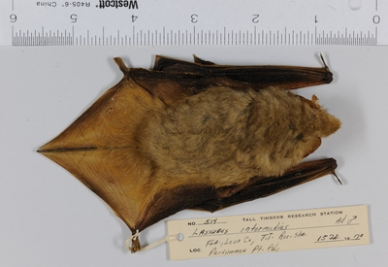
Public Participation in the Digitization of Biodiversity Collections
Austin Mast
Florida State University
Betty Dunckel
University of Florida

Slide 2

The Big Challenge
Key Objective 1: Digitize data from all U.S. biological collections, large and small, and integrate these in a web accessible interface using shared standards and formats.
Estimates suggest that there are on the order of 1 billion specimens held in U.S. biological collections, residing in thousands of institutions.
About 90% are not accessible online!!
One of three key objectives in the 2010 document
“A Strategic Plan for Establishing a Network Integrated Biocollections Alliance.”

Slide 3
The Big Challenge
Key strategy elements:
Community coordination and standardization
More efficient workflows
Technological innovation
Broader participation in digitization

Slide 4
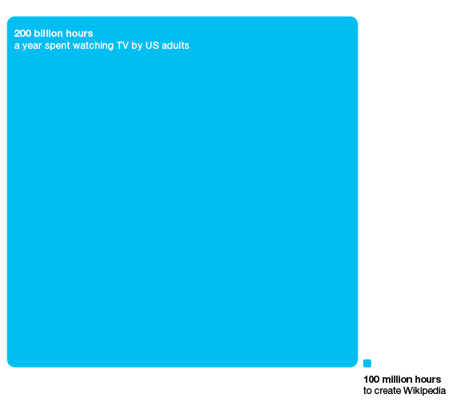
The Big Challenge
Clay Shirky’s “Cognitive Surplus”
http://www.informationisbeautiful.net/2010/cognitive-surplus-visualized/

Slide 5
The Big Challenge
Word cloud of “A Strategic Plan for Establishing a Network Integrated Biocollections Alliance” produced with wordle.com

Slide 6
The Big Challenge
“Finally, citizen scientists may contribute
significantly to the digitization workforce and
they too must have access to training in digitization
and best practices.”
“A Strategic Plan for Establishing a Network Integrated Biocollections Alliance”

Slide 7
The Big Challenge
Public Participation
Citizen Science
Word cloud of “A Strategic Plan for Establishing a Network Integrated Biocollections Alliance” produced with wordle.com

Slide 8
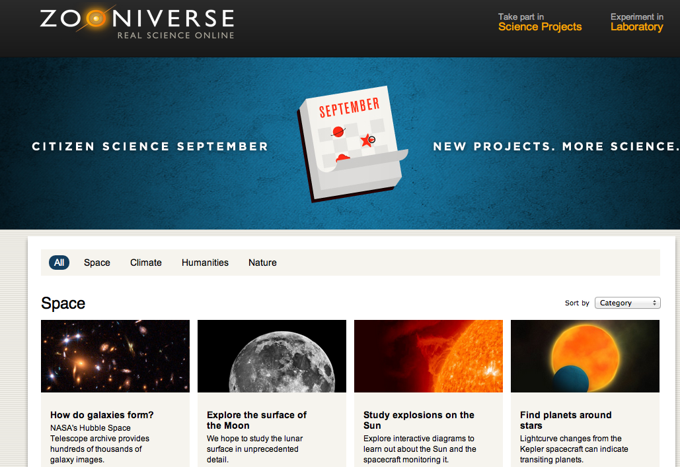
Evidence that Science Projects can Engage It
https://www.zooniverse.org/

Slide 9
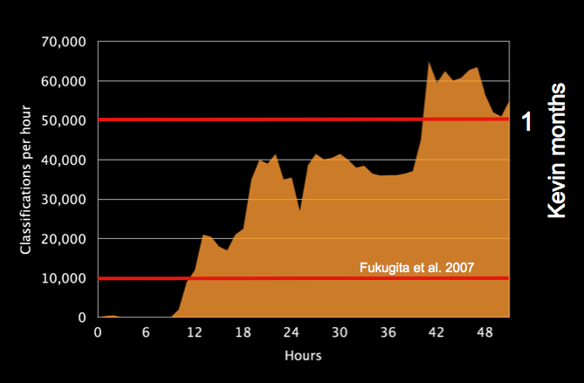
Evidence that Science Projects can Engage It
Classifications per hour when Galaxy Zoo launched in 2007. Over the following year about 170,000 people contributed more than 50 million classifications of 1 million galaxies. Source: Arfon Smith.

Slide 10
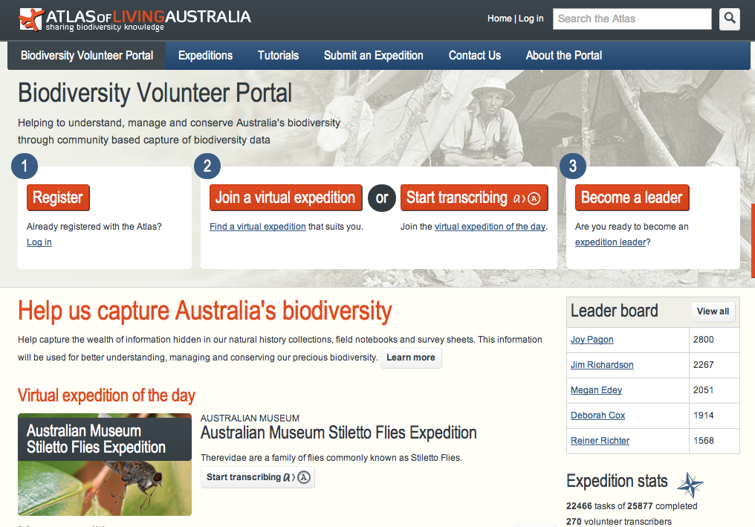
Evidence that Science Projects can Engage It
http://volunteer.ala.org.au/

Slide 11

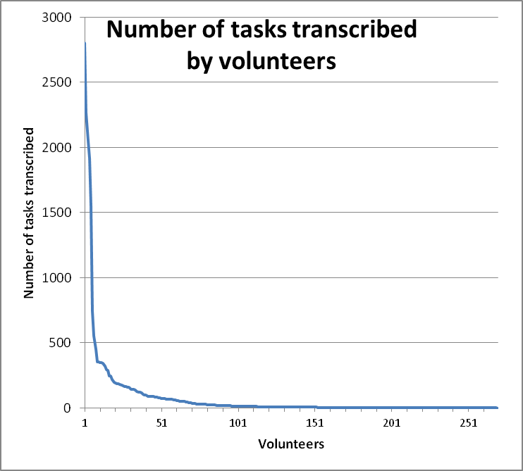
Atlas of Living Australia Biodiversity Volunteer Portal
No. Volunteers | No. Tasks Completed | Total
57 | 1 | 57
85 | 1-10 | 371
87 | 10-100 | 2994
36 | 100-1000 | 8405
2 | 1000-2000 | 3465
3 | 2000+ | 7116
This table and graph illustrate that a small number of volunteers get very involved and become very productive. These volunteers have been keen to provide feedback on improving the site and some have now taken on validation reponsibilities as well.
Just over half the volunteers who register for transcribing do less than 10 tasks and cease involvement in the first week or so.
The middle group of volunteers contributing between 10 and 1000 tasks is equally as productive overall as the really dedicated ones. It is this group that I plan to target as I believe it has the most potential for increasing the output of through virtual and tangible rewards and the development of a forum.
Source: Paul Flemons

Slide 12
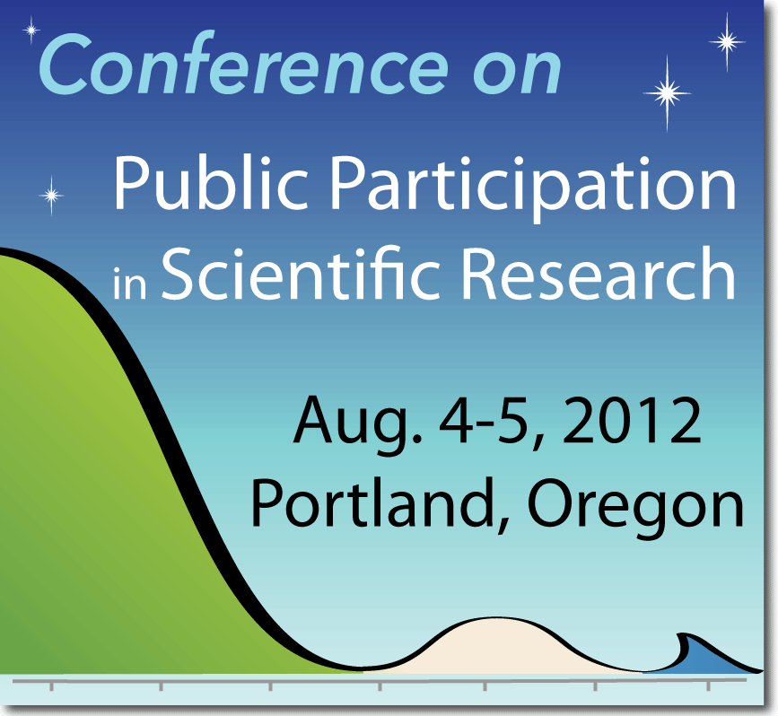
Evidence that Science Projects can Engage It

Slide 13
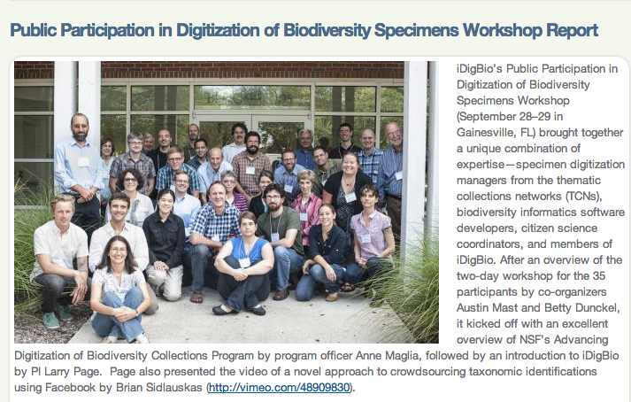
Public Participation in Digitization Workshop
September 28–29, 2012

Slide 14
Public Participation in Digitization Workshop
Citizen Science Experts
Tool Developers
TCNs
iDigBio
September 28–29, 2012

Slide 15
Goals of iDigBio
Enable digitization of biodiversity collections data
  Develop efficient and effective digitization standards and workflows
  Actively seek partners and data sources
  Respond to cyberinfrastructure needs
Provide portal access to biodiversity data in a cloud-computing environment
Engage users of biodiversity data to address environmental and economic challenges: research and outreach
  Collections community
  Researchers
  Educators
  Citizen scientists, general public, students
  Policy-makers
Plan for long-term sustainability

Slide 16
Public Participation in Digitization Workshop
The workshop identified the following:
Ca. 15 activities where the public can participate. Many can be offsite with some preliminary digitization.
Ca. 37 potential communities to engage.
Ca. 40 motivations of the public.
Ca. 30 digitization tools for public engagement.
Ca. 80 successful citizen science projects from which to learn and ca. 59 lessons learned.
Other resources, including relevant standards, working groups, and organizations.

Slide 17
PPSR models:
Contributory
Collaborative
Co-Created
Define a question/issue
Gather information
Develop explanations
Design data collection methods
Collect samples
Analyze samples
Analyze data
Interpret data/conclude
Disseminate conclusions
Discuss results/inquire further
Source: Jennifer Lynn Shirk
Notes:
Fundamentally, the similarities between these projects involve participation of the public in research. POINTS OF ENGAGEMENT In the traditional model of research, scientists or technicians filled all of these roles. In PPR, the public can be involved in one or many of these steps. How the public is involved differs across programmatic models.

Slide 18
Increased Understanding of Science
PPSR models:
Contributory
Collaborative
Co-Created
Define a question/issue
Gather information
Develop explanations
Design data collection methods
Collect samples
Analyze samples
Analyze data
Interpret data/conclude
Disseminate conclusions
Discuss results/inquire further
A. Mast modification of slide from Jennifer Lynn Shirk
Notes:
Fundamentally, the similarities between these projects involve participation of the public in research. POINTS OF ENGAGEMENT In the traditional model of research, scientists or technicians filled all of these roles. In PPR, the public can be involved in one or many of these steps. How the public is involved differs across programmatic models.

Slide 19
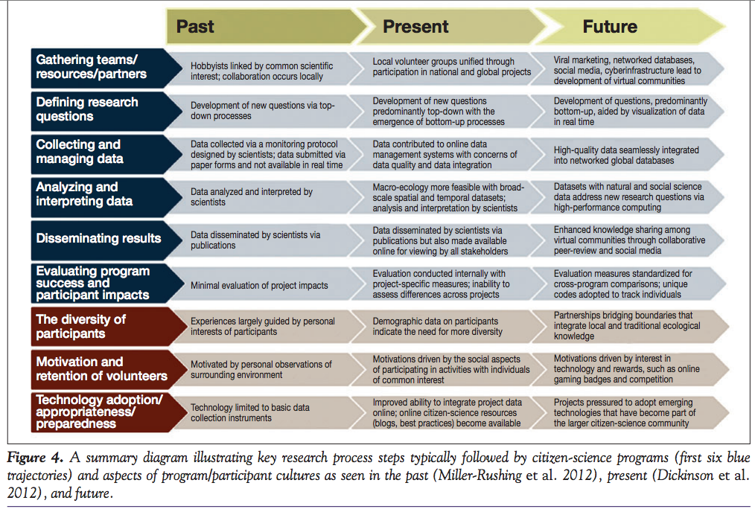
Direction of Citizen Science
Greg Newman, Andrea Wiggins, Alycia Crall, Eric Graham, Sarah Newman, Kevin Crowston. 2012.
The future of citizen science: emerging technologies and shifting paradigms.
Frontiers in Ecology and the Environment 10: 298–304.

Slide 20
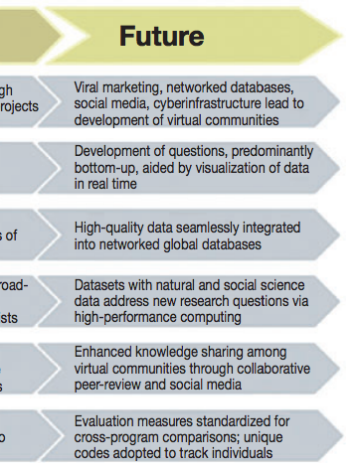
Direction of Citizen Science
Greg Newman, Andrea Wiggins, Alycia Crall, Eric Graham, Sarah Newman, Kevin Crowston. 2012.
The future of citizen science: emerging technologies and shifting paradigms.
Frontiers in Ecology and the Environment 10: 298–304.

Slide 21
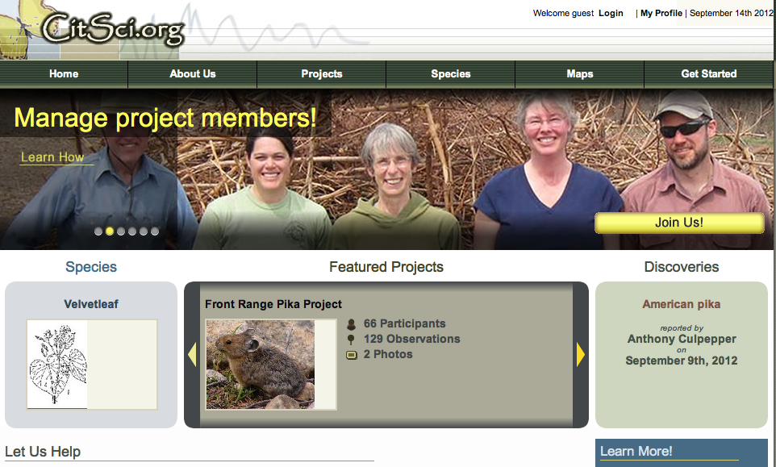
Direction of Citizen Science
http://citsci.org/

Slide 22
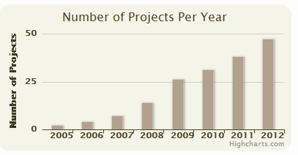
CitSci.org Project Growth
Direction of Citizen Science
2005 – 2 Projects
2006 – 4 Projects
2007 – 7 Projects
2008 – 14 projects
2009 – 26 Projects
2010 – 31 Projects
2011 – 38 projects
2012 – 47 Projects
# new projects per month not too telling because projects typically get started annually
Source: Greg Newman

Slide 23
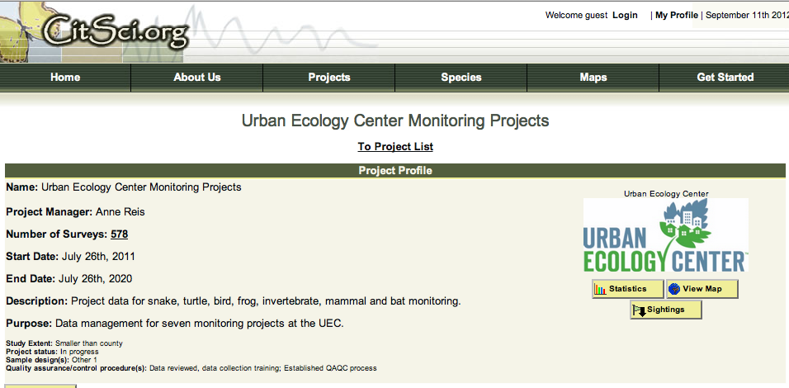

Direction of Citizen Science
http://citsci.org/

Slide 24
Goals of iDigBio
Enable digitization of biodiversity collections data
  Develop efficient and effective digitization standards and workflows
  Actively seek partners and data sources
  Respond to cyberinfrastructure needs
Provide portal access to biodiversity data in a cloud-computing environment
Engage users of biodiversity data to address environmental and economic challenges: research and outreach
  Collections community
  Researchers
  Educators
  Citizen scientists, general public, students
  Policy-makers
Plan for long-term sustainability
Challenges: At the same time, contribute to the democratization of science and a deeper understanding of science.

Slide 25
Challenges for ADBC Community
http://citsci.org/
What cyberinfrastructure and protocols are necessary for this community to build a historical dataset of relevant specimens from Milwaukee by digitizing target specimens from across US collections? And what is necessary for sharing that information to CitSci.org as it is constructed?

Slide 26
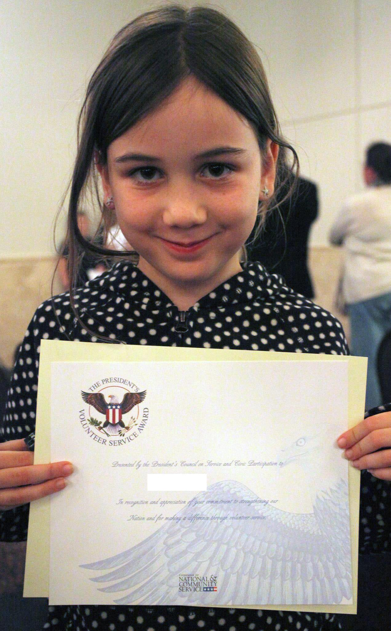
Challenges for ADBC Community
Photo: A. Mast
What cyberinfrastructure and protocols are necessary for this student to gain recognition for volunteer hours spent participating in this kind of science?

Slide 27

iDigBio gratefully acknowledges NSF Award 1115210. The bird, butterfly, and bat images are courtesy of Kevin Robertson (Tall Timbers Research Station).

