Slide 1
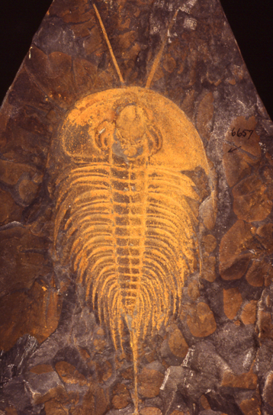
Digitizing Fossils to Enable New Syntheses in Biogeography – Creating a PALEONICHES - TCN
Bruce S. Lieberman
Department of Ecology & Evolutionary Biology and Natural History Museum
The University of Kansas, Lawrence, Kansas U.S.A.

Slide 2
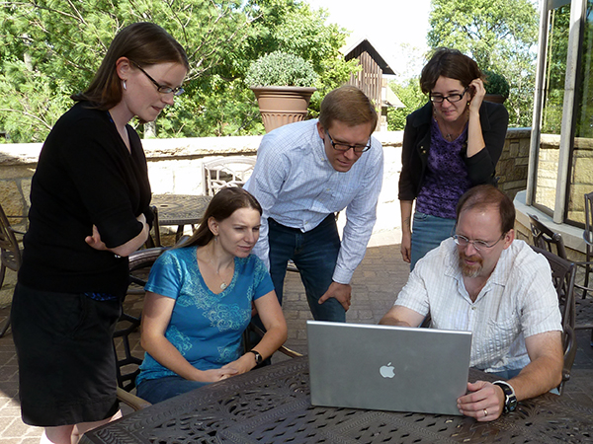
TCN Overview
“Digitization TCN: Collaborative Research: Digitizing Fossils to Enable New Syntheses in Biogeography – Creating a PALEONICHES-TCN”
Principal Investigators:
Bruce Lieberman (Univ. Kansas)
Alycia Stigall (Ohio Univ.)
Jonathan Hendricks (San Jose State Univ.)

Slide 3
TCN: Goals
Database several major invertebrate fossil collections.
Georeference fossil collections to enable study of biogeographic patterns over time.
Generate digital atlases of fossil life for the general public and scientific community:
Digital images of ancient biodiversity.
Paleogeographic maps for individual species over multiple time intervals.

Slide 4
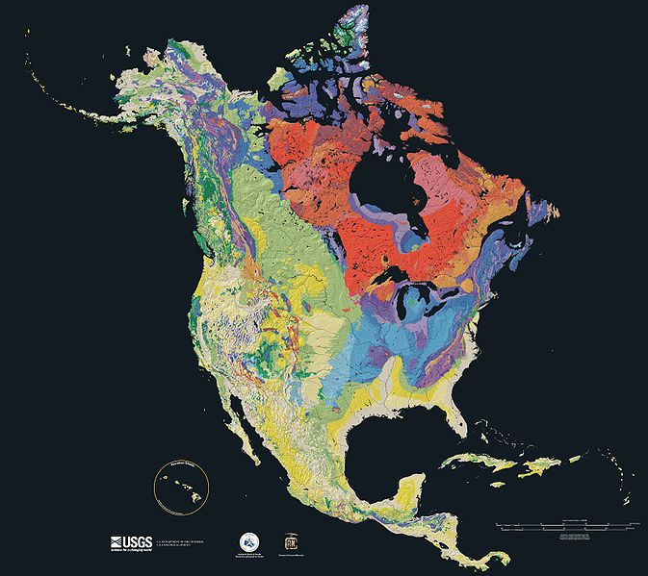
Project Coverage in Time and Space
Eon | Era | Period | Epoch
Phanerozoic | Cenozoic | Quaternary | Holocene
 |  |  | Pleistocene
 |  | Neogene | Pliocene
 |  |  | Miocene
 |  | Paleogene | Oligocene
 |  |  | Eocene
 |  |  | Paleocene
 | Mesozoic | Cretaceous | -
 |  | Jurassic | -
 |  | Triassic | -
 | Paleozoic | Permian | -
 |  | Pennsylvanian | -
 |  | Mississippian | -
 |  | Devonian | -
 |  | Silurian | -
 |  | Ordovician | -
 |  | Cambrian | -
Proterozoic | - | Ediacaran (630-542 Ma)- | -
Archean | - | - | -
Hadean | - | - | -
Younger
Slide shows the geological time scale.
Older

Slide 5
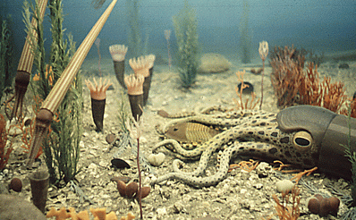
Ordovician (488-444 Ma) Collections
Region: Cincinnati area.
Collections:
Ohio University Zoological Collections (Alycia Stigall)
Department of Invertebrate Paleontology, Cincinnati Museum Center (Brenda Hunda)
Karl E. Limper Geology Museum, Miami University (Kendall Hauer)
Material to be digitized:
100,000 specimens
115 species
http://www.ucmp.berkeley.edu/ordovician/ordovician.php

Slide 6
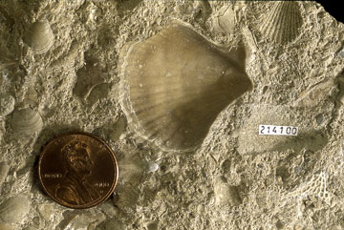
Pennsylvanian (318-299 Ma) Collections
Region: Mid-Continent.
Collection:
University of Kansas Biodiversity Institute, Division of Invertebrate Paleontology (Bruce Lieberman and Una Farrell along with Jim Beach)
Material to be digitized:
170,000 specimens
240 species
http://www.kgs.ku.edu/Extension/fossils/bivalve.html

Slide 7
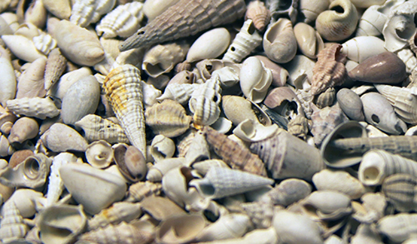
Neogene (23-2.6 Ma) Collections
Region: Southeastern USA.
Collection:
Division of Invertebrate Paleontology, Florida Museum of Natural History (Roger Portell)
Material digitized (focus will be on digital atlases):
176,615 specimens
500 species

Slide 8
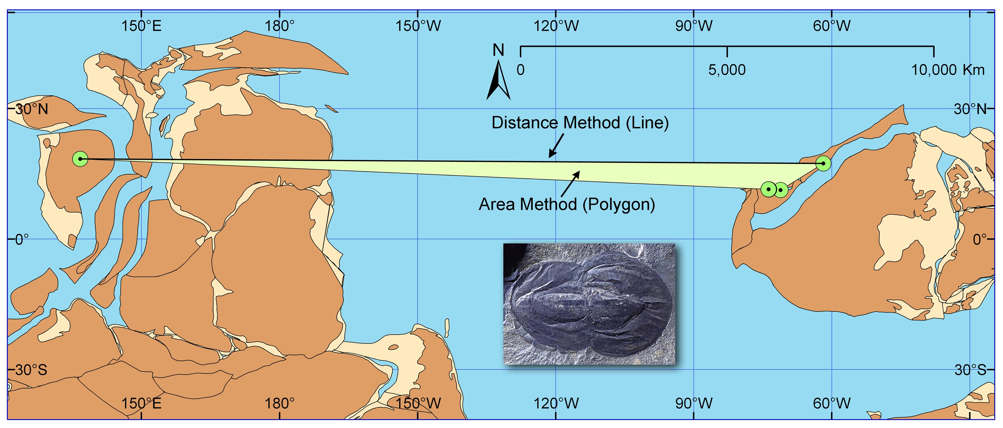
Most wide-ranging species - Naraoia compacta
Hendricks, Lieberman, and Stigall. 2008. Palaeo ³

Slide 9
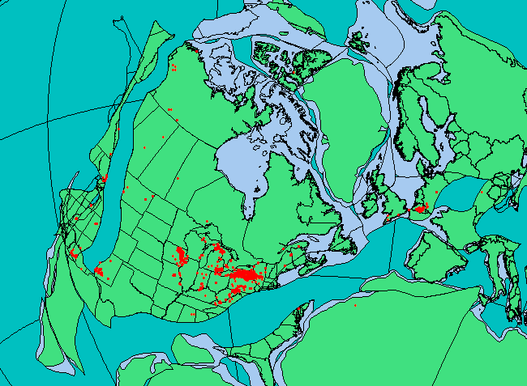
Over 5000 occurrence data from museum collections and the field
Rode and Lieberman. 2004. Palaeo ³
Stigall and Lieberman. 2006. Journal of Biogeography

Slide 10
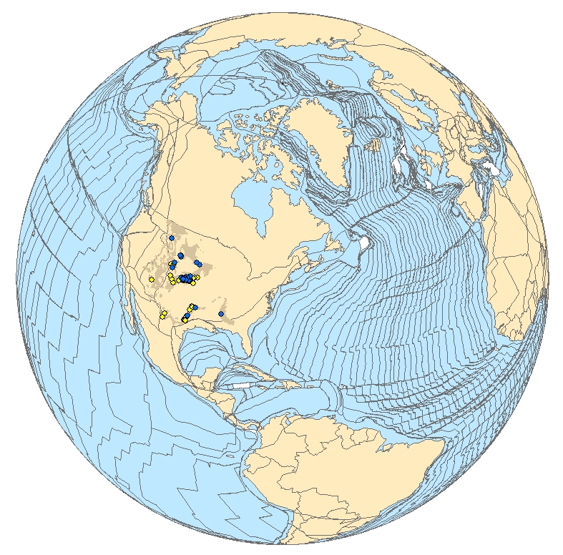
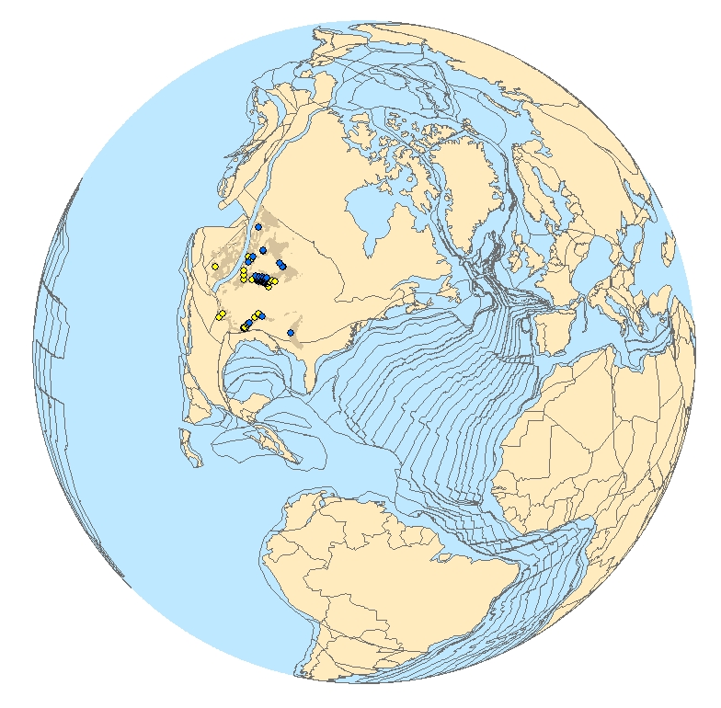
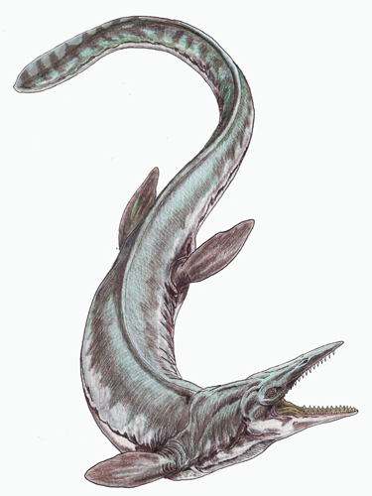
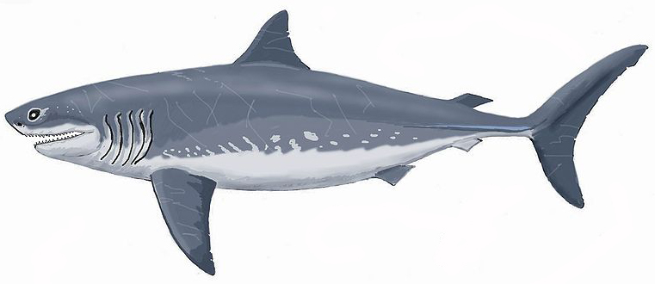
Present Day
Coniacian (~87Ma)
Cretoxyrhina mantelli
Tylosaurus sp.
Myers & Lieberman. 2011. Proceedings of the Royal Society Ser. B

Slide 11
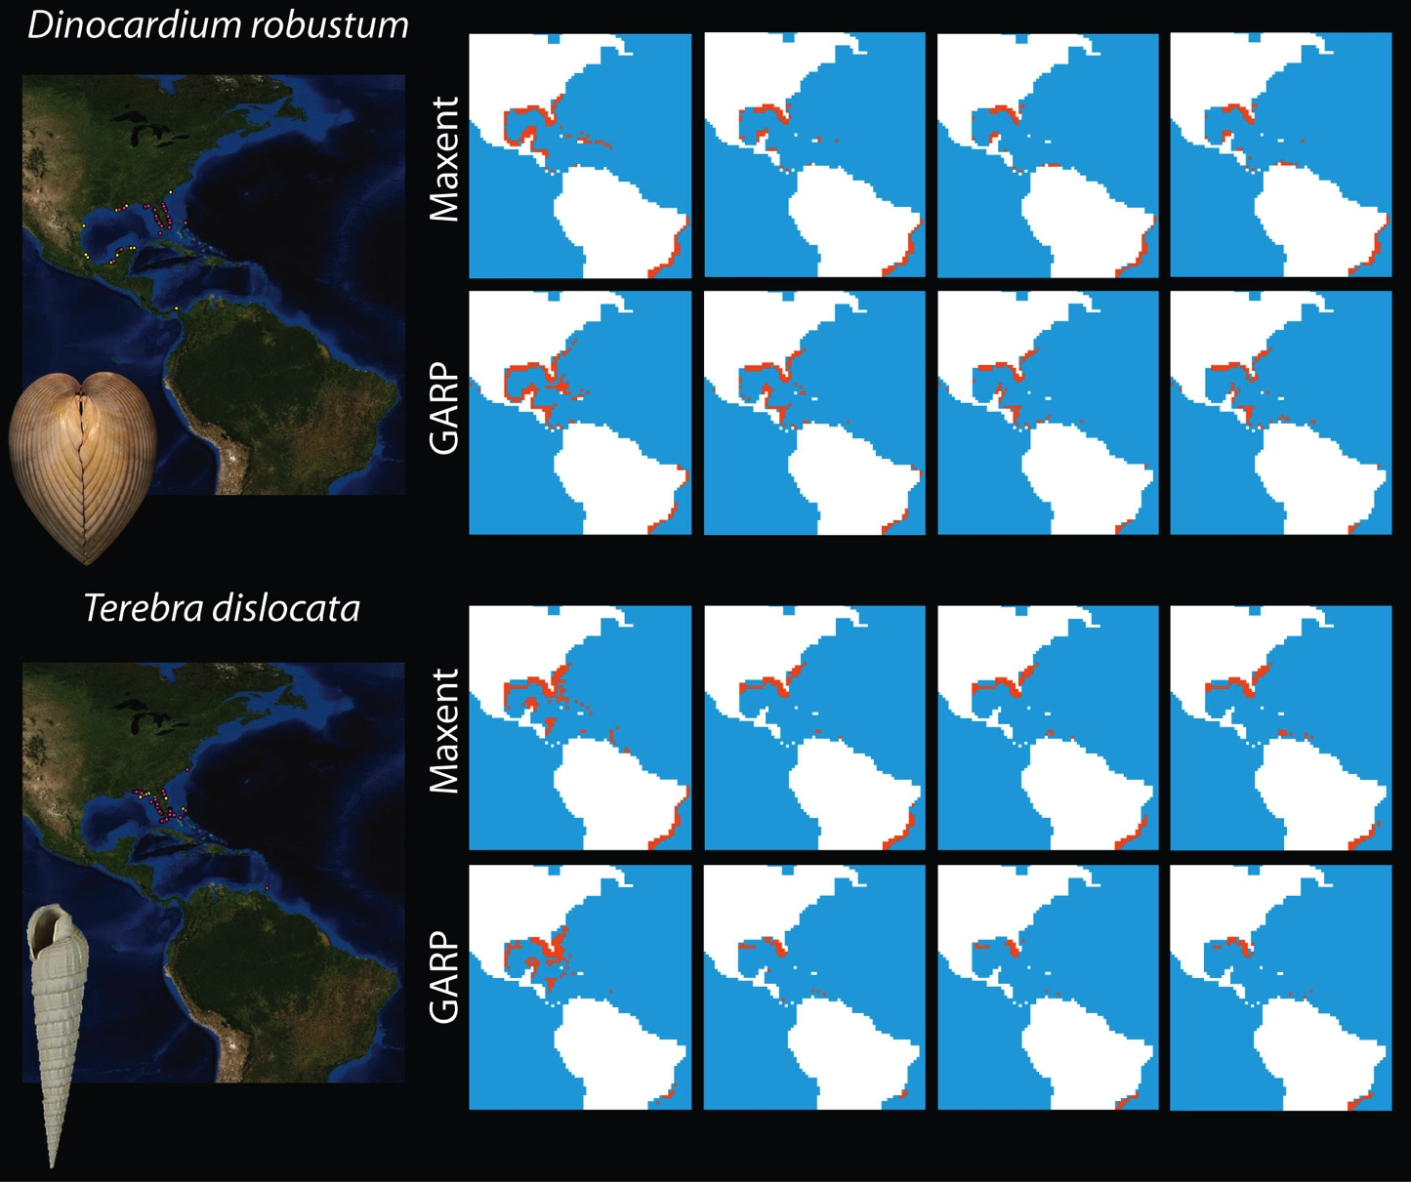
Present
2021-2040
2041-2060
2081-2100
Saupe, Hendricks, Peterson, and Lieberman. In review.

Slide 12
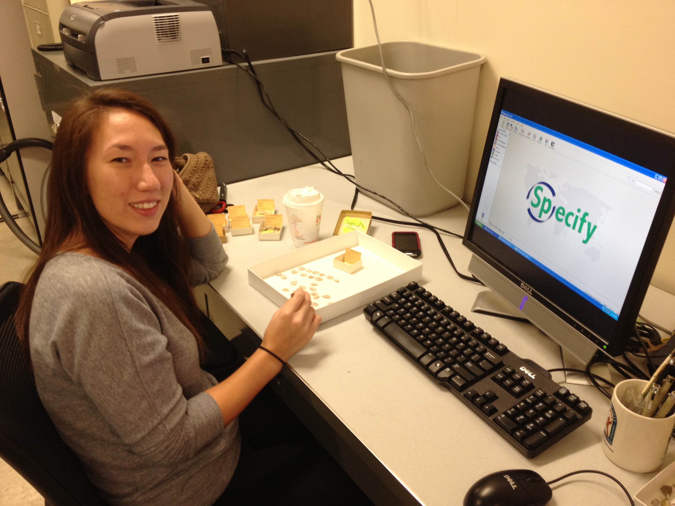
Databasing Activities

Slide 13
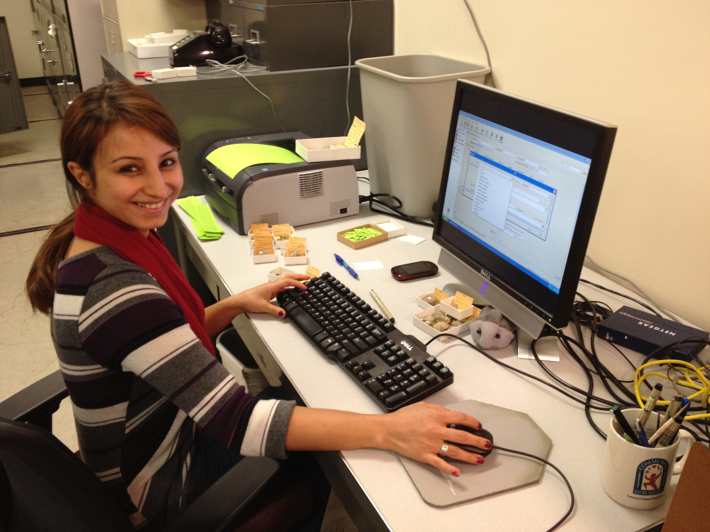
Databasing Activities

Slide 14
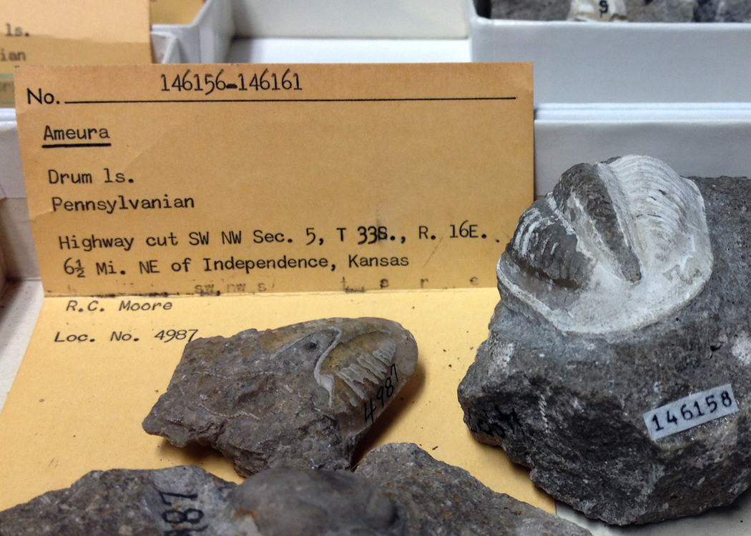
Specimen number(s)
Taxon
Lithostratigraphy
Geologic Age
Locality
Collector
Locality number

Slide 15
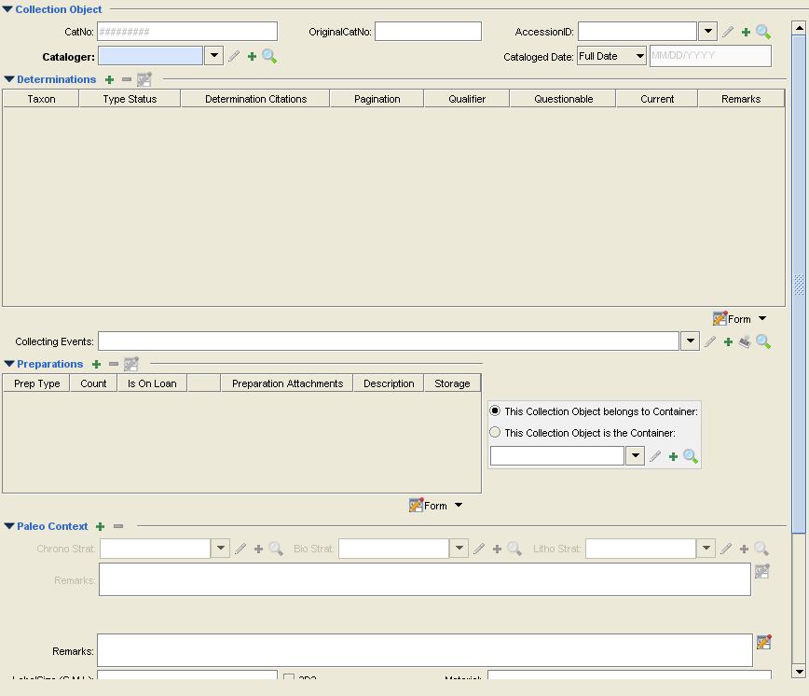

Slide 16
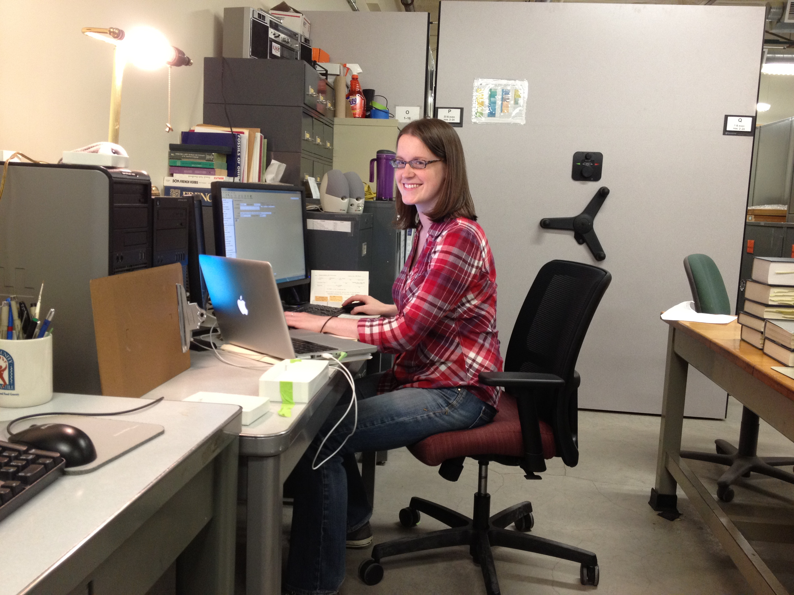
Georeferencing Activities

Slide 17
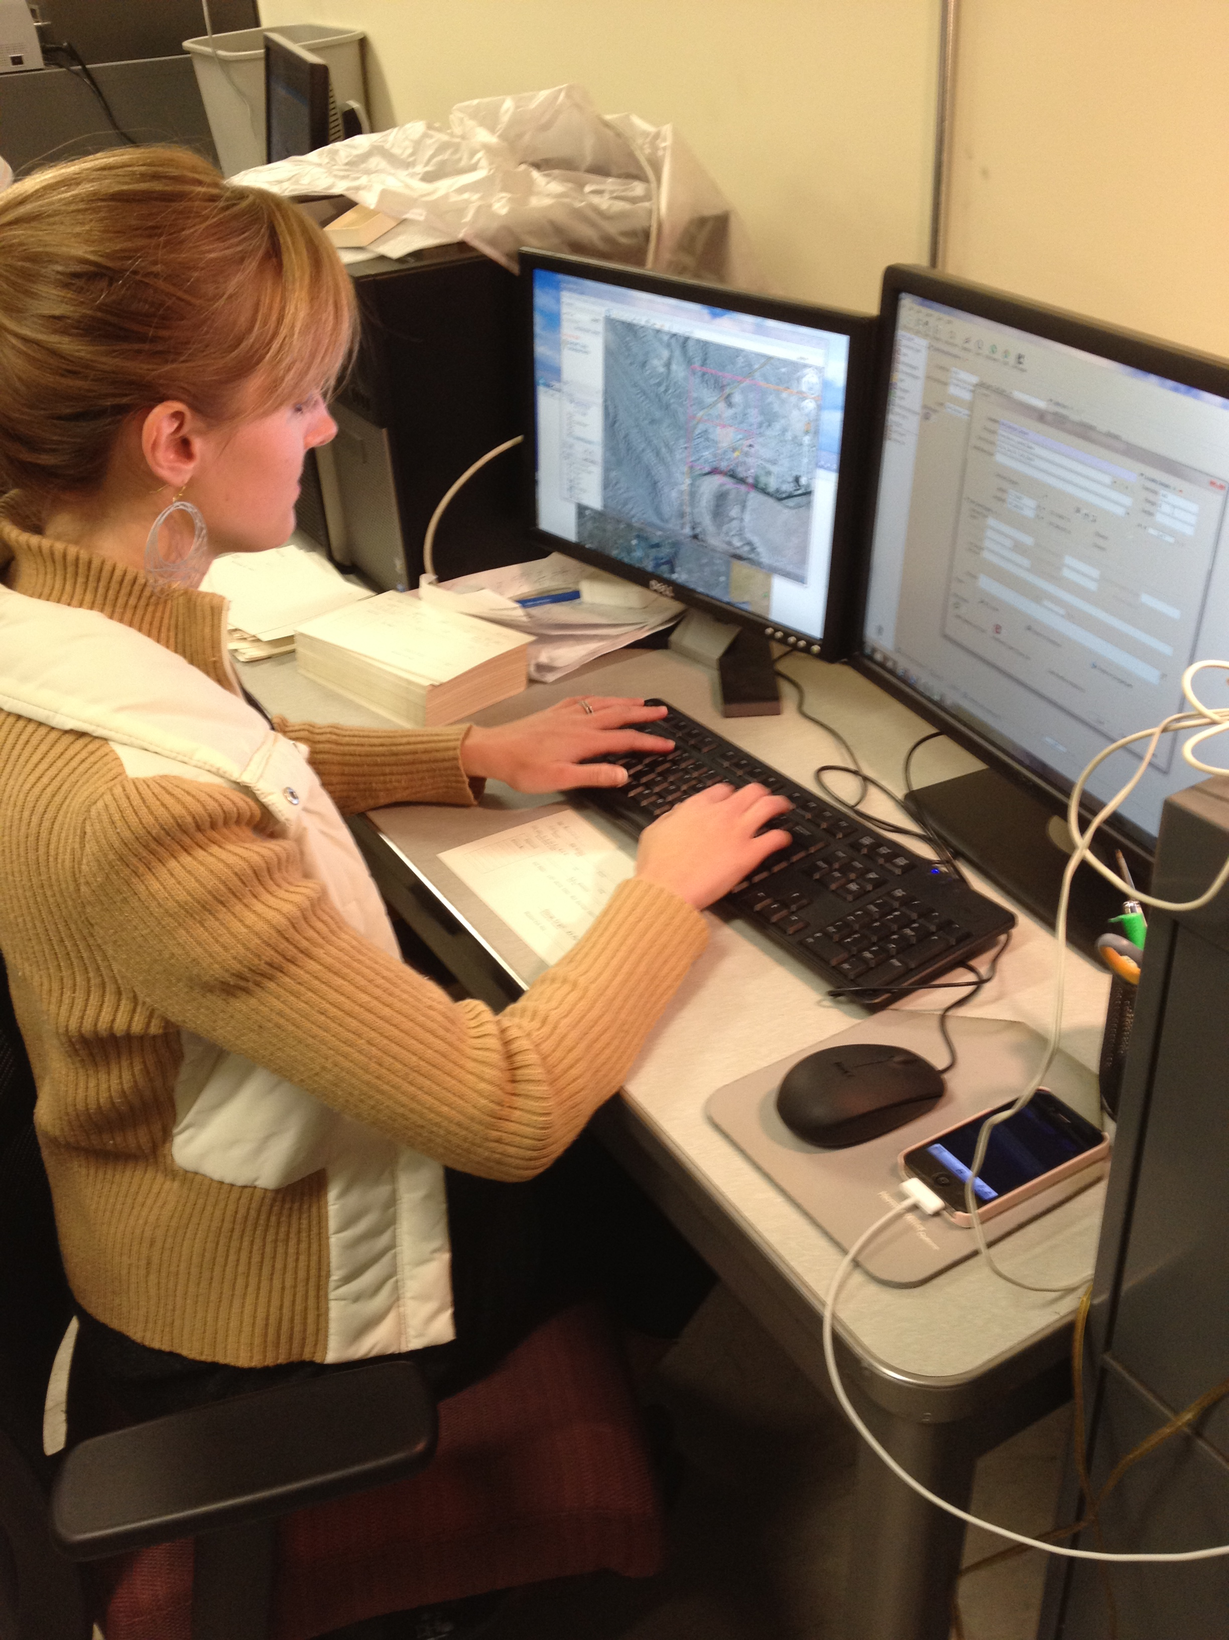
Georeferencing Activities

Slide 18
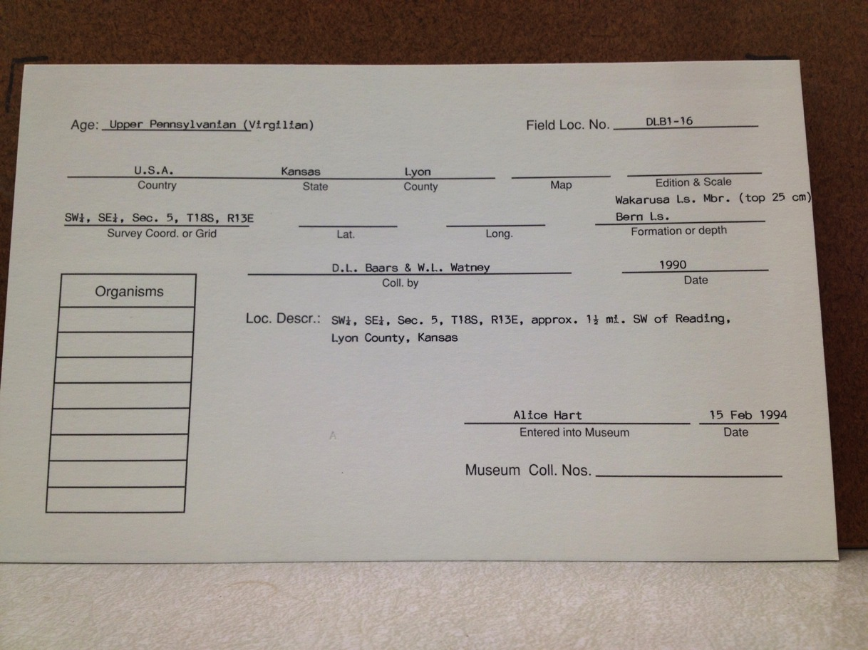
Geologic Age
Locality Number
Higher Geography
TRS
Lithostratigraphy
Collection Date
Collector(s)
Locality

Slide 19
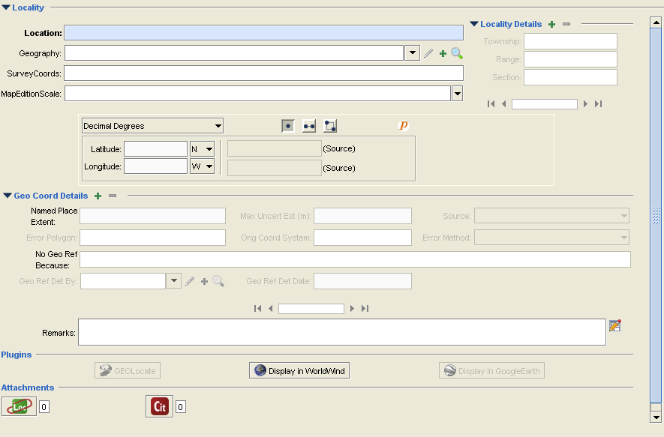

Slide 20
KUMIP Results/Stats Since June
Specimens databased – 5,109
Other data modified – 6,261
Specimens georeferenced – 641
Locality information modified – 3,081

Slide 21
Digital Atlases: Goals
Digital atlases:
“Field guides to the past” for three of the United States’ most fossil-rich regions
Online webpages
“App” for mobile devices
Intended audiences: scientists and advocational fossil collectors
Atlases will be generated for the following numbers of specimens from each time period:
Ordovician: 115 species
Pennsylvanian: 240 species
Neogene: 500 species

Slide 22
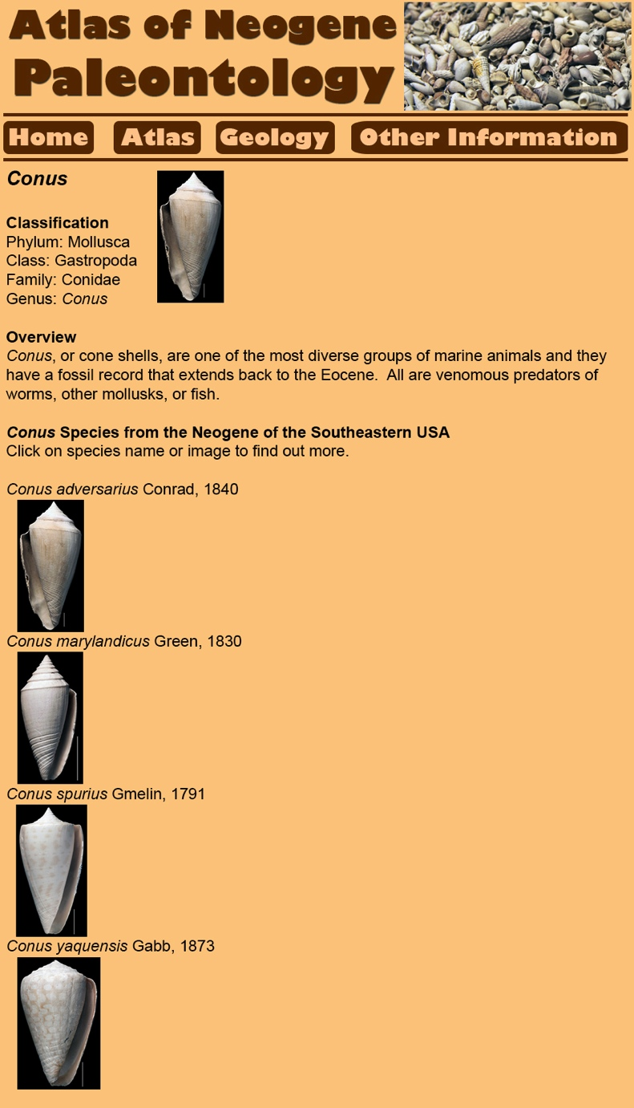
Genus Page
Classification (hyperlinks)
Overview of genus
Species list, with hyperlinked images to assist identifications
Slide shows figure of sample taxon webpage for Conus.

Slide 23
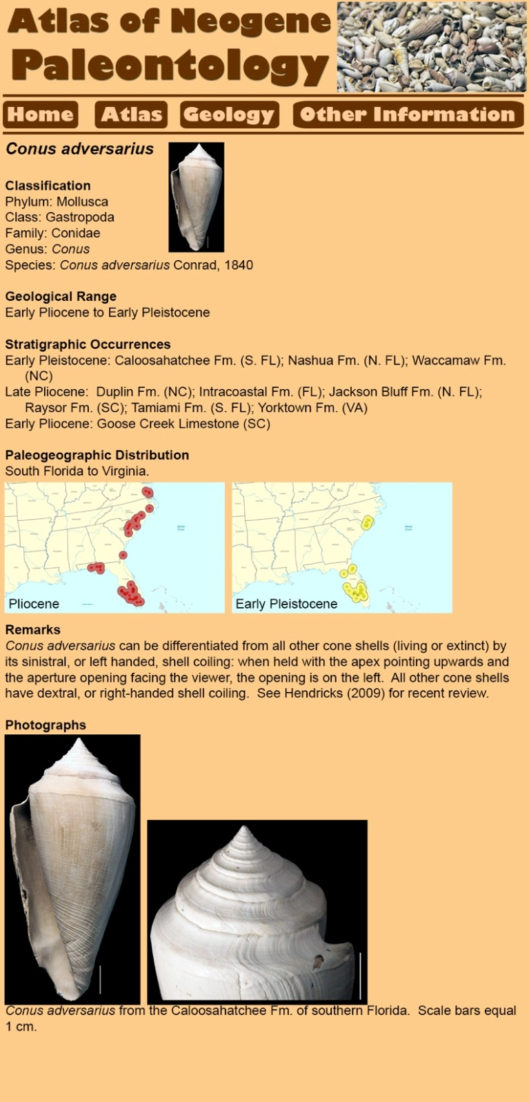
Species Page
Classification (hyperlinks)
Geological range
Stratigraphic occurrences (hyperlinks to taxon lists)
Paleogeographic distributions with “time-slice maps”
Remarks:
Features useful for identification
Important references
Photographs illustrating key features for identification
Slide shows figure of sample taxon webpage for Conus adversarius.

Slide 24
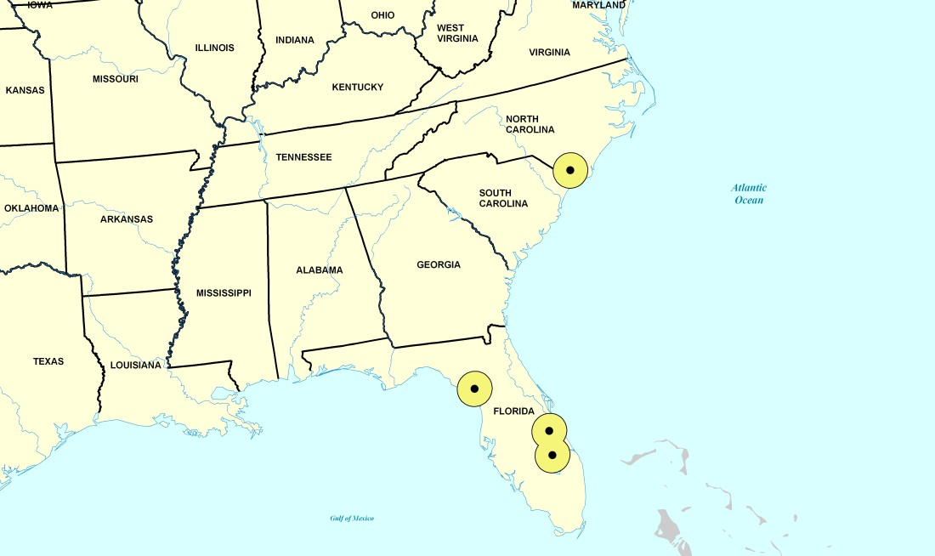
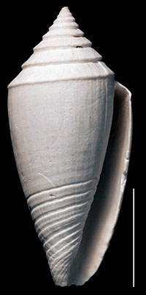
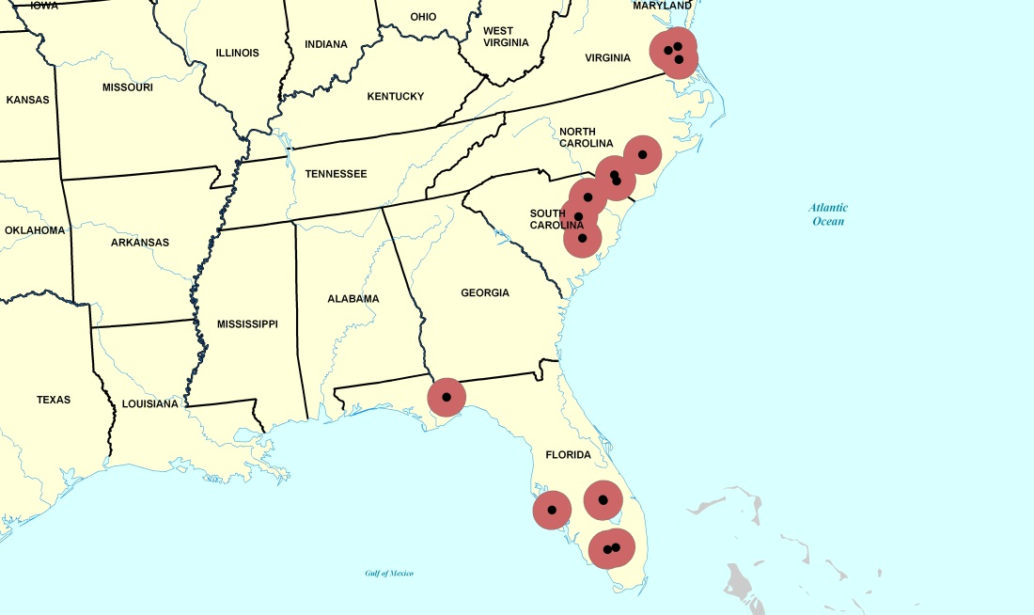
Conus marylandicus
Early Pleistocene
Pliocene
Note: Dots are actual occurrence areas, surrounded by a 50km buffer.
All records

Slide 25
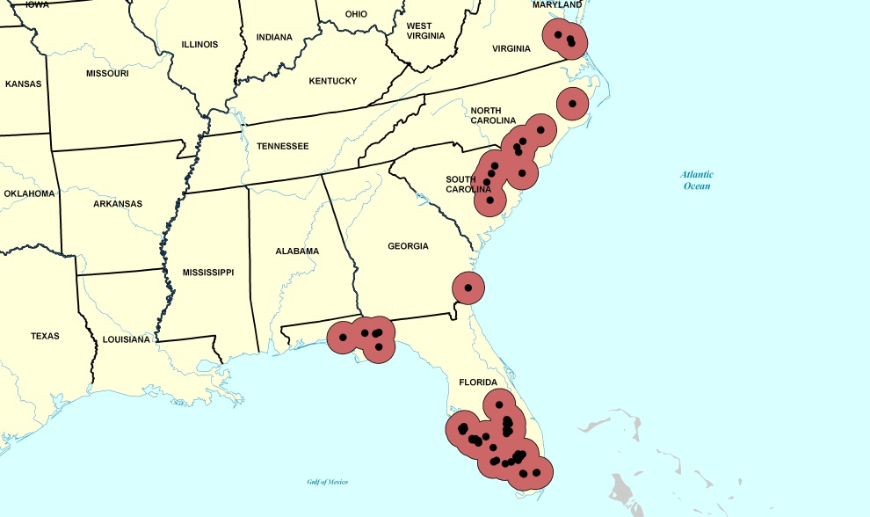
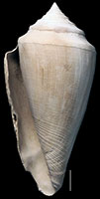
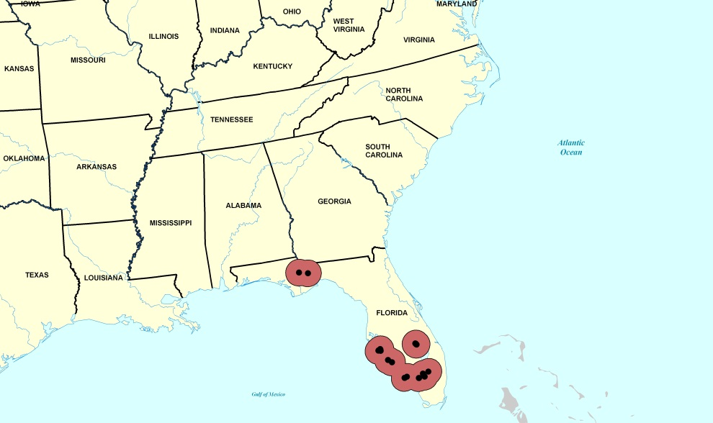
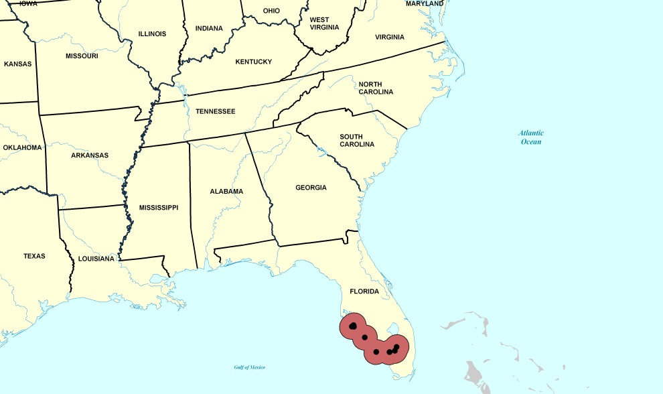
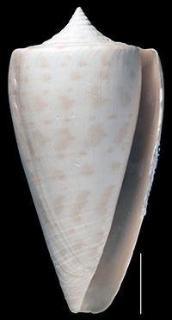
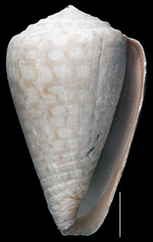
Different Ranges of Four Conus Species During the Pliocene
Conus adversarius
Conus marylandicus
Conus spurius
Conus yaquensis

Slide 26
Conclusions
Progress proceeding apace
Very excited about our new project
Enjoyed meeting various folks associated with the program and interacting with the different TCN’s

Slide 27
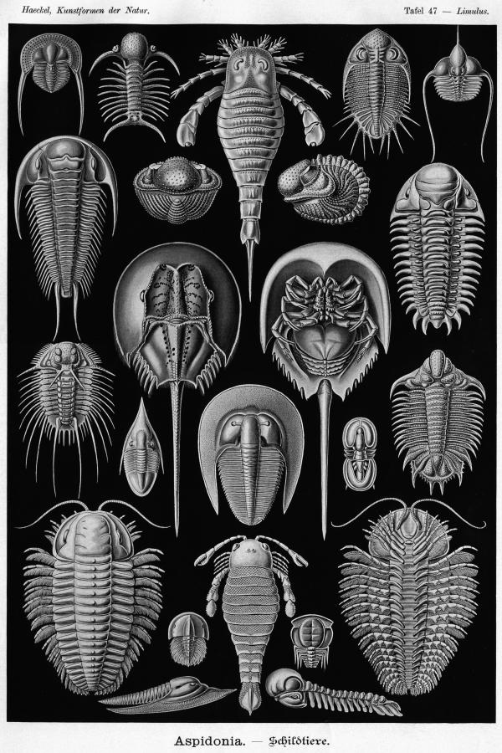
Thanks to:
J. Hendricks (SJSU)
U. Farrell (KU)
Jim Beach and Specify (KU)
Funding
NSF Emerging Frontiers
NSF Sedimentary Geology & Paleobiology
NSF Systematic Biology

