Slide 1
Lichens, Bryophytes and Climate Change Update
Corinna Gries
Edward Gilbert
Thomas H. Nash III

Slide 2
Lichens Bryophytes Climate Change
NSF ADBC funding 2011
~ 2.3 million specimen (90%)
900,000 lichens
1.4 million bryophytes
65 non-governmental US herbaria (95%)
16 digitization centers (collaborators)
Mobilizing existing
digital records
2 PEN proposals funded 2012
Add 120,000 specimen

Slide 3
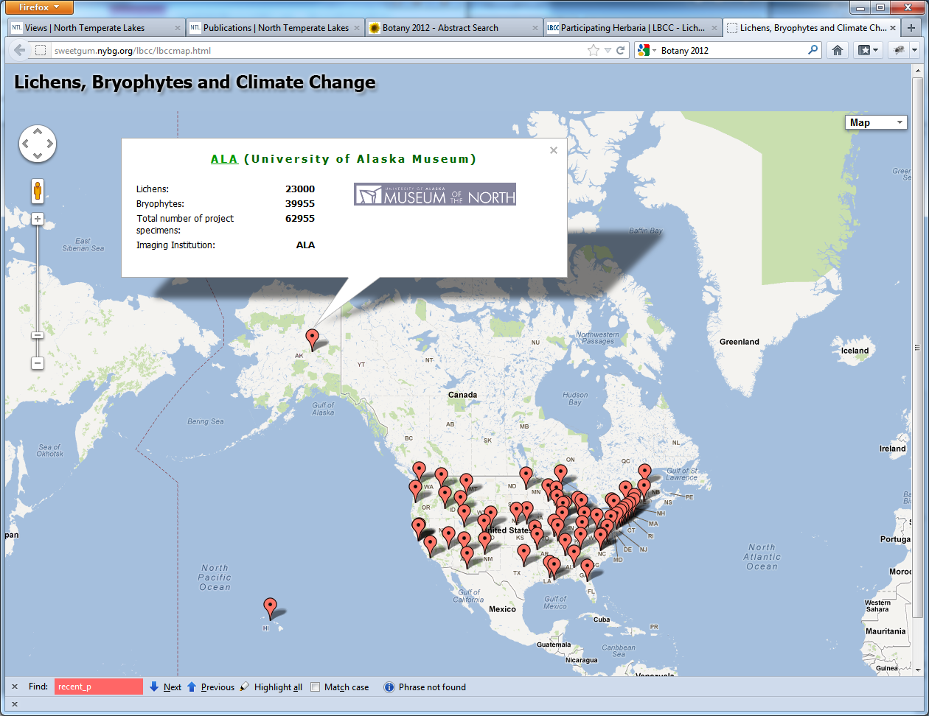
Participating Herbaria

Slide 4
Lichens Bryophytes Climate Change
Research Questions:
How are changes in distribution patterns of lichens and bryophytes over time correlated with man-made environmental changes?
How accurately can we predict where specific species can be found using existing herbarium data?

Slide 5
Workflow
Central Processing
OCR
NLP
Bulk processing
Preliminary
geo-referencing
processed
Take Image
File name: barcode
Upload to folder on FTP server Florida
Image processing
+
Create/Merge Record in Portal
Link Image
unprocessed
Create Skeleton File
Darwin Core Fields: barcode, species name +
Upload to folder on FTP server Florida
Upload Record in Portal
Link Image
reviewed
Find Duplicates and Edit Record in Portal
Pending review
Existing Digitized Records
Darwin Core+
Manage Records in Portal
Approve Record in Portal
reviewed

Slide 6
Technology
Custom System
Metadata capture program

Slide 7
Imaging stations
Great variety
Camera stands
Jewelry lighting boxes
Black coverings
Requirements
Resolution: small letter x needs to be 20 pixels high
Camera needs to connect to a computer
Barcode reader

Slide 8
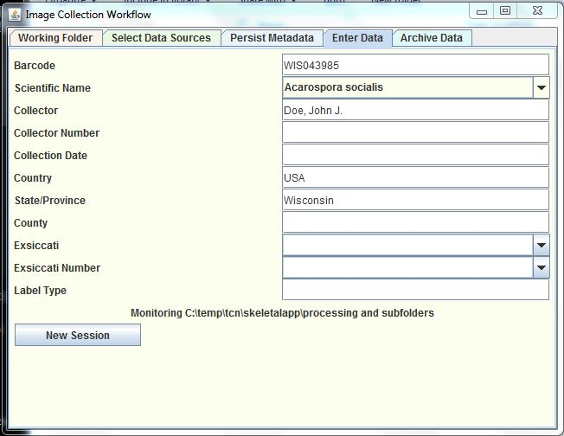
Metadata
Barcode
Latest species name
Collector
Collection number

Slide 9
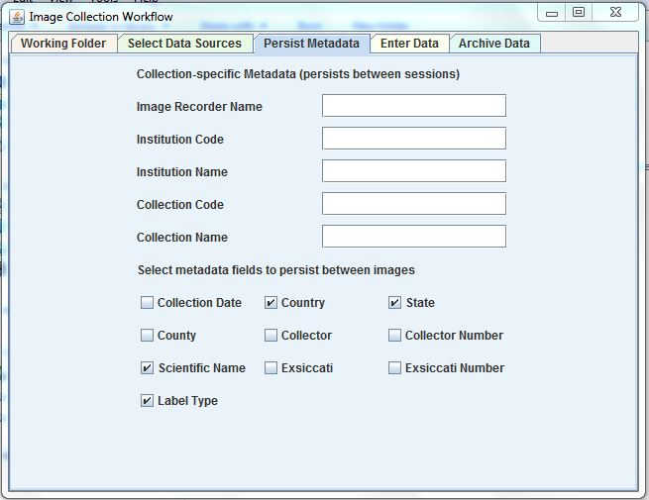
Persistent Metadata

Slide 10
Numbers
People involved in LBCC 70
Imaging Speed 300 to 750 per day
Institutions currently imaging 11
Additional institution imaging years 2-4 7
Total number of images generated (Oct. 2012) 242,000
Records available on bryophyte portal 1,068,003
Involving 16 institutions
Records available on lichen portal 803,823
Involving 24 institutions

Slide 11
Numbers
New York Botanical Garden (from 7/11) 65,600
University of Wisconsin (from 3/12) 49,900
University of Michigan (from 7/11) 42,400
University of Washington (from 7/11) 27,100
University of Tennessee (from 3/12) 15,500
Smaller collections completed or nearly so
Boise State University (WTU & SRP) 16,300
Oregon State University (WTU & OSC) 4,100
University of Vermont (NY) 12,100

Slide 12
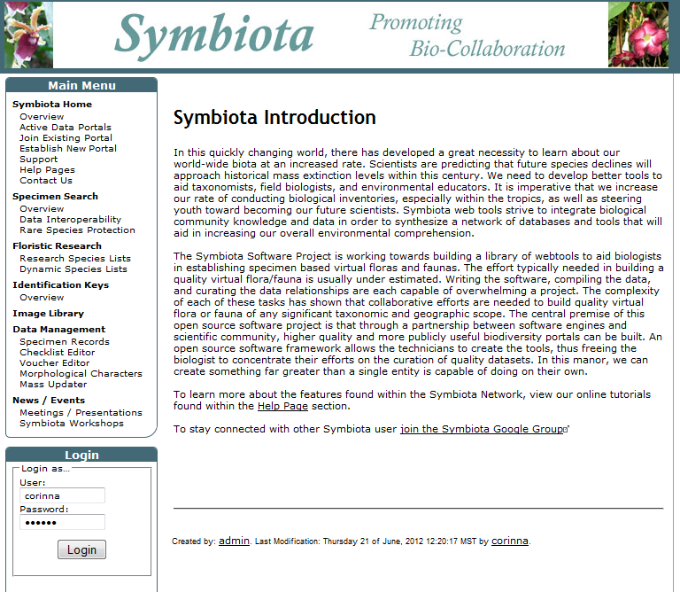
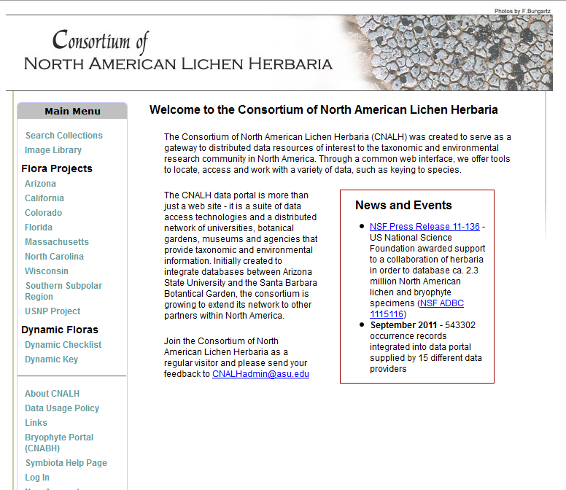
Portals
http://lichenportal.org
http://bryophyteportal.org
http://lbcc.limnology.wisc.edu/
http://symbiota.org

Slide 13
Next Year
Crowd Sourcing / Citizen Science
National transcription coordinator - John Brinda at Missouri Botanical Garden
Sophisticated User and Workflow Management System in SYMBIOTA
Transcription
Geo-referencing
Professional quality control
Talking to Mexican Collections

Slide 14
Transcription

Slide 15
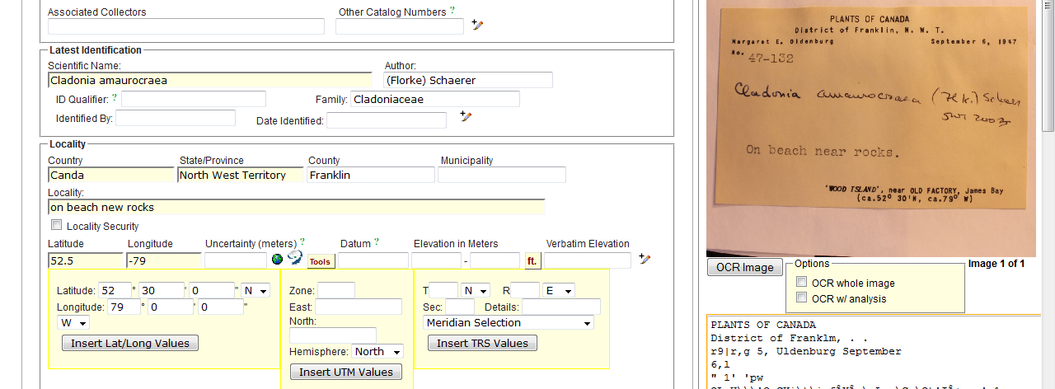
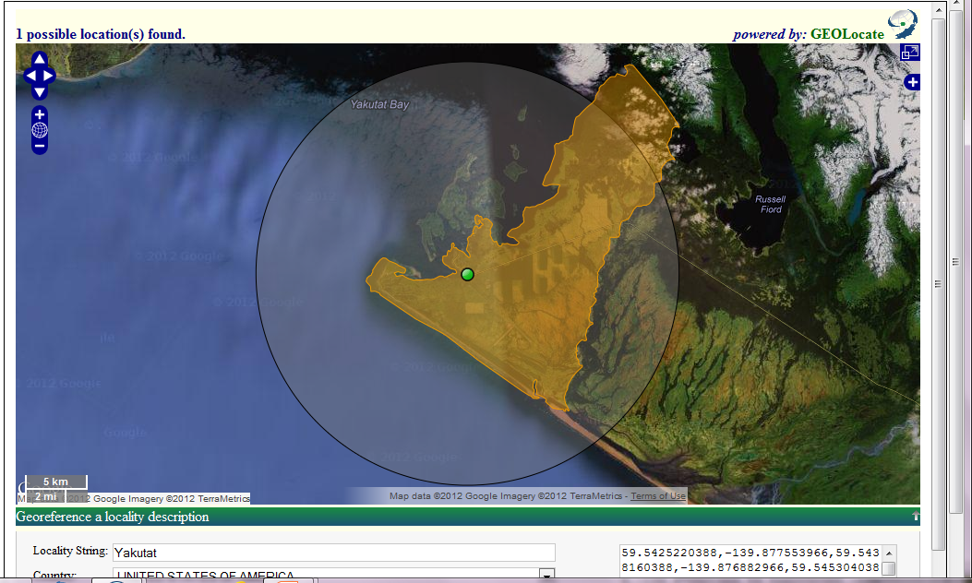
Geo-referencing
Supervised batch
geo-referencing

Slide 16
Thank you
Michael Adamo
Bruce Allen
Meredith Blackwell
Bill Buck
Alina Freire-Fierro
John Freudenstein
Alan Fryday
David Giblin
Tim Hogan
Karen Hughes
Steffi Ickert-Bond
Timothy James
Jennifer S. Kluse
Matt Von Konrat
Ben Legler
Tatyana Livshultz
Robert Lücking
Francois Lutzoni
Bob Magill
Andrew Miller
Brent Mishler
Donald Pfister
Richard Rabeler
Malcolm Sargent
Edward Schilling
Michaela Schmull
Blanka Shaw
Jon Shaw
Carol Shearer
Larry StClair
Barbara Thiers
Funded by the NSF ADBC program

