Slide 1
iDigBio Cloud and Appliances: Concept, Processes and Progress
Jose Fortes
(on behalf of the
iDigBio IT team)
iDigBio Summit, Gainesville
October 23- 24, 2012

Slide 2
iDigBio IT Vision
Cyberinfrastructure to enable
the collaborative creation, integration and management of digitized biocollections, and
their use in scientific research, education and outreach.
Visible as a collection of persistent Internet-accessible services, data and resources for
biocollection “producers”, “consumers” and “service providers”
cyberinfrastructure providers
national/global data aggregators

Slide 3
CI Stakeholders
TCNs
Domain Data Producers
Infrastructure Providers
Domain Service Providers
Domain Data Consumers
National/Global Data Aggregators
Museums
Collectors
Amazon Turk
GBIF
iPlant
Amazon WS
Domain-level data
ALA
Google
iDigBio
DataONE
EOL
TCNs
BISON
Microsoft Azure
Data Conservancy
Georeferencing
Researchers
Teachers
Imaging services
Citizens
Data quality
NESCent
TCNs
Translation
Mapping
TCNs
OCR
Government
iPlant
Notes:
This diagram presents the stakeholders listed in the previous slide that will form the iDigBio cloud and that are distinct from a CI point of view.
Representative projects, industry and organizations of each group are shown around each rounded-box, and one can have multiple “hats”.
For example, a TCN will certainly be a biocollections data producer, would also likely be a consumer of this data, and could potentially offer biocollections-specific services or provide cyberinfrastructure for the iDigBio cloud.

Slide 4
Evolution of iDigBio capabilities
Data ingestion
Data access, provision and visualization
Provide and enable data feedback
Data linking and federation
Process and visualize integrated data
Time
Increasing storage and server hosting in support of the above
Increasing number of appliances in support of the above
Web site for interaction with public, community, education and above

Slide 5
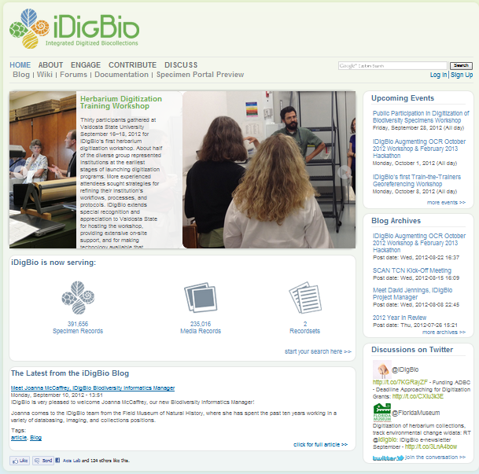
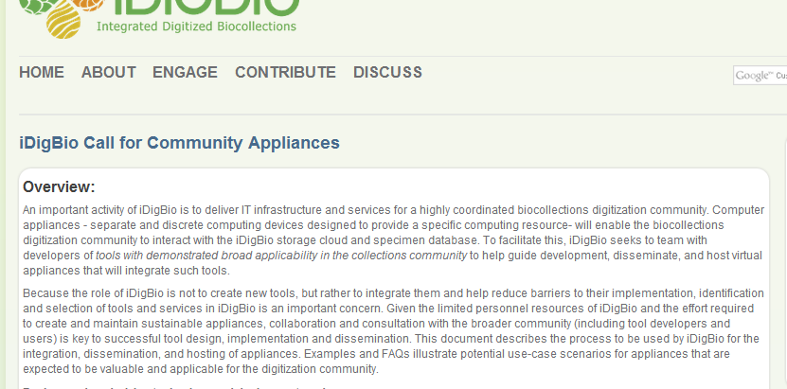
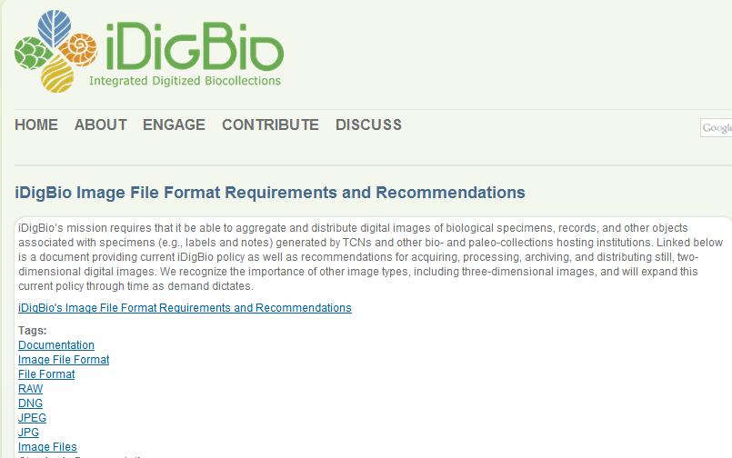
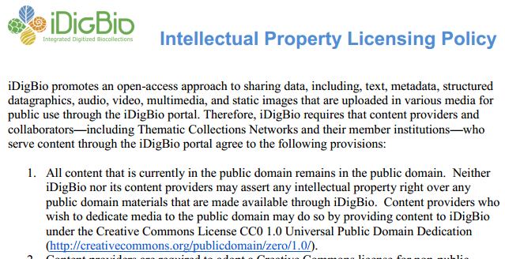
iDigBio.org
News
Events
Forums
Documents
Links
Data
portal
Working
groups

Slide 6
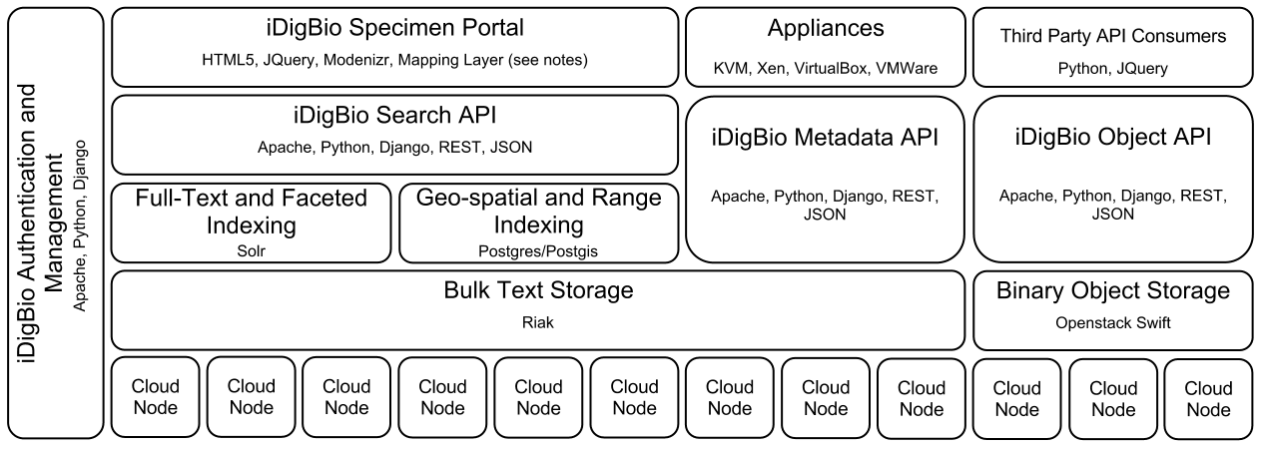
Building the iDigBio Cloud
Useful services/APIs (programmatic and web-based)
Scalable object storage and information processing
Digitization-oriented virtual appliances
Standards, proven solutions and software reuse if possible
Stakeholder input(surveys, summit, workshops, working groups …)
Needs: storage, server hosting, data feedback transformations …

Slide 7
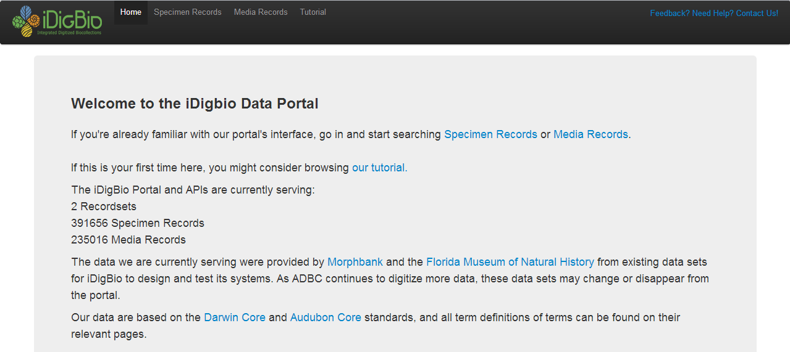
iDigBio data portal v0 at work

Slide 8
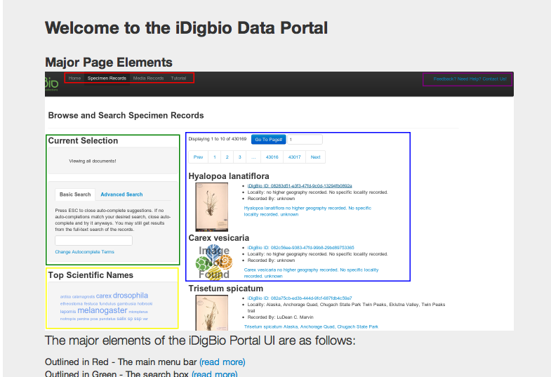
iDigBio Data Portal: Tutorial

Slide 9
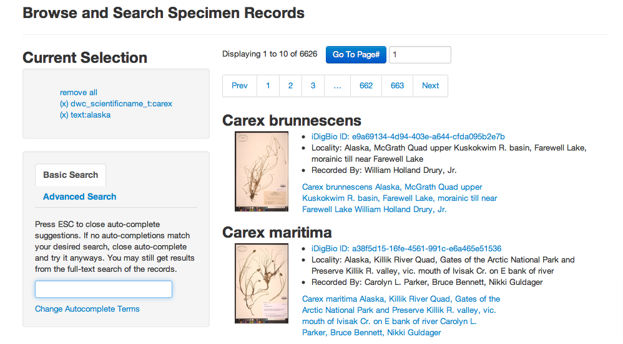
iDigBio data portal v0: search

Slide 10
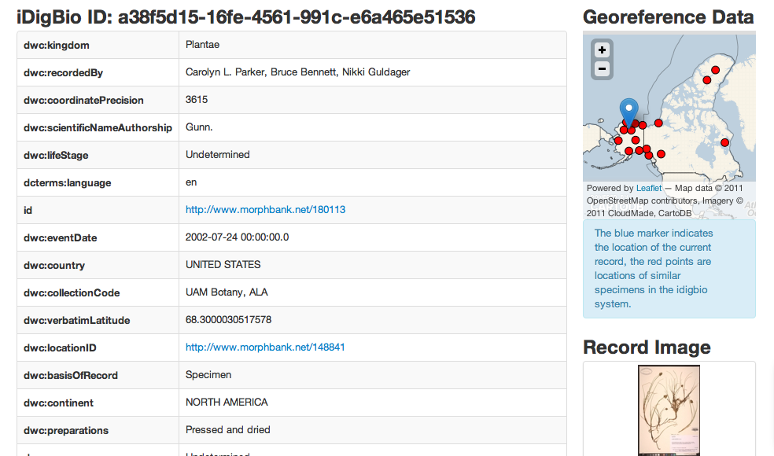
iDigBio data portal v0: record info

Slide 11
Storage hosting
“iDigBio may be able to facilitate storage of images on a case-by-case basis.”
“iDigBio currently does not provide archival storage, and hosting of images in iDigBio should not be seen as such.”
iDigBio currently has approximately 30 TB space committed to storage for the dissemination of images and derivatives produced by the following TCNs:
LBCC TCN
MaCC TCN
TTD TCN
If you would like iDigBio to store and disseminate your TCN data as well, please contact us.
iDigBio also provides limited storage space along with its hosting services, this space currently totals approximately 8TB of storage.
Notes:
iDigBio currently has approximately 30 TB space committed to storage for the disemenation of images and derivatives produced by the following TCNs:
LBCC TCN
MaCC TCN
TTD TCN
If you would like iDigBio to store and disseminate your TCN data as well, please contact us.
iDigBio also provides limited storage space along with its hosting services, this space currently totals approximately 8TB of storage.

Slide 12
Appliances, Virtual Private Servers
iDigBio packages and distributes pre-configured software tools and environments as software “appliances”
Deployment in end-user or in a hosted server environment
iDigBio cloud hosts virtual private servers exposing services to the bio-collections community
Proposal requests through iDigBio portal interface
Virtual private servers on iDigBio cloud:
Symbiota, FilteredPush, VertNet, Biogeomancer
Virtual appliances
Under development: Media ingestion; augmenting-OCR workshop and hack-a-thon
Community interactions: Image-to-record services (OCR, NLP, duplicate discovery, workflow), Kepler Kurator, Specify

Slide 13
Data Ingestion Tool Demo
Initial Setup

Slide 14
Initial Screen – Sign In
Notes:
The user needs to sign in to use the application.

Slide 15
Fill out Sign In Form
Notes:
Account ID & API Key combination is provided by iDigBio

Slide 16
Settings Pane After Signing In
Notes:
If the settings have not been configured (e.g. in the first use of the application) the user will first be directed to the setting pane.
If settings are configured already, the user goes directly to the uploader pane.

Slide 17
Fill Out Settings

Slide 18
Move Next to Uploader Pane

Slide 19
Copy and Paste Path, Upload
Notes:
User clicks “Upload” button.

Slide 20
Upload Started
Notes:
The progress bar shows the percentage of the pictures that the tool has attempted to upload.

Slide 21
Data Ingestion Tool Demo
Case 1: Ingestion Successful on the First Attempt

Slide 22
Upload Finishes Successfully
Notes:
If everything goes well, the batch upload finishes with all images successfully uploaded.
There can be temporary failures that have been recovered by several retries on each image, each retry after a exponential back-off.
Click ‘CSV’ or ‘PDF’ to export the entire mapping table.
Click the link to download the image.

Slide 23
Data Ingestion Tool Demo
Case 2: Ingestion Successful After Several Attempts

Slide 24
Network Failed - Upload Aborted
Notes:
Batch upload failed due to continuing network failure
- In this case, ACIS VPN disconnected.
- Upload is aborted after 9 consecutive failed images.

Slide 25
Upload Resumes
Notes:
Batch upload resumes after the user clicks the ‘retry’ button.
- The directory is rescanned for old and potentially new images.
- Images already uploaded are skipped.

Slide 26
Upload Finished with Some Errors
Notes:
This time there was no major network errors but,
- 2 images still failed even after multiple retries.

Slide 27
Resume Again
Notes:
Resume again.

Slide 28
Now Entire Batch is Successful
Notes:
All images are successfully uploaded.

Slide 29
Summary
iDigBio cloud
Service-oriented, standards-based, focused on ADBC needs
Scalable data management and information processing using standard interfaces, data formats, protocols, tools
Toolboxes as appliances
Evolving collection of community-selected tools
Built-in interfaces for effortless iDigBio integration
Embed best practices and standards in biocollections work
Summit is an opportunity to help iDigBio get it right
For feedback: fortes@ufl.edu and “Contacts” at idigbio.org

Slide 30
Acknowledgments
National Science Foundation
Judith Skog and Anne Maglia
iDigBio IT team at U. of Florida
Renato Figueiredo & Andrea Matsunaga, Senior Personnel
Alex Thompson, Kevin Love & Matt Collins, IT Experts
Jiangyan Xu, Graduate student
iDigBio IT team at Florida State U.
Greg Riccardi, Director for Informatics
Austin Mast, Senior Personnel
Gil Nelson & Deb Paul, Digitization Specialists
Guillaume Pierre, IT expert

Slide 31
Extras

Slide 32
Virtual Appliances in iDigBio
Virtualization technologies enable packaging of software and dependences in appliances
End user/desktop (e.g. VMware, Virtualbox)
Infrastructure-as-a-Service clouds (e.g. OpenStack)
Platform to integrate and package bio-collection tools
To enhance/simplify user experience
Facilitate integration with the iDigBio storage cloud and specimen database
Notes:
The main points for this slide are:
iDigBio is not funded to develop tools, but there are many tools produced by the community that can be of general use
There are also tools that support interaction with cloud infrastructures (e.g. cloud storage put/get, provisioning of VMs)
Our goal is to integrate existing and future tools and package in a way that makes them accessible to end users
Our general framework to accomplish this is to use virtualization to encapsulate pre-configured tool(sets)

Slide 33
Examples
Image ingestion appliances (short term)
Batch upload of several images from a local storage device/file system to cloud storage
Generate GUID/URLs for later processing
Reliable transfers using cloud APIs (e.g. Swift/iDigBio)
Post-processing appliances
OCR tools; end-user or for batch processing
Geo-referencing appliances
Training/verification
Research workflow appliances
Data-intensive/batch processing workflows; e.g. data mining, image processing
Notes:
These are examples of appliances that can run ranging from end-user to iDigBio cloud environment
Image ingestion: end user (images are on their local resources)
Post-processing: might be at the end-user side (if post-processing is in workflow before committing to iDigBio), or on iDigBio cloud environment (if workflow has post-processing decoupled from image capture)
Geo-referencing (appliances with pre-set data/examples/benchmarks for training; hosting of geo-referencing services as virtual appliances in the iDigBio cloud)
Research workflow: run in iDigBio back-end infrastructure; e.g. provide APIs for scalable Map/Reduce information processing with queries to iDigBio specimen/image databased

Slide 34
Now: appliance proposal process
Users/developers can propose appliances through the iDigBio Web portal
Requirements – demonstrates usage/buy-in, software license, documentation, etc
Queue of appliances for integration
iDigBio will prioritize and work with developers
Leverage expertise in appliance development
Focus on images that users can download and run on VMware, Virtualbox
Application, in addition to virtual appliance, if applicable/desirable
Notes:
The point to make here is that the process of identifying appliances comes from the community and our own anticipation of needs of iDigBio users (e.g. tools to interact with the cloud/APIs), and that in the long term a goal is to foster the development of appliances by the community.

Slide 35
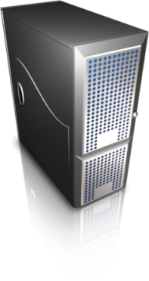
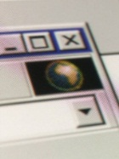
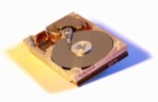
Appliances
Facilitate data ingestion, interface with iDigBio
Evolving collection of community-selected tools
Built-in interfaces for effortless iDigBio integration
Embedded best practices and standards in biocollections work
Ingestion
appliance
Web-based UI
Batch upload,
Cloud APIs
Web
server
Cloud
client
File interface
/1/100.tif GUID1
/1/101.tif GUID2
Images captured
(e.g. HD/flash media)
/images/1/100.tif
/1/101.tif
/2/200.tif
…
iDigBio object
Storage cloud
Notes:
This overviews where we are in the data ingestion appliance
This is an example of an appliance that addresses a need identified internally – ingesting image files into the iDigBio cloud in a simple, reliable manner
A goal here is to streamline the process of consolidating images into a repository that is Web accessible. For instance, a TCN with multiple institutions can use this mechanism to ingest images in a distributed fashion, then later post-process the image to extract metadata, OCR, etc – rather than expecting TCNs to coordinate the exchange of these images, they get stored in iDigBio cloud
The approach here is akin to synchronizing media to storage; media here would be typically images captured using a camera/scanner.
The user interface is Web-based, so it’s accessible from a browser
An embedded web server is in the appliance and take user requests to specify a folder that are to be uploaded
The appliance takes this request and becomes responsible for locating and uploading images, interacting with the iDigBio API, dealing with failures, and providing unique URL identifiers that can be used to reference the uploaded image(s) (and can be used as GUIDs)

Slide 36
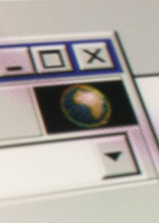
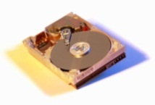
Short term
Facilitate data ingestion, interface with iDigBio
Tools identified by community in workshops/groups
Ingestion
appliance
Web-based UI
Web
server
Cloud
client
Batch upload,
Cloud APIs
File interface
/1/100.tif GUID1
/1/101.tif GUID2
iDigBio object
Storage cloud
(Swift)
Images captured
(e.g. HD/flash media)
/images/1/100.tif
/1/101.tif
/2/200.tif
…
Notes:
This overviews where we are in the data ingestion appliance
This is an example of an appliance that addresses a need identified internally – ingesting image files into the iDigBio cloud in a simple, reliable manner
A goal here is to streamline the process of consolidating images into a repository that is Web accessible. For instance, a TCN with multiple institutions can use this mechanism to ingest images in a distributed fashion, then later post-process the image to extract metadata, OCR, etc – rather than expecting TCNs to coordinate the exchange of these images, they get stored in iDigBio cloud
The approach here is akin to synchronizing media to storage; media here would be typically images captured using a camera/scanner.
The user interface is Web-based, so it’s accessible from a browser
An embedded web server is in the appliance and take user requests to specify a folder that are to be uploaded
The appliance takes this request and becomes responsible for locating and uploading images, interacting with the iDigBio API, dealing with failures, and providing unique URL identifiers that can be used to reference the uploaded image(s) (and can be used as GUIDs)

Slide 37
Medium-term – “Marketplace”
End
users
Users/
Developers
Community
appliances
iDigBio
appliances
Proposals
iDigBio Portal
iDigBio
Personnel
Notes:
Here, in the medium term, more appliances will be proposed and developed either in collaboration with iDigBio personnel, or by users in the community.
The portal will serve as an aggregator of the appliance images (and best practices for their development) and users will be able to download and use tools from this repository

Slide 38
Long-term – information processing
End
users
Users/
Developers
Workflows
Map/Reduce
Download
Community
appliances
Deploy
iDigBio Portal
iDigBio
Personnel
Specimen
Database
Notes:
Here, in the long term, appliances serve not only as user interfaces to interact with iDigBio for tasks such as ingestion, but they also can be packaged to run on iDigBio cloud resources (eventually also on a user’s private cloud, or on a commercial cloud). The goal here is to encapsulate in appliances workflows that are useful for research processes and that can programmatically retrieve from the specimen database and iDigBio storage.
The process continues to take proposals and working with the community, as well as enabling contributions from users, but here the appliances have a different purpose – e.g. scalable queries and data-intensive processing using for instance appliances that run Hadoop map/reduce jobs.

Slide 39
iDigBio Cloud Internal Architecture
Domain Data Producers
Specimen-record objects
Specimen-image objects
National/Global Data Aggregators
Publish
API/XML Consumer
GBIF
Morphbank
…
Comment
Updates
Notifications
iDigBio Collections Management
Initial deployment
on UF ACIS resources;
partially replicated at FSU for
reliability and performance
Object store
Database
Compute
(NOVA)
(SWIFT)
(RIAK)
Data Intensive Processing
Media
Data/Metadata
Notes:
Potential object store: Swift
Potential database: MySQL/Triple store
The Darwin Core community is very anal about distinguishing between an occurrence (in nature) and the specimen object documenting that occurrence…

Slide 40
Stakeholders APIs
TCNs
Domain Data Producers
Infrastructure Providers
Domain Service Providers
Domain Data Consumers
National/Global Data Aggregators
Museums
Collectors
Amazon Turk
GBIF
Updates
Notification
Usage track
Amazon WS
Domain-level data
ALA
Google
DataONE
EOL
iDigBio
TCNs
Domain data
BLOBs
Appliances
BISON
Microsoft Azure
Data Conservancy
Updates
Notification
Query results
Processed data
Customer Requests
Georeferencing
Researchers
Teachers
Imaging services
Citizens
Data quality
NESCent
TCNs
Translation
Mapping
TCNs
OCR
Government
iPlant
Notes:
To distinguish more each stakeholder, the animation show the “API” bewtween iDigBio and each stakeholder will differ with respect to the types of interactions and the level of interactions. (here types=unidirectional, bi-directional; level=software/data stack level, more generic at lower levels, more domain-specific at higher-levels).
With infrastructure providers, “APIs” will be generic BLOBs and appliances. It could be bi-directional or unidirectional. iDigBio will provide appliances specific for certain clouds, appliances from certain clouds could be used by iDigBio. iDigBio may have mutual agreements with storage providers to geographically replicate data. IaaS-like APIs (i.e., APIs to request resources on demand) will certainly be part of this “API”.
Interactions with biocollection data producers will certainly be bi-directional. Biocollection data producers will share their domain-specific data (mainly specimen occurrence, including media) with iDigBio for integration with other sources. Biocollection producers are the “owners” of the data, the ones responsible for administering/managing the data and getting credit for it (here administering does not necessarily include administering the CI, it means mainly organizing and defining the data that can be shared, potentially defining different access rights; and managing means being responsive to updates, ensuring correctness of the data, assignment of persistent globally unique ids, availability of the data, etc.). iDigBio will facilitate producers’ data to be found and used, recommend tools/standards/protocols for data producers, updates/annotations/notifications to be fed back to producers, and for usage to be tracked. Note: it is still not clear if iDigBio will have a push or pull model (or a mixture).
iDigBio will simply share/republish data received from data producers with other national and global biocollection data aggregators, since currently no aggregator presents a feedback mechanism. This could change in the future, depending on agreements established with these organizations/projects.
Biocollection data consumers will be able to query/access data integrated from multiple producers through programmatic APIs (and likely through a diverse set of user interfaces). iDigBio will receive back updates/annotations/notifications and forward those to producers, adding accounting value to this interaction.
Finally, biocollections SaaS providers will offer specific services that facilitate the data workflow of iDigBio, e.g. offering OCR services to transform label digital pictures into digital formatted text, imaging transformation services that automatically crop, rotate, and correct color/contrast. In turn, these services will get customers from this community.

Slide 41
Stakeholders APIs
TCNs
Domain Data Producers
Infrastructure Providers
Domain Service Providers
Domain Data Consumers
National/Global Data Aggregators
Museums
Collectors
Amazon Turk
GBIF
Updates
Notification
Usage track
Amazon WS
Domain-level data
ALA
Google
DataONE
EOL
iDigBio
TCNs
Domain data
BLOBs
Appliances
BISON
Microsoft Azure
Data Conservancy
Updates
Notification
Query results
Processed data
Customer Requests
Georeferencing
Researchers
Teachers
Imaging services
Citizens
Data quality
NESCent
TCNs
Translation
Mapping
TCNs
OCR
Government
iPlant
Notes:
To distinguish more each stakeholder, the animation show the “API” bewtween iDigBio and each stakeholder will differ with respect to the types of interactions and the level of interactions. (here types=unidirectional, bi-directional; level=software/data stack level, more generic at lower levels, more domain-specific at higher-levels).
With infrastructure providers, “APIs” will be generic BLOBs and appliances. It could be bi-directional or unidirectional. iDigBio will provide appliances specific for certain clouds, appliances from certain clouds could be used by iDigBio. iDigBio may have mutual agreements with storage providers to geographically replicate data. IaaS-like APIs (i.e., APIs to request resources on demand) will certainly be part of this “API”.
Interactions with biocollection data producers will certainly be bi-directional. Biocollection data producers will share their domain-specific data (mainly specimen occurrence, including media) with iDigBio for integration with other sources. Biocollection producers are the “owners” of the data, the ones responsible for administering/managing the data and getting credit for it (here administering does not necessarily include administering the CI, it means mainly organizing and defining the data that can be shared, potentially defining different access rights; and managing means being responsive to updates, ensuring correctness of the data, assignment of persistent globally unique ids, availability of the data, etc.). iDigBio will facilitate producers’ data to be found and used, recommend tools/standards/protocols for data producers, updates/annotations/notifications to be fed back to producers, and for usage to be tracked. Note: it is still not clear if iDigBio will have a push or pull model (or a mixture).
iDigBio will simply share/republish data received from data producers with other national and global biocollection data aggregators, since currently no aggregator presents a feedback mechanism. This could change in the future, depending on agreements established with these organizations/projects.
Biocollection data consumers will be able to query/access data integrated from multiple producers through programmatic APIs (and likely through a diverse set of user interfaces). iDigBio will receive back updates/annotations/notifications and forward those to producers, adding accounting value to this interaction.
Finally, biocollections SaaS providers will offer specific services that facilitate the data workflow of iDigBio, e.g. offering OCR services to transform label digital pictures into digital formatted text, imaging transformation services that automatically crop, rotate, and correct color/contrast. In turn, these services will get customers from this community.

Slide 42
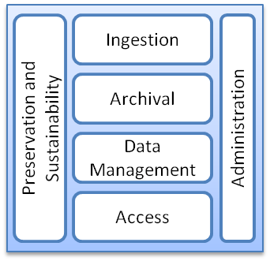
Interface Model for iDigBio and TCNs
TCNs
SQL
UTF-8
. . .
REST WS
SAML
WS-I
TAPIR
. . .
TDWG
XML
Archiving
Data Collections
Wiki
Workshop Resources
Workflow Engines
Taxonomic Validation
Learning Modules
Structured Data Services
Storage
Non-structured Data Services
Geographical Mapping
Data Conversion
Virtual Appliances
Machines
Networking
Collaboration Tools
iDigBio + Resources
TCP
OCCIWG
HTTP
RDF
JPEG2000
X.509
OpenID
XMPP
ODBC
National History Museums
Federal Collections
Applied Innovations
Microsoft Azure
Amazon EC2/S3
Google Apps
Microsoft Live
Google App Engine
iPlant
NCBI
EOL
LifeMapper
ALA
XSEDE
TCNs
DataONE
Academic Clouds
NESCent
Infrastructure Providers, National/Global Data Aggregators, Domain Service Providers, Domain Data Consumers
Notes:
iDigBio (darker blue area) will be driven by the biocollections community (especially TCNs) and partner with commercial and academic providers/consumers/aggregators (green box); work with existing standards to leverage previous investments (the dark blue contour); and offer resources (machines, storage, network), information (data collections, appliances, learning modules, workshop, wiki), services (data services, mapping, validation, conversion, collaboration).
In particular, the diagram shows that digitization efforts of different TCNs may be in different stages and that support from iDigBio will come in different shapes and forms to accommodate the need to implement an OAIS model (composed of data ingestion, data archival, data management, data access, data preservation and sustainability, and data administration components).
Note: Eventually all TCNs will be responsible for maintaining their OAIS model workflow (for a particular collection) and iDigBio will concentrate on the “integrated/aggregated OAIS model workflow”.
HTTP: Hypertext Transfer Protocol
OCCIWG: Open Cloud Computing Interface Working Group
ODBC: Open Database Connectivity
PNG: Portable Network Graphics (like JPEG, GIF, …)
RDF: Resource Description Framework
REST: Representational State Transfer
SAML: Security Assertion Markup Language
SQL: Structured Query Language
TAPIR: TDWG Access Protocol for Information Retrieval
TCP: Transmission Control Protocol
TDWG: Taxonomic Database Working Group
UTF-8: UCS Transformation Format-8-bit (most generic way of representing characters)
WS-I: Web Services Interoperability
XML: Extensible Markup Language
XMPP: Extensible Messaging and Presence Protocol
IPT “=“ http + Darwin-core archive (DwC-A which refers to a zip file of Darwin core records + xml metadata file) + registry (I am such institution and will provide such data – like uddi)
IPT stands for Integrated Publishing Toolkit

